Slide 1
LECTURE SIX
Vectors and pests
31st MARCH 2022
BY JOY MURIITHI

Slide 2
Objectives
Introduction
Vectors /pests
Vectors and Public health
Vector borne infections
Insect vectors & rodents
Management & Control of vectors

Slide 3
Expected outcomes
Acquire knowledge of vectors/pests that are important for public health in our community.
Describe various environments that support vector breeding.
Name some communicable diseases transmitted by vectors/pests.
Explain the main methods of vector/Pests control that are applicable in a local context.

Slide 4
Introduction
Definition
Vectors: any non-human carriers of pathogenic organisms that can transmit these organisms directly to humans
Pests: Any animal or plant which has a harmful effect on humans, their food or their living conditions.
This topic deals with disease vectors and pests as factors related to the health of households.

Slide 5
Key facts - WHO (2nd March 2020)
1. Vector-borne diseases account for more than 17% of all infectious diseases, causing more than 700 000 deaths annually. They can be caused by either parasites, bacteria or viruses.
2. Malaria causes an estimated 219 million cases globally, and results in more than 400,000 deaths every year. Most of the deaths occur in children under the age of 5 years.
Many of vector-borne diseases are preventable, through protective measures, and community mobilization.

Slide 6
Vectors
Most vectors are bloodsucking insects, which ingest disease-producing microorganisms during a blood meal from an infected host (human or animal)
Later when circumstances are convenient, they transmit to a new host, after the pathogen has replicated.
Often, once a vector becomes infectious, they are capable of transmitting the pathogen for the rest of their life during each subsequent bite/blood meal.

Slide 7
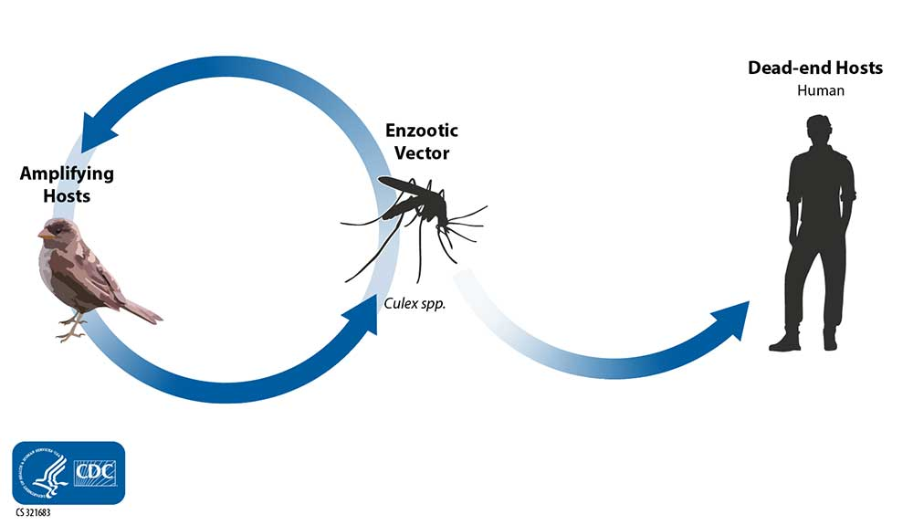

Slide 8
Pests
A pest is any animal or plant harmful to humans or human concerns.
Following is a brief description of some of the identified pests or category of pests and an explanation for designating each as a public health pest:
1. Insects
Cockroaches. The listed cockroaches are controlled to halt the spread of asthma, allergy, and food contamination.
Body, head, and crab lice. These lice are surveyed for and controlled to prevent the spread of skin irritation and rashes, and to prevent the occurrence of louse-borne diseases such as epidemic typhus, trench fever, and epidemic relapsing fever in the United States.
Mosquitoes. Mosquitoes are controlled to prevent the spread of mosquitoes bearing such diseases as malaria, zika, encephalitis, yellow fever and dengue fever…

Slide 9
Insects…..
Ticks: The various tick species transmit diseases such as Lyme disease, tick-borne relapsing fever, and Rocky Mountain spotted fever.
Bed bugs: Controlled because their bites can cause allergic reactions.
2. Rodents
Various rats and mice. The listed rats and mice include those which are controlled to prevent the spread of rodent-borne diseases and contamination of food for human consumption.

Slide 10
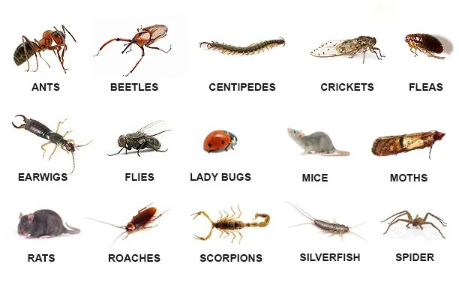
3. Various microorganisms, including bacteria, viruses, and protozoans. The listed microorganisms are the subject of control programs by public health agencies and hospitals for the purpose of preventing the spread of numerous diseases.
4. Reptiles and birds. The listed organisms are controlled to prevent the spread of disease and the prevention of direct injury.
5. Various mammals. The listed organisms have the potential for direct human injury and can act as disease reservoirs (i.e., rabies, etc.).

Slide 11
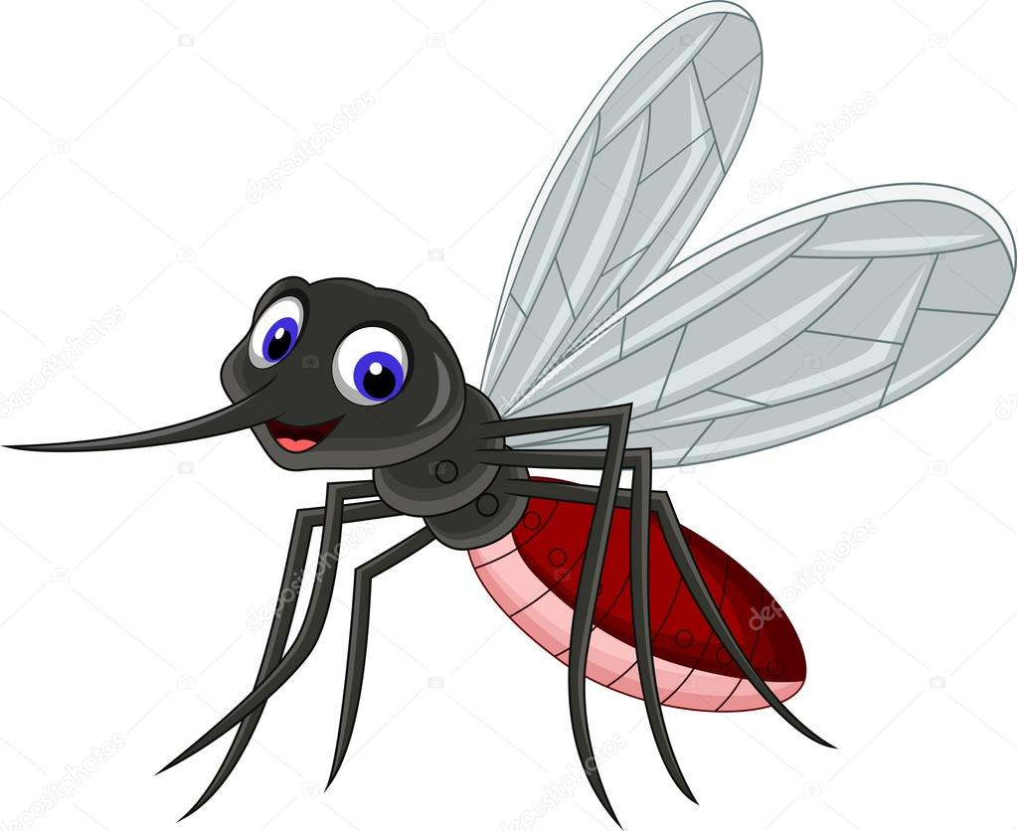
Vectors and Public health
Vector-borne diseases: Vector-borne diseases are illnesses that are transmitted by vectors, which include mosquitoes, ticks, and fleas. These vectors can carry infective pathogens such as viruses, bacteria, and protozoa, which can be transferred from one host (carrier) to another.
Vector borne diseases is 17% of all infectious diseases. 2.5 billion people in over 100 countries are at risk of these diseases.
What is the most vector-borne disease in KENYA?
Prevention and control…

Slide 12
Vector-borne diseases not only cause illness, they also act as a barrier to development. Eg.
1. Persons working in irrigation farms will not be productive if they contract diseases like malaria, Schistosomiasis etc.
2. Diseases like Onchocerciasis (river blindness) have a devastating health impact if untreated
would end up in blindness.
Additionally, vectors like rats destroy food and household materials.
Some pests like termites destroy temporary houses made of timber

Slide 13
Vector-borne disease transmission mechanisms
There are two ways that vector-borne diseases are transmitted:
Mechanical transmission: takes place when a vector simply carries pathogenic microorganisms on their body and transfers them to food, which people then consume.
Flies and cockroaches are in this category.
They carry infectious agents through their mouth and on their legs and other body parts and contaminate food and water.
They deposit these agents on ready-to-eat foods and the recipient gets infected if they consume the contaminated food.

Slide 14
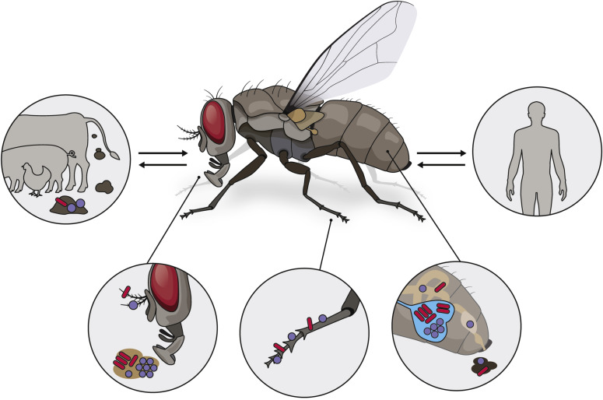
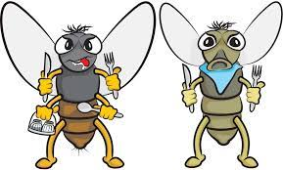

Slide 15
b) Biological transmission: involves the multiplication and growth of a disease-causing agent inside the vector’s body.
Eg. Malaria : The female mosquitoes take the malaria infectious agent (Plasmodium) from an infected person with a blood meal.
After sexual reproduction in the gut of the mosquito, the infectious agent migrates into the salivary gland of the insect, where it grows in size, matures and becomes ready to infect humans.
When the mosquito next bites a human, the saliva is injected into the skin and transfers the infection to another host

Slide 17
Common insect vectors
Housefly
The presence of flies is a sign of poor sanitation. Because of the housefly close association with people, its abundance, and its ability to transmit disease, it is considered a greater threat to human welfare than any other species of nonbiting fly.
Favorite breeding sites include garbage, animal manure, spilled animal feed, and soil contaminated with organic matter.
The control of the housefly is hinged on good sanitation (denying food sources and breeding sites to the fly). This includes the proper disposal of food wastes by placing garbage in cans with close-fitting lids. Cans need to be periodically washed and cleaned to remove food debris. The disposal of garbage in properly operated sanitary landfills is paramount to fly control.

Slide 18
Public Health Importance
Nuisance: In large numbers flies can be a nuisance by disturbing people during work and at leisure.
Flies soil the inside and outside of houses with their feces.
They can also have a negative psychological impact because of their presence.
They annoy us at meal times as intruders.
2. Diseases transmission: Common House Fly transmit disease causing microorganisms in three ways,
i.e.- by their body hairs, regurgitating a drop of liquid and by feces contaminated with pathogens.
Flies can spread diseases because they feed freely on human food and filthy matter alike.
Transmission takes place when the fly makes contact with people or their food.

Slide 19
The diseases that flies can transmit includes enteric infections (such as dysentery, diarrhoea, typhoid, cholera and certain helminthes infections), eye infections, (such as trachoma and epidemic conjunctivitis), poliomyelitis and certain skin infections (such as yaws)
Control Measure:
Flies should preferably be controlled by improving environmental
sanitation and hygiene.
Than by the application of chemicals.
This approach provides longer-lasting results, more cost effective and usually has other benefits.

Slide 20
2. Mosquito
The majority of mosquitoes are limited to aquatic habitats such as holes, pools, small ponds, and other stagnant water bodies.
Mosquitoes have four distinct stages in their life cycle: egg, larva, pupa and adult.
The females usually mate only once but produce eggs at
intervals through out their life.
In order to be able to do so most female mosquitoes require a blood meal.

Slide 21
Female mosquito feed on animals and humans.
Most species show a preference for certain animals or for humans.
Mosquitoes are attracted by the body odors, carbon dioxide and heat emitted from the animal or person.

Slide 22
Public Health Importance:
Nuisance
Some species of anopheles attack and may cause considerable annoyance.
In some areas, particularly in the northern areas of temperate regions, out door activities can be made impossible by swarms of biting mosquitoes.
2. Malaria
Only mosquitoes of the genus anopheles is responsible in transmitting the disease malaria.

Slide 23
There are four species of plasmodium parasite that infect man.
► Plasmodium falciparum:- occurs through out tropical Africa, Asia, the Western pacific, South and Central America, Haiti and Dominican Republic.
► Plasmodium Vivax:- is one of the malaria parasite in Africa, and is the predominant malaria parasite in Asia and Western and Central America.
► Plasmodium malariae:- is found world wide but has a very patchy distribution.
► Plasmodium ovale occurs mainly in tropical West Africa and rarely in the pacific.
Malaria is widely distributed in the tropics and also occurs in subtropical and temperate regions.
It is among the most important causes of death and illness in Africa, especially among children and pregnant women.

Slide 24
Prevention and control
1. Personal protection measure
Measures that are taken to avoid being bitten by anopheles mosquitoes includes the wearing of protective clothing, the use of repellents on exposed skin, sleeping under mosquito nets, and improving dwellings (Screening of doors and windows).
2. Biological control: The biological control of mosquitoes involves introducing their natural enemies in to the environment eg the use of larvivorous fish.
Larvivorous fish feed on mosquito larvae.

Slide 25
Alteration of natural breeding place and media: The filling of mosquito breeding sites with soil, stones, ash or rubbish is the most permanent control measure available.
It is most suitable for reducing breeding in small depressions, water holes, burrow-pits, ditches or pools, which do not require much filling material.

Slide 26
Application of Insecticides: By the application of insecticide control mainly focus on adult. Powder of residual insecticide to the interior surface of wall, ceilings and roofs can be sprayed.

Slide 27
3. Bedbug
Bedbugs are night-biting insects. They are typically found in houses with poor housing sanitation and are abundant in poor urban and rural areas.
They irritate the person while sleeping
Bedbugs love to hide around the bed and inside crevices of the wall during the daytime, and then become active at night.
Adult bedbugs can survive for up to seven months without blood and have been known to live in empty buildings for up to one year.

Slide 28
4. Fleas
Fleas are small flightless insects that form the order Siphonaptera.
As external parasites of mammals and birds, they live by consuming the blood of their hosts.
The human flea infests houses with poor sanitation, especially those with a warm, earth floor and dark places.
There are human, rat, cat, bird and dog fleas, but they can all readily feed on other species in the absence of their primary host
The adults live by biting and sucking blood. The bite is painful, disturbing and irritating. The fleas may be seen on the host animal, on bedding or clothing.

Slide 29
Vector | Diseases | Mechanism
Housefly | Diarrhoeal diseases, TB, polio, worms, food poisoning, infective hepatitis etc… | Mechanical
Mosquito | Malaria, yellow fever, filariasis, dengue fever | Biological
Louse | Typhus fever, relapsing fever, dermatitis | Biological
Mite | Scabies | Biological
Sandfly | Leishmaniasis | Biological
Blackfly | Onchocerciasis ( an eye and skin disease caused by a worm (filaria). | Biological
bedbug | Dermatitis, Chagas disease (American trypanosomiasis) | Biological
Cyclops | Guinea worm, fish tapeworm | Biological
Tsetse fly | Sleeping sickness (African trypanosomiasis) | Biological
Freshwater snail | Schistosomiasis | Biological
Dog | Rabies | Biological

Slide 30
Rodents
Rodents belong to the larger class of vectors and pests.
They constitute the largest order of mammals:
They are reservoirs and hosts for several zoonotic diseases such as plague, leptospirosis, and leishmaniasis.
The group includes rats and mice. They are found inside houses, in fields and around heaps of waste.
Three types of rodent are commonly associated with public health problems.
1. Norway rats (Rattus norvegicus)
2. Roof rats
3. Mice

Slide 31
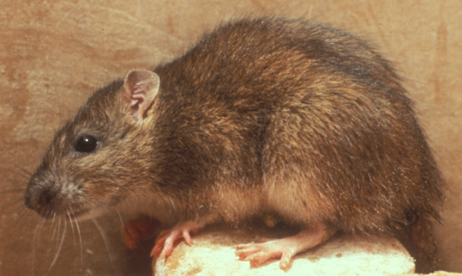
1. Norway rats (Rattus norvegicus)
Other name brown - rat or sewer rat.
Most numerous in urban areas.
They burrow and live in the ground, and in woodpiles, debris and rubbish.
Are omnivorous, prefer cereal grains, meat, fish, nuts and some fruits.
When they invade buildings, they usually remain in the basement or ground floor. They reproduce rapidly (4 – 7 times a year with a gestation period of 22 days).

Slide 32
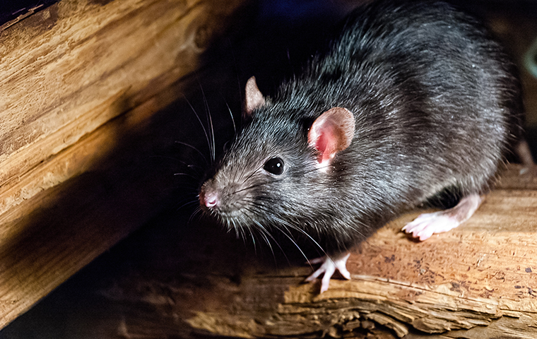
2. Roof rats
Also know as the black or grey rat, roof rats are more numerous in rural areas. They live in roofs, and eat mainly grains.
They are smaller than Norway rats with longer tails and ears. They are excellent climbers and usually live and nest above ground in shrubs, trees and dense vegetation.
In buildings, they are most often found in enclosed or elevated spaces in walls, false ceilings, roofs and cabinets.

Slide 33
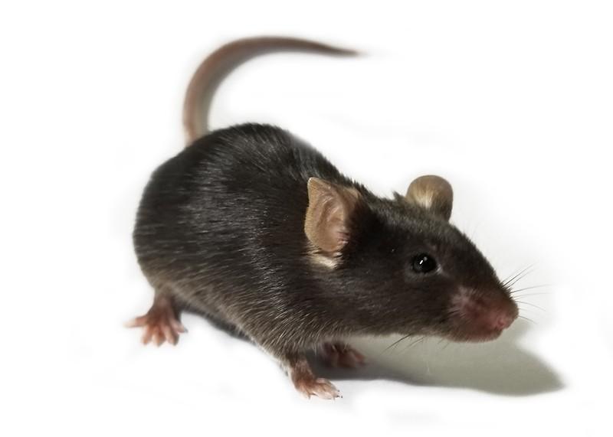
3. Mice
Mice are smaller in size than rats and fed on fruits, grains ,meat, etc. omnivorous)

Slide 34
Rodents and public health
Rodents cause a number of problems:
1. Disease transmission: rats are the natural hosts of fleas that may carry bubonic plague and murine typhus or endemic typhus from an infected rat to a human.
2. Food damage: mice and rats eat stored food, mainly grains, and spoil food by leaving their droppings.
eg . one rat can consume 15 kilograms of food per year. Rats are estimated to destroy 20% of the world’s crop production.
3. Material damage: gnawing by front teeth to doors, windows, wood, boxes, bags, clothes,

Slide 35
Vector management and control
This is by observing basic hygiene and sanitation
This approach targets the elimination or reduction of the factors that facilitates thriving of vectors.
1. Prevention and clearing of stagnation of water which attracts to breeding of mosquitoes
2. Proper solid waste management.
3. Use of latrine to control the breeding of houseflies.
4. use of clean water from protected sources for drinking to prevent the transmission of diseases.
5.Clearing bushes
6. Personal hygiene to control bed bugs, lice , fleas, etc.
7. Maintaining general cleanliness of homes and environment

Slide 36
Methods of control
Environment
(Source reduction, Waste management)
Vector HUMAN (PPM, Repellants)
(Chemical Control,
Biological Control,
Genetic Control)

Slide 37
Summary:
Vectors cause illness that could be fatal or restrict working capacity.
They damage food and household goods.
They are therefore, barriers to development.
Proper hygiene and sanitation is the key to management and control vectors.

Slide 38
Assignment
Read on Integrated vector management

