Slide 1
Venomous Bites and Stings
Samuel Ngigi K.
KMTC

Slide 2
Introduction
Many creatures, including humans, bite when frightened or provoked.
Certain animals can inject venom (poison) through mouthparts or a stinger.
Most are not medical emergencies.
Treatment is usually for bleeding, wound care or infection.
If victim allergic it can be a medical emergency.

Slide 3
Snake Bites
It is a major medical concern.
Many death occurs before the victim reaches the hospital.
All snakebite patients do not develop clinical symptoms and signs of envenomation reactions because snakes sometimes bite without injecting venom or inject too little venom to cause damage.
Complications due to snake bite may also vary from individual to individual.

Slide 4
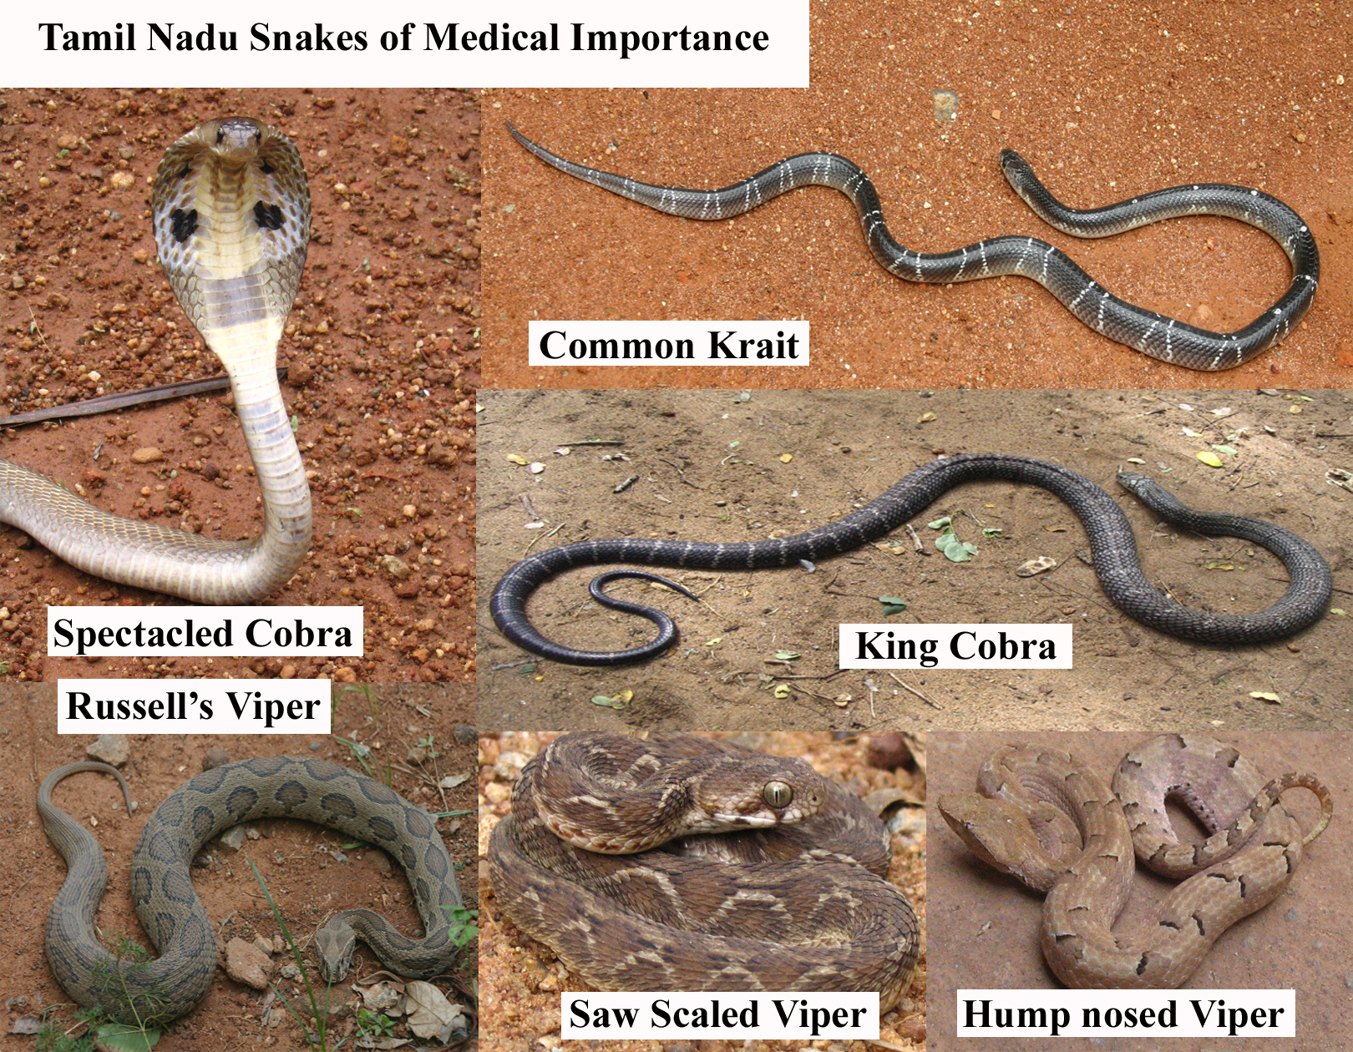
Types of Snakes
Snakes are classified into three types for all practical purposes and they are:
Cobra group [Colubridae]
b) Viper group [Viperidae]
c) Sea snake group [Hydrophidae]

Slide 5
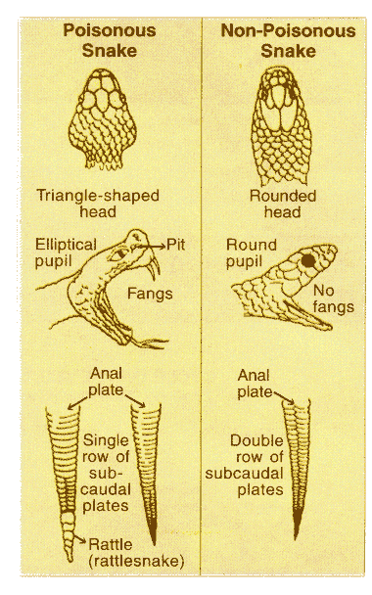
Snakes Types
Non Poisonous Snakes
Head - Rounded
Fangs - Not present
Pupils - Rounded
Anal Plate - Double row
Bite Mark - Row of small teeth.
Poisonous Snakes
Head – Triangle
Fangs – Present
Pupils - Elliptical pupil
Anal Plate - Single row
Bite Mark - Fang Mark

Slide 6
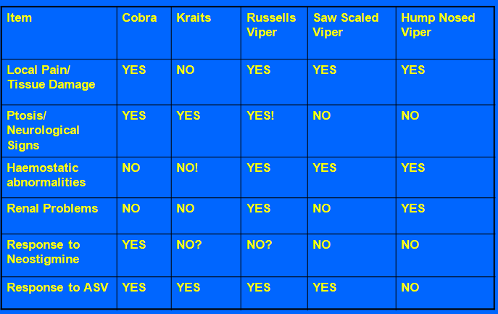
Manifestations & Response to Drugs

Slide 7
General Signs and Symptoms
two puncture wounds
swelling and redness around the wounds
pain at the bite site
difficulty breathing
vomiting and nausea
blurred vision
sweating and salivating
numbness in the face and limbs

Slide 8
Approach to Management
Discarded methods:
Tourniquets
Cutting and Suction
Washing the wound
Pressure immobilization method

Slide 9
Management - Investigations
20 Minute Whole Blood Clotting Test (20WBCT)
The most reliable test of coagulation and can be carried out, at the bedside without specialist training.
Wash hands with soap and water and wear the gloves.
Collect 2ml blood from peripheral vein of the unaffected limb.
2 ml of fresh venous blood is placed in a clean and dry glass test tube and left untouched and unshaken at ambient temperature for 20 minutes.
Note the time.
The test tube is gently tapped and if the blood is still liquid then the patient has incoagulable blood.

Slide 10
Management – Investigations cnt’d
Other useful tests:
  Clinical Test – PR / BP / RR / Postural Blood Pressure
  Lab Studies –
  CBC
Coagulation studies: PT / APTT /D-Dimer / Peripheral Smear
  Blood grouping & cross matching
  UECs
  Urinalysis
  Oxygen saturation
  Imaging studies – X-ray Chest / CT / Ultrasound (whenever required)
  Others – ECG and other special investigations when needed.
Notes:
activated partial thromboplastin time (aPTT )
Prothrombin time (PT)

Slide 11
Management - Treatment
Currently recommended First Aid:
The first aid being currently recommended is based around the pneumonic “Do it R.I.G.H.T.
It consists of the following:
R. = Reassure the patient. 70% of all snakebites are from
non- venomous species. Only 50% of bites by venomous
species actually envenomate the patient
I = Immobilize without compression. No tight bandages or ties.
G. H. = Get to Hospital fast. Traditional remedies have
NO PROVEN benefit in treating snakebite.
T= Tell the doctor of any systemic symptoms such as ptosis that
manifest on the way to hospital.

Slide 12
ANTI-SNAKE VENOM(ASV)
Points to be remembered before using Anti Snake Venom ( ASV):
No alternative to Anti Snake Venom.
There is no dose adjustment for ASV administration for children.
Health staff administering the ASV should read the manufacturers information leaflet.
ASV can be administered as IV infusion in Normal Saline or Glucose. It should not be given as IV bolus or IM directly.
ASV is administered slowly over a period of one hour.
ASV is required only to those who show definite signs and symptoms of envenomation.
There is no prophylactic dose of ASV.
ASV neutralizes the unbound venom, hence give it early.

Slide 13
Points to be remembered before using Anti Snake Venom ( ASV)…
ASV administration should not be delayed or denied on the grounds of anaphylactic reactions to a deserving case
Total dose requirement cannot be decided on the basis of Whole blood clot test (or) clinical signs and symptoms
Even if the patient develops reaction the total dose required should be administered slowly after the patient recovers from the reaction.
There is no other drug of choice other than ASV for the treatment of snake poisoning.
The patient has to be closely monitored at least for 2 hours
Timely administration of Inj.ASV will not gurantee the recovery or protect the individual from the venom induced toxicity or complications definitely.

Slide 14
Recommended Dose of ASV
Haemotoxic Envenomation:
Treat the patient with Anti Snake Venom(ASV)
Start IV Normal Saline with wide bore needle
Begin with one Vial of ASV in one pint of NS and start 10-15 drops per minute for 15 minutes & watch for reactions.
If the patient is not having signs and symptoms of anaphylactic shock continue the ASV drip with remaining seven vials/ampoules
Continue to monitor the vital signs at five minutes interval for first 30 minutes and then at 15 minutes interval for two hours
REPEAT DOSE:
For Haemotoxic Envenomation: 5 vials after 6 hours (if the toxicity persists)

Slide 15
Recommended Dose of ASV
Neurotoxic Envenomation:
Treat the patient with Antisnake venom (ASV) with the same dose for Haemotoxic Envenomation → plus
Inj.Neostigmine 1.5 mg (Test dose) as I.M and
Inj.Atropine 0.6 mg(Test dose) as I.V
After that observe patients for every five minutes for 30 minutes for signs of response
REPEAT DOSE:
For Neurotoxic Envenomation: 5 vials after 2 hours (if the toxicity persists)

Slide 16
ASV Reactions
itching (often over the scalp)
urticaria, even a single spot
nausea,
vomiting,
abdominal colic,
diarrhoea
tachycardia
fall in blood pressure, low volume pulse
dry cough
angio-oedema of lips and mucous membrane.
fever / shaking chills (rigors)
febrile convulsions in children
sweating / cold and clammy skin / central cyanosis
Notes:
Urticaria, also known as hives, is an outbreak of swollen, pale red bumps or plaques (wheals) on the skin that appear suddenly -- either as a result of the body's reaction to certain allergens, or for unknown reasons. Hives usually cause itching, but may also burn or sting.

Slide 17
Scorpion Bite
Initial pain and paresthesia at the stung extremity that becomes generalised
Cranial nerve- abnormal roving eye movements, blurred vision, pharyngeal muscle incoordination and drooling and respiratory compromise
Excessive motor activity
Nausea, vomiting, tachycardia, and severe agitation can also be present.
Cardiac dysfunction, pulmonary edema, pancreatitis, bleeding disorders, skin necrosis, and occasionally death can occur
Notes:
Paresthesia (or paraesthesia) is an abnormal dermal sensation (e.g., a tingling, pricking, chilling, burning, or numb sensation on the skin) with no apparent physical cause. The manifestation of a paresthesia may be transient or chronic, and may have any of dozens of possible underlying causes.

Slide 18
Treatment
Pain Management
Ice pack; Immobilization of limb; Local anaesthetics are better than opiates
Tetanus prophylaxis, wound care and antibiotics
Stabilize Airway Breathing and Circulation
Hyperdynamic circulation
Always combination of alpha blocker( with beta blocker: atenolol, Carvedilol, labetalol. to prevent unopposed alpha action causing tachycardia
Nitrates for Hypertension/MI
Hypodynamic Circulation:
CVP guided fluids; Decrease preload with furosemide (not hypovolumic)
Reduction of afterload improves outcome-Prazosin, nitroprusside, hydralizine, ACE inhibitor
Noradrenaline can be used

Slide 19
Order Hymenoptera: Ants, Bees, & Wasps
Members have the most advanced communication, learning, and vision
Stingers are modified ovipositors so only females sting
Most stinging females are not reproductive
Stinger itself can be a problem but mostly it’s the venom
Hymenopteran families of most medical significance are:
  Ants
  Wasps
  Bees

Slide 20
First Aid
Topical steroid cream (hydrocortisone),
Cream containing aloe vera.
Fire ant creams:
  regular toothpaste.
  Solution of half bleach and half water applied immediately to the area can reduce the pain, itching and, perhaps, pustule formation.
Oral medicines: antihistamines.

Slide 21
Bee Sting RX
Immediate removal is the important principle and the method of removal is irrelevant.
Sting site should be washed thoroughly with soap and water to minimize the possibility of infection.
Intermittent ice packs at the site- diminish swelling and delay the absorption of venom while limiting edema.
Oral antihistamines and analgesics may limit discomfort and pruritus.
Nonsteroidal anti-inflammatory drugs (NSAIDs) can be effective in relieving pain

Slide 22
References
https://www.msdmanuals.com/home/injuries-and-poisoning/bites-and-stings/snakebites
http://webcache.googleusercontent.com/search?q=cache:CSI-1uFwXf8J:www.isakanyakumari.com/docs/Snake%2520Bite%2520,Bee%2520sting%2520and%2520Scorpian%2520Bite.ppt+&cd=7&hl=en&ct=clnk&gl=ke
World HEALTH ORGANIZATION: http://webcache.googleusercontent.com/search?q=cache:J3PnBeqRrRQJ:apps.searo.who.int/PDS_DOCS/B4508.pdf+&cd=4&hl=en&ct=clnk&gl=ke

