Slide 1
Voluntary Medical Male Circumcision
(VMMC
By H.N.MAKARI
Webuye KMTC
SEP2019

Slide 2
DEFINATIONS
Voluntary Medical Male Circumcision (VMMC) is the surgical removal of all or part of the foreskin of the penis (prepuce) by a trained health-care professional

Slide 3
Introduction
It is an ancient practice that has its origin in religious rites.
In many communities, it is usually performed on the first or second day after birth.
In some communities, it is performed at the beginning of adolescence as a rite of passage into adulthood.

Slide 4
Epidemiology of MC
According to WHO (2018);
  Approx. 30% of the world’s males aged 15 years or older are circumcised
  Male circumcision is common in many African countries, and is almost universal in North Africa and most of West Africa.
  It is less common in southern Africa, where prevalence is around 15% in several countries (Botswana, Namibia, Swaziland, Zambia & Zimbabwe), and higher in others (Malawi 21%, South Africa 35%, Lesotho 48%, Mozambique 60%, and Angola and Madagascar > 80%) .
  Prevalence in Central and East Africa varies from approx. 15% in Burundi & Rwanda to 70% in Tanzania, 84% in Kenya and 93% in Ethiopia

Slide 5
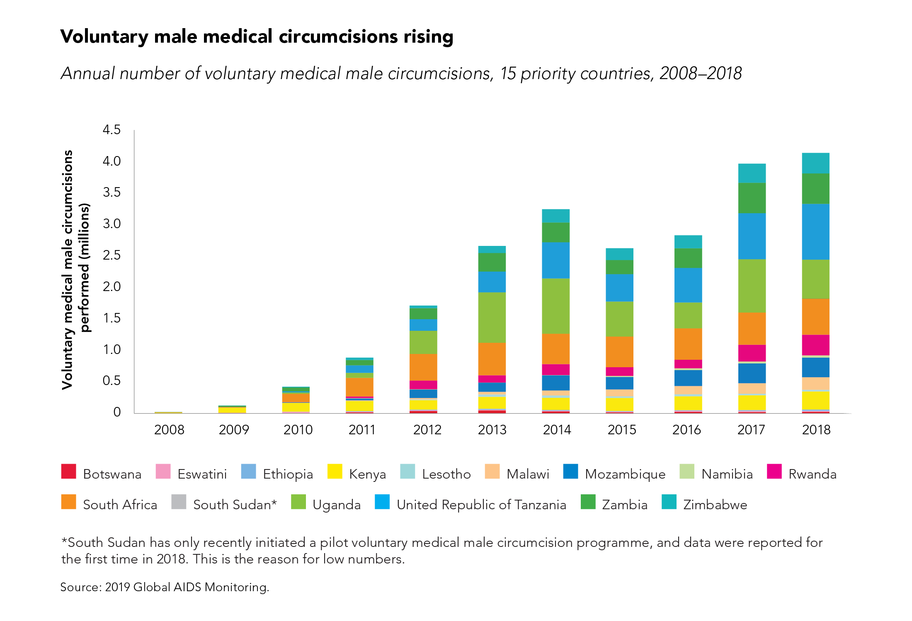

Slide 6
Epidemiology
Although an estimated 84% of all Kenyan men are circumcised, the percentage is much lower among the Luo and Turkana ethnic groups (17% and 40%, respectively). Instead, children traditionally had their six lower front teeth removed at initiation.
Kenya launched its VMMC programme in 2008 with an initial target of circumcising 860,000 men by July 2013 (80% coverage)
Kenya has achieved coverage among communities that did not previously practice male circumcision such as the Nyanza region and is targeting the counties of Turkana, Marsabit, West Pokot and Coast.

Slide 7
Kenya
Between 2008 and 2013, the number of annual VMMCs increased dramatically from 8,000 to 190,000. The country fell just short of its target, reaching 800,000 men (71%) but achieved its coverage goal in the Nyanza region where most of the implementation took place.
The next phase of Kenya’s VMMC strategy aims to see 95% of men circumcised by 2019. The second stage of the programme has shifted its focus to infant male circumcision, which targets children between 0 to 60 days old, and adolescents (10 to 14 years). The country also aims to encourage safer surgical practices within traditionally circumcising communities. In 2015, under the new phase of the strategy, Kenya surpassed its annual target of 940,000 circumcisions by around 100,000.
As of 2014, the last data available, Kenya had reached 93% eligible men with VMMC.

Slide 8
HEALTH NEEDS AND SERVICES IN VMMC
For many men, accessing circumcision services may be their first contact with health services. This contact offers an opportunity to address other aspects of men’s sexual and reproductive health.
Male circumcision does not provide full protection against HIV, but appears to reduce the risk of infection by 50–60%. It gives little or no protection against STIs that affect the urethra, such as gonorrhoea and chlamydia. It provides no protection against acquisition of HIV infection from unsafe injections, from infected blood products, or through receptive anal intercourse. It also does not prevent pregnancy.
To reduce the risk of STIs, including HIV, and unwanted pregnancy, comprehensive education and information programmes are needed, as well as services for contraception and STI prevention and management.

Slide 9
Male circumcision should therefore be regarded as an entry point for sexual, reproductive and other health services for men , including:
sexual and reproductive health education and counselling;
screening and treatment for sexually transmitted infections;
counselling and testing for HIV (with referral for care and support for those testing positive);
family planning education, counselling and services, including provision of condoms and vasectomy;
evaluation and management of infertility;
counselling on gender issues, including promotion of respect for women’s and girls' sexual and reproductive health needs and rights and the importance of preventing gender-based violence;
education about cancers of the male reproductive organs (testes, penis and prostate);
counselling for alcohol dependence and other substance abuse, which are associated with a number of health risks.

Slide 10
Barriers to male sexual and reproductive health services
There are a number of barriers to the development and use of reproductive health services for men, including:
a lack of information on men’s needs and concerns that could be used to design appropriate programmes and services;
embarrassment and alienation among men about using health facilities that are primarily designed to address women’s reproductive health issues;
men’s reluctance to seek medical care;
inadequate training of health workers to address men’s sexual and reproductive health issues;
limited availability of contraceptive methods for men;

Slide 11
negative attitudes of policy-makers and service providers towards men; for example, viewing men as irresponsible, or not interested in playing a positive role in support of women’s reproductive health needs, or not an appropriate clientele for sexual and reproductive health services;
unfavorable legal and policy constraints, such as bans on promotion of condoms;
logistic constraints such as lack of separate waiting and service areas for men, lack of trained male staff, lack of male-friendly clinics, and inconvenient clinic hours.
These barriers must be addressed if men are to become more involved in sexual and reproductive health matters.

Slide 12
MEETING THE SEXUAL AND REPRODUCTIVE HEALTH NEEDS OF MEN
Access to sexual and reproductive health services is a human rights issue for women, men and young people. The lack of services to address the sexual and reproductive health needs of men contributes to stress and anxiety among them.2 Various strategies have been used to extend sexual and reproductive health services to men, and to engage men as partners in improving women’s sexual and reproductive health:
Services for men may be offered in existing clinic-based services.
• Separate services may be established to provide information, education and counselling on sexuality, physiological development, family planning, STIs and HIV, genital health and hygiene, interpersonal communication, and sexual and reproductive behaviour.
• Special services may be established to offer diagnosis and treatment of sexual dysfunction, STIs and HIV, cancer of the prostate, testis and penis, and medical indications for male circumcision.

Slide 13
Other approaches include:
community-based distribution and social marketing of condoms;
reaching men with information and services through the workplace, the military and men’s groups;
special outreach campaigns to young men;
educational campaigns through the media;
special initiatives, such as outreach through football matches or other popular sporting events;
• promotion of vasectomy.
Because gender inequality has a strong influence on women’s sexual and reproductive health, programme managers need to consider the needs and perspectives of men, women and young people. It is also important to use gender-related and gender-disaggregated indicators when evaluating programmes.

Slide 14
MEN'S ROLES IN WOMEN’S AND CHILDREN'S HEALTH
Men can influence women’s health in numerous ways.3 As husbands, boyfriends, fathers, brothers, and friends, men can have a positive effect on women’s health by:
preventing the spread of STIs by using condoms consistently and correctly and supporting and encouraging regular condom use by others;
using, or supporting the use by partners, of contraception, so that couples are better able to control the number and timing of their children;
supporting women during pregnancy, childbirth and the postpartum period;
supporting women to take decisions about their health without reference to their partner;
responding to the physical and emotional needs of women prior to and following miscarriage and abortion;
refraining from, and insisting others avoid and prevent, all forms of violence against women and girls;

Slide 15
working to end harmful sexual practices, such as female genital mutilation and “dry sex”;
sharing financial resources with women, and supporting the notion of shared property rights;
supporting women’s full participation in civil society, including their access to social, political and educational opportunities, many of which have a direct or indirect impact on women’s health;
supporting the rights of daughters to the same health care, education, and respect as sons.

Slide 16
The foreskin
The foreskin is a continuation of skin from the shaft of the penis that covers the glans penis and the urethral meatus.
It is attached to the glans by the frenulum, a highly vascularized tissue of the penis.
The frenulum forms the interface between the outer and inner foreskin layers, and when the penis is not erect, it tightens to narrow the foreskin opening.
Circumcision removes some, or all, of the foreskin from the penis.
The word “circumcision” comes from the Latin circumcidere (meaning “to cut around”).

Slide 17
How is MC performed?
– The foreskin is freed from the head of the penis (glans).
– Excess foreskin is clipped off.
If done in the newborn period, the procedure is simpler and quicker than in adolescents and adults.
The period of superficial healing after MC is 5-10 days (although it takes 4–6 weeks for the wound to be fully healed).

Slide 18
Medical indications for male circumcision
Phimosis (inability to retract the foreskin) – The most frequent medical reason for male circumcision
Paraphimosis - the inability to return the foreskin to its original location; it forms a tight band of constricting tissue, causing swelling of the glans and foreskin,
Balanposthitis - an acute or chronic inflammation of the mucosal surface of the foreskin and glans
Balanitis xerotica obliterans - a chronic sclerosis and atrophic process of the glans penis and foreskin – a risk factor for penile cancer and the only absolute indication for circumcision.
Excessive skin and tears in the frenulum - are rare but can occur in adults

Slide 19
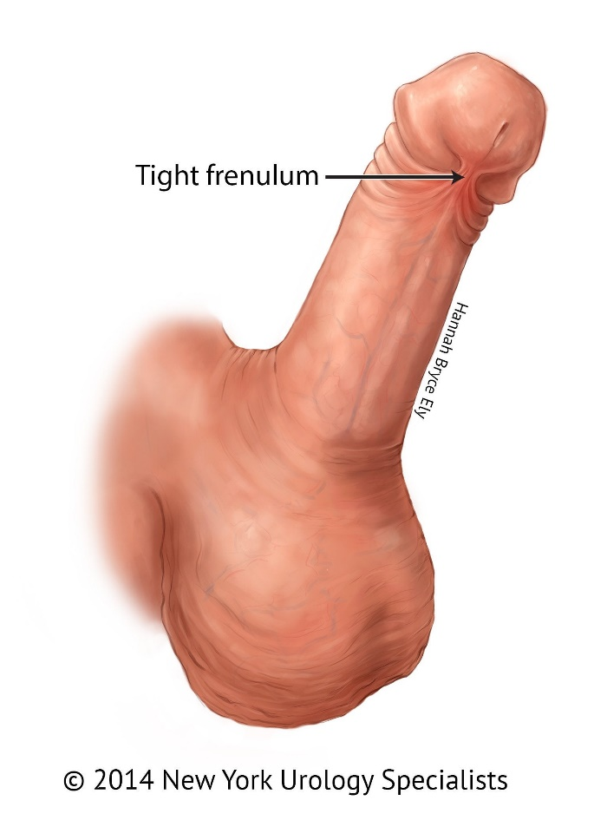
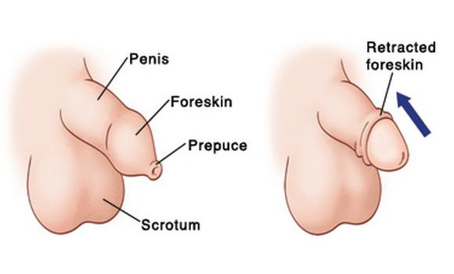
Indications….

Slide 20
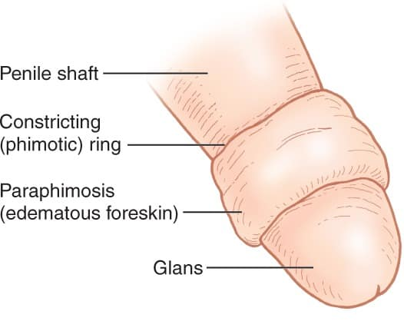
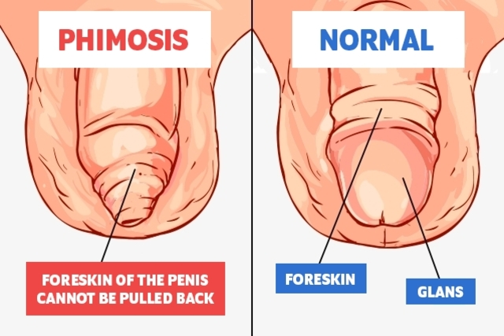
Indications …..
Paraphimosis
phimosis
.

Slide 21
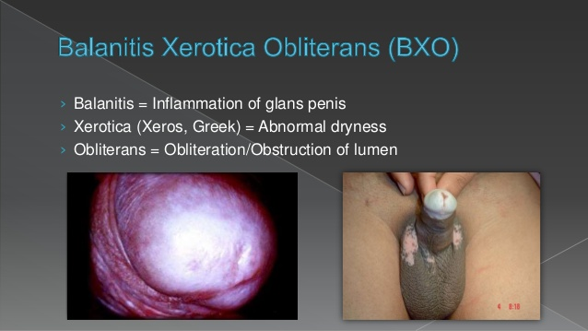

Slide 22
Benefits of Male Circumcision
Easier to maintain penile hygiene
A decreased risk of urinary tract infections
Prevention of inflammation of the glans (balanitis) and the foreskin (posthitis)
Prevention of phimosis (the inability to retract the foreskin) and paraphimosis (the inability to return the foreskin to its original location)
A reduced risk of some sexually transmitted diseases in men, especially ulcerative diseases like chancroid and syphilis
A reduced risk of men becoming infected with HIV (reduced the risk by approx. 60%.)
A reduced risk of penile cancer
Reduced risk of Human papillomavirus (HPV) infection

Slide 23
How MC Protects against HIV
The highly vascularized foreskin mucosa, which is prone to tearing or bleeding during intercourse (especially with the “dry sex” practices common in Southern Africa) facilitates HIV infection in uncircumcised men.
Ulcerative STIs like HSV-2, chancroid and syphilis, which are more prevalent in uncircumcised men, facilitate HIV infection
The inner foreskin has numerous Langerhans cells and other immune cell targets which are unusually susceptible to HIV infection.
    Studies show that the viral uptake in this tissue is 7 times more efficient than in cervical tissue in women.
    HPV infection was lower in circumcised men and, as long suspected, cervical cancer rates were higher in the female partners of uncircumcised men

Slide 24
Methods of Circumcision
Dorsal slit method
Forceps guided method
Sleeve resection method

Slide 25
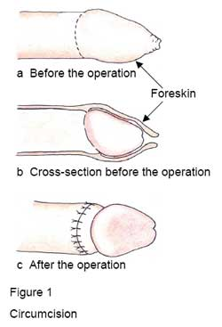
The circumcised penis

Slide 26
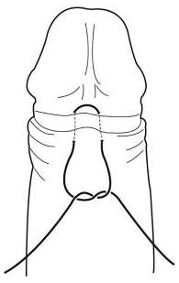
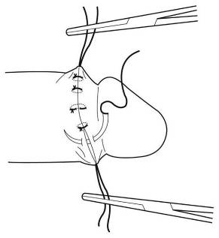
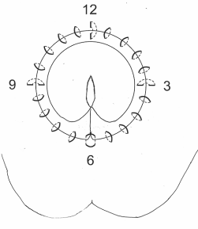
Suturing Plan
a
b
c
Horizontal mattress suture at the frenulum (6 o’clock). Vertical mattress sutures at 9, 12 and 3 o’clock and simple sutures between these.

Slide 27
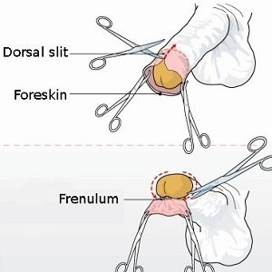
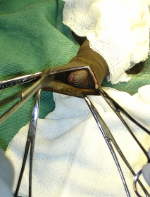
Dorsal slit method

Slide 28
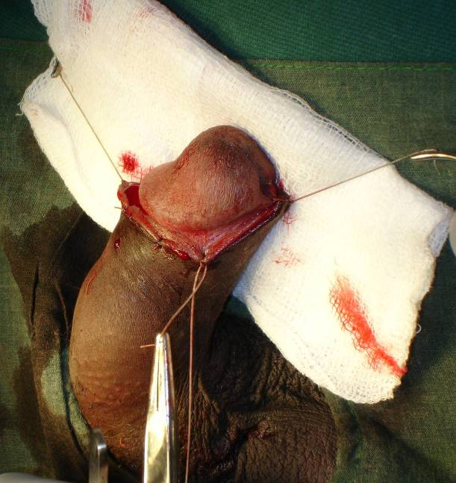
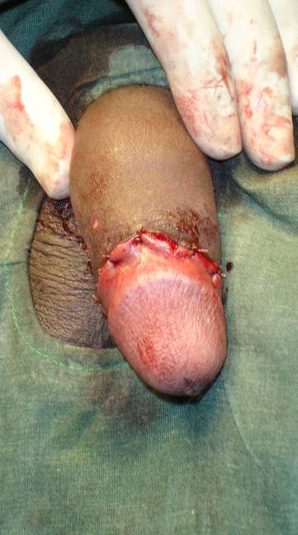
Once the four mattress sutures are in place, further simple sutures are placed to accurately approximate the wound edges.

Slide 29
Forceps Guided Method
Advantages:
  Can be learned by surgeons/ surgical assistants who are relatively new to surgery
  Ideal for use in a clinic with limited resources
  Can be done without a surgical assistant
Disadvantages:
  Leaves 0.5–1.0 cm of mucosal skin proximal to glans
  Cosmetic effect may be less satisfactory

Slide 30
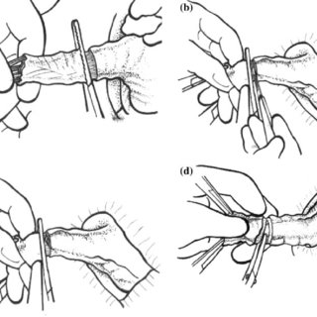
Forceps guided method

Slide 31
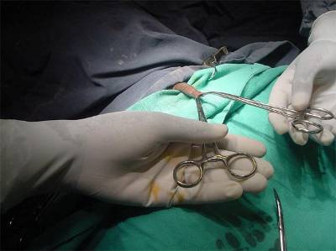
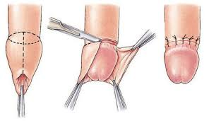
Forceps-guided

Slide 32
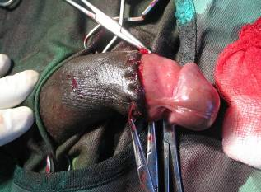
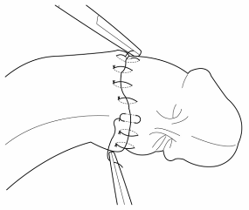
Forceps Guided Method
Final outcome:
Note residual mucosal portion of the foreskin

Slide 33
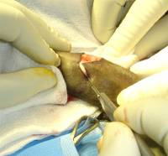
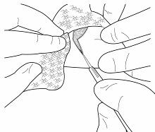
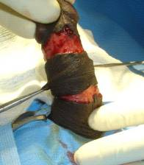
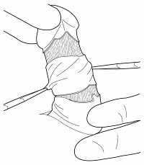
Sleeve Resection Method
Outer and inner incisions are made
Then the two incisions are joined together by cutting the skin between the proximal and distal incisions with scissors

Slide 34
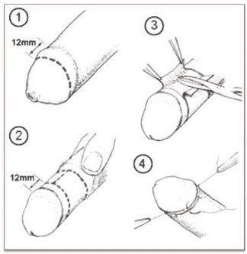
Sleeve Resection Method….

Slide 35
Risks/complications of Male Circumcision
Pain
Risk of bleeding + haematoma formation
Infection at the site of the circumcision
Increased sensitivity of the glans for first few months after the procedure
Irritation of the glans
Meatitis (inflammation of the opening of the penis)
Injury to the penis
Reactions to the anaesthetic used during circumcision
Delayed wound healing

Slide 36
Post-op Management
Irrespective of the method of circumcision, a standard penile dressing technique is used:
  Check that there is no bleeding. Minor bleeding from a skin edge will often stop after five minutes of pressure with a gauze.
  Once satisfied that bleeding has stopped, place a piece of paraffin embedded gauze (or Sofratulle) around the wound.
  Apply a sterile, dry gauze over this, and secure it in position with adhesive tape.

Slide 37
Post-op care….
Incision Care
A wrap-around dressing is usually applied to the penis. If the bandage falls off after the surgery, which often happens, it isn't a major concern.
The bandage/dressing is normally removed on the 2nd day after surgery if it hasn't already fallen off.
Removing the dressing can be easier after a sitz bath or shower for 10 minutes
After the bandage is off, the penis is open to air ; antibiotic ointment (e.g. Bactroban cream) may be applied around the sutures, several times each day. This will prevent the dry edges of the incision from sticking to clothes.
Tight clothing should be avoided to reduce pressure on the penis.
After removal of the dressing, a slight ooze is expected. If oozing persists, patient should return to the hospital

Slide 38
Post-op care….
Encourage patient to;
Avoid rough or active sports for the two weeks following surgery, as they can cause oozing from the incision.
Avoid strenuous activities, such as bicycle riding, jogging, weight lifting, or aerobic exercise, for 4 weeks or until review by surgeon.
Eat a balanced diet & drink plenty of fluids
Avoid full-body bathing until the 2nd day post-op, but sponge baths are fine; After the second day, they can shower or bathe as normal, but should not scrub the incision site

Slide 39
* Post-op care….
Pain Control – can be achived using NSAIDs or Paracetamol.
Follow-up - a post-operative visit should be done about four weeks after the surgery

