Slide 1
Writing Skills
We learn to read by reading, and We learn to write by writing.
But ,We also learn to read by writing, and We learn to write by reading.

Slide 2
Writing is:
A process of putting thought, ideas and concepts into words using continuous prose;
A thinking process;
a form of output/production because it is a demonstration of what we know, implicitly or explicitly
Opportunity for negotiation of meaning through peer interaction – at every stage of the writing process
a means of building fluency;
a way of developing accuracy (in grammar, vocabulary, etc.);

Slide 3
thinking made evident, external memory;
a critical skill for academic or professional success
is a way to demonstrate proficiency
helps us discover what we do or do not know
is more than a paragraph or essay

Slide 4
What are writing Skills
Ability to put sounds down on graphic form according to the conventional sound-spelling rules.
Ability to spell English words correctly, including using correct punctuation and capitalization.
Ability to do writing practice, such as dictation, grammar exercises, constructing dialogues according to the model, simple translation exercises.
Ability to write short compositions, including functional writing skills, such as writing simple letters, taking notes, writing outlines and summaries.

Slide 5
What a good writing entails
Any writing assignment needs to have:
Form (letter, email, summary, report, etc.)
Audience
Topic
Purpose (describe, explain, persuade, etc.)
Clear
Grammatically correct

Slide 6
Have variety
Precise
Interesting pace
Not be emotional
Appropriate: language and audience
Supported by evidence

Slide 7
Grammar
To be a good writer, one must be conversant with the grammar surrounding the sentence.
This is because writing begins at the sentence level because it is a combination of sentences in a meaningful way.
We will begin by outlining/ drawing the hierarchical Scale of English Grammar as follows:
  Sentence
  Clause
  Phrase

Slide 8
Sounds
Sounds are the smallest units in grammar.
They combine to make words, words combine to make phrases, phrases join to make clauses and clauses make sentences.
A sentence is the largest unit in English Grammar.

Slide 9
Types of Sentences
Sentences can be categorized based on their structure or based on their function.
Sentence category based on structure include:
  Simple sentences.
  Double sentence
  Multiple sentence
  Exclamatory sentences
  Imperative sentences/Commands

Slide 10
A good writer must be able to use variety of sentences in any piece of essay.
Variety gives a piece of writing a fast pace and makes it interesting to read.

Slide 11
There are 4 types of essays in writing namely:
Narrative: Giving an account of events. It is mainly used in Fiction, creative writing, history and literature review.
Descriptive: Describe people, events, places, things e.g. history
Expository/Explanatory: This is advanced descriptive writing that describes events and people in depth. It involves defining explaining and expounding on an idea
Argumentative/ persuasive also called Academic writing

Slide 12
Narrative
Narrative writing involves recounting events in an orderly manner. Narratives are mainly fictions or creative writing. Narratives are mainly used in Literature, history and writing stories. They may recount:
  a series of events; a report
  biography or autobiography
  historical events
  fiction or nonfiction
Narrative writing is imaginative and subjective or factual and objective.

Slide 13
Descriptive writing
This is writing that is used to describe a person, a place or a thing or event. There are different types of descriptive writing e.g.
  static description describes something that is still/not moving
  Cause and Effect describes how one thing causes the effect of another
Descriptive writing can be either objective or subjective in content.

Slide 14
A description of something contains full factual and quantifiable information about it.
Such information may be personal, touching or sensory impressions and feelings.
Descriptive writing is a domain of arts and history.

Slide 15
Expository/Explanatory writing
This is advanced description and focuses on explaining, defining and expounding on an idea. Such writing explains and analyses:
  a process
  an opinion or point of view
  event(s) and phenomena
  instructions and directions

Slide 16
Argumentative Essays
Argumentative writing is an academic writing which is also called persuasive writing.
It is a rational effort to defend or refute a claim and does not have place for emotions, or anger.
Most academic writing falls under this category.
Argumentative writing is done argumentatively.
The writer collects all his/her points and presents them logically and constructively.

Slide 17
The aim of an argumentative writing is to persuade the audience and convince them to accept the writers point of view.
Argumentative essays are expected to be clear and coherent. The writer must be clear about his/her argument.

Slide 18
CHARACTERISTICS OF AN ARGUMENTATIVE ESSAY
Clarity
Complete
Accurate
Based on sound premises
Logical Avoid arguing in circles
Reasonable
Be based on evidence
Must acknowledge opposition
Avoid fallacies i.e. unqualified generalizations

Slide 19
The process of writing
1. Planning
Involves gathering ideas and focusing on the topic: Topic selection, gathering ideas, extensive reading and interpretation. When planning one must ask himself/herself the following questions:
  What is the purpose of my writing?
  Who is my audience?
  What are the special requirements of my writing task?

Slide 20
2. Shaping
Considering how best to organize your ideas on pen and paper.
Shaping involves:
  Determining the tone
  Drafting a thesis statement
  Outlining ideas

Slide 21
others
3. Drafting
4. Revising
5. Editing
6. Proof reading

Slide 22
Paragraphs
A paragraph is a group of sentences that work together in unity to explain an idea.
A paragraph is a group of sentences that work to develop a unit of thought.
A paragraph is a selection of sentence which is related because they are all talking about the same thing, or are dealing with a single topic.
Paragraphing permits you to subdivide material into parts and arrange those parts into a unified whole that effectively communicates its message.

Slide 23
Paragraphs can be classified as: Topical
A topical paragraph is basically a paragraph made up of a group of sentences arranged around one main idea, or one topic.
This is the type of paragraph you are most familiar with. Topical paragraphs are probably the only type most student think of as a paragraph.
They are also called developmental paragraphs or body paragraphs.
They are usually found after the introductory paragraph and before the concluding paragraph.
Topical paragraphs consist of a statement of a main idea and specific, logical support for that main idea.

Slide 24
Characteristics of a topical Paragraph
Must have a topic sentence which should appear early in the first few lines of the paragraph preferably the 1st, 2nd or3rd line.
The topic sentence tells you what the paragraph is about. Because there's only one topic developed in each paragraph, there should only ever be one topic sentence.
The topic sentence of a paragraph is developed, or built on, by the addition of supporting information and details.

Slide 25
Others
Unity
Coherence
Grammatical
Order (Direction of Movement)

Slide 26
Special: Introductory, concluding and transitory
Introductions
Introductions or introductory paragraphs perform very important functions.
First, they must attract the reader, influencing him/her to read the remainder of the essay.
Second, they must not only introduce readers to the essay topic but they must also limit that topic and identify the writer's attitude toward the topic.
Finally, they must provide readers with information regarding what is to be expected within the remainder of the essay.

Slide 27
Every paper you write should have a main point, a main idea, or central message.
The argument(s) you make in your paper should reflect this main idea.
The sentence that captures your position on this main idea is what we call a thesis statement.
The thesis statement comes in the introductory paragraph and must be concise and well-written.

Slide 28
A thesis statement must come early in your essay, e.g. in the introduction.
This will enable your reader to:
  Establish your position and Give your reader a sense of direction.

Slide 29
Your thesis statement should be
clear
specific
Short
In line with your argument
Must indicate your position
Types of introduction Paragraphs

Slide 30
The introduction must be a road map for the rest of your essay
Anecdotal
Regular Triangular
Inverted Triangle
Summary
A wise word
Provoking question
Corrective introduction
Historical Review

Slide 31
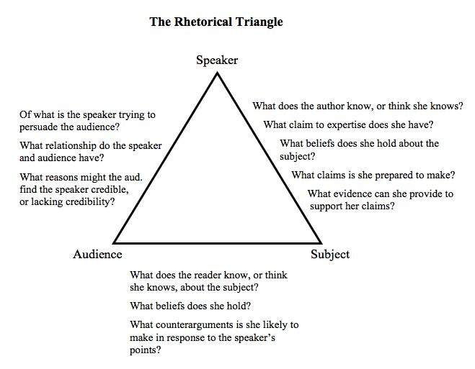

Slide 32
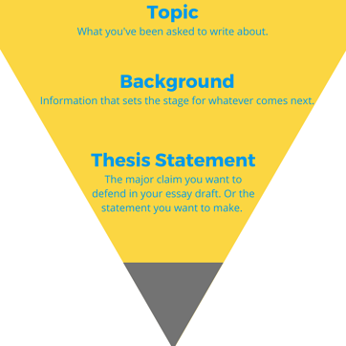

Slide 33
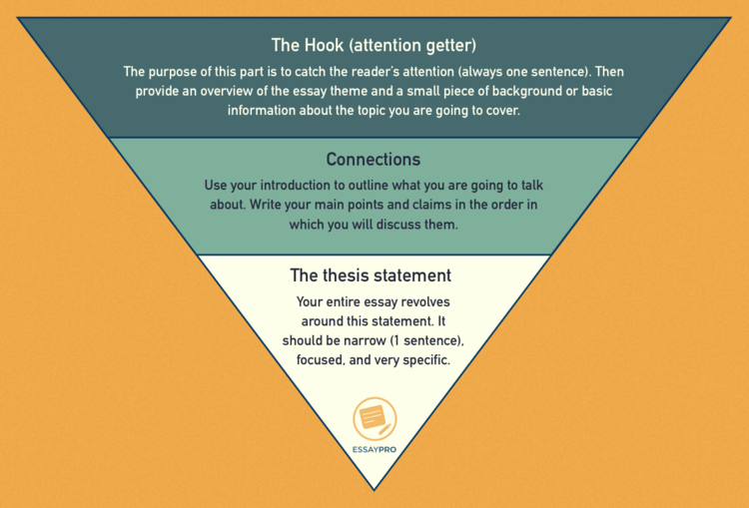

Slide 34
Concluding Paragraph
This should be the last paragraph in the essay.
Its purpose is to bring the essay to a graceful end.
The concluding paragraph gives the writer one final chance to leave a lasting impression on the reader.

Slide 35
Ways of writing a concluding paragraph:
A brief summary of the paper's main points.
Restate the main idea of your essay, or your thesis statement
A provocative question.
A quotation.
Evoke a vivid image. Call for some sort of action.
End with a warning.
Universalize (compare to other situations).
Suggest results or consequences.

Slide 36
It is important to have a strong conclusion, since this is the last chance you have to make an impression on your reader.
The goal of your conclusion isn’t to introduce any new ideas, but to sum up everything you’ve written.

Slide 37
Transitional paragraph
The transitional paragraph marks a transition in the paper from one section to another, or from one thought to another, one sub-topic to another.
It indicates to the reader either that there will be a change in idea or topic or that there will be a movement from a broad topic to a specific one.
These types of paragraphs usually are small and consist of one double or multiple sentences which begins with a connector or a gerundive.

Slide 38
Example
  Having explained the general importance of education, this research is now going to discuss the importance of education as the fourth pillar in humanitarian aid.
A transitional paragraph tends to be a short paragraph in an essay that announces a shift from one section or idea to another.
A transitional paragraph is most commonly used to summarize the ideas of one part of a text in preparation for the beginning of another part

