Slide 1
ANATOMY AND PHYSIOLOGY OF
LYMPHATIC SYSTEM

Slide 2
WHAT IS LYMPHATIC SYSTEM?
• The lymphatic system is part of
the circulatory system and an important part of the immune system, comprising a network of lymphatic vessels that carry a clear fluid called lymph (from
Latin, lympha meaning
"water”)directionally towards the heart.

Slide 3
LYMPH VESSELS
• These originate as blind end tubes in the interstitial spaces.
• Structurely,they are same as blood capillaries.
• Their walls are more permeable to all interstitial fluid including proteins and cell debris.
• The capillaries joint to form larger lypmph vessels.
• Lymph vessels have numerous cup shaped valves that prevent back flow of movements of lymph in vessels.
• Lymph vessels join together to form two larger ducts
•
(i) The Thoracic duct
•
(ii) The right Lymphatic duct

Slide 4
LYMPH VESSELS

Slide 5
(i) THE THORACIC DUCT
• What is duct?
A duct is a circumscribed channel leading from an organ.
Length-40cm
it drains Lymph from
Both legs
The pelvicabdominal cavities Left half of the The Thorax
Head & Neck
The Left upper Limbs.

Slide 6
(ii) THE RIGHT LYMPHATIC DUCT
• IT LIES IN THE ROOT OF THE NECK AND OPEN INTO RIGHT SUBCLAVIAN VEIN.
• IT DRAINS LYMPH FROM
RIGHT HALF OF THE THORAX
NECK
RIGHT UPPER LIMB

Slide 7
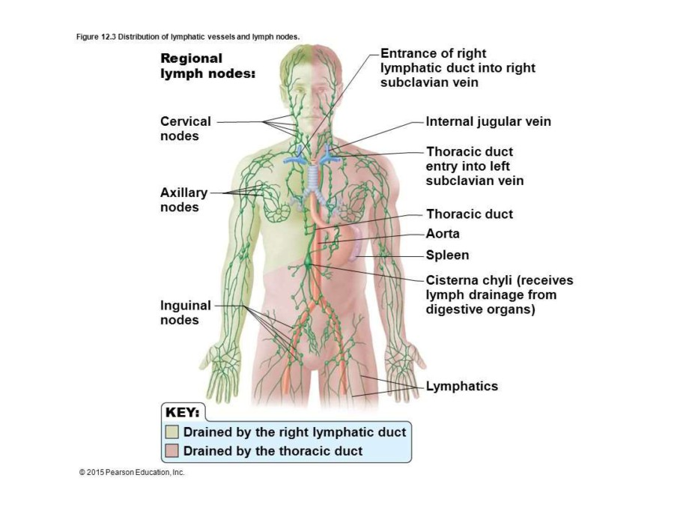

Slide 8
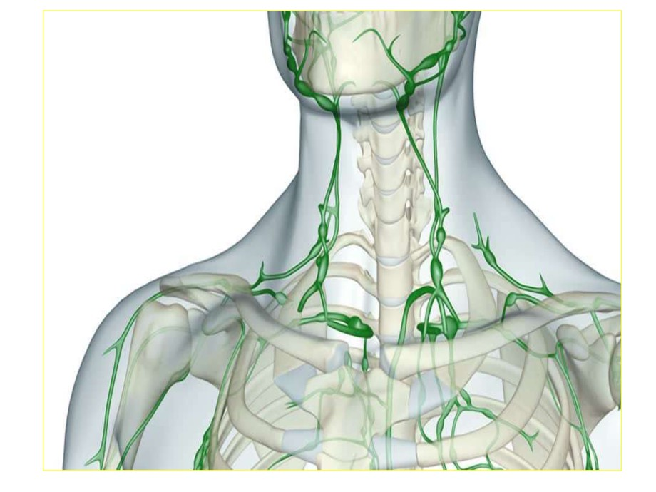

Slide 9
LYMPHATIC TISSUE OR LYMPHATIC
ORGANS
• The lymphatic organs are found in a number of situations n the body.
• such as
(i)Tonsils
(ii)Spleen
(iii)Bone Marrow
(iv)Thymus Gland

