Slide 1
GROUP ONE PRESENTATION
GROUP MEMBERS-
Shali purity
Cecilia makitiro
Job kihara
Winnie mutindi
Mohammed omar
Ezekiel matata
Sarah nyawira
Emmanuel juma
Merciline mrunde
Chepngeno claire

Slide 2
DEFORMITIES
Deformities
Congenital deformities Acquired deformities
Deformities maybe acquired or congenital and they may reflect an underlying abnormality of bone, joint or soft tissue.

Slide 3
CONGENITAL DEFORMITIES
Are attributable to faulty development and are present at birth.
They vary from severe malformations that are not compatible with life to minor malformations.
Causes
Genetics
Environment
Both genetics and environment

Slide 4
Genetic causes include mutation of a whole chromosome as in Down’s syndrome and mutation of a small portion of the chromosome as in achondroplasia. The defect is not necessarily always inherited from an affected parent, it may arise from a fresh mutation in the germ cell.
Environmental causes are not well understood, experiments have shown that different types of environmental influence in essence:- diatetic, hormonal, chemical, physical, etc may cause abnormalities .
Combined genetic and environmental factors seem to be the usual cause of the more common congenital malformations in man.

Slide 5
Name of deformity | Clinical features
Generalized
Osteogenesis imperfecta (fragilitas ossium | Fragile soft bones, easily broken or deformed. Often blue sclerotics. Joint laxity. Otosclerosis
Diaphysial aclasis | Cartilage-capped bony outgrowths from metaphyses. Deficient remodelling. Stunted growth
Dyschondroplasia (multiple chondromatosis; Ollier’s disease | Masses of cartilage in metaphyses of long bones. Impaired growth. Deformity. Often unilateral
Achondroplasia | Short-limb dwarfing from defective growth of long bones. Trident hand. Large head
Osteopetrosis (Albers–Schönberg disease; ‘marble bones’) | Hard dense bones, but with increased liability to fracture. Anaemia from obliteration of medulla
Gargoylism | Dwarfing. Kyphosis from deformed vertebrae. Corneal opacity. Large liver and spleen. Mental deficiency
Cranio-cleido dysostosis | Impaired ossification of skull. Deficient clavicles. Often deficient symphysis pubis
Pseudohypertrophic muscular dystrophy | Genetic transmission to boys through female carriers. Progressive muscle weakness evident at age 3–6 years. Raised urinary creatine phosphokinase: carriers may thus be identified. The defect may be diagnosed in early pregnancy, when abortion may be advised
Haemophilia | Prolonged blood clotting time from deficiency of Factor VIII. Bleeding into joints or soft tissue
Trunk and spine
Congenital short neck (Klippel–Feil syndrome) | Short stiff neck with low hair-line. Fused or deformed cervical vertebrae
Congenital high scapula (Sprengel’s shoulder) | Scapula tethered high up, usually only on one side. Scapular movement impaired
Cervical rib | Often symptomless. Vascular symptoms (partial ischaemia) or nerve symptoms (paraesthesiae, lower trunk paresis)
Hemivertebra (congenital scoliosis) | Defective development of vertebra (and often of adjacent structures) on one side. Scoliosis
Spina bifida (spinal dysraphism) | Spina bifida occulta, meningocele or myelocele. Often leg deformities from paralysis or muscle imbalance. Often incontinence. Often associated hydrocephalus. Diagnosable in early pregnancy from excess of alpha-fetoprotein in urine and amniotic fluid
Limbs
Congenital arterio-venous fistula | Hypertrophy and lengthening of limb. Bruit
Congenital amputation | Part or whole of one or more limbs absent
Phocomelia | Aplasia of proximal part of limb, the distal part being present (‘seal-limb’). Diagnosable in pregnancy by ultrasonography
Constriction rings | Limb or digit constricted as if by a tight string. May be associated with syndactyly
Absence of radius (radial club hand) | Hand deviated laterally from lack of normal support by radius. Thumb often absent
Absence of thumb | Thumb alone may be absent, but other deformities may co-exist
Absence of proximal arm muscles | Trapezius, deltoid, sternomastoid, or pectoralis major absent
Radio-ulnar synostosis | Forearm bones fused at proximal ends, preventing rotation
Madelung’s deformity | Head of ulna dislocated dorsally from lower end of radius. Radius bowed
Syndactyl | Webbing of two or more digits
Polydactyl | More than five digits
Congenital dislocation of hip | Neonatal: diagnostic click obtainable. Later infancy: shortening; limited abduction. Radiographs diagnostic
Congenital coxa vara | Defective ossification of femoral neck, with reduced neck–shaft angle
Congenital short femur | Proximal end of femur deficient or rudimentary. Thigh short
Congenital tibial pseudarthrosis | Resembles ununited fracture in tibial shaft. Aetiology unknown, may be neurofibromatosis
Absence of fibula | Leg under-developed on outer side. Foot small and everted; lateral two or three digital rays may be absent
Congenital club foot | Foot inverted and plantarflexed (equino-varus), or everted and dorsiflexed (calcaneo-valgus)
Congenital curled toe | Lateral angulation of one or more toes. Toe may lie over or under adjacent toe

Slide 6
CONGENITAL PSEUDARTHROSIS
Also known as a false joint occurs when a fractured bone fails to unite and remains mobile. Can be present at birth or the bone can bend resulting in anterolateral bowing and then fracture in the first few years of life. Seen in most long bones.
The periosteum for several cms either side of the pseudarthrosis is abnormally thickened.

Slide 7
ACQUIRED DEFORMITIES
They can be classified into two groups in that there are those deformities that arise at a joint and those which arise in a bone.
DEFORMITY ARISING AT A JOINT.
A deformity is said to be at a joint when the joint caanot be placed voluntarily in the neutral anatomical positions.
CAUSES
Dislocation or sublaxation
Muscle imbalance
Tethering or contracture of muscles or tendons
Contracture of soft tissues
Arthritis

Slide 8
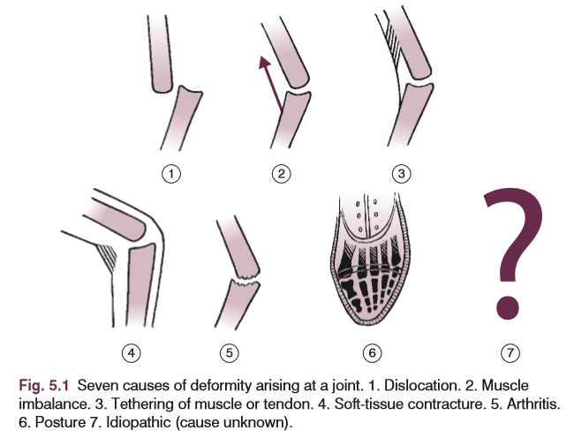
6. Prolonged abnormal posture

Slide 9
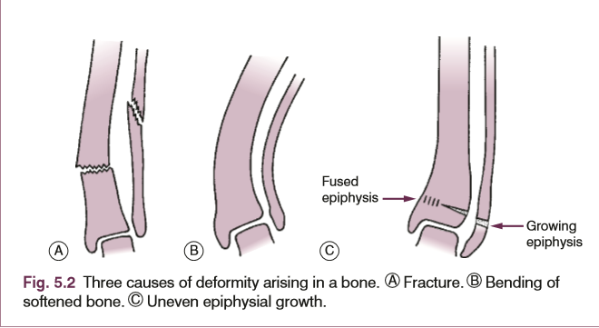
DEFORMITY ARISING IN A BONE
Deformity arises in a bone when it is out of its normal anatomical alignment.
CAUSES
There are three causes:
Fracture
Bending
Uneven epiphyseal growth

Slide 10
TREATMENT OF DEFORMITIES
One of the following methods may be used in appropriate cases:
Manipulative correction and retention in a plaster or a splint for example in a displaced fracture.
Gradual correction by prolonged traction for example in certain types of arthritis.
Alternatively the gradual exertion force may be applied by an external frame such as the ilizarov external fixator.
Division or excision of contracted or tethered soft tissues.
Osteotomy
Arthrodesis
Selective retardation of epiphyseal growth.

