Slide 1
Basics of PHARMACOLOGY

Slide 2
Pharmacokinetics
Greek word-Pharmakon means drug, Kinein means: To move
It deals with-
Absorption – taken into the body
Distribution – moved into tissues
Metabolized – changed so can be excreted
Excreted – removed from the body

Slide 3
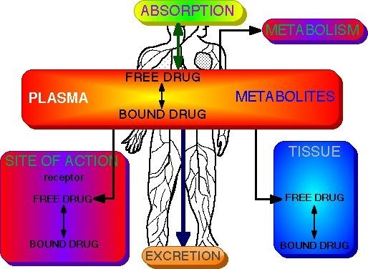

Slide 4
ABSORPTION OF DRUG
The process by which the drug enters into the systemic circulation from the site of administration ( except intravenous or intra-arterial routes ) through the biological membrane is called absorption of drug .
In case of intravenous or intra-arterial administration the drug is not absorbed and it enters into the circulation directly .

Slide 5
DISTRIBUTION OF DRUG
All the consequences of delivery of drug to the tissue is called distribution of drug. Distribution of drug means dividing and spreading of drug to the tissue.
•
Selective distribution of drug: It means special distribution of drug in the certain tissue of the body due to special affinity between particular drug & particular body constituents
Examples- Ephedrine Tetracycline
Heavy metal (arsenic) Dioxin
Thiopental Na+
→ Iris
→ Ca++ containing tissue (bones/teeth)
→ hair and nail
→ heart
→ adipose tissue

Slide 6
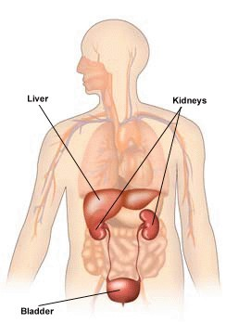
BIO-TRANSFORMATION OF DRUG ( METABOLISM)
Site of Metabolism

Slide 7
BIO-TRANSFORMATION OF DRUG (METABOLISM)
Molecular alteration of drug in a living body with or without enzyme .
Why necessary ?
Drugs are chemical substance & interact with living organism. As we need drugs for treatment of diseases similarly we also want to get rid of them from the body to overcome their persistent effects.
100 mg of phenobarbitone would have a half life of greater than 100 years if it is not removed from the body by making some changes in its molecules . For this reason drug metabolism is necessary .

Slide 8
Result of biotransformation:
Active drug is converted to inactive drug e.g.. morphine
→morphine glucouronide
Inactive drug is converted to active drug e.g. Levedopa→ Dopamine
Active drug is converted to active metabolites e.g. Heroine→ Morphine
Toxic drug are converted to less toxic or nontoxic drug e
.g.
morphine →morphine glucouronide
Nontoxic drug is converted to toxic drug e.g. Parathione
→Paroxine

Slide 9
ELIMINATION OF DRUG
Elimination includes all the processes that terminate the presence of the drug in the body .
Drugs are excreted from the body after being partly or wholly converted into polar metabolites .

Slide 10
Routes of excretion of drug
•
Major processes:
Kidney: Frusemide pethidine ,
Hepato-billiary process: Tetracycline, Chloramphenicol
Gastro-intestinal: Antacid , BaSO4
Pulmonary: Inhalation anesthetics, Alcohol
Minor processes:
Skin/ sweat glands : Vit-C ,iron, Griseofulvin
Saliva : morphine, caffeine
Breast : morphine ,phenobarbitone
Vagina :Metronidazole
Tear: Rifampicin
•

Slide 11
Factors affecting elimination
Disease: Heart liver or kidney disease lowers perfusion to organs of elimination.
Age: Reduced glomerular filtration, and liver metabolism
Obesity: Slows elimination of lipid soluble drugs.
Presence of other drugs: Phenobarbitol induces liver oxidizing enzymes. Cimetidine inhibits liver oxidizing enzymes

Slide 12
PHARMACODYNAMICS
It is a branch of Pharmacology which deals with the effects of Drug & Mechanism of action.

Slide 13
Dosage
Plasma Concen. | Site of Action
Effects
Pharmacokinetics
Pharmacodynamics

Slide 14
Effects of Drugs
Therapeutics (Beneficial effect)
Toxicology (Adverse effect)

Slide 15
Drug- Derived from Drouge (French word) = A Dry Herb
Definition: According to the World Health Organization (WHO),1992-
‘’ A Drug is any substance or product that is used or intended to be used to modify or explore Physiological system or Pathological states for the benefit of the recipient.’’
Aim of Drugs: To improve quality of life.

Slide 16
Basic use of drugs
Diagnosis- BaS04 →GIT lesion
Prevention- Vaccine, Contraceptives, toxins
Suppression/Control- Insulin for DM, Anti-hypertensive drugs.
Treatment- Antibiotics for infection, Diuretics for edema, analgesic for pain.

Slide 17
Prodrug
The drugs which do not produce any pharmacological effect until they are chemically altered within the body.
Purpose of prodrug:
To modify absorption ?
To modify distribution ?
To modify the duration of action ?
To reduce adverse effect ?
To overcome difficulties in Pharmaceutical formulation.?
Examples- Castor oil, levodopa etc.

Slide 18
Drug nomenclature
Pharmacopoeia: It is an official publication written by legally authorized body constituted by law which describes drugs that are used commonly with their source, properties, action, standardization, indication, contraindication etc.
B.P → British Pharmacopoeia.
U.S.P → United States Pharmacopoeia
I.P → Indian Pharmacopiea
INN → International non-proprietary name (WHO recommended)
JP → Japanese Pharmacopoeia

Slide 19
Naming of Drugs
Chemical Name
Generic/Non-proprietary/Official/Approved name. Trade/Proprietary/Commercial/Brand name.
Examples of a Drug with 3 types of name:
Acetylsalicylic acid (Chemical name) Aspirin (Generic name)
Eras ( Trade name)

Slide 20
Receptor
•
Receptor are macromolecular structures with which the drug binds & form a drug-receptor complex that initiates a chain of events leading to the pharmacologic/therapeutic action (s).
Receptors are:
protein or lipoprotein in nature
situated on the cell membrane or within the cell (cytoplasm, nucleus)
bound mostly reversibly
Location of Receptor:
On the cell membrane- Insulin
Within cytoplasm- Steroid receptor
Within nucleus- Thyroid receptor.

Slide 21
Common Receptor and their Subtypes
▪
Cholinoceptor or cholinergic receptor
Muscarinic nicotinic
▪
▪
▪
Adrenoceptor or adrenergic receptor
Alpha Beta
Histamine receptor
H1 H2 H2
Dopamine receptor
D1 D2
▪
▪
▪
▪
▪
▪
▪
▪
▪

Slide 22
Common Receptor and their Subtypes-- continued
5-hydroxytryptamine receptor
•
•
•
5-HT1
5-HT2
5-HT3
▪
Opoid receptor
•
•
•
Mu Kappa delta
▪
GABA receptor
▪
▪
GABA1 GABA2
▪
Prostaglandin receptor

Slide 23
Drug-Receptor Terminologies
Affinity: Affinity is the tendency of drug to bind with a receptor.
Efficacy: The effect produce by a drug is called efficacy.
Potency: The power of a drug to produce the desired effect is called potency.
Agonist: Drugs having affinity as well as efficacy are called agonist. E.g. Sulbutamol → Beta-receptor agonist
Antagonist: Drugs having affinity but lacking efficacy are called antagonist. E.g. Atropine → Muscarinic antagonist.

Slide 24
Posology: Deals with dosage of Drug.
Dose: Amount of drug or medicinal substance to be administered at one time is called dose
Dosage: Determination of the amount , frequency and number of dose for a patient is called dosage.
Therapeutic dose: Dose require to produce the optimal therapeutic effect is called therapeutic dose.
Maximum dose: Largest dose of drug that is safe to administration and produce no toxic effect is called maximum dose.
Minimum dose: Smallest dose of drug that will be effective is called minimum dose.

Slide 25
POSOLOGY
Lethal dose: Dose that cause death of some experimental animals.
Toxic dose: Dose that causes signs and symptoms of drug toxicity.
Pediatric drug dose: Calculation of dosage based on age or weight are conservatives and tend to underestimate the required dose.
Age (Young’s rule):
Dose=Adult dose x Age(years)/Age+12

Slide 26
POSOLOGY
•
Booster dose: An additional dose( of an immunizing agent) to increase the protection afforded by the original series of injections. The booster dose is given some months or years after the initial immunization.
Loading dose: The “loading dose” is one or series of doses that may be given at the onset of therapy with the aim of achieving the target concentration rapidly.
Maintenance dose: Dose required to maintain the desired effect that is achieved by preceding dose.
Test dose: Amount of drug given initially ( before giving full therapeutic dose) to see the response of drug to tissue is called test dose.
Fatal dose: Amount of dose that cause death of 100% of experimental animals.
•
•
•
•

Slide 27
Plasma concentration vs. time profile of a single dose of a drug ingested orally
Plasma Concentration
Time

Slide 28
POSOLOGY
ED50(Median effective dose): The dose at which 50% of individual exhibit the specified quantal effect is called ED50
TD50(Median toxic dose): The dose required to produce a particular toxic effect in 50% of test animals is called TD50.
LD50(Median lethal dose): The dose required to produce death in 50% of experimental animals is called the LD50.

Slide 29
THERAPEUTIC INDEX
Therapeutic index is the ratio between the median lethal dose and the median effective dose.
So, therapeutic index =LD50/ED50 [In experimental animal]
Or, Therapeutic index is the ratio between median toxic dose and the median effective dose.
So, therapeutic index =TD50/ED50
[In clinical medicine]

Slide 30
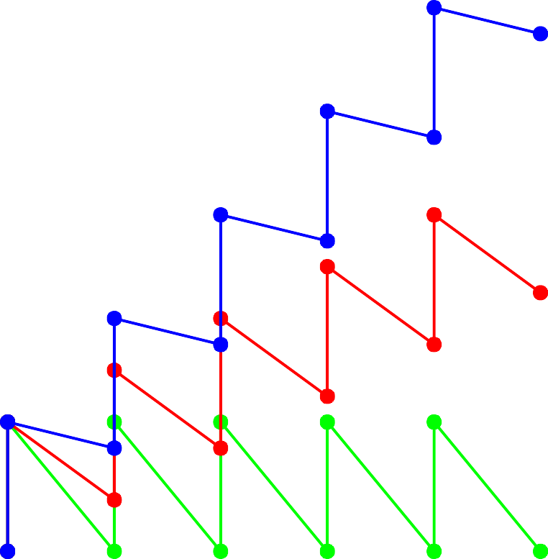
TOXIC RANGE
12
Plasma Concentration
10
8
6
THERAPEUTIC RANGE
4
2
SUB-THERAPEUTIC
0
0
1
2
3
4 5
Dose
6
7
8
9

Slide 31
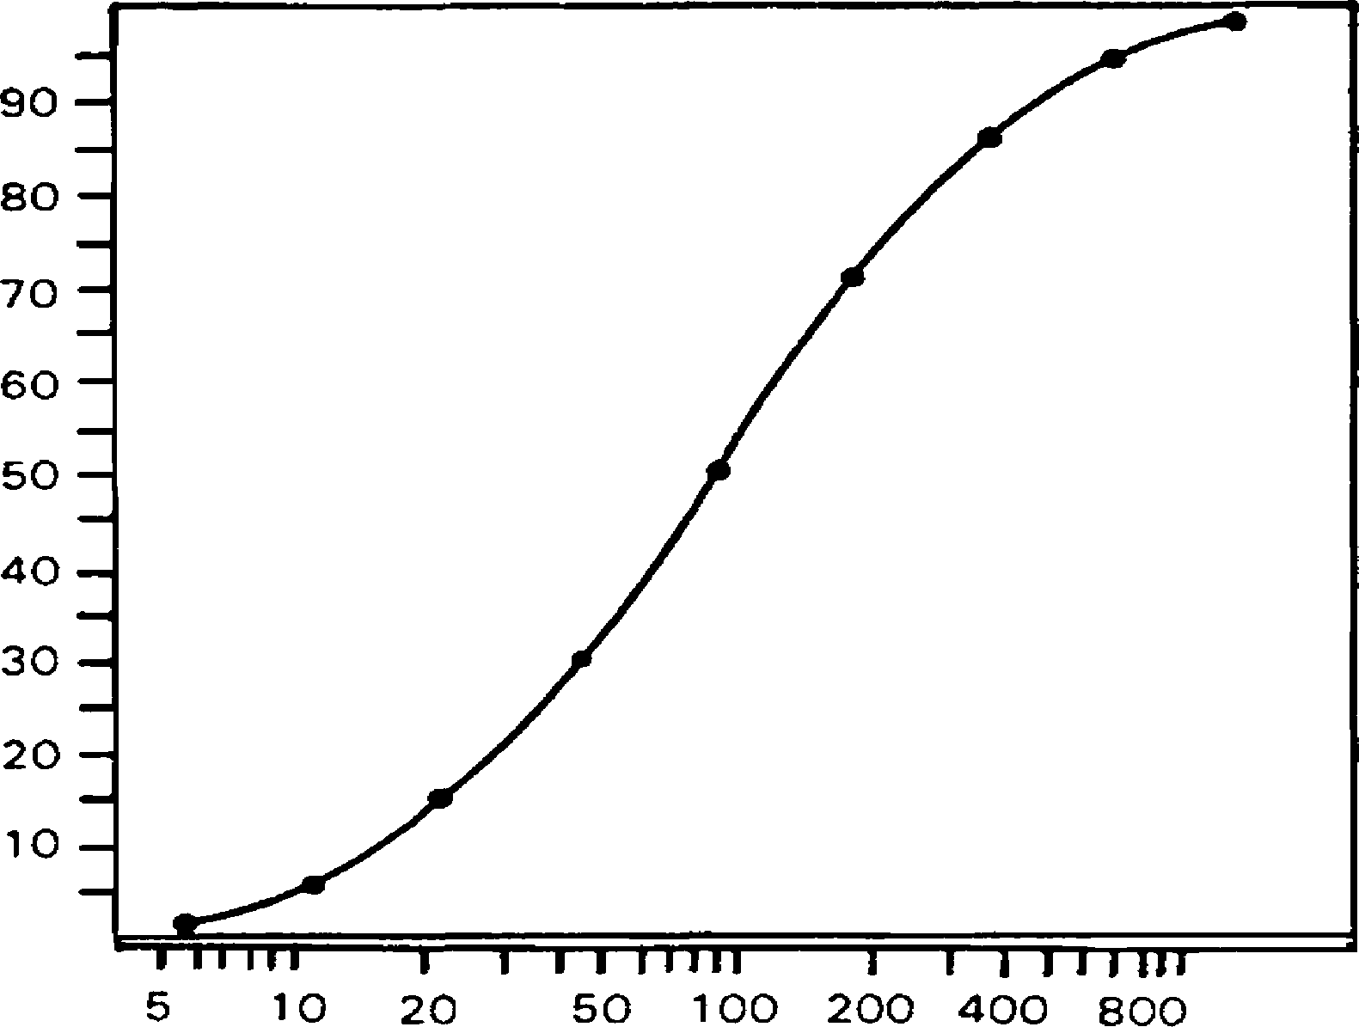
THE DOSE-RESPONSE RELATIONSHIP

Slide 32
Half life
Definition: The time by which the effect of a drug will come to half is called the Biological half life of that drug.
Example: 4 mg of a drug is administered. Blood concentration become 2mg (50%) after 10 minutes. So, plasma half-life =10 minutes.
Importance:
Half life gives gross idea about the Pharmacokinetics and Pharmacodynamics of a drug.
Half life gives idea about the duration of action of a drug.
It can guide the dosage schedules.
Low Half life → Frequent administration
High half life→ Should be given once or twice daily
➢
➢

Slide 33
Bioavailability
Definition: It is the amount or percentage of active drug that is being absorbed from a given dosage form & is made available to the site of action is called the Bioavailability of that particular from.
e.g. Bioavailability of Paracetamol is 50%. It means if a patient orally takes 500 mg of Paracetamol, only 250mg (50%) of drug will reach to the systemic circulation.

Slide 34
Bioavailability
Destroyed in gut
Not absorbed
Destroyed by gut wall
Destroyed by liver
to systemic circulation
Dose

Slide 35
Bioavailability
Plasma concentration
70
60
50
40
30
20
10
0
i.v. route
(AUC)o (AUC)iv
oral route
Time (hours)
0
2
4
6
8
10

Slide 36
Drug interaction
•
Drug interaction is a phenomenon which occurs when the effects of one drug are modified by the prior or concurrent administration of another drug. Drug interaction may result beneficial or harmful effects. Drug interaction may occur-
Out side the body- Phenytoin + Infusion fluid = Precipitation
At absorption level- Antacid + Tetracycline = Decreased absorption of Tetracycline
At distribution level- Sulfonamide + Aspirin = Sulfonamide toxicity
At bio-transformation level- Warfarin + Barbiturates = Decreased anticoagulation
At excretion level- Penicillin + Probenecid = Increased penicillin level
At receptor level (Pharmacodynamics) – Thiazide diuretic + Beta Blocker = Hypertension

Slide 37
Route of Drug Administration:
Oral
Intravenous
Intra-arterial
Intramuscular
Subcutaneous
Intraperitoneal
Topical
Suppository
Inhalation
Sub-lingual
Local injection
Intrathecial

Slide 38
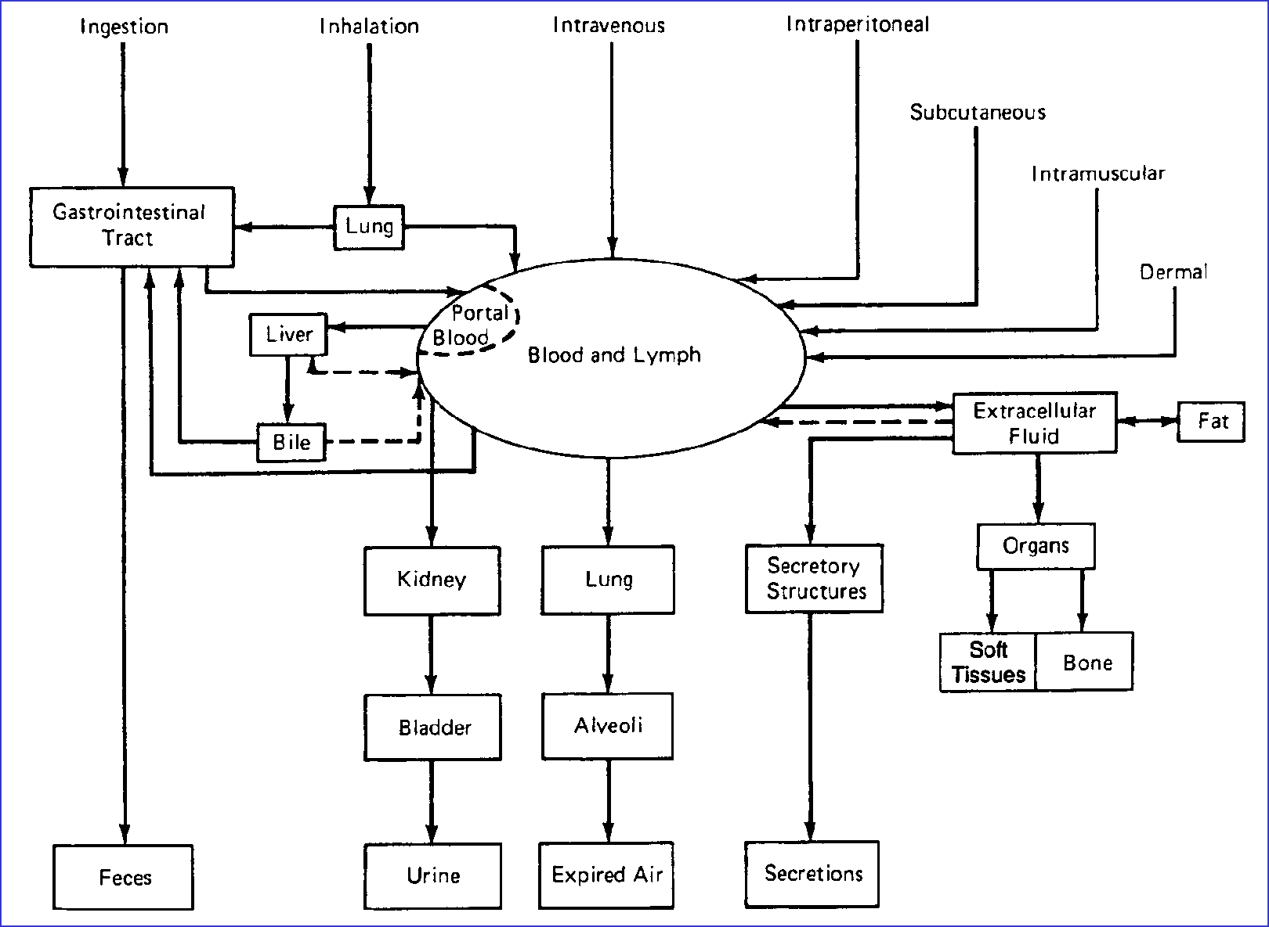
DISPOSITION OF DRUGS

Slide 39
THANK YOU ALL

