Slide 1
BEHAVIOURAL SCIENCE
FIRST YEAR

Slide 2
Behavioral sciences
SOCIOLOGY And ANTHROPOLOGY
”
KMTC Thika Campus

Slide 3
Module outcome
The learner will be able to apply knowledge of sociology and anthropology in delivery of health services

Slide 4
Module Competence:
This module is designed to enable
the learner apply knowledge of sociology
and anthropology in assisting patients / clients
to promote health, prevent illness, manage
and rehabilitate patients.
:

Slide 5
Module content
Basic concepts and terminology
Man and culture
socialization process,
social stratification
,social change,
social mobility

Slide 6
, social institutions,
family,
religion
peace building,
conflict resolution,
negotiation
socio-cultural beliefs and practices affecting health

Slide 7
sociology
Is the study society, human social behaviour, patterns of social relationships, social interaction and culture that surrounds everyday life.
Is the study of social life, social change and the social causes and consequences of human behaviour.
Sociologists investigate the structure of groups and how people interact within this contexts

Slide 8
Importance of sociology
The study of sociology has great value in modern complex society:
Sociology studies society in a scientific way:
we need scientific knowledge about human society in order to achieve progress in various fields

Slide 9
Sociology improves our understanding of society:social institutions,social groups,their functions and changes in trends etc.
help us to lead an effective
meaningful social life.

Slide 10
Sociology helps us become broad minded: sociology has impressed upon its students
to overcome their prejudices,misconceptions,egoistic ambitions and class and religious hatred,
It makes our life richer, meaningful and fuller.

Slide 11
Sociology enlightens us regarding the major social institutions: social institutions decide the strength and weakness of the society.
institutions play a vital role in our social life.

Slide 12
Sociology helps us to solve social problems:the study of sociology will help s identify social problems and suggest
measures to solve them.
Social planning-social planning has been made easier by sociology, its regarded as the vehicle for social reform and re organization.
It is very useful for law makers need to know the background of informal and formal laws of the
society through the study of sociology.

Slide 13
Use of sociology in healthcare sector.
Sociology helps the healthcare workers
to know the culture and social life of patients.
it is important to know peoples culture and beliefs especially in a country with diverse tribes and religions.
Personal adjustments: knowledge in sociology helps the healthcare workers adjust to situations in the hospital environment and enhances relations with colleagues and patients.

Slide 14
Healthcare services: medical sociology is extremely useful. For the entire healthcare services.. recognition of social forces in health, change in cognitive process,
Disease prevention-when healthcare workers know the social background of the patients its easier to offer disease prevention techniques.
Improve the quality of treatment-through the knowledge of social-psycholgical problems of patients

Slide 15
Support government in various schemes of social planning-eg family health,HIV aids programmes,drug abuse rehabilatation.
Care for special groups in the society
Understand the relationship between various elements of social life,eg

Slide 16
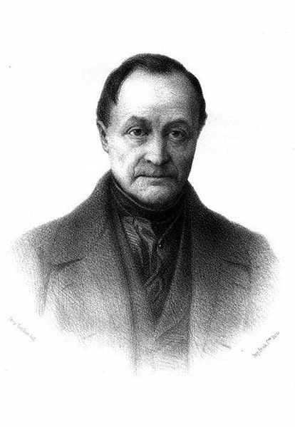
I.
hAuguste Comte: (1798 – 1857)
The Father of Sociology

Slide 17
AUGUSTE COMTE (Cont…)
He lived during the years following
the French revolution.
He was keen to establish sociology as
a science and he arrogantly saw
it as the “queen of the sciences”

Slide 18
His followers wore jackets with buttons at the back so that other people had to button or unbutton them.
This involved some form of social interactions.
He described three stages of historical development:
Stage 1
This is where the human mind is ruled by religions, myths, superstitions and delusions
This is the primitive stage which is not regarded as possible today.
However, a few pockets of this is found in some African societies where gods are still worshipped.

Slide 19
Cont…
STAGE 2
It was marked by philosophical thinking
in the society. Each individual started
thinking beyond his family but more
on a collective order e.g. state.
STAGE 3
This is when man reached rational and scientific level of thinking and action.
It is called positive or scientific stage.

Slide 20
II. Karl Max (1818 – 1883)
Reviewed/criticized capitalism and promoted socialism.
He described the concept of class and the social relationship.
He described two classes:
The proletariat - poor/working class and,
the Bourgeoisie - ruling class who owned
production.
He stated that a gap exists between the two groups
(the proletariat and the bourgeoisie).

Slide 21
Cont…
BOURGIESIES | PROLITERIAT
Owned means of Production e.g. money, land | They produced labor, Land, tenants
Boss – superordination (superiority, class/rank) | Workers, surbordination
Control political power because of economic power | Were followers

Slide 22
Cont…
Karl Max argued that:
Power belonged to the masses and must be seized by them through use of force and have socialist
societies where there is public ownership of property.
The relationship between the two classes is characterized by struggle, conflict and tension.
Class conflict is inevitable where there is private ownership of land.
Karl Max theory was used to organize states such as Russia, Ethiopia and Tanzania

Slide 23
III. MAX WEBER – 1864 – 1920
He believed that man could determine his destiny by his beliefs, values and ideas, but not economic forces.
He described the value which derives from discipline and denial in the pursuit of one’s goal.
He came up with some related statements in “inner worldly ascetism” e.g. any legal occupation is good in the sight of God.
Profit made from legal occupation is legitimate.
(austere person - somebody who is self-denying and lives with minimal material comforts)

Slide 24
IV. EMILE DURKHEIM – (1858-1917)
He was the first professor of Sociology
He was keen in to demonstrate that sociology was a science.
He believed e.g. that social phenomena can be measured and that even if it is not possible to undertake laboratory experiments with human beings corporative studies which serve a similar purpose can be undertaken.
He succeeded in showing that suicide rates differ very significantly between social groups (even though suicide is personal),
e.g. that members of some religious groups are more prone to suicide than others.

Slide 25
Others
Piel (1977) explained how relationships between individuals or groups function, and how changing circumstances and relationships influence these.
He found that suicide rates are co-related to social factors such as loneliness and economic well being.
E.g.: A family = School child + college student + father + mother: a social system & if any one of them is affected, then the whole family is disturbed.

Slide 26
Terminolgy
Norms-standards that govern behaviour in
roles. Socially accepted patterns of behaviour
Mores- the essential or characteristic customs and conventions of a society or community. stronger social norms receiving severe punishment e.g. adultery
Laws- written socially confirmed rules and regulations of conduct which are punishable
Sanctions-form of direct social control
that uses rewards and punishment to
encourage conformity to social norms

Slide 27
Socialization-the process by which new members of a society are taught to participate in that society learn
their roles and develop a self image.
Stratification-a pattern where scarce resources,
such as wealth income, and power are distributed unequally among the members of a society
Re socialization-a process occurring in social institutions designed to undo the effects of previous socialization and teach an individual new and different beliefs and attitudes and behavior pattern

Slide 28
Anomie-a situation in which social norms either do not exist or have become ineffective
Acculturation-a process in which immigrant minority group are expected to adopt the dominant culture of the host county
Sociology studies of social rules and processes (changes) that bind and separate people not only as individuals, but as members of voluntary associations, professional bodies (e.g. KCOA,NNAK), groups, and institutions.

Slide 29
Definition Cont…
Areas studied in sociology can range from the analysis of brief contacts between anonymous individuals on the street to the study of global social interaction.
The word sociology was coined by French thinker Auguste Comte in 1838 (from Latin: socius, "companion"; and the suffix - ology, "the study of“).
Sociology is thus defined as “the scientific study of society, including patterns of social relationships, social interaction, and culture

Slide 30
SOCIOLOGY
Sociology is the study of social life, social change, and the social causes and consequences of human behaviour.
It includes culture passed down through generations
And
Civilization which is associated with cities and being educated.

Slide 31
ANTHROPOLOGY
Definition:
Classification and analysis of humans and their society.
Includes:
Descriptive
Cultural
Historical and
Physical aspects of humankind.

Slide 32
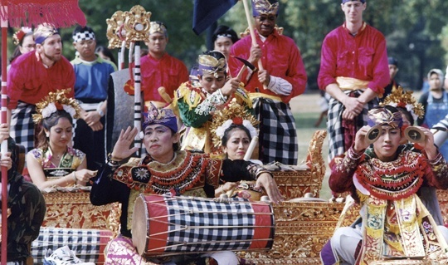
Anthropology

Slide 33
Cont…
Defination;the study of human societies and cultures and their development
Study of human biological and physiological characteristics and their evolution.
Anthropology can be divided into:
Physical, and
Cultural anthropology.

Slide 34
Sociology and anthropology
 | SOCIOLOGY | ANTHROPOLOGY
SIZE | DEALS WITH LARGE MODERN INDUSTRIALIZED SOCIETIES AS THE GROUP OF STUDY | STUDIES PRIMITIVE, ILLITERATE, SIMPLE COMMUNITIES.
TYPE OF STUDY | ONLY STUDIES A PART OF THE LARGE SOCIETY | STUDIES ALL SOCIAL INTERACTIONS AND RELATIONSHIPS WITHIN THE SMALL SOCIETAL GROUP

Slide 35
Anthropology
It is the classification and analysis of humans and their society, descriptively, culturally, historically and physically
It relies on data from non literate people.

Slide 36
Man and culture
Aristotle the ancient Greek philosopher declared long time ago that man Is a social animal, he who does not need society should be either a beast or an angel!
A man is a product of group life, it is the group that socializes him.it is the group life that will make a man a coward or a self sacrificing hero, law abiding citizen or a criminal, it is this man-society relationship that forms the central theme of sociological inquiry

Slide 37
The relationship between man and society is one of the most profound problems we have to tackle, it takes us to a more fundamental question of relation between the individual and society.
The question is what do we owe each other?
Man depends on society
Is observed that everyone breathe, live and work like millions around them in the society.

Slide 38
In the society and individual is surrounded and encompassed by culture, a societal force , he conforms to norms, occupy statuses and play roles within the society.
Social life is an intrinsic need for a man. Emotional, material and intellectual developments are impossible without society.
There are two theories that explains the relationship between man and society

Slide 39
1.the social contract theory
2.the organismic theory of society
According to the social contract theory
all men are born free and equal.
Individuals precedes society.

Slide 40
Society came into existence because of an agreement entered into by individuals. the main proponents of this theory are Thomas hobbes,
John locke and J. Rousseau

Slide 41
A} Thomas Hobbes (1588-1679) he was an English thinker,he opined that society came into being as a means for the protection of men against the consequences of their own nature.
He claims that man was solitary, poor,nasty,brutish and short.
Man in his state of nature was not at all social, he
says that all men were selfish, cunning, egoistic,brutal,as.

Slide 42
these things become intolerable men entered
into a contract to ensure security and certainty of life and property.
The agreement was each for all and all for each.
B) john Locke
He was an English philosopher, he believed that man in his natural state enjoys liberty, freedom, but there was no system of law and justice. Hence corruption and degeneration of man upset him.

Slide 43
There was an ill condition full of fears and continual danger. In order to get rid of this fear , man entered in to social social contract. This led to governmental contract in order to relieve the ill condition.

Slide 44
J.J. Rousseau (1712-1778) ,a French writer in his book “the social contract” wrote that man in his state of nature was a “noble savage” he was leading a life of primitive simplicity and idyllic hapinness, he was
unaware of wrongs and rights.

Slide 45
As population grew these things disappeared property institutions destroyed equality.
man thought of mine and thine
thus became rich, and richness led to war,conflict and murders,this led
to emergent of society according to him..

Slide 46
TASK 1
Read about the criticism levelled against
the social contact theory.
-read about the organismic theory and
its limitations.

Slide 47
Man lives as member of a social group,
isolated he ceases to exist,
we depend on society not livelihood,
but for life itself society not only controls our movements but structures of society become the structures of our own consciousness
SOCIETY.
Society is one of the most inclusive concepts in sociological literature.

Slide 48
Definations:
MacIver and Page; society is a system of usages and procedures of authority and mutual aid of many groupings and divisions of controls of human behavior and liberties, this complex system is the web of social relationships and its always changing.
G.D.H COLE: society is the complex of organized associations and institutions within community.

Slide 49
Proff.Gidding; society is the union itself, the organization, the sum of formal relations in which associating individuals are bound together
Characteristics of a society
1.Society consists of people,without people there is no social relationships, no life at all.
2.Interaction,its when the people in a group interact that they become a society

Slide 50
3.society is a group of groups, it consists of various groups and subgroups,
4.Likeness or similarities, the principle of likeness is essential for society.it exists among hose who resemble one another in some degree, in body and mind, likeness denote similarities.
5.Difference-society consists not only likeness it has differences, and these are on the basis of age, sex, religion, education, occupation and various aspects.

Slide 51
6.Absract- society is intangible, we can only conceive it and understand its existence, society is not a thing but a process of associating.
7.System of control-human behavior needs certain checks o keep it within certain limits, so that healthy social life is a continued. Society has its own way of social control.
8.Complex-society and human behavior are both complex

Slide 52
9.Cooperation and division of labour
10.Culture
11.Society is dynamic
12.Non human being too have society
13.Gregarious nature of man.

Slide 53
TASK :
Read about community
-defination and elements of community
-difference btn society and community
-read about association
-characteristics of association
Read about institution and its characteristics
Difference btn institution and association.

Slide 54
SOCIALIZATION PROCESS
Socialization is the process of earning group norms, habits and ideals
The following factors are important in this process
1.Imitation-coping the acts of others, either consciously or unconsciously, spontanoeus or deliberate, through this a child learns social behavior patterns, children have great capacity to imitate they do it indiscriminately

Slide 55
2.Suggestion-this is a process of communication in which the suggested i.e. a is accepted without logical grounds a child lacks the ability to think and reason hence highly suggestible.
3.Identification-as the child grow they begin to identify with the people around them, and these are usually
things that satisfy the child's need. As the child grows the areas of identification increases

Slide 56
4.language-languge is the medium of
expression ,in the beginning the child
utters meaningless words but gradually the
skill of language is acquired.
Thus in the process of learning,
language is important.

Slide 57
Phases or forms of socialization
1.primary socialization
2.anticipatory socialization
3.Secondary socialization.
4.developmental socialization
5.re socialization

Slide 58
Primary socialization-takes place in infancy
and childhood, it's the most crucial
stage of socialization. The basic behavior
pattern of a child is learnt
at this stage.

Slide 59
The child internalizes many of the
socially accepted values,attitudes,beleifs, and behavior patterns of his culture.
This stage has three sub stages
1-the oral-where child builds up

Slide 60
definite expectations about feeding time, and learns to signal pressing needs for care.
2- the anal stage begins more or
less after a year of infancy

Slide 61
Here the child is trained to
take care of themselves such as
toilet training.
3-the oedipal stage begins roughly from
the fourth year and goes up
to puberty, all the roles prescribed

Slide 62
according to sex are internalized by
the child.
The child identifies with the social roles.

Slide 63
Secondary socialization starts from the latter stage of childhood up to maturity.
Socialization is a continuous process that
takes place throughout the individuals life.

Slide 64
Anticipatory socialization, is learning that is described towards a persons future role anticipatory socialization makes the individual expect their own participation in a
social situation by watching how others
would behave in that situation.

Slide 65
Developmental socialization-as the individual grows he changes and moulds themselves according to the standards and the needs of the society.
he identifies himself with the society,
also

Slide 66
Social institutions
The family
Types- nuclear, extended, blended, single parent, child headed
and composition
Functions of the family – reproduction, sexual gratification, support, nurturing, educational, economic, spiritual
Individual roles of each family member in health care provision
Family in the changing society-fewer children, working mothers, increased life expectancy due to better health

Slide 67
Family
This is the primary social group,
it is the basic unit of human society.
Family is found in every society including the primitive ones,rural and even in urban areas
family is the cradle of socialization unit composed of wife ,husband and children.

Slide 68
Is durable association of husband and wife with or without or of a man or woman alone, with children.
is a group defined by a sex relationship sufficiently precise and enduring to provide for the procreation and upbringing of children.
Is a set of persons related by blood, marriage or adoption who share the primary responsibility for reproduction and caring for members of society.

Slide 69
characteristics
There general and distinctive characteristics of
the family.
1.The general characteristics of the family.
-a mating relationship: the whole existence
of the family depends on mating relationship either short term or long-term
-be a form of marriage-the relationships established through the institution of marriage.
it may monogamous or poly gamous.

Slide 70
2. A system of nomenclature
3. Economic provisions
4. A common habitation
TASK
Read about the distinctive characteristics of the family

Slide 71
Functions of the family
The functions are divided into primary
and secondary functions
1. essential or primary functions
a)stable satisfaction of sexual need;-sex gratification is the first essential function of a family, sex relations between husband and wife are regarded as legitimate by society. It also avoids uncertainty and sexual rivalry and develops sexual harmony and better personality adjustments.

Slide 72
B)procreation and rearing-a human child is unable to survive on its own after birth and requires the help of its parent into prolonged infancy.
Family alone can lay basic foundation for the individual personality effectively.

Slide 73
C) provision of a home..-children are nurtured and brought up at homes,there is a strong desire felt
by both men and women. Even parents who work outside are dependent on homes
D)socialization function-the family is the agent of socialization. This is the process whereby one internalizes the norms of ones group so as to get comfort, protection and peace. Home sweet home.

Slide 74
The child develops distinct self image, unique to the individual in the socialization strage. Child also acquires the family in doctrine the child with the values,morals,beleifs, and ideals of the society.
E)affection function-man has physical as well as mental needs.it is the family that provides the mental
or emotional satisfaction.

Slide 75
Secondary functions of family.
A) economic functions-its an economic unit fulfilling the economic need of the family.
but now due to industrialization the
center has moved from family to factory.
B) socialization function

Slide 76
C)educational functions-the family provides the basis for the formal learning inspite of the changes, the family still gives the child his basic training in the social attitudes and habits which are important in participation in the society.
D)religious functions
E) recreational functions.

Slide 77
Basic needs of the family.
The family being the most important social institution fulfills very vital needs such as:
-affection function
-sex
-procreation
-religion
upbringing of the children
socialization

Slide 78
A healthy family requires:
healthy parents
healthy children
-good house
-employment of parents
-education of parent
-healthy neighborhood
-good recreation
-standard of life.

Slide 79
Good nutrition,
interpersonal relationships and environment as well as the need
for family planning and family education.
the family should be able to take care of the children ,adolescents Youth,adults, and the aged.

Slide 80
The two broad categories of needs met by family includes
1.physical needs health,food,house,household amenities
2.socio cultural-psychological needs-education,socialization, recreation,plus moral and spiritual needs.
Centripetal tendency.

Slide 81
Types of families
1.Matriarchal-mother centered or dominated family. The mother is the family head and exercises authority. She is the owner of the property and head of the household. All other members are subordinated to her.
Its the earliest form of family.
They are common among the eskimos and some indian tribes.

Slide 82
Characteristics of matriarchal family
-descent, inheritance and succession,traced through the mother, its matrilineal.
daughters inherit the mothers property.they succeed their mothers and their sons
Matrilocal-this means after marriage the wife stays back in her mothers house.
The husband pays occasional visits to the wife's house. He is only treated as a privileged visitor,he is only given a secondary position.

Slide 83
Exercise of power-mother exercises authority and power in the family. She is the head of the family
and her decisions are final.
The family structure.-it brings together
kinsmen from the wifes family,her mother ,grandma her children and bothers.
This type of family is usually associated with exogamy.

Slide 84
Patriarchal family
This is also known as the father centered family or father dominated family. The father and the eldest
man is the head of the family and he exercises authority.
He is the owner and administrator of the family property.
On all family matters his voice and opinion is final.

Slide 85
Characteristics of patriarchal family
-1.descent,inheritance and succession are recognized through the male line.
Patriarchal families are patrilineal in characters, because the descent is traced through the males line. Its only the male children who inherit property and in some instances the eldest son enjoys some special rights.
Males also succeeds their fathers after his death.
Children are recognized as belonging to the father.

Slide 86
2.residence-they are patrilocal in residence,sons continue to stay with the father in his own house even
after their marriages. Only the wives come and join them.
3.authority-the father and the eldest member of the family is the dominant member. He dictates the terms for other members and they are all subordinate to him. Its of note though that both patriarchal and matriarchal families are diminishing.

Slide 87
There is a new system of
equalitarian families where the father and
mother enjoy equal status and opportunities.

Slide 88
Nuclear family.
This is the universal social phenomenon.
it consists of the husband, wife, and their children. Soon after their marriage the children leave their parental
homes and establish their own separate households. the nuclear family is free from elders, since there is a physical distance between the parent and their children.
A nuclear family is mostly independent
since there is minimal interdependence with
their parents.

Slide 89
Functions of modern nuclear family
1. stable satisfaction of sexual needs- it’s the family that serves as the executive means of provision of
the sexual needs through the institution of marriage.

Slide 90
2.procreation and upbringing of children-the family is regarded as the proper authority to produce children and bring up children. This is because the
family is the one equipped to bring up children and offer the right physical care.

Slide 91
3.socialization of the children-the family remains as the main agent of socialization of the new child.
the child develops a self and its personality mainly in the family. the child picks the social norms, values and ideals.
4.provision of home.-the home is a happy place for both the parents and the children to live and grow.here affection,love and sympathy are found

Slide 92
Recent trends in the modern nuclear family
The structure and functions of the family have changed in the last century. The family picture has been altered and affected by various factors includding,social,economic,educational,legal,cultural,scientific and technological.
lets look at the specific causes.
1. industrialization-with the industrial revolution in the 18th century the factories took the role of production and the family as a consumer.

Slide 93
2.urbanization-this goes in hand with industrialization where cities grow in size
and in number. Family is cut to size, they are the smallest and home ties weakest. Trends towards disorganization are set in motion.

Slide 94
3.democratic ideals-democracy assures equality and provides liberty to all women who play not only domestic roles but also economic and political roles.
they have become property Owners and business managers.
4.declining influence of mores and religious believes-religion and morality are slowly losing ground. Family members are more secular in outlook. The religious functions of he family have diminished.

Slide 95
5.the spirit of individualism and romantic
love-the spirit of individualism and romanticism have destroyed the family authority. Romanticism have brought the idea of free choice of mate on the basis of love. Marriage has become easily dissoluble as it is started by just mutual consent.
6.economic independence of women
7.decline in birth rate
8.divorce
9.parental youth conflict
10.provide better status for women.

Slide 96

(SOURCE STANDARD NEWSPAPER)

Slide 97
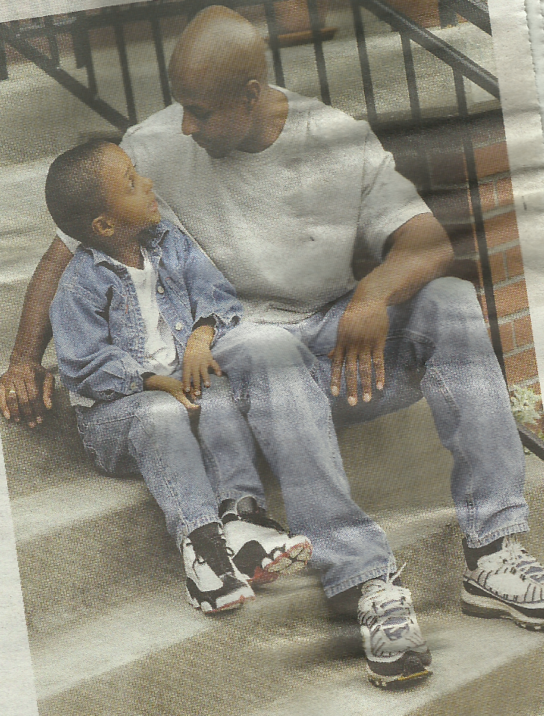
SINGLE PARENT FAMILY
(SOURCE STANDARD NEWSPAPER)

Slide 98
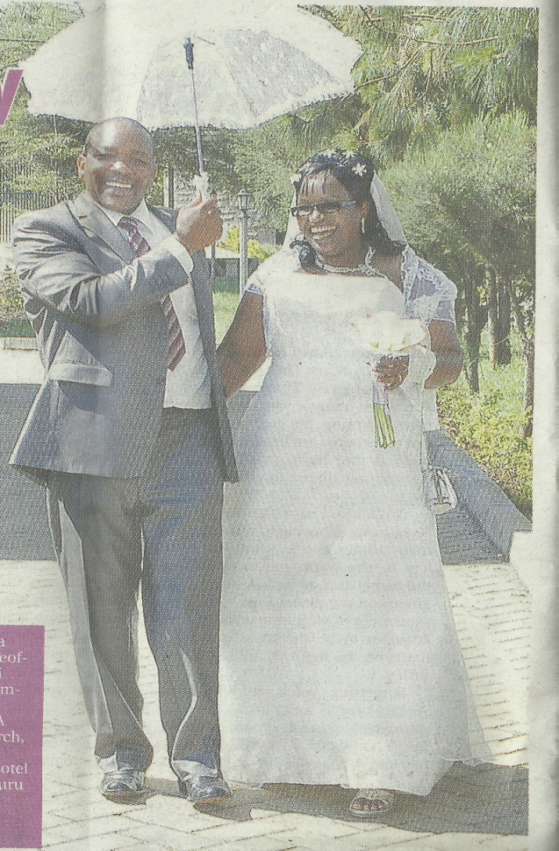
Institution of Marriage
Types- civil, religious, monogamous, polygamy, polyandry, intermarriage, arranged child marriage, group marriage, trial marriage, wife inheritance
ROLE OF MARRIAGE
Companionship
Promotes peace
Legal recognition
Financial security

Slide 99
Social mobility
The ability to move up or down the social level
The amount of mobility in a society depends on two factors:
i. The rules governing how people gain or keep their position may make mobility difficult or easy
ii.Structural changes in society

Slide 100
Types of Social Mobility
Vertical Social Mobility
This refers to the ability of the individual to move up the social ladder, thereby raising their social status and role.eg a clinical officer moving from RCO to a professor in a medical field
Or a nurse moving from nursing to a professor in nursing

Slide 101
Horizontal Social Mobility
This refers to the type of social mobility where the individual maintains the same status
For example a general nurse who trains as a midwife but has no change in salary. This nurse maintains the same status although their role may have changed

Slide 102
Factors that can affect the individual's chances of moving up the social ladder
Community Size
Number of Siblings
Mother Dominance
Late Marriage
Few Children
Discuss how this factors affect social mobility??

Slide 103
The Concept of Social Mobilisation
Social mobilisation is an approach and tool that enables people to organise for collective action, by pooling resources and building solidarity required to resolve common problems and work towards community advancement.
It empowers women and men to organise their own democratically self-governing groups or community organisations which enable them to initiate and control their own personal and communal development, as opposed to mere participation in an initiative designed by the government or an external organisation

Slide 104
The key elements of social mobilisation
Organizational development
Capitol formation for development through community savings
Training for human resource development

Slide 105
Organisational Development
Organisational development is a process in which community members and, especially the poor, form their own groups or organisations based on common development interests and needs that are best served by organising themselves as a group.

Slide 106
Capital Formation for Development through Community Savings
Capital formation (through mobilisation of savings) enhances a community organisation's power to realise its full potential. 'Savings generated by individual members are the assets of the community organisation and are the first step towards their self-reliance' (Pandey 2002).
Accumulated savings can be used for internal credit with interest, to enable individual members to engage in income generation activities whilst at the same time, accumulating the organisation's capital base.

Slide 107
Training for Human Resource Development
Community members can maximise their potential not only by organising themselves but also by upgrading their existing skills to better manage new inputs and establish effective links with local government and other actors.
Socio-economic Development
Socio-economic development initiatives are a great incentive for community members to organise themselves.

Slide 108
The Benefits of Social Mobilisation
Poverty Alleviation
Promoting Democratic Governance
Environmental conservation
Conflict Prevention
Others?

Slide 109
Social institutions
Political – manifestos which affect health of citizens. Political parties influence Govt policies. Trade unions lobby for better working conditions
Economic- cost sharing, national health budget, NGOs and CBOs, NHIF, medical insurance policies, improve health infrastructure

Slide 110
Social institutions
Educational – secondary socialization, personal devt, custodial function, health included in curriculum for a healthy nation
Health care institutions-traditional medicine(herbs, magic, divination)
private hospitals ( offer quality care)
public hospitals hospitals( Level 2-5 h)
Have high level of expertise & variety of services

Slide 111
Social institutions
Religious – mosques, churches, temples, mountains
Role-uphold beliefs , reduction of stress, unity of group members, improving morals, offer comfort and support to members, restores faith
faith based organizations e.g mission hospitals , CHAK, Catholic secretariat in provision of health services

Slide 112
Socialization
It is a process by which a person is introduced to be part of society into which one was born and learns its culture.
Primary socialization – learnt from parents and extended family on acceptable behaviour.
Secondary socialization – from peers(age mates ), school, neighbours and by watching adults.
other agents of socialization- the family, media such as Television, newsprint

Slide 113
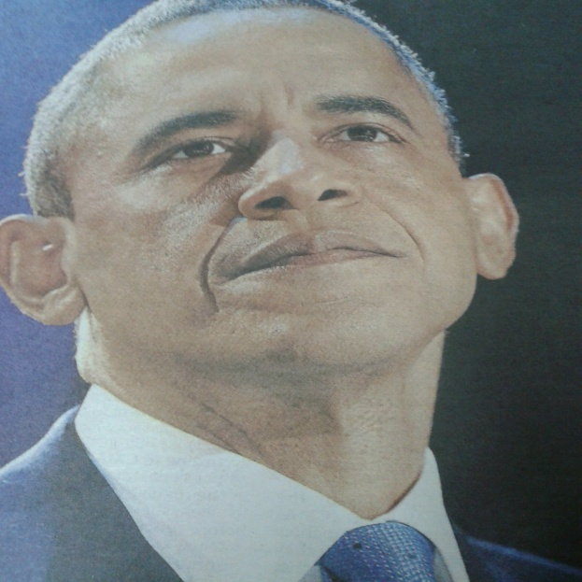
Social stratification
It is process which ranks members of society according to wealth, prestige, power, sex, age and ethnic origin
Status may be: ascribed/born with e.g Prince
Or
Achieved/acquired.eg President

Slide 114
What is culture
Explain Any food taboos that are practiced in your culture
How did people get treatment in your culture
Identify cultural practices which improved health
Describe any practices which have a negative effect on health

Slide 115
What is culture?
It is group of socially transmitted:
Behaviour patterns,
Values,
Arts,
Beliefs
Symbols
And all products of human works & thought.

Slide 116
culture
Artifacts Daily Nation newspaper

Slide 117
Cultural practices & beliefs
A belief is a personal conviction.
It may relate to:
Food taboos
Breastfeeding
Bottle-feeding
Pregnancy
Marriage
How do these affect the health of the society you live in?

Slide 118
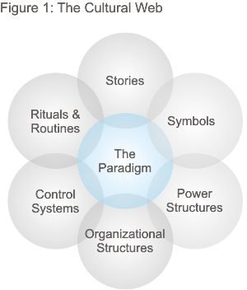
Elements of Culture (Paradigm=Model)

Slide 119
Rural urban migration
What are its health effects on
country
The family
Individual
community

Slide 120
Social change
The law of nature is change.
society is not a static phenomenon
it is a dynamic entity.
change has occurred in all societies
and at all times.
Change is any observable difference or

Slide 121
alteration in any phenomenon over period
of time.
Definitions:
;-social change is any alteration that occur
in social organization that is the
structure and functions of society.

Slide 122
-variations or modifications in any aspect of social process, pattern or form.
Characteristics of social change
-social change is a universal phenomenon:
-no society remains completely static.
changes happens in all aspects including

Slide 123
the population,technologies,material eequipment,institutional structures and functions undergo reshaping.

Slide 124
The speed of change differs from society to society
-social change is community change-
it is social and not individual
-speed of social change is not uniform
-social change occurs in all societies

Slide 125
the speed varies, in some its
fast in others its slow.
-it occurs as an essential law of nature.

Slide 126
-the nature and speed of social
change is affected by and related
to time factor
-it shows chain reaction sequence-
society being made up of interrelated parts.
Hence change in one reacts in

Slide 127
others until the whole system changes
-definite prediction of social change is not possible-

Slide 128
-it is a form of replacement
-results from the interaction of a number of factors.

Slide 129
Factors of social change
1.geographical factor
2.biological factor
3.technological factor
4.cultural factors
5.population factors
6.

Slide 130
geographical /physical ones includes, changes in the planet, like earthquakes,famine,floods,volcanoes
Biological ones includes-these includes heredity, selection of the qualities, social attitudes and interests as sex relations,mariage
.

Slide 131
and racial intermixes.
Technological factors include-rise to economic istitutions,,social institutions,social values

Slide 132
Cultural factors-there is the material culture and non material culture-a CHANGE IN ONE AFFECTS THE OTHER ONE.

Slide 133
HOW YOU CAN INITIATE SOCIAL CHANGE
Create awareness-
Evoke desire for change
Impact skills by showing them how to attain the goal

Slide 134
Be optimistic.
Support and facilitate the change.
Stimulate them/ inspire them e.g. through a reward
Get feedback.

Slide 135
Social stratification
Stratification is the process by which the individuals and groups are ranked more or less enduring hierarchy of status.
Difference is the law of nature., every society is stratified in one way or the other.no two individuals are exactly alike.diverstity and inequality are inherent in every society. Hence human society is stratified everywhere.

Slide 136
Characteristics of social stratification.
Its social-biological traits do not determine social superiority or inferiority until they are socially recognized and given importance. For example a manager is chosen on the basis of their education,training,skills,experience and personality.
Its universal-the difference between rich and poor is found everywhere

Slide 137
Stratification is ancient-it has been around for ages-
Its diverse in its form-its not uniform,it differs from region to region
Its consequential-these are life chances and life styles.
Chances refers to thins like,infant mortality,physicl and mental illness,longevity,divorce,disertion.life chances are not voluntary

Slide 138
Lifestyles are,mode of houses,education,recreation means,relationship between parents and children
Functions of stratification
-provides for the placement and motivation of individuals to effect he performance of their necessary social duties.

Slide 139
-provides a system of rewards and inducements to members for carrying for carrying out various duties associated with various posts
The rewards usually economic,prestige,leisure are built into the social positions so that being unequal they result in inequality of positions.
Stratification sets apart the various positions of

Slide 140
A society in a hierarchy of statuses levels that regulate the relationship between the people within a society.

Slide 141
Social Change
This is the transformation of culture and social institutions over time e.g. coming in contact with Europeans led to change in health seeking behaviour.
Changes affecting health are:
Population growth
Education
Nutrition – adopting refined foods

Slide 143
peace building and conflict resolution
The learners will be able to :
Define conflict
Identify factors that contribute to conflict
state the values of conflict
Discuss types of conflicts
Explain causes of conflict
Discuss Conflict resolution
Outline the negotiation process

Slide 144
Peace and conflict resolution
peace – state of harmony. It is the presence of cultural and economic understanding and unity
Conflict resolution- process that includes negotiation, mediation, diplomacy and creative peace building. Formal complaint through an ombudsman resolves disputes

Slide 145
What is conflict?
Stephen Robbins states that conflict “refers to all kinds of opposition or antagonistic interaction. It is based on scarcity of power, resources or social positions, and differing value structures.”
According to Prowler conflict is defined as a fight, struggle with others or groups also as a collision or clashing of opposed principles

Slide 146
Values of a conflict
Spotlights problems that require attention
Forces clarification
Forces leaders to look for solutions
Stimulates interest and curiosity
Creates new ideas
Many improve practice and standards
May foster better working relationships
Forces leaders to consider alternative view
May foster creativity

Slide 147
Factors that contribute to conflict
During the process of adjustment to forced change
When various groups are not in agreement
When some society groups feel left out when change is being implemented

Slide 148
Causes of conflicts
Gender conflict
Different expectations or role pressures
Divergent goals
Self esteem or status threat
Personality clashes
Insufficient resources
An individual or group trying to control the other

Slide 149
Conflict can be healthy when used
To understand
To clarify expectations and roles
To strengthen relationship
Conflict is more a sign of a group’s health than a symptom of disease. Indifference threatens the growth o f a relationship more than conflict

Slide 150
Destructive conflict can lead to:
Slowing down of the decision making process
Hostility between individuals/groups
Poor communication by deliberately withholding information
Destruction of emotional and physical wellbeing
Psychosomatic disorders e.g. anxiety, stress and burnout
Substance abuse as a means of escaping stressful situations

Slide 151
Destructive conflict can lead to
Transfers or resignations
Waste of time and resources trying to resolve conflict
No flexibility or cooperation among staff
The “US” and “THEM” situation
Unresolved problems etc

Slide 152
TYPES OF CONFLICTS
INTRA PERSONAL
Conflict between oneself e.g.
Medical staff have many roles such as
-Manager, teacher, counselor, researcher, care giver etc
-Has to collaborate with other members of the health team
-Conflicts can occur due to work overload creating conflicting priorities

Slide 153
Types of conflict ct
INTERPERSONAL
Involves two or more persons who have differing attitudes, goals or behavior
INTRA GROUP -Involves some or all group members affecting their performance
INTER GROUP- Clashes between groups
INTER ORGANIZATIONAL CONFLICTS
between organizations

Slide 154
The negotiation process
Has 3 phases-
The information- understand the problem
The competitive – get the best possible deal
The cooperative phase- focus on joint interest of both parties

Slide 155
Skills needed to resolve conflict peacefully
Be an active listener
Look and listen to the other persons feelings
Look for anger cues and triggers
Maintain good eye contact
Use a calm voice
Make sure you have cooled down before trying to work out things

Slide 156
Conflict resolution techniques
AVOIDING
A conflict management technique in which the individual don’t say anything to their partner .They avoid arguments altogether.
ACCOMODATING.
An unassertive cooperation tactic used in conflict management when individuals neglect their own concerns in favour of others concerns.
SUPPRESION
A technique used to manage conflict in which one party is eliminated through transfer or termination.

Slide 157
Conflict management techniques
WITHDRAWAL
The removal of at least one party from the conflict, making it impossible to resolve the situation.
SMOOTHING
Managing conflict by complimenting one’s opponent, downplaying differences and focusing on minor areas of agreement.
FORCING
A conflict management technique that forces an immediate end to conflict but leaves the cause unresolved.

Slide 158
CONFLICT RESOLUTION -OPTIONS
WIN – WIN
Both parties apply problem solving techniques to resolve differences. /COLLABORATION
All parties work together to solve a problem.
LOSE – LOSE
On attempt to compromise both parties lose some face but neither has lost to the other./ COMPROMISE- rewards are divided between both parties.
WIN - LOSE
One party feels cheated/devalued at the expense of the other.
CONCENSUS
A conflict strategy in which a solution that meets everyone’s needs
COMPETING
An all out effort to win, regardless of the cost.

Slide 159
COUNSELING
This is a process of enabling
individuals to know themselves and their
current situation and possible future situations
in order that they make substantial
contributions to the society and to
solve his own problems through a face

Slide 160
to face personal relationship with the
counselor.
Defination:
An acccepting,trusting and safe relationship

Slide 161
In which clients learn to discuss
openly what worries and upsets them,
to define precise behavior goals to
acquire essential social skills and to
develop the courage and self confidence
to implement desired new behaviors.

Slide 162
A professional guidance in resolving personal conflicts and emotional problems.

Slide 163
Principles of counselling
Respect-the ability of the counselor
lies in communicating to the client
the belief that every person posses
an inherent strength and capacity, the
right to choose their own alternatives
and make own decisions

Slide 164
Authenticity- counselors should posses genuineness, honesty,and simplicity and avoid superiority feeling.

Slide 165
Non possessive warmth-demonstration of concern,interest,and value for others
and a deep concern for the
well being of other person.
Non judgmental attitude-avoid bias making assumptions or judgment client.

Slide 166
Accurate understanding of the client-precise evaluation of the perceptual and cognitive behavior of the individual.

Slide 167
Recognizing the clients potential-recognize the strength and abilities of the client.
Confidentiality-maintain confidentiality and develop trust. Avoid revealing clients identity, personal details, and other information without consent.

Slide 168
Types of counseling.
1.individual counseling-
This is a one to one
helping relationship between the counselor and the counseled.
It focuses on an individuals need
for growth and adjustiment,problem solving,

Slide 169
and decision making. This requires highly
trained and skilled counselors .
it also requires certain personality traits
that exhibit understanding,

Slide 170
Warmth,humane and positive attitude towards the client.
Group counseling-its used for individuals
who haven't responded well to the
individual counseling. The group interaction helps the individuals to gain insight into his

Slide 171
problems by listening to others discussing
their difficulties. Group counseling not only
helps the individual to change.

Slide 172
It also enhances his desire and
ability to help others faced with
distressing life circumstances.

Slide 173
Phases of counseling.
1.Appointment and establishing relationship
2.Asssesment 6.termination and follow up
3.Diagnosis
4.Setting goals
5intervention

Slide 174
Appointment and establishing-fix appointment according to the convenience of the
counselee. the counselor should take all
possible efforts to establish rapport and
build relationship of confidence, trust and
mutual appreciation.it helps the client

Slide 175
to express himself without inhibitions and resistance.
Asssesment-this is the data collection
phase,

Slide 176
Analysis of data and clarification
of expectations. The counselee is encouraged
to talk about his problems and
ventilate his feelings, whereas the counselor
asks questions,collects information, observes and possibly helps the counselee to clearly
state his problem.

Slide 177
Diagnosis-the counselor diagnose the problem of the individual and decides the
areas of intervention.
Setting goals-the counselor explains to
the individual what is possible, the
set goals provides a direction to

Slide 178
the counselee and counselor. Goals may
be immediate ,short term or long term.
Short term goals lead to attainment
of long-term goals.

Slide 179
Intervention-explain to the individual how
the set goals can be achieved.
The interventions employed will depend upon
the technique used by the counselor.

Slide 180
The main aspect in this phase
the individual alone is responsible for
the decisions they make.

Slide 181
includes developing insight and putting it
to work. This process of clarifying
and gaining insights leads to decision
making and planning courses of action.
However

Slide 182
Termination and follow up-successful termination is an important aspect of counseling it should be done without
destroying the achievements gained and should be done in a phased manner
covering few sessions. This will prevent

Slide 183
the development of a feeling of
sense of loss in the counselee.
Follow up appointments, planning for the next sessions if needed should also be
carried out.

Slide 184
Attributes and skills required for a consellor.
Pre training attributes: a person with
awareness of needs, feelings, personal strengths, and weaknesses acts as a
good counselor
sensitivity –the ability to understand an individual acts as a good counsellor.

Slide 185
Open mindedness
Objectivity
Trustworthiliness

Slide 186
Approachability, be friendly, have positive attitude, about others and approachable without a feeling of apprehension.
Good psychological health.

Slide 187
Guidelines for successful counseling.
A very careful scheduling of the counseling sessions should be done.
make appointments to save time

Slide 188
Provide privacy and maintain confidentiality
Know the client before he/she comes
for the session, gather data from
different sources
Know your own personality ,this prevents
your opinions or attitudes from affecting

Slide 189
the objectivity of your perception of
clients problem
-be a good listener

Slide 190
Techniques or approaches to counseling.
There three approaches to counseling based
on the nature of the counseling
process and the role of the counselor.
1.directive
2.non directive
3.Eclectic counseling

Slide 191
Directive or counselor centered counseling-here the counselor is active and
directs the individual in

Slide 192
Making decisions and finding solutions to problems. The counselor does not force
the individual but directs the process
of thinking of counselee by informing,explaining,interpreting,and advising. However the decision has to be

Slide 193
made by the counselee.
Non directive counseling- here the counselee is

Slide 194
Is guided to use his/her own
inner resources to solve the problem.
in this approach, the counselee plays a predominant role.
Eclectic-the strategy arises out of
the appropriate knowledge of individual behavior

Slide 195
and a combination of directive and
other approaches. Irrespective of the differences, all approaches should have developmental, preventive and remedial values.

Slide 196
Areas of counseling.
Counseling about risks:
It involves giving information about a
problem
-provide an opportunity for reflection
Help to work out ways of
reducing this impact
-

Slide 197
Counseling to relieve stress
-interpersonal counseling-focused on change in life events, sources of persistent distress
in the family or place

Slide 198
Marriage guidance and counseling-this is directed towards helping couples to talk constructively about problems in their relationship, understand each others point of view and to identify positive aspects
of the relationship, as well as

Slide 199
those causing conflicts
Bereavement counseling- focuses on working through the stages of grief,i.e
denial, extreme sadness, coming to terms
with the loss.

Slide 200
Problem solving counseling-the client is
helped to do the following-
List problems causing distress
Consider course of action to solve
each problem

Slide 201
Select on problem and try out
the course of action that appear
most practical
Review the results
Choose another problem for action if
the first

Slide 202
Succeeds
Choose another course of action,
if the first has not succeeded.
Crisis intervention-helps individuals adapt to immediate effect of severe life events.

Slide 203
While acquiring better ways of deleaing
with future stressful circumstances. These includes,rape,divorce,unexpected bereavement,natural disaters.

Slide 204
Purpose of guidance and counseling
Aid the individual in identification of
his abilities,aptitudes,interests and attitudes
Assisting the individual to understand, accept and utilize these traits

Slide 205
Help one recognize their aspirations in
the light of his traits
Provide the individual with the opportunities
for learning areas of occupation and educational endeavors.

Slide 206
Aid the individual in the development
of value senses.
Help the develop his potential to
their optimum
Assist the individual in obtaining experience, which will assist him in the

Slide 207
making of free and wise choices.
Aid the individual in becoming more
self driven.

Slide 208
The GATHER approach to Conseling entails
Greet-the person
Ask-ask how can I help you
Tell –tell them any relevant information

Slide 209
Help-help them to make decisions
Explain-explain any misunderstanding
Return-return for follow up or referral.

Slide 210
SOLER
S-sit squarely
O-open posture
L-lean forward
E-eye contact
R-relax

Slide 211
Economic institutions
In every society needs must be met if happiness and health of the societal members are to be maintained. these needs include,food,shelter,healthcare,clothing,education, and entertainent. all these are meant to enhance the quality of life .to satisfy these needs every society develops a system of roles and norms that govern the production ,distribution and consumption of goods

Slide 212
And services. This system is called economic institution.
This need for economic institutions is rooted.in the problem of scarcity. Peoples needs are always greater than the resources available to satisfy them hence societies have to develop the best ways to use these limited resources for everyone's benefit. This is done by answering three basic questions.

Slide 213
1.wht goods and services should be produced.
2.how should these goods and services be produced.
3.for whom should these good and services be produced.How a society answers these questions is determined in large part by the society’s available factors of production and technological levels.

Slide 214
Resources that can be used to produce and distribute goods and services are called factors of production
These factors include:
Natural resources(land,water,minerals,plants,animals,sun and wind) human resources(labour) and capiitall resources(money,tools,machenery,buildings

Slide 215
A society’s available factors of production and its technological ability to manipulate those resources shape the nature of its economic system.

Slide 216
The nature of economic system
All economic systems contain three basic sectors
The primary sector, the secondary sector, and the tertiary sector.
The primary sector deals with the extraction of raw materials from environment. This includes, fishing,hunting,mining and farming.
Secondary sector concentrates on the use of raw materials to manufacture goods.

Slide 217
Activities in the secondary sector can range from turning a log into a primitive canoe to manufacturing a rocket that can travel deep into space.
Tertiary sector, the emphasis shifts to the provision of services.the degree to which any of the secrors is emphasized over the others depends on societys avilabl reources and its technologicaal levels

Slide 218
Economic models
Sociologist focus on three economic models…
1.capitalism
2.socialism
3.communism.
The difference between the first two models hinges on who owns the factor of production in society and how economic activity is regulated.

Slide 219
In capitalism the factors of production are owned by individuals rather than y the government. Economic activity is regulated by the forces of profit and competition. In socialism, on the other hand the factors of production are owned by the government, which regulates all economic activity.in reality though there is no society follows a pure capitalist or socialist model.

Slide 220
Although some societies lean heavily on one or the other. The united states and Canada for example follows the capitalist model while, the people republic of china and Cuba on the other hand follow the social model. Between these extremes there host of nations who combine the two models to various degrees. Countries like Kenya, Great Britain,france and Sweden.

Slide 221
In these countries the government control essential services and industries, such as healthcare, energy production and production of industrial goods. However a wide range of businesses are still owned by individuals.

Slide 222
capitalism
In a pure capitalist system the economy is regulated by self interest and market competition. Self interest regulates the economy by guiding the actions of the consumers and producers. Self interest leads the consumers to try and purchase the goods and services they require at the least price possible. Producers on the other side are guided by the ventures with potential for profit.

Slide 223
Market competition regulates the economy by influencing the answers to the three economic questions of: what to produce, how to produce, and for whom to produce. Businesses that produce goods or services wanted by the consumers at the prices the consumers are willing to pay will be successful. For competition to be effective in regulating the market however it must operate with limited government interfernce

Slide 224
Rather than government regulation the laws in pure capitalist system works on the laws of supply and demand.
The law of supply ; states that produces will supply more products when they can charge higher prices and fewer products when they must charge lower prices. The law of demand states that the demand for a product increases

Slide 225
As the price of the product decreases. On the other hand , the demand for a product decreases as the price increases. Economist Adam smith calls this inter play between the forces of supply and demand the ‘invisible hand’.According to him if the governments interference is left at bare minimum and if competition is not restricted the invisible hand of market forces keeps the economy in balance.

Slide 226
This pure capitalist form is sometimes referred to as laissez-faire(lay-say-fair) capitalism. This is a French term for to ‘let people do as they choose’.in practice though every capitalist system has gov’t regulation that protect the consumer and ensure fair business competion.This however does not prevent individual setting up and running own businesses hence the label free enterprise system/free market economy.

Slide 227
socialism
In a pure socialist system, economic activity is controlled by social need rather than self interest and by gov’t in central planning rather than by the market forces. The three basic questions of what, how and for whom to produce are answered differently. What to produce is determined by the society's need, regardless of whether it can be produced profitably.

Slide 228
Need is determined by economic planners at the central gov’t. what to produce is also planned for and the gov’t provides consumers with basically one variety of each good. Thus market competition is not a factor in regulating supply and demand in a pure socialist economy. For whom to produce is determined by need rather than the ability to pay.it is for this reason that the means of production are owned by gov’t.

Slide 229
The goal of communism has never been fully achieved. The nations that adopt this model for their economies also adopt a totalitarian forms of gov’t. they hold complete authority over the lives of societal members. Public opposition to gov’t policies is rarely allowed and most personal freedoms are greatly restricted .

Slide 230
He principles guiding socialism are social equality and economic fairness.in the pure socialist model, socialists ultimate goal is communism.
Communism is where property is communally owned .in such a system ,social classes cease to exist and the role of the government declines as individuals learn to work together peacefully and willingly for the good of all.

Slide 231
Political institution
No society can survive for long if each person in the society does exactly as he or she pleases. For society to run smoothly ,people must ac together for the common good. Thus all society exercise some degree of power over societal members.
Power is the ability to control the behavior of others, with or without their consent.

Slide 232
In very simple societies power is held by the family, but in more complex societies ultimate power falls to the state. Which Is the primary political authority in society. Power of the state is shaped by the political institution-the system of roles and norms that governs the distribution and exercise of power in society .according to conflict theorists different segments of the society compete with one another for power

Slide 233
Although political institution generally favors the wealthier segment of the society,ongoing,conflict causes the distribution of power to shift enough to result in varying degree of social change. The main functions of the state include:
Creation and enforcement of laws, the settling of conflicts between individuals,

Slide 234
The provision of services, the establishment of economic and social policies and maintenance of relations with other nations, all these functions center on the task of maintaining law and order.sociologist who adopt the conflict perspective on the other hand focus on how the political istitution brings about social change.different groups in society compete on one another for power

Slide 235
And although the political institution generally favors the wealthier segment of society, ongoing conflict causes the distribution of power to shift enough to result in varying degrees of social change.
Legitimacy of power. Refers to whether those in power are viewed as having the right to control or govern others.

Slide 236
authority
Max weber referred to legitimate power as authority. He was interested in how leaders come o be viewed as having the legitimate right to exercise power over others. This right to govern is based on three types of authority: traditional authority, charismatic authority or rational –legal authority

Slide 237
Traditional authority
That is power that is legitimated by long-standing custom, in other words people accept the exercise of power as legitimate because it has been considered legitimate in the past. Its based on birthrights ,its passed down from generation to generation. kings,queens and tribal chieftains are examples of leaders who rely on traditional authority for their right to rule.

Slide 238
Charismatic authority
Its legitimated by the personal characteristics of the individual exercising the power. These charismatic leaders are able to exercise authority because their followers believe that such leaders possess special qualities that merit devotion and obedience. This type of leadership generally arises during periods of social unrest when people are searching for leaders who can offer them a better life. Examples of charismatic.

Slide 239
Leaders includes Buddha ,Jesus, Adolf Hitler, Mahatma Gandhi, Mao Zedong, Rev. Martin Luther King Jr.,Ayatollah Khomeini and Saddam Hussein…modern charismatic leaders,Mandela, Obama,Kenyatta,Kwame Nkurumah,Raila Odinga.
As its evident from the mentioned names charismatic leaders can have either positive or negative consequences in society.

Slide 240
Rational-legal authority
Its a power legitimated by formal rules and regulations.in most instances these rules and regulations are contained in a written constitution and set of laws that clearly outline the rights and obligations of those in power. power rests not in the individual but in the office or position the individual holds. Thus the authority to govern is lost when the individual leaves or is removed from office.

Slide 241
Rational-legal authority
is the most common form of authority in modern societies. This is legitimized by formal rules and regulations.in most instances these rules and regulations are contained in a written constitution and set of laws that clearly outline the rights and obligations of those in power. Power rests not on the individual but the office or position the individual holds.

Slide 242
Authority to govern is lost when individual leaves office or loses power.

Slide 243
Types of governments
This consist of the people who direct the power of the state.in kenya the government has two levels .the county and the national government. There are three arms of governments namely the executive, the judiciary and the legislature.
Most government are either democratic or authoritarian

Slide 244
Democracy is where power is exercised through the people. The central feature of democracy is the right of the governed to participate in the political decision making processses.in practice these are representational democracies. Here voters elect representatives who are entrusted with the task of making political decisions.

Slide 245
If these elected officials do not perform to the liking of the electorate ,they can be ousted.
Monarchy.is the type of government where one person rules. The ruler known as the monarch comes to power through inheritance. Most of the remaining monarchs have limited power. The power rests mostly with the elected officials. The monarch is mostly more than the symbolic head of state.

Slide 246
This type of monarchy is called constitutional monarchy. They are considered to be democratic because the ultimate power rests with the elected officials. Great Britain is such example. There also authoritarian systems of government.

Slide 247
Here the power firmly rests with the state. Members of society have little or no say in the political decision making process and in most cases ,government leaders cannot be removed from office through legal means. There is absolute monarchy where hereditary ruler holds absolute power. For example Bahrain and Oman. Are two nations ruled by absolute monarchies.

Slide 248
Where power is in the hands of one individual its called dictatorship.

Slide 249
culture
Sociologist and anthropologists use the term culture as a collective noun that includes languages, custom and convention by which humans behaviour can be distinguished from other primates .it refers a vast store of learned behaviour that has been passed down through the generations and which, increasingly has differentiated the human way of life from that other human species.

Slide 250
Illness and illness behavior
Illness behaviour thus involves the manner in which persons monitor their bodies ,define and interpret their symptoms, take remedial action and utilize various sources of help as well as the more formal healthcare system.J

Slide 251
The term culture is derived from the Latin word colere.whic means to cultivate or to till the soil.
So initially the term had some reference to agriculture. But its now used to refer to the beleifs,values and expressive symbols of any group or society.
Definitions of culture:
That complex whole that includes knowledge

Slide 252
Belief, art, morals, law, custom, and any other capabilities and habits acquired by man as a member of the society.
-organized body of conventional understanding manifest in art and artifact which, persisting through tradition ,characterizes a human group.
-culture is the handiwork of man and the medium through which he achieves his ends.

Slide 253
Characteristic of culture.
Culture is learnt- its not innate and cultural traits can be acquired through socialization and habits
-culture is social-culture does not exist in isolation.it originates and develops through social interaction. Man acquires human qualities through association with others.

Slide 254
-culture is shared- its not individual its collective.it includes the expectations of the group as a whole., culture is the totality of group way, thought and action duly accepted and followed by a group of people.
-culture is idealist-what is include in culture is not all attainable. Its idealized and efforts are made to achieve these ideals .it reflects ideal norms,behaviour of a group.

Slide 255
-culture is transmittive-always has a link with the past.it is past that is given to the future in the form of customs and traditions.
Culture is gratifying-each group has a certain common ends, which are met by he culture.it meets ethical and social needs of the group as a whole.
Culture is dynamic-its not static.it means

Slide 256
A way of life. inventions,problems,planned changes. New ways of life are evolved and adopted in an attempt o adjust to changed circumstances.
Culture is integrated-various parts of the culture are closely linked and integrated with one another. Thus culture is not a disintegrated whole, not only this but also any element

Slide 257
Which gets introduced and accepted by the culture also gets integrated.
Non-Material culture
-this consists of the words people use,the ideas,customs and beleifs,they hold and the habits they follow

Slide 258
Material culture
It consists of culture of manufactured objects such as tools,furniture,automobiles,roads,bridges.
Note..material culture is always the outgrowth of non material Culture.

Slide 259
Key terminologies
Cultural lag-this is the time between the appearance of a new material invention and the making of appropriate adjustments in corresponding area of non-material culture.
Sub culture-.a culture within a larger culture, often having beliefs or interests at variance with those of the larger culture

Slide 260
Acculturation-this is cultural change occurring under special conditions of intensive contact between culture and involving extensive and relatively rapid change in one or both cultures involved.
Ethnocentrism-this is a characteristic of the in group.

Slide 261
This is that view of things in which ones own group is the center of everything and others are rated with reference to it. the culture of others is looked upon with contempt and a belief that your is superior to others.
Cultural diffusion-process by which the cultural traits invented or discovered in one society are spread directly or indirectly to other societies.

Slide 262
Life style- a way of life or style of living that reflects the person values and attitude. This includes patterns of social relations, consumption, entertainment and dress.it also reflects persons values and attitudes. The conscious or unconscious choice between one site of behaviors and some other set of sets of behaviors.

Slide 263
Cultural effects on health.
The effect of culture on health is vast.it affects perceptions on health, illness and death. beliefs about caused of diseases, approach to health promotion, how illness and pain are expressed and experienced, where patients seek help and the types of treatment patients prefer. To improve healthcare delivery and outcomes the health care providers should know the patients cultural view on:

Slide 264
Role of family members, heirachy,key decision makers
Role of community
Religion-impact on diet, beliefs about illness, treatment.
Views on health and wellness.
Views on death and dying.
Alternative or traditional medicine.

Slide 265
Beliefs about causes and treatments of illness disease (physical and mental).
Gender roles and relationships.
Sexuality, fertility, childbirth.
Food beliefs and diet.

Slide 266
Knowledge of patients culture can help avoid misunderstanding and enable practitioners to provide better care.
The role of generalization
Generalization is a statement about common trends within a group, but with the recognition hat further information is needed to ascertain whether the generalization applies to a particular person.

Slide 267
Another are is the aspect of prognosis, whereas some cultures want to know exact prognosis and disease process. Some believe that their religious beliefs do nit allow such. Some members may consider bad news to be inappropriate. And insensitive.
Nurses are taught the importance of touch. Yet if they are caring for certain opposite sex patients.

Slide 268
But its important to know about cultural and religious barriers. And some touches are prohibited.
Factors of disease causation
Supernatural causes-wrath of God,small pox,chicken pox,breaking social taboos,sins,evil eye ghost/spirit.

Slide 269
Physical causes-extremity of weather,heat stroke,frost bite,contaminated water,impurity of blood,scabies,acne,boils.
Environmental sanitation-disposal of human excreta-open field defacation.
Disposal of waste
-food habits-influnce by climate,soil type,customs,beleifs,religion,deep psychological

Slide 270
Root.
Things related to affection, warmth, image, social prestige, food taboos, concept of hot and cooked food, fasting, vegetarian and non vegs. adulteration-to make impure by addition of foreign or inferior substance.
Maternal child health-universality of mariage

Slide 271
Male child preference
Beneficial-breastfeeding,exosure to sunlight
Harmful-restriction of food intake during pregnancy
Home delivery by untrained aids
Discarding colostrum
Pre lacteal feeding

Slide 272
Skin branding
Sedative given to infant.
Un important ones
-piercing ear/nose
-topical application on head
-

Slide 273
Personal hygiene
Oral hygiene,neem twigs,mukobero,ash,charcoal,
Baths-adequcay of space,prrivacy,clothing,intelligence,religion,weather,
Regular baths-

Slide 274
Ritual bathing,on fixed occasions and ceremonies.
After child birth ,menstruation women must take bath.
Villaages,no use of soap.use of common bath cloth.

Slide 275
Sleeping habits
-newborn 0-2 months -12-18 hrs.
Infants 3-11 months 15- 15 hours
Toddlers 1-3 years 12 to i4 hours
Preschoolers 3-5 years 11– 13 hours
Young children 5-10 years 10 to 11 hours
Teens 10-17 years 8.5-9 hours

Slide 276
Adults 6.5 hours of sleeping
Lack of healthy and disturbed relationship

Slide 277
Illness and Sickness behaviour
Illness-a disease or period of sickness affecting the body or mind.

Slide 285
The end
Thank you
Work hard
revise
And prepare for exams

