Slide 1
BRONCHIECTASIS
S M N

Slide 2
Definition
Defined as
- It is an abnormal dilatation of bronchi. It maybe either focal, involving the
airways supplying a limited region of lung parenchyma or diffuse, airways including a more widespread distribution.

Slide 3
HISTORY
René Laennec, the man who invented the stethoscope, used his invention to first discover bronchiectasis in 1819.The disease was researched in greater detail by Sir William Osler in the late 1800s; it is suspected that Osler actually died of complications from undiagnosed bronchiectasis.

Slide 4
Epidemiology
No systematic data are available but it is considered as the reflection of the socio-economic conditions of the population under study.
In 20th century the cases of bronchiectasis significantly reduced due to emergence of anti-biotics and vaccines.
Race, sex and age related demography :
-no racial prelidiction.
-CF related bronchiectasis more common in white females older than 60yrs and is often caused by MAC infection. Its called as Lady-Winderrnere syndrome named after a character in novel by Oscar Wilde.

Slide 5
- In pre antibiotic era the disease used to start as early as in the first decade. But now the disease has found itself in the age group > 60yrs.

Slide 6
Etiology
1.Focal:
-obstruction. For eg: Aspirated foreign body, tumor mass.
2. Diffuse:
- Cystic fibrosis, Necrotising and suppurative pneumonia (Staphylococcus Aureus and Klebsiella), Post tubercular sequale.

Slide 7
Childhood
Pertussis, measles, Necrotizing pneumonia
2. Primary infections
klebsiella species
staphylococcal species
Mycoplasma pneumoniae
Mycobacterium tuberculosis
Measles virus
Influenza virus
Herpes simplex virus
Adenovirus
Pertusis virus

Slide 8
MAC infections has increased propensity to occur in HIV infection as well as in immuno compromised individual.
It is found mainly in women >60yrs who are non-smokers, who don’t have any predisposing pulmonary disorder and who tend to suppress cough.
3. Obstruction
Foreign body
4. Tumor
Laryngeal papillomatosis, adenoma, bronchogenic , carcinoma

Slide 9
5. Hilar adenopathy
Tuberculosis, histoplasmosis
6. Mucoid impaction
Allergic bronchopulmonary aspergillosis, bronchocentric granulomatosis, fibrinous bronchitis
7.Congenital anatomic defect
Williams-Campbell syndrome (congenital cartilage deficiency), Mounier-Kuhn syndrome (tracheo-bronchomegaly), Swyer-James syndrome(unilateral hyperlucent lung), pulmonary sequestration, pulmonary artery aneurysm, yellow nail syndrome(Hypoplastic lymphatics, pleural effusion, yellow nails )

Slide 10
8.Immunodeficiency state
IgG subclass deficiency, X-linked, agammaglobulinemia, selective IgA, IgM, or IgE deficiency, bare lymphocyte syndrome, chronic granulomatous disease, Nezelof syndrome (Thymic dysplasia with normal immunoglobulins)
9.Hereditary abnormality
Dyskinetic cilia syndrome, Kartagener’s syndrome (situs inversus, nasal polyposis and bronchiectasis) ,a ₁-antitrypsin deficiency, cystic fibrosis, ADPKDK

Slide 11
Pathogenesis
Bronchieactasis is a consequence of inflammatory and destruction of structural component of the bronchial tree mainly mid sized airways, segmental and sub-segmental bronchi.
Micro-organisms such as staphylococcus aureus , klebsiella, psuedomonas aeruginosa,
haemophilus influenzae etc.
protease and other toxins

Slide 12
Up-regulation of neutrophils
(Elastase and Matrix metallo-protinases)
Destruction of wall structures- cartilage,muscle,elastic tissue and replaced by fibrous connective tissue
Dilatation of the bronchi leading to accumulation of the thick pool of purulent material and occlusion due to fibrous thickening
Increased vascularity due to enlargement of bronchial arteries and increased anastonosis between bronchial artery and pulmonary artery

Slide 13
pathology

Slide 15
Clinical Features
Symptoms
1.Persistent and recurrent cough with purulent and sputum production.
2.Repeated respiratory tract infection.
3.Haemoptysis 50-70% of cases.
4.Systemic symptoms like : fatigue, weight loss and myalgia
5.Pneumonia type- chronic cough and sputum production.

Slide 16
6.Few patients give an history of insidious onset of symptoms.
7.Some remain asymptomatic.
8.Some give history of non-productive cough termed as ‘Dry-bronchiectasis’.
9.Dyspnea in around 72% cases.
10.Wheezing
11.Pleuretic chest pain

Slide 17
In past the severity of the bronchiectasis was classified according the amount of sputum production.
<10ml – Mild bronciectasis
10-150ml- Moderate Bronchiectasis
>150ml – Sever Bronchiectasis.
At present it is classified accorrding to the radiological findings

Slide 18
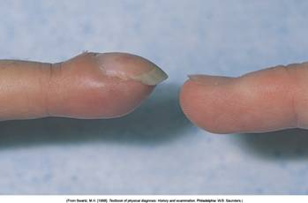
Signs
Many a times combination of crackles(73%), wheeze and ronchi are heard.
Clubbing(2-3%) may be present.
In severe cases with hypoxemia it may be associated with cor-pulmonale and features of right ventricular failure.
Cyanosis and plethora are a rare finding secondary to polycythemia from chronic hypoxia.

Slide 19
WORK-UP

Slide 20
Patient history
Childhood infections, exposure to pulmonary pathogens, aspiration of foreign bodies, pulmonary symptoms in siblings
Physical examination
Auscultation for focal wheezes or other adventitial sounds, examination of nares and upper respiratory tract for polyps or evidence of chronic sinusitis
Laboratory tests
Routine hematology is non specific but may show anaemia and increased white blood count. It may also show polycythemia as a response to chronic hypoxia.

Slide 21
Quantitative immunoglobulin levels of IgG, IgM and IgA are useful to exclude hypogammaglobulinemia.
Quantitative serum alpha 1 anti trypsin levels used to rule out AAT deficiency
Sputum analysis
when sputum is allowed to settle may reveal Dittrich plugs, small, white or yellow concretions.
Gram’s stain may reveal Pseudomonas and E-coli suggestive of CF but not diagnostic.
Presence of non-mucoid sputum is suggestive of pseudomonas aeruginosa, while presence of eosinophilia and golden plugs containing hyphae is suggestive of aspergillous species.

Slide 22
Routine bacterial, fungal, and mycobacterial cultures may reveal other organisms.
Pilocarpine ionophoresis (Sweat test)
for the evaluation of CF
Skin test*
Aspergillus antigen
Aspergillus Precipitin test
Diagnostic criteria 1000 IU/ml or a greater than 2 folds increase from the base-line

Slide 23
Auto-immune screening test
For RA and other auto-immune diseases. For ex ANA antibody assay.
Computerized tomography
the HRCT is has almost completely replaced bronchography. The sensitivity and specificity are 84-89% and 82-99% respectively.
additional advantages include non invasiveness, avoidance of possible allergen to contrast media and information regarding other pulmonary processes.

Slide 24
Reid’s classification :
depending on the findings of the CT scan it is classified as :
1.Cylindical bronchiectasis has a tram track lines in longitudinal section or signet ring in case of a horizontal section and the adjacent pulmonary artery representing the stone.
2.Varicose bronchiectasis : has irregular or beaded bronchi with alternating dilatation and constriction.
3.Cystic bronchiectasis has large cystic spaces and a honey comb appearance. This contrasts with blebs of emphysema.

Slide 25
This CT scan depicts areas of both cystic bronchiectasis and varicose bronchiectasis.

Slide 26
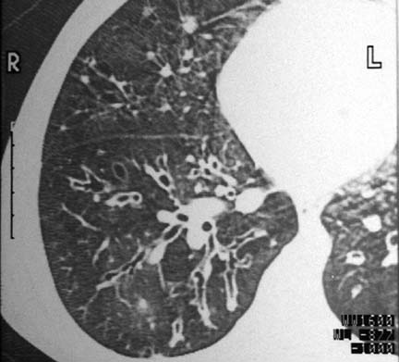
Varicose bronchiectasis with alternating areas of bronchial dilatation and constriction

Slide 27
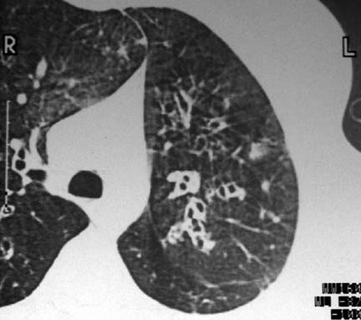
Cylindrical bronchiectasis with signet-ring appearance. Note that the luminal airway diameter is greater than the diameter of the adjacent vessel.

Slide 28
Cystic and cylindrical bronchiectasis of the right lower lobe on a posterior-anterior chest radiograph

Slide 29
Radiography
P-A and lateral chest radiographs should be taken.
Expected findings :
1. Increased pulmonary markings
2. Honey combing
3. Atelectasis
4. Plueral changes
Specific findings – Tram –tracking, dilated bronchi, clustered cysts.

Slide 30
Pulmonary function tests :
Patients with bronchiectasis show yearly rapid deterioration in FEV-1 than a patient without bronchiectasis. More rapid decline is seen in Pseudomonas aerugenosa infection and in increased pro inflammatory markers.
Electron microscopy examination
to observe the evidence of primary ciliary structural abnormalities and dyskinesia.

Slide 31
Bronchography
Its being significantly replaced by CT. It is performed by instilling contrast via a catheter or bronchoscope and performing plane radiographic imaging. In current practice, its only of potential value in conforming the location of focal bronchiectasis and excluding the disease elsewhere in the setting of possible surgical resection.
It carries a high risk of acute broncho-constriction.

Slide 32
Bronchoscopy
Not helpful in diagnosing bronchiectasis but useful in identifying abnormalities such as tumors, foreign bodies or other lesions. It may also used along with lavage for collection of specimens for culture and staining.

Slide 33
Treatment

Slide 34
Supportive Treatment
Cessation of smoking
Avoidance of second-hand smoking
Adequate nutritional intake
Immunizations for influenza and pneumococcal pneumonia
Conformation of immunizations for measles, rubella and pertusis
Oxygen therapy is reserved for patients with hypoxemia and end stage complications such as cor-pulmonale

Slide 35
Treatment of infection
Clearance of the secretion
Reduction of the inflammation
Treatment of the underlying problem

Slide 36
Antibiotics- Initially during the acute phase amoxicillin,TMP or levofloxacin should be started and later proper antibiotic should be chosen accordingly to the Sputum culture and Gram’s stain.
When pseudomonas is the organism oral Quinolone or parentral therapy with aminoglycosides, carbapenam or third generation cephalosporins should be given.
There is no firm guidelines for therapy and hence should be continued for 10-14 days.

Slide 37
Aerosolized antibiotics
It delivers relatively high concentration of drugs with relatively lesser systemic side-effects.
It is beneficial in treating Pseudomonas infection.
Currently, inhaled Tobramycin is most widely used. Gentamycin and Colistin have also been used

Slide 38
Bronchial hygiene
Proper mechanical and devices with proper positioning of the patient can help the patients with copious secretions.
Postural drainage with percussion and vibration helps in effective clearance.
Devices like Flutter device, Intrapulmonic percussive ventilation device and incentive spirometry are available.
Newest device is the ‘Vest’ system wherein a pneumatic compression vest is worn by the patient periodically throughout the day.

Slide 39
Tapping of the chest wall to dislodge the secretions

Slide 40
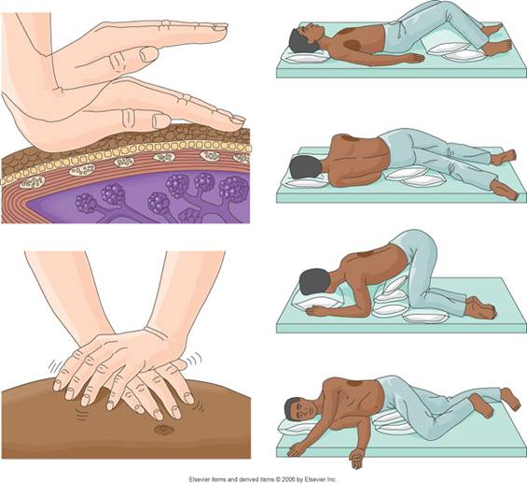
Positional drainage and physiotherapy

Slide 41
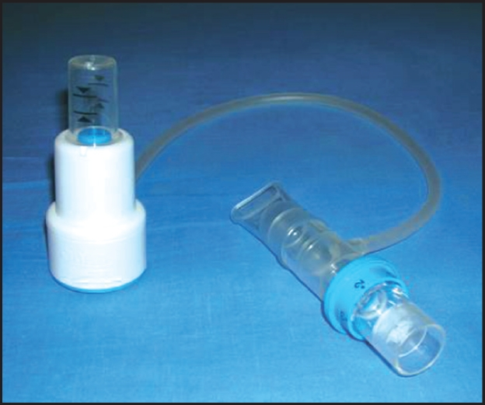
Positive expiratory thera- PEP

Slide 42
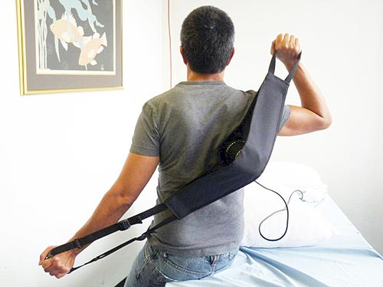
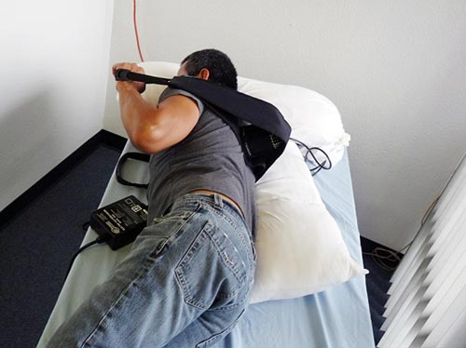
Use of oscillator

Slide 43
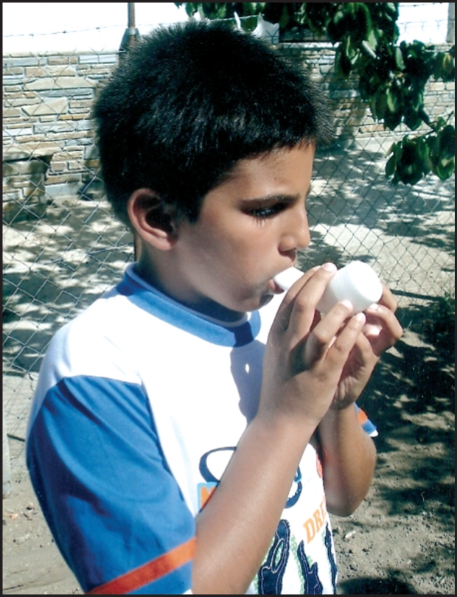
Use of Flutter

Slide 44
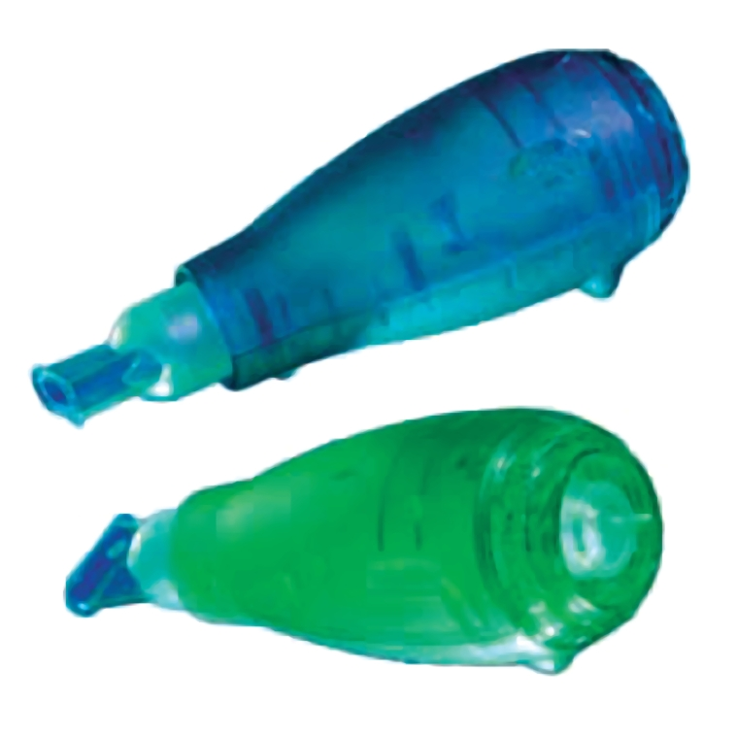
Acapella Device

Slide 45
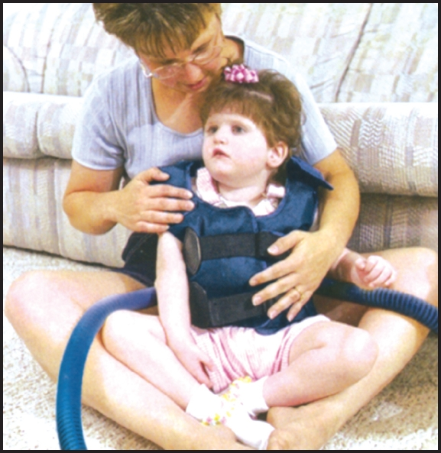
Use of a vest

Slide 46
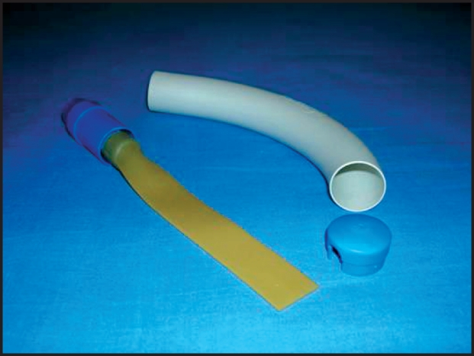
Cornet device

Slide 47
Use of mucolytics can help thinning out the thick mucous secretions.
Use of recombinant DNAse which help in the destruction of the DNA released by the neutrophiles has shown improvement in the PF in case of CF.
Bronchodilators help in the obstruction and clearance e of the bronchus.
Use of nebulizations concentrated with 7% NaCl have shown beneficial in CF-related Bronchiectasis.

Slide 48
Anti-inflammatory therapy
Reduce the inflammation caused by the organisms and subsequently reduce the tissue damage.
Inhaled corticosteroids, Leucotriene inhibitors and NSAID can be given.
Studies have shown use of inhaled corticosteroids have shown qualitative improvement in the quality of life.
Azithromycin has known anti-inflammatory properties and its long term use has shown ,marked improvement in CF and non-CF bronchiectasis.

Slide 49
Surgical resection
Helpful in advanced or complicated disease.
Indications :
1.Patients who have focal disease that is poorly controlled by anti-biotics.
2.Reduction of acute infective episodes
3.Massive haemoptysis(Alternatively bronchial artery embolization may be attempted)
4. Foreign body or tumor removal
5. Consideration in the treatment of MAC or Aspergillus specific infections

Slide 50
Complications :
empyema, haemmorrhage, prolonged air leak and persistent atelectasis. Mortality is <1 %.
Lung transplantation
Single or double lung transplantation for severe bronchiectasis, predominantly related to CF. FEV1 < 30
and in younger patients it may be considered.

