Slide 1
BRONCHITIS
SMN

Slide 2
DEFINITON OF DISEASE
Bronchitis is inflammation of the mucous membranes of the bronchi.

Slide 3
Acute bronchitis is characterized by the development of a cough, with or without the production of sputum, mucus that is expectorated (coughed up) from the respiratory tract. Acute bronchitis often occurs during the course of an acute viral illness such as the common cold or influenza.Viruses cause about 90% of cases of acute bronchitis, whereas bacteria account for fewer than 10%.^{[1]}

Slide 4
Chronic bronchitis, a type of chronic obstructive pulmonary disease, is characterized by the presence of a productive cough that lasts for three months or more per year for at least two years. Chronic bronchitis most often develops due to recurrent injury to the airways caused by inhaled irritants. Cigarette smoking is the most common cause, followed by air pollution and occupational exposure to irritants. ^{[1]}

Slide 5
ETIOLOGIC AGENT
Acute bronchitis is usually caused by infections, such as those caused byMycoplasma species, Chlamydia pneumoniae, Streptococcus pneumoniae, Moraxella catarrhalis, and Haemophilus influenzae, and by viruses, such as influenza, parainfluenza, adenovirus, rhinovirus, and respiratory syncytial virus. Exposure to irritants, such as pollution, chemicals, and tobacco smoke, may also cause acute bronchial irritation

Slide 6
PHATOPHYSIOLOGY
During an episode of acute bronchitis, the cells of the bronchial-lining tissue are irritated and the mucous membrane becomes hyperemic and edematous, diminishing bronchial mucociliary function. Consequently, the air passages become clogged by debris and irritation increases. In response, copious secretion of mucus develops, which causes the characteristic cough of bronchitis.

Slide 7
In the case of mycoplasmal pneumonia, bronchial irritation results from the attachment of the organism (Mycoplasma pneumoniae) to the respiratory mucosa, with eventual sloughing of affected cells. Acute bronchitis usually lasts approximately 10 days. If the inflammation extends downward to the ends of the bronchial tree, into the small bronchi (bronchioles), and then into the air sacs, bronchopneumonia results.

Slide 8
symptoms of acute bronchitis include the following:
Sore throat
Runny or stuffy nose
Headache
Muscle aches
Extreme fatigue

Slide 9
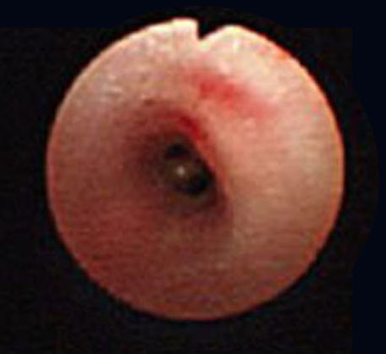
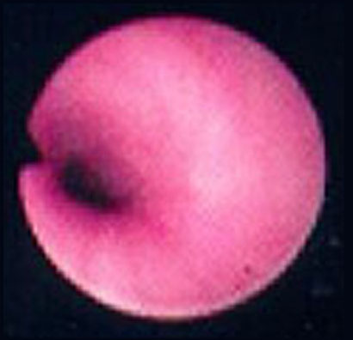

Slide 10
Clinical manifestation
Bronchitis
Productive cough
Dyspnea
Wheezing
Barrel chest
Prolonged expirations
Cyanosis
Classic sign
Late in course
Intermittent
Occasionally
Always present
common

