Slide 1
Respiration and Circulation “Bronchitis”
SMN

Slide 2
What is Bronchitis?
The bronchial tubes, or bronchi, connect the windpipe to the lungs. When the lining of the bronchial tubes becomes inflamed or infected, this condition is called bronchitis. Bronchitis reduces the amount of air and oxygen that can flow into the lungs and causes a heavy mucus or phlegm to form in the airways.
Bronchitis may be short-lived (acute) or chronic, meaning that it lasts a long time and often recurs.

Slide 3
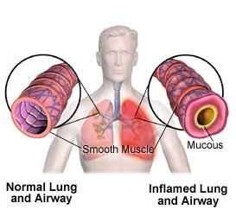

Slide 4
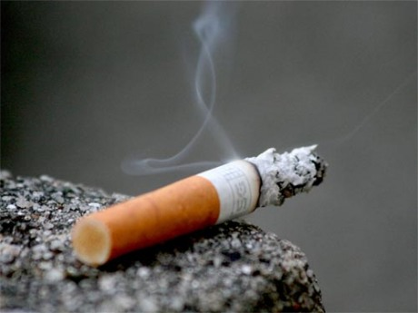
Causes of Bronchitis
Causes of Acute Bronchitis :-
Acute bronchitis is most often caused by viruses that infect the epithelium of the bronchi, resulting in inflammation and increased secretion of mucus. In addition to viruses, bacteria, exposure to tobacco smoke, exposure to pollutants or solvents, and gastro esophageal reflux disease (GERD) can also cause acute bronchitis.

Slide 5
Causes of Chronic Bronchitis :-
Chronic bronchitis, a type of chronic obstructive pulmonary disease, is defined by a productive cough that lasts for 3 months or more per year for at least 2 years.
It is most commonly caused by cigarette smoking. However, it can also be the result of continuous attacks of acute bronchitis. Air pollution, dust, toxic gases, and other industrial fumes are known to be responsible for the condition.

Slide 6
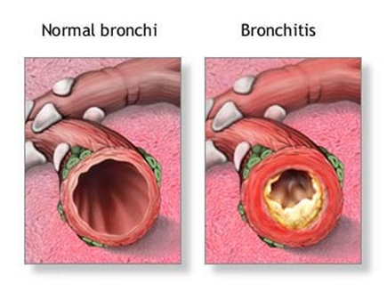

Slide 7
Symptoms of Bronchitis
Signs and symptoms for both acute and chronic bronchitis include:
Inflammation or swelling of the bronchi.
Coughing
Production of clear, white, yellow, grey or green mucus.
Shortness of breath
Wheezing
Fatigue

Slide 8
Fever and chills
Chest pain or discomfort
Blocked or runny nose
Additional symptoms of chronic bronchitis include :
Ankle, feet and leg swelling
Blue-colored lips from low levels of oxygen.
Frequent respiratory infections
(such as colds or the flu).

Slide 9
Effects of Bronchitis
Acute bronchitis usually results in a nagging cough that lingers for several weeks even after the bronchitis resolves.
Chronic bronchitis's long-term inflammation leads to scarring of the bronchial tubes and airways, which leads to production of excessive mucus.

Slide 10
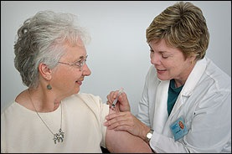
Bronchitis : Preventions
These measures help prevent bronchitis and protect your lungs in general:
Avoid tobacco smoke – Whether
it includes your own smoke or
secondhand smoke from others, try
to avoid it.
Get an annual flu shot – Most cases
of acute bronchitis result from
influenza. So, getting your yearly flu shot
can help protect you from both
bronchitis and the flu.

Slide 11
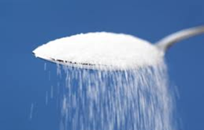
Limit the use of cough
suppressants since mucus
should be coughed up to help
unblock bronchi.
Reduce intake of foods such
as sugar, white flour, dairy and
others that may be mucus-
producing.

Slide 12
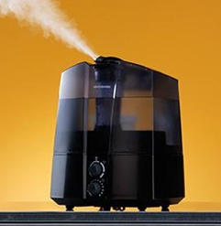
Wash your hands. To reduce
your risk of catching a viral
infection, wash your hands
frequently and get in the habit
of using hand sanitizers.
Use an air humidifier. Warm,
moist air loosens mucus in the
airways and helps to relieve
coughing.

