Slide 1
Management of Burns
MR SAMBURU
04/08/2020

Slide 2
Learning objectives
At the end of this lesson, learners should be able to:
Define burns
Classify the causes of burns
Discuss classification of burns
Describe the Pathophysiology
Outline the management
Discuss the complications

Slide 3
DEFINITION
A burn is a skin or even deep tissue injury due to heat caused by biological, chemical, electrical and physical agents with local and systemic repercussions

Slide 4
introduction
Classification according to type of Injuries
Thermal burns
Cold exposure
Electrical burns
Chemical burns
Inhalation burns
Radiation burns and laser burns

Slide 5
Classification according to type of Injuries
1. Thermal burns
Depth of the burn is usually related to; contact temperature, duration of contact of the external heat source and the thickness of the skin
Flame: Burn injury by fire eg house fires, falling onto open fire, automobile accidents, smoking related fires and improper use of flammable liquids.
Scald: Burn injury by moist heat /steam. Mostly by hot water or hot liquids.
Flash: Explosion of natural gas , gasoline and other flammable liquids that cause intense heat in a short period of time.
Contact: Direct conduction of heat from a hot surface to the body.

Slide 6
Classification according to type of Injuries
2. Cold burns ( frostbite)
Damage occurs on the skin and underlying tissues when ice crystals puncture the skin or when they create hypertonic tissue environment.
Usually occurs in distal parts of the body eg toes , fingers nose and ears
Severe vasoconstriction causes decreased blood flow causing microvascular stasis and increased viscosity and resulting in thrombus formation and microvascular emboli finally resulting in ischemia

Slide 7
Classification according to type of Injuries
3. Chemical burns
Caused by acids and alkali and can cause :
1. alteration of pH,
2. Disruption of cellular membranes
3.Direct effect on metabolic processes
Cause damage until they are inactivated by reaction
In addition to duration of exposure , the nature of the agent will determine severity of the injury

Slide 8
Classification according to type of Injuries
Acids cause tissue coagulative necrosis
Alkaline burns generate colliquation necrosis
4. Electrical burns
Can be due to high voltage or low voltage .
Electrical energy is transformed into thermal energy as the current passes through poorly conducting body tissues.
Mechanisms (types)of injury; electrical current injury, electro-thermal burns from arcing agents, and flame burn caused by ignition of clothes.

Slide 9
Classification according to type of Injuries
Flash or arc burns are thermal injuries to the skin caused by a high-tension electrical current reaching the skin from the conductor. The thermal injury to the skin is intense and deep, because the electrical arc has a temperature of about 2500º C (high enough to melt bone). Flame burns from ignited clothing are often the most serious part of the injury. Treatment is the same as for any thermal injury

Slide 10
Classification according to type of Injuries
Ohm’s law:
Amperage= voltage / resistance
the amperage depends on the voltage and on the resistance provided by various parts of the body.
Voltages above 40 V are considered dangerous.

Slide 11
Classification according to type of Injuries
Once current has entered the body, its pathway depends on the resistances it encounters in the various organs. The following are listed in descending order of resistance: bone, fat, tendon, skin, muscle, blood and nerve,
The pathway eg, if it passes through the heart or the brain stem, death may be immediate from ventricular fibrillation or apnea. Current passing through muscles may cause spasms severe enough to cause long-bone fractures or dislocations

Slide 12
Classification according to type of Injuries
Electrical current injuries are more than just burns. Focal burns occur at the points of entrance and exit through the skin. Once inside the body, the current travels through muscles, causing an injury more like a crush than a thermal burn. Thrombosis frequently occurs in vessels deep in an extremity, causing a greater depth of tissue necrosis.
Myoglobinuria may develop with the risk of acute tubular necrosis. The urine output must be kept two to three times normal with intravenous fluids. Alkalinization of the urine and osmotic diuretics may be indicated if myoglobinuria is present. If not treated aggressively with fluids , it could result in ARF.

Slide 13
Classification according to type of Injuries
5. Inhalation burns
Toxic products of combustion injure airway tissues and frequently occur with flash burns from fire and steam.
Hot smoke usually burns the pharynx while steam can also burn below the glottis.
Carbon monoxide which is a product of combustion impairs cellular respiration.
CO binds to hemoglobin resulting in decreased oxygen delivery to tissues leading to cerebral and myocardial hypoxia

Slide 14
Predisposing factors
Mental illness – attempted suicide /assault
Medical conditions such as epilepsy
Alcohol and other drug abuse
Overcrowding
Poverty/Low social-economic status
Ignorance
Poor knowledge on electrical appliance connection

Slide 15
Mitigating measures
Legislation
Health promotion-smoke alarms, design cookers and gas fires
Appliance design
Regulation regarding flame retardant clothes and furniture
Universal use of cordless kettles
Education of parents to keep their hot water thermostat to 60 degrees

Slide 16
Epidemiology
Worldwide
Burns are the 4th most common type of trauma worldwide.
More than 90% of burns are caused by carelessness or ignorance and are completely preventable.
Most burn injuries (about 90%) occur in low and middle income countries.
Most burn injuries occur in domestic setting, with cooking as the most common activity related to burns

Slide 17
Epidemiology
Age
Mostly affect children and young adults.
children under 8yrs –scald burns
in older children and adults – flame related burns.
Work related burns
Mostly due to chemicals or hot liquids, electricity and molten or hot metals

Slide 18
Epidemiology
6.Radiation
Can be due to radiofrequency energy or ionizing radiation.
Most common type of radiation burn is the sunburn.
Radiation burns are often associated with radiotherapy due to the ability of ionizing radiation to interact with and damage DNA

Slide 19
Normal skin anatomy
Functions of the skin
Thermoregulation
Prevention of fluid loss by evaporation
Barrier against infection
Sensory function
Protection from external injury

Slide 20
Pathophysiology of burns
Once burns reaches 25- 30% of total body surface area, cytokines and other inflammatory mediators are released at the site of injury. These inflammatory mediators have systemic effects affecting almost all body system as described in the following slides.

Slide 21
Cardiovascular changes
Capillary permeability is increased, leading to loss of intravascular proteins and fluids into the interstitial compartment.
Peripheral and splanchnic vasoconstriction occurs.
Myocardial contractility is decreased but the rate increases causing reduced cardiac output.
There is also fluid loss from the burn wound
All these result in systemic hypotension, hyperviscosity and end organ hypoperfusion
24 hours after burn injuries, cardiac output returns to normal if adequate fluid resuscitation has been given

Slide 22
Respiratory changes
Inflammatory mediators cause bronchoconstriction, and in severe burns respiratory distress syndrome can occur.
Gross edema of the throat causing airway obstruction.
May have an increased respiratory rate as a result of pulmonary edema and as an attempt to compensate the increased metabolic rate.

Slide 23
Metabolic changes
The basal metabolic rate increases up to three times its original rate.
This, coupled with splanchnic hypoperfusion, necessitates early and aggressive enteral feeding to decrease catabolism and maintain gut integrity.
Muscle mass may also decrease due to increased catabolism

Slide 24
Digestive system
Decreased blood supply
Risk of curling’s ulcer (duodenal ulcer that develops 8-14 days after burns. (first sign is vomiting of bright blood).

Slide 25
Nervous system
Pain depending on the degree of burns

Slide 26
Endocrine System
Increased secretions of catecholamines ( adrenaline and nor-adrenaline) in response to the injury may lead to increased body temperature and increased cell metabolism

Slide 27
Lymphatic System
Inflammation increases as a result of damaged tissue, which results in greater strain on the lymphatic system and pitting oedema

Slide 28
Urinary system changes
The kidneys compensate for the hypovolemia by decreasing urine output.
There is potential for kidney damage as a result of poor perfusion as well as by excessive myoglobin

Slide 29
Immune system changes
The inﬂammatory changes causes Cell-mediated immunity to signiﬁcantly reduce especially in large burns.
The burn wound becomes more susceptible to bacterial and fungal infections.
There are many potential sources of infection, especially from the burn wound, the lung if this is injured, any central venous lines, tracheostomies or urinary catheters present.

Slide 30
Changes to the intestine
The inﬂammatory stimulus and shock can cause microvascular damage and ischaemia to the gut mucosa.
Gut motility is reduced and this can prevent the absorption of food.
There is the translocation of gut bacteria, which can become an important source of infection in large burns.
Gut mucosal swelling, gastric stasis and peritoneal oedema can also cause abdominal compartment syndrome by splinting the diaphragm=respiratory compromise

Slide 31
Danger to peripheral circulation
In full-thickness burns, the collagen ﬁbres are coagulated.
The normal elasticity of the skin is lost.
A circumferential full-thickness burn to a limb acts as a tourniquet as the limb swells.
If untreated, this will progress to limb-threatening ischaemia

Slide 33
Classification of burns
Classified by:
depth
type
extent of injury.
Every aspect of burn treatment depends on the assessment of the depth and extent.

Slide 35
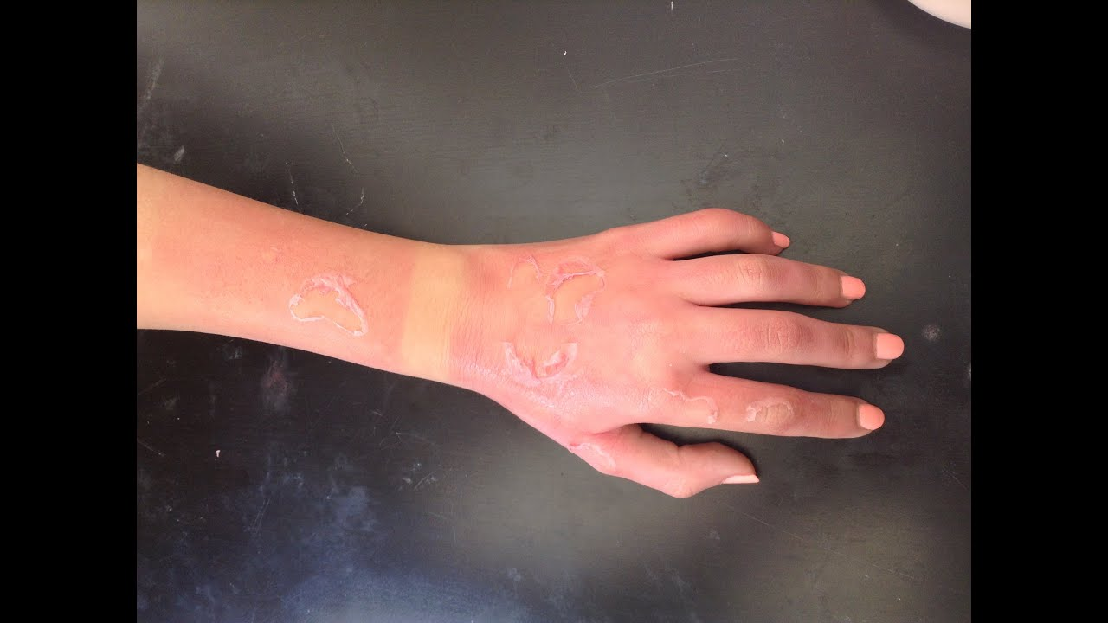
First degree burn
Involves the epidermis only.
Tissue will blanch with pressure.
Characterized by erythema and pain, without blisters
Minimal tissue damage
Eg sunburn
Heals within 3-6 days without sequale.

Slide 36
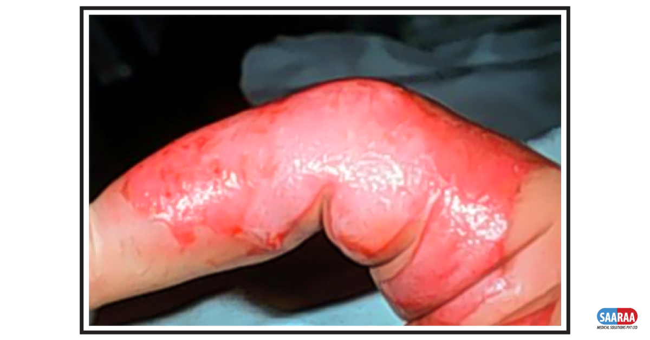
Second degree (superficial burn)
Involves the epidermis and part of the dermis and often involve other structures such as sweat glands and hair follicles.
Usually pink, moist surface with blisters and are painful as nerve endings are exposed.
Usually heals within 7-20 days

Slide 37
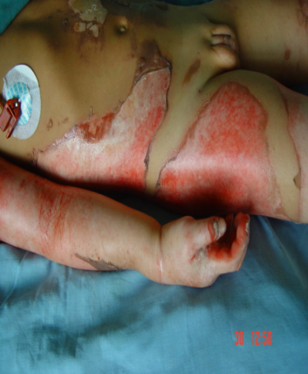
Second degree (deep burns)
As a result of deep dermal injury.
Characterized by blisters and have a mottled red appearance with no capillary return or pressure, absent sensation to pinprick with intact pressure sensation
Usually heals within 2-5 weeks in the absence of infection and always leaves a large a scar .

Slide 38
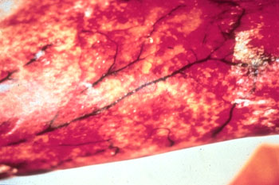
Third degree burns
Also known as full thickness burns.
Characterized by a pearly white , charred appearance(eschar), dry with thrombosis of superficial vessels, with absent sensation(nerves destroyed) leaving no potential for epitheliliazation.

Slide 39
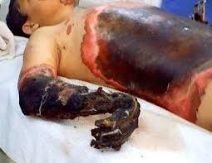
Fourth degree burns
Involve the subcutaneous tissue, tendons and bone.

Slide 40
Initial management of burns
Stop the burning process:
Flames on the skin surface should be extinguished by water, or by wrapping the patient in a fire blanket, clothing, or some fire extinguishers;
Burned or heated water-soaked clothing should be removed;
With electrical burns, any live current is switched off .
With chemical burns, prolonged irrigation(more than 1 hour ) has to be given, the first-aid worker must avoid contact with the chemical.
Cool the burn surface immediately , use cool water not ice cold water for 30 minutes.

Slide 41
Initial management of burns
Careful history, duration and time of contact with heat source should be recorded; primary survey use ATLS philosophy (A,B,C, D)
Then, assessment of area and depth of burns; secondary survey
T, PR, BP, RR and urine output have to be monitored and maintained;
A large bore iv catheter should be inserted preferably into a large peripheral vein.
. “If the burn exceeds 20% of body surface area, a urinary catheter should be inserted to monitor urine output. And a strict input output chart

Slide 42
Initial management of burns
ABC’S IN MANAGEMENT OF BURNS
A: Airway maintenance with C-spine control. Intubate if suspected inhalation injury, as airway oedema can be fatal( severe neck and facial burns , upper airway injury, semi comatose, etc)
B: Breathing and ventilation：
C: circulation: closed cardiac massage, fluid resuscitation
D: Disability and neurological status
E. Exposure and environmental control
F: Fluid resuscitation children >10%, TBSA: adults >15%

Slide 43
Initial management of burns
The wound should be debrided of all loose skin and dirt, after intravenous fluids are started and vital signs stabilized.
Tetanus toxoid, 0.5mL, should be administered to all patients with any significant burn.
Samples are taken for haemoglobin, urea and electrolytes, blood gases and blood analysis for carbon monoxide or cyanide poisoning are required in the unconscious patient.

Slide 44
Fluid resuscitation
Severe burns that cause large loss of intravascular fluid , which are greatest during the first 6-8 hours post burn, the fluid shifts are significantly diminished by 24 hours post burn.
Having estimated the percentage burned surface area (BSA), depth and measured the body weight, initial fluid resuscitation can be planned

Slide 45
Assessment of the burn area
The rule of palm: good for estimating small patches of burn wounds.
The rule of the nines: quick estimate of burn percentage
Lund and Browder: more accurate in terms of assessment , and is useful in children as it takes into account the head size proportion.

Slide 46
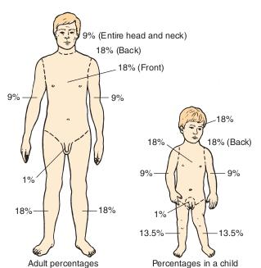
Rule of nines

Slide 47
Lund and Browder chart

Slide 48
Parkland formula ( for adults,1952)
3~4ml / kg/%BSA/ in the first 24 hours (Lactaed Ringer’s solution).
½: In the first 8 hours,
½: Next 16 hours .
Half of this volume is given in the first 8 hours and the rest in the next 16 hours. Timings begin from the time of the burn, not the start of resuscitation.

Slide 49
Crystalloid resuscitation
Ringer’s lactate is the most commonly used crystalloid.
Crystalloids are said to be as effective as colloids for maintaining intravascular volume. They are also less expensive, large protein molecules leak out of capillaries following burn injury. Maintenance ﬂuid in children.
This is normally dextrose–saline given as follows: • 100mlkg–1 for 24 hours for the ﬁrst 10kg;
• 50mlkg–1 for the next 10kg;
• 20mlkg–1 for 24 hours for each kilogram over 20kg body weight.

Slide 50
Hypertonic saline
Human albumin solution (HAS) is a commonly used colloid. Hypertonic saline effectively treats burn shock.
It produces hyperosmolarity and hypernatraemia.
This reduces the shift of intracellular water to the extracellular space.
Advantages include less tissue oedema and a resultant decrease in escharotomies and intubations

Slide 51
Colloid resuscitation
Proteins should be given after the ﬁrst 12 hours of burn because, before this time, the massive ﬂuid shifts cause proteins to leak out of the cells.
colloid-based formula ( Muir and Barclay formula:) 0.5 × percentage body surface area burnt × weight = one portion;
• periods of 4/4/4, 6/6 and 12 hours respectively; • one portion to be given in each period

Slide 52
Monitoring resuscitation
Monitor urine output. Urine output should be between 0.5 and 1.0mlkg–1 body weight per hour.
If the urine output is below this, the infusion rate should be increased by 50%.
If the urine output is inadequate and the patient is showing signs of hypoperfusion (restlessness with tachycardia, cool peripheries and a high haematocrit), then a bolus of 10mlkg–1body weight should be given.
A haematocrit measurement is a useful tool in conﬁrming suspected under- or overhydration.
Those with cardiac dysfunction, acute or chronic, may well need more exact measurement of ﬁlling pressure, preferably by transoesophageal ultrasound or with the more invasive central line.

Slide 53
Investigations
FHG
URINALYSIS
CXR
ABG
Coagulation profile
ECG

Slide 54
Indications for admission &Transfer to Burn Centre
American Burn Association Criteria
• patients with partial or full-thickness burns that involve the hands, feet, genitalia, face, eyes, ears, and/or major joints or perineum partial thickness burns ≥20% TBSA in patients aged 10-50 yr old
Partial thickness burns ≥10%TBSA in children aged ≤10 or adults aged ≥50yrold
Full thickness burns≥5% TBSA in patients of all ages
Electrical burns , including lightning(internal injury underestimated by TBSA),and chemical burns
Inhalation injury (high risk of mortality and may lead to respiratory distress)

Slide 55
Indications for admission &Transfer to Burn Centre
Burn injuries in patients with medical comorbidities, could complicate management and recovery
Any patient with simultaneous trauma plus burns should be stabilized for trauma first ,then triaged appropriately to burn centre
Any patients with burn injury and who will require special emotional ,social, and rehabilitation intervention eg intubation
Children with burns in a hospital not equipped with pediatric care specialits

Slide 56
Complications of burns
Pain
Sepsis/infection- late complication
Hypertrophic scars and keloids.
Seizures – unique to children due to electrolyte imbalances .
Hypotension or even circulatory shock due to hypo-perfusion. Earlier complication
Myoglobinuria , acute tubular necrosis in electrical burns
Pneumonia , airway compromise in inhalation burns

Slide 57
Complications of burns
Contractures (shortening and hardening of muscle, tendons, and other tissues leading to deformity and rigidity of joints)
Compartment syndrome in 3rd degree burns where the rigid eschar doesn’t expand as tissue fluid accumulates thus causing extreme compression of the affected extremety .
Acute gastro-duodenal (curling) ulcers (small circumscribed lesions within the lining of the stomach and the duodenum.

Slide 58
Complications of burns
Multiple organ failure:
Stress ulcer (or Curling’s ulcer) and acute gastric dilatation
Acute respiratory distress syndrome (ARDS)
Acute renal dysfunction
Hepatic dysfunction
Heart failure

Slide 59
Aims of burn management
To restore function, form and feeling
Stepwise management of burns “ the seven R s”
RESCUE- from the source of injury, first aid - nonprofesionals
RESUSCITATE- fluid
RETRIEVE- specialists
RESURFACE- repair , simple dressings , surgical debridement, grafting
REHABILITATE- return to preinjury level, physical emotional and psychological
RECONSTRUCT
REVIEW * multidisciplinary approach

Slide 60
First aid and initial management of minor burns
1. Stop the burning process- flames are stopped by use of water/ smothered with a light blanket, roll on the ground, remove clothes and adherent material such as nylon should be left alone,
2. electrical burns- remove / disconnect victim from the source
3. Cooling the burn- active cooling of the burn prevents progress done within 20mins of the burn, removes noxious agents reduces pain and edema, iced water should not be used. In case of chemicals irrigate with water
3. Analgesia- opioids and NSAIDS

Slide 61
4. Covering the burn- polyvinyl chloride film – pliable nonadherent impermeable and transparent for inspection
5. Cleaning the burn- a new burn is essentially sterile, use of antibiotics is discouraged, blisters , for large ones deroof , small ones leave intact
6.Dressings –check at 24hours ideally, 48 hours can be done then dressing every 3-4 days however change immediately if dressings get soaked , smelly and if pain is involved

Slide 62
Specialists dressings
Flamazine- topical application – every 2 days 3- 5mm layer
Granuflex ( duoderm) hydrocolloid dressing- change in 3-4 days
Mepitel – flexible polyamide net covering easy to remove

Slide 63
Initial management of burns Primary survey
Modified advanced trauma life support
Airway with cervical spine control
Inhalation of hot gases, inspect oropharynx, patency and access for intubation
Breathing
Access for mechanical restriction of breathing- deep dermal , full thickness circumferential burns of the chest limits and prevents adequate ventilation- consider Escharactomies
Blast injuries- explosion, blast lung can complicate ventilation

Slide 64
Smoke inhalation products of combustion irritants to the lung leading to bronchospasms, inflammation, and bronchorrhea, impaired ciliary action, severe in asthmatic pts- noninvasive management, nebulizers and positive pressure ventillationand expiratory pressure ventilation
Adequate oxygenation and permits regular lung toileting
carboxyhaemoglobin- do a blood gas analysis ,treatment 100% oxygen

Slide 65
Circulation- intravenous fluid resuscitation, circumferential burns act like tourniquets thus escharactomies
Neurological disability- assess GCS
Exposure and environmental control

Slide 66
Investigations
-General investigations
FHG
UEC
COAGULATION SCREEN
GXM
Electrical injuries
12 lead ECG
Cardiac enzymes

Slide 67
Inhalational injuries
CXR
Arterial BGA

Slide 68
SECONDARY SURVEY
A head to toe examination to look for any concomitant injuries

Slide 69
REFFERRAL TO A BURNS UNIT
Complex burns Adults > 20% children >15%
Extremes of age –under 5 and over 60years
Special areas burns- site
Inhalational burns
Electrical burns
Chemical burns

Slide 70
Initial management
Initial intravenous access lines- for rehydration
Catheterization- urine output
Ngt insertion- feeding
Analgesia, sedatives and antiacids- pain management
Tetanus immunization- environment
Temperature regulation (? 33degrees celcius)

Slide 71
Fluid management( maintain perfusion at the zone of stasis)
Goal – to restore and maintain adequate tissue perfusion, first 24hours has the highest loss of fluid 8-12 hours shift of fluid from i.v to interstitial fluid compartment
Use of crystalloids
Which patients ? ADULTS > 15% CHILDREN> 10%
Use of parklands formula 4*TBSA*BWT , brooke formula,; it starts from time of injury
At the end of 24hours colloid infusion 0.5MLS*TBSA*BWT
Use of colloids “ controversial”

Slide 72
High tension electrical injuries
9mls* burn area* body wt first 24 hrs and a higher urine output is expected 1.5-2mls/kg/hr

Slide 73
The single most important monitor of fluid replacement is urine output- ADULTS- 30MLS-50MLS /HR ,CHILDREN 0.5MLS/ Kg/hr.
Pulse rate and pulse pressure
sensorium and capillary refill

Slide 74
DEGREE
DEPTH
HISTORY
ETIOLOGY
SENSATION
APPEARANCE
HEALING
1st degree
superficial
momentary exposure
sunburn
sharp, uniform pain
blanches red, pink, edematous, soft, flaking, peeling
+ 7 days
2nd degree
partial thickness
exposure of limited duration to lower temperature (40-55°C)
scalds, flash burn without contact, weak chemical
dull or hyperactive pain, sensitive to air/temp changes
mottled red, blanches red/pink, BLISTERS, edema, serous exudate, moist
14-21 days
3rd degree
full thickness
long duration of exposure to high temperature
immersion, flame, electrical, chemical
painless to touch and pinprick, may hurt at deep pressure
no blanching, pale white, tan charred, hard, dry, leathery, hair absent
granulates, requires grafting
4th degree
underlying structures
prolonged duration of exposure to extreme heat
electrical, flame, chemical
usually painless
charred, 'skeletonized'
amputation fasciectomy

Slide 75
Escharactomies “compartment syndrome”
Circumferential deep dermal burns
Full thickness burns
Incisions – midlateral or medial aspect of the limbs- fasciotomies
Chest- midaxillary line to the subcostal region, the lines are joined by the chevron incision running parallel to the subcostal margin

Slide 76
Chemical burns
It can be acidic ,alkali ,organic solutions, inorganic solutions
Acids- coagulative necrosis of superficial tissue
Bases-liquefactive necrosis
-Assessment
Personal protective equipment- clinician
Primary and secondary survey
History taking- insulting agent, concentration,quantity,duration of contact, immediate mngt

Slide 77
Removal of the chemical- remove contaminated clothing, irrigation using running water- dilutes- efficacious,accessible and cost effective
Complete wound evaluation- if debridement is needed
Evaluate for systemic toxicity-
-metabolic disturbances acid base imbalances, BGA,
electrolyte disturbances eg hydrofluoric acid HFA causes hypocalcaemia thus cardiac arrhythmias,
Hypothermia-prolonged duration of wound lavage, use close to room temperature water

Slide 78
Specific agents
Cement- alkali- water irrigation later examine for debridement
Tar– liquefactive necrosis- surgical debridement* adherent tar not removed in the prehospital setting
Hcl and sulphuric acid- coagulative necrosis-irrigation- debridement

Slide 79
Electrical burns
Evaluate as a trauma patient
ABC
Evaluate for hidden injuries
Iv access, cardiac monitoring, measuring oxygen saturation levels, catheterization
Worries –massive fluid shifts, extensive tissue damage and acidosis
Invx –baseline urine myoglobinuria, a 12 lead electrocardiograph, cardiac enzymes for cardiac arrhythmias and direct cardiac injury, cxr, abdominal xray for bowel perforation, color Doppler-ischaemia

Slide 80
Initial resuscitation aim -0.5cc/kg/hr if no sign of myoglobinuria and 1cc/kg/hr if present- parklands formula
Based on the parklands formula increase the fluid replacement by 2-3times depending on surface area
Use isotonic balanced saline solution- RL
Indwelling catheter to monitor hematuria or dark urine- needs aggressive therapy to avoid myoglobin induced tubular necrosis
Administer mannitol at 1g/kg body weight to promote osmotic diuresis, target urine output is 2-3mls/kg/h and urine ph >6.5
Bicarbonate treats the underlying acidosis and alkalinizes the urine making myoglobin more soluble
Surgical debridement of necrotic tissue

Slide 81
Inhalational burns
Inhalation of hot gases
Smoke inhalation- products of combustion are inhaled irritating the lungs leads to bronchospasms, inflammation and bronchorrhea
Impaired mucociliary function especially in asthmatics
Non invasive management, nebulizers and positive pressure ventilation and expiratory pressure ventilation
Adequate oxygenation permits regular lung toilet
Blood gas analysis for carboxyhaemoglobin
Treatment ;100% oxygen

Slide 82
Successful management of burns
Adequate nutrition- early enteral feeding
Controlled environment 28- 33degree c
Prevent sepsis- topical antimicrobials
Infection control- prevent dessication of viable tissue, use of antimicrobial agents , apply biological dressing

Slide 83
Diagnosis criteria of sepsis in burn patients
ABA 2007 diagnostic criteria of sepsis in burn pts
Progressive tachycardia
Progressive tachypnea
Thrombocytopenia
Hyperglycemia without preexisting dm
Inability to continue enteral feeds> 24hrs
- Sepsis related organ failure score 17

Slide 84
Rehabilitation
Limit loss of motion
Minimize deformity
Prevent loss of muscle mass
Return to work

Slide 85
prognosis
A study was done on 64 pts in ICU WITH burns in order to find indicators for prognosis, burns varied from 7 to 90%, 17 pts – 27% died.
By kaukinen L, et al , Annn Chir Gynaecol ,1985
Age of the patient
Arterial ph
Serum protein concentration
*done at the beginning of treatment

Slide 86
Specific prognostic factors
Creatinine kinase in electrical burns
Serum calcitonin in inhalational burns
Tnf alpha
Procalcitonin
Platelet count
Serum lactate
Interlukin-8

Slide 87
referrences
Scwartzs
https;//emedicine.Medscape.com
Jelenko C 3rd chemicals that burn. J Trauma
Uptodate
NIH/NCBI
Current Diagnosis & Treatment Surgery ,LANGE 14th edition
Clinical Scenarios in Surgery By Justin B Dimick, Gilbert R. Upchurch, Christopher J
Toronto Notes 2018
https://www.omicsonline.org/open-access/burns-definition-classification-pathophysiology-and-initial-approach-2327-5146-1000298.pdf

