Slide 1
CAST TECHNIQUES AND TRACTION
BY VINCENT 0701876727
ORTHOPAEDIC TRAUMA MEDICINE DEPT
OTHOPAEDIC TRAUMA TECHNICIAN

Slide 2
fiberglass
Fibre glass cast and splint material is available from suppliers in ready-made rolls. it is lighter than plaster and resistant to water, but is more difficult to remove and is more expensive.

Slide 3
T he function of a cast is to rigidly protect an injured bone or joint .
It serves to hold the fracture in proper alignment and prevent it from moving while it heals.
Cast may also be used to help rest a bone or joint to relieve pain that is cause by moving it
different types of cast and splint are available depending on the reason for the immobilization and type of fracture.
Cast are usually made of either plaster or fiberglass material

Slide 4
CASTING AND SPLINTING
Cast and splints are hard wraps used to support and protect injured bones, ligaments tendon, and other soft tissue. they help fractures heal by keeping the fragment ends together and as straight as possible cast and splints also help with pain and swelling and protects the injured area from more harm.

Slide 5
Definition of a cast
A method of temporary immobilization that circumferentially incorporate part of a body
The term cast implies that the plaster or fiberglass encase the part of the body
Cast and splints are hard wrap used to support and protect injured bone,ligaments,tendon, and other tissues
externally applied structure that hold bones in one position
I s a rigid protective material of plaster or fiberglass

Slide 6
Contu-
6.An orthopedic cast, body cast, plaster cast or surgical cast is a shell, frequently made from plaster, encasing a limb to stabilize and hold anatomical structures, most often a broken bone in place until healing is confirm it is similar in function to a splint
7.Nowdays bandages of synthetic are often used

Slide 7
Why do we use plaster 0f Paris
It is used extensively as a mean of securing accurate and well –fitting external splintage of any part of human frame
we find that traditional methods of fixing required be manufactured and maintained by technician and skilled constant supervision was essential if the accuracy of use was to be sustained
In comparison plaster has an advantage of immediacy. We use skilled trained plaster tech.

Slide 8
a

Slide 9
What is a plaster
Plaster – is the common name for calcium suphate hemi hydrated made by heating the mineral gypsum, the common name for sulphate for lime plaster was made about 9000 years ago and has been used by ancient Egyptians Greek and roman civilization however, it wasn’t used on a large scale until 1700s when it was require to be used in all construction in Paris in 1666, a fire raged a cross London destroying many parts of it thus during the early 18th century, Paris became the centre of plaster production and hence the name plaster of Paris started

Slide 10
CHIMISTRY OF PLASTER OF PARIS
Plaster of Paris is derived from gypsum, which is calcium sulfate in its nature state the formula of gypsum is 2(caso4.2h20)

Slide 11
Casting
Casting is act or process of making cast molds
Casting of throwing a fishing line or net
Casts immobilize joint below and above
Cast hold a broken bone in place as it heals
cast help to prevent or decrease muscle contraction
Provide immobilization, especially after surgery

Slide 12
Splintage
Is a device used for support or immobilization of a limb or the spine. it can be used in multiple situation include temporary immobilization of potentially broken bone or damage joint and support for joint during activity.
To correct deformity
To stabilize and rest the limb when ligament has occurred
To rest infected tissue

Slide 13
Characteristics of plaster of Paris
It soaks rapidly
Smooth when moldings
It is creamy and innocuous to the skin
it set first -can be mounded as desired
Cast translucent to the x-ray
Setting time-3-9 minutes
Drying time 24-72 hours

Slide 14
Indication of plaster of Paris
Immobilization b of fracture
Immobilization of diseased bone and joint
Correction of deformities e.g. C.T.E.V
Prevention of deformities
Emergency splint age
Immobilization in the treatment of burns and soft tissues injuries

Slide 15
Disadvantage of plaster of Paris
Causes circulatory calatrphes
Cause pressure sores
Stiffness of joint
Joint becomes osteoporotic
loss of position of the fracture
Not waterproof
Heavy and inconvenient to the patient

Slide 16
Rules of application plaster of Paris
Pop are in different sizes; 8inch,6inch,4inch,2inch.
One joint above and joint below
Mould with palm
Not too tight or too loose,adequate padding
dip pop vertically into water till water air bubbles ceases to come
uniform thickness of plaster is preferred

Slide 17
Complication of plaster of Paris
Plaster sores
Impaired circulation
Tighten of plaster
Loss of plaster
Crack of plaster

Slide 18
Principles of casting and splinting
The ability to properly apply cast and splint is a technical skill easily mastered with practice and an understanding of basic principles. The initial approach to casting and splinting requires assessment of the injured extremity for proper diagnosis. Once need for immobilization is ascertained, casting and splinting start with application of stockinet, splint are faster and easier to apply, allow for the natural swelling that occurs during the acute inflammatory phase of an injury.

Slide 19
splinting versus casting
Casts and splint serve to immobilize orthopedic injuries
They promote healing
Maintain bone alignment
Relieve pain
Protect the injury
Compensate for surrounding muscular weakness

Slide 20
Splint comparison casts
Splint/cast | construction | indication | advantages
splint | no circumferential | Acute and definite treatment of select fracture ,soft tissue injuries (sprains, tendon). acute management of injuries awaiting orthopedic intervention
cast | circumferential | definitive management of simple ,complex,unstable,or potentially unstable fractures, | More effective immobilization

Slide 21
Various forms of plaster or Paris
Slab; Only A Part Of Circumference Of Limb Is Incorporated
Cast; Encircle Whole Circumference Of The Limb
Spice
Brace

Slide 22
The Major Categories Of Cast Are
Upper extremities
Extremity cast incorporates all or a portion of the designated extremity
Spinal and cervical
Spinal and cervical cast incorporate all or a portion of the body or the cervical area
Spica
Spica refers to a cast that incorporate part or the entire trunk of the body.

Slide 23
Cast application
Before casting material is applied (plaster or fiberglass) a ;’stockinette’ is usually place on the skin where the cast begin this stockinet protects the skin from casting material
After stockinet is place cast padding is rolled
Next ,the plaster or fiberglass cast material is rolled on while it is still wet
The cast begin to feel hard about 10 to 15 minutes
Mould the cast then apply arm sling.

Slide 24
Plaster casts
Plaster cast is made from rolls or pieces of dry muslin that have starch or dextrose and calcium sulfate added
When plaster cast get wet , a chemical reaction happen(between the water and the calcium sulfate
The temp of the water used to wet the plaster affects the rate the which the cast sets
plaster cast are usually smooth and white

Slide 25
Plaster splints
Plaster splint are ready- made in difference sizes
Short narrow splint
Short wide splint
Long wide splint
Extra long wide splint

Slide 26
Reasons for splinting
Reduces pain
Reduces further damage to vessels and nerves
Reduces risk of inadvertently a closed# into and open #
Facilities pts transport
Splint jet above and below the broken bone to immobilized the fracture site

Slide 27
Commonly used splints
Sugar- tong splint-used for forearm or wrist
Ulna-gutter splint- used for #4th/5th metarcarplanxs
Volar wrist splint -used for wrist injuries
Thumb-spica splint – injuries of thumb
Posterior lower leg splint—ankles injuries with swelling
Posterior full leg splint-injuries of leg with swelling
Posterior elbow splint- injuries of elbow
Finger splint- used for the fingers
Wrist/arm splint-used for wrist injuries
Ankle splint-used for ankle injuries

Slide 28
When to cast
Indication –circumferential cast may be used
Fractures
Severe sprains
Dislocation
Protection of post-operative repairs
Gradual correction of a deformity with serial casting

Slide 29
Cast application(equipment)
STOCKINETTE-is usually the first layer applied over to be cast
Orthopeadic cast- comes of width 5-15cm;the smallest one are5-10cm; should be for upper extremity then 10-15cm for the lower extremity
PLASTER 0F PARIS - plaster is the most used casting material
BUCKET –the bucket should be filled with water at room temperature

Slide 30
Evaluation
Before cast application certain examination must be performed;
Complete exam of the affected region
note the quality of the skin in the region to be cast
Radiographs as necessary

Slide 31
plaster sores
Comes as result of the following
Technique,instruction,supervision,foreign bodies
-Technique- failure to trim the extremities of the cast correctly
-instructions-failure of the patient to understand how to care for cast.
Children with cast can put small toys,coins,etc

Slide 32
Contraindication; circumferential casts should not be used
Open fractures
Severe swelling compartment syndrome
Ulcers or draining

Slide 33
Splinting in the Accident &Emergency Room

Slide 34

Why Do We Splint?
To stabilize the extremity
To decrease pain
Actually treat the injury

Slide 35
Complications of Splinting
Abrasions
Sores
Neurovascular compromise (tight fitting splints)
Contact dermatitis
Pressure ulcers
Thermal burns

Slide 36


How to prevent complications
Apply splint by trained professional
Us!
What we do!
Apply splint correctly
Collaboration with the Docs!
Monitor neurovascular status.

Slide 37
The 6 P’s of extremity assessment
Pain: Palpate the entire extremity for increase pain | Pallor: Note color and temperature and capillary refill | Pulses: Palpate proximal and distal pulses
Paresthesia: Assess for burning, tingling, numbness | Paralysis: Assess motor function (both active and passive | Pressure: Palpate for firmness of compartment

Slide 38
Equipment need for application
Cotton bandage( soft roll, cotton roll) Pad entire area to be splinted
Plaster slabs or pre padded fiberglass (Orthoglass), immobilize above and below injury
Room temperature water (apply generously)
Elastic bandage
Adhesive tape or fastners

Slide 39
Types of Splints
Yes,its broken and needs a splint!
Why sure Doctor, not a
problem!

Slide 40
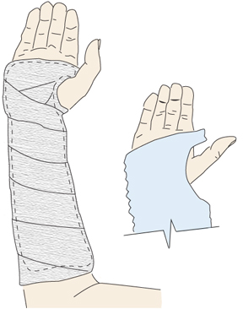
Volar Splint
The Volar short arm splint is used for:
Fractures of the wrist
Fractures of the second to fifth metacarpals,
Carpal tunnel syndrome
Soft tissue injuries

Slide 41
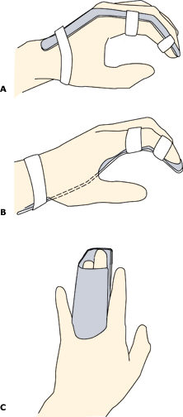
Finger Splint
Finger Splints are used for phalangeal fractures
(A&B) commercial splints
© is custom splint

Slide 42
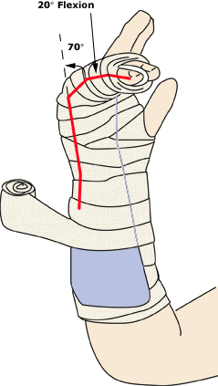
Gutter Splint
Two types: radial and ulnar
Gutter splints are used for:
Phalangeal fractures
Metacarpal fractures
Two types: radial and ulnar

Slide 43
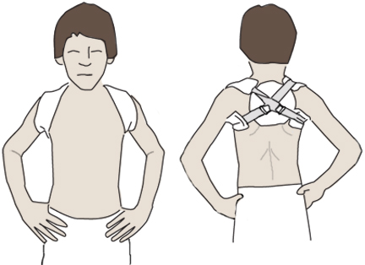
Figure Eight Splint
Used to stabilize a clavicle fracture
To be applied properly the patient must be erect with hands on his iliac crest with shoulders in abduction (as seen in picture)

Slide 44
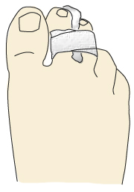
Buddy taping of toes
Secure the fractured toe to the adjacent toe with adhesive strips
Sheet wadding between toes prevents maceration

Slide 45
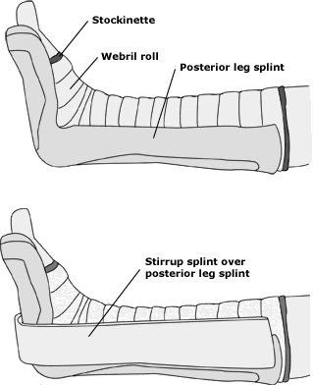
Posterior Leg Splint
This splint is used for:
Distal leg fractures
Ankle fractures
Tarsal fractures
Metatarsal fractures

Slide 46
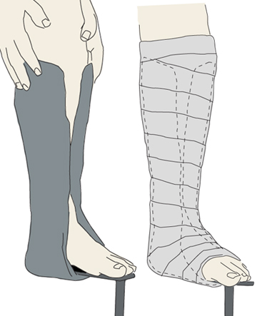
Stirrup Splint
To prevent inversion or eversion of the ankle
Immobilizes the ankle for fractures near the ankle
Apply from below the knee and wrap around the ankle

Slide 47
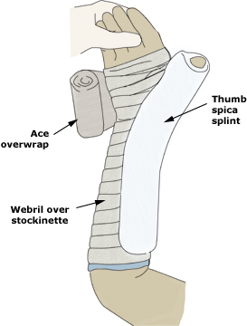
Thumb Spica Splint
This splint is used for :
Scaphoid fractures
Extraarticular fractures of the thumb
Ulnar collateral ligament injuries

Slide 48
What do you do after you have applied your splint???

Slide 49
Plaster Cast
A plaster is made from rolls or pieces of dry muslin that have starch or dextrose and calcium sulfate added.
When the plaster gets wet , a chemical reaction happens ( between the water and the calcium sulfate) that produces heat and eventually causes the plaster to set , or get hard , when it dries.
A person can usually feel the cast getting warm on the skin from this chemical reaction as it sets.
The temperature of the water used to wet the plaster affects the rate at which the cast sets. When cold water is used , it takes longer for the plaster to set , and a smaller amount of heat is produced from the chemical reaction.
Plaster casts are usually smooth and white.

Slide 50
Fiberglass casts
Fiberglass casts are also applied starting from a roll that becomes wet.
After the roll is wet, it is rolled on to from the cast. Fiberglass casts also become warm and harden as they dry.
Fiberglass casts are rough on the outside and look like a weave when dry. Fiberglass are available in many colors.

Slide 51
Taking Care of Your Cast
Always keep the cast dry.
If the cast becomes very loose as the swelling goes down, call the doctor for an appointment, especially if the cast is rubbing against the skin.
Cover the cast with a plastic bag or wrap the cast to bathe ( and check the bag for holes before using the bag a second time). Some drug stores or medical suppliers have cast covers –plastic bags with Velcro straps or rubber gaskets to seal out water for protection during bathing .
If the cast gets wet enough that the skin gets wet under the cast , contact the doctor . If the skin is wet for a long period of time, it may break down , and infection may occur.
Sweating enough under cast to make it damp may cause mold or mildew to develop. Call the doctor if mold or mildew or any other odor comes from the cast.

Slide 52
Conti-
Do not try to scratch the skin under the cast with any sharp objects ; it may break the skin under the cast and lead to an infection. Do not put any powders or lotions inside the cast.
Do not trim the cast or break off any rough edges because this may weaken or break the cast. If a fiberglass cast has a rough edge , use a metal file to smooth it. If rough places irritate the skin , call the doctor for an adjustment.
An arm sling may be needed for support if the cast is on the hand, wrist, arm or elbow. Wrapping a towel or cloth around the strap that goes behind the neck can help protect the skin on the neck from becoming sore and irritated.
If the cast is on the foot or leg , do not walk on or put any weight on the injured leg, unless the doctor allows it.

Slide 53
Conti-
Do not lean on or push on the cast because it may break.
Do not put anything inside the cast.
If the doctor allows walking on the cast , be sure to wear the cast boot ( if given one by the doctor) . The boot is to keep the cast from wearing out on the bottom and has a tread to keep people in casts from falling .
Crutches may be needed to walk if a cast is on the foot, ankle or leg. Make sure the crutches have been adjusted properly before leaving the hospital or the doctor’s office and make sure you understand and can demonstrate proper use of crutches.
If a fiberglass cast gets damp , dry it ( make sure it dries completely )

Slide 54
How a Cast Is Removed.
Do not try to remove the cast.
When it is time to remove the cast, the doctor will take it off with a cast saw and a special tool. - A cast saw is a specialized saw made just for taking off casts. It has a flat and rounded metal blade that has teeth and vibrates back and forth at a high rate of speed. - The cast saw is made to vibrate and cut through the cast but not to cut the skin underneath. - After several cuts are made in the cast ( usually along either side), it is then spread and opened with a special tool to lift the cast off. - The underlying layers of cast padding and stockinet are then cut off with scissors.
.

Slide 55
Conti-
After a cast is removed , depending on how long the cast has been on , the underlying body part may look different than the other uninjured side . -The skin may be pale or a different shade . - The pattern and length of hair growth may also be different. - The injured part may even look smaller or thinner than the other side because some of the muscles have weakened and have not been used since the cast was put on. - If the cast was over a joint , the joint is likely to be stiff. It will take some time and patience before the joint regains its full range of motion.
Complications of plaster cast can be divided in systemic , which affects whole body or local which affects limb where plaster has been applied.
Local complications of plaster can be further classified as immediate and delayed

Slide 56
Systemic Complications of Plaster Cast
The most serious is deep venous thrombosis leading to pulmonary embolism. Pain in the calf is an important sign needing medical advice.
Immobilization in trunk plaster beds may also produce nausea, abdominal muscle cramps , retention of urine and abdominal distention.
Good nursing and diet with regular exercises will help ensure that the initial period of extensive immobilization is achieved without complications.
Immediate Local Complications Plaster Cast.
Swelling of the Part.
A plaster produces constricting effect on the limb and most of it is well tolerated but a moderate constriction of the veins , damming the blood , and causing swelling , discomfort or pain , and a blue colour in the skin and under the nails.
.

Slide 57
Conti-
Temporary remedies such as elevation of the limb and exercising the digits may be tried , but , if persistent , the constriction must be relieved. The cast can be splint and eased or bivalved , taking care not to damage the skin.
Impaired Arterial Supply .
A pale skin which is cool and without a palpable pulse indicates that the arterial supply is disrupted . If a pressure on the finger nail the colour does not immediately return. This is a serious complication. Medical advice must be sought immediately.
Splitting the cast may relieve the arterial compression but sometimes surgery may be necessary.
Incomplete arterial occlusion may present with pain or aching with loss of power. If in doubt ask for medical advice.

Slide 58
Conti-
Pain .
Pain has many causes. This may be due to tissue damage at injury or reduction, swelling within the cast , muscle spasm , pressure on blood vessels or nerves, skin irritation or sores . Although diagnosis may be difficult , persistent pain or intermittent acute pain should not be ignored . Medical advice must be sought

Slide 59
Grade of Sore.
Sore are graded according to depth of the involvement.
Grade I – Redness of skin.
Grade II – Involvement of subcutaneous tissue or cellulitis.
Grade III – Involvement of muscles.
Grade Iv – Bone Deep.
The treatment of sore depends upon the grade . While grade I only requires removal of offending pressure others require treatment that varies from simple dressings to surgical debridement and reconstructive procedures.
The fracture needs to be splinted throughout. In some cases it might be pertinent to shift to external fixation of the fracture.
Apart from immediate complications and plaster sores there are many other problems that can arise with plaster application.

Slide 60
Conti-
Loss of Position.
Because swelling occurs with most fractures especially after reduction , the technician puts padding under the cast to protect the skin . This padding gets compressed. After 48 hours when the oedema is subsiding, the cast may be too loose to hold the bone ends in position against undesirable muscle action.
Such displacement may be sudden and cause pain or gradual being first noticed on the next X-ray. This complication may seriously delay sound healing and may produce permanent deformity.
Medical advice must be sought if the position is suspect.
Never Damage.
Loss of power , tingling and numbness distal to the cast are signs of impaired nerve function . The cause may be direct compression by bone ends or plaster pressure , indirect compression of oedematous tissue or tourniquet effect, or reduced blood flow.
Routine testing of power and sensation will detectanty defect quickly . Corrective action includes relieving cast pressure , supporting and protecting paralyzed parts , and physiotherapy to help restore normal function of muscle and joints.

Slide 61
Conti-
Avoiding the Complications of Plaster Cast.
Complications of plaster cast can be reduced by taking all precautions of application of cast, keep a vigilant eye and making sure the patient is well instructed about care of cast.
Application of the plaster cast should be done by a skilled person in proper manner.
Patient , as a routine should always be called for follow up examination next day . Strict elevation of the limb should be instructed.
Patient should report on pain that is not relieved , swelling , bluishness or pallor of distal part.
Patient should be carefully examined in the follow up for probable complications of plaster cast.

Slide 62
Complications of Plaster of Paris (casts) Continues.
Loss of position of fracture fragments.
Plaster sores.
Impaired circulation.
General constitutional complications.
Loss of Position .( Fractures )
Swelling is the main feature of any fracture.
A cast technician should apply a firm padded plaster to anticipate swelling and ensure the limb is elevated and the extremities exercised.
A cast can be loose when swelling has subsided leading to loose plaster – if left like that there will be movement of fragments.
Loss of position of the fracture.
Solve that - change P.O.P if swelling subsides.

Slide 63
Conti-
Plaster Sores .
Comes as a result of the following ;
Technique
Instruction
Supervision
Foreign bodies.
Technique .
Inadequate skeletal protection . Failure to trim the extremities of the cast correctly .
Instructions .
Failure of the patient to understand how to care for the cast can result to cracking , wetting or friction occurring with inevitable skin damage.
Supervision .
Observation for signs of tightness and looseness should be accurate and prompt action taken depending on circumstances .
Foreign bodies .
Children in cast can put small toys , coins and sweets inside the cast and cause pressure sores.
Patients should be warned of dangers of scratching the skin beneath the cast with metal ( implements ) eg. Knitting needles, back scratchers – the trauma cause can result to infected sore

Slide 64
Conti-
Loss of Power.
Inability to extend the fingers , toes suggest loss of power.
It can be due to;
Pressure of the P.O.P on the superficial nerve.
Post – operative – due to prolonged tourniquet pressure.
It is also feature of impairment of circulation.
Management – Split the cast to relieve tension.
Impairment of Circulation .
(Impairment venous return )
Coldness to the extremities blueness and swelling.
Colour change , bluish and swelling of the extremities.
Management .
If there is swelling – elevated the part affected.
Ensure that digital exercise is done .
If the problem persist and the patient experience a lot of discomforts , split the . P.O.P and elevate the limb

Slide 65
Conti-
General Constitutional Complications of Plaster.
Stiffness of the joint due to inactivity . Free joints are to be kept mobile - , Encourage exercises.
Muscle wasting – keep the muscles in tone . E.g encouraging exercises.
Venous thrombosis – common sites coronary and pulmonary infraction . Comes about due to blood flow cut off.
Advise on exercise to maintain general circulation .
Other Complications .
Trunk cast / pop beds
Abdominal strain – constipation may arise. Patient should report at once.
Feel of nausea/aching , pain around the groin.
Abdominal strain (Prevention)
Evacuation of bowel
Light diet
Patent encourages changing the potion of sitting
Exercises
Accurate maintenance of field balance

Slide 66
Plaster Room Environment.
Basic Principles.
Equipment's.
Personnel.
Records.
Application.
Environment.
Casting is being done in cast room and so the distinguishing features such a location are;
Sink with a plaster trap to protect blockage of the drains by plaster fragments.
Long , smooth drainage boards of metal, glass/laminate.
A floor which can be washed down easily, a gutter should drain into a plaster trap.
Suitable furniture , cough , chair table and suspension.
.

Slide 67
Conti-
Equipment’s.
They can be placed into two groups;
That which can protect the patient .
The implements used for applying and removing cast.
Protection
The following is an example of basic equipment’s;
Dust sheets and other covering material to protect the patient’s clothing are essential.
Apron and boots will protect the operator.
Sandbags and supportive pillows for comfort and support of the patient.
Ring cutters.
Instruction cards to guide the patient when away from the hospital supervision.

Slide 68
Conti-
Implements.
The average plaster trolley carries the following items;
Protective materials- stockinette , felt wool bandages of varying widths.
Plaster bandages of varying widths.
Slabs of various widths.
Plaster shears and plaster spreaders.
Plaster scissors , plaster knife , marking pencil.
Orthopedic pad/soft ban of varying length.
Electric plaster Cutter.
Water buckets.
Triangular bandages /arm sling/collar and cuff.
Walking heels, boots /iron for lower limb.
Steel basin.

Slide 69
Conti-
Personnel.
The number of staff required to support the operator will depend on the type of cast to be applied.
An assistant is very necessary.
The assistant should be aware of the procedure you want to carry out and sure of the role to play.
Records .
A book , card fill/ other form of record of each patient should be retained.
The essential requirements are;
Name , address and age.
Diagnosis and plaster type applied , an aesthetic given , manipulation , simple application.
Instructions given.
Supplementary appliances given , eg. Crutches.
Date of next return

Slide 70
Conti-
Applications.
With the equipment’s ready and buckets filled with the water.
The patient sits comfortably with suitable protective covering.
The patient must understand what is happening.
Ensure privacy of the patient.
The assistant must hold the patient in the desired way.
Put suitable padding especially around the pressure areas. (bony prominence).

Slide 71
Conti-
Applications.
With the equipment’s ready and buckets filled with the water.
The patient sits comfortably with suitable protective covering.
The patient must understand what is happening.
Ensure privacy of the patient.
The assistant must hold the patient in the desired way.
Put suitable padding especially around the pressure arears. (bony prominence).

Slide 72
Conti-
Bandages .
Immerse the bandage fully in water at angle of 45 degrees so as to encourage the release of the bubbles.
Hold the bandage gently – otherwise will not penetrate between the layers so effectively .
After five (5) seconds – the bubble ceases.
Keep the leading end free when handling the bandage and squeeze inorder to expel water using to hands.
Keep the leading end free when handling the bandage to the operator.
Immerse another bandage as the operator unrolls the wet bandage round the limb In an even manner.
Use circular and spiral turn and no reverse turns should be made.
Moulding of the bandage should be done by constant smoothing with the palm of the wet hands.
After obtaining the thickness , the extremities of the cast may require trimming – for free movement of the digits .
To be done when the cast is still wet not fully dry.

Slide 73
Conti-
Slabs .
Measure the length required and the width.
Measure the length and the width of the pad.
Make about twelve (12) to fifteen (15) layers of the same length and the width.
Roll the slabs end to end.
Immerse in water.
Remove immediately .
Smooth carefully and quickly on a flat surface.
Compress the layers together and exclude the bubbles.
Operator can carry out the remaining procure using gauze roll / crepe bandage.

Slide 74
Conti-
Methods of Applying Plaster of Paris Cast.
Every Orthopaedist has his own pet method of applying Plaster of Paris cast , but in essence , there are three schools.;
1. The Skin Tight Cast.
Was advocated by Bohler , the famous Viennese fracture surgeon. The Plaster of Paris is applied directly to the skin without intervening padding , in an effort to gain most efficient immobilization possible.
This type of cast is rarely ( if ever) used now.
It required a great deal of skill to apply , was fraught with danger of pressure sores and circulatory embarrassment , and was uncomfortable to remove because the patient’s hair was incorporated into the cast . Unpadded cast.

Slide 75
Conti-
Skin Tight.
Stokinette lining – can’t be called padding. They are discouraged because there is a possibility that it can damage the skin.
Advantages .
Skilled Operator,
A light weight.
Comfortable.
Perfectly fitting cast is achieved.
Indication.
Can be used only in situations where swelling is unlikely to develop.

Slide 76
2. The Bologna Cast.
Emanating from the Rizzori Institute , is advocated by charnley , and in contrast to contrast to Bohler’s method , generous amounts
of cotton wading are applied to the limb and compressed by the plaster bandage with “ just the right amount of tension, “ This
technique is said by Charnley to be demanding , so that most people split the difference and apply a padded cast without tension .
We shall call this the third way.
3. In the Third Way.
Most people use stockinette , a tubular knitted stoking , which stretches freely in diameter but sparingly in length.
It makes the cast look tidy and pads the sharp margins --- main use.
Following the stockinette , sheet wadding is applied from the distal to proximal end of the limb, as smoothly aspossible. Each turn
should be applied transversely , tearing the border that transverses the greater diameter of the limb so that it lies smoothly.

Slide 77
Cast Padding .
The best form of the cast purely for the benefits of the fracture is non – padded cast because it is close contact with the fractured bone.
However , this method has several disadvantages;
Limiting allowance for swelling.
Friction of the hard cast against the skin and the bone may cause sores.
There is no padding to act as a protective barrier against shears and saws on removal of the cast.
N.B.
Therefore all casts should be adequately padded with the expectation of the non- padded removal cast.
Usually two layers of padding are used;
Tabular gauze.
Cotton wool/ soft ban.

Slide 78
Conti-
Tabular Gauze.
The first layer , applied directly to the skin , is synthetic mesh called tabular or thicker stockinette . Stockinette is more expensive and preferably used with the synthetic casts.
Functions of the Tabular Gauze.
It helps prevent the limb – hairs from becoming caught in the plaster.
It removes any roughness caused by the plaster casts edges ( the edge of the tabular gauze are turned back over the cast and sealed; this creates a smooth edge which will prevent chaffing of the skin
It allows the conduction of perspiration from the limb.
It aids in the removal of the cast.

Slide 79
Conti-
N.B.
Tabular gauze may not be used following operation procedure and where gross swelling is likely to occur as it may be difficult to split the plaster cast.
WOOL PADDING
Reasons .
To protect bony prominences e.g. the ulna and styloid of the lower arm , those areas must have extra padding. As the plaster cast dries out, it becomes loose and any movement over the bony prominences may cause some friction and sores if the skin is inadequately protected by padding.
Where swelling is anticipated extra padding may be required over the whole length of the limb.
Where electric saws or shears are used for removal of the cast , padding is needed to protect the skin.
It Increases patient comfort.
To help to absorb blood and serious fluid.
Orthopaedic padding required . It is unrolled firmly over the full area of the limb to be covered the plaster of Paris.(wool padding)

Slide 80
Conti-
Indications of Padding.
Where swelling is expected /present i.e in almost every acute conditions.
Where the limb is thin and the bones are very superficial.
When electric plaster cutter are used for removal.
When wedging is needed.
It is always wise to protect bony prominences e.g around joints when any plaster is applied.
Fibre glass/ Synthetic Casting Tape.
Synthetic in form – polyurethane.
Indications.
Non- displaced fracture.
Fitted when swelling has subsided.
Long term Casting.

Slide 81
Conti-
Advantages.-fibre glass
Light weight – less bulky.
Easy to apply .
Moisture proof.
Fast drying. (15min)
With different colors.
Early weight bearing.
Radiolucent ( x-ray vision can past)
Strength weight ration.
Feels color in hot weather.
No crumble.
Disadvantages .
Application requires speed and accuracy.
May bind if tissue swell ( rigid).
High risk for irritation – tissue breakdown under the cast – extra rigidity.
Expensive.
Inner layer dries slowly .
Risk for over physical mobility – light .

Slide 82
FIBREGLASS CAST APPLICATION.
Although plaster casts have been used forcenturies , there are several disadvantages .One is the weight of the plaster . Under ordinary circumstances and with small casts , the weight does not pose a major problem; with large cast, however , especially for a patient who does not have good muscular control , the weight of the plaster may inhibit ambulatory potential. An additional disadvantage of the plaster cast is its inability to maintain immobility when it becomes wet.
These disadvantages have prompted research over the years to develop a material that will offer the same degree of immobilization as a plaster cast but it will alleviate the disadvantages. Within the past decade , fiberglass immobilization was introduced. This form of cast alleviates some of the disadvantages of plaster but it’s quite expensive. It is currently used by some orthopaedic surgeons and institutions , but on a selective rather than on a general basis. Its degree of popularity , however , at least warrants familiarity with equipment and the materials used in the construction.

Slide 83
Conti-
A fiber cast applied with special materials and eqiupment.The lining or padding of the cast is specially designed stockinette that is much heavier than the type used with a plaster “. A coarsely woven padding is rolled over the stockinette. The fiberglass material glass material is supplied in rolls and splints of various sizes. Its open – meshed and the application is similar to that of plaster cast. The fiberglass material has a rather strong odour until is “ cured” and should be applied in a well – ventilated room. Rubber gloves and special cream facilitate handling of the fiberglass material. Because the edges tend to be extremely sharp, a special compound is used to smooth the edges. In addition , a finishing tape , made of a finer mesh, secures the stockinet and padding over the edges of the cast.
A special ultraviolet light is used to cure or harden the fiberglass. The time required depends on the size of the cast and the number of layers of the size of the cast and the number of layers of fiberglass applied. Because the cast is porous it dries fairly quickly. Of course, the larger the cast the longer the drying period necessary . The weight of this cast is considerably less than a plaster cast.

Slide 84
DynaCast Prelude Synthetic Splint System.
The Dynacast Prelude Synthetic Splint System is a synthetic splinting system specifically incorporating incorporating fiberglass , covered by a polypropylene padding , to offer easy application for the support and immobilisation of fresh fractures and soft tissue injuries. It is presented in a roll format for versatility in use and application . The DynaCast Prelude is a versatile splinting system for individual patient application and is a clean modern alternative to plaster , being as strong and light but with no plaster mess. The DynaCast Prelude is ideally suited to the theatre and ward environment for his reason and the continous roll format ensures the clinician will only use what is required and provides versatility to choose the length of splint to suit the indication.
The DynaCast Prelude is made with strong resin coated fiberglass making it resistant to breakdown. Soft polypropylene padding also covers the fiberglass splint which minimizes the risk of pressure points.

Slide 85
Conti-
Features of the DynaCast Prelude Synthetic Splint System.
Can be used throughout then rehabilitation process.
All in one roll for ease of application.
Set within 3-5 minutes, weight bearing in 20 minutes.
No mess and will not break down, unlike plaster casts.
Naturally aids moisture transmission away from the skin to enhance patient comfort.
The DynaCast Prelude Synthetic Splint System is available in various dimensions in White.
The DynaCast AS Ankle Splint is a uniquely designed mouldable solution for external ankle support following injury or chronic instability. The DynaCast AS is lightweight but also strong and durable. They will fit easily into a shoe or boot. The DynaCast AS therapy solution can be used continuously throughout the entire rehabilitation process.

Slide 86
Features of the DynaCast AS Ankle Splint.
Allows for a precise fit for increased patient comfort.
6-ply stirrup splint with micro-perforated foam covering.
Allows the use of normal footwear.
All in one treatment from acute to rehabilitation.
The DynaCast AS Ankle Splint dispenser pack contains 10 splints and 10 elastic straps which are latex- free.

Slide 87
Conti-
The DynaCast Prelude Solo Synthetic Splint System is a fibreglass splinting system of great strength that is also covered by a thin , breathable material that is available in a variety of individually wrapped widths and lengths. The DynaCast is stronger and more versatile than traditional Plaster of Paris splints or slabs . DynaCast Prelude Solo is easy to apply and clean and will provide stable support for fractures.
Features of the DynaCast Prelude Solo.
Stronger than traditional plaster cast.
Reduces weight and bulk to patient.
No dust or mess associated with casts.
Interlocking strength technology minimises wrinkling.

Slide 88
Six advantages to Fiberglass Impregnated with polyurethane as a Cast Material.
Lightweight.
Durable.
Porous. ( has breathability ) .
Waterproof.
Sets in 5 minutes , weight bearing in 10 – 20 minutes.
Areradiolucent.
Six disadvantages to Fiberglass impregnated with polyurethane as a Cast Material.
More expensive than plaster cast.
Doesn’t mould as easily as plaster cast.
Extremely rigid so can cause pressure sores if applied unevenly.
Mildly irritating ( wear gloves when applying ).
Packages of casting material cannot freeze.
If package has hole , moisture can get in causing it to harden.

Slide 89
REMOVABLE SPLINT .
Bivalve Casts.
Splints.
It can (P.O.P) be used in making splints. Any complete split can be converted into a
Removable splint by bivalving it.
A bivalved cast is simply one that has been cut into two pieces,usually an interior and posterior
half.
A cast that is cut in half to detect or relieve pressure underneath,especially when a patient has
decreased or no sensation in the portion of body surrounded by the cast.”Windows” are often
cut out of the cast over the pressure areas to assess circulation or open wound sunder the cast.
.

Slide 90
Conti-
To bivalve a cast means to cut it on both sides from top of the cast to the toes so it can “open up”
and allow for swelling. After cut, the cast is usually held together with an ace bandage to keep it
in place. A cast is usually bivalved after surgery or immediately after an injury to stabilize a
body part and allow for swelling.
Indication for Bivalving .
To facilitate daily dressing of a wound and immobilization is to continue.
To facilitate care of a complication ( pressure sore ) when immobilization remains necessary.
To support the foot and wrist in the appropriate position.
A bivalve cast may may be used for immobilization during the rest periods or at night.
To facilitate exercise programs between periods of immobilization.
Note.
We find that the anterior and posterior sections are both preserved and held in place by a firm cotton / bandage

Slide 91
What is the difference between a Cast and a Splint?
A cast wraps all the way around an injury and can only be removed in the hospital . All casts are custom –made with fiberglass or plaster.
A splint is like a “ half cast “ . The hard part of a splint does not wrap all the way around the injured area. It is held in place by an elastic bandage or other material. Unlike casts , splints can be easily removed or adjusted . Many splints are custom- made from fiberglass or plaster. Others are premade ( ‘off – the – shelf ‘) and come in lots of shapes and sizes for different injuries . The term cast implies that the Plaster or fiberglass encases the entire part of the body.
A splint supports rather than encases the trunk or extremity.
A splint provides less immobility , is frequently used on part time rather than full time basis, and is removable

Slide 92
Splinting Versus Casting.
When considering whether to apply a splint or a cast the physician / Technician must assess the stage and severity of the injury, the potential for instability , the risk of complications ,and the patient’s functional requirements . Splinting is more widely used in primary care for acute as well as definitive management ( management following the acute phase of an injury )of orthopedic injuries. Splints are often used for simple or stable fractures , sprains , tendon injuries , and other soft – tissue injuries; casting is usually reserved for definitive and /or complex fracture management.
Casts and splints serve to immobilize orthopedic injuries. They promote healing , maintain bone alignment , diminish pain , protect the injury , and help compensate for surrounding muscular weakness. Improper or prolonged application can increase the risk of complications from immobilization ; therefore , proper application technique and timely follow-up are essential.

Slide 93
ADVANTAGES OF SPLINTING.
Splints are faster and easier to apply.
They may be static ( i.e , prevent motion ) or dynamic ( i.e, functional ,assist with controlled motioned).
Because a splint is noncircumferential , it allows for the natural swelling that occurs during the initial inflammatory phase of the injury.
Pressure – related complications ( e.g., skin breakdown , necrosis , compartment syndrome) increase with severe soft tissue swelling , particularly in a contained space such as a circumferential cast. Therefore , splinting is the preffered method of immobilization in the acute care setting. Furthermore , a splint may be removed more easily than a cast, allowing for regular inspection of the injury site.
Both custom – made and standard “ off-the- shelf “ splints are effective .
DISADVANTAGES OF SPLINTING.
Lack of patient compliance.
Excessive motion at the injury site.
Splints also have limitations in their usage .
Fractures that are unstable or potentially unstable ( e.g., fractures requiring reduction , segmental or spiral fractures , dislocation fractures ) may be splinted acutely to allow for swelling or to provide stability while awaiting definitive care.
However , splints themselves are inappropriate for definitive care of these types injuries . Such fractures are likely to require casting and orthopedic referral.

Slide 94
Back Slab
The backslab is the simplest and the safest form of plaster splint . Instead of using encircling bandages , the Plaster Slabs are applied longitudinally to the limb and bandaged in place while still soft. As the plaster firms up , the slabs conform to the contours of the limb to provide support with less risk of limb constriction than with a complete cast.
Indications for backslab includes;
Buckle injuries and minor physeal injuries at the wrist.
Fresh fractures where swelling is expected.
Posterior slabs – indicated for injuries around the joints , supracondylar fractures in children.
Most elbow fractures . Complete casts are not necessary and are dangerous, even if split.
Temporary support for many hand and foot injuries.
Tibial fractures with significant swelling.
Crush injuries and open fractures.

Slide 95
Slabs for strengthening areas of potential weakness.
Slabs are prepared in two ways ;
By unrolling a gypsona bandages to a required length.
The average thickness is 5 to 6 layers . Should avoid short ends.
Any inequality in length can cause wrinkle /ridge to form.
Areas required to be strengthened.
Large joint areas e.g . Hip joints region.
Where the pull of gravity is considerable such as shoulder joint region. ( prevent cracking and loss of apposition.)
Areas as a sole of the foot which are subject able to considerably weight stresses and dampness from sweat.
If a patient is obese-extra care must be taken to ensure that the cast is suitably reinforced.
Use of slab to reduce the overall weight of the cast.
This is mainly confined to large casts especially those that cover the trunk i.e Plaster Jackets . They can be made lighter and less bulky if slabs are applied.

Slide 96
The Procedure.
Measured slabs should be placed a long superior and inferior borders.
Measured slabs should be placed anteriorly from the sternal notch to the symphysis pubis and posteriorly from upper border to the sacrum along the line of the spine.
Measured slabs should be placed laterally from lower border of the axillae to a point mid-way between the iliac crests and the greater tronchanter.
After that the bandages can be encircled to cover the slabs . Both strength and lightness is achieved.

Slide 97
Plaster Beds.
Aim
To secure complete physical relaxation of the body and immobilization of the spine and hip region.
What care is required?
The wet casts
P.O.P sets in about 3 to 5 minutes depending on water temperature and cast thickness.
Cast takes about 36- 72 hours to dry.
Wet cast when tapped gently with the knuckles the still-damp cast will emit a dull sound .
But the sound from dry cast will be crisp and clear.
Damage Due to Pressure.
Patients must be warned not to rest the wet cast on any hard/firm surface e.g unpadded chair.
Dent the cast and produce a ridge on the internal surface which may cause soreness to apart.( plaster sores).

Slide 98
Drying the Cast.
Natural Method.
Most commonly accepted method to dry in the presence of circulating air.
Patient in bed should leave the cast uncovered.
If possible patients position to be changed after two or four hours to ensure each drying of both surfaces.
The outpatient should be advised to expose the cast to warm air.
Artificial Method.
The use of electrically heated bed cradles for drying cast is discouraged.
Patient can suffer from overheating and cast can dry too quickly , unevenly and become brittle.
The amount of heat used must be controlled accurately.
Example – routine is a half – hourly of direct heat followed by half routine without heat.
Parts of the patient not enclosed in the plaster must be protected from scorching.

Slide 99
The dry cast.
Once the cast is safe from the danger of pressure- walking Plaster sole of wood /rubber may be applied ./bohler iron inserted to give sole protection.
Canvas boots may also be used to give protection from damp /wet.
Instructions to Patients.
Cards of written instructions regarding the care of Plaster casts should be given to all patients who are going home wearing Plaster cast.
Orthopaedic department.
Please read the following instructions careful;
Do not wet , cut, or otherwise interfere with the plaster cast.

Slide 100
Conti-
Report at once; cast
If it cracks , becomes loose/ otherwise uncomfortable.
If there is any pain.
If there is any discharge.
If the fingers /toes become numb /difficult to move.
If the fingers /toes become swollen /blue.
Advice to the Patient.
The plaster cast may feel tight for sometime after application.
This can usually be relieved by lying arm/leg on one moving pillows by constantly moving those joints of the arm and the leg that are not covered by the Plaster Cast.
Patient sign for the instruction cards.

Slide 101
Conti-
Recognition of Sores.
Friction major cause;
Clinical features.
Burning
Itching
Stabbing pain.
In young children increase in temperature /disturbed sleep.
Important Features of Plaster Sores on Examination.
Heat and swelling of the digits.
Increase in the area of staining which has already been marked in the immediate post-operative period.
Odour detected locally when the extent of the cast has been sniffed over carefully.
A pronounced odour and visible pus. Discharging show that a sore has developed.

Slide 102
Conti-
Action to be Taken.
Encourage the patient to pin point the area and then mark it. Patient to report at once.
Window the part and inspect the underlying skin.
Cut by electric plaster cutter , plaster saw.
Dress the sore.

Slide 103
Removal of Plaster of Paris(Equipments).
Plaster Shears.
Plaster Spreader.
Plaster Saw.
Electric Plaster cutter.
Mackin Tosh.
Removal of Plaster requires much skills and care just as in the Application.
Equipment should be available to wash the limb.
Apply in supportive bandage.
NB.
It is not applicable to cut the Plaster Cast when facing the patient but the operator should be in a position that you can see the patient. ( observation done ). Choice of the operators to be used depends on the following;
Unpadded cast/skin tight – use Plaster Shear.
Well- padded cast- you can use the electric plaster cutter.

Slide 104
Conti-
In children the electric Plastic cutter is discouraged so use the plastic shears.
Procedure.
You should explain the procedure to the patient and the apparatus introduced – This helps to reduce fear of the patient.
Gain the patient co-operation and attention –assisting in some ways.
Encourage the patient to play a role.
Use of Plaster Shear.
The size depends on the dimension of the Cast.
Draw a guideline along the cast to avoid the bony prominence.
Try to insert the shear between the cast and the padding wool.
As you use it, shear must lie parallel to the skin with the handle.
Align the shear correctly after every cut made.

Slide 105
Conti-
Reasons for the above instructions ;
Discomfort
Injury
Bruising
Even laceration to the skin.
After every four to six cuts remove the shear to clear the cutting area . Patient can also relax. Gives position of shearing in good alignment .
NB.
It is not easy – most operators get tired because of arm movement.
Elbow joint should remain stiff; cutting force should originate from shoulder girdle. These method conserve energy and give the operator controlled power.

Slide 106
Uses of Electric Plaster Cutter.
Used in removing completely padded cast. It has got a cable.
Position the patient on the desired way.
Warnings – Electric plaster cutter must not be used in oxygen or any other inflammable gases, since it has the sparks .
Should be serviced regularly to ensure safety.
Operator should not use if his/her hands are wet.
Mark the Guideline.
Introduce the patient to then sound or the noise of the motor.
Assure the patient that the blade only cuts a hard object but not a soft material.
Fine oscillation but not through revolution.
Cutter may sometimes become hot ( patient feels scorched ) stop immediately and inspect the area when the patient complains.
Position the blade lightly at the start of the guideline . Exert gentle pressure on the trigger. Move the cutter on along the line smoothly built with a gentle pressure.

Slide 107
Advantages of Electric Plaster Cutter.
Faster / speedy.
Gives a clean cut compared to plaster shear.
Precaution – never ignore any complain from the patient when using electric plaster cutter.
Consideration of the Part released from the cast.
Remove the Plaster completely.
Bivalve of the cast.
Bivalves for inspection . X- ray taking , skin preparation prior to operation.
Special Precautions.
Two halves are replaced together and then held with bandages until further direction is given.
When you remove the two halves you are supposed to support between the sand bags.
Inspect it fully or any sign of trauma caused during removal procedure.
Wash and dry the part . Gently massage with oil and spirit mixture to restore normal nutrition and elasticity of the skin.
After extend of immobilization ,oedema is likely to be there.
Use – Elastoplast.
Elastocrepe
Advice the patient to extend his/her activities gradually.
Patient should be advised to rest the part at regular interval when maintaining digital movement when at rest.
Plaster removed prior to surgery , skin texture and nutrition should be improved by massage. This can stimulate wound healing.

Slide 108
CAST SETTING
The ‘setting ‘ of a cast is the change of Plaster of Paris to crystalline gypsum. The dipping of the bandages releases the Plaster from the carrier fabric ,primarily after application.
The plaster reacts with water and forms long slender crystals that interlock with each other through the gauze layers, creating slender crystals that interlock with each other through the gauze layers , creating a rigid unlaminated piece of gypsum. If motion occurs during setting, the crystals will be short and join as rigidly , thus weakening the completed cast.
The time interval Plaster of Paris takes to form a rigid dressing after the contact with water is the “setting time “.
The cast should be applied rapidly enough to set as one unit.
Warm or hot water speeds the chemical reaction. Plaster bandages thoroughly squeezed of excess water prior to application are said to set faster.
The commercially available Plaster Bandages usually fall into two categories; the fast-setting plaster which hardens in 5 to 8 minutes , and the extra-fast bandage , requiring 2 to 4 minutes.
.
IDEAL PLASTER CAST.
Fit – the cast should have a glove like fit and be molded precisely to the part.
Extent – plaster to cover enough of the body to effectively immobilize the injured part. The joint above and the joint below should be included in the cast.
A long arm cast is required to adequately immobilize elbow joint motion and forearm pronation and supination are transmitted to the fracture site through the proximal fragments.
A fracture of the Tibia and Fibula requires a long cast to control both knee and ankle joints.
DANGERS AND COMPLICATIONS CASTS.
Pressure.
Skin cast pressure on the bony prominences e.g. ( acromion process, olecranon , radial syloid, iliac crests, head of the fibula and the ankle malleoli) compresses the skin and the subcutaneous tissues directly against the underlying bone causing;
localized ischemia.
Prolonged ischemia results in tissue necrosis.
Development of pressure sore.
Area of compression may cause pain , however with tissue death nerves are devitalized and the patients lose his symptoms.
Nerve – Pressure sores are not only squeal of a poorly padded or ill fitted cast.
A superficial peripheral nerve may be compressed by the cast against underlying bone.
The common preoneal nerve if compressed – prevents the transmission of the nerve impulses and results in anesthesia and paralysis.
Complete common peroneal nerve palsy is manfested by the ‘foot drop’ and loss of sensation on the dorsolateral aspect of the foot.
Neurologic damage may be incomplete or complete , reversible or not. If recognized the compression on the nerves must be relieved by windowing the cast.
Constriction.
Constriction of the limb is caused by circumferentially rigid pressure applied to the extremity by the cast. The forces are sufficient to impeded or prevent the venous and arterial circulation.
When venous return is diminished and arterial flow continues , the distal extremity will become swollen and engorged with blood. If thee arterial blood supply is embarrased or stopped , the distal limb is rendered ischaemic and the stage is set for gangrene.
Constriction caused by improper plaster cast technique is avoidable.
Constriction from within.
Most frequent cause of constriction is swelling of the limb after cast application. If a circular cast is applied prior to maximum tissue reaction, continued swelling against the unyielding Plaster may occlude venous and arterial flow.
Blood soaked and clotted dressings under Plaster cast that do not yield to the tissue swelling . These may bind the limb tightly and occlude the circulation.
Recognition of constriction.
Begins with the suspicion . The diagnosis is confirmed by subjective and objective findings.
The five p’s identified below are a valuable checklist.
Symptoms.
Pain.
Is the symptom of developing circulatory embarrassment from the cast?
The pain is burning or cramping in quality and is not localized . The evaluation of pain must be individualised.
Paresthesia.
The patient may complain of numbness of the exposed fingers or toes. This sensation may be prickly , tingly , or burning in quality consistent with paresthesia.
Paralysis.
The patient may or may not be aware of the inability to move the fingers , toes . The pain may be so severe as to inhibit any attempt at motion. Paralysis may be both symptom and a sign.

Slide 109
GREEN CAST.
The plaster cast which has just set is in “ green stage” . Chemical reaction of Plaster of Paris is promoted by an abundance of water ; however, the water is not completely bound in the crystalline latticework. This excess water accumulates in pocket and explains the dampness and increased weight of the green cast. Maximum cast strength requires evaporation of the unbound water.
CAST DRYING.
The cast dries by the evaporation the excess water. The result is a mature cast containing multiple air pockets that lighter the cast and make it permeable.
The skin ‘ breathes’ by these air vents through the Plaster bandages.
Cast drying time depends on the amount of water to be evaporated and the thickness of the Plaster Cast.
A thin cast reaches maturity more rapidly than a thick one.
Evaporation is also promoted or retarded by the surrounding environment.
A “ green cast” in a humid atmosphere created by covering blanket dries slowly.
The moisture evaporates more rapidly if the cast is exposed to dry, warm, circulating air. All ‘ green casts’ should be kept uncovered until dry

Slide 110
SIGNS.
Pulseless.
If vascular embarrassment is suspected , areas affected should be windowed to allow for palpation of the vessels.
Gentle pressure on the nail bed will cause blanching on removal of the pressure the rapidity with which the nail bed returns to its normal colour is an indication of the adequacy of circulation . A pulses limb may demonstrate adequate capillary refill in the nail beds.
Pallor and Poikilothermia.
The exposed fingers and toes are pale and cool with arterial insufficiency . Examining the opposite side both visually and by touch will make this evident . The digits may have decreased sensation to pin prick and light touch . Hypethesia and anesthesia are ominous signs.

Slide 111
Paralysis.
Motor Paralysis is a late finding in the ischaemic limb. The patient becomes unable to actively move the fingers or the toes.
Paralysis maybe based on primary nerve injury . If pain is severe , vascular impairment must be considered .
Correction of Constriction.
The result of prolonged circulating insufficiency may be amputation or the irreversible tissue damage of a volkmann’s ischaemic contracture.
Constriction of a limb by a rigid cast or dressing must immediately relieved by removal of cast and the division of all padding and dressing down to the skin. A skin may be bivalve and spread.
In summary.
There is first suspicion , then the observation and the recognition , and finally the prompt action to relieve compression.
AFTER CARE OF P.O.P.
The “ green”cast is protected from stress and supported as necessary with the pillows.
The plaster is kept uncovered to promote cast drying.
The patient is instructed in the danger signals and advised how to care for the cast.
The supplies and equipment are cleaned , replaced and readied for further use.

Slide 112
PATIENT INSTRUCTIONS.
Danger Signs.
Pain.
Patient must immediately report to the physician any increased discomfort after cast application.
Immediately after cast application the patient may be concerned by the heat of the Plaster, reassurance – this is normal and will pass in 10- 15 minutes.
2. Swelling.
This swelling may be reduced by elevation of the part above the level of the heart , increasing venous and lymphatic return.
3. Miscellaneous.
An untoward medical event should also be reported to and evaluated by the physician . Nausea , vomiting , chills, fever or rash may all reflect a complication under the Plaster Cast.

Slide 113
DOS.
Keep uncovered . The ‘’ green” cast should be left exposed to air until mature. The drying time varies with the thickness of the plaster cast but is usually 24hours to 48hours.
Protect. A cast does not reach maximum strength until completely dry and should be protected. Upper extremity casts are placed in slings until maturity is reached. Lower extremities casts, weight bearing or not , are initially protected by crutches. Patient should be instructed not to bear weight on a walking cast for 24hours to 48hours after application.
Keep clean. The cast must be kept clean, for this prevents cast breakdown and somewhat restricts the patient from undesirable activities.
Avoid moisture. The cast must be kept dry . Water causes the mature plaster to crumble and become soft. The gypsum is washed out and only the gauge bandage remains.
Exercise joints. The patient should be encouraged to move all the adjacent joints not immobilized by the cast.
Above knee Plaster cast – patient should exercise the hip joint and toes.
Above elbow plaster cast- shoulder , thumb and fingers for exercise.
Isometric exercises of the muscles immobilized by the cast may be important to maintain good muscular tone.

Slide 114
NB. This exercise is not routine and must be advised only on the recommendation of the physician.
DON’TS .
Don’t scratch. Many patients develop a tremendous desire to scratch an itch beneath a plaster. Manipulating devices such a coathanger , back scratcher , or pencil beneath a plaster is prohibited.
Inserted foreign bodies – no foreign objects should be introduced under the cast. FB may cause localized pressure on the skin with the possibility of pressure sore.
Toothbrushes , coins, good luck charms , and may other objects have been associated with skin and tissue necrosis.
Do not remove padding – padding aids in immobilization and alleviates much of the uncomfortable sensation of the cast saw.

Slide 115
Support & Braces
Wrist Support Elbow Splints
By Zacharia Kimengich

Slide 116
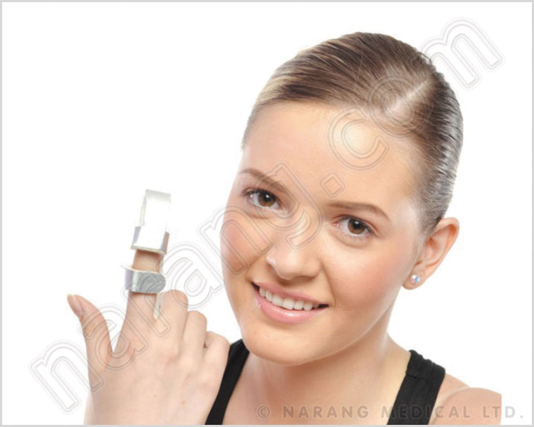
RH401 - Finger Baseball Splint
Size: S, M, L
Feature:
For protection and support to tip of finger
Its flaps fold to maintain the finger in fixed position.
Application :
To prevent contractures due to burns
In case of fractures and sprains

Slide 117
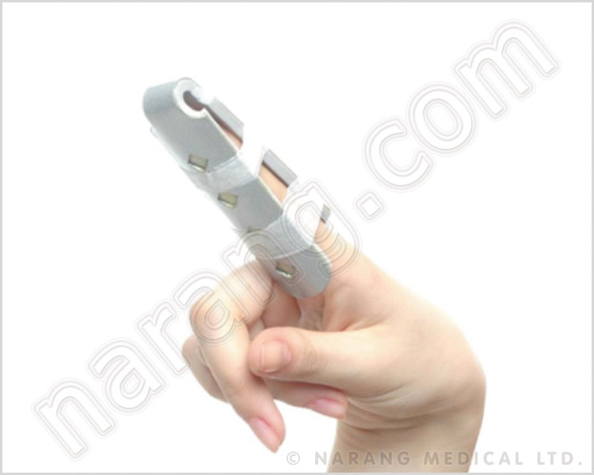
RH402 - Finger Cot
Size: S, M, L
Feature:
V shaped malleable Aluminium splints designed for easy application
Poly foam padding for comfort
Fits any finger, meant to keep straight for given period of time.
Application:
Fractures of distal inter phalangeal joints
Collateral ligament injury of the distal inter phalangeal joint.
Protection from Nail bed injuries of fingers.

Slide 118
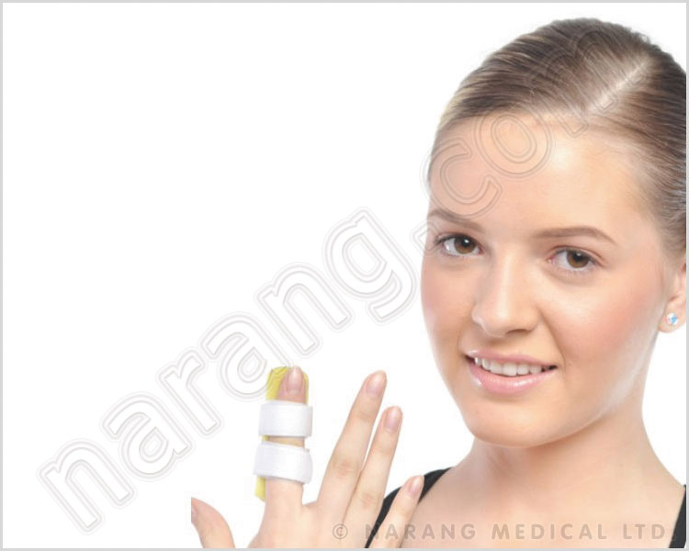
RH404 - Straight Splint
Size: S, M, L
Feature:
Flat design with velcro straps. Malleable splint with foam padding.
Application:
During conditions requiring support and immobilization of inter phalangeal joints. Dislocations or sprain during sports and crushed fractures due to accidents.

Slide 119
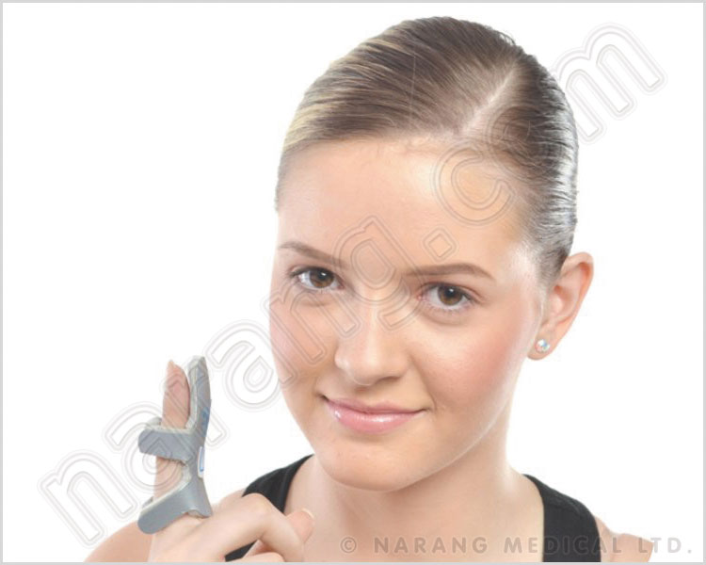
RH403 - Frog Splint
Size: S, M, L
Feature:
Foam padded aluminium splint in unique shape to cover the dorsal surface of finger to remain open
Four extended arms to ensure good fitting.
Application:
To hold distal inter phalangeal joints in correct alignment
Collateral ligament injuries of distal inter phalangeal joint
Hyper flexion injuries
Swan neck deformity

Slide 120
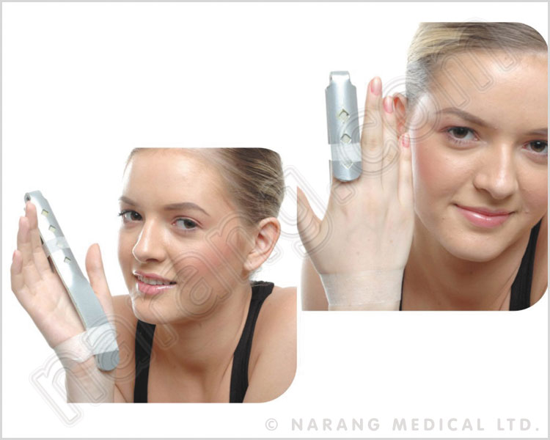
RH405 - Finger Extension Splint
Size: Universal
Feature:
Malleable aluminium used to keep interphallangeal joints in right position
Polyfoam padding for comfort
Fits any finger
Can be moulded by bare hands
Application:
Extensor tendon injuries of the finger
Collateral ligament injuries of the inter phalangeal joint
Boutonniere's deformity
Immobilization to the fractured finger

Slide 121
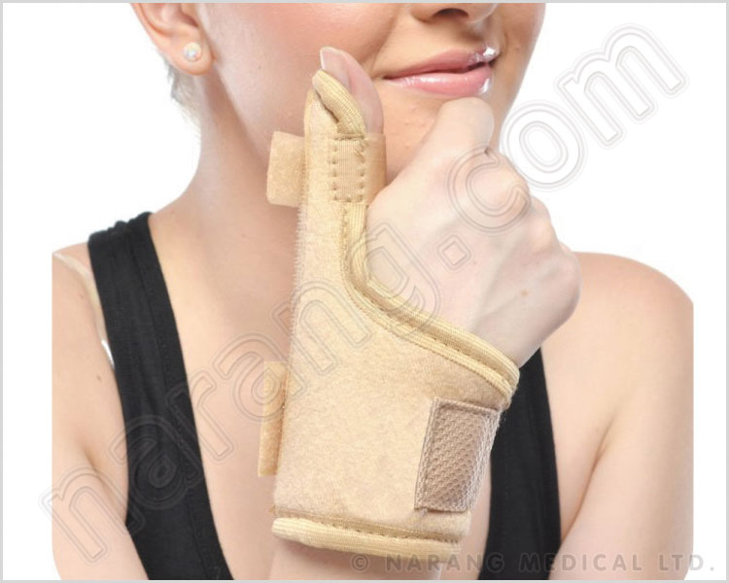
RH409 - Thumb Spica Splint
Size: Universal
Feature:
High quality fabric with suede lining for comfort and durability
Allows performance of routine tasks in comfort as it limits extreme motion of the joint of the thumb.
Application:
Designed for patients with painful wrists and thumb tendentious
Splint provides light compression to assist in decreasing pain and relieving inflammation

Slide 122
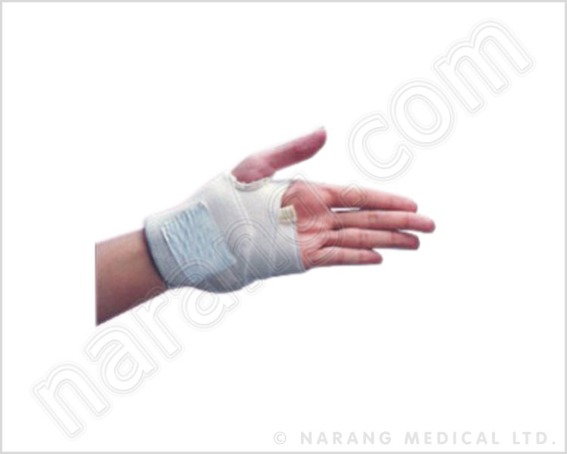
RH416 - Wrist Brace with Thumb
Size: Universal
Feature:
Thumb hole present to fit through the thumb to the wrist region
Sets of velcro present on elastic for adjustment.
Application :
Sprains and strains
Post trauma compression support.

Slide 123
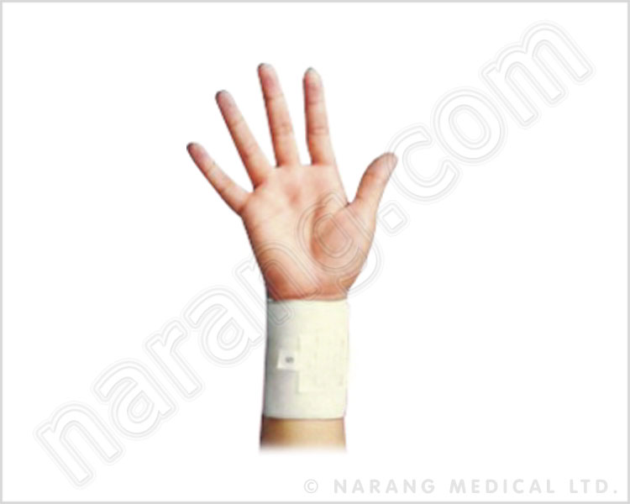
RH417 - Wrist Brace With Double Lock
Size: S, M, L, XL
Feature:
Elastic strap with two sets of velcro closures for better compression
Easy to apply and peel to open.
Application:
Sprain, strains post trauma compression support
Preventive support during sports activities.

Slide 124
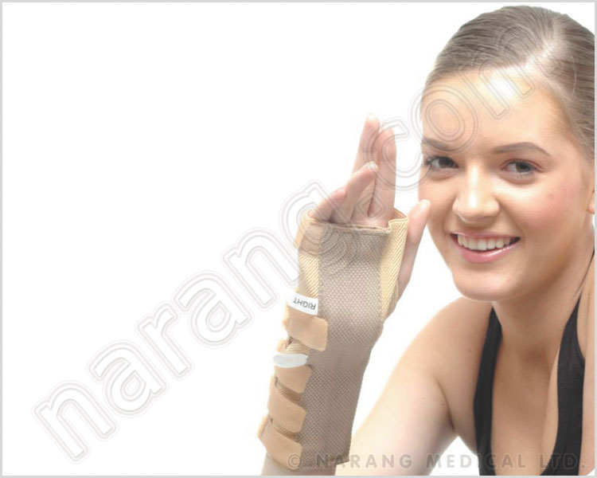
RH418 - Wrist And Forearm Splint
Size: S, M, L, XL (Left, Right)
Feature:
Pre shaped splint for immobilization in dorsiflexion.
High quality fabric and foam padding for comfort wear.
Thumb flap with velcro closure.
Application:
Minor fractures of the wrist and distal forearm..
Strain and sprain in the wrist.
Early cast removal.

Slide 125
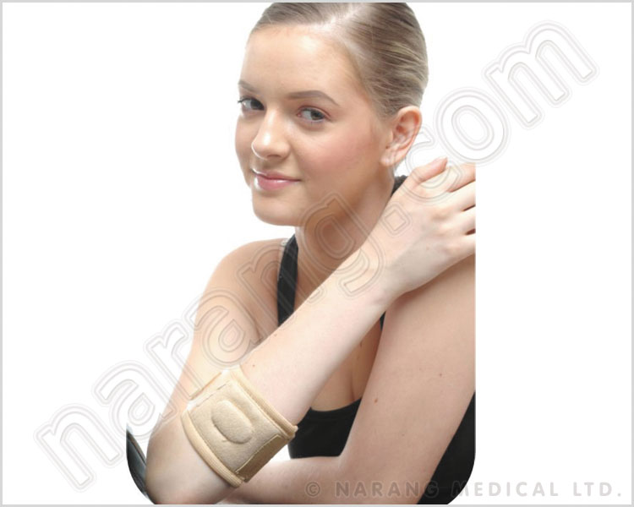
RH423 - Tennis Elbow Support
Size: S, M, L, XL
Feature:
Foam padded synthetic strap with velcro and buckle provision for proper fittings.
Application:
Tennis elbow syndrome or lateral epicondylitis.
Preventive care support for tennis elbow syndrome.

Slide 126
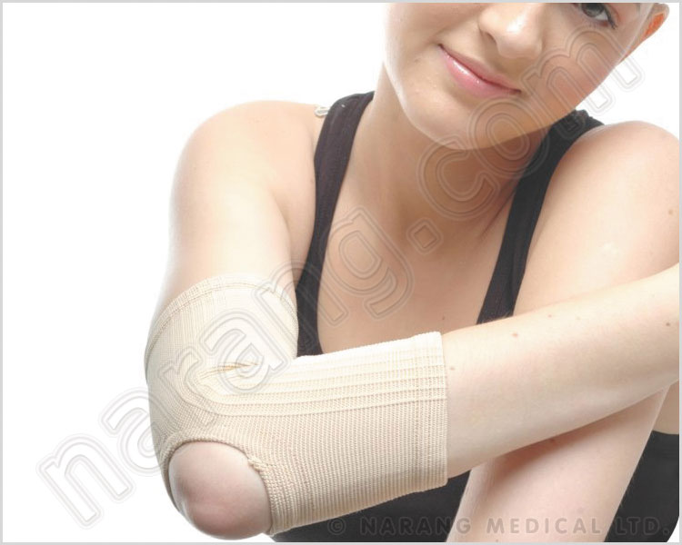
RH424 - Elbow Brace
Size: S, M, L, XL
Feature:
Soft yarn and heat resistant rubber thread for comfortable and prolonged use.
Gives graduated compression.
Application:
Relieves discomfort from tired, aching or swollen elbow.

Slide 127
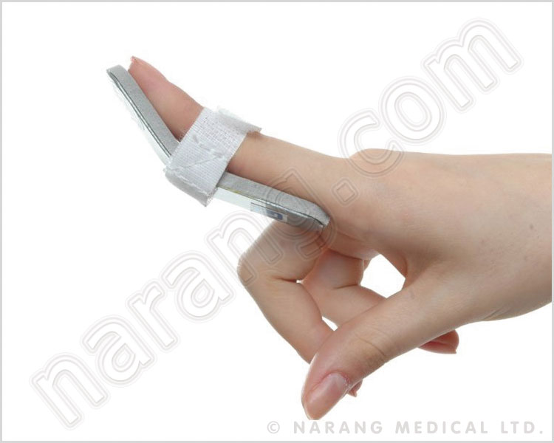
RH425 - Finger Mallet Splint
Size: Universal
Feature:
Splint keeps the finger joints in hyper extension.
Aluminium made with padding for comfort wear.
Application:
Hyper flexion injuries like mallet finger

Slide 128
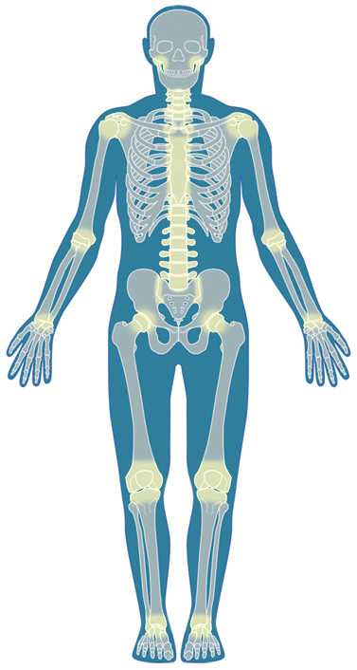

Slide 129
Closed Reduction, Traction, and Casting Techniques

Slide 130
Closed Reduction Principles
All displaced fractures should be reduced to minimize soft tissue complications, including those that require ORIF
Use splints initially
  Allow for swelling
  Adequately pad all bony prominences

Slide 131
Closed Reduction Principles
Adequate analgesia and muscle relaxation are critical for success
Reduction maneuver may be specific for fracture location and pattern
Correct/restore length, rotation, and angulation
Immobilize joint above and below

Slide 132
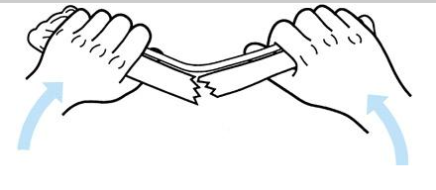
Closed Reduction Principles
Reduction may require reversal of mechanism of injury, especially in children with intact periosteum
When the bone breaks because of bending, the soft tissues disrupt on the convex side and remain intact on the concave side
Figure from Chapman’s Orthopaedic Surgery 3rd Ed. (Redrawn from Charnley J. The Closed Treatment of Common Fractures, 3rd ed. Baltimore: Williams & Wilkins, 1963.)

Slide 133
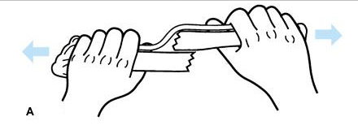
Closed Reduction Principles
Longitudinal traction may not allow the fragments to be disimpacted and brought out to length if there is an intact soft-tissue hinge (typically seen in children who have strong perisoteum that is intact on one side)
Figure from Chapman’s Orthopaedic Surgery 3rd Ed. (Redrawn from Charnley J. The Closed Treatment of Common Fractures, 3rd ed. Baltimore: Williams & Wilkins, 1963.)

Slide 134
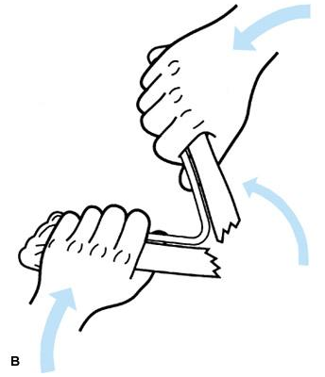
Closed Reduction Principles
Reproduction of the mechanism of fracture to hook on the ends of the fracture
Angulation beyond 90° is usually required
Figure from Chapman’s Orthopaedic Surgery 3rd Ed. (Redrawn from Charnley J. The Closed Treatment of Common Fractures, 3rd ed. Baltimore: Williams & Wilkins, 1963.)

Slide 135
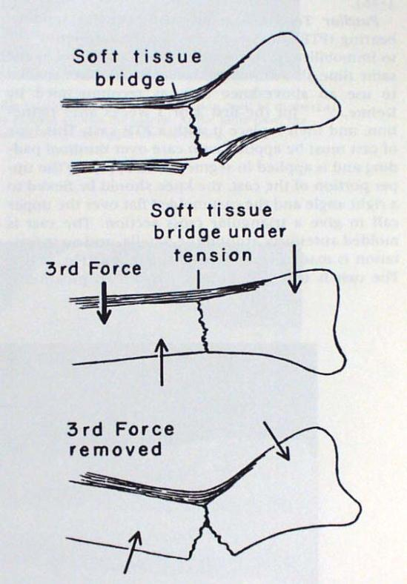
Closed Reduction Principles
Three point contact (mold) is necessary to maintain closed reduction
Removal of any of the three
forces results in loss of reduction
Figure from: Rockwood and Green: Fractures in Adults, 4th ed, Lippincott, 1996.
Notes:
Figure from: Rockwood and Green: Fractures in Adults, 4th ed, Lippincott, 1996.

Slide 136
Closed Reduction Principles
Cast must be molded to resist deforming forces
“Straight casts lead to crooked bones”
“Crooked casts lead to straight bones”

Slide 137
Anesthesia for Closed Reduction
Hematoma Block - aspirate hematoma and place 10cc of Lidocaine at fracture site
  Less reliable than other methods
  Fast and easy
  Theoretically converts closed fracture to open fracture but no documented increase in infection

Slide 138
Anesthesia for Closed Reduction
IV Sedation
Versed - 0.5 – 1 mg q 3 minutes up to 5mg
Morphine - 0.1 mg/kg
Demerol - 1- 2 mg/kg up to 150 mg
  Beware of pulmonary complications with deep conscious sedation - consider anesthesia service assistance if there is concern
  Pulse oximeter and careful monitoring are recommended

Slide 139
Anesthesia for Closed Reductions
Bier Block - superior pain relief, greater relaxation, less premedication needed
Double tourniquet is inflated on proximal arm and venous system is filled with local
  Lidocaine preferred for fast onset
  Volume = 40cc
  Adults 2-3 mg/kg Children 1.5 mg/kg
  If tourniquet is deflated after < 40 minutes then deflate for 3 seconds and re-inflate for 3 minutes - repeat twice
  Watch closely for cardiac and CNS side effects, especially in the elderly

Slide 140
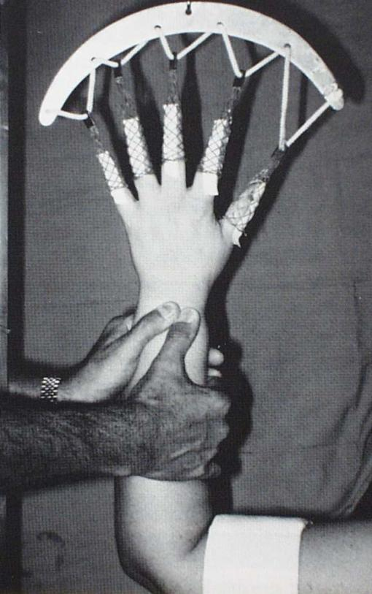
Common Closed Reductions
Distal Radius
Longitudinal traction
Local or regional block
Exaggerate deformity
Push for length and reversal of deformity
Apply splint or cast with 3-point mold
Figure from: Rockwood and Green: Fractures in Adults, 4th ed, Lippincott, 1996.
Notes:
Figure from: Rockwood and Green: Fractures in Adults, 4th ed, Lippincott, 1996.

Slide 141
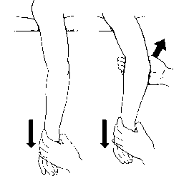
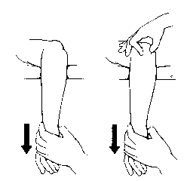
Common Joint Reductions
Elbow Dislocation - traction, flexion, and direct manual push
Figures from Rockwood and Green, 5th ed.
Notes:
Figures from Rockwood and Green, 5th ed

Slide 142
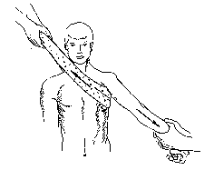
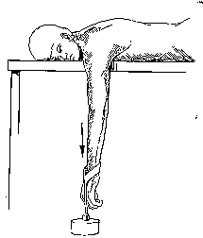
Common Joint Reductions
Shoulder Dislocation - relaxation, traction, gentle rotation if necessary
Figures from Rockwood and Green, 5th ed.
Notes:
Figures from Rockwood and Green, 5th ed..

Slide 143
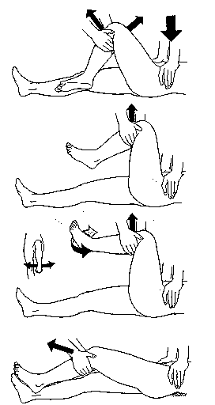
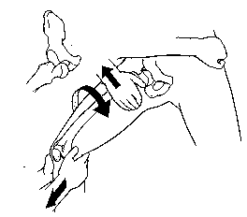
Common Joint Reductions
Hip Dislocation
Relaxation, flexion, traction, adduction and internal rotation
Gentle and atraumatic
Relocation should be palpable and permit significantly
improved ROM. This often requires very deep sedation.
Figures from Rockwood and Green, 5th ed.
Notes:
Figures from Rockwood and Green, 5th ed.

Slide 144
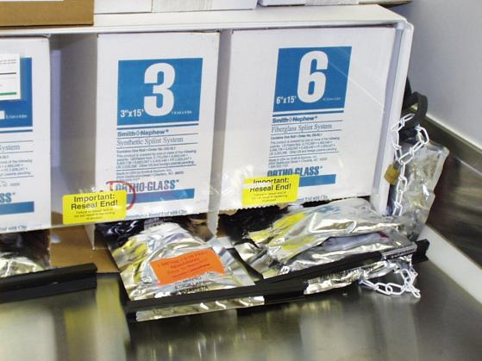
Splinting
Non-cicumferential – allows for further swelling
May use plaster or prefab fiberglass splints
(plaster molds better)

Slide 145
Common Splinting Techniques
“Bulky” Jones
Sugar-tong
Coaptation
Ulnar gutter
Volar / Dorsal hand
Thumb spica
Posterior slab (ankle) +/- U splint
Posterior slab (thigh)

Slide 146
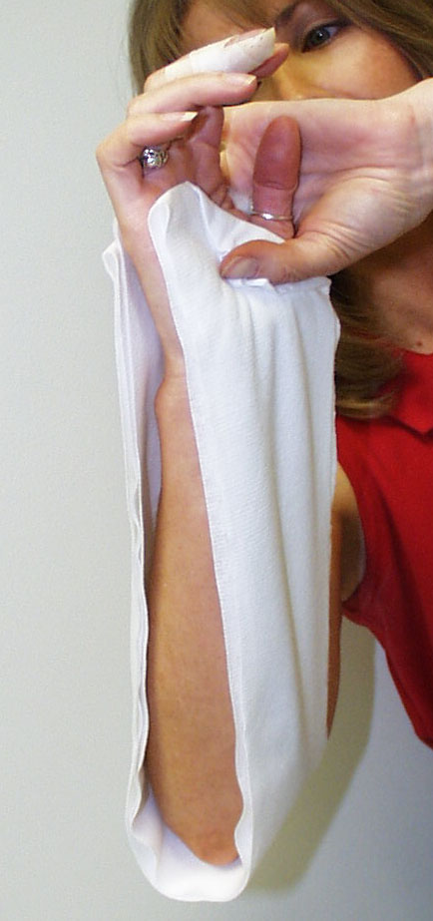
Sugar Tong Splint
Splint extends around the distal humerus to provide rotational control
Padding should be at least 3 - 4 layers thick with several extra layers at the elbow

Slide 147
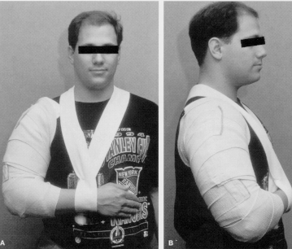
Humeral Shaft Fracture Coaptation Splint
Medially splint ends in the axilla and must be well padded to avoid skin breakdown
Lateral aspect of splint extends over the deltoid
Figure from Rockwood and Green, 4th ed.
Notes:
Figure from Rockwood and Green, 4th ed.

Slide 148
Fracture Bracing
Allows for early functional ROM and weight bearing
Relies on intact soft tissues and muscle envelope to maintain alignment and length
Most commonly used for humeral shaft and tibial shaft fractures

Slide 149
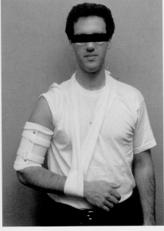
Convert to humeral fracture brace 7-10 days after fracture
(i.e. when fracture site is not tender to compression).
Allows early active elbow ROM
Fracture reduction maintained by hydrostatic column principle
Co-contraction of muscles
  - Snug brace during the day
  - Do not rest elbow on table
Patient must tolerate a snug fit for brace to be functional
Figure from Rockwood and Green, 4th ed.
Notes:
Figure from Rockwood and Green, 4th ed.

Slide 150
Casting
Goal of semi-rigid immobilization while avoiding pressure / skin complications
Often a poor choice in the treatment of acute fractures due to swelling and soft tissue complications
Good cast technique necessary to achieve predictable results

Slide 151
Casting Techniques
Stockinette - may require two different diameters to avoid overtight or loose material
Caution not to lift leg by stockinette – stretching the stockinette too tight around the heel may case high skin pressure

Slide 152
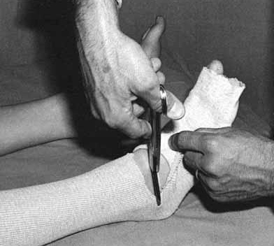
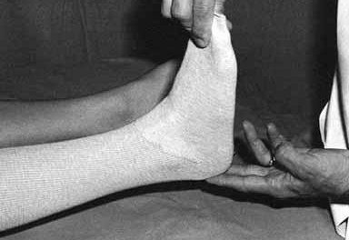
Casting Techniques
To avoid wrinkles in the stockineete, cut along the concave surface and overlap to produce a smooth contour
Figure from Chapman’s Orthopaedic Surgery 3rd Ed.

Slide 153
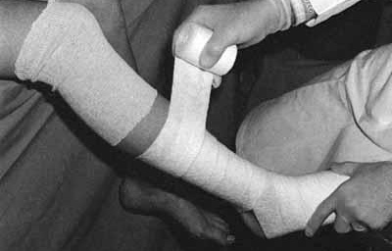
Casting Techniques
Cast padding
  Roll distal to proximal
  50 % overlap
  2 layers minimum
  Extra padding at fibular head, malleoli, patella, and olecranon
Figure from Chapman’s Orthopaedic Surgery 3rd Ed.

Slide 154
Plaster vs. Fiberglass
Plaster
  Use cold water to maximize molding time
Fiberglass
  More difficult to mold but more durable and resistant to breakdown
  Generally 2 - 3 times stronger for any given thickness

Slide 155
Width
Casting materials are available in various widths
  6 inch for thigh
  3 - 4 inch for lower leg
  3 - 4 inch for upper arm
  2 - 4 inch for forearm

Slide 156
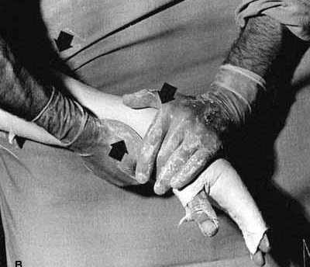
Cast Molding
Avoid molding with anything but the heels of the palm in order to avoid pressure points
Mold applied to produce three point fixation
Figure from Chapman’s Orthopaedic Surgery 3rd Ed.

Slide 157
Below Knee Cast
Support metatarsal heads
Ankle in neutral – flex knee to relax gastroc
Ensure freedom of toes
Build up heel for walking casts - fiberglass much preferred for durability

Slide 158
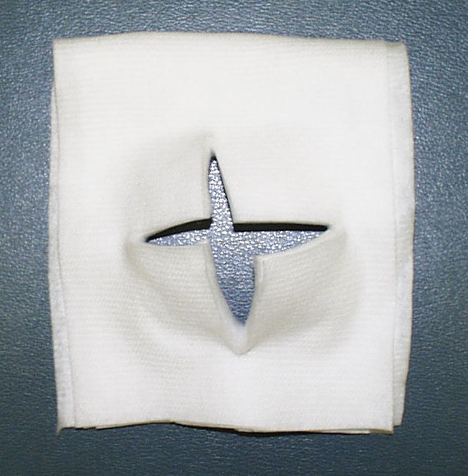
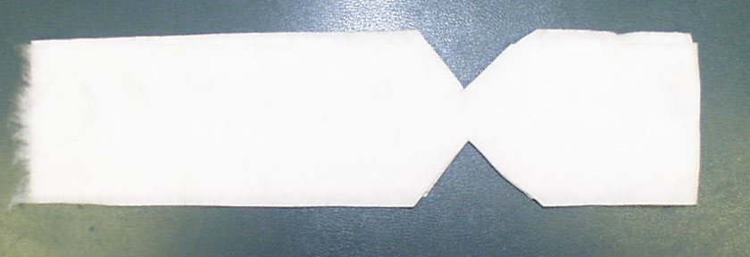
Padding for fibular head and plantar aspect of foot

Slide 159
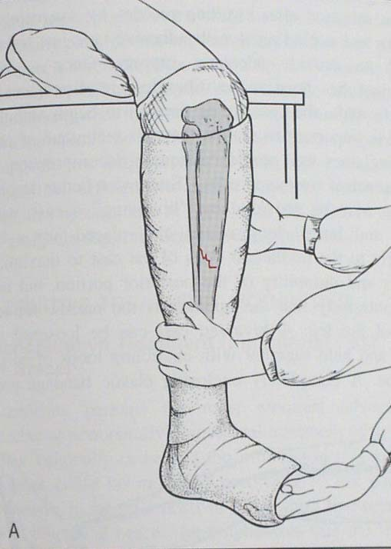
Flexed knee
Padded fibular
head
Neutral ankle
position
Toes free
Assistant or foot stand required to maintain ankle position
Figure from: Browner and Jupiter: Skeletal Trauma, 2nd ed, Saunders, 1998.
Notes:
Figure from:Figure from: Browner and Jupiter: Skeletal Trauma, 2nd ed, Saunders, p 2221 1998.

Slide 160
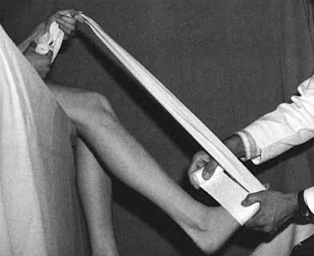
Short Leg Cast
When working alone, the patient can help maintain proper ankle position by holding onto a muslin bandage placed beneath the toes
Figure from Chapman’s Orthopaedic Surgery 3rd Ed.

Slide 161
Above Knee Cast
Apply below knee first (thin layer proximally)
Flex knee 5 - 20 degrees
Mold supracondylar femur for improved rotational stability
Apply extra padding anterior to patella

Slide 162
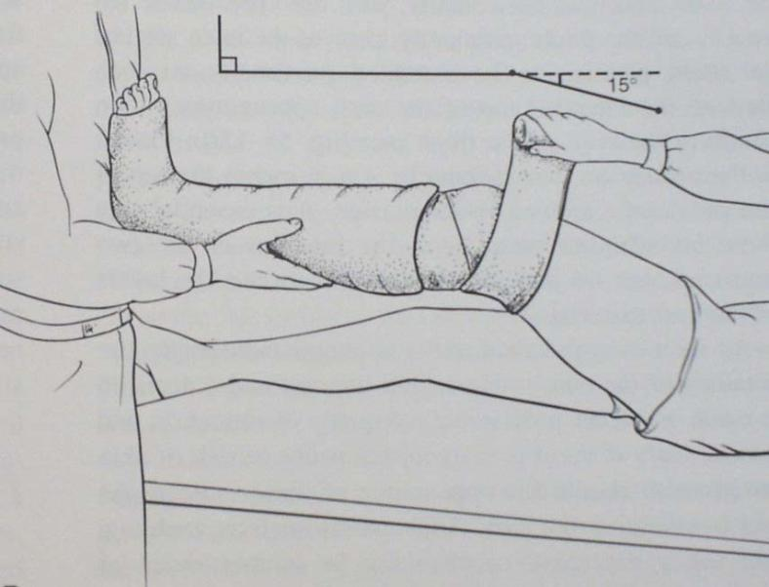
Anterior padding
Support lower
leg / cast
Extend to
gluteal crease
Figure from: Browner and Jupiter: Skeletal Trauma, 2nd ed, Saunders, 1998.
Notes:
Figure from:Figure from: Browner and Jupiter: Skeletal Trauma, 2nd ed, Saunders, p 2221, 1998.

Slide 163
Forearm Casts & Splints
MCP joints should be free
  Do not go past proximal palmar crease
Thumb should be free to base of MC
  Opposition of thumb to little finger should be unobstructed

Slide 164
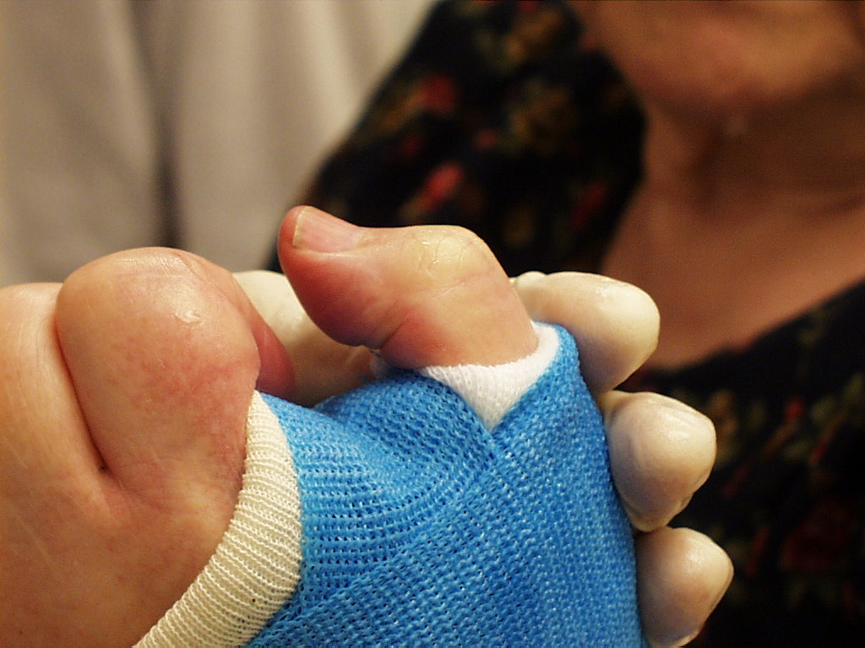
x
x

Slide 165
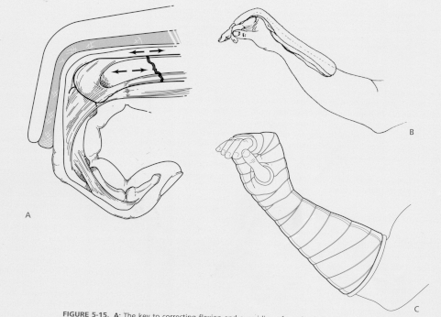
Examples - Position of Function
Ankle - Neutral dorsiflexion – No Equinus
Hand - MCPs flexed 70 – 90º, IPs in extension
70-90 degrees
Figure from Rockwood and Green, 5th ed.
Notes:
Figure from Rockwood and Green, 5th ed.

Slide 166
Cast Wedging
Early follow-up x-rays are required to ensure reduction is not lost
Cast may be “wedged” to correct reduction
Deformity is drawn out on cast
Cast is cut circumferentially
Cast is wedged to correct deformity and the over-wrapped
Example of cast wedging to correct loss of reduction of a pediatric distal both bone forearm fracture. From Halanski M, Noonan KJ. J Am Acad Orthop Surg. 2008.

Slide 167
Complications of Casts & Splints
Loss of reduction
Pressure necrosis – may occur as early as 2 hours
Tight cast → compartment syndrome Univalving = 30% pressure drop Bivalving = 60% pressure drop
    Also need to cut cast padding
Notes:
Loss of reduction is the most common complication of cast treatment as the swelling decreases and the padding compresses while the patient regains mobility. Careful casting technique can avoid this (careful molding, attention to detail—deforming forces:gravity and muscle). Appropriately time radiographic reevaluation and correction of problems will lead to a satisfactory outcome.

Slide 168
Complications of Casts & Splints
Thermal Injury - avoid plaster > 10 ply, water >24°C, unusual with fiberglass
Cuts and burns during removal
Keloid formation as a result of an injury during cast removal. From Halanski M, Noonan KJ. J Am Acad Orthop Surg. 2008.

Slide 169
Complications of Casts & Splints
DVT/PE - increased in lower extremity fracture
  Ask about prior history and family history
  Birth Control Pills are a risk factor
  Indications for prophylaxis controversial in patients without risk factors
Joint stiffness
  Leave joints free when possible (ie. thumb MCP for below elbow cast)
  Place joint in position of function

Slide 170
Objectives
Identify common fractures in Primary Care
Proper use of a splint versus a cast
Identify commonly used casting materials and when to use them
Demonstrate proper cast application and removal
Describe appropriate patient education with regards to casting

Slide 171
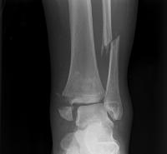
Introduction
Orthopedic problems are over 10% of all primary care visits
1.6% of all visits to any physician are fracture related
16% of all fracture care is handled by family physicians

Slide 172
Fractures seen by FPs
Fracture | Eiff | Hatch | Alcoff
Finger | 17% | 18% | 12%
Metacarpal | 16 | 7 | 5
Radius | 14 | 10 | 16
Toe | 9 | 9 | 1
Fibula | 7 | 7 | 7
Metatarsal | 6 | 5 | 4
Clavicle | 5 | 6 | 7

Slide 173
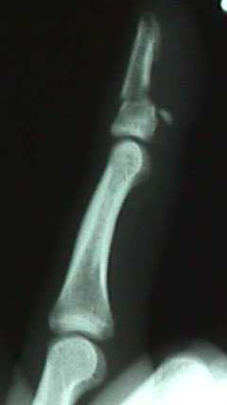
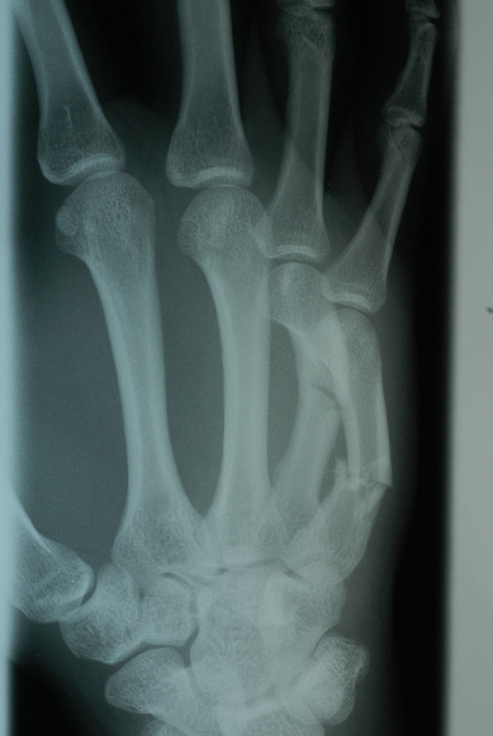

Fractures seen by FPs
4th digit distal phalanx fracture
4th and 5th metacarpal fracture
Distal radius fracture

Slide 174


Fractures seen by FPs
Other Fractures:
Radius and ulna
Carpal
Ulna
Humerus
Tibia
Tarsal

Slide 175

Casting and Splinting

Slide 176

Overview
Mainstay of treatment for most fractures
Joint above and a joint below
Avoid pressure points
  Excessive molding
  Cast indentations
Appropriate padding
  More at bony prominence
  Not too much at fracture site
Consider skin wounds

Slide 177

Splinting

Slide 178

Splinting
Purpose
Reduce pain
Reduce bleeding and swelling
Prevent further soft tissue damage
Prevent vascular constriction
What to splint
Fracture
Dislocation
Tendon rupture

Slide 179


Specific splints
Forearm and wrist
  Ulnar gutter
    Metacarpal
  Thumb spica
    Scaphoid
Ankle
  Posterior splint
  “L and U” or Sugartong

Slide 180


Casting
Jones Fracture

Slide 181


Supplies
Stockinette
Padding material
Cast material
  Plaster: cheaper, long shelf life, easier to work with
    May be fragile, disintegrate in water
  Fiberglass: more durable, lighter, dry quicker, multiple colors, water tolerant
  Newer synthetic materials

Slide 182


Procedure
Apply stockinette
  Protect skin and provide smooth edge
Apply padding
  Protect bony prominence
  Allows for swelling
Wet the casting material
  Hot water hardens faster
  Squeeze out excess water
Apply splint or cast

Slide 183

Patient Education
Keep injured limb elevated and iced
Warning signs
  Numb extremity
  Inability to move extremity
  Discoloration, Cold
  Increased pain
Avoid getting wet
  Completely with plaster
  May use hair dryer on cool setting if fiberglass

Slide 184
Patient Education
Keep cast clean
Do not stick objects into cast
Do not pull out the padding
Watch for skin irritation
Do not modify your cast
Watch for cracking and breaking of cast

Slide 185



Cast Removal
Cast saw
Vibrates, doesn’t rotate
Biggest concern is burn

Slide 186
Take Home Points
You will see fractures
Know your comfort level and when to refer
Splint acutely and with active swelling
Variety of materials
  Know what you have, be comfortable with it
Educate your patients

Slide 187

Thank You!

