Slide 1
CELL ANATOMY AND CHEMISTRY OF LIFE
CMS SEPT 2016 CLASS
LECTURER
KAUSYA J.J.M.
KMTC-MWINGI

Slide 2
Objectives
By the end of the lesson the learner should be able to;
i. define terms used in cell anatomy
ii. Explain cell structure (morphology)
iii. Describe the morphology various organelles
iv. Appreciate the cell as the basic building block of human body .
V. Demonstrate how cell anatomy relevant in diagnose and management of diseases.

Slide 3
WHY STUDY THE CELL
The cell is the basic unit of life and disease conditions affect specific cells-eg malaria affect red blood cells, diabetes –beta cells of the pancrease that produce insulin
Interventions in terms of drugs target specific cells – eg antibiotics target bacterial cells or aspects of the same.
Understanding the cell structure helps us develop and carry out interventions that are efficient, and appropriate to sustain life, also in genetic engineering.

Slide 4
The atom is the smallest particle of an element which can exist as a stable entity. An element is a chemical substance whose atoms are all of the same type; e.g. iron contains only iron atoms. Compounds contain more than one type of atom; for instance, water is compound containing both hydrogen and oxygen atoms(H2O). An element is a substance made of only one type of atom (therefore, an atom is the smallest part of an element). There are 92 naturally occurring elements in the world around us.
Examples are hydrogen (H), iron (Fe), oxygen (O), calcium (Ca), nitrogen (N), and carbon (C). In nature, an element does not usually exist by itself but rather combines with the atoms of other elements to form compounds.
Atomic structure
Atoms are made up of three main types of particles.
Protons are particles present in the nucleus or central part of the atom. Each proton has one unit of positive electrical charge and one atomic mass unit.

Slide 5
Atoms are the smallest parts of an element that have the characteristics of that element. An atom consists of three major subunits or particles: protons, neutrons, and electrons. A proton has a positive electrical charge and is found in the nucleus (or center) of the atom. A neutron is electrically neutral (has no charge) and is also found in the nucleus. An electron has a negative electrical charge and is found outside the nucleus orbiting in what may be called an electron cloud or shell around the nucleus. The number of protons in an atom gives it its atomic number. Protons and neutrons have mass and weight; they give an atom its atomic weight. In an atom, the number of protons () equals the number of electrons (); therefore, an atom is electrically neutral. The electrons, however, are important in that they may enable an atom to connect, or bond, to other atoms to form molecules. A molecule is a combination of atoms (usually of more than one element) that are so tightly bound together that the molecule behaves as a single unit. Each atom is capable of bonding in only very specific ways. This capability depends on the number an the arrangement of the electrons of the atom.Electrons orbit the nucleus of an atom in shells or energylevels

Slide 6
The first, or innermost, energy level can contain a maximum of two electrons and is the considered stable. The second energy level is stable when it contains its maximum of eight electrons. The remaining energy levels, more distant from the nucleus, are also most stable when they contain eight electrons, or a multiple of eight. A few atoms (elements) are naturally stable, or uninterested in reacting, because their outermost energy level already contains the maximum number of electrons. The gases helium and neon are examples of these stable atoms, which do not usually react with other atoms. Most atoms are not stable, however, and tend to gain, lose, or share electrons in order to fill their outermost shell. By doing so, an atom is capable of forming one or more chemical bonds with other atoms. In this way, the atom becomes stable, because its outermost shell of electrons has been filled. It is these reactive atoms that are of interest in our study of anatomy and physiology.

Slide 7
The human body is a precisely structured container of chemical reactions. The body consists of trillions of atoms in specific arrangements and thousands of chemical reactions proceeding in a very orderly manner. The keys to understanding human consciousness and self awareness are still beyond our grasp. We do not yet know what enables us to study ourselves—no other animals do, as far as we know—but we have accumulated a great deal of knowledge about what we are made of and how it all works. Some of this knowledge makes up the course you are about to take, a course in basic human anatomy and physiology. Pathophysiology is the study of disorders of functioning, and a knowledge of normal physiology makes such disorders easier to understand.

Slide 8
Anatomy is the study of body structure, which includes size, shape, composition, and perhaps even coloration. Physiology is the study of how the body functions. The physiology of red blood cells, for example, includes what these cells do, how they do it, and how this is related to the functioning of the rest of the body. Physiology is directly related to anatomy. For example, red blood cells contain the mineral iron in molecules of the protein called hemoglobin; this is an aspect of their anatomy. The presence of iron enables red blood cells to carry oxygen, which is their function. All cells in the body must receive oxygen in order to function properly, so the physiology of red blood cells is essential to the physiology of the body as a whole.

Slide 9
CHEMICALS
The chemicals that make up the body may be divided into two major categories: inorganic and organic. Inorganic chemicals are usually simple molecules made of one or two elements other than carbon (with a few exceptions). Examples of inorganic chemicals are water (H2O); oxygen (O2); one of the exceptions, carbon dioxide (CO2); and minerals such as iron (Fe), calcium (Ca), and sodium (Na). Organic chemicals are often very complex and always contain the elements carbon and hydrogen. In this category of organic chemicals are carbohydrates, fats, proteins, and nucleic acids.

Slide 10
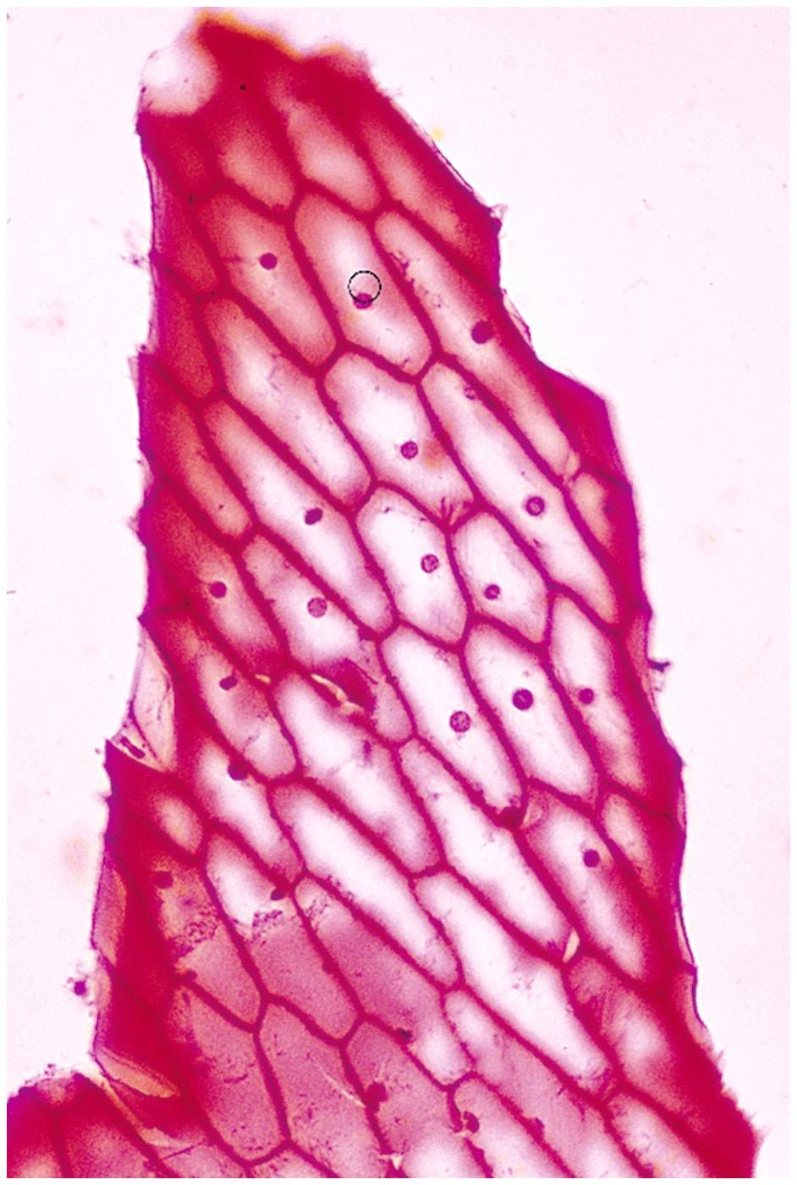
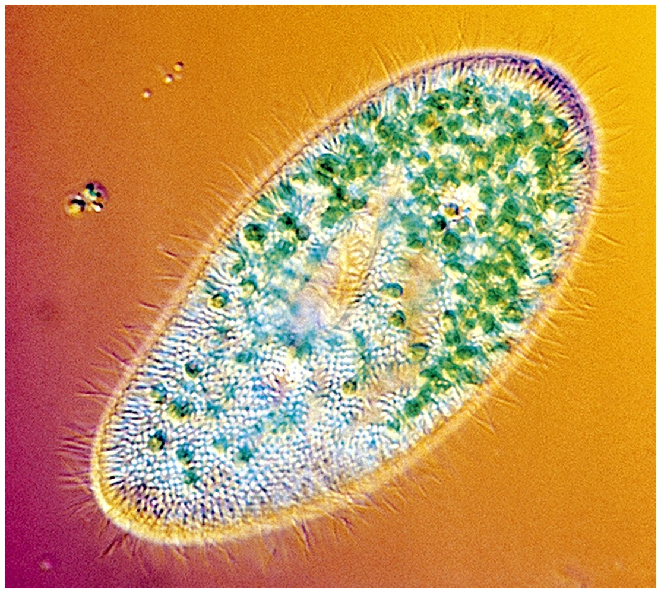
Cells
Smallest living unit
Most are microscopic. A cell is the smallest unit that is capable of performing life functions.

Slide 11
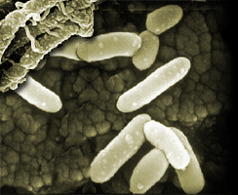
Examples of Cells
Amoeba Proteus
Plant Stem
Bacteria
Red Blood Cell
Nerve Cell

Slide 12
History of Cell Theory
i. mid 1600s – Anton van Leeuwenhoek
Improved microscope, observed many living cell
ii. mid 1600s – Robert Hooke
Observed many cells
iii. 1850 – Rudolf Virchow
Proposed that all cells come from existing cells
iv. Cells were discovered in 1665 by Robert Hooke.
v. Early studies of cells were conducted by
- Mathias Schleiden (1838)
- Theodor Schwann (1839)
vi. Schleiden and Schwann proposed the Cell Theory.

Slide 13
Cell Theory
All organisms consist of 1 or more cells.
Cell is the smallest unit of life.
All cells come from pre-existing cells.
Principles of Cell Theory
All living things are made of cells
Smallest living unit of structure and function of all organisms is the cell
All cells arise from preexisting cells
(this principle discarded the idea of spontaneous generation)
All cells today represent a continuous line of descent from the first living cells.
Microscopes are required to visualize cells.
Light microscopes can resolve structures that are 200nm apart.
Electron microscopes can resolve structures that are 0.2nm apart.

Slide 14
Characteristics of All Cells
A surrounding membrane
Protoplasm – cell contents in thick fluid
Organelles – structures for cell function
Control center with DNA
Cell Types
1. Prokaryotic
2. Eukaryotic
Prokaryotic
Do not have structures surrounded by membranes
Few internal structures
One-celled organisms, Bacteria

Slide 15
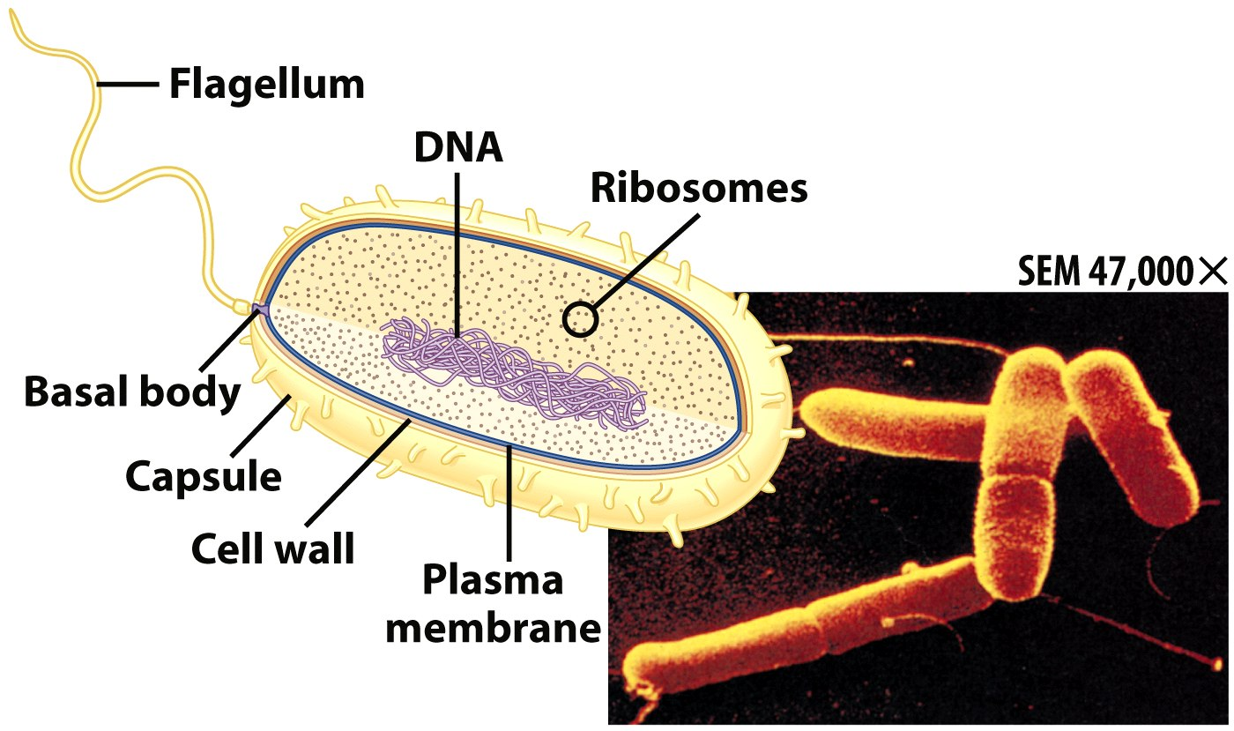
Prokaryotic Cells
First cell type on earth
Cell type of Bacteria and Archaea

Slide 16
Prokaryotic Cells
No membrane bound nucleus
Nucleoid = region of DNA concentration
Organelles not bound by membranes

Slide 17
Eukaryotic Cells
1. Include fungi, protists, plant, and animal cells
2. compartmentalize many cellular functions within organelles and the endomembrane system ie
-Contain organelles surrounded by membranes
3 . Most living organisms
4. possess a membrane-bound nucleus
-are more complex than prokaryotic cells
5. possess a cytoskeleton for support and to maintain cellular structure

Slide 18
Plant
Animal
Plant (lt)…………. And,……….. animal (rt) cells

Slide 19
INTRODUCTION
The cell is the basic unit of structure and function in living things. Cells vary in their shape size, and arrangements but all cells have similar components, each with a particular function.
Some of the 100 trillion of cells make up human body.
All human cell are microscopic in size, shape and function.
The diameter range from 7.5 micrometer (RBC) to 150 mm (ovum).
Cell is defined as the fundamental living unit of any organism.
-Cell is important to produce energy for metabolism (all chemical reactions within a cell)
-Cell can mutate (change genetically) as a result of accidental changes in its genetic material (DNA).
Cytology: the study of the structure and functions of cells.

Slide 20
Cell Parts
Organelles
=components of cell
.
n

Slide 21
cell organelles
Cell membrane
Cytoplasm
Nucleus
Mitochondria
Endoplasmic reticulum
Ribosomes
Lysosomes
Vacuoles
Golgi bodies
Chloroplast

Slide 22
Endomembrane System
Endomembrane system is
-a series of membranes throughout the cytoplasm
-divides cell into compartments where different cellular functions occur
1. endoplasmic reticulum
2. Golgi apparatus
3. lysosomes

Slide 23
Membrane Junctions
Tight junction – impermeable junction that encircles the cell & prevents leakage
– Blood brain barrier
- Skin
Desmosome – anchoring junction scattered along the sides of cells. Prevents tissues from fraying
Stomach, uterus , bladder
Gap junction – allows chemical substances to pass between cells
Heart

Slide 24
Cell structure
1) THE CELL (PLASMA) MEMBRANE
The cell membrane is a thin, dynamic membrane that encloses the cell and controls what enters and leaves the cell.
Fluid Mosaic Model
composed of a double layer (bilayer) of phospholipid molecules with many protein molecules dispersed within it

Slide 25
Fluid Mosaic Model
a. The surfaces of the membrane are "hydrophilic" due to the polar phosphate heads;
b. The internal portion of the membrane is "hydrophobic" due to the non-polar fatty acid tails;
The membrane proteins also have both hydrophilic and hydrophobic
PLASMA MEMBRANE
hydrophillic phosphate head, hydrophobic fatty acid tails
Chemical attractions are the forces that hold membranes together

Slide 26
Function of plasma membrane
Serves as boundary of the cell.
Serve as markers that identify the cells.
Play significant role in transportation.
Cell recognition proteins-allow cell to recognize other cells.
Membrane proteins-
Some membrane proteins have carbohydrates attached to them, forming glycoproteins that act as identification markers
Some membrane proteins are receptors that react to specific chemicals, sometimes permitting a process called signal transduction

Slide 27
Cytoplasm
Is a gel-like matrix of water, enzymes, nutrients, wastes, and gases and contains cell structures (organelles).
Fluid around the organelles called cytosol.
Most of the cells metabolic reactions occur in the cytoplasm.
Viscous fluid containing organelles
components of cytoplasm
Interconnected filaments & fibers
Fluid = cytosol
Organelles (not nucleus)
storage substances
NB: Structures found inside the cell are called organelles.

Slide 28
Cytoskeleton
Filaments & fibers
Made of 3 fiber types
Microfilaments
Microtubules
Intermediate filaments
3 functions:
mechanical support
anchor organelles
help move substances

Slide 29
“Typical” Animal Cell
http://web.jjay.cuny.edu/~acarpi/NSC/images/cell.gif

Slide 30
“Typical” Plant Cell
http://waynesword.palomar.edu/images/plant3.gif

Slide 31
Phospholipids
Interacts with water
Polar;
Hydrophylic head
Non polar;
Hydrophobic tail

Slide 32
Membrane Proteins
1. Channels or transporters
Move molecules in one direction
2. Receptors
3. Glycoproteins
Identify cell type
4. Enzymes
Catalyze production of substances
Recognize certain chemicals
(see diag. below)

Slide 33
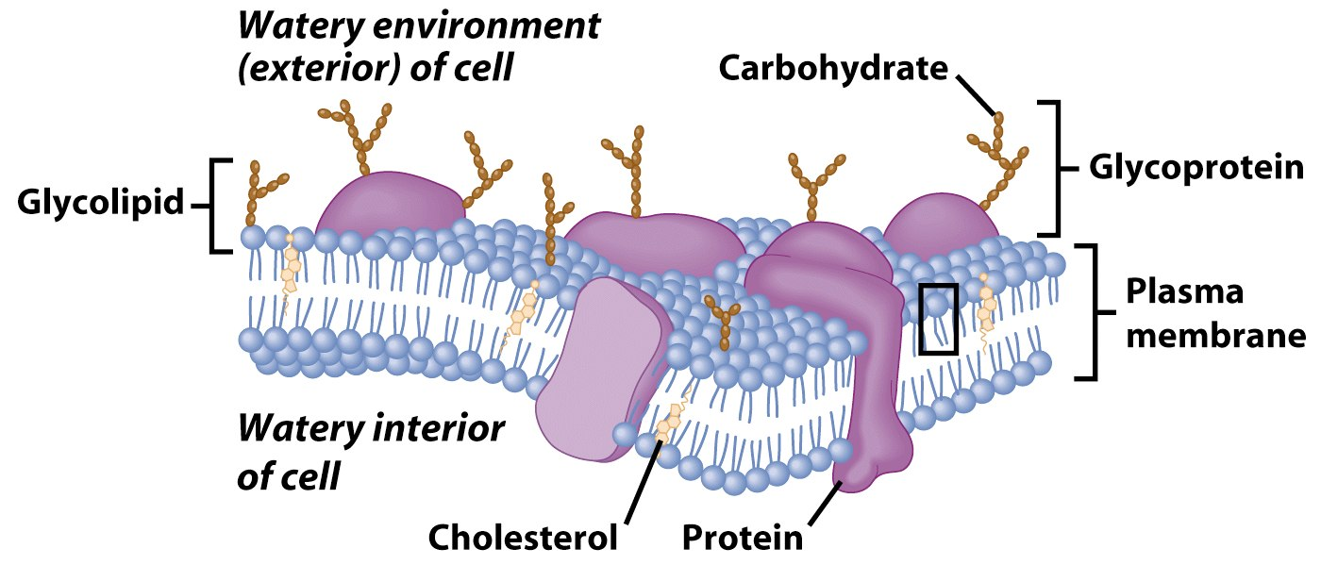
Membrane Proteins

Slide 34
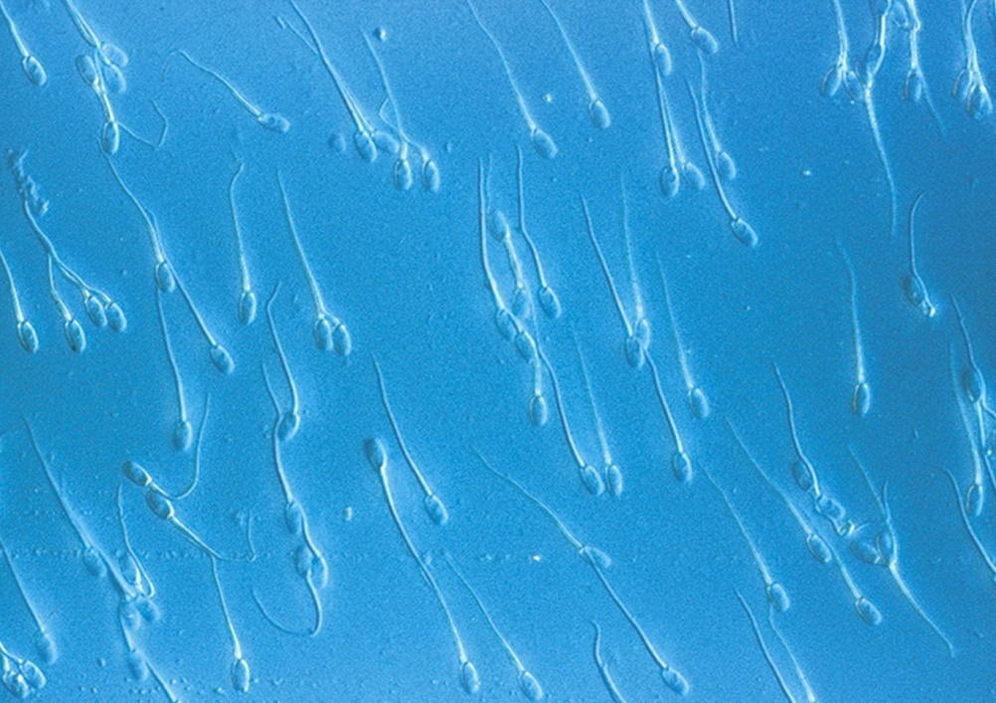
Cilia & Flagella
Provide motility
Cilia
Short
Used to move substances outside human cells
Flagella
Whip-like extensions
Found on sperm cells
Basal bodies like centrioles
microvilli

Slide 35
Nucleus : enclosed by nuclear membrane
Directs cell activities
Separated from cytoplasm by nuclear membrane
Contains genetic mater
Contains:-
i. Hereditary material
ii. Chromosomes
DNA
Proteins
Form for cell division
iii. Chromatin
iv - DNA

Slide 36
Chromosomes
In nucleus
Made of DNA
Contain instructions for traits & characteristics
http://library.thinkquest.org/12413/structures.html

Slide 37
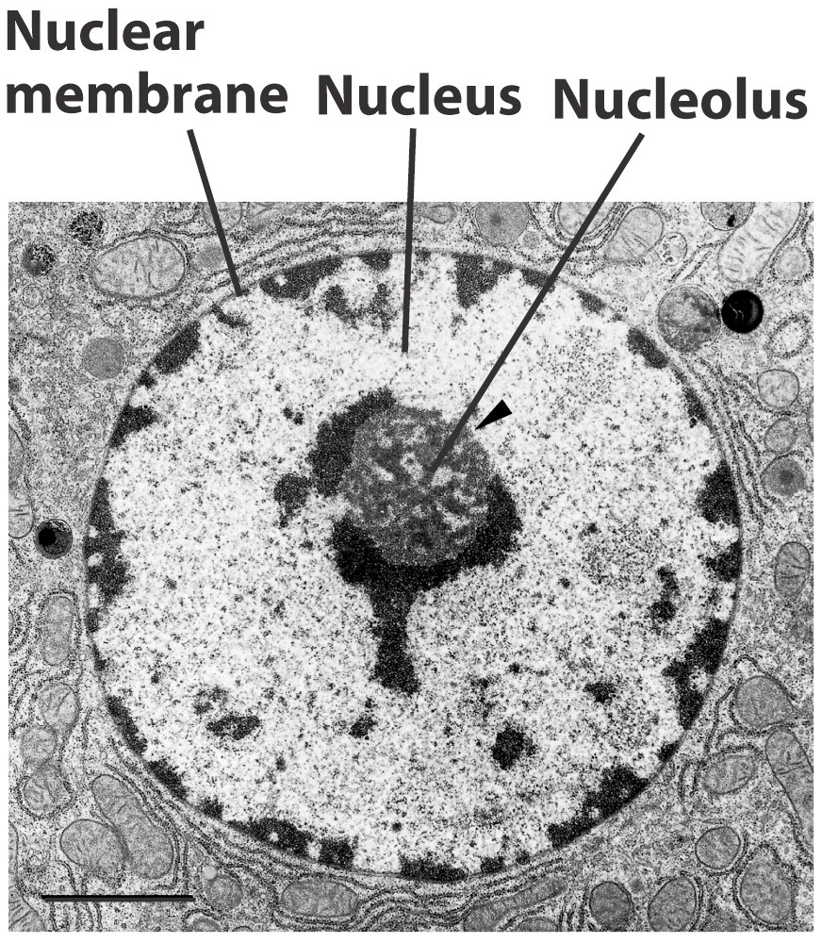
Nucleolus-found in the nucleus
Most cells have 2 or more
Directs synthesis of RNA
Forms ribosomes
Endoplasmic Reticulum
Helps move substances within cells
Network of interconnected membranes
Two types
Rough endoplasmic reticulum
Smooth endoplasmic reticulum

Slide 38
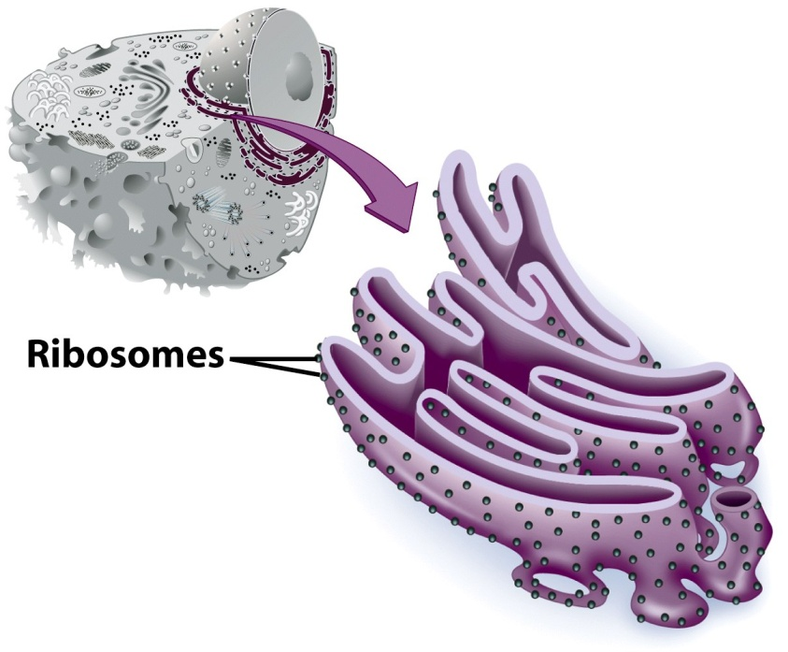
Rough Endoplasmic Reticulum
Ribosomes attached to surface
Manufacture protiens
Not all ribosomes attached to rough ER
May modify proteins from ribosomes

Slide 39
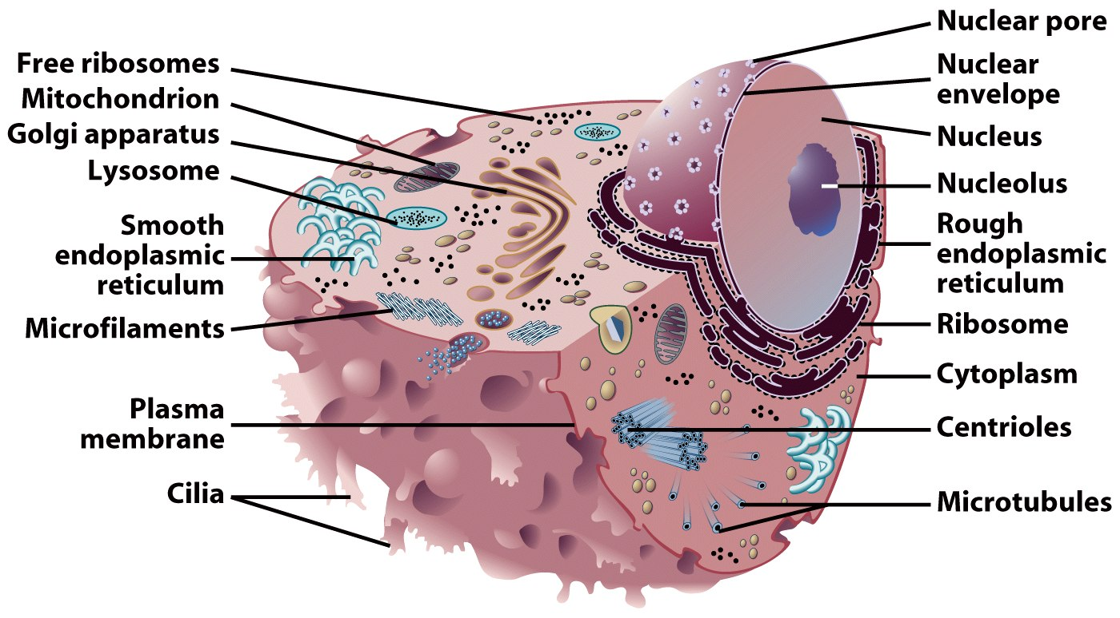
Smooth Endoplasmic Reticulum
No attached ribosomes
Has enzymes that help build molecules
Carbohydrates
Lipids

Slide 40
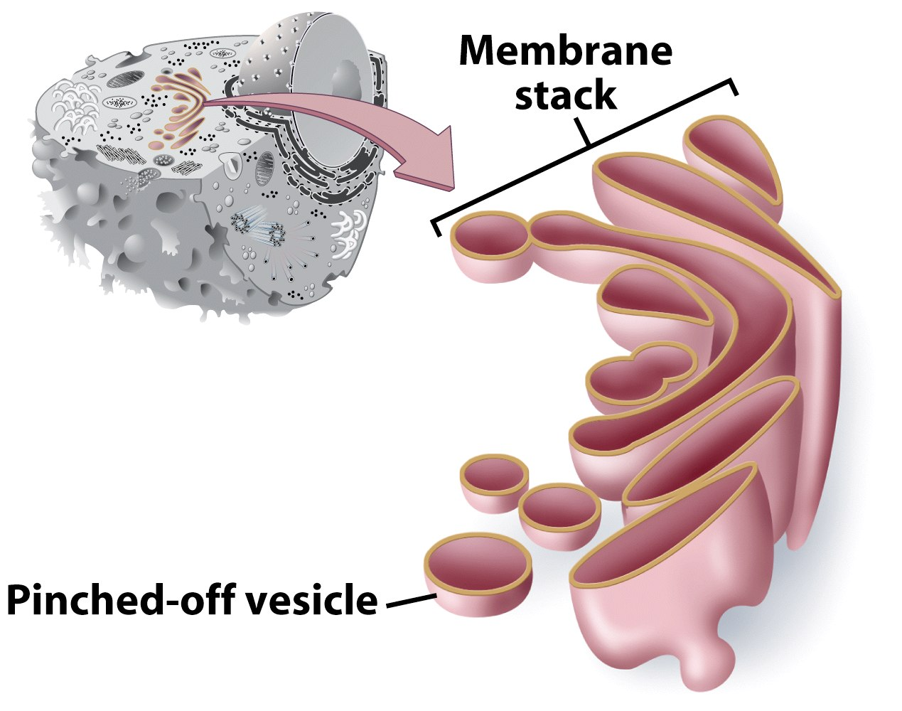
Golgi Apparatus
Involved in synthesis of plant cell wall
Packaging & shipping station of cell

Slide 41
Golgi Apparatus Function
1. Molecules come in vesicles
2. Vesicles fuse with Golgi membrane
3. Molecules may be modified by Golgi
4. Molecules pinched-off in separate vesicle
5. Vesicle leaves Golgi apparatus
6. Vesicles may combine with plasma membrane to secrete contents

Slide 42
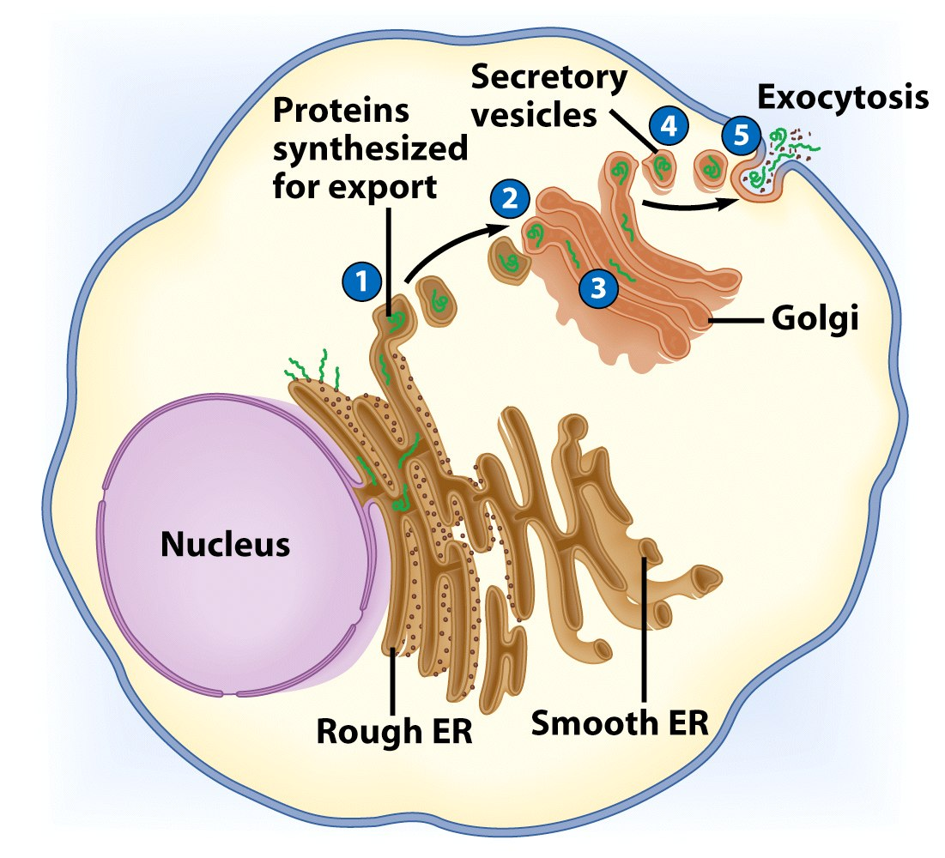

Slide 43
Lysosomes
Contain digestive enzymes
Functions
Aid in cell renewal
Break down old cell parts
Digests invaders
Vacuoles
Membrane bound storage sacs
More common in plants than animals
Contents
Water
Food
wastes

Slide 44
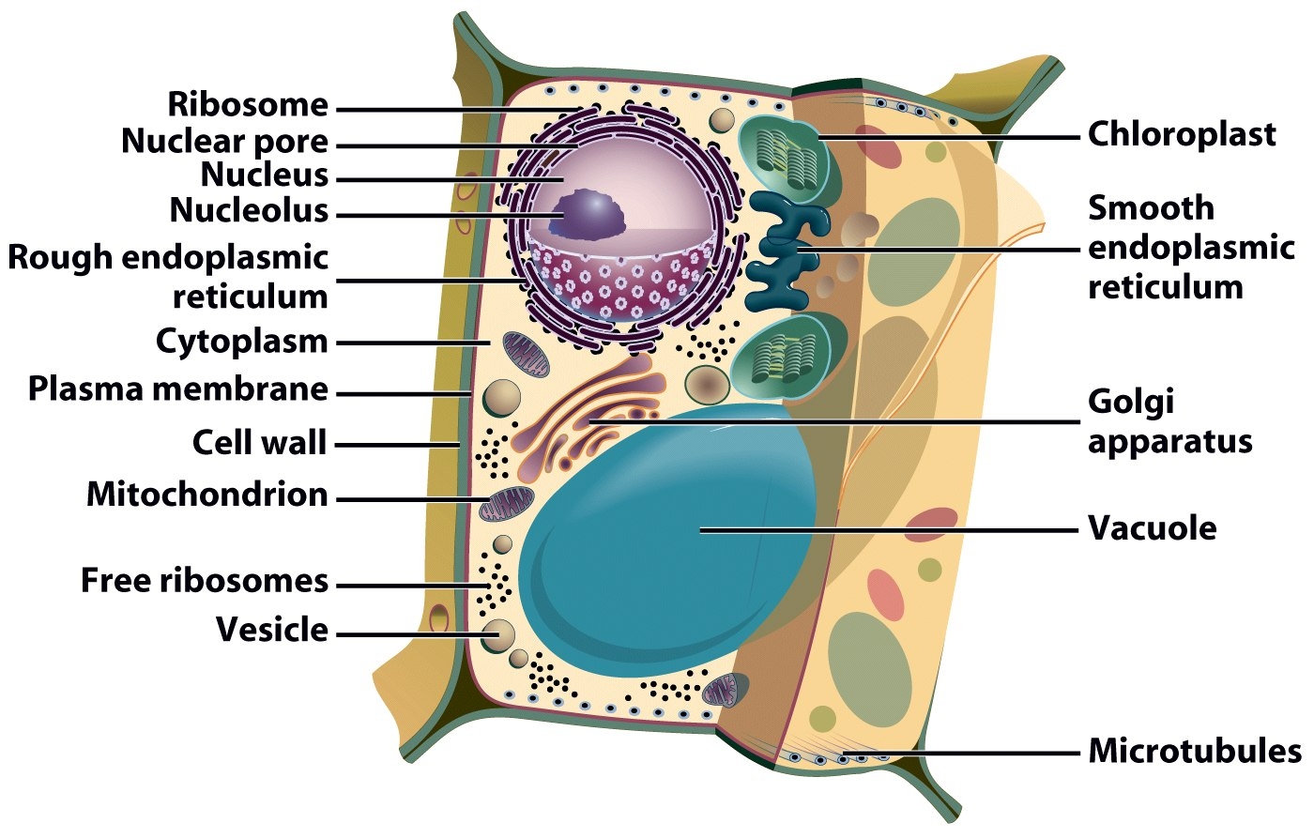
Bacteria-Like Organelles
Release & store energy
Types
Mitochondria
(release energy)
Chloroplasts
(store energy)

Slide 45
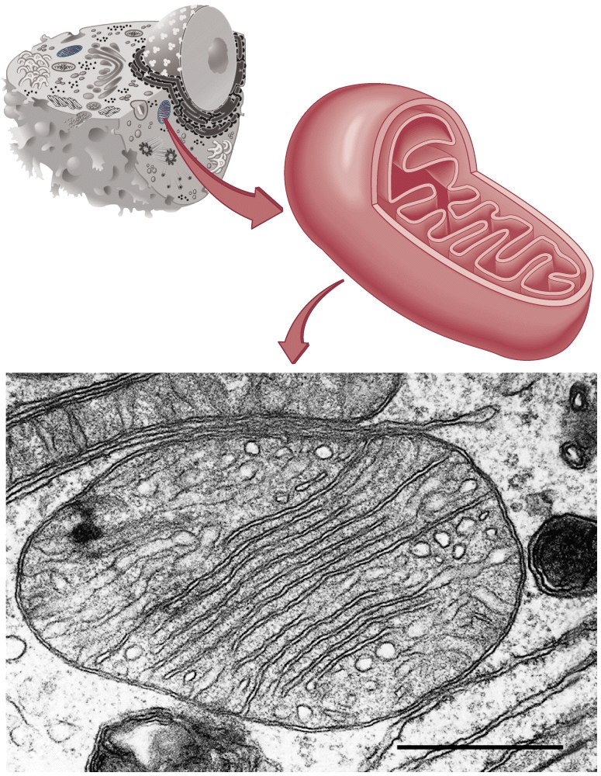
Mitochondria
Have their own DNA
Bound by double membrane
Break down fuel molecules (cellular respiration)
Glucose
Fatty acids
Release energy
ATP

Slide 46
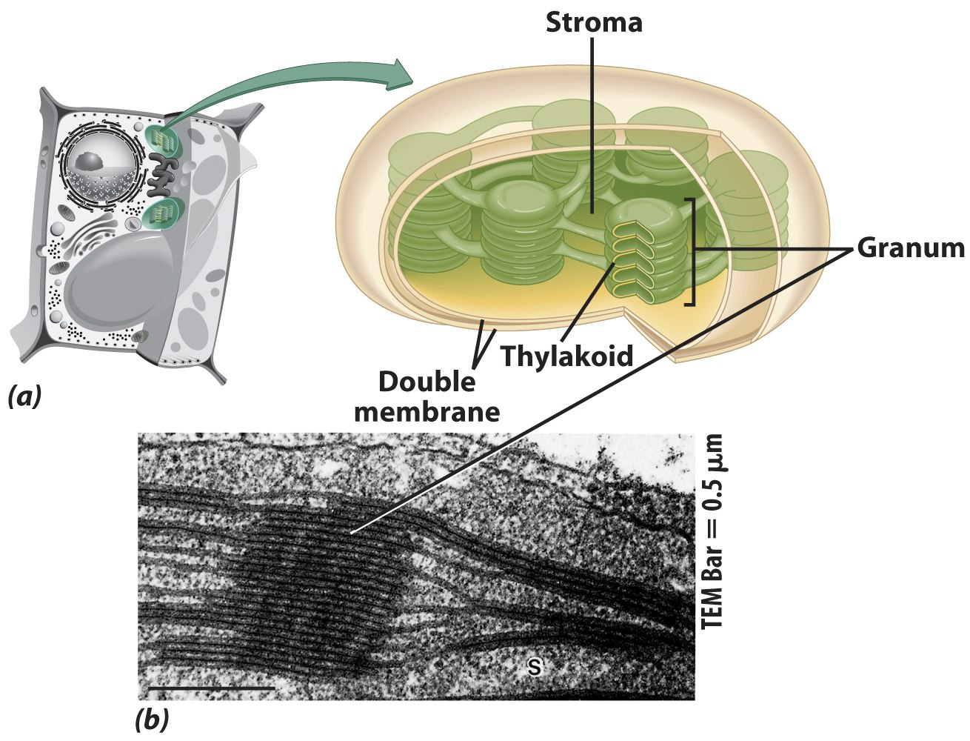
Chloroplasts
Derived form photosynthetic bacteria
Solar energy capturing organelle
Takes place in the chloroplast
Makes cellular food – glucose
photosynthesis
Takes place in the chloroplast
Makes cellular food – glucose

Slide 47
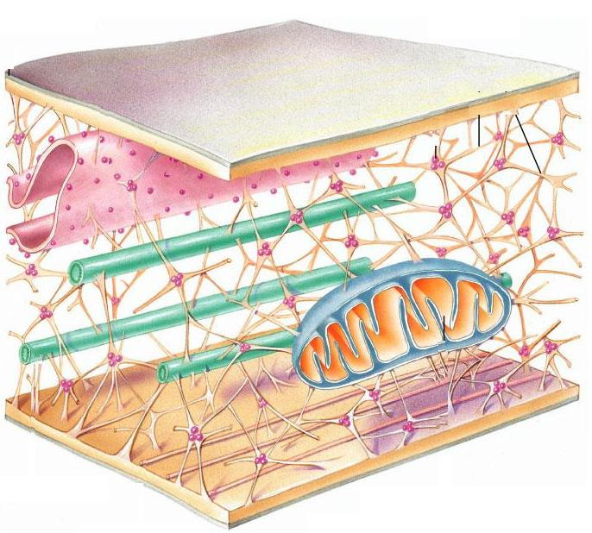
"free" ribosomes
ER
Plasma membrane
microtubule
mitochondrion
Intermediate filaments
microfilament

Slide 48
Review of Eukaryotic Cells

Slide 49
Review of Eukaryotic Cells

Slide 50
Molecule Movement & Cells
Passive Transport
Active Transport
Endocytosis-(phagocytosis & pinocytosis)
Exocytosis
Passive Transport
i.No energy required
ii.Move due to gradient
differences in concentration, pressure, charge
iii.Move to equalize gradient
High moves toward low

Slide 51
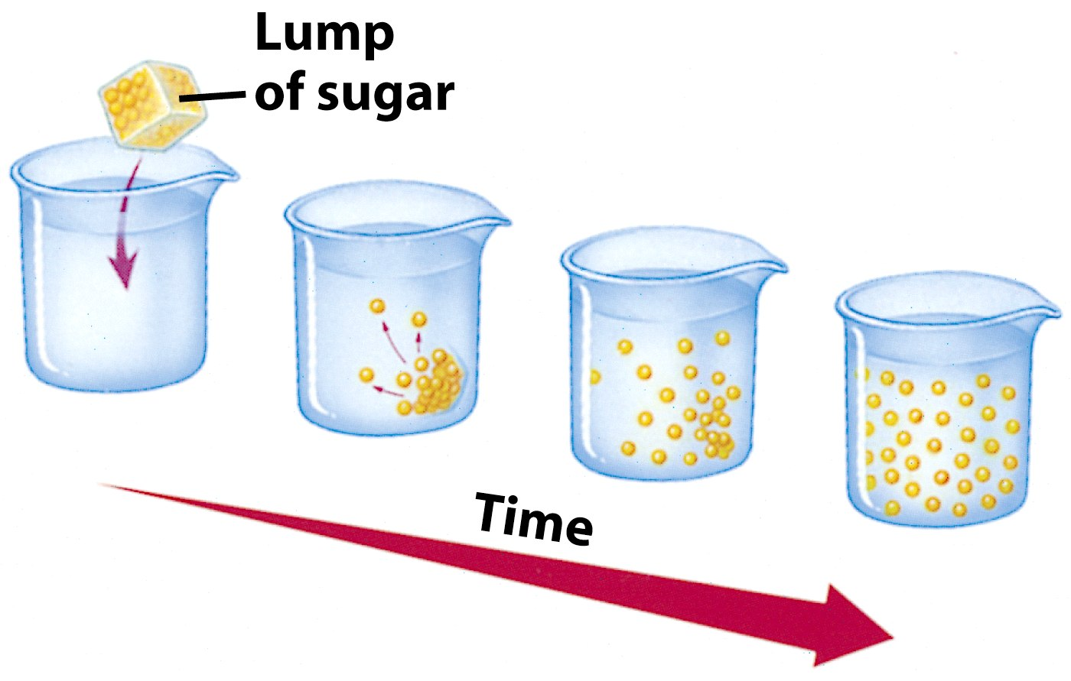
Types of Passive Transport
1. Diffusion
2. Osmosis
3. Facilitated diffusion
Diffusion
Molecules move to equalize concentration

Slide 52
Osmosis
Special form of diffusion
Fluid flows from lower solute concentration
Often involves movement of water
Into cell
Out of cell
solvent + solute = solution
Hypotonic
Solutes in cell more than outside
Outside solvent will flow into cell
Isotonic
-Solutes equal inside & out of cell
Hypertonic
-Solutes greater outside cell .Fluid will flow out of cell
Solution Differences & Cells

Slide 53
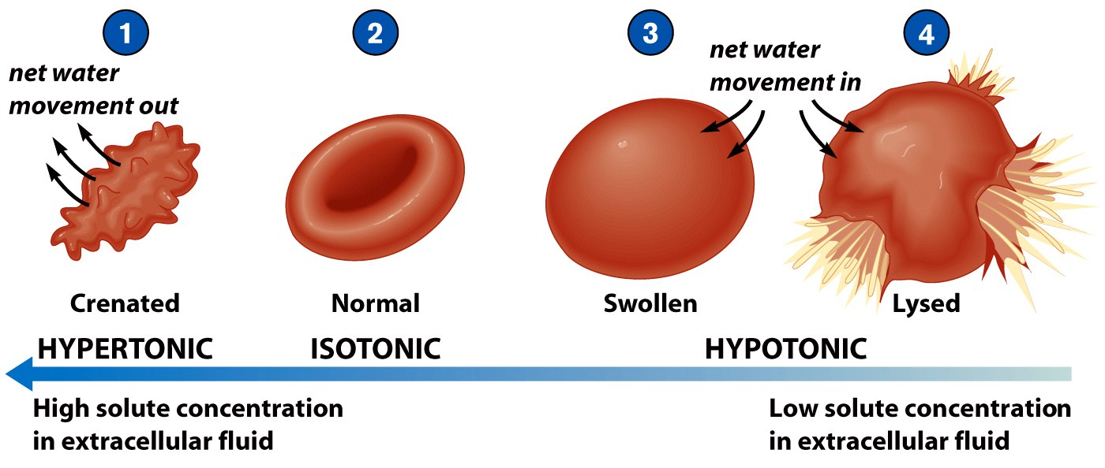
Types of Passive Transport
1. Diffusion
2. Osmosis
3. Facilitated diffusion

Slide 54
Facilitated Diffusion
Differentially permeable membrane
Channels (are specific) help molecule or ions enter or leave the cell
Channels usually are transport proteins (aquaporins facilitate the movement of water)
No energy is used
Process of Facilitated Transport
Protein binds with molecule
Shape of protein changes
Molecule moves across membrane (see diag. below)

Slide 55
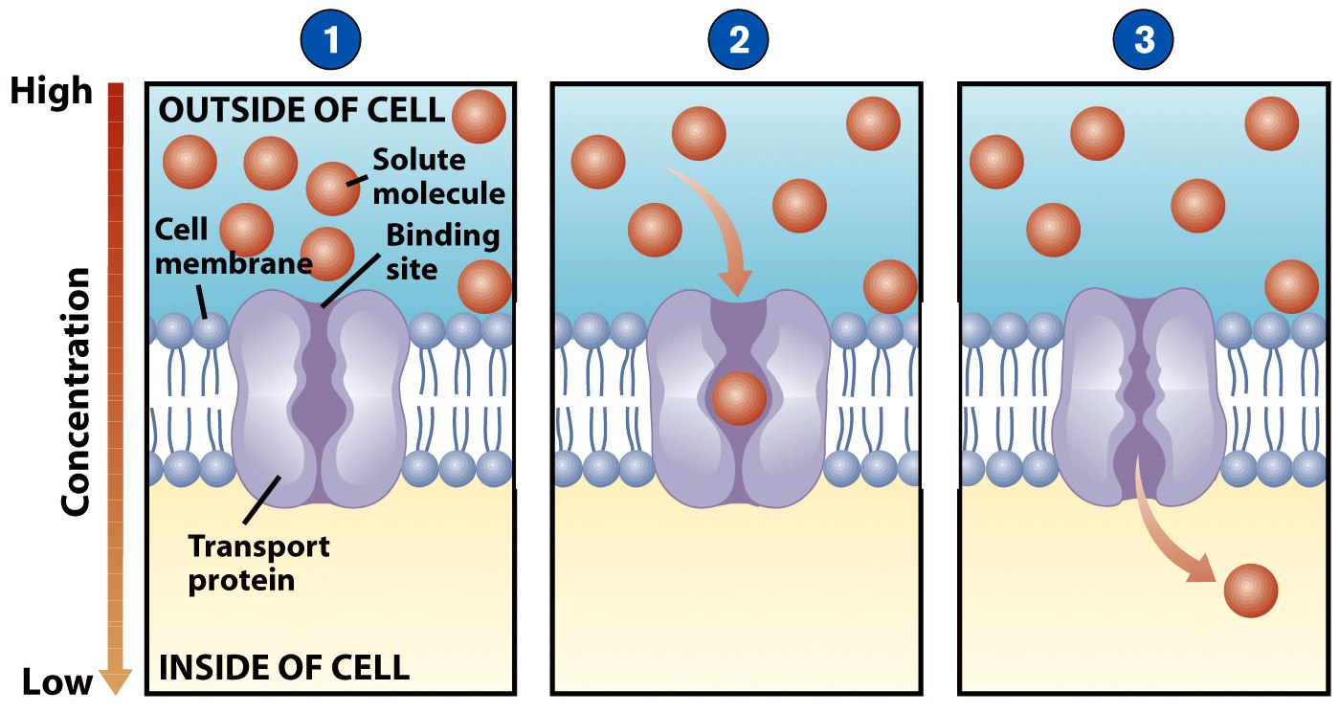

Slide 56
Active transport - movement of a substance from a lower concentration to a higher concentration using a carrier and energy
Endocytosis - brings substances into the cells
:solutes moving against concentration gradient
-Uses carrier proteins ,can be driven by ATP use or via energy stored in ionic concentration
Types :
Primary active transport
Secondary active transport
Endocytosis
Exocytosis
Transcytosis

Slide 57
Primary active transport
uses ATP and transporter proteins sodium potassium pump

Slide 58
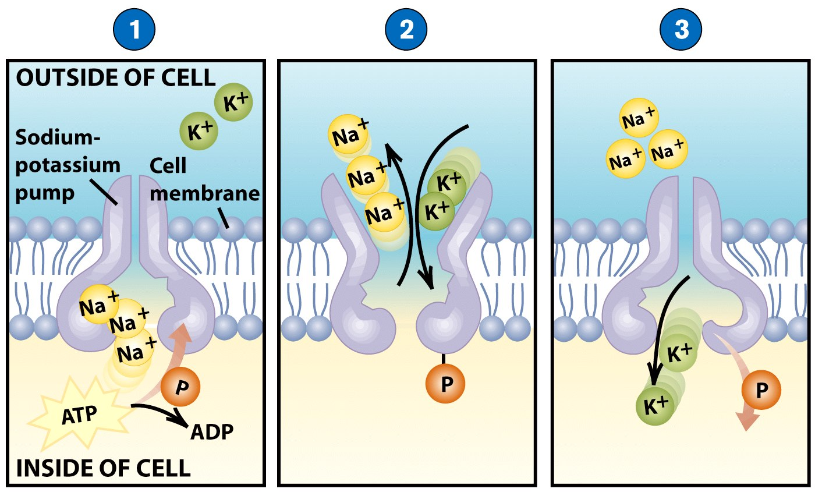
Active Transport
Molecular movement
Requires energy (against gradient)
Example is sodium-potassium pump

Slide 59
Endocytosis
Movement of large material
Particles
Organisms
Large molecules
Movement is into cells
Types of endocytosis
bulk-phase (nonspecific)
receptor-mediated (specific)
Process of Endocytosis
Plasma membrane surrounds material
Edges of membrane meet
Membranes fuse to form vesicle s

Slide 60
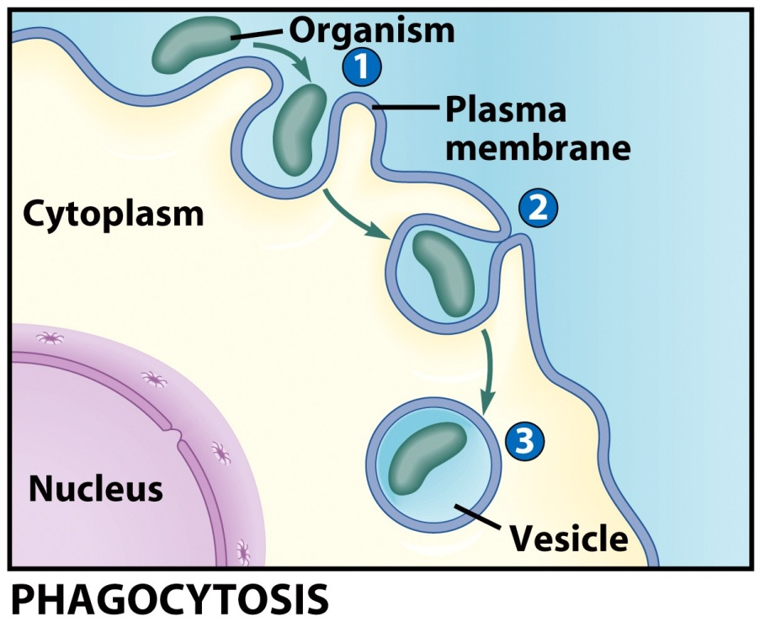
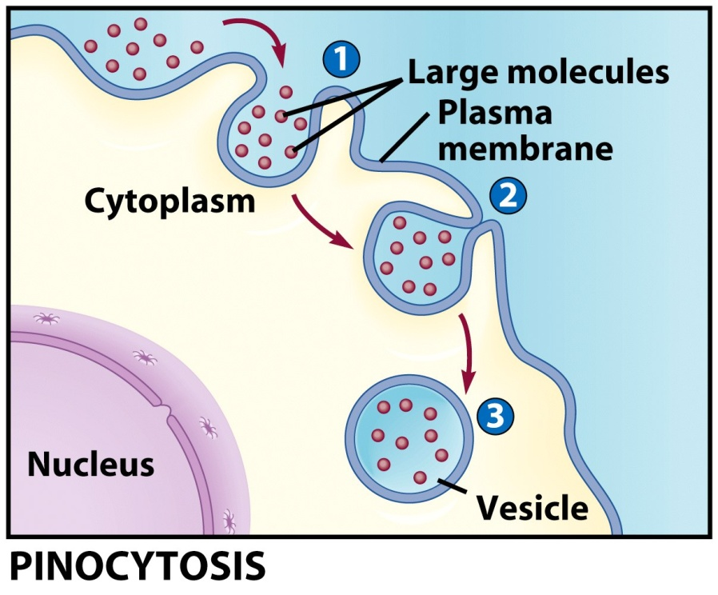

Slide 61
Endocytosis
Movement of large material
Particles
Organisms
Large molecules
Movement is into cells
Types of endocytosis
bulk-phase (nonspecific)
receptor-mediated (specific)

Slide 62
Process of Endocytosis
Plasma membrane surrounds material
Edges of membrane meet
Membranes fuse to form vesicle

Slide 63
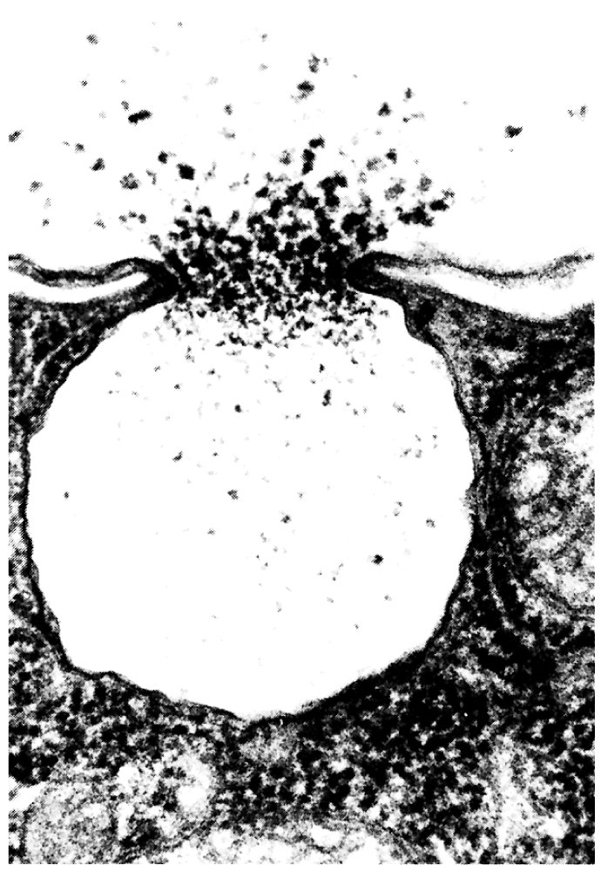
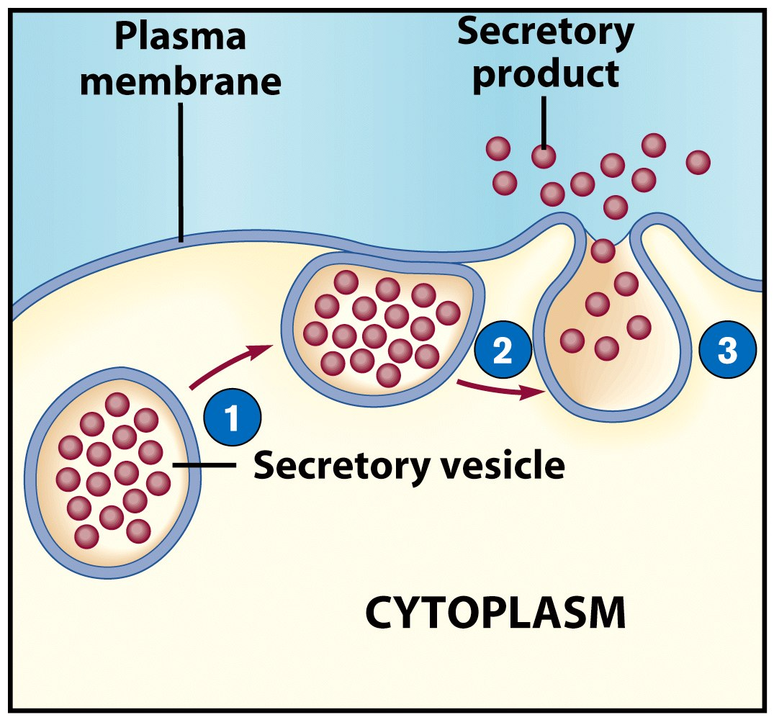
Exocytosis
Reverse of endocytosis
Cell discharges material

Slide 64
Exocytosis
Vesicle moves to cell surface
Membrane of vesicle fuses
Materials expelled

Slide 65
END
THANK YOU

