Slide 1
Cranial nerves
Like spinal nerves, cranial nerves are bundles of sensory or motor fibers that innervate muscles or glands; carry impulses from sensory receptors, or show a combination of these fiber types.
They are called cranial nerves because they emerge through foramina or fissures in the cranium and are covered by tubular sheaths derived from the cranial meninges.
There are twelve pairs of cranial nerves, which are numbered I to XII, from rostral to caudal, according to their attachment to the brain and penetration of the cranial dura. Their names reflect their general distribution or function.

Slide 2
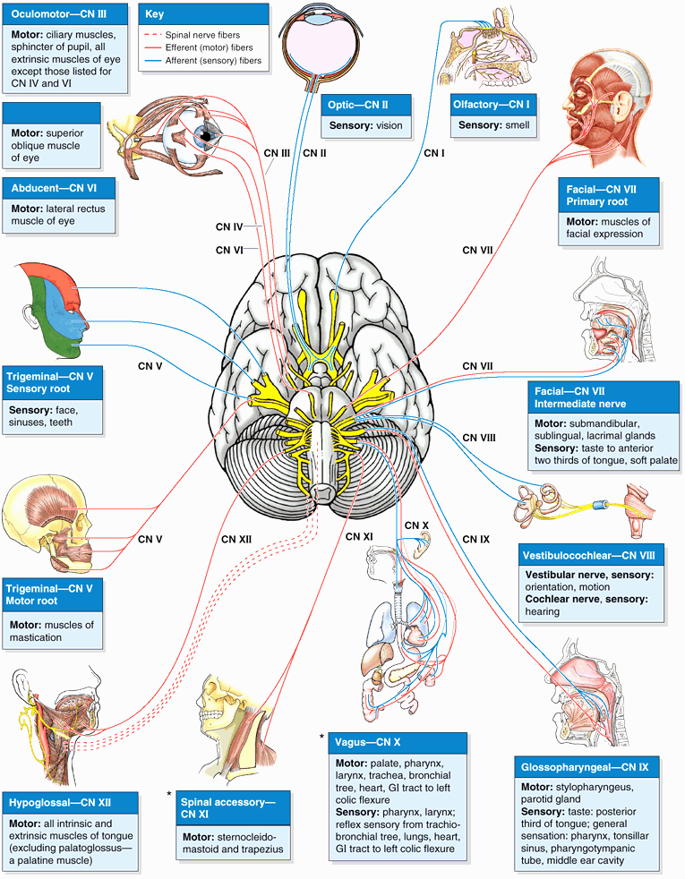
Cranial nerves

Slide 3
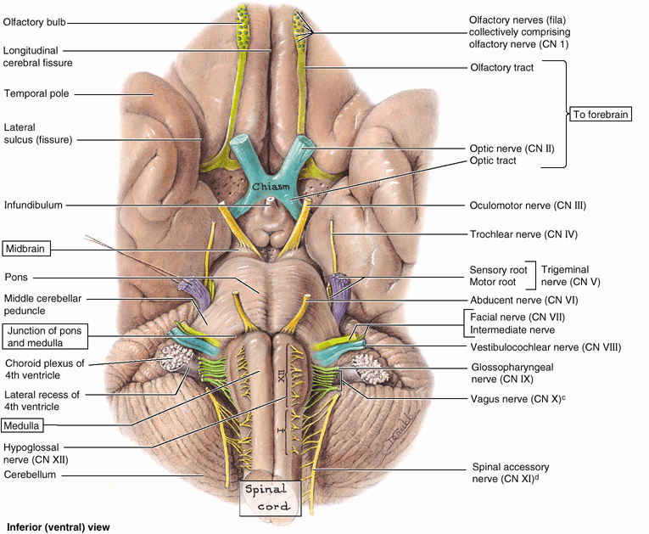
Cranial nerves

Slide 4
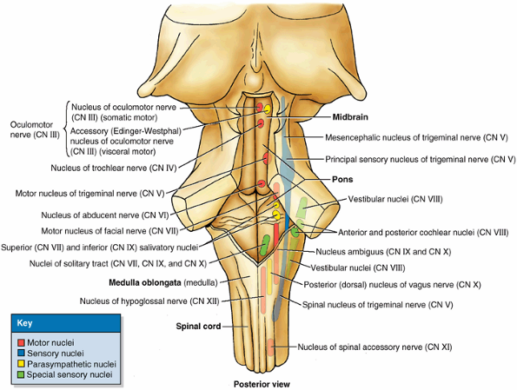
Cranial nerves

Slide 5
Classification of cranial nerves
They are classified into 3
Sensory nerves
olfactory nerve
Optic nerve
Vestibulocochlear nerve
2.Motor cranial nerves
Occulomotor nerve
Trochlear nerve
Abduces nerve
Accessory nerve
Hypoglossal nerve
3.Mixed cranial nerves
Trigeminal nerve
Facial nerve
Glossopharyngeal nerve
Vagus nerve

Slide 6
Cranial nerves
Olfactory Nerve (CN I)
Function: Special sensory (special visceral afferent) that is, the special sense of smell. Olfaction is the sensation of odors that results from the detection of odorous substances aerosolized in the environment (The cell bodies of olfactory receptor neurons are located in the olfactory organ (the olfactory part of the nasal mucosa or olfactory area), which is located in the roof of the nasal cavity and along the nasal septum and medial wall of the superior nasal concha. Olfactory receptor neurons are both receptors and conductors. The apical surfaces of the neurons possess fine olfactory cilia, bathed by a film of watery mucus secreted by the olfactory glands of the epithelium. The cilia are stimulated by molecules of an odiferous gas dissolved in the fluid.

Slide 7
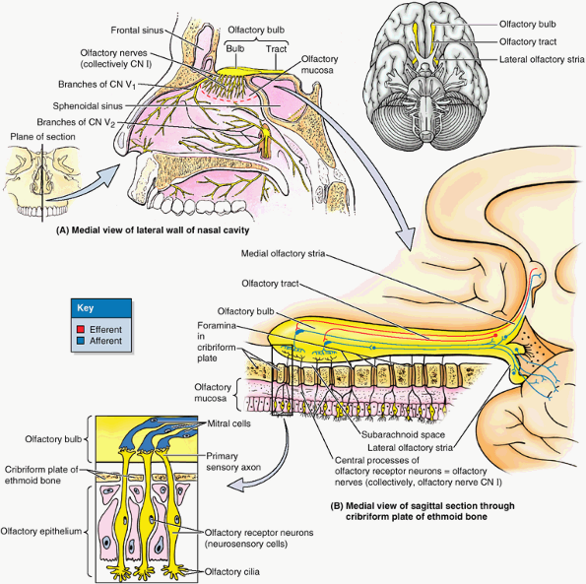
Cranial nerves

Slide 8
Cranial nerves
Optic Nerve (CN II)
Function: Special sensory (special somatic afferent) that is, the special sense of vision.
Although they are officially nerves by convention, the optic nerves (CN II) develop in a completely different manner from the other cranial nerves. The structures involved in receiving and transmitting optical stimuli (the optical fibers and neural retina, together with the pigmented epithelium of the eyeball) develop as evaginations of the diencephalon (The optic nerves are paired, anterior extensions of the forebrain (diencephalon) and are, therefore, actually CNS fiber tracts formed by axons of retinal ganglion cells. In other words, they are third-order neurons, with their cell bodies located in the retina.
The nerve passes posteromedially in the orbit, exiting through the optic canal to enter the middle cranial fossa, where it forms the optic chiasm (L. chiasma opticum). Here, fibers from the nasal (medial) half of each retina decussate in the chiasm and join uncrossed fibers from the temporal (lateral) half of the retina to form the optic tract. The partial crossing of optic nerve fibers in the chiasm is a requirement for binocular vision, allowing depth-of-field perception (three-dimensional vision). Thus fibers from the right halves of both retinas form the left optic tract. The decussation of nerve fibers in the chiasm results in the right optic tract conveying impulses from the left visual field and vice versa. The visual field is what is seen by a person who has both eyes wide open and who is looking straight ahead Most fibers in the optic tracts terminate in the lateral geniculate bodies of the thalamus. From these nuclei, axons are relayed to the visual cortices of the occipital lobes of the brain.

Slide 9
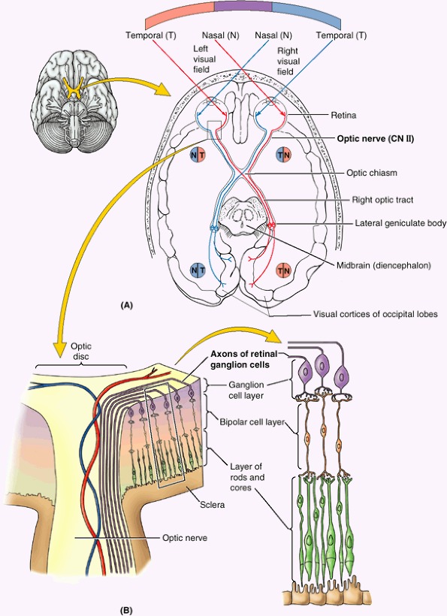
Cranial nerves

Slide 10
Cranial nerves
Oculomotor Nerve (CN III)
Functions: Somatic motor (general somatic efferent) and visceral motor (general visceral efferent parasympathetic).
Nuclei: There are two oculomotor nuclei, each serving one of the functional components of the nerve. The somatic motor nucleus of the oculomotor nerve is in the midbrain. The visceral motor (parasympathetic) accessory (Edinger-Westphal) nucleus of the oculomotor nerve lies dorsal to the rostral two thirds of the somatic motor nucleus (The oculomotor nerve (CN III) provides the following:
Motor to the striated muscle of four of the six extraocular muscles (superior, medial, and inferior recti and inferior oblique) and superior eyelid (L. levator palpebrae superioris); hence the nerve's name.
Proprioceptive to the muscles listed above.
Parasympathetic through the ciliary ganglion to the smooth muscle of the sphincter of the pupil (L. sphincter pupillae), which causes constriction of the pupil and ciliary body, which produces accommodation (allowing the lens to become more rounded) for near vision.
CN III is the chief motor nerve to the ocular and extraocular muscles. It emerges from the midbrain, pierces the dura lateral to the sellar diaphragm roofing over the hypophysis, and then runs through the roof and lateral wall of the cavernous sinus.
CN III leaves the cranial cavity and enters the orbit through the superior orbital fissure. Within this fissure, CN III divides into a superior division (which supplies the superior rectus and levator palpebrae superioris) and an inferior division (which supplies the inferior and medial rectus and inferior oblique). The inferior division also carries presynaptic parasympathetic (visceral efferent) fibers to the ciliary ganglion, where they synapse. Postsynaptic fibers from this ganglion pass to the eyeball in the short ciliary nerves to innervate the ciliary body and sphincter of the pupil.

Slide 11
Cranial nerves
Trochlear Nerve (CN IV)
Functions: Somatic motor (general somatic efferent) and proprioceptive to one extraocular muscle (superior oblique).
Nucleus: The nucleus of the trochlear nerve is located in the midbrain, immediately caudal to the oculomotor nucleus.
The trochlear nerve (CN IV) is the smallest cranial nerve. It emerges from the posterior surface of the midbrain (the only cranial nerve to do so), passing anteriorly around the brainstem, running the longest intracranial (subarachnoid) course of the cranial nerves. It pierces the dura mater at the margin of the cerebellar tentorium (L. tentorium cerebelli) and passes anteriorly in the lateral wall of the cavernous sinus.
CN IV continues past the sinus to pass through the superior orbital fissure into the orbit, where it supplies the superior oblique the only extraocular muscle that uses a pulley, or trochlea, to redirect its line of action (hence the nerve's name).

Slide 12
Cranial nerves
Abducent Nerve (CN VI)
Functions: Somatic motor (general somatic efferent and proprioceptive) to one extraocular muscle (lateral rectus).
Nucleus: The abducent (L. abducens) nucleus is in the pons near the median plane.
The abducent nerves (CN VI) emerge from the brainstem between the pons and the medulla and traverse the pontine cistern of the subarachnoid space, straddling the basilar artery. Each abducent nerve then pierces the dura to run the longest intradural course within the cranial cavity of the cranial nerves that is, its point of entry into the dura covering the clivus is the most distant from its exit from the cranium via the superior orbital fissure.
During its intradural course, it bends sharply over the crest of the petrous part of the temporal bone and then courses through the cavernous sinus, surrounded by the venous blood in the same manner as the internal carotid artery, which it parallels in the sinus.
CN VI traverses the common tendinous ring (L. anulus tendineus communis) as it enters the orbit (see Chapter 7), running on and penetrating the medial surface of the lateral rectus, which abducts the eye (this function being the basis for the name of the nerve).

Slide 13
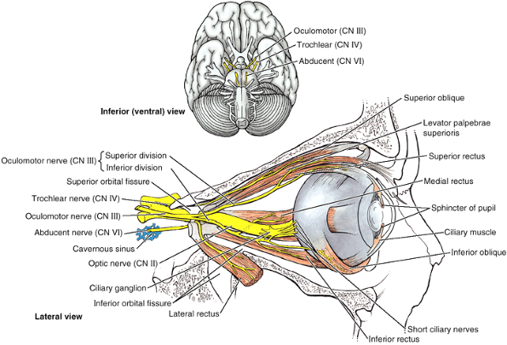
Cranial nerves

Slide 14
Cranial nerves
Trigeminal Nerve (CN V)
Functions: General sensory (general somatic afferent) and branchial motor (special visceral efferent) to derivatives of the 1st pharyngeal arch.
Nuclei: There are four trigeminal nuclei one motor and three sensory.
The trigeminal nerve (CN V) is the largest cranial nerve.
It emerges from the lateral aspect of the pons by a large sensory root and a small motor root. The roots of CN V are comparable to the posterior and anterior roots of spinal nerves.
CN V is the principal general sensory nerve for the head (face, teeth, mouth, nasal cavity, and dura of the cranial cavity). The large sensory root of CN V is composed mainly of the central processes of the pseudounipolar neurons that make up the trigeminal ganglion. The trigeminal ganglion is flattened and crescent shaped (hence its unofficial name, semilunar ganglion) and is housed within a dural recess (trigeminal cave) lateral to the cavernous sinus. The peripheral processes of the ganglionic neurons form three nerves or divisions:
ophthalmic nerve (CN V1), maxillary nerve (CN V2), and sensory component of the mandibular nerve (CN V3). Maps of the zones of cutaneous innervation by the three divisions resemble the dermatome maps for cutaneous innervation by spinal nerves. Unlike dermatomes, however, there is little overlap in innervation by the divisions; lesions of a single nerve result in clearly demarcated areas of numbness.
The fibers of the motor root of CN V pass inferior to the trigeminal ganglion along the floor of the trigeminal cave, bypassing the ganglion just as the anterior roots of spinal nerves bypass the spinal sensory ganglia. They are distributed exclusively via the mandibular nerve (CN V3), blending with the sensory fibers as the nerve traverses the foramen ovale in the cranium; entering branches pass to the muscles of mastication, mylohyoid, anterior belly of the digastric, tensor veli palatini, and tensor tympani, which are derived from the 1st pharyngeal arch.
Although CN V conveys no presynaptic parasympathetic (visceral efferent) fibers from the CNS, all four parasympathetic ganglia are associated with the divisions of CN V. Postsynaptic parasympathetic fibers from the ganglia join branches of CN V and are carried to their destinations along with the CN V sensory and motor fibers.

Slide 15
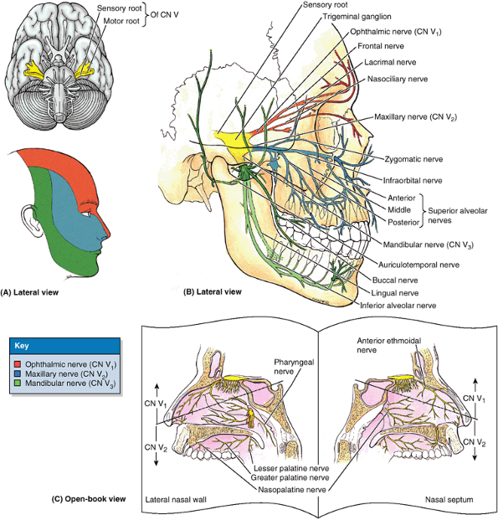
Cranial nerves

Slide 16
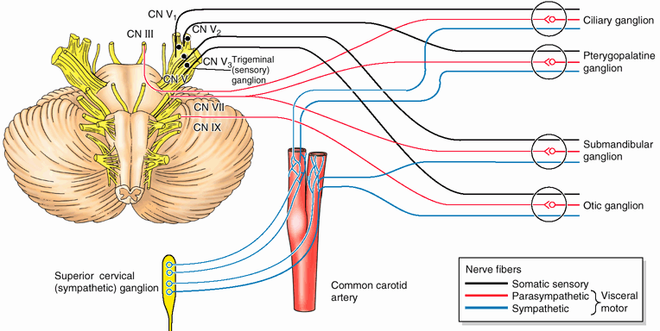
Cranial nerves

Slide 17
Cranial nerves
Facial Nerve (CN VII)
Functions: Sensory (special visceral afferent and general somatic afferent), motor (branchial motor or special visceral efferent), and parasympathetic (general visceral efferent). It also carries proprioceptive fibers from the muscles it innervates.
Nuclei: The motor nucleus of the facial nerve is a branchiomotor nucleus in the ventrolateral part of the pons. The cell bodies of the primary sensory neurons are in the geniculate ganglion. The central processes of those concerned with taste end in the nuclei of the solitary tract in the medulla. The processes of those concerned with general sensations (pain, touch, and thermal) from around the external ear end in the spinal nucleus of the trigeminal nerve.
The facial nerve (CN VII) emerges from the junction of the pons and medulla as two divisions, the motor root and the intermediate nerve. The larger motor root (facial nerve proper) innervates the muscles of facial expression, and the smaller intermediate nerve (L. nervus intermedius) carries taste, parasympathetic, and somatic sensory fibers. During its course, CN VII traverses the posterior cranial fossa, internal acoustic meatus, facial canal, stylomastoid foramen of the temporal bone, and parotid gland. After traversing the internal acoustic meatus, the nerve proceeds a short distance anteriorly within the temporal bone and then turns abruptly posteriorly to course along the medial wall of the tympanic cavity. The sharp bend is the geniculum of the facial nerve (L. genu, knee), sometimes called the external genu of CN VII, the site of the geniculate ganglion (sensory ganglion of CN VII). While traversing the temporal bone within the facial canal, CN VII gives rise to the: Greater petrosal nerve. Nerve to the stapedius. Chorda tympani nerve.
Then, after running the longest intraosseous course of any cranial nerve, CN VII emerges from the cranium via the stylomastoid foramen; gives off the posterior auricular branch; enters the parotid gland; and forms the parotid plexus, which gives rise to the following five terminal motor branches: temporal, zygomatic, buccal, marginal mandibular, and cervical.
Branchial Motor As the nerve of the 2nd pharyngeal arch, the facial nerve supplies striated muscles derived from its mesoderm, mainly the muscles of facial expression and auricular muscles. It also supplies the posterior bellies of the digastric, stylohyoid, and stapedius muscles.
Presynaptic Parasympathetic
CN VII provides presynaptic parasympathetic fibers to the pterygopalatine ganglion for innervation of the lacrimal mucous glands and to the submandibular ganglion for innervation of the sublingual and submandibular salivary glands. The pterygopalatine ganglion is associated with the maxillary nerve (CN V2), which distributes its postsynaptic fibers, whereas the submandibular ganglion is associated with the mandibular nerve (CN V3). Parasympathetic fibers synapse in these ganglia, whereas sympathetic and other fibers pass through them.
General Sensory Some fibers from the geniculate ganglion supply a small area of the skin of the concha of the auricle, close to external acoustic meatus.
Taste (Special Sensory) Fibers carried by the chorda tympani join the lingual nerve to convey taste sensation from the anterior two thirds of the tongue and soft palate.

Slide 18
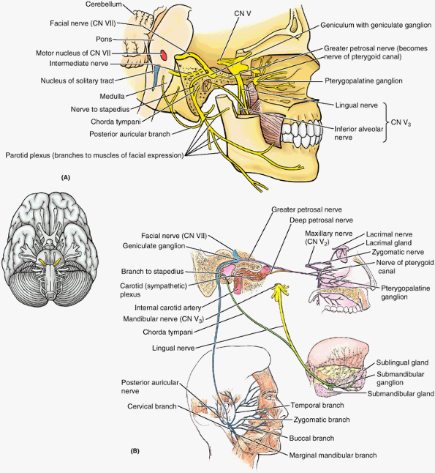
Cranial nerves

Slide 19
Cranial nerves
Vestibulocochlear Nerve (CN VIII)
Functions: Special sensory (special somatic afferent) that is, special sensations of hearing and equilibrium.
Nuclei: Four vestibular nuclei are located at the junction of the pons and medulla in the lateral part of the floor of the 4th ventricle; two cochlear nuclei are in the medulla.
The vestibulocochlear nerve (CN VIII) emerges from the junction of the pons and medulla and enters the internal acoustic meatus. Here it separates into the vestibular and cochlear nerves.
The vestibular nerve is concerned with equilibrium. It is composed of the central processes of bipolar neurons in the vestibular ganglion; the peripheral processes of the neurons extend to the maculae of the utricle and saccule (sensitive to the line of linear acceleration relative to the position of the head) and to the ampullae of the semicircular ducts (sensitive to rotational acceleration).
The cochlear nerve is concerned with hearing. It is composed of the central processes of bipolar neurons in the spinal ganglion; the peripheral processes of the neurons extend to the spiral organ.

Slide 20
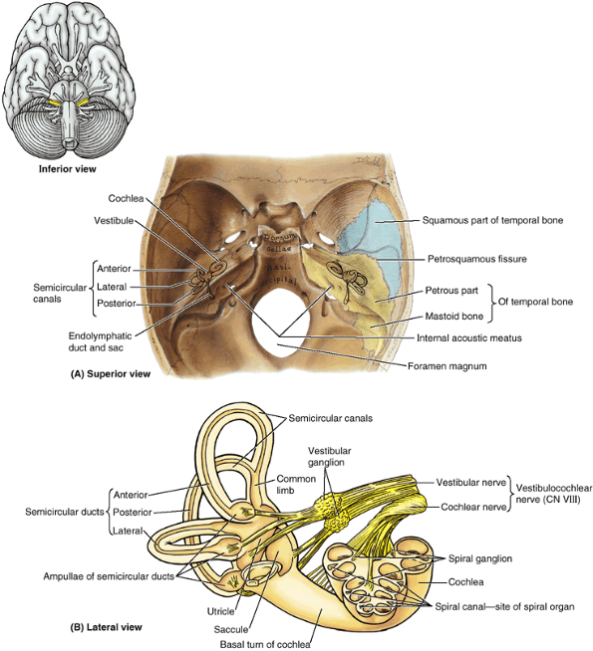
Cranial nerves

Slide 21
Cranial nerves
Glossopharyngeal Nerve (CN IX)
Functions: Sensory (general somatic afferent, special visceral afferent, general visceral afferent), motor (special visceral efferent), and parasympathetic (general visceral efferent) for derivatives of the 3rd pharyngeal arch.
Nuclei: Four nuclei in the medulla send or receive fibers via CN IX: two motor and two sensory. Three of these nuclei are shared with CN X.
The glossopharyngeal nerve (CN IX) emerges from the lateral aspect of the medulla and passes anterolaterally to leave the cranium through the anterior aspect of the jugular. At this foramen are superior and inferior (sensory) ganglia, which contain the pseudounipolar cell bodies for the afferent components of the nerve. CN IX follows the stylopharyngeus, the only muscle the nerve supplies, and passes between the superior and the middle constrictor muscles of the pharynx to reach the oropharynx and tongue. It contributes sensory fibers to the pharyngeal plexus of nerves.
CN IX is afferent from the tongue and pharynx (hence its name) and efferent to the stylopharyngeus and parotid gland.
Branchial Motor Motor fibers pass to one muscle, the stylopharyngeus, derived from the 3rd pharyngeal arch.
Parasympathetic (Visceral Motor)
Following a circuitous route initially involving the tympanic nerve, presynaptic parasympathetic fibers are provided to the otic ganglion for innervation of the parotid gland. The otic ganglion is associated with the mandibular nerve (CN V3), branches of which convey the postsynaptic parasympathetic fibers to the parotid gland .
Sensory (General Sensory)
The general sensory branches of CN IX are as follows : The tympanic nerve. The carotid sinus nerve to the carotid sinus, a baro- (presso) receptor sensitive to changes in blood pressure, and the carotid body, a chemoreceptor sensitive to blood gas (oxygen and carbon dioxide levels).
The pharyngeal, tonsillar, and lingual nerves to the mucosa of the oropharynx and isthmus of the fauces (L. throat), including palatine tonsil, soft palate, and posterior third of the tongue. In addition to general sensation (touch, pain, temperature), tactile (actual or threatened) stimuli determined to be unusual or unpleasant here may evoke the gag reflex or even vomiting.
Taste (Special Sensory) Taste fibers are conveyed from the posterior third of the tongue to the sensory ganglia.

Slide 22
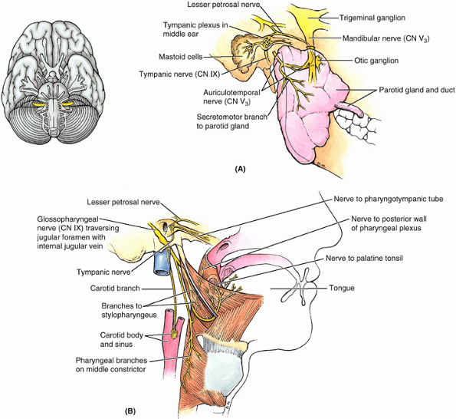
Cranial nerves

Slide 23
Cranial nerves
Vagus Nerve (CN X)
Functions: Sensory (general somatic afferent, special visceral afferent, general visceral afferent), motor (special visceral efferent), and parasympathetic (general visceral efferent).
Sensory from the inferior pharynx, larynx, and thoracic and abdominal organs.
Sense of taste from the root of the tongue and taste buds on the epiglottis. Branches of the internal laryngeal nerve (a branch of CN X) supply a small area, mostly general but some special sensation; most general and special sensation to the root is supplied by CN IX.
Motor to the soft palate; pharynx; intrinsic laryngeal muscles (phonation); and a nominal extrinsic tongue muscle, the palatoglossus, which is actually a palatine muscle based on its derivation and innervation.
Proprioceptive to the muscles listed above.
Parasympathetic to thoracic and abdominal viscera.
Nuclei: Four nuclei of CN X in the medulla send or receive fibers via CN IX two motor and two sensory. Three of these nuclei are shared with CN IX.
The vagus nerve (CN X) has the longest course and most extensive distribution of all the cranial nerves, most of which is outside of (inferior to) the head. The term vagus is derived from the Latin word vagari meaning wandering. CN X was so called because of its extensive distribution. It arises by a series of rootlets from the lateral aspect of the medulla that merge and leave the cranium through the jugular foramen positioned between CN IX and CN XI.
What was formerly called the cranial root of the accessory nerve is actually a part of CN X.
CN X has a superior ganglion in the jugular foramen that is mainly concerned with the general sensory component of the nerve. Inferior to the foramen is an inferior ganglion (nodose ganglion) concerned with the visceral sensory components of the nerve. In the region of the superior ganglion are connections to CN IX and the superior cervical (sympathetic) ganglion. CN X continues inferiorly in the carotid sheath to the root of the neck, supplying branches to the palate, pharynx, and .
The course of CN X in the thorax differs on the two sides, a consequence of rotation of the midgut during development. CN X supplies branches to the heart, bronchi, and lungs. The vagi join the esophageal plexus surrounding the esophagus, which is formed by branches of the vagi and sympathetic trunks. This plexus follows the esophagus through the diaphragm into the abdomen, where the anterior and posterior vagal trunks break up into branches that innervate the esophagus, stomach, and intestinal tract as far as the left colic flexure.

Slide 24
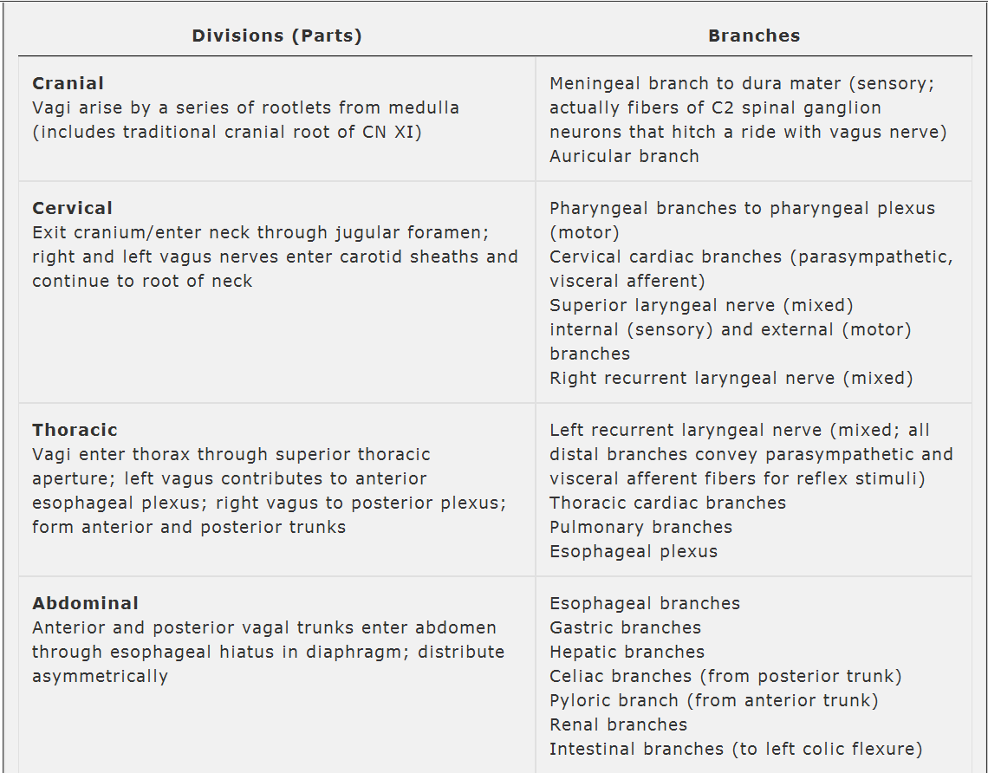
Cranial nerves

Slide 25
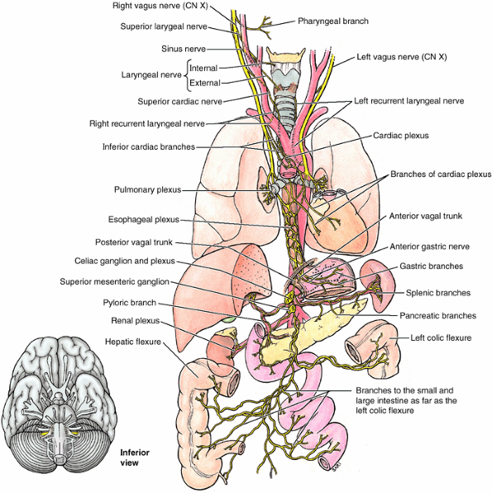
Cranial nerves

Slide 26
Cranial nerves
Spinal Accessory Nerve (CN XI)
Functions: Motor to the striated sternocleidomastoid and trapezius muscles.
Nuclei: The spinal accessory nerve arises from the nucleus of the accessory nerve, a column of anterior horn motor neurons in the superior five or six cervical segments of the spinal cord .

Slide 27
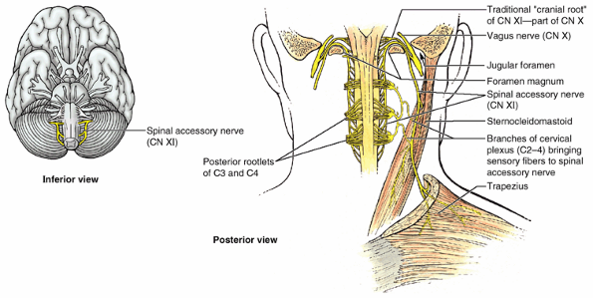
Cranial nerves

Slide 28
Cranial nerves
Hypoglossal Nerve (CN XII)
Functions: Motor (general somatic efferent) to the intrinsic and extrinsic muscles of the tongue (G. glossa) styloglossus, hyoglossus, and genioglossus.
The hypoglossal nerve (CN XII) arises as a purely motor nerve by several rootlets from the medulla and leaves the cranium through the hypoglossal canal. After exiting the cranial cavity, CN XII is joined by a branch or branches of the cervical plexus conveying general somatic motor fibers from C1 and C2 spinal nerves and general somatic sensory fibers from the spinal ganglion of C2. These spinal nerve fibers hitch a ride with CN XII to reach the hyoid muscles, with some of the sensory fibers passing retrograde along it to reach the dura mater of the posterior cranial fossa. CN XII passes inferiorly medial to the angle of the mandible and then curves anteriorly to enter the tongue.
CN XII ends in many branches that supply all the extrinsic muscles of the tongue, except the palatoglossus (which is actually a palatine muscle). CN XII has the following branches:
A meningeal branch returns to the cranium through the hypoglossal canal and innervates the dura mater on the floor and posterior wall of the posterior cranial fossa. The nerve fibers conveyed are from the sensory spinal ganglion of spinal nerve C2 and are not hypoglossal fibers.
The superior root of the ansa cervicalis branches from CN XII to supply the infrahyoid muscles (sternohyoid, sternothyroid, and omohyoid). This branch actually conveys only fibers from the cervical plexus (the loop between the anterior rami of C1 and C2) that joined the nerve outside the cranial cavity, not hypoglossal fibers. Some fibers continue past the descending branch to reach the thyrohyoid muscle.
Terminal lingual branches supply the styloglossus, hyoglossus, genioglossus, and intrinsic muscles of the tongue.

Slide 29
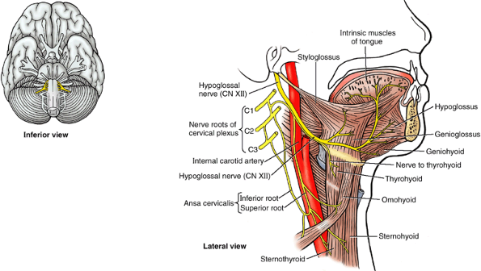
Cranial nerves

