Slide 1
DEVELOPMENT OF BODY CAVITIES, BODY WALL AND THORACIC DIAPHRAGM
Prof Peter Gichangi
March 2016

Slide 2
OBJECTIVES
Understand development of body cavities, body wall and thoracic diaphragm
To describe the separation of the abdominal and thoracic cavities and development of the diaphragm
List congenital malformations associated with development of these parts

Slide 3
Body Cavities and Membranes (1)
Dorsal body cavity
  Cranial cavity
  Vertebral cavity
Ventral body cavity
  Thoracic cavity – divided into three parts
    Two lateral parts each containing a lung surrounded by a pleural cavity
    Mediastinum – contains the heart surrounded by the pericardial sac
  Abdominopelvic cavity – divided into two parts
    Abdominal cavity – contains the liver, stomach, kidneys, and other organs
    Pelvic cavity – contains the bladder, some reproductive organs, and rectum

Slide 4
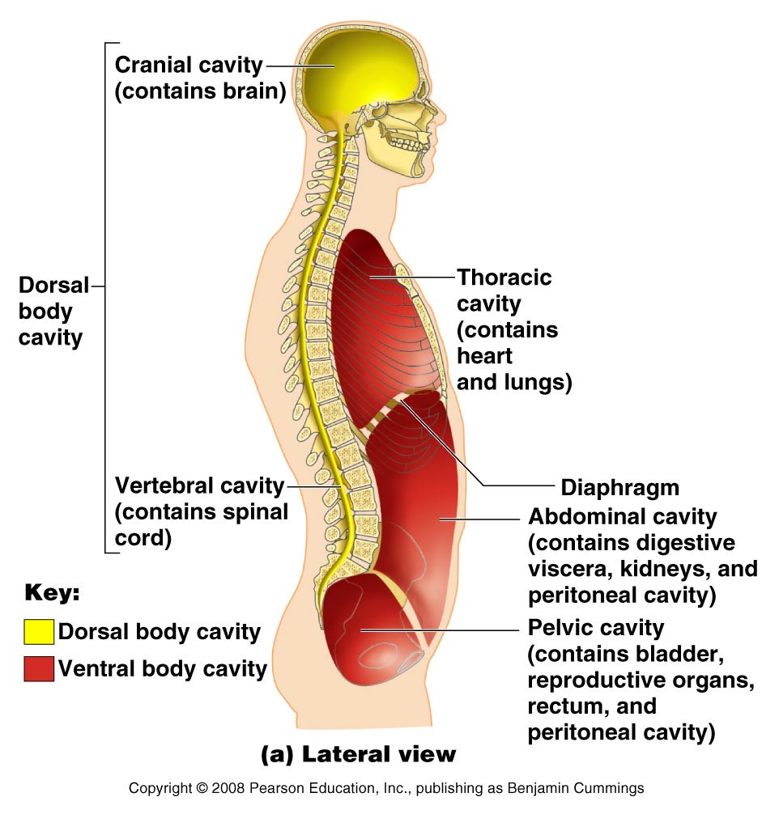
Body Cavities and Membranes (2)

Slide 5
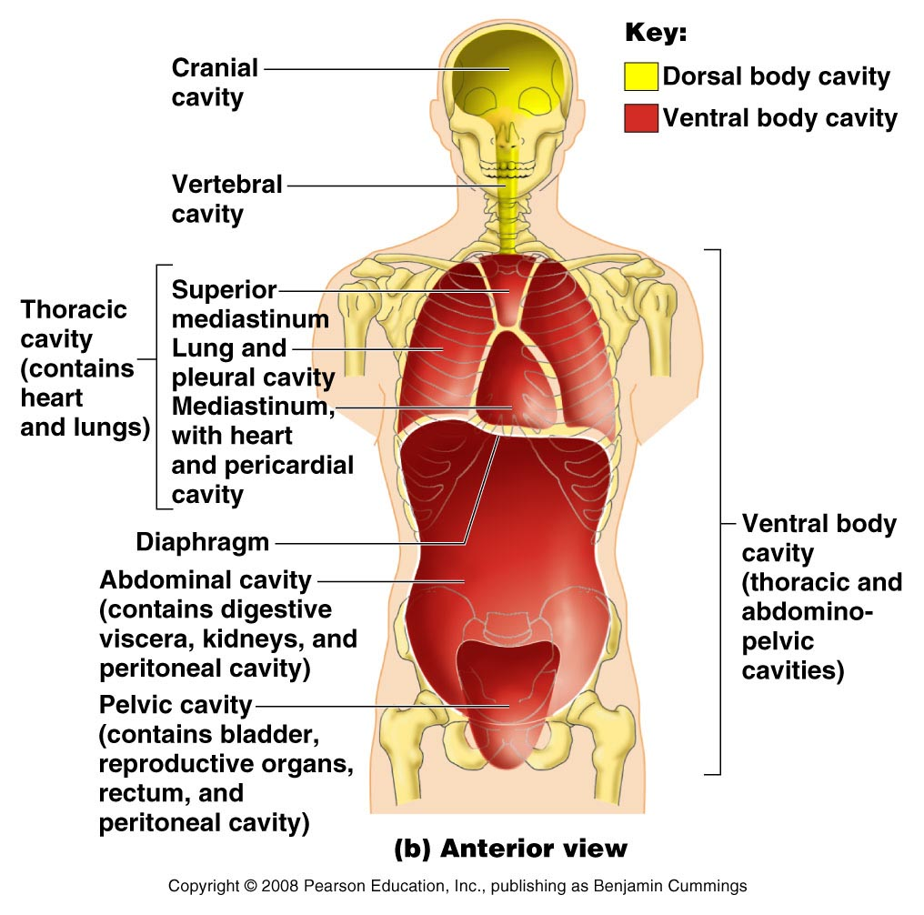
Body Cavities and Membranes (3)

Slide 6
Body Cavities and Membranes (4)
Serous cavities – a slit-like space lined by a serous membrane
  Pleura, pericardium, and peritoneum
    Parietal serosa – outer wall of the cavity
    Visceral serosa covers the visceral organs

Slide 7
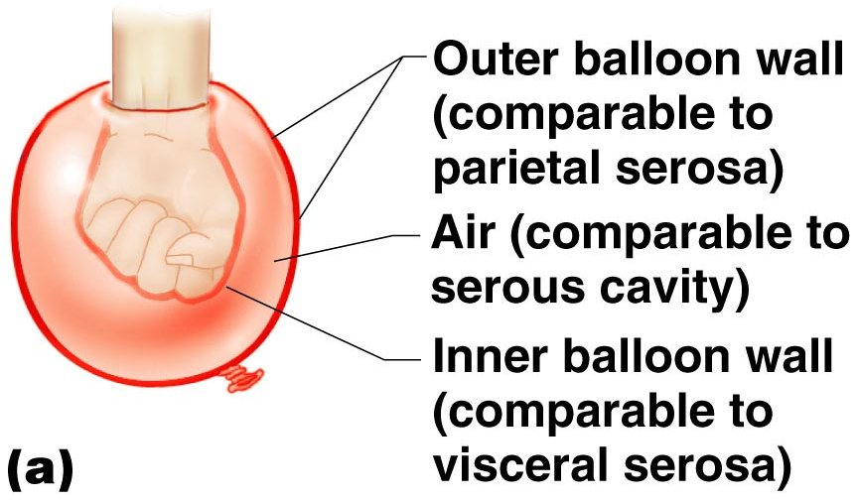
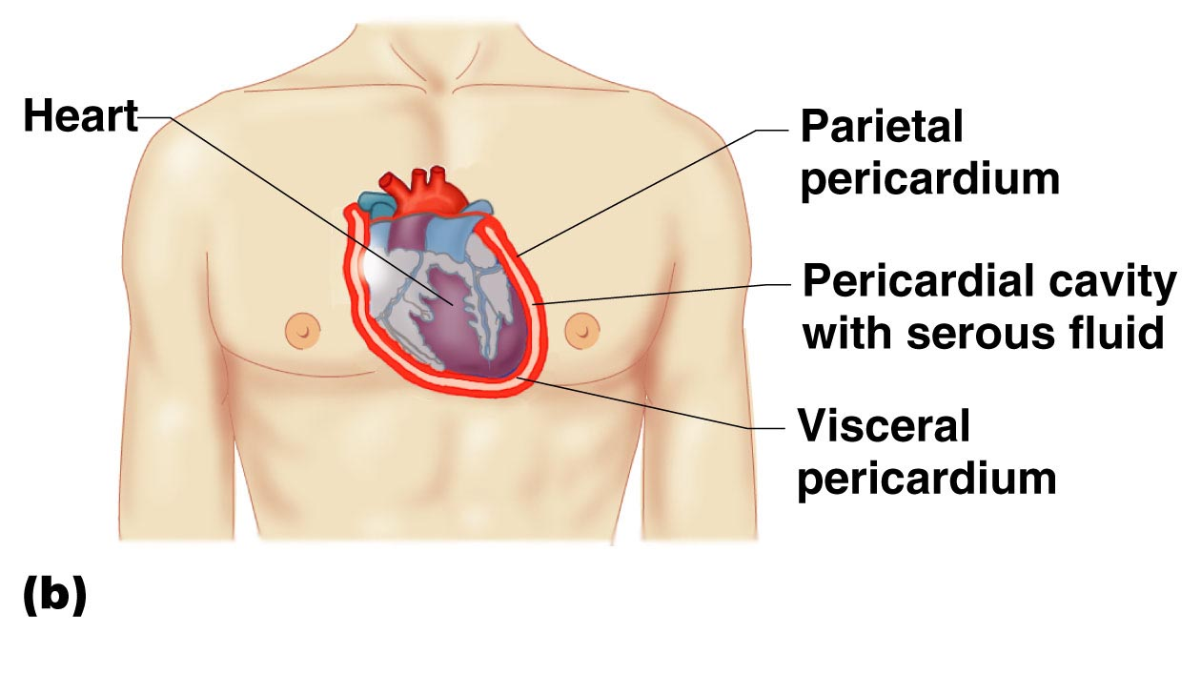
Body Cavities and Membranes (5)

Slide 8
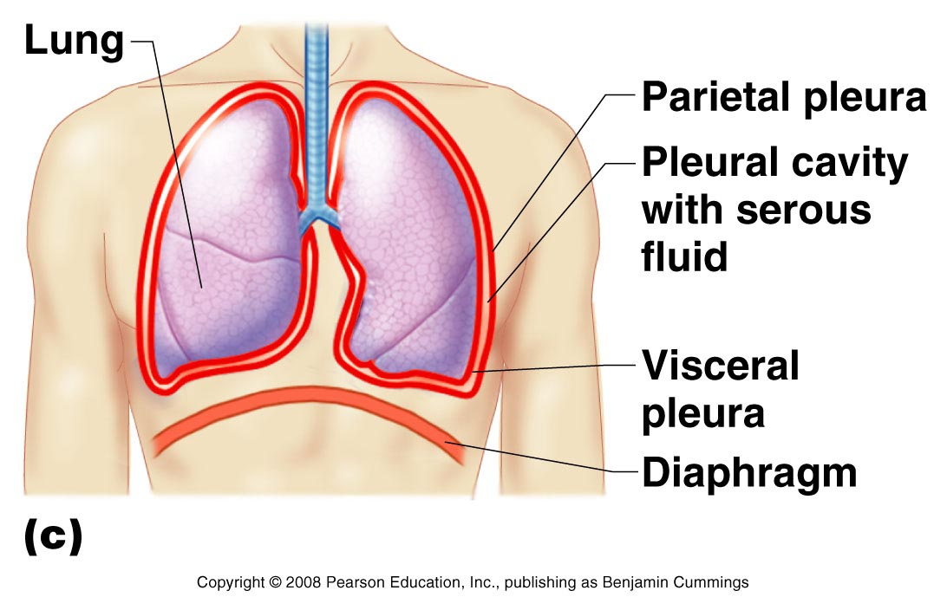
Body Cavities and Membranes (6)

Slide 9
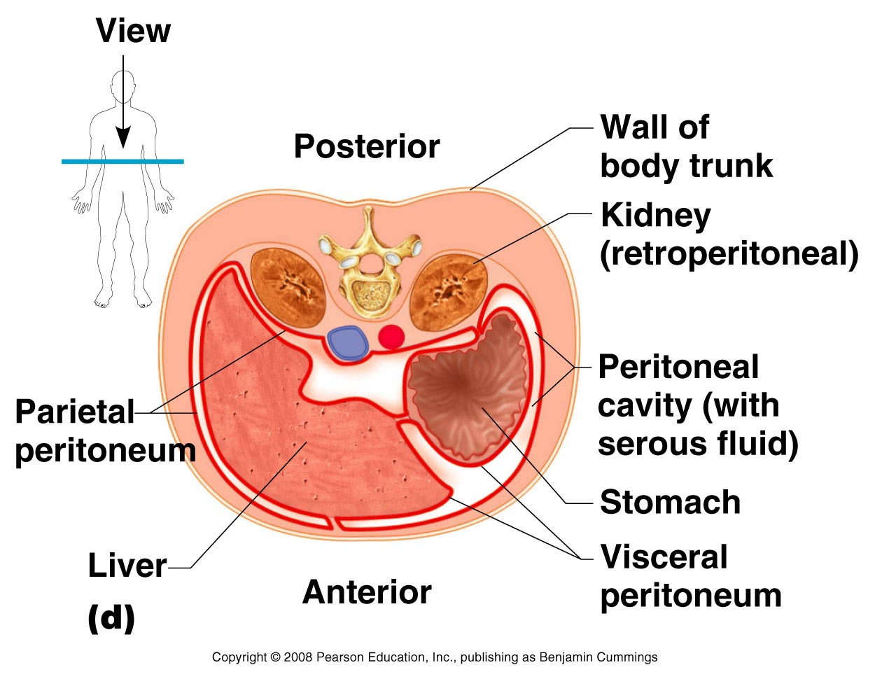
Body Cavities and Membranes (7)

Slide 10
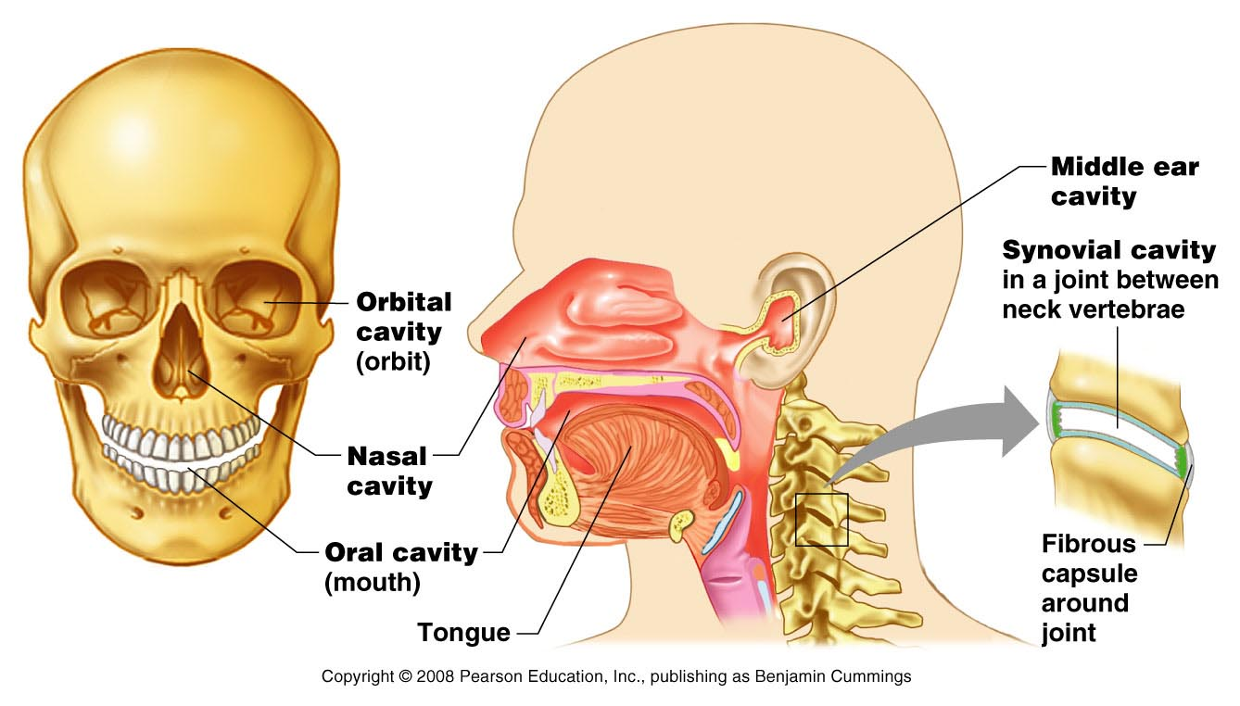
Body Cavities and Membranes (9)
Other cavities
  Oral cavity
  Nasal cavity
  Orbital cavities
  Middle ear cavities
  Synovial cavities

Slide 11
EMBRYONIC BODY CAVITY
4th week, intraembryonic cavity is divided into:
  The pericardial cavity
  Two pleuroperitoneal canals
  Peritoneal cavity

Slide 12
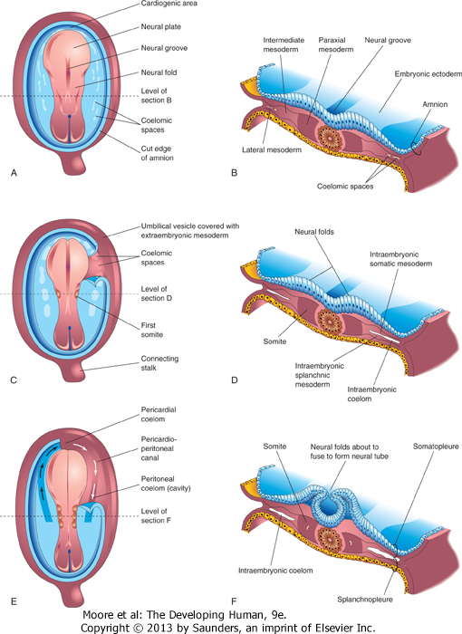
Drawings of embryos at 19 to 21 days illustrating development of the somites and intraembryonic coelom. A, C, and E, Dorsal views of the embryo, exposed by removal of the amnion. B, D, and F, Transverse sections through the trilaminar embryonic disc at the levels shown. A, Presomite embryo of approximately 18 days. C, An embryo of approximately 20 days showing the first pair of somites. Part of the somatopleure on the right has been removed to show the coelomic spaces in the lateral mesoderm. E, A three-somite embryo (approximately 21 days) showing the horseshoe-shaped intraembryonic coelom, exposed on the right by removal of part of the somatopleure.

Slide 16
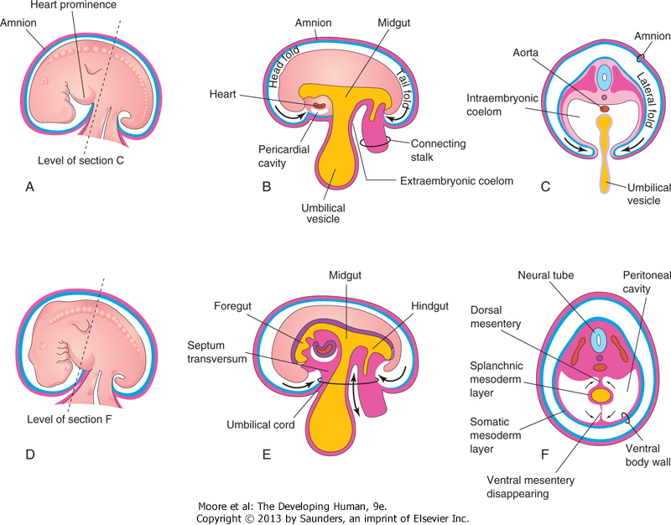
Illustrations of embryonic folding and its effects on the intraembryonic coelom and other structures. A, Lateral view of an embryo (approximately 26 days). B, Schematic sagittal section of this embryo showing the head and tail folds. C, Transverse section at the level shown in A, indicating how fusion of the lateral folds gives the embryo a cylindrical form. D, Lateral view of an embryo (approximately 28 days). E, Schematic sagittal section of this embryo showing the reduced communication between the intraembryonic and extraembryonic coeloms (double-headed arrow). F, Transverse section as indicated in D, illustrating formation of the ventral body wall and disappearance of the ventral mesentery. The arrows indicate the junction of the somatic and splanchnic layers of mesoderm. The somatic mesoderm will become the parietal peritoneum lining the abdominal wall, and the splanchnic mesoderm will become the visceral peritoneum covering the organs (e.g., the stomach).

Slide 17
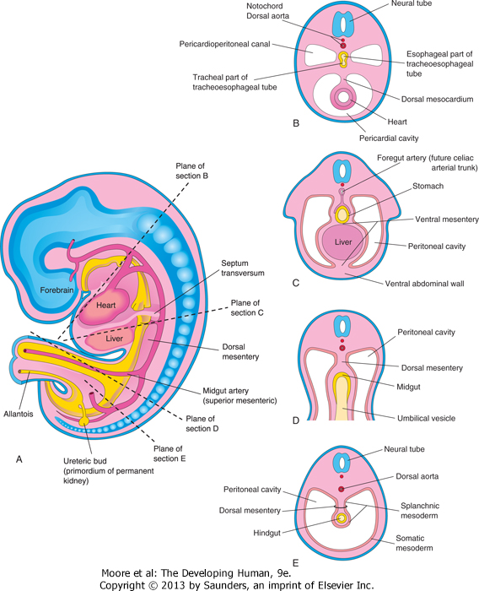
Illustrations of the mesenteries and body cavities at the beginning of the fifth week. A, Schematic sagittal section. Note that the dorsal mesentery serves as a pathway for the arteries supplying the developing gut. Nerves and lymphatics also pass between the layers of this mesentery. B to E, Transverse sections through the embryo at the levels indicated in A. The ventral mesentery disappears, except in the region of the terminal esophagus, stomach, and first part of the duodenum. Note that the right and left parts of the peritoneal cavity, separate in C, are continuous in E.

Slide 18
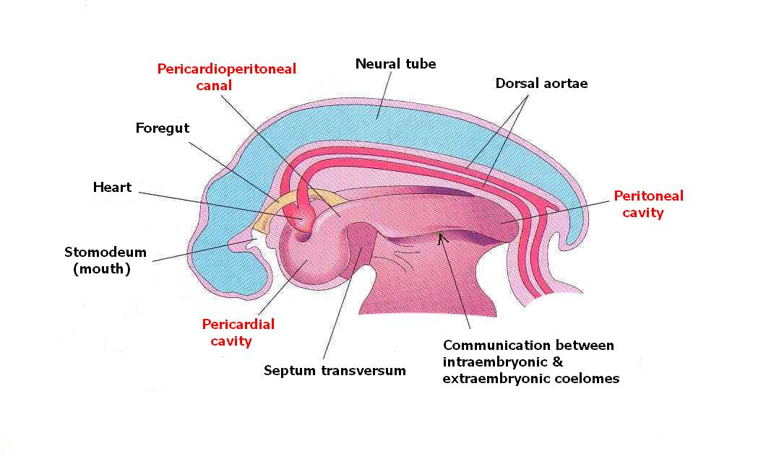
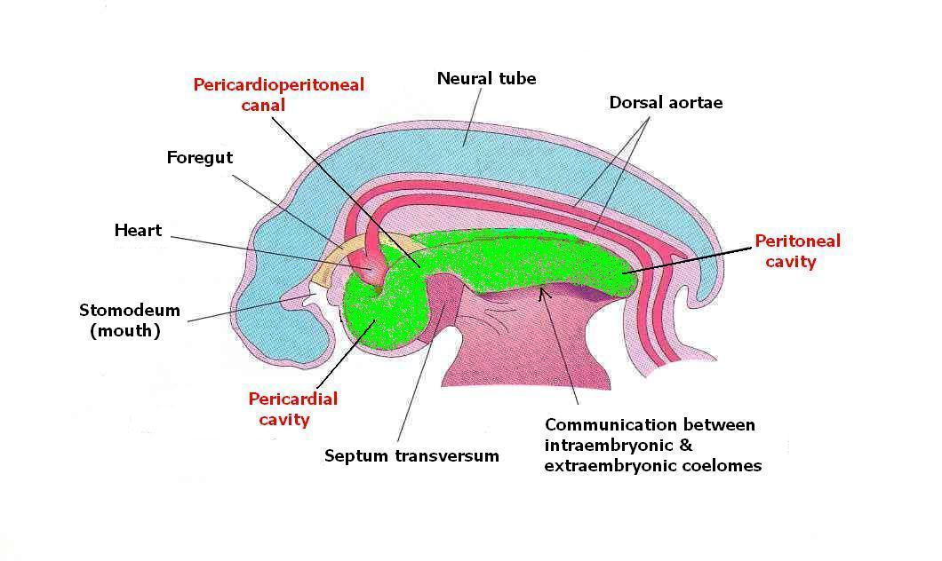
During cranial folding of embryo, the pericardial cavity comes to lie ventral to the foregut
The pericardioperitoneal canals:
  arise from the dorsal wall of the pericardial cavity
  pass on each side of the foregut (future esophagus)
  lie dorsal to septum transversum
  open into the peritoneal cavity

Slide 19
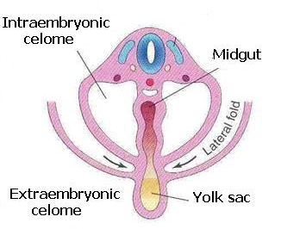
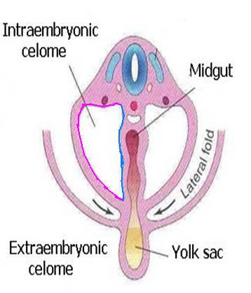
During horizontal folding, the limbs of the coelom are brought together on the ventral aspect of the embryo
The coelom is lined by:
  mesothelium derived from the somatic mesoderm (parietal layer)
  and the splanchnic mesoderm (visceral layer)
Peritoneal cavity is connected with extraembryonic coelom at the umbilicus
The connection is lost during the 10th week as the intestine return from umbilical cord
Parietal layer
Visceral layer

Slide 20
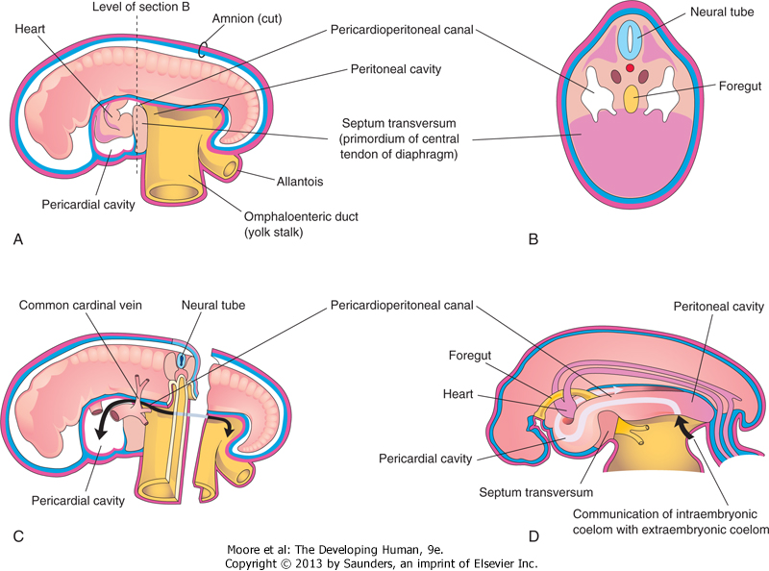
Schematic drawings of an embryo (approximately 24 days). A, The lateral wall of the pericardial cavity has been removed to show the primordial heart. B, Transverse section of the embryo illustrating the relationship of the pericardioperitoneal canals to the septum transversum (primordium of central tendon of diaphragm) and the foregut. C, Lateral view of the embryo with the heart removed. The embryo has also been sectioned transversely to show the continuity of the intraembryonic and extraembryonic coeloms (arrow). D, Sketch showing the pericardioperitoneal canals arising from the dorsal wall of the pericardial cavity and passing on each side of the foregut to join the peritoneal cavity. The arrow shows the communication of the extraembryonic coelom with the intraembryonic coelom and the continuity of the intraembryonic coelom at this stage.

Slide 21
Division of Embryonic Coelom
Partitions appear to separate the pericardioperitoneal canals from the pericardial cavity and the peritoneal cavity
As the lung buds grow into the pericardioperitoneal canals, a pair of membranous ridges is produced in the lateral wall of each canal:
  The pleuropericardial folds cranial to the developing heart
  The pleuroperitoneal folds caudal to the developing lungs

Slide 22
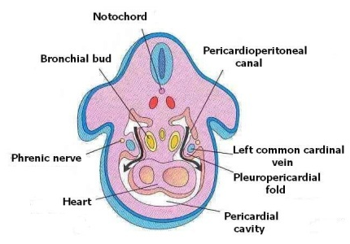

Pleuropericardial Membranes
The bronchial buds grow laterally from the caudal end of the trachea into the pericardioperitoneal canals (future pleural cavities)
As the pleural cavities expand ventrally, they grow into the body wall in the angle between the body wall and a ridge raised by the common cardinal vein and the phrenic nerve

Slide 23
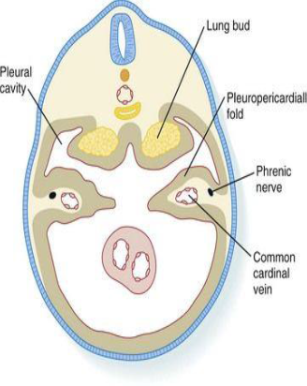
This results in splitting the mesenchyme into:
  An outer layer that forms the thoracic wall
  An inner layer that forms the pleuro-pericardial membrane
  The pleuropericardial membranes project into the cranial end of the pericardioperitoneal canals

Slide 24
With the growth and descent of the heart and expansion of the pleural cavities, the pleuro-pericardial membranes expand and move medially
By 7th week, the membranes fuse with the mesenchyme ventral to the esophagus forming the primordial mediastinum, thus closing the pleuropericardial openings.

Slide 25
The right pleuropericardial opening closes slightly earlier than the left (right common cardinal vein is larger than the left and so raises a bigger fold)
The fused pleuropericardial membranes form the fibrous pericardium
(Note the position of phrenic nerve in the fibrous pericardium)
Phrenic nerve

Slide 26
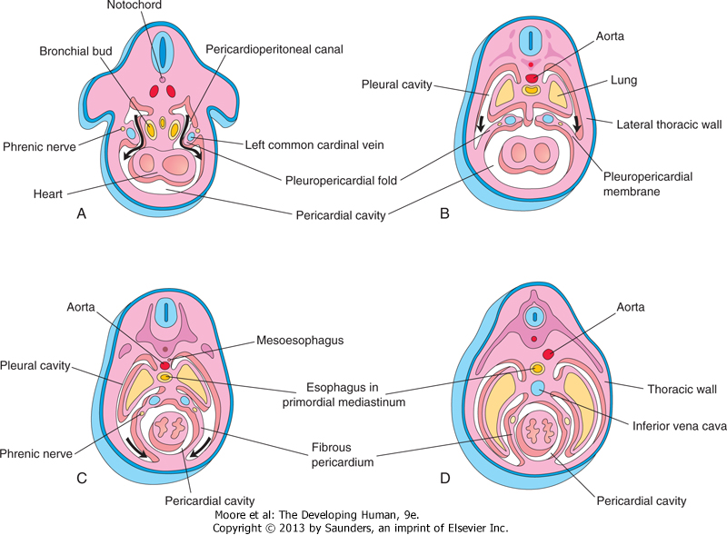
Drawings of transverse sections through embryos cranial to the septum transversum, illustrating successive stages in the separation of the pleural cavities from the pericardial cavity. Growth and development of the lungs, expansion of the pleural cavities, and formation of the fibrous pericardium are also shown. A, At 5 weeks. The arrows indicate the communications between the pericardioperitoneal canals and the pericardial cavity. B, At 6 weeks. The arrows indicate development of the pleural cavities as they expand into the body wall. C, At 7 weeks. Expansion of the pleural cavities ventrally around the heart is shown. The pleuropericardial membranes are now fused in the median plane with each other and with the mesoderm ventral to the esophagus. D, At 8 weeks. Continued expansion of the lungs and pleural cavities and formation of the fibrous pericardium and thoracic wall are illustrated.

Slide 28
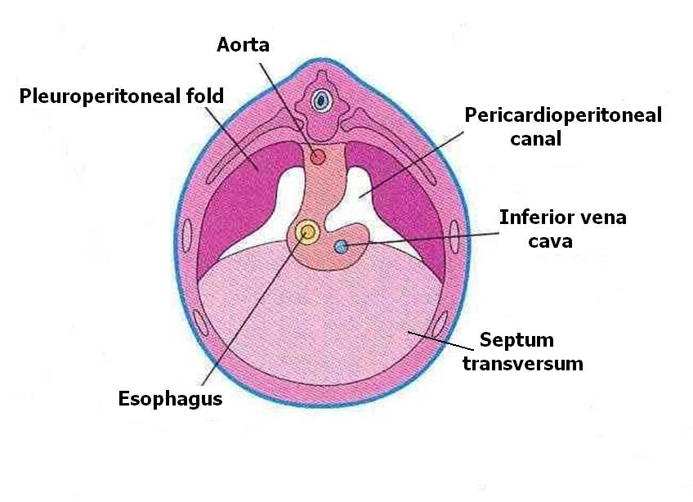
Pleuroperitoneal Membranes
Develop from the pleuroperitoneal folds that are attached dorsolaterally to the body wall and their free edges project into the caudal part of the pericardioperitoneal canals
As the developing lung enlarges cranially and liver expands caudally, these folds become more prominent and gradually become membranous
They are invaded by the myoblasts (primitive muscle cells)

Slide 29
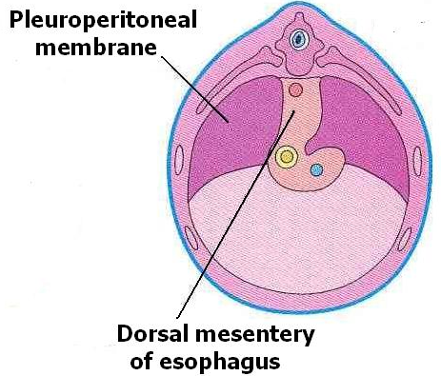
During 6th week, the pleuroperitoneal membranes extend ventromedially and fuse with the dorsal mesentery of the esophagus and the septum transversum
This results in closure of the pericardioperitoneal openings.
The right opening closes slightly earlier than the left

Slide 30
CONGENITAL PERICARDIAL DEFECTS
Defective formation and/or fusion of the pleuropericardial membranes separating the pericardial and pleural cavities is uncommon.
This anomaly results in a congenital defect of the pericardium, usually on the left side.
Consequently, the pericardial cavity communicates with the pleural cavity.
In very unusual cases, part of the left atrium of the heart herniates into the pleural cavity at each heartbeat.

Slide 31
Development of the Diaphragm

Slide 32
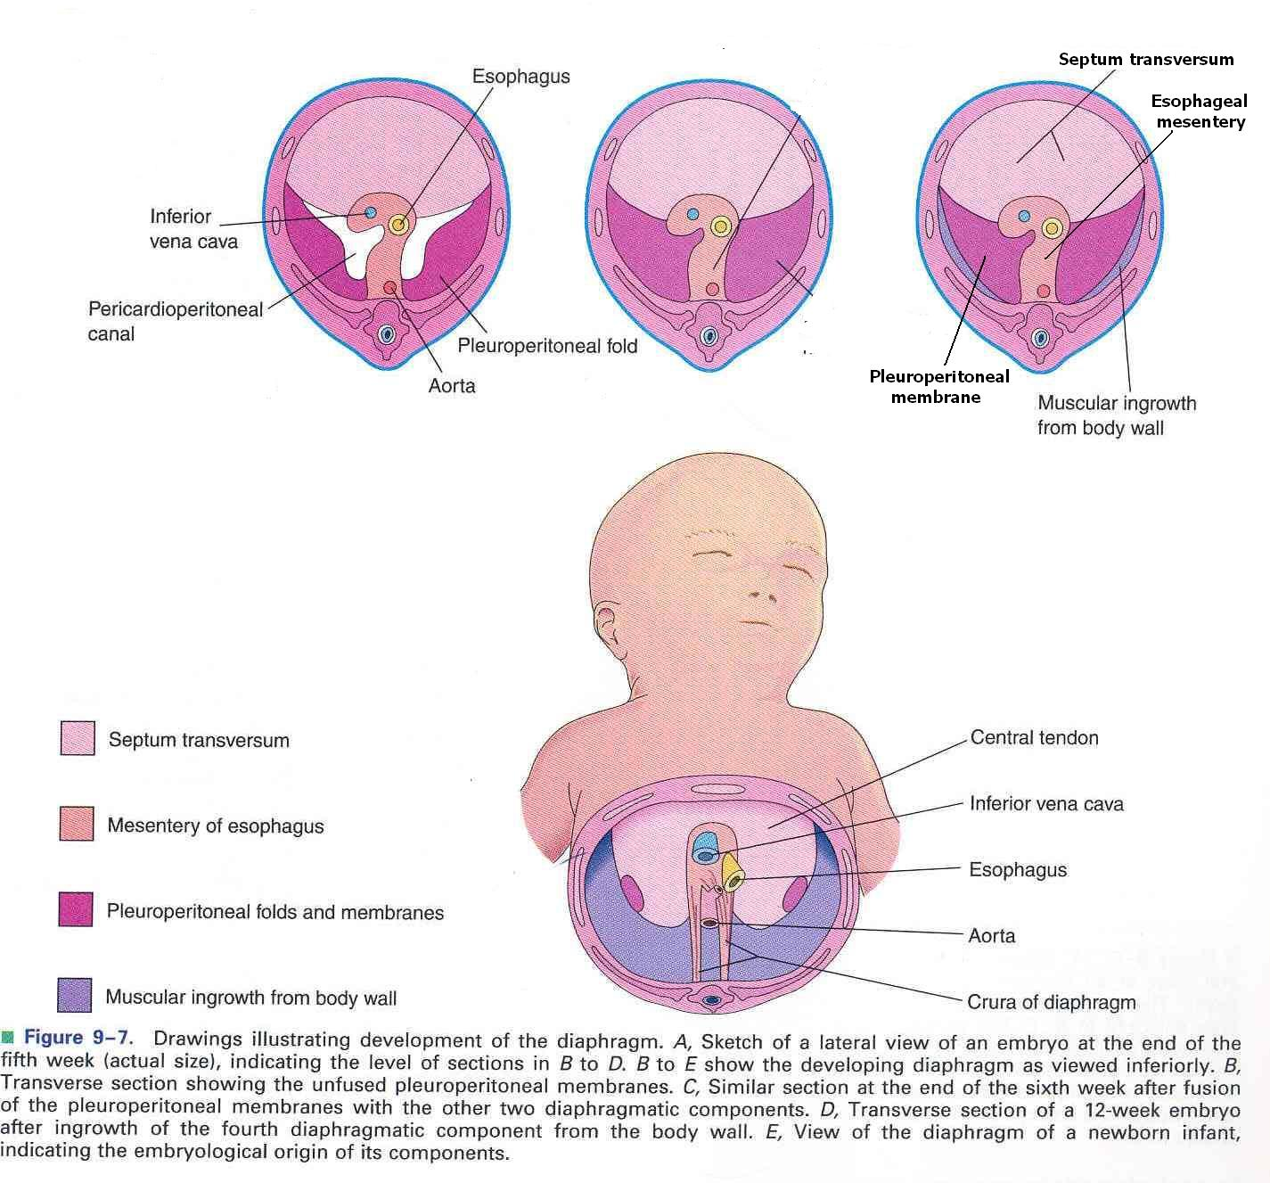
The diaphragm develops from four embryonic components:
  Septum transversum
  Pleuroperitoneal membranes
  Dorsal mesentery of esophagus
  Muscular ingrowth from lateral body walls
1
3
2
4

Slide 33
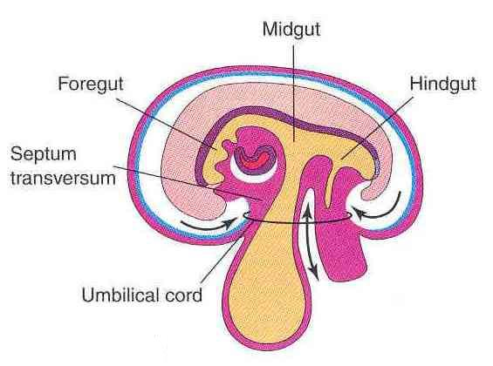
Septum Transversum
A thick plate of mesodermal tissue
Lies:
  Between the pericardial cavity and the umbilical vesicle
  Ventral to the foregut and the pleuro-peritoneal canals
  Grows dorsally from the ventrolateral body wall

Slide 34
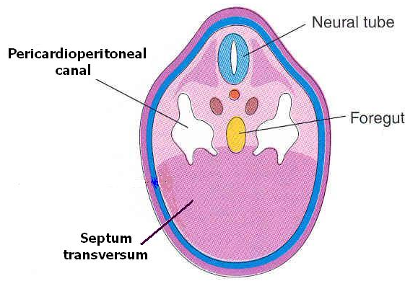
Forms an incomplete partition between the thoracic cavity and the abdominal cavity
Expands and fuses with the pleuroperitoneal membranes and the mesenchyme ventral to the esophagus
Septum transversum is the primordium of the central tendon of the diaphragm

Slide 35
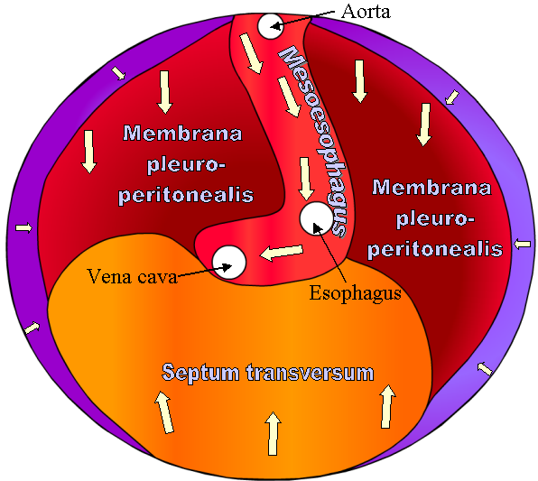
During 6th week, the four basic components:
  Pleuroperitoneal membranes
  Mesoesophagus
  Septum transversum
  Muscular ingrowth from lateral body wall – cervical somites 3,4,5
4
1
2
3
1
The 4 fuse with each other and form a complete partition between the thoracic and abdominal cavities

Slide 36
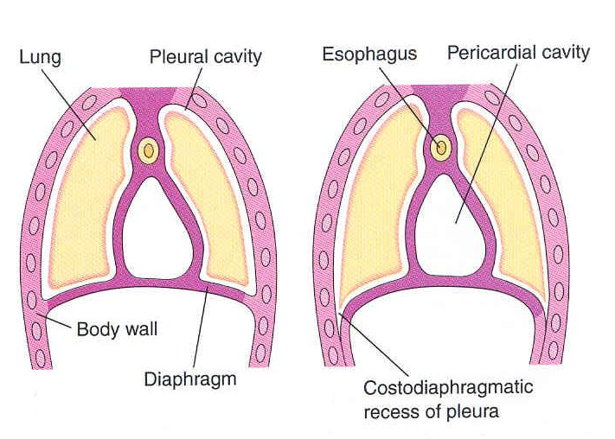
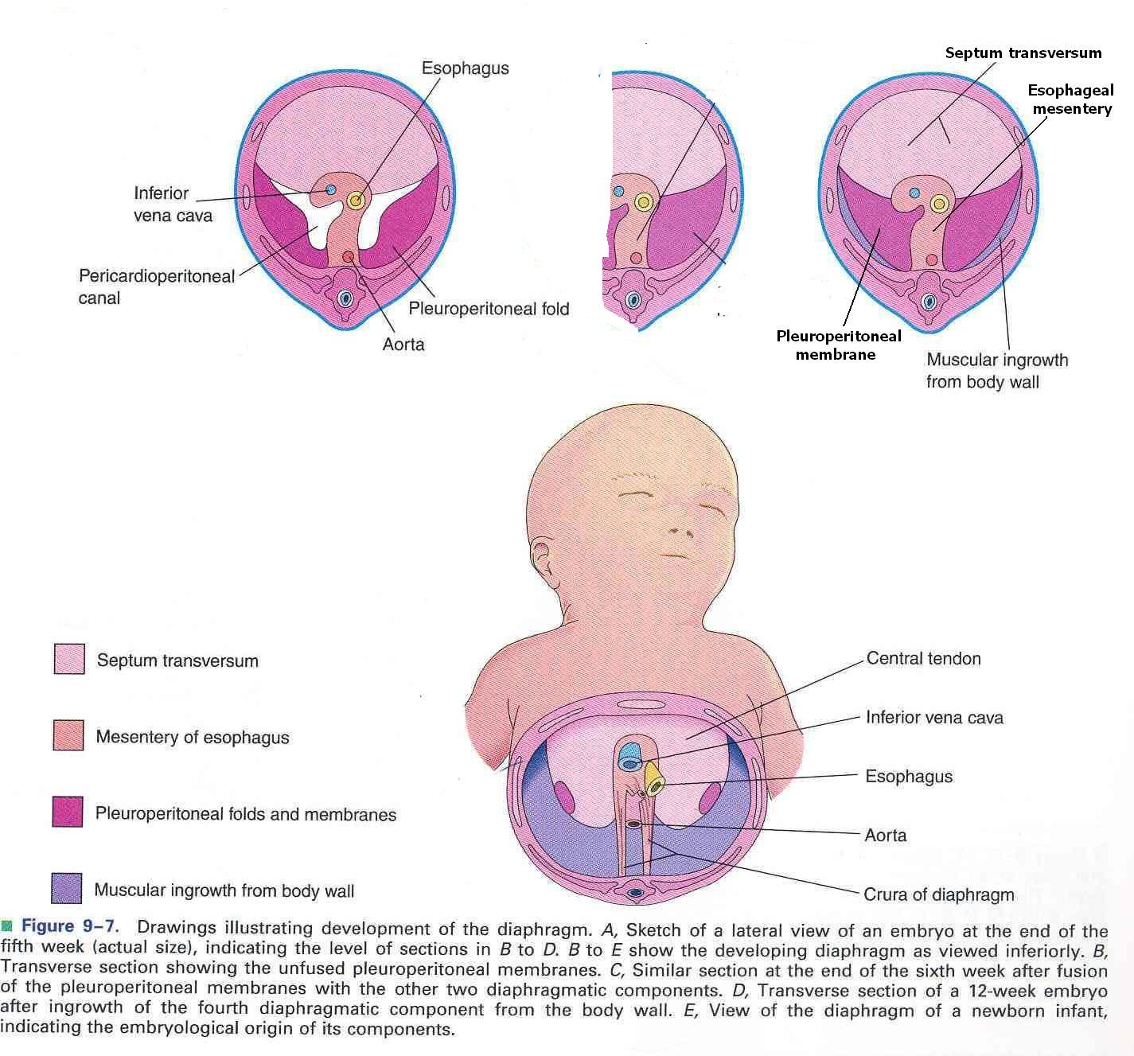
During 9th – 12th weeks the lungs and pleural cavities enlarge, burrowing into the body wall, splitting it into:
External layer that becomes part of the body wall
Internal layer that contributes muscles to peripheral portions of diaphragm, extending to the parts derived from the pleuroperitoneal membranes

Slide 37
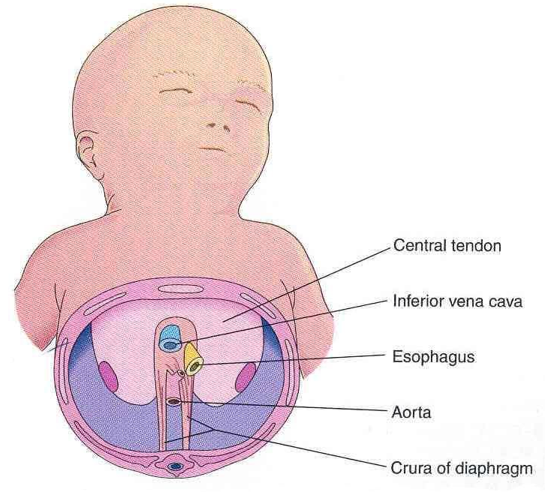
Septum transversum: Central tendon
Pleuroperitoneal membranes: form large portion of fetal diaphragm but represent a smaller portion in infants
Dorsal mesentery of esophagus: Crura
Body wall: peripheral muscular part

Slide 38
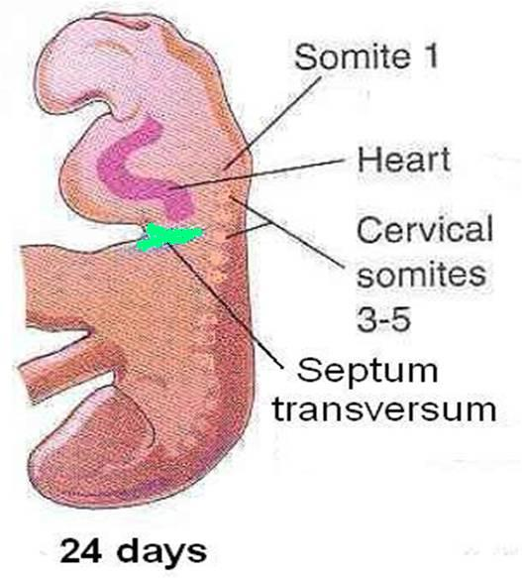
Positional Changes and Innervation of the Diaphragm
During the 4th week, the septum transversum lies opposite the 3rd – 5th cervical somites
During 5th week, myoblasts from these somites move to the developing diaphragm bringing their nerve fibers with them

Slide 39
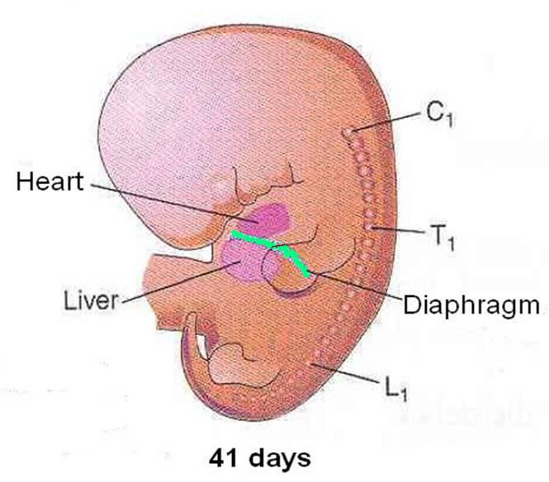
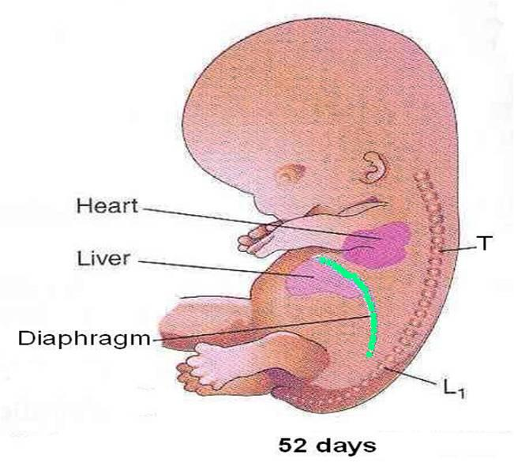
Rapid growth of the body of embryo result in further descent of diaphragm
By the 6th week, the diaphragm lies at the level of the thoracic somites
By the end of 8th week the dorsal end of diaphragm lies at the level of first lumbar vertebra

Slide 40
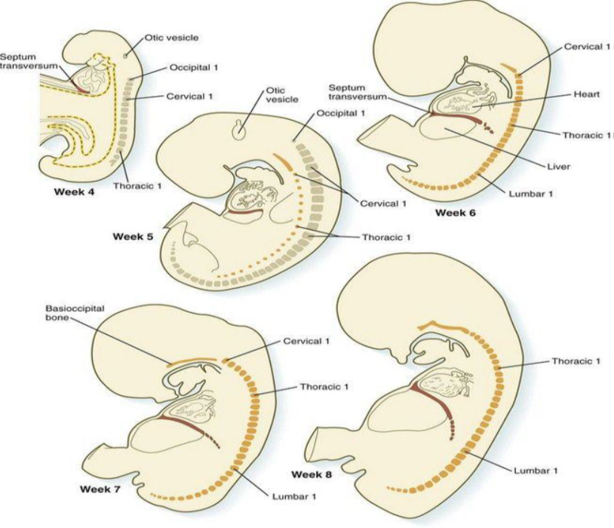
Changes in the position of the septum transversum (red) during the embryonic period. The gray repeating structures are somites. The orange repeating structures are elements of the axial skeleton.

Slide 41
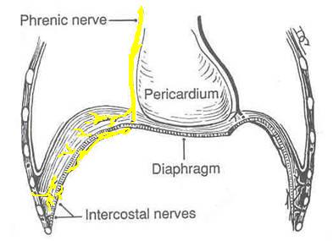
When the 4 parts of the diaphragm fuse, the mesenchymal cells from the septum transversum extend into the other three parts, change into myoblasts, and give rise to the muscles of the diaphragm.
Thus phrenic nerve supplies all the muscles of diaphragm
The phrenic nerve also supplies sensory fibers to diaphram except in the peripheral region which is derived from the body wall and brings its nerve supply (lower intercostal nerves) with it

Slide 43
POSTEROLATERAL DEFECT OF DIAPHRAGM
Posterolateral defect of the diaphragm is the only relatively common birth defect of the diaphragm .
This diaphragmatic defect occurs about once in 2,200 newborn infants and is associated with congenital diaphragmatic hernia (CDH); herniation of abdominal contents into the thoracic cavity.
Life-threatening breathing difficulties may be associated with CDH because of inhibition of development and inflation of the lungs.
Fetal lung maturation may be delayed.
Polyhydramnios (excess amniotic fluid) may also be present.
CDH is the most common cause of pulmonary hypoplasia.

Slide 44
The candidate region for CDH has been reported to be chromosome 15q26.
CDH, usually unilateral, results from defective formation and/or fusion of the pleuroperitoneal membranes with the other three parts of the diaphragm.
This results in a large opening in the posterolateral region of the diaphragm.
As a result, the peritoneal and pleural cavities are continuous with one another along the posterior body wall.
This birth defect, sometimes referred to as the foramen of Bochdalek, occurs on the left side in 85% to 90% of cases.

Slide 46
The preponderance of left-sided defects may be related to the earlier closure of the right pleuroperitoneal opening.
Prenatal diagnosis of CDH depends on ultrasound examination and magnetic resonance imaging of abdominal organs in the thorax.
The presence of abdominal viscera in the thorax pushes the lungs and heart anteriorly and compression of the lungs occurs.
Often the stomach, spleen, and most of the intestines herniate.
Most babies born with CDH die not because there is a defect in the diaphragm or abdominal viscera in the chest, but because the lungs are hypoplastic due to compression during development.

Slide 48
The severity of pulmonary developmental abnormalities depends on when and to what extent the abdominal viscera herniate into the thorax, that is, on the timing and degree of compression of the fetal lungs.
The effect on the ipsilateral (same side) lung is greater, but the contralateral lung also shows morphologic changes.
If the abdominal viscera are in the thoracic cavity at birth, the initiation of respiration is likely to be impaired.
Because the abdominal organs are most often in the left side of the thorax, the heart and mediastinum are usually displaced to the right.
The lungs are often aerated and achieve their normal size after reduction (repositioning) of the herniated viscera and repair of the defect in the diaphragm.
Prenatal detection of CDH occurs in about 50% of cases.
Most infants with CDH now survive because of improvements in ventilator care.

Slide 49
EVENTRATION OF DIAPHRAGM
In this uncommon condition, half the diaphragm has defective musculature and balloons into the thoracic cavity as an aponeurotic (membranous) sheet, forming a diaphragmatic pouch.
Consequently, there is superior displacement of abdominal viscera into the pocket-like outpouching of the diaphragm.
This birth defect results mainly from failure of muscular tissue from the body wall to extend into the pleuroperitoneal membrane on the affected side.
Eventration of the diaphragm is not a true diaphragmatic herniation; it is a superior displacement of viscera into a sac-like part of the diaphragm.
However, the clinical manifestations of diaphragmatic eventration may simulate CDH.

Slide 50
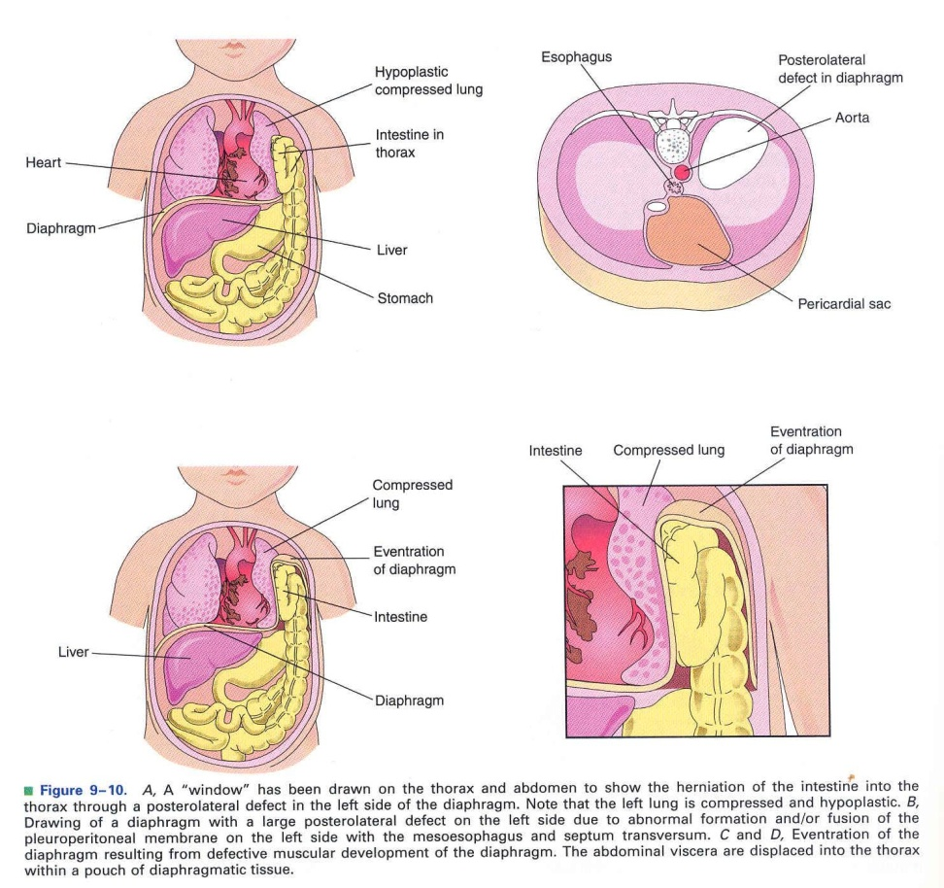
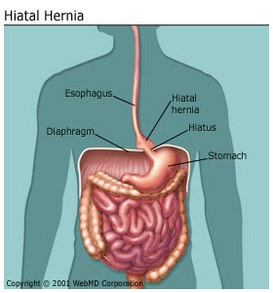
Congenital Anomalies
Congenital hiatal hernia: because of large esophageal hiatus
Eventration of diaphragm: because of defective musculature

Slide 51
Retrosternal (parasternal) hernia: Commonly through a posterolateral defect in diaphragm (foramen of Morgagni).
Mostly on left side.
Left lung shows hypoplasia .
Large defects associated with body wall defects

Slide 52
ACCESSORY DIAPHRAGM
More than 30 cases of this rare anomaly have been reported.
It is most often on the right side and associated with lung hypoplasia and other respiratory complications.
An accessory diaphragm can be diagnosed by magnetic resonance imaging and computed tomography.
It is treated by surgical excision.

Slide 53
GASTROSCHISIS AND CONGENITAL EPIGASTRIC HERNIA
Gastroschisis is a congenital fissure in the anterior abdominal wall: usually there is protrusion of viscera.
This uncommon hernia occurs in the median plane between the xiphoid process and umbilicus.
The defect is similar to an umbilical hernia except for its location.
Gastroschisis and epigastric hernias result from failure of the lateral body folds to fuse completely when forming the anterior abdominal wall during folding in the fourth week.
The small intestine herniates into the amniotic cavity, which can be detected prenatally by ultrasonography.

Slide 55
Test yourself
A newborn infant cannot breathe and soon dies. An autopsy reveals a large diaphragmatic defect on the left side, with the stomach and the intestines occupying the left side of the thorax. Both lungs are severely hypoplastic. What is the embryological basis for this defect?
A child is born with a large defect lateral to the umbilicus. Most of the large and the small bowel protrude through the defect and are not covered by amnion. What is the embryological basis for this abnormality, and should you be concerned that other malformations may be present?
Explain why the phrenic nerve, which supplies motor and sensory fi bers to the diaphragm, originates from cervical segments when most of the diaphragm is in the thorax. From which cervical segments does the nerve originate?

Slide 56
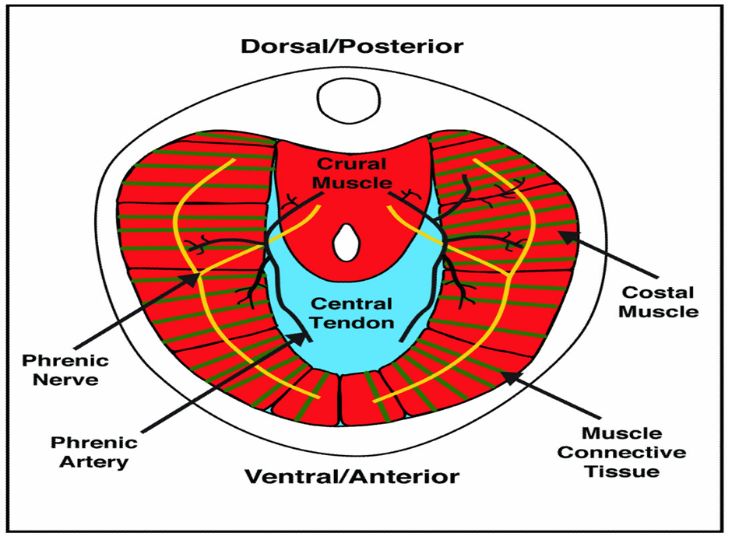
THANK YOU

