Slide 1
DEVELOPMENT OF THE RESPIRATORY SYSTEM
Prof Peter Gichangi
March 2017

Slide 2
OBJECTIVES
Describe the development of the respiratory system from the endodermal and mesodermal components.
Describe the main steps in the development of the lungs.
List the respiratory changes before and after birth.
Describe congenital malformations of the developing respiratory system.

Slide 3
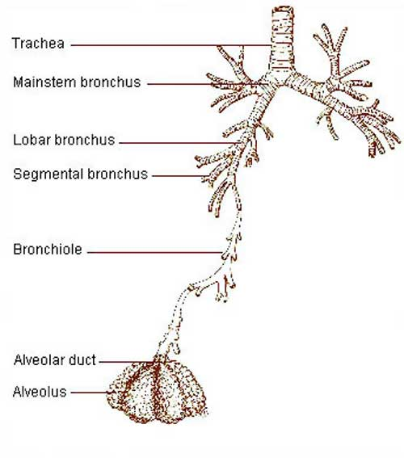

Slide 4
RESPIRATORY PRIMORDIUM
The primordium of tracheobronchial tree is the laryngotracheal groove found in the floor of the caudal end of the primordial pharynx, caudal to the fourth pair of pharyngeal pouches.
Sources of:
  pulmonary epithelium and glands of the larynx, trachea, and bronchi - endoderm lining the laryngotracheal groove
  connective tissue, cartilage, and smooth muscle - splanchnic mesoderm surrounding the foregut
End of the 4th week, evagination of the laryngotracheal groove forms a pouch-like laryngotracheal diverticulum (lung bud).
The lung bud elongates into splanchnic mesenchyme.
Distal end enlarges to form a globular respiratory bud which froms the respiratory tree.

Slide 5
Laryngotracheal diverticulum separates from the primordial pharynx; but maintains a communication with it through the primordial laryngeal inlet.
End of the 5th week, longitudinal tracheoesophageal folds develop in the laryngotracheal diverticulum, they approach each other, and fuse to form a partition, the tracheoesophageal septum.
This septum divides the cranial portion of the foregut into:
  a ventral part, the laryngotracheal tube,
  a dorsal part - primordium of oropharynx and esophagus
Expression of the transcription factors NKx2.1 (ventral) and Sox2 (dorsal) are critical for dorsal-ventral patterning and trachea-esophageal separation.

Slide 6
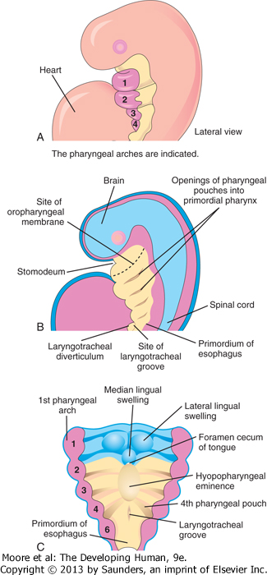
10-1 A, Lateral view of a 4-week embryo illustrating the relationship of the pharyngeal apparatus to the developing respiratory system. B, Sagittal section of the cranial half of the embryo. C, Horizontal section of the embryo illustrating the floor of the primordial pharynx and the location of the laryngotracheal groove.

Slide 7
DEVELOPMENT OF LARYNX
Epithelial lining is from the endoderm of the cranial end of the laryngotracheal tube.
Cartilages develop from 4th and 6th pairs of pharyngeal arches mesenchyme that is derived from neural crest cells.
Rapid proliferation of mesenchyme at the cranial end of the laryngotracheal tube produces paired arytenoid swellings.
Growth of arytenoid swellings towards the tongue, convert the slit-like aperture - the primordial glottis-into a T-shaped laryngeal inlet and reduce the developing laryngeal lumen to a narrow slit.

Slide 8
The laryngeal epithelium proliferates rapidly, resulting in temporary occlusion of the laryngeal lumen.
By the 10th week:
  Recanalization of the larynx normally occurs
  Formation of laryngeal ventricles as part of the recanalization process.
Laryngeal ventricles (recesses) are bounded by folds of mucous membrane that become the vocal folds (cords) and vestibular folds.
Hypopharyngeal eminence forms:
  caudal part - the epiglottis
  rostral part - the posterior third or pharyngeal part of the tongue.

Slide 9
Laryngeal muscles:
  develop from myoblasts in the 4th and 6th pairs of pharyngeal arches,
  innervation by the laryngeal branches of the vagus nerves that supply these arches.
Growth of the larynx and epiglottis is rapid during the first 3 years after birth where epiglottis reaches its adult form.
LARYNGEAL ATRESIA
A rare birth defect, resulting from failure of recanalization of the larynx, which produces obstruction of the upper fetal airway-congenital high airway obstruction syndrome.
Distal to the region of atresia or stenosis:
  the airways become dilated,
  the lungs are enlarged and filled with fluid;
  the diaphragm is either flattened or inverted
  there is fetal ascites and/or hydrops
Incomplete atresia (laryngeal web) results from incomplete recanalization of the larynx during the 10th week.
A membranous web forms at the level of the vocal folds, partially obstructing the airway.

Slide 10
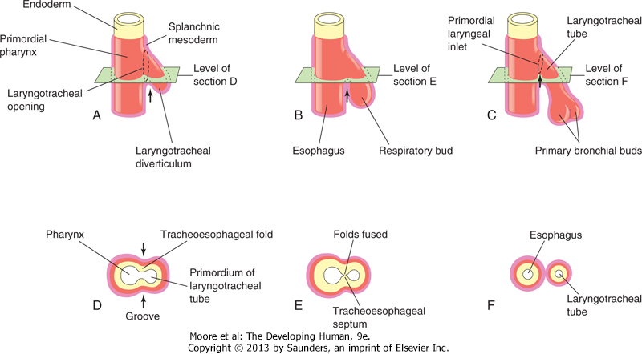
10-2 Successive stages in the development of the tracheoesophageal septum during the fourth and fifth weeks. A to C, Lateral views of the caudal part of the primordial pharynx showing the laryngotracheal diverticulum and partitioning of the foregut into the esophagus and laryngotracheal tube. D to F, Transverse sections illustrating formation of the tracheoesophageal septum and showing how it separates the foregut into the laryngotracheal tube and esophagus. The arrows indicate cellular changes resulting from growth.

Slide 11
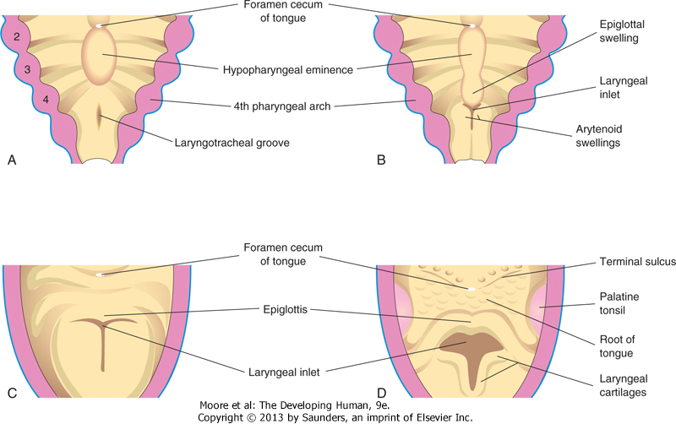
10-3 Successive stages in the development of the larynx. A, At 4 weeks. B, At 5 weeks. C, At 6 weeks. D, At 10 weeks. The epithelium lining of the larynx is of endodermal origin. The cartilages and muscles of the larynx arise from mesenchyme in the fourth and sixth pairs of pharyngeal arches. Note that the laryngeal inlet changes in shape from a slit-like opening to a T-shaped inlet as the mesenchyme surrounding the developing larynx proliferates.

Slide 12
DEVELOPMENT OF TRACHEA
The trachea and two lateral outpouchings, the primary bronchial buds are formed after separation of laryngotracheal diverticulum from the foregut.
The endodermal lining of the laryngotracheal tube distal to the larynx differentiates into the epithelium and glands of the trachea and the pulmonary epithelium.
The cartilage, connective tissue, and muscles of the trachea are derived from the splanchnic mesenchyme surrounding the laryngotracheal tube.

Slide 13
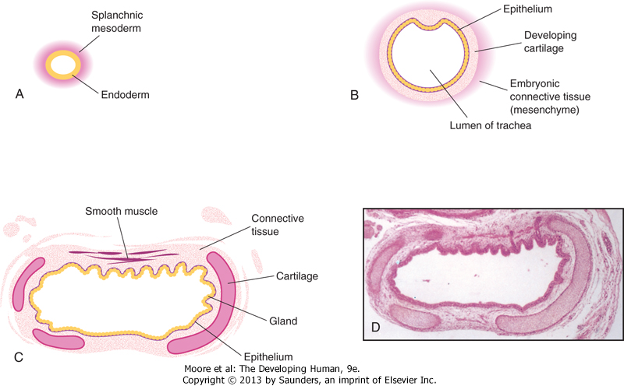
10-4 Transverse sections through the laryngotracheal tube illustrating progressive stages in the development of the trachea. A, 4 weeks. B, 10 weeks. C, 11 weeks (drawing of micrograph in D). Note that endoderm of the tube gives rise to the epithelium and glands of the trachea and that mesenchyme surrounding the tube forms the connective tissue, muscle, and cartilage. D, Photomicrograph of a transverse section of the developing trachea at 12 weeks. (D, From Moore KL, Persaud TVN, Shiota K: Color Atlas of Clinical Embryology, 2nd ed. Philadelphia, WB Saunders, 2000.)

Slide 14
TRACHEOESOPHAGEAL FISTULA
A Tracheosophageal fistula (TEF) results from incomplete division of the cranial part of the foregut into respiratory and esophageal parts during the 4th week.
Incomplete fusion of the tracheoesophageal folds results in a defective tracheoesophageal septum.
A fistula between the trachea and esophagus occurs once in 3000 to 4500 live births.
Most affected infants are males.
In more than 85% of cases, the TEF is associated with esophageal atresia.

Slide 15
TEF is the most common anomaly of the upper respiratory tract and may include:
  Blind ending esophagus - superior part of the esophagus end blindly (esophageal atresia)
  There are other varieties to be discussed under foregut development.
Infants with the common type of TEF and esophageal atresia cannot swallow, so they frequently drool saliva at rest and immediately regurgitate milk when fed.
Gastric and intestinal contents may also reflux from the stomach through the fistula into the trachea and lungs causing pneumonitis (inflammation of the lungs) leading to respiratory compromise.
Polyhydramnios is often associated with esophageal atresia.
The excess amniotic fluid develops because fluid cannot pass to the stomach and intestines for absorption and subsequent transfer through the placenta to the mother's blood for disposal.

Slide 16
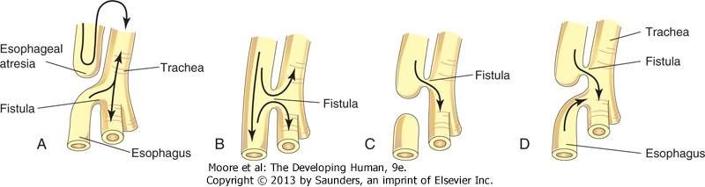
The four main varieties of tracheoesophageal fistula (TEF). Possible directions of the flow of the contents are indicated by arrows. Esophageal atresia, as illustrated in A, is associated with TEF in more than 85% of cases. B, Fistula between the trachea and esophagus. C, Air cannot enter the distal esophagus and stomach. D, Air can enter the distal esophagus and stomach, and the esophageal and gastric contents may enter the trachea and lungs.

Slide 17
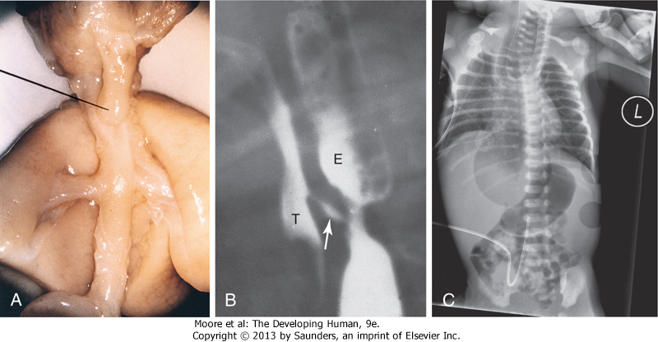
10-6 A, Tracheoesophageal fistula (TEF) in a 17-week male fetus. The upper esophageal segment ends blindly (pointer). B, Contrast radiograph of a neonate with TEF. Note the communication (arrow) between the esophagus (E) and trachea (T). C, Radiograph of esophageal atresia and trachea-esophageal fistula. The blind proximal esophageal sac is clearly visible. Note the air present in the distal GI tract indicating the presence of the tracheo-esophageal fistula. An umbilical venous catheter can also been seen. (A, From Kalousek DK, Fitch N, Paradice B: Pathology of the Human Embryo and Previable Fetus. New York, Springer-Verlag, 1990. B, Courtesy of Dr. Prem S. Sahni, formerly of the Department of Radiology, Children's Hospital, Winnipeg, Manitoba, Canada. C, Courtesy of Dr. J.V. Been and Dr. M.J. Schuurman, Department of Pediatrics, and Dr. S.G. Robben, Department of Radiology, Maastricht University Medical Centre, Maastricht, Netherlands.)

Slide 18
LARYNGOTRACHEOESOPHAGEAL CLEFT
Uncommonly, the larynx and upper trachea may fail to separate completely from the esophagus.
This results in a persistent connection of variable lengths between these normally separated structures.
Symptoms of this congenital anomaly are similar to those of tracheoesophageal fistula because of aspiration into the lungs, but aphonia (absence of voice) is a distinguishing feature.

Slide 19
TRACHEAL STENOSIS AND ATRESIA
Stenosis and atresia of the trachea are uncommon anomalies that are usually associated with one of the varieties of TEF.
Stenoses and atresias probably result from unequal partitioning of the foregut into the esophagus and trachea.
Sometimes there is a web of tissue obstructing airflow (incomplete tracheal atresia).
Atresia or agenesis of the trachea is uniformly fatal.

Slide 20
TRACHEAL DIVERTICULUM (TRACHEAL BRONCHUS)
This anomaly consists of a blind, bronchus-like projection from the trachea.
Outgrowth may terminate in normal-appearing lung tissue, forming a tracheal lobe of the lung.
A tracheal diverticulum may cause recurrent infection and respiratory distress in infants.

Slide 21
DEVELOPMENT OF BRONCHI AND LUNGS
The respiratory bud divides into two outpouchings - the primary bronchial buds.
These buds grow laterally into the pericardioperitoneal canals, the primordia of the pleural cavities.
Secondary and tertiary bronchial buds soon develop.
Together with the surrounding splanchnic mesenchyme, the bronchial buds differentiate into the bronchi and their ramifications in the lungs.
The embryonic right main bronchus is slightly larger than the left one and is oriented more vertically thus foreign body is more likely to enter the right main bronchus than the left one.

Slide 22
The main bronchi subdivide into secondary bronchi that form lobar, segmental, and intrasegmental branches.
Right side:
  superior lobar bronchus will supply the upper (superior) lobe of the lung,
  inferior bronchus subdivides into two bronchi,
    one to the middle lobe of the right lung
    the other to the lower (inferior) lobe
Left side:
  two secondary bronchi supply the upper and lower lobes of the lung
Each lobar bronchus undergoes progressive branching.
The segmental bronchi, 10 in the right lung and eight or nine in the left lung, begin to form by the 7th week.
Segmental bronchi, with the surrounding mass of mesenchyme, form the primordial of the bronchopulmonary segments.
By 24 weeks, approximately 17 orders of branches have formed and respiratory bronchioles have developed.
An additional 7 orders of airways develop after birth.

Slide 23
As the bronchi develop, splanchnic mesenchyme gives rise to:
  cartilage.
  smooth muscle
  connective tissue
  pulmonary connective tissue
  capillaries and other blood vessels
  layer of visceral pleura
With expansion, the lungs and pleural cavities grow caudally into the mesenchyme of the body wall and soon lie close to the heart.
The thoracic body wall becomes lined by a layer of parietal pleura, derived from the somatic mesoderm.
Parietal and visceral pleura are separated by the pleural cavity.

Slide 24
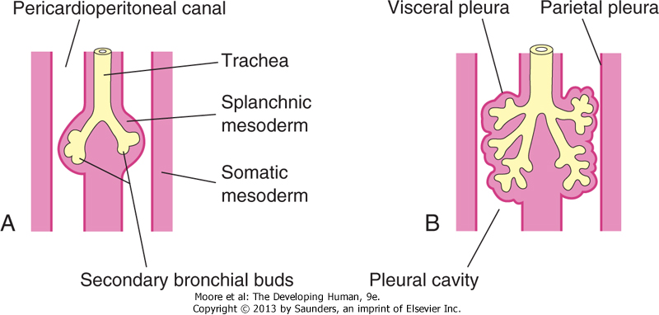
10-7 Illustrations of the growth of the developing lungs into the splanchnic mesenchyme adjacent to the medial walls of the pericardioperitoneal canals (primordial pleural cavities). Development of the layers of the pleura is also shown. A, 5 weeks. B, 6 weeks

Slide 25
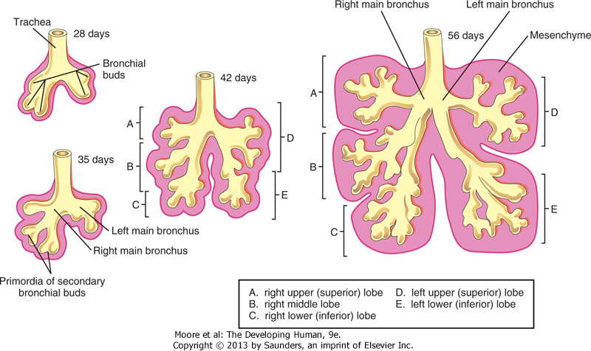
10-8 Successive stages in the development of the bronchial buds, bronchi, and lungs.

Slide 26
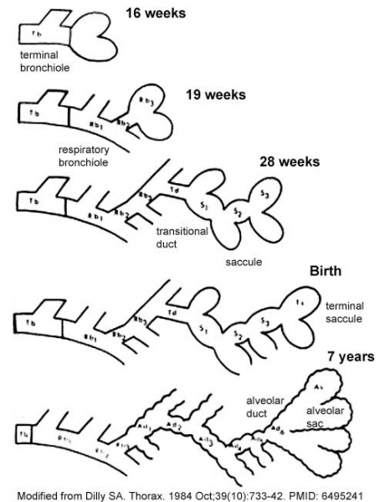
The sequence is most important rather than the actual timing, which is variable in the existing literature

Slide 27
Maturation of Lungs
Maturation of the lungs is divided into four stages:
  pseudoglandular,
  canalicular,
  terminal sac,
  alveolar
Pseudoglandular Stage (6 to 16 Weeks)
  The developing lungs histologically somewhat resemble exocrine glands during this stage.
  By 16 weeks, all major elements of the lung have formed, except those involved with gas exchange.
  Fetuses born during this period are unable to survive.
Canalicular Stage (16 to 26 Weeks)
  Period overlaps the pseudoglandular stage because cranial segments of the lungs mature faster than caudal ones.
  During this stage, the lumina of the bronchi and terminal bronchioles become larger and the lung tissue becomes highly vascular .
  By 24 weeks, each terminal bronchiole has given rise to two or more respiratory bronchioles, each of which then divides into three to six passages-primordial alveolar ducts.

Slide 28
Respiration is possible at the end of the canalicular stage because some thin-walled terminal sacs (primordial alveoli) have developed at the ends of the respiratory bronchioles, and the lung tissue is well vascularized.
Although a fetus born toward the end of this period may survive if given intensive care, it often dies because its respiratory and other systems are still relatively immature.

Slide 29
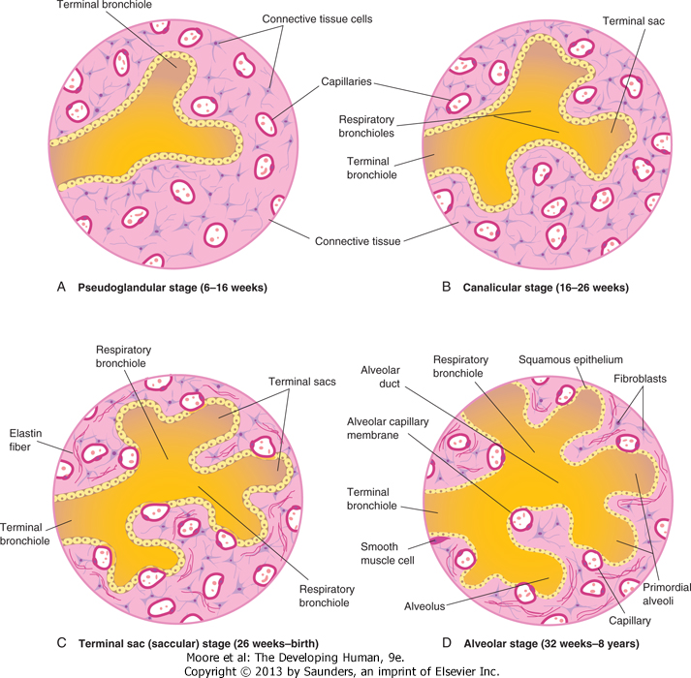
10-9 Diagrammatic sketches of histologic sections illustrating the stages of lung development. A and B, Early stages of lung development. C and D, Note that the alveolocapillary membrane is thin and that some capillaries bulge into the terminal sacs and alveoli.

Slide 30
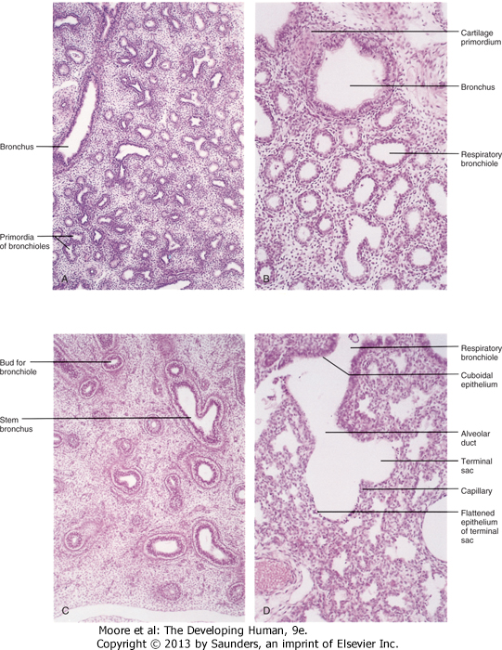
10-10 Photomicrographs of sections of developing embryonic and fetal lungs. A, Pseudoglandular stage, 8 weeks. Note the "glandular" appearance of the lung. B, Canalicular stage, 16 weeks. The lumina of the bronchi and terminal bronchioles are enlarging. C, Canalicular stage, 18 weeks. D, Terminal sac stage, 24 weeks. Observe the thin-walled terminal sacs (primordial alveoli) that have developed at the ends of the respiratory bronchioles. Also observe that the number of capillaries have increased and some of them are closely associated with the developing alveoli. (From Moore KL, Persaud TVN, Shiota K: Color Atlas of Clinical Embryology, 2nd ed. Philadelphia, WB Saunders, 2000.)

Slide 31
Terminal Sac (Saccular) Stage (26 Weeks to Birth)
Many more terminal sacs (saccules) develop, and their epithelium becomes very thin.
Capillaries begin to bulge into these sacs (developing alveoli).
The intimate contact between epithelial and endothelial cells establishes the blood-air barrier, which permits adequate gas exchange for survival of the fetus if it is born prematurely.
By 26 weeks, the terminal sacs are lined mainly by squamous epithelial cells of endodermal origin-type I pneumocytes-across which gas exchange occurs.
The capillary network proliferates rapidly in the mesenchyme around the developing alveoli, and there is concurrent active development of lymphatic capillaries.
Scattered among the squamous epithelial cells are rounded secretory epithelial cells-type II pneumocytes, which secrete pulmonary surfactant, a complex mixture of phospholipids and proteins.

Slide 32
Surfactant forms as a monomolecular film over the internal walls of the alveolar sacs and counteracts surface tension forces at the air-alveolar interface.
Surfactant facilitates expansion of the sacs by preventing atelectasis (collapse of sacs) during exhalation.
The maturation of type II pneumocytes and surfactant production varies widely in fetuses of different gestational ages.
The production of surfactant increases during the terminal stages of pregnancy, particularly during the last 2 weeks.
Surfactant production begins at 20 to 22 weeks, but it is present in only small amounts in premature infants; it does not reach adequate levels until the late fetal period.
By 26 to 28 weeks after fertilization, the fetus usually weighs approximately 1000 g and sufficient alveolar sacs and surfactant are present to permit survival of a prematurely born infant.

Slide 33
Before 26-28 weeks, the lungs are usually incapable of providing adequate gas exchange, partly because the alveolar surface area is insufficient and the vascularity underdeveloped.
It is the development of an adequate pulmonary vasculature and sufficient surfactant that is critical to the survival and neurodevelopmental outcome of premature infants.
Fetuses born prematurely at 24 to 26 weeks after fertilization may survive if given intensive care; however, they may suffer from respiratory distress because of surfactant deficiency.
Survival of these infants has improved with the use of antenatal corticosteroids, which induces surfactant production, and also with postnatal surfactant replacement therapy.

Slide 34
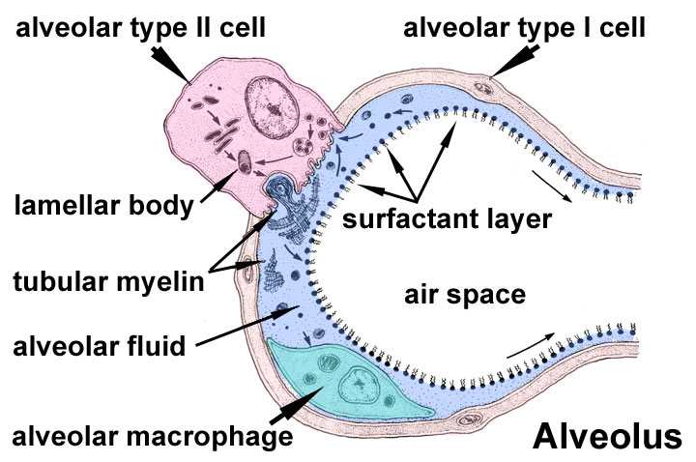

Slide 35
Alveolar Stage (32 Weeks to 8 Years)
Stage defined by presence of alveolus.
Sacs analogous to alveoli are present at 32 weeks.
The epithelial lining of the terminal sacs attenuates to a thin squamous epithelial layer.
The type I pneumocytes become so thin that the adjacent capillaries bulge into the alveolar sacs.
By the late fetal period, the lungs are capable of respiration because the alveolocapillary membrane (pulmonary diffusion barrier or respiratory membrane) is sufficiently thin to allow gas exchange.
Although the lungs do not begin to perform this vital function until birth, they are well developed so that they are capable of functioning as soon as the baby is born.

Slide 36
At the beginning of the alveolar stage, each respiratory bronchiole terminates in a cluster of thin-walled alveolar sacs, separated from one another by loose connective tissue.
These sacs represent future alveolar ducts .
The transition from dependence on the placenta for gas exchange to autonomous gas exchange requires the following adaptive changes in the lungs:
  Production of surfactant in the alveolar sacs
  Transformation of the lungs from secretory into gas exchanging organs
  Establishment of parallel pulmonary and systemic circulations

Slide 37
Approximately 95% of mature alveoli develop postnatally.
After birth, the primordial alveoli enlarge as the lungs expand,
The greatest increase in the size of the lungs results from an increase in the number of respiratory bronchioles and primordial alveoli rather than from an increase in the size of the alveoli.
Alveolar development is largely completed by 3 years of age, but new alveoli are added until approximately 8 years of age.
Unlike mature alveoli, immature alveoli have the potential for forming additional primordial alveoli.
The major mechanism for increasing the number of alveoli is the formation of secondary connective tissue septa that subdivide existing primordial alveoli.
Initially, the septa are relatively thick, but they are soon transformed into mature thin septa that are capable of gas exchange.

Slide 38
Lung development
During the first few months after birth lung development is characterized by an exponential increase in the surface area of the air-blood barrier through the multiplication of alveoli and capillaries.
Approximately 150 million primordial alveoli, one half of the adult number, are present in the lungs of a full-term neonate.
On chest radiographs, therefore, the lungs of neonates are denser than adult lungs.
Between the third and eighth years, the adult complement of 300 million alveoli is achieved.

Slide 39
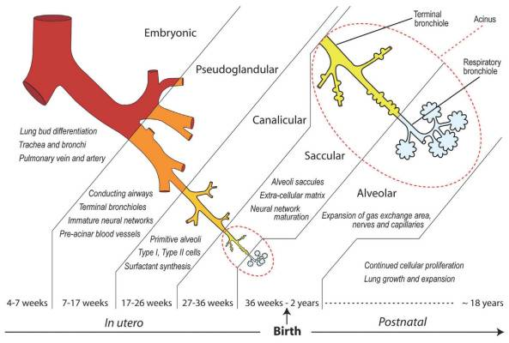

Slide 40
Molecular studies
Lung development is controlled by a cascade of signaling pathways that are regulated by the temporal and sequential expression of highly conserved genes.
The commitment and differentiation of endodermal foregut cells to form respiratory-type epithelial cells are associated with expression of several transcription factors:
  thyroid transcription factor 1,
  hepatocyte nuclear factor (HNF) 3β,
  GATA-6,
  other Zinc-finger family members,
  retinoic acid receptors,
  homeobox (Hox) domain-containing genes
Hox genes specify the anteroposterior axis in the embryo.
Fibroblast growth factor 10 and other signals from splanchnic mesenchyme probably induce the outgrowth of the respiratory bud.

Slide 41
Branching of the respiratory bud (branching morphogenesis) and its proliferation depend on epithelial (endodermal foregut)-mesenchymal (mesoderm) interactions.
The Wnt signaling pathway plays an essential role in the inductive interactions between epithelium and mesenchyme.
Recent studies suggest that Wnt7b signaling from the epithelium regulates mesenchymal proliferation and blood vessel formation in the lung.
The patterning morphogen sonic hedgehog (Shh-Gli) modulates the expression of fibroblast growth factor 10, which controls the branching of the bronchial buds.
The morphogen retinoic acid regulates Hox a5, b5, and c4, which are expressed in the developing lung.

Slide 42
Fetal breathing movements (FBMs)
FBM can be detected by real-time ultrasonography
FBM occur before birth, exerting sufficient force to cause aspiration of some amniotic fluid into the lungs.
FBMs occur intermittently (approximately 30% of them during rapid eye movement sleep) and are essential for normal lung development.
The pattern of FBMs is widely used in the monitoring of labor and as a predictor of fetal outcome in a preterm delivery.
By birth, the fetus has had the advantage of several months of breathing exercise.
FBMs, which increase as the time of delivery approaches, probably condition the respiratory muscles.
In addition, these movements stimulate lung development, possibly by creating a pressure gradient between the lungs and the amniotic fluid.

Slide 43
At birth, the lungs are approximately half-filled with fluid derived from the amniotic cavity, lungs, and tracheal glands.
Aeration of the lungs at birth is not so much the inflation of empty collapsed organs but rather the rapid replacement of intra-alveolar fluid by air.
The fluid in the lungs is cleared at birth by three routes:
  Through the mouth and nose by pressure on the fetal thorax during vaginal delivery
  Into the pulmonary arteries, veins, and capillaries
  Into the lymphatics
In the near-term fetus, the pulmonary lymphatic vessels are relatively larger and more numerous than in the adult.
Lymph flow is rapid during the first few hours after birth and then diminishes.
Three factors are important for normal lung development:
  Adequate thoracic space for lung growth,
  FBMs,
  Adequate amniotic fluid volume

Slide 44
OLIGOHYDRAMNIOS AND LUNG DEVELOPMENT
When oligohydramnios is severe and chronic because of amniotic fluid leakage or decreased production, lung development is retarded and severe pulmonary hypoplasia results from restriction of the fetal thorax.
LUNGS OF NEONATES
Fresh healthy lungs always contain some air; consequently, pulmonary tissue removed from them will float in water.
A diseased lung, partly filled with fluid, may not float.
Of medicolegal significance is the fact that the lungs of a stillborn infant are firm and sink when placed in water because they contain fluid, not air.

Slide 45
RESPIRATORY DISTRESS SYNDROME
Respiratory distress syndrome (RDS) affects approximately 2% of live newborn infants; those born prematurely are most susceptible.
These infants develop rapid, labored breathing shortly after birth.
RDS is also known as hyaline membrane disease (HMD).
An estimated 30% of all neonatal disease results from RDS or its complications.
Surfactant deficiency is a major cause of RDS or HMD.
The lungs are underinflated and the alveoli contain a fluid with a high protein content that resembles a glassy or hyaline membrane.
This membrane is thought to be derived from a combination of substances in the circulation and from the injured pulmonary epithelium.
It has been suggested that prolonged intrauterine asphyxia may produce irreversible changes in the type II alveolar cells, making them incapable of producing surfactant.

Slide 46
Other factors may cause RDS.
All growth factors and hormones controlling surfactant production have not been identified, but corticosteroids and thyroxine, which are involved in fetal lung maturation, are potent stimulators of surfactant production.
Maternal glucocorticoid treatment during pregnancy accelerates fetal lung development and surfactant production.
It is now routine to use corticosteroids (betamethasone) for the prevention of RDS in preterm labor.
Administration of exogenous surfactant (surfactant replacement therapy) reduces the severity of RDS and neonatal mortality.

Slide 47
LOBE OF AZYGOS VEIN
This lobe appears in the right lung in approximately 1% of people.
It develops when the apical bronchus grows superiorly, medial to the arch of the azygos vein, instead of lateral to it.
As a result, the vein lies at the bottom of a fissure in the superior (upper) lobe, which produces a linear marking on a radiograph of the lungs.
CONGENITAL LUNG CYSTS
Cysts (filled with fluid or air) are thought to be formed by the dilation of terminal bronchi.
They probably result from a disturbance in bronchial development during late fetal life.
If several cysts are present, the lungs have a honeycomb appearance on radiographs.
Congenital lung cysts are usually located at the periphery of the lung.

Slide 48
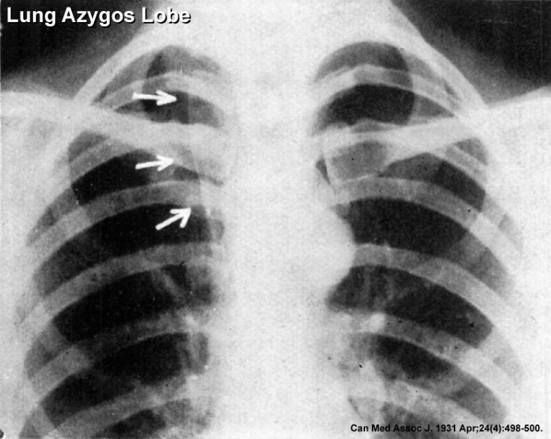

Slide 49
AGENESIS OF LUNGS
Absence of the lungs results from failure of the respiratory bud to develop.
Agenesis of one lung is more common than bilateral agenesis, but both conditions are rare.
Unilateral pulmonary agenesis is compatible with life.
The heart and other mediastinal structures are shifted to the affected side, and the existing lung is hyperexpanded.
LUNG HYPOPLASIA
In infants with congenital diaphragmatic hernia, the lung is unable to develop normally because it is compressed by the abnormally positioned abdominal viscera.
Lung hypoplasia is characterized by:
  markedly reduced lung volume
  hypertrophy of the smooth muscle in the pulmonary arteries
The pulmonary hypertension leads to decreased blood flow through the pulmonary vascular system as the blood continues to shunt through the ductus arteriosus.

Slide 50
Many infants with congenital diaphragmatic hernia may die of pulmonary insufficiency, despite optimal postnatal care, because their lungs are too hypoplastic for air exchange and there is too much resistance for pulmonary blood flow to support extrauterine life.
ACCESSORY LUNG
A small accessory lung (pulmonary sequestration) is uncommon.
It is almost always located at the base of the left lung and nonfunctional.
It does not communicate with the tracheobronchial tree and its blood supply is usually systemic.

Slide 51
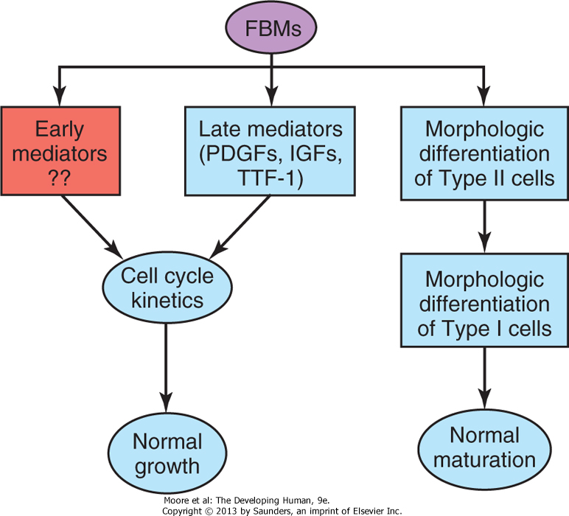
Fetal breathing movements (FBMs) seem to play a role in lung growth through their effects on lung cell cycle kinetics by regulating the expression of growth factors, such as platelet-derived growth factors (PDGFs) and insulin-like growth factors (IGFs), and establishing the gradient of thyroid transcription factor 1 (TTF-1) expression at the last stage of lung organogenesis (i.e., late mediators). It is also suggested that FBMs influence the expression of other unknown growth factors (i.e., early mediators) that are responsible for changes in cell cycle kinetics at earlier stages of lung development. FBMs appear to also be required for the accomplishment of the morphologic differentiation of type I and II pneumocytes. (From Inanlou MR, Baguma-Nibasheka M, Kablar B: The role of fetal breathing-like movements in lung organogenesis. Histol Histopathol 20:1261, 2005.)

Slide 52
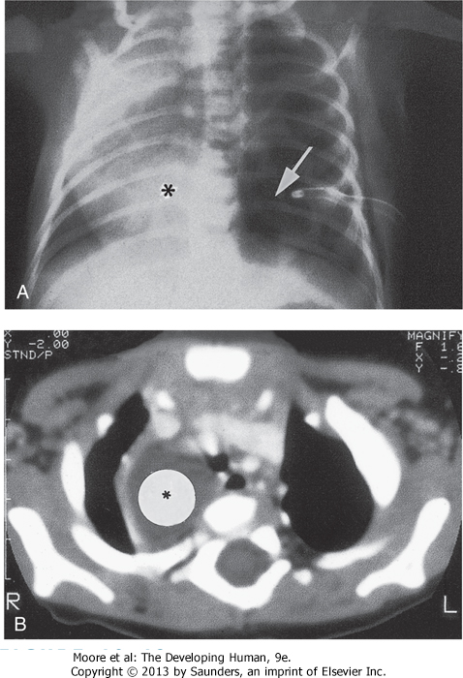
10-12 Congenital lung cysts. A, Chest radiograph (posteroanterior) of an infant showing a large left-sided congenital cystic adenomatoid malformation (arrow). The heart (asterisk) has shifted to the right. Note the chest tube on the left side, which was placed on the initial diagnosis of a pneumothorax (air in pleural cavity). B, Axial computed tomography image of the thorax in an infant with a large right-sided congenital bronchogenic cyst (asterisk). (Courtesy of Dr. Prem S. Sahni, formerly of the Department of Radiology. Children's Hospital, Winnipeg, Manitoba, Canada.)

Slide 53
SUMMARY OF MAJOR EVENTS
Week 4 - laryngotracheal groove forms on floor foregut.
Week 5 - left and right lung buds push into the pericardioperitoneal canals (primordia of pleural cavity)
Week 6 - descent of heart and lungs into thorax. Pleuroperitoneal foramen closes.
Week 7 - enlargement of liver stops descent of heart and lungs.
Month 3-6 - lungs appear glandular, end month 6 alveolar cells type 2 appear and begin to secrete surfactant.
Month 7 - respiratory bronchioles proliferate and end in alveolar ducts and sacs.

Slide 54
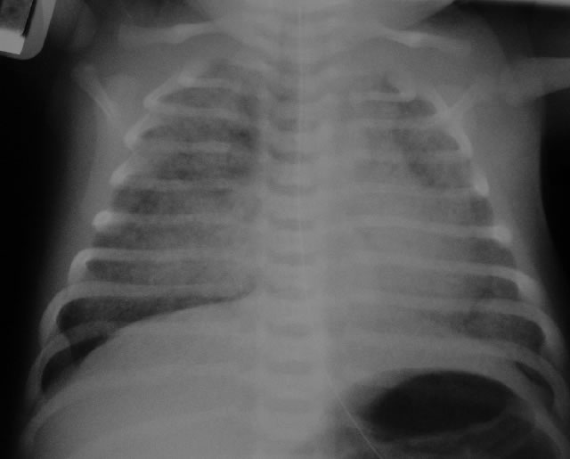
Newborn X-ray Meconium aspiration syndrome

Slide 55
DEVELOPMENT OF BODY CAVITIES, BODY WALL AND THORACIC DIAPHRAGM
Prof Peter Gichangi

Slide 56
OBJECTIVES
Understand development of body cavities, body wall and thoracic diaphragm
List congenital malformations associated with development of these parts

Slide 57
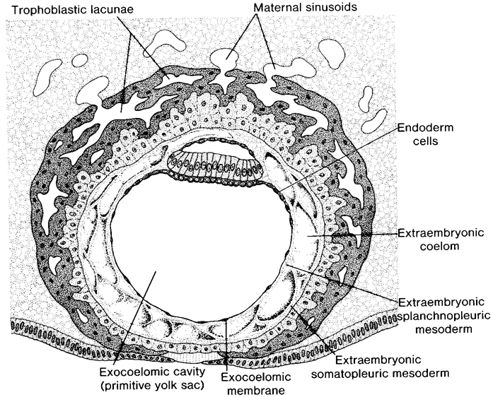

Slide 58
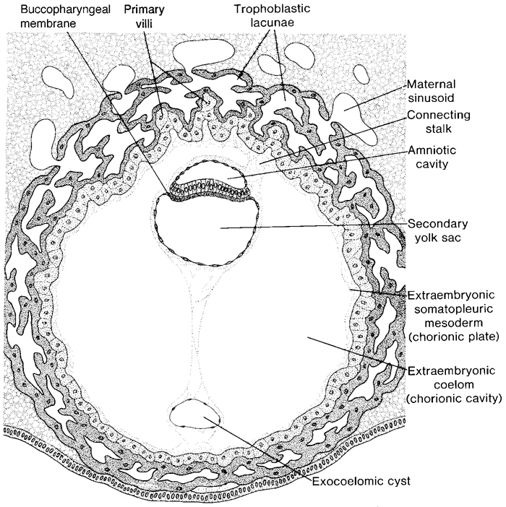

Slide 59
Body Cavities and Membranes (1)
Dorsal body cavity
  Cranial cavity
  Vertebral cavity
Ventral body cavity
  Thoracic cavity – divided into three parts
    Two lateral parts each containing a lung surrounded by a pleural cavity
    Mediastinum – contains the heart surrounded by the pericardial sac
  Abdominopelvic cavity – divided into two parts
    Abdominal cavity – contains the liver, stomach, kidneys, and other organs
    Pelvic cavity – contains the bladder, some reproductive organs, and rectum

Slide 60
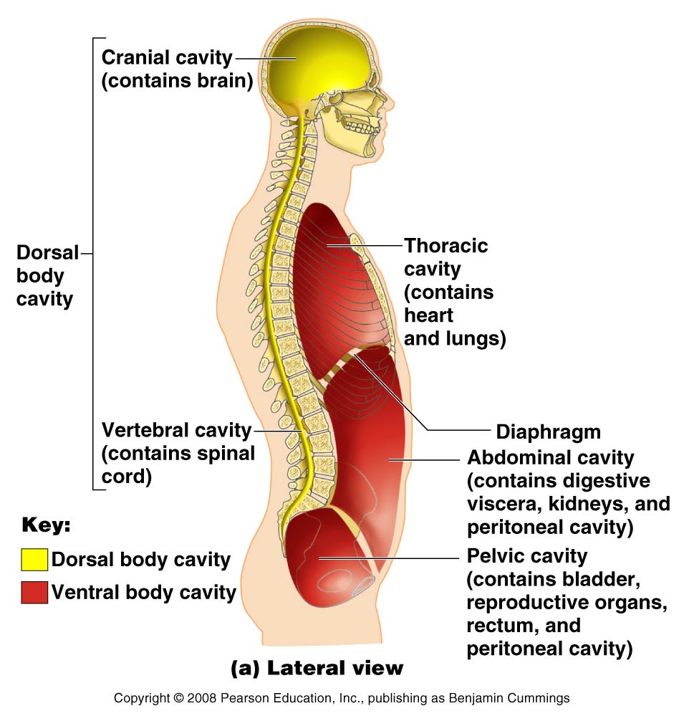
Body Cavities and Membranes (2)

Slide 61
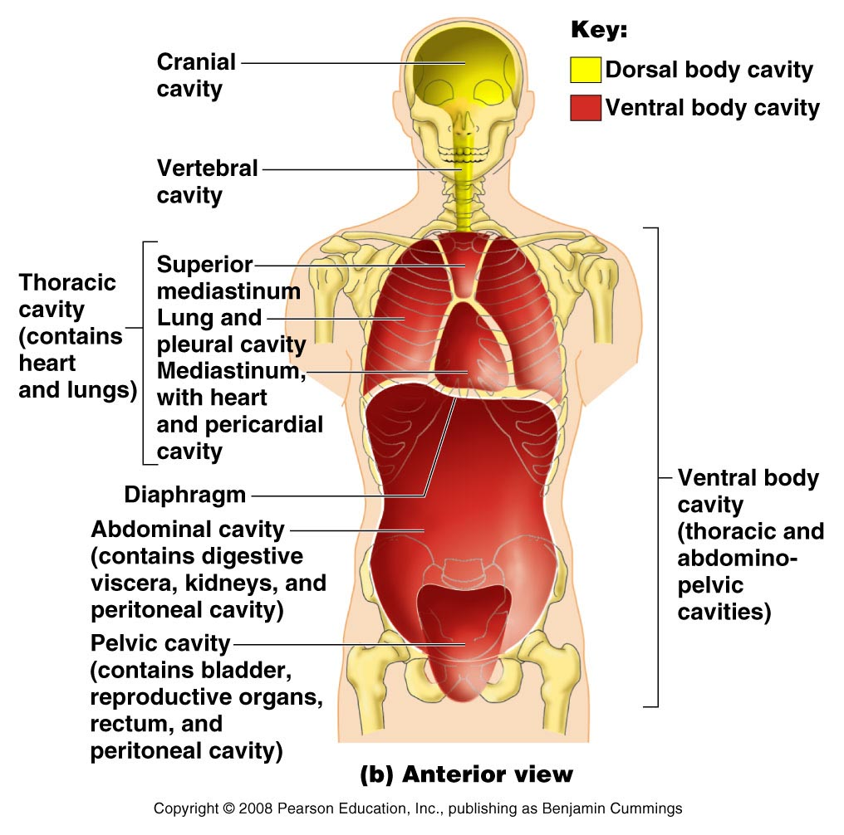
Body Cavities and Membranes (3)

Slide 62
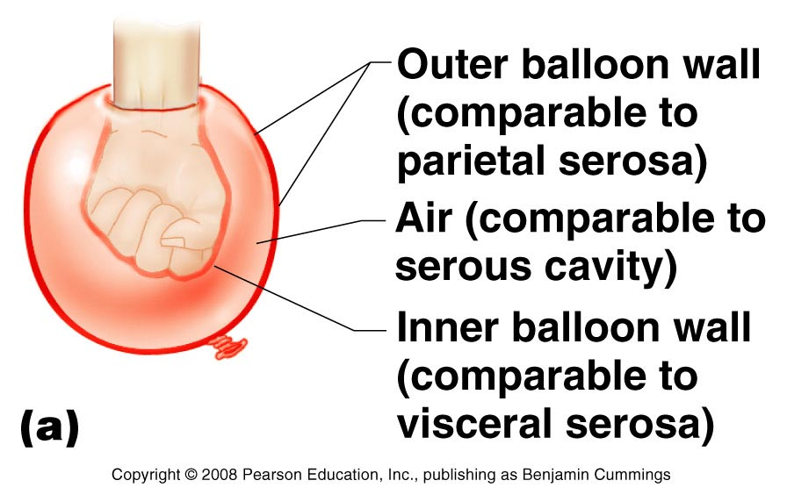
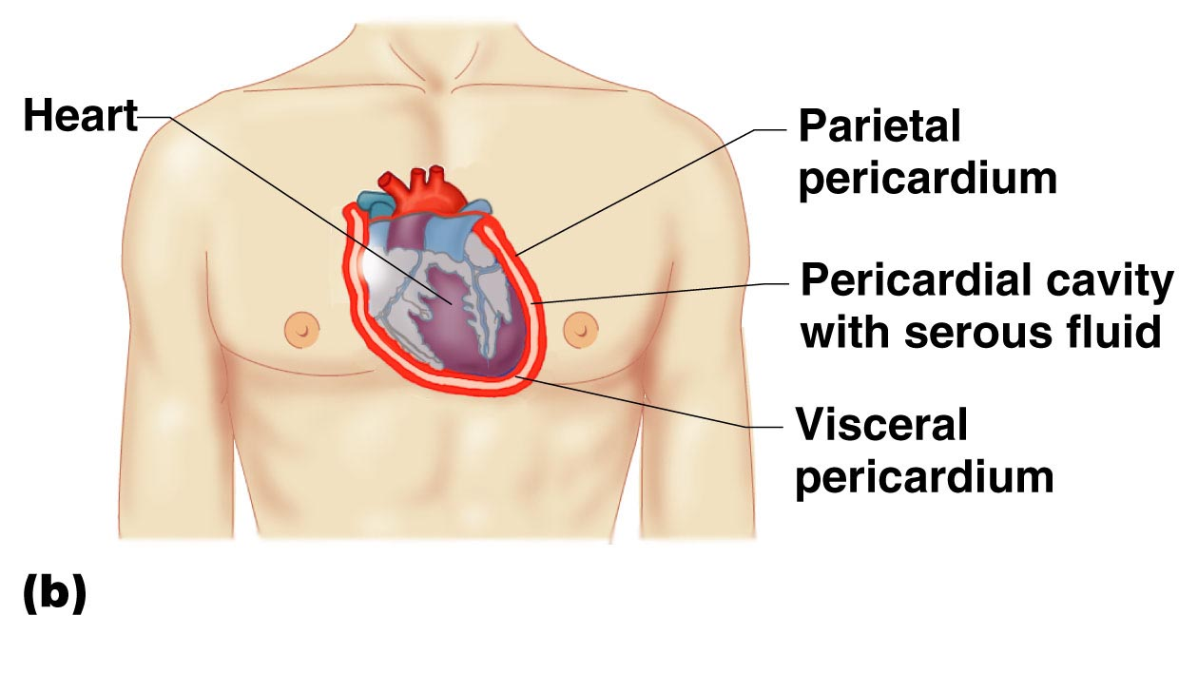
Body Cavities and Membranes (4)
Serous cavities – a slit-like space lined by a serous membrane
  Pleura, pericardium, and peritoneum
    Parietal serosa – outer wall of the cavity
    Visceral serosa covers the visceral organs

Slide 63
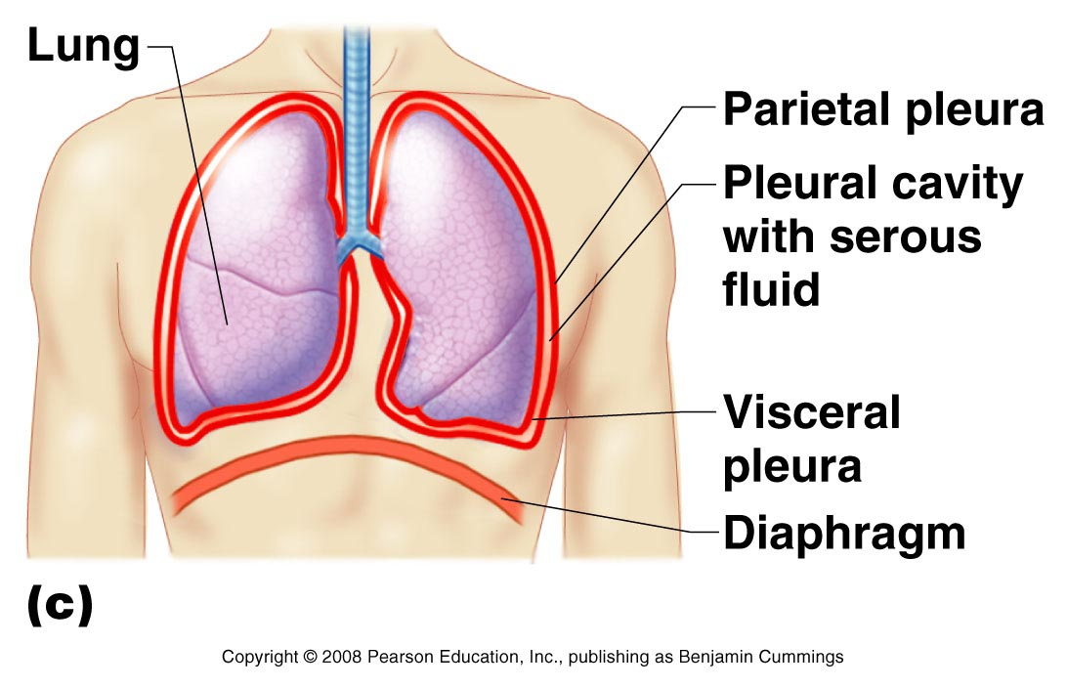
Body Cavities and Membranes (5)

Slide 64
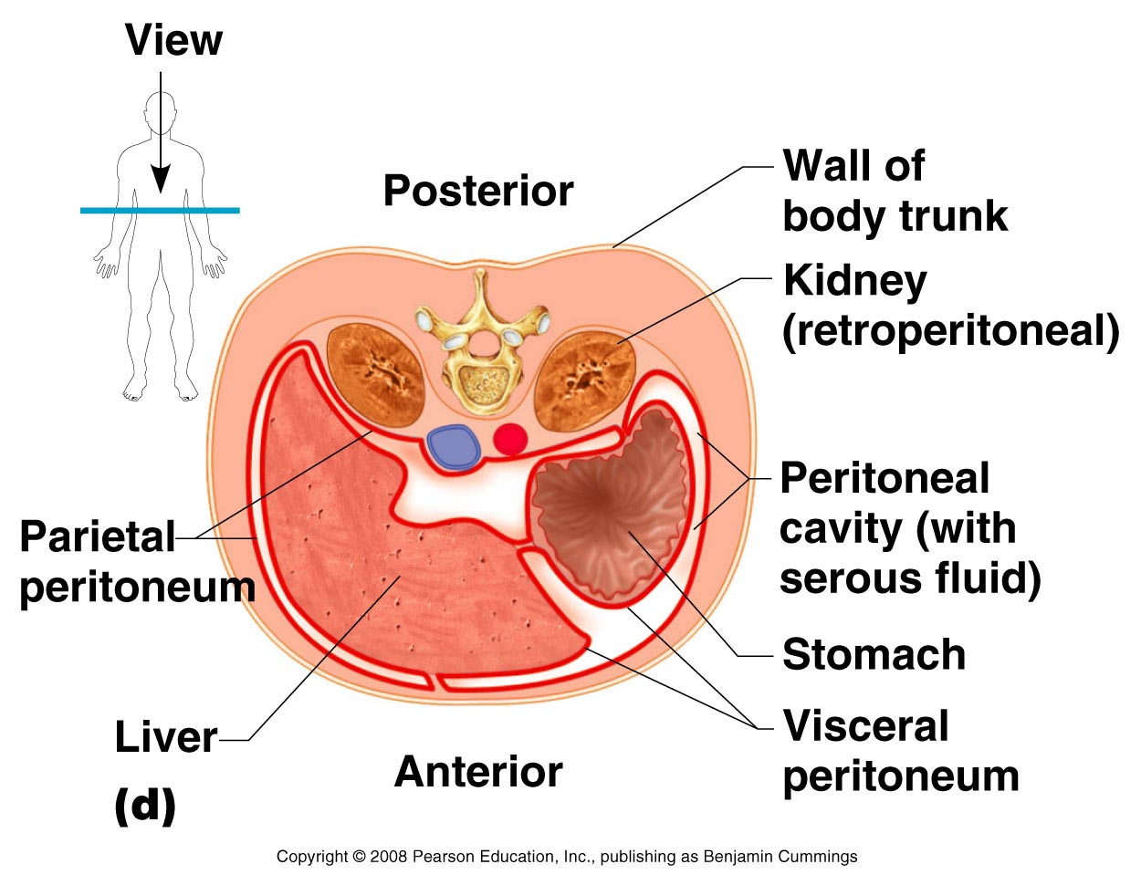
Body Cavities and Membranes (6)

Slide 65
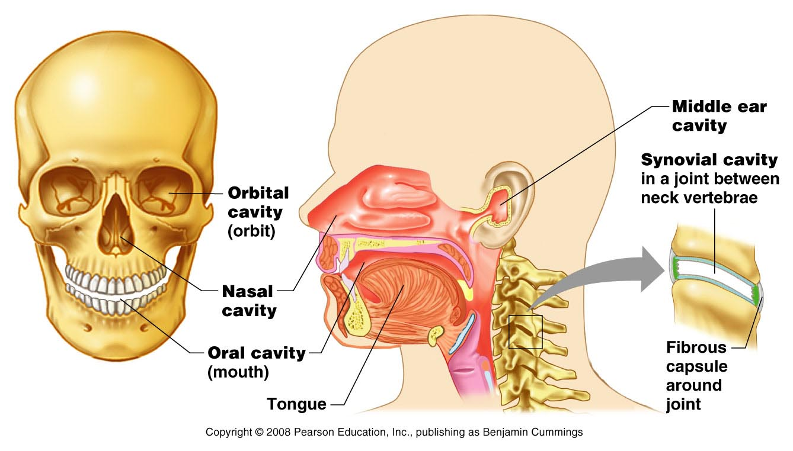
Body Cavities and Membranes (7)
Other cavities
  Oral cavity
  Nasal cavity
  Orbital cavities
  Middle ear cavities
  Synovial cavities

Slide 66
EMBRYONIC BODY CAVITY
4th week, intraembryonic cavity is divided into:
  The pericardial cavity
  Two pleuroperitoneal canals
  Peritoneal cavity

Slide 67
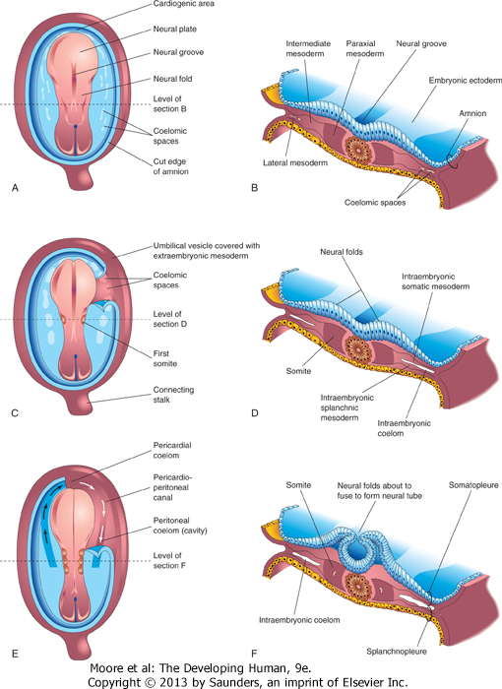
Drawings of embryos at 19 to 21 days illustrating development of the somites and intraembryonic coelom. A, C, and E, Dorsal views of the embryo, exposed by removal of the amnion. B, D, and F, Transverse sections through the trilaminar embryonic disc at the levels shown. A, Presomite embryo of approximately 18 days. C, An embryo of approximately 20 days showing the first pair of somites. Part of the somatopleure on the right has been removed to show the coelomic spaces in the lateral mesoderm. E, A three-somite embryo (approximately 21 days) showing the horseshoe-shaped intraembryonic coelom, exposed on the right by removal of part of the somatopleure.

Slide 68
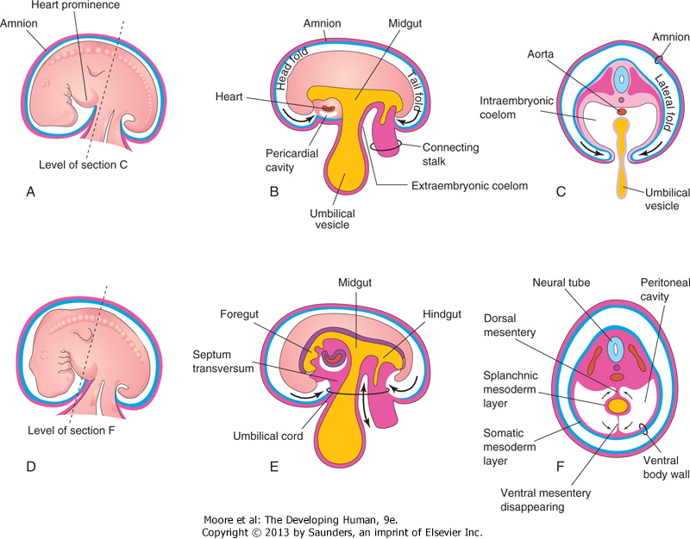
Illustrations of embryonic folding and its effects on the intraembryonic coelom and other structures. A, Lateral view of an embryo (approximately 26 days). B, Schematic sagittal section of this embryo showing the head and tail folds. C, Transverse section at the level shown in A, indicating how fusion of the lateral folds gives the embryo a cylindrical form. D, Lateral view of an embryo (approximately 28 days). E, Schematic sagittal section of this embryo showing the reduced communication between the intraembryonic and extraembryonic coeloms (double-headed arrow). F, Transverse section as indicated in D, illustrating formation of the ventral body wall and disappearance of the ventral mesentery. The arrows indicate the junction of the somatic and splanchnic layers of mesoderm. The somatic mesoderm will become the parietal peritoneum lining the abdominal wall, and the splanchnic mesoderm will become the visceral peritoneum covering the organs (e.g., the stomach).

Slide 69
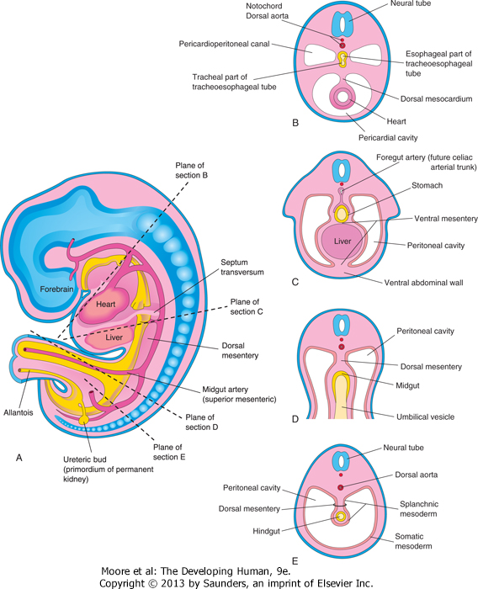
Illustrations of the mesenteries and body cavities at the beginning of the fifth week. A, Schematic sagittal section. Note that the dorsal mesentery serves as a pathway for the arteries supplying the developing gut. Nerves and lymphatics also pass between the layers of this mesentery. B to E, Transverse sections through the embryo at the levels indicated in A. The ventral mesentery disappears, except in the region of the terminal esophagus, stomach, and first part of the duodenum. Note that the right and left parts of the peritoneal cavity, separate in C, are continuous in E.

Slide 70
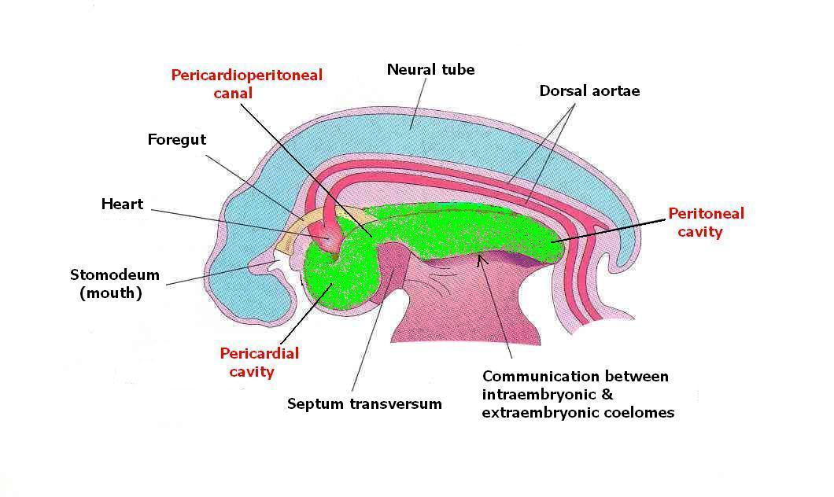
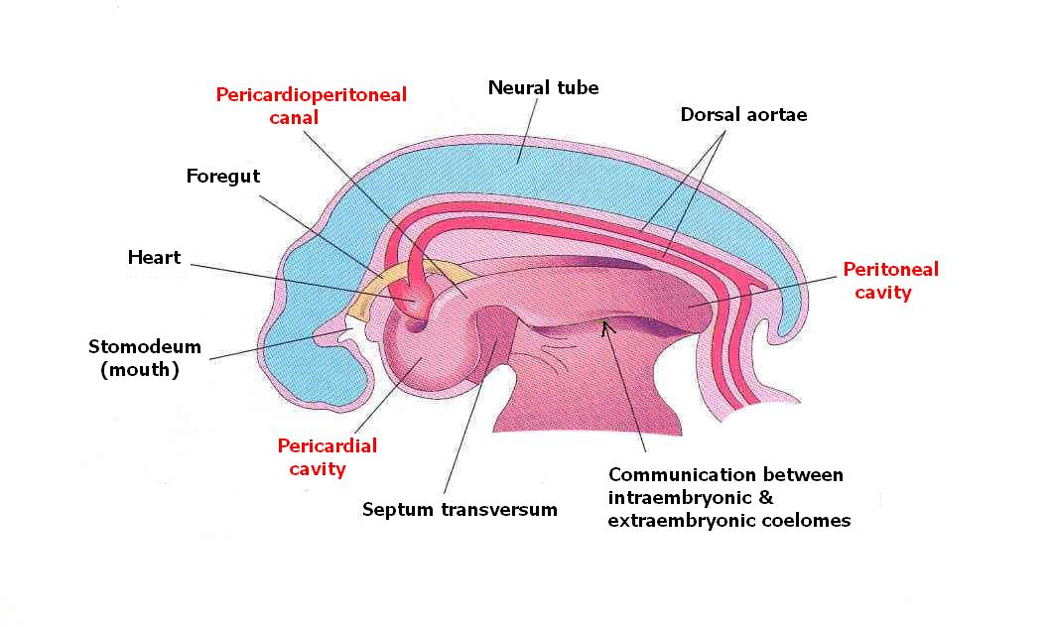
During cranial folding of embryo, the pericardial cavity comes to lie ventral to the foregut
The pericardioperitoneal canals:
  arise from the dorsal wall of the pericardial cavity
  pass on each side of the foregut (future esophagus)
  lie dorsal to septum transversum
  open into the peritoneal cavity

Slide 71
BODY WALL
Formed by somatic messenchyme surrounding the developing amniotic cavity.
Results from:
  Horizontal folding
  Cranial-caudal folding

Slide 72
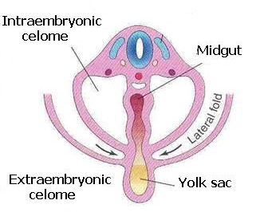
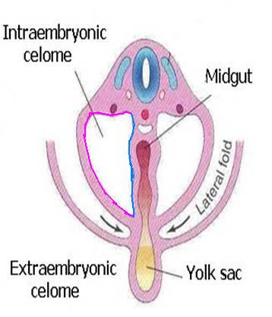
During horizontal folding, the limbs of the coelom are brought together on the ventral aspect of the embryo
The coelom is lined by:
  mesothelium derived from the somatic mesoderm (parietal layer)
  and the splanchnic mesoderm (visceral layer)
Peritoneal cavity is connected with extraembryonic coelom at the umbilicus
The connection is lost during the 10th week as the intestine return from umbilical cord
Parietal layer
Visceral layer

Slide 73
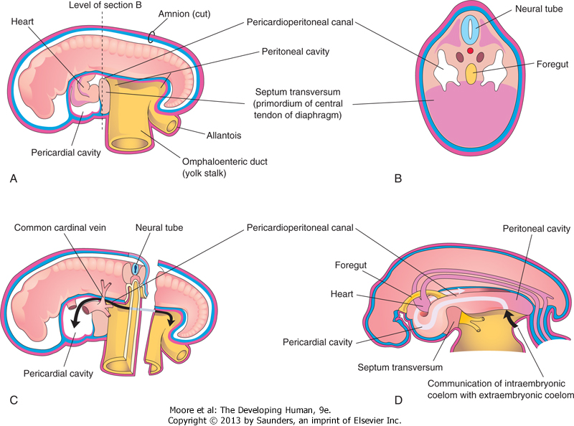
Schematic drawings of an embryo (approximately 24 days). A, The lateral wall of the pericardial cavity has been removed to show the primordial heart. B, Transverse section of the embryo illustrating the relationship of the pericardioperitoneal canals to the septum transversum (primordium of central tendon of diaphragm) and the foregut. C, Lateral view of the embryo with the heart removed. The embryo has also been sectioned transversely to show the continuity of the intraembryonic and extraembryonic coeloms (arrow). D, Sketch showing the pericardioperitoneal canals arising from the dorsal wall of the pericardial cavity and passing on each side of the foregut to join the peritoneal cavity. The arrow shows the communication of the extraembryonic coelom with the intraembryonic coelom and the continuity of the intraembryonic coelom at this stage.

Slide 74
CONGENITAL MALFORMATIONS
Ventral wall defects
Ectopia cordis
Gastroschisis
Cantrell pentalogy
  Ectopia cordis
  Defective anterior diaphragm
  Absence of pericardium
  Defective sternum
  Defective anterior abdominal wall

Slide 75
Division of Embryonic Coelom
Partitions appear to separate the pericardioperitoneal canals from the pericardial cavity and the peritoneal cavity
As the lung buds grow into the pericardioperitoneal canals, a pair of membranous ridges is produced in the lateral wall of each canal:
  The pleuropericardial folds cranially which is between the developing lung and heart
  The pleuroperitoneal folds caudally to the developing lungs

Slide 76
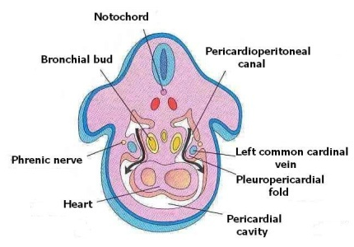

Pleuropericardial Membranes
The bronchial buds grow laterally from the caudal end of the trachea into the pericardioperitoneal canals (future pleural cavities)
As the pleural cavities expand ventrally, they grow into the body wall in the angle between the body wall and a ridge raised by the common cardinal vein and the phrenic nerve

Slide 77
This results in splitting the mesenchyme into:
  An outer layer that forms the thoracic wall
  An inner layer that forms the pleuro-pericardial membrane
The pleuropericardial membranes project into the cranial end of the pericardioperitoneal canals

Slide 78
With the growth and descent of the heart and expansion of the pleural cavities, the pleuro-pericardial membranes expand and move medially
By 7th week, the membranes fuse with the mesenchyme ventral to the esophagus forming the primordial mediastinum, thus closing the pleuropericardial openings .

Slide 79
The right pleuropericardial opening closes slightly earlier than the left (right common cardinal vein is larger than the left and so raises a bigger fold)
Phrenic nerve
The fused pleuropericardial membranes form the fibrous pericardium
(Note the position of phrenic nerve in the fibrous pericardium)

Slide 80
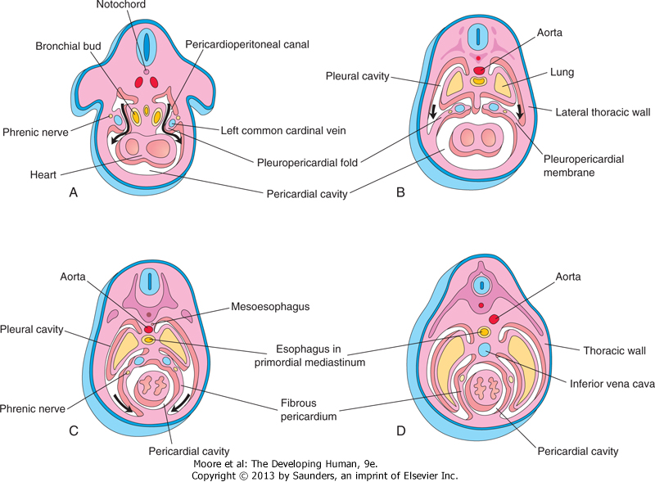
Drawings of transverse sections through embryos cranial to the septum transversum, illustrating successive stages in the separation of the pleural cavities from the pericardial cavity. Growth and development of the lungs, expansion of the pleural cavities, and formation of the fibrous pericardium are also shown. A, At 5 weeks. The arrows indicate the communications between the pericardioperitoneal canals and the pericardial cavity. B, At 6 weeks. The arrows indicate development of the pleural cavities as they expand into the body wall. C, At 7 weeks. Expansion of the pleural cavities ventrally around the heart is shown. The pleuropericardial membranes are now fused in the median plane with each other and with the mesoderm ventral to the esophagus. D, At 8 weeks. Continued expansion of the lungs and pleural cavities and formation of the fibrous pericardium and thoracic wall are illustrated.

Slide 81
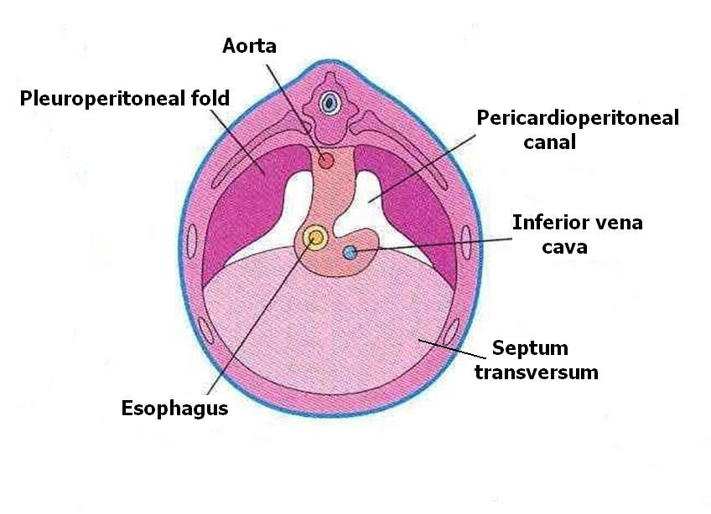
Pleuroperitoneal Membranes
Develop from the pleuroperitoneal folds that are attached dorsolaterally to the body wall and their free edges project into the caudal part of the pericardioperitoneal canals
As the developing lung enlarges cranially and liver expands caudally, these folds become more prominent and gradually become membranous
Are soon invaded by the myoblasts (primitive muscle cells)

Slide 82
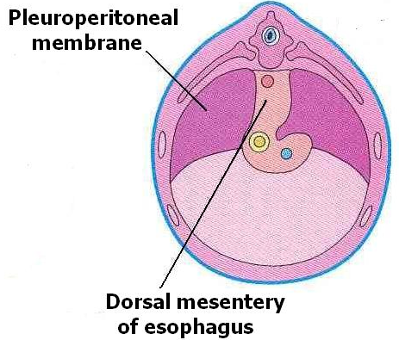
During 6th week, the pleuroperitoneal membranes extend ventromedially and fuse with the dorsal mesentery of the esophagus and the septum transversum
This results in closure of the pericardioperitoneal openings. The right opening closes slightly earlier than the left

Slide 83
CONGENITAL PERICARDIAL DEFECTS
Defective formation and/or fusion of the pleuropericardial membranes separating the pericardial and pleural cavities is uncommon.
This anomaly results in a congenital defect of the pericardium, usually on the left side.
Consequently, the pericardial cavity communicates with the pleural cavity.
In very unusual cases, part of the left atrium of the heart herniates into the pleural cavity at each heartbeat.

Slide 84
Development of the Diaphragm

Slide 85
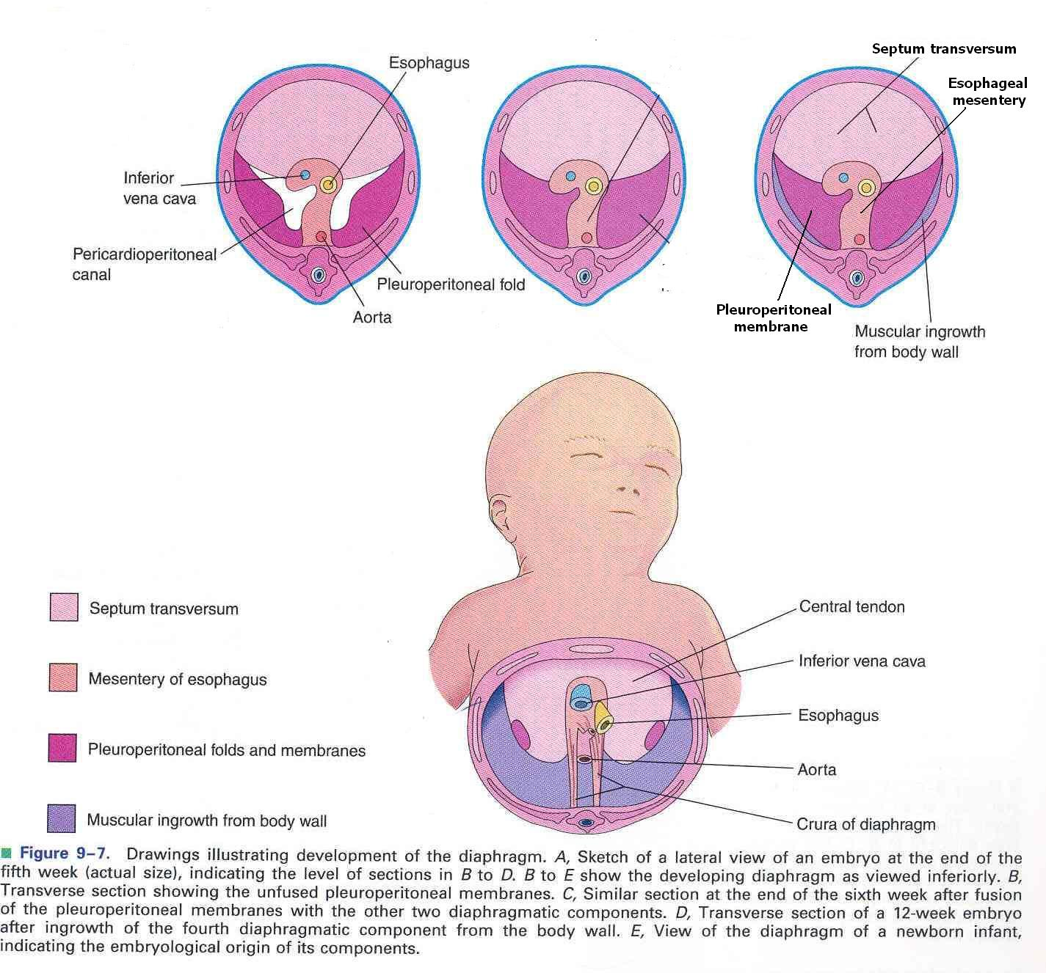
The diaphragm develops from four embryonic components:
  Septum transversum
  Pleuroperitoneal membranes
  Dorsal mesentery of esophagus
  Muscular ingrowth from lateral body walls
1
3
2
4

Slide 86
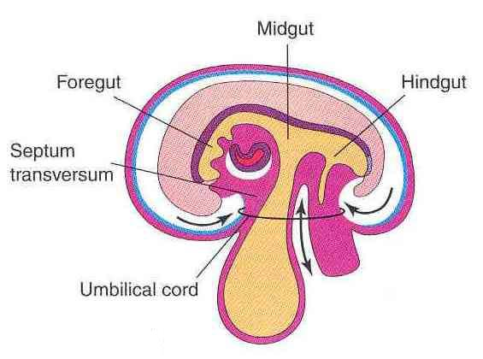
Septum Transversum
A thick plate of mesodermal tissue
Lies:
  Between the pericardial cavity and the umbilical vesicle
  Ventral to the foregut and the pleuro-peritoneal canals
Grows dorsally from the ventrolateral body wall

Slide 87
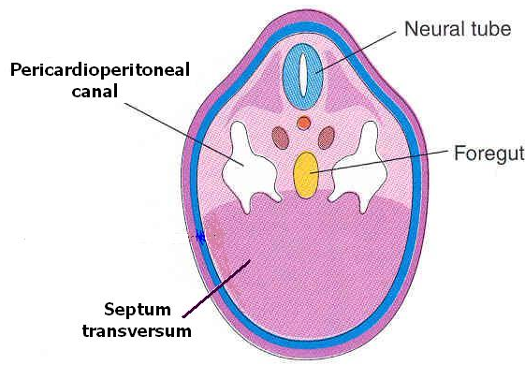
Forms an incomplete partition between the thoracic cavity and the abdominal cavity
Expands and fuses with the pleuroperitoneal membranes and the mesenchyme ventral to the esophagus
Septum transversum is the primordium of the central tendon of the diaphragm

Slide 88
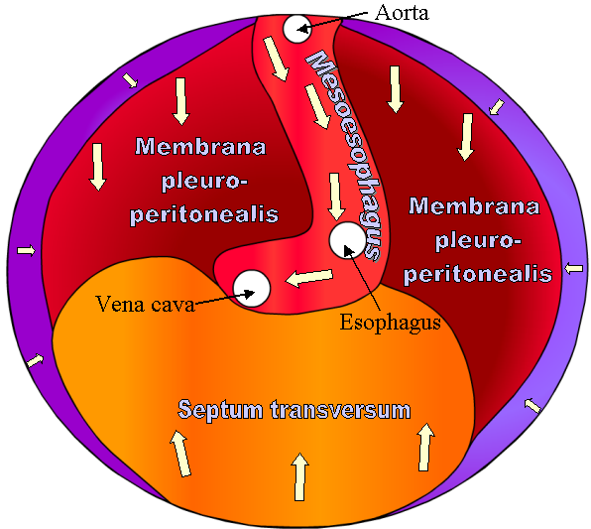
During 6th week, the three basic components:
  Pleuroperitoneal membranes
  Mesoesophagus
  Septum transversum
1
2
3
1
The 3 fuse with each other and form a complete partition between the thoracic and abdominal cavities

Slide 89
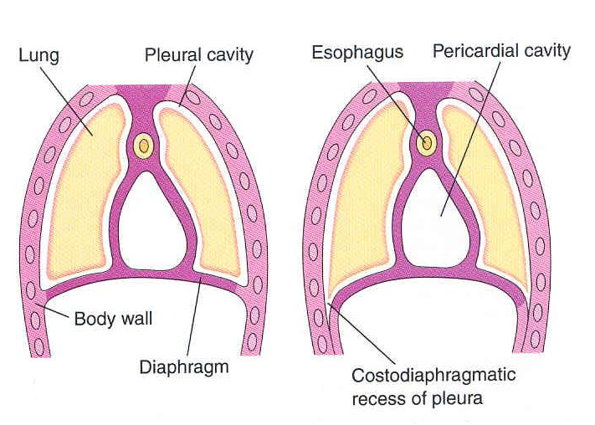
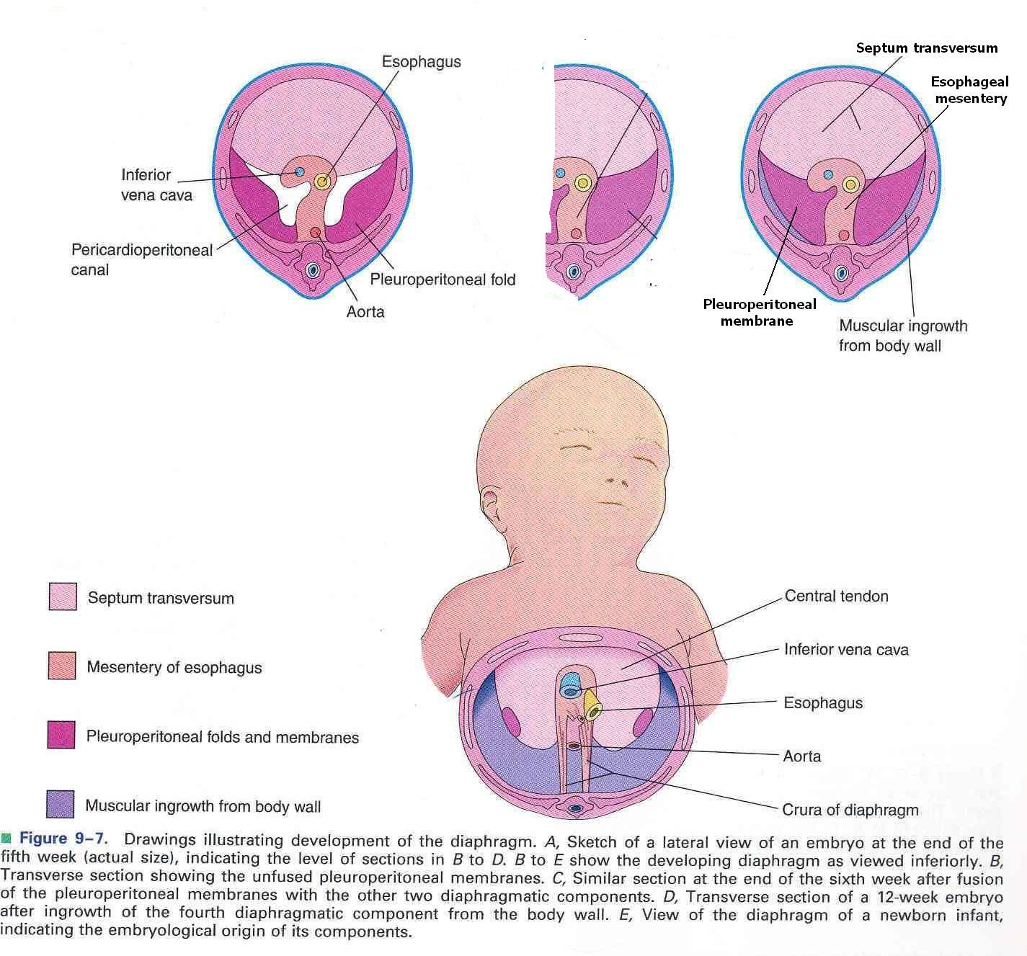
During 9th – 12th weeks the lungs and pleural cavities enlarge, burrowing into the body wall, splitting it into:
External layer that becomes part of the body wall
Internal layer that contributes muscles to peripheral portions of diaphragm, extending to the parts derived from the pleuroperitoneal membranes

Slide 90
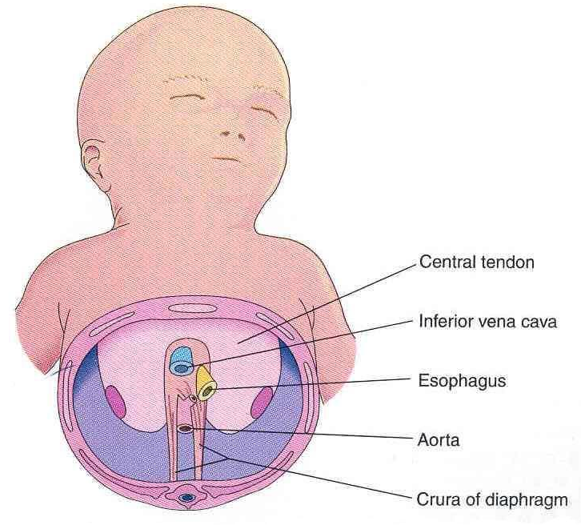
Septum transversum: Central tendon
Pleuroperitoneal membranes: form large portion of fetal diaphragm but represent a smaller portion in infants
Dorsal mesentery of esophagus: Crura
Body wall: peripheral muscular part

Slide 91
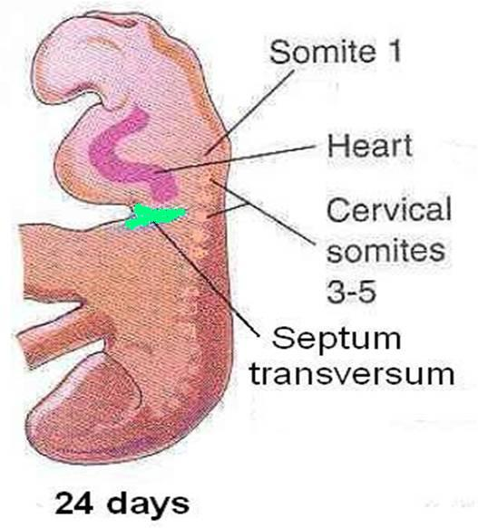
Positional Changes and Innervation of the Diaphragm
During the 4th week, the septum transversum lies opposite the 3rd – 5th cervical somites
During 5th week, myoblasts from these somites move to the developing diaphragm bringing their nerve fibers with them

Slide 92
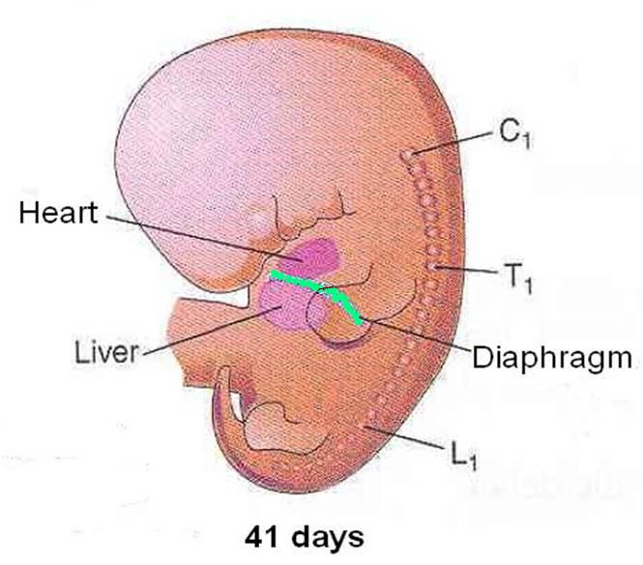
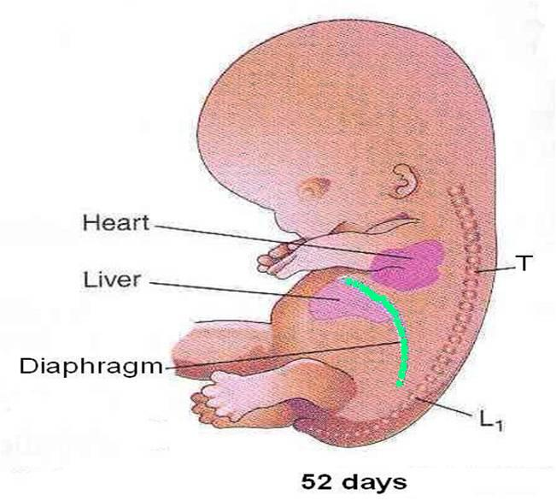
Rapid growth of the body of embryo result in further descent of diaphragm
By the 6th week, the diaphragm lies at the level of the thoracic somites
By the end of 8th week the dorsal end of diaphragm lies at the level of first lumbar vertebra

Slide 93
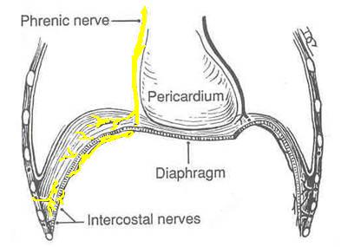
When the 4 parts of the diaphragm fuse, the mesenchymal cells from the septum transversum extend into the other three parts, change into myoblasts, and give rise to the muscles of the diaphragm. Thus phrenic nerve supplies all the muscles of diaphragm
The phrenic nerve also supplies sensory fibers to diaphram except in the peripheral region which is derived from the body wall and brings its nerve supply (lower intercostal nerves) with it

Slide 94
POSTEROLATERAL DEFECT OF DIAPHRAGM
Posterolateral defect of the diaphragm is the only relatively common birth defect of the diaphragm .
This diaphragmatic defect occurs about once in 2,200 newborn infants and is associated with congenital diaphragmatic hernia (CDH); herniation of abdominal contents into the thoracic cavity.
Life-threatening breathing difficulties may be associated with CDH because of inhibition of development and inflation of the lungs.
Fetal lung maturation may be delayed.
Polyhydramnios (excess amniotic fluid) may also be present.

Slide 95
CDH is the most common cause of pulmonary hypoplasia.
The candidate region for CDH has been reported to be chromosome 15q26.
CDH, usually unilateral, results from defective formation and/or fusion of the pleuroperitoneal membranes with the other three parts of the diaphragm.
This results in a large opening in the posterolateral region of the diaphragm.
As a result, the peritoneal and pleural cavities are continuous with one another along the posterior body wall.

Slide 96
This birth defect, sometimes referred to as the foramen of Bochdalek, occurs on the left side in 85% to 90% of cases.
The preponderance of left-sided defects may be related to the earlier closure of the right pleuroperitoneal opening.
Prenatal diagnosis of CDH depends on ultrasound examination and magnetic resonance imaging of abdominal organs in the thorax.
The presence of abdominal viscera in the thorax pushes the lungs and heart anteriorly and compression of the lungs occurs.

Slide 97
Often the stomach, spleen, and most of the intestines herniate.
Most babies born with CDH die not because there is a defect in the diaphragm or abdominal viscera in the chest, but because the lungs are hypoplastic due to compression during development.
The severity of pulmonary developmental abnormalities depends on when and to what extent the abdominal viscera herniate into the thorax, that is, on the timing and degree of compression of the fetal lungs.
The effect on the ipsilateral (same side) lung is greater, but the contralateral lung also shows morphologic changes.

Slide 98
If the abdominal viscera are in the thoracic cavity at birth, the initiation of respiration is likely to be impaired.
Because the abdominal organs are most often in the left side of the thorax, the heart and mediastinum are usually displaced to the right.
The lungs are often aerated and achieve their normal size after reduction (repositioning) of the herniated viscera and repair of the defect in the diaphragm.
Prenatal detection of CDH occurs in about 50% of cases.
Most infants with CDH now survive because of improvements in ventilator care.

Slide 99
EVENTRATION OF DIAPHRAGM
In this uncommon condition, half the diaphragm has defective musculature and balloons into the thoracic cavity as an aponeurotic (membranous) sheet, forming a diaphragmatic pouch.
Consequently, there is superior displacement of abdominal viscera into the pocket-like outpouching of the diaphragm.
This birth defect results mainly from failure of muscular tissue from the body wall to extend into the pleuroperitoneal membrane on the affected side.
Eventration of the diaphragm is not a true diaphragmatic herniation; it is a superior displacement of viscera into a sac-like part of the diaphragm.
However, the clinical manifestations of diaphragmatic eventration may simulate CDH.

Slide 100


Congenital Anomalies
Congenital hiatal hernia: because of large esophageal hiatus
Eventration of diaphragm: because of defective musculature

Slide 101
Retrosternal (parasternal) hernia: Commonly through a posterolateral defect in diaphragm (foramen of Morgagni).
Mostly on left side.
Left lung shows hypoplasia .
Large defects associated with body wall defects

Slide 102
ACCESSORY DIAPHRAGM
More than 30 cases of this rare anomaly have been reported.
It is most often on the right side and associated with lung hypoplasia and other respiratory complications.
An accessory diaphragm can be diagnosed by magnetic resonance imaging and computed tomography.
It is treated by surgical excision.

Slide 103
GASTROSCHISIS AND CONGENITAL EPIGASTRIC HERNIA
Gastroschisis is a congenital fissure in the anterior abdominal wall: usually there is protrusion of viscera.
This uncommon hernia occurs in the median plane between the xiphoid process and umbilicus.
The defect is similar to an umbilical hernia except for its location.
Gastroschisis and epigastric hernias result from failure of the lateral body folds to fuse completely when forming the anterior abdominal wall during folding in the fourth week.
The small intestine herniates into the amniotic cavity, which can be detected prenatally by ultrasonography.

Slide 104
THANK YOU

