Slide 1
Review Marathon
Compiled by
Beda Otieno

Slide 2
Instructions
Each slide represents 1 question on the question paper
A slide will stay on for 1 minute then change automatically
You cannot go back to a previous slide
There are 25 questions
Each question is 4 marks

Slide 3
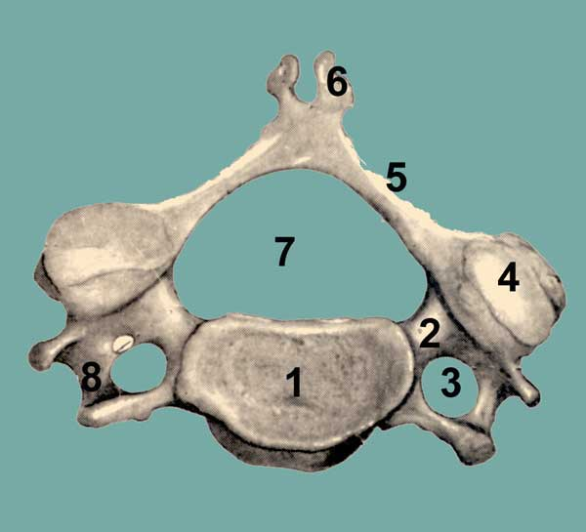
1

Slide 4
2

Slide 5
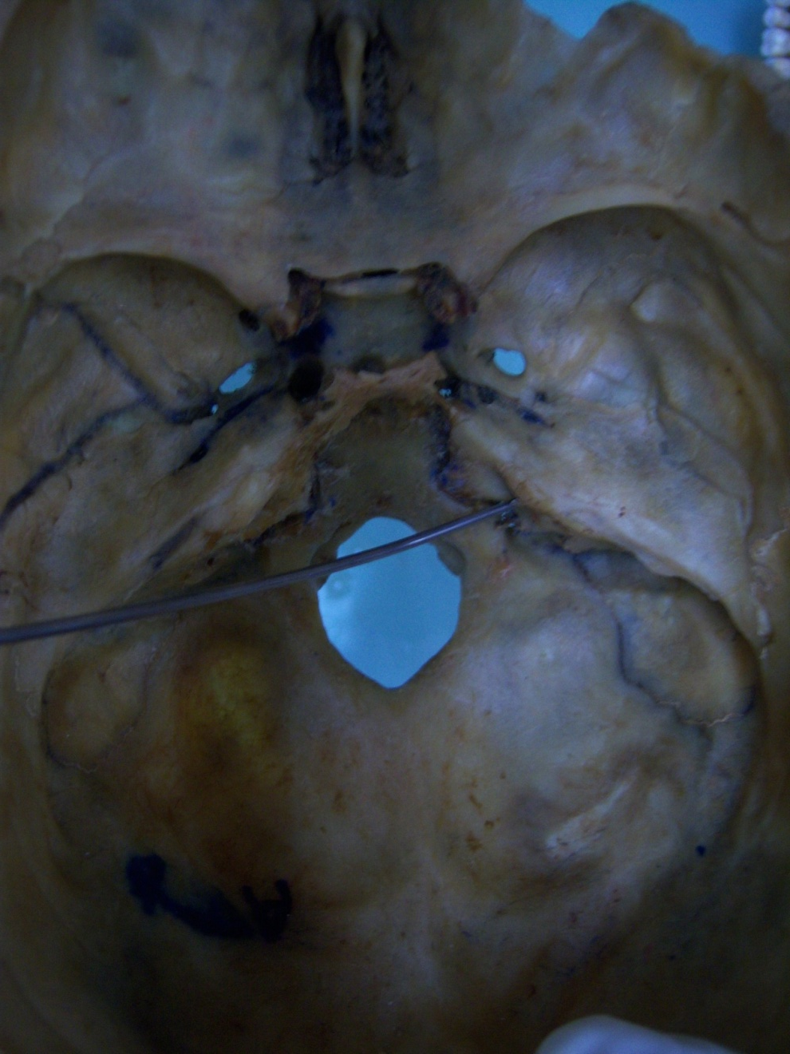
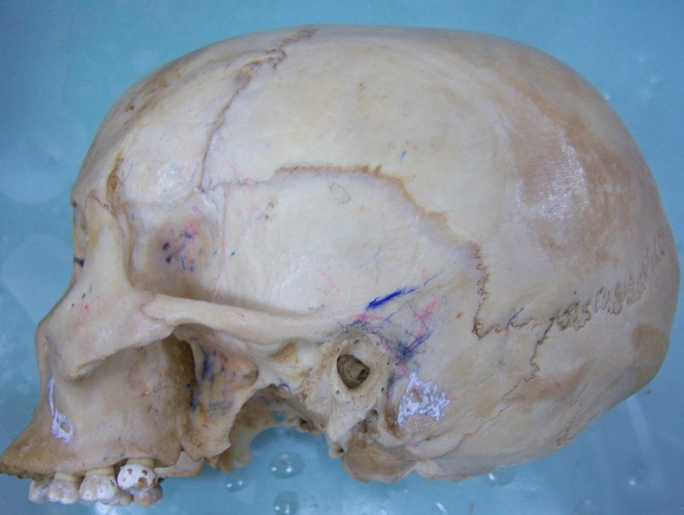
3
A
B
Z

Slide 6
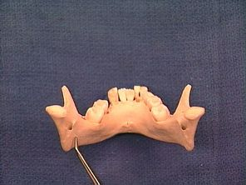
4
X
Y
Q

Slide 7
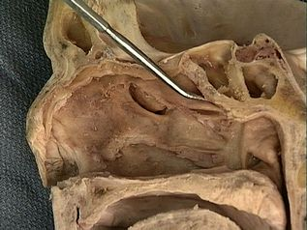
5
N
M

Slide 8
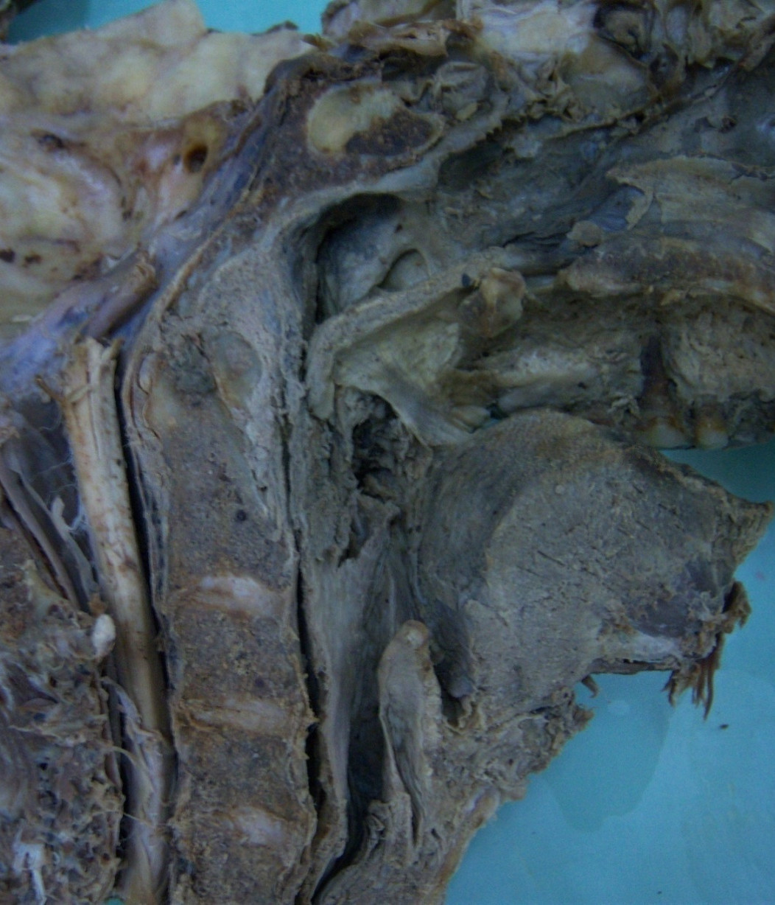
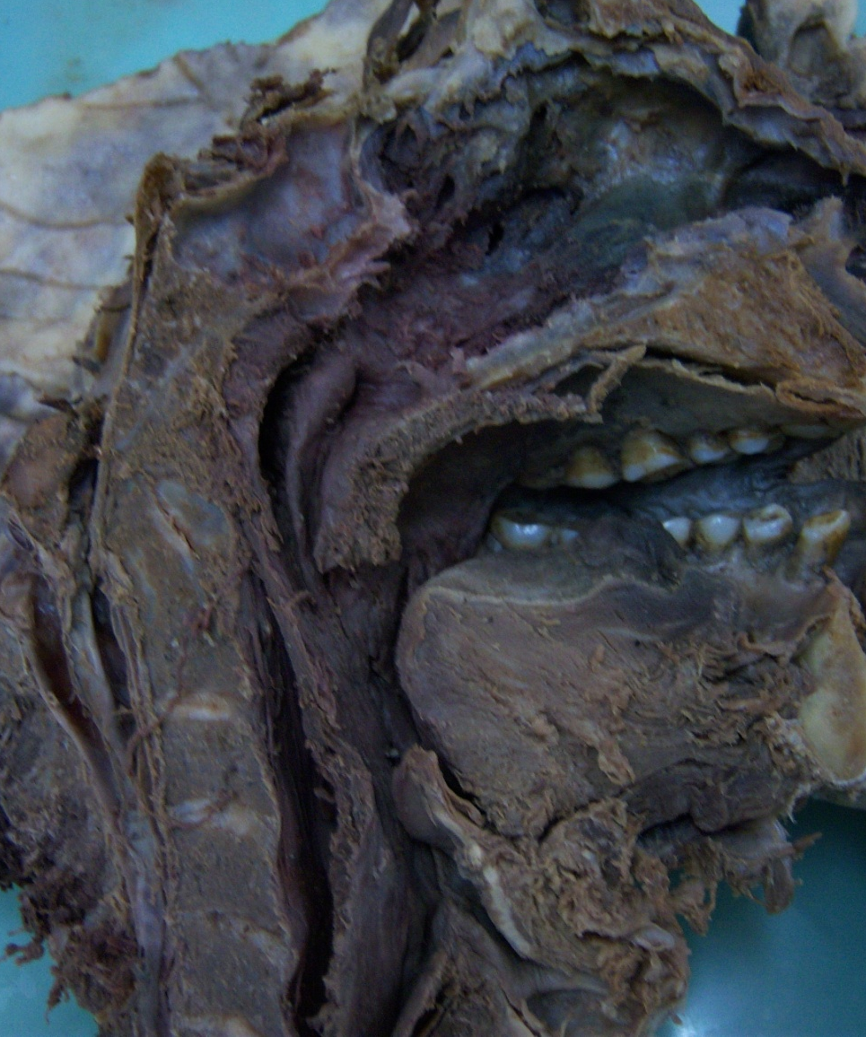
6
A
B
Y
R
Tongue
Tongue
X

Slide 9
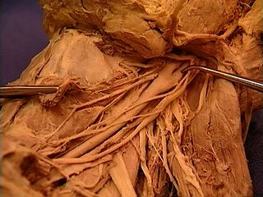
7
G

Slide 10
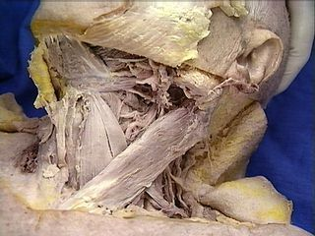
8
B
A

Slide 11
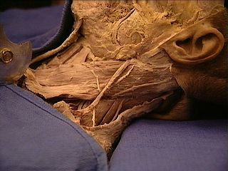
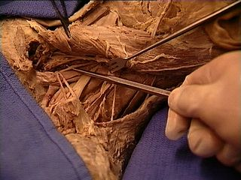
9
X
M
N
Y

Slide 12
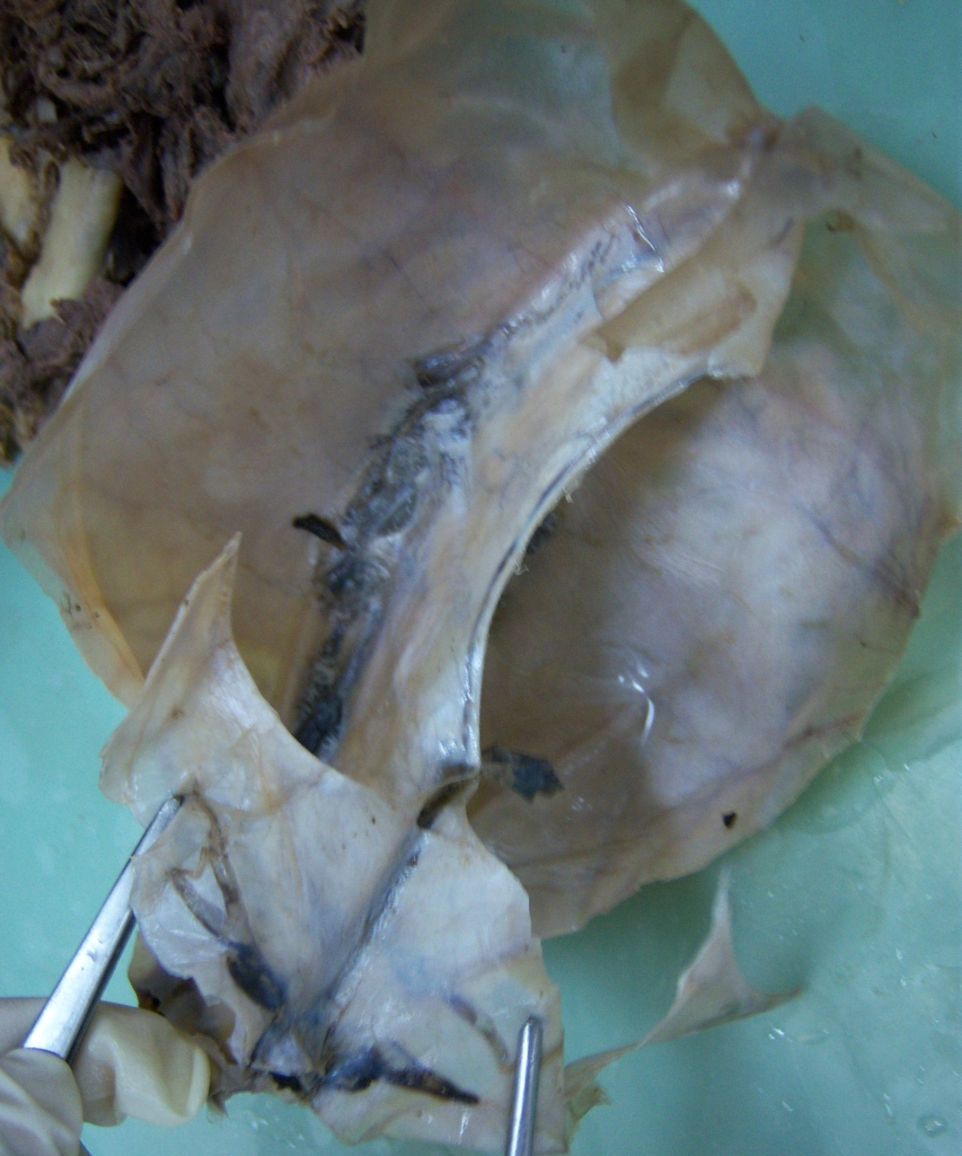
10
H

Slide 13
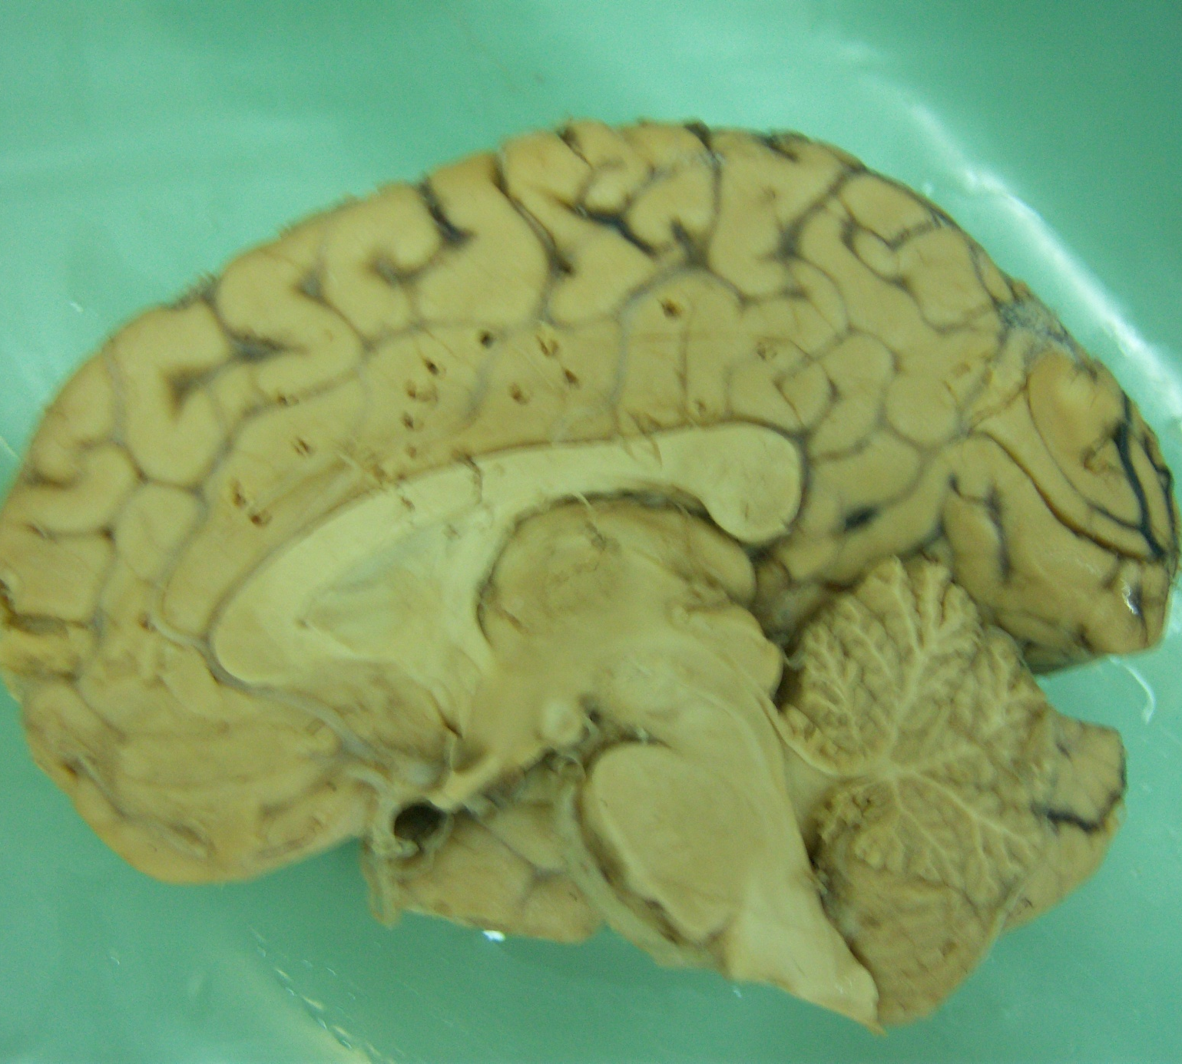
11
Central sulcus
W
T
D

Slide 14
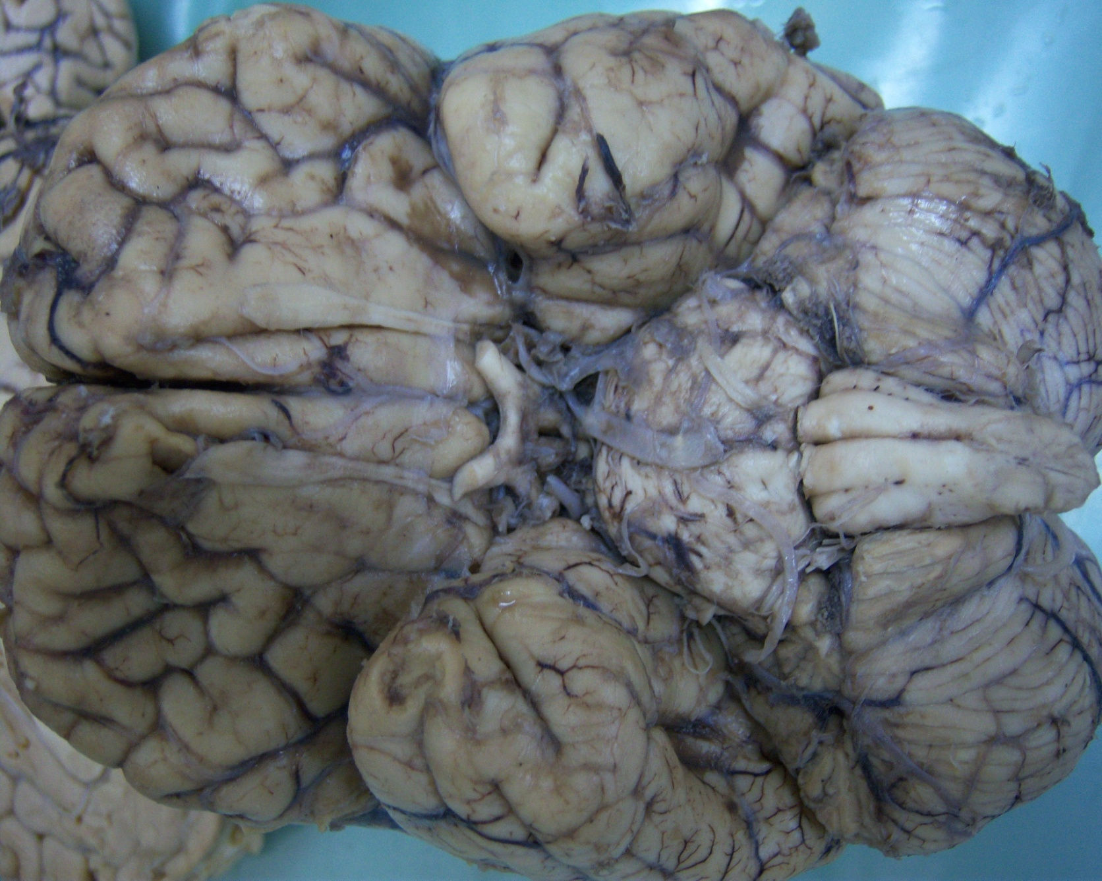
12
V
Z
U

Slide 15
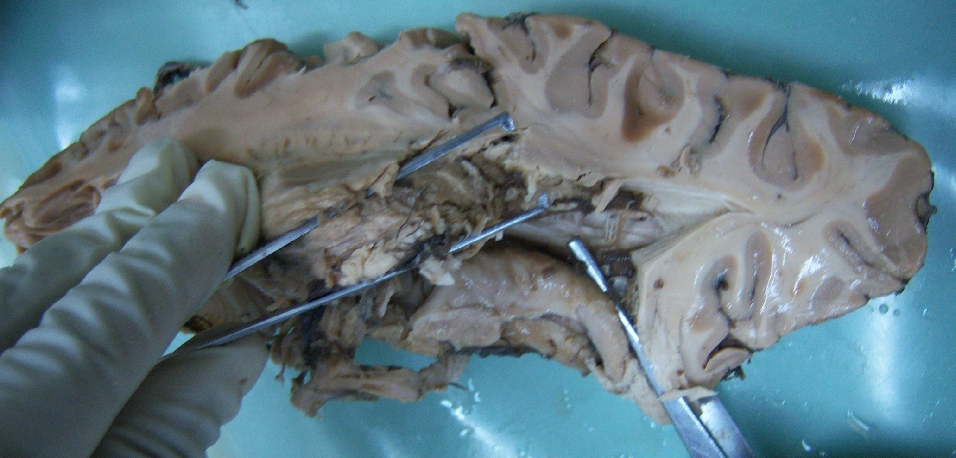
13 - Horizontal section of the brain
Y
X

Slide 16
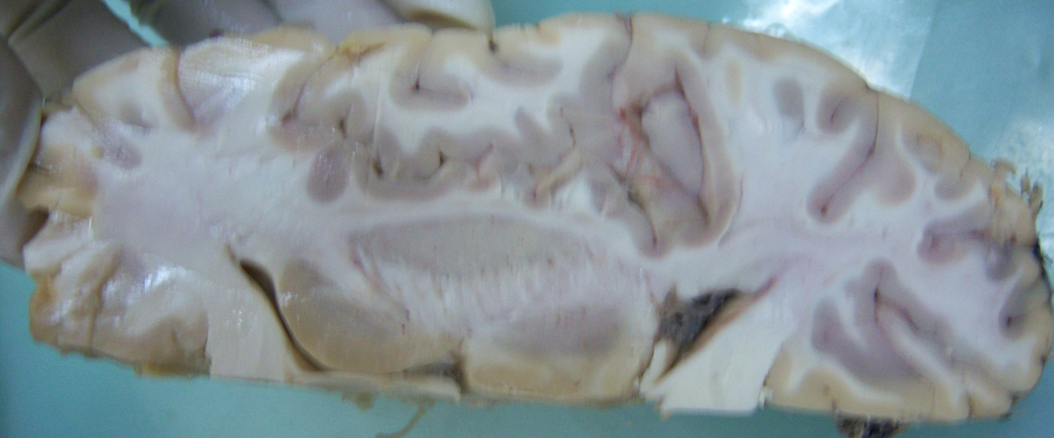
14
P

Slide 17
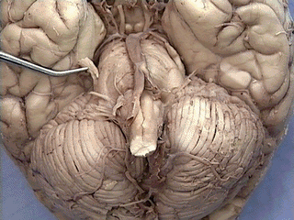
15
H

Slide 18
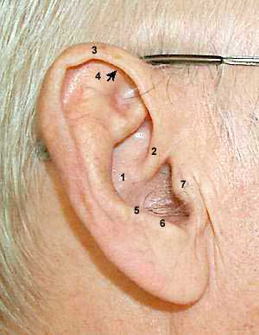
16

Slide 19
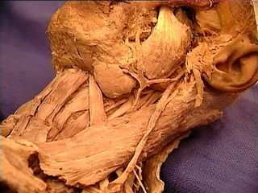
17
N
M

Slide 20
18
A
B

Slide 21
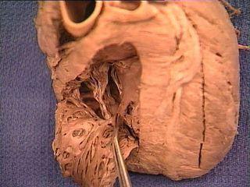
19
F

Slide 22
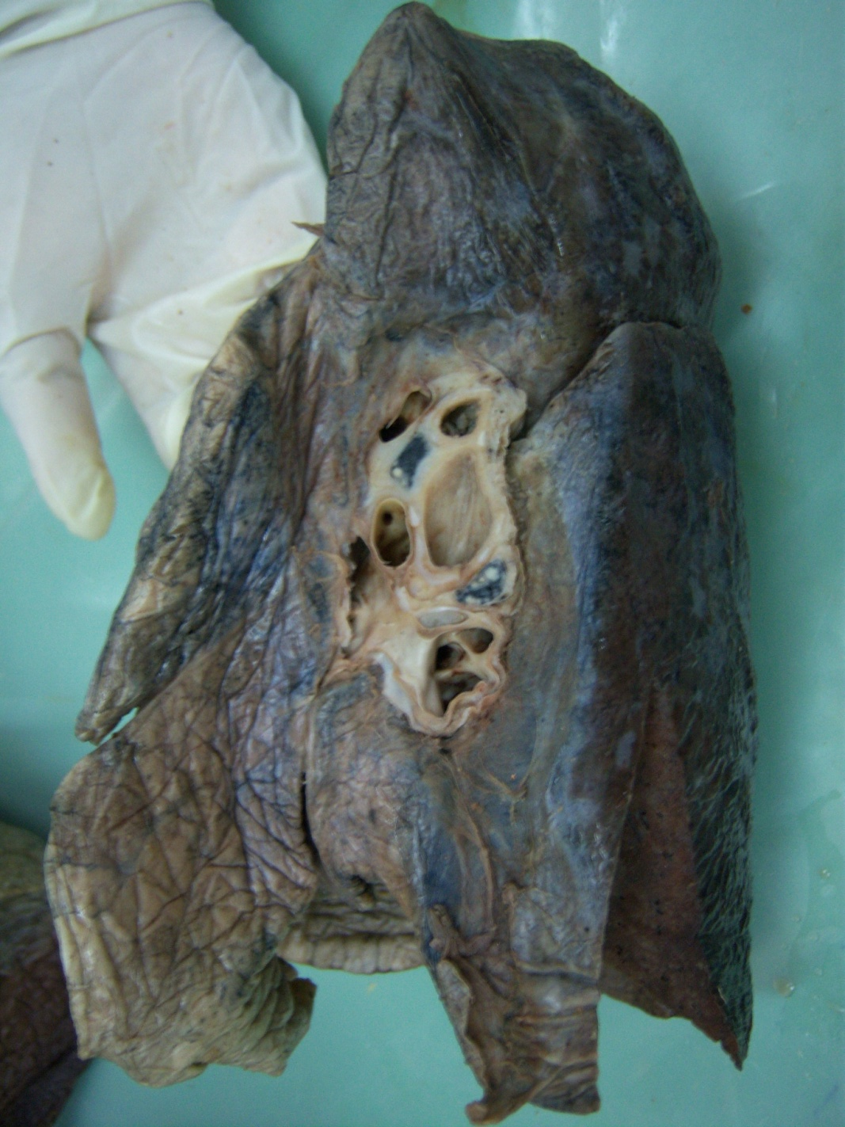
20
L

Slide 23
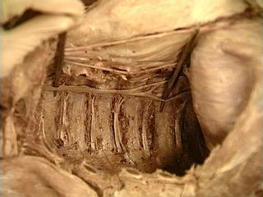
21
Y

Slide 24
22

Slide 25
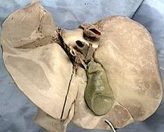
23
N
M
P

Slide 26
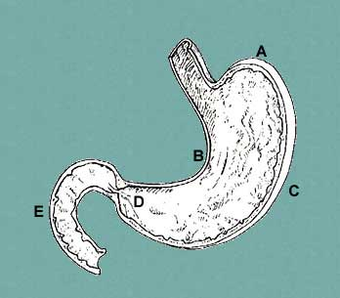
24

Slide 27
Heb 10:23 Heb 10:35
25

Slide 28
Let us hold fast the confession of our hope without wavering, for He who promised is faithful
Therefore do not throw away your confidence, which has a great reward

Slide 29
End

