Slide 1
WEEK 12 REVIEW
By
Beda Olabu

Slide 2
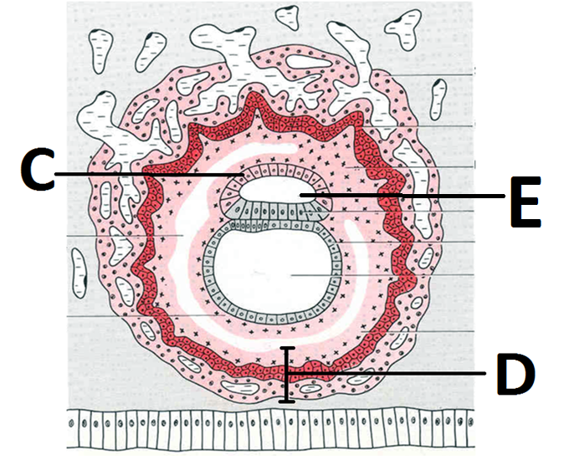
1 (a) Identify C and D (2 marks) (b) State two abnormalities of E (2 marks)

Slide 3
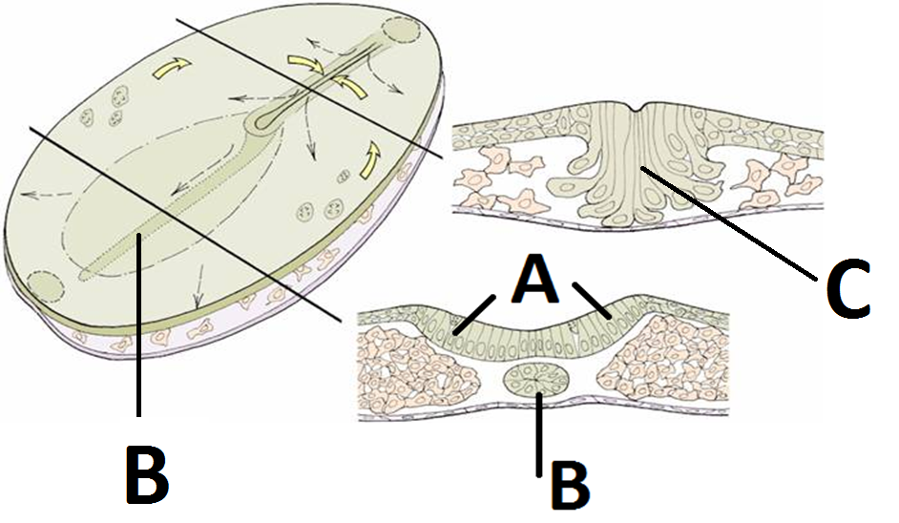
2 a) State two immediate differentiation of A (2 marks) b) State the anomalies associated with B and C (2 marks)

Slide 4
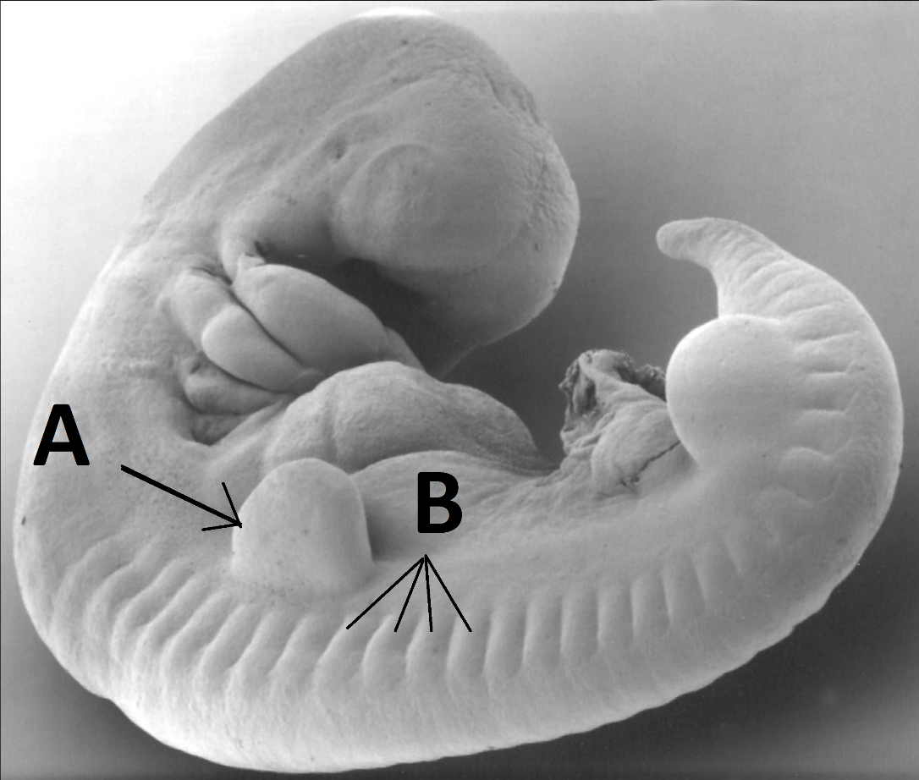
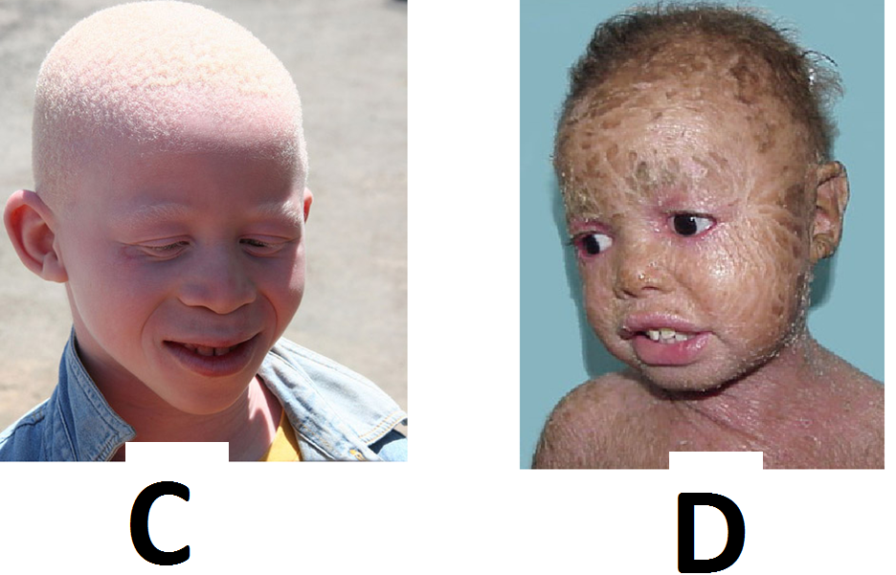
3 (a) Identify the structures A and B (2 marks) (b) State the embryological basis of C and D (2 marks)

Slide 5
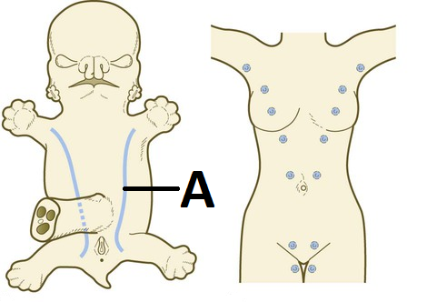
4 (a) Identify structure A and state its fate in humans (3 marks) (b) State one effect of abnormal persistence of A (1 mark)

Slide 6
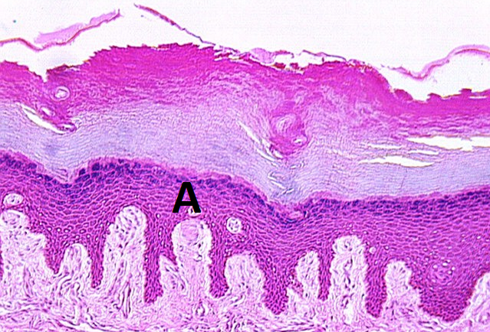
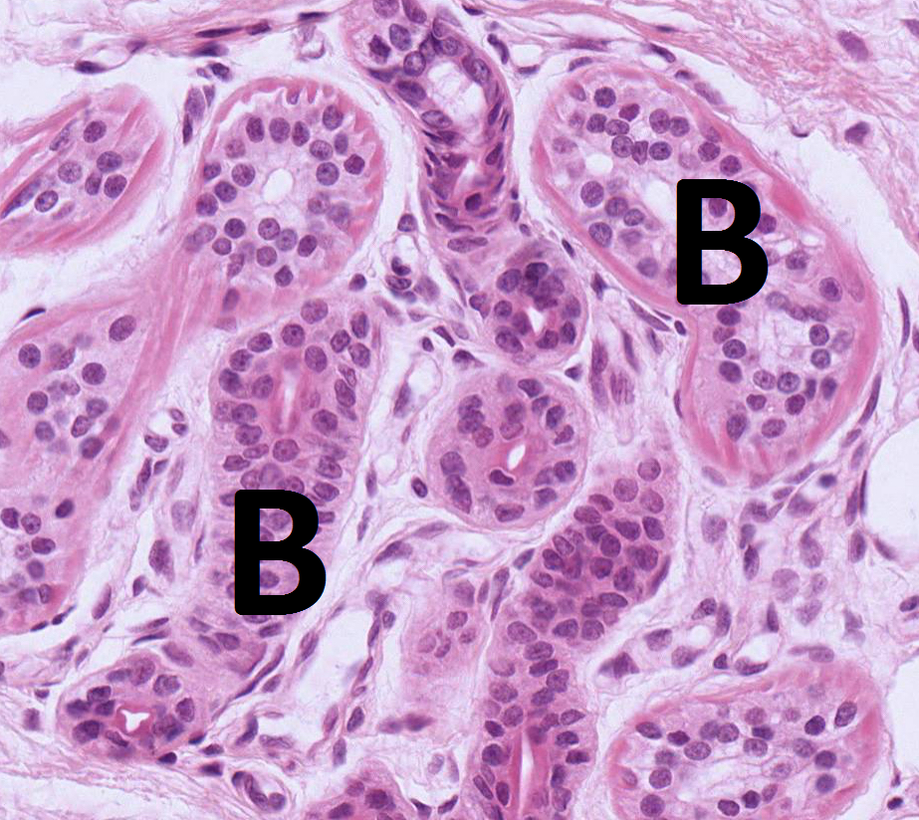
5 (a) Name two least abundant cell types in epithelium A (2 marks) (b) Give two varieties of structure B (2 marks)

Slide 7
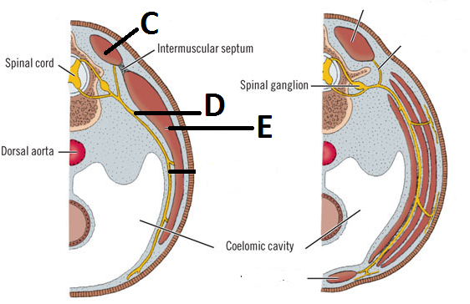
6 – (a) Identify structures D and E (2 marks) (b) State the derivatives of C (2 marks)

Slide 8
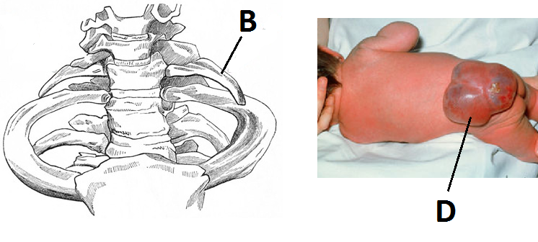
7 (a) State two symptoms associated with B (2 marks) (b) Give two varieties of D (2 marks)

Slide 9
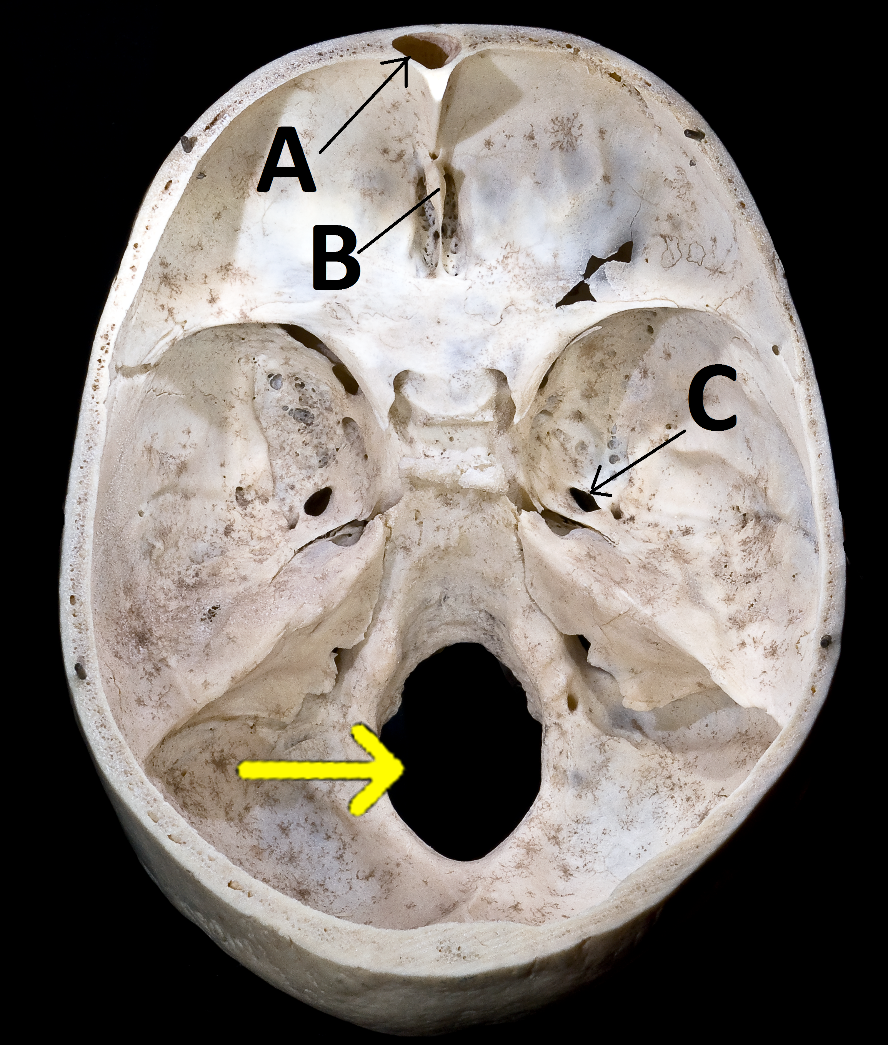
8 (a) Identify the structures and A and B (2 marks) (b) Name two major structures that go through C (2 marks)

Slide 10
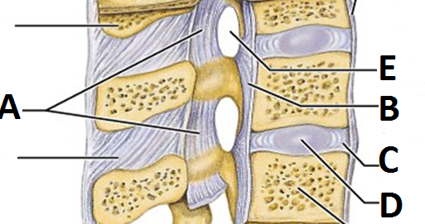
9 (a) Name the ligaments labelled A and B (2 marks) (b) State the embryonic origin of C (1 mark) (C) Name two structures that traverse E (2 marks)

Slide 11
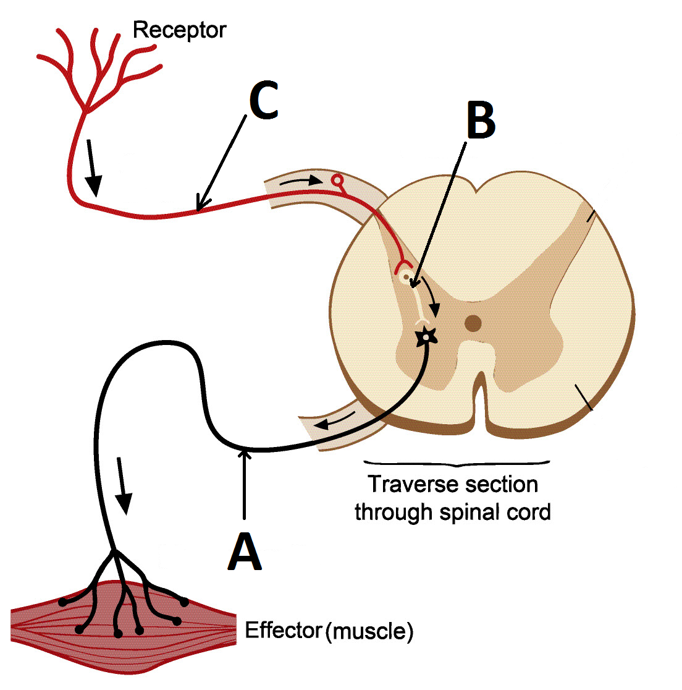
10 – State the functional types of A-C and indicate the structural type of each (3 marks)

Slide 12
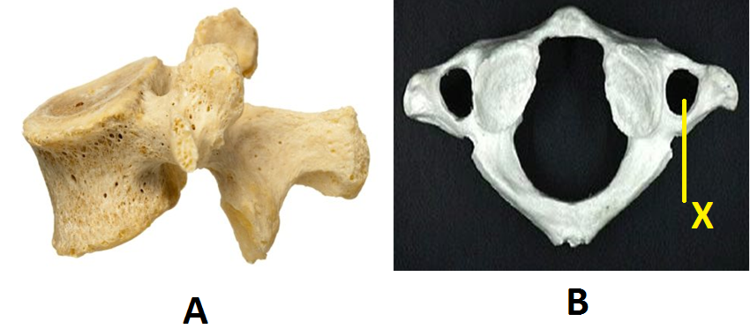
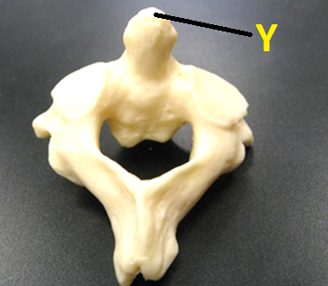
11 (a) Identify the vertebrae A and B (2 marks) (b) State the main structure that traverses X (1 mark) (c) State one structure that attaches at part Y (1 mark)

Slide 13
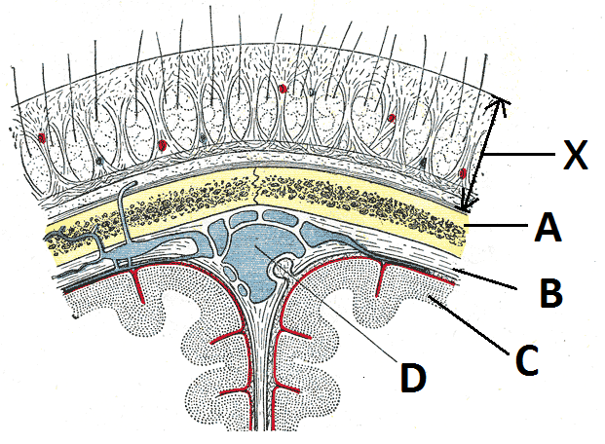
12 (a) Identify the structures A and B (2 marks) (b) State the main structure that constitute C and D (2 marks)

Slide 14
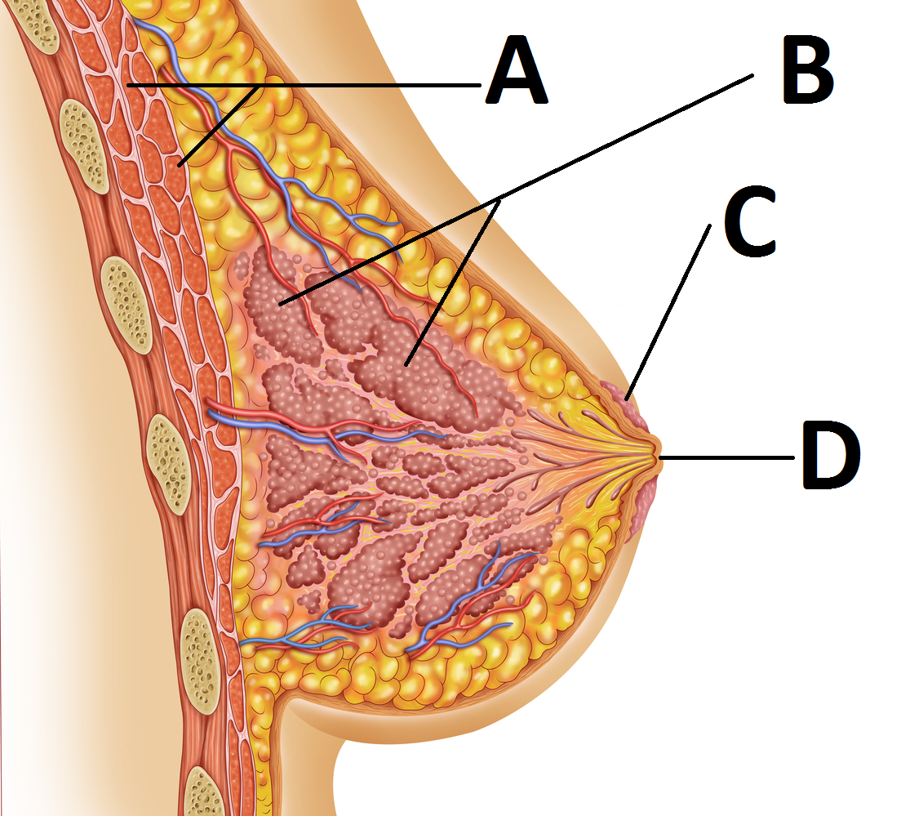
13 (a) Identify the structures A and C (2 marks) (b) State one functional variation of B (1 mark) (c) State the surface landmark of D (1 mark)

Slide 15
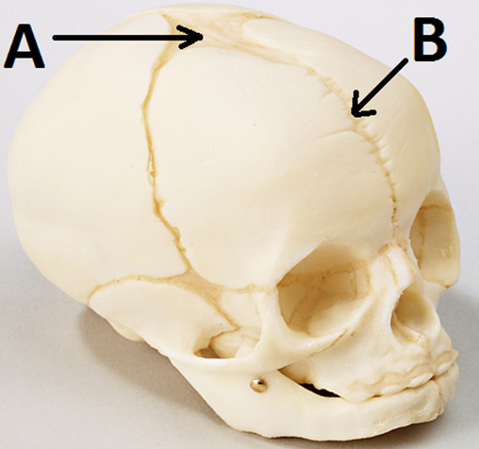
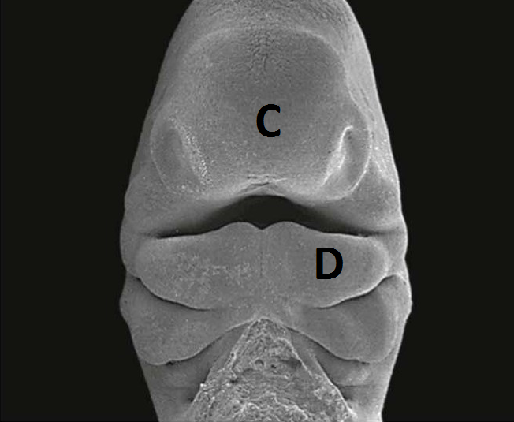
14 (a) State in months when A and B close (2 marks) (b) Name the prominences C and D (2 marks)

Slide 16
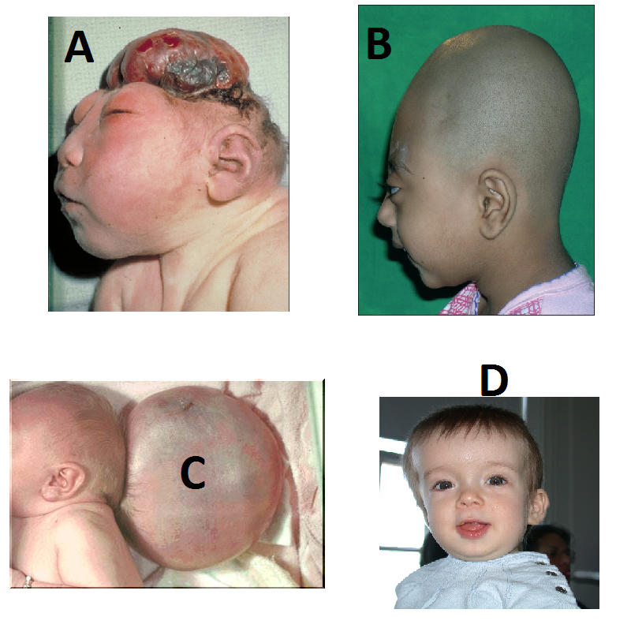
15 (a) Name the skull anomalies A and C (2 marks) (b) State the sutures involved in B and D (2 marks)

Slide 17
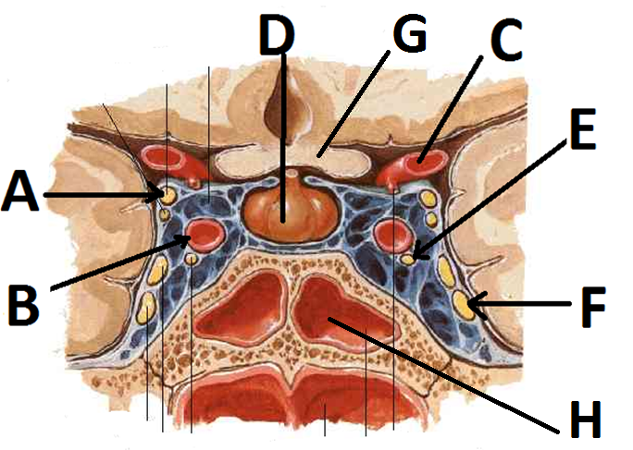
16 (a) Identify structures G and H (2 marks) (b) State the foramen of exit of E and F (2 marks)

Slide 18
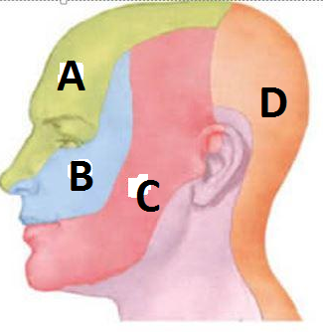
17 (a) State the sensory innervation of regions C and D (2 marks) (b) State two primary lymph node groups that drain the scalp (2 marks)

Slide 19
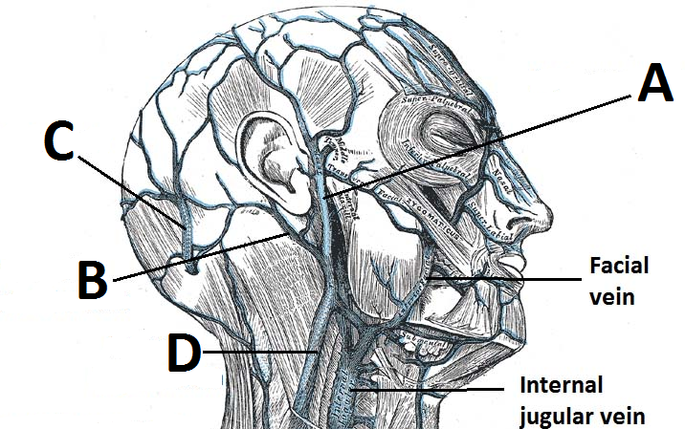
18 (a) Name the veins labelled A and B (2 marks) (b) State the immediate termination of C and D (2 marks)

Slide 21
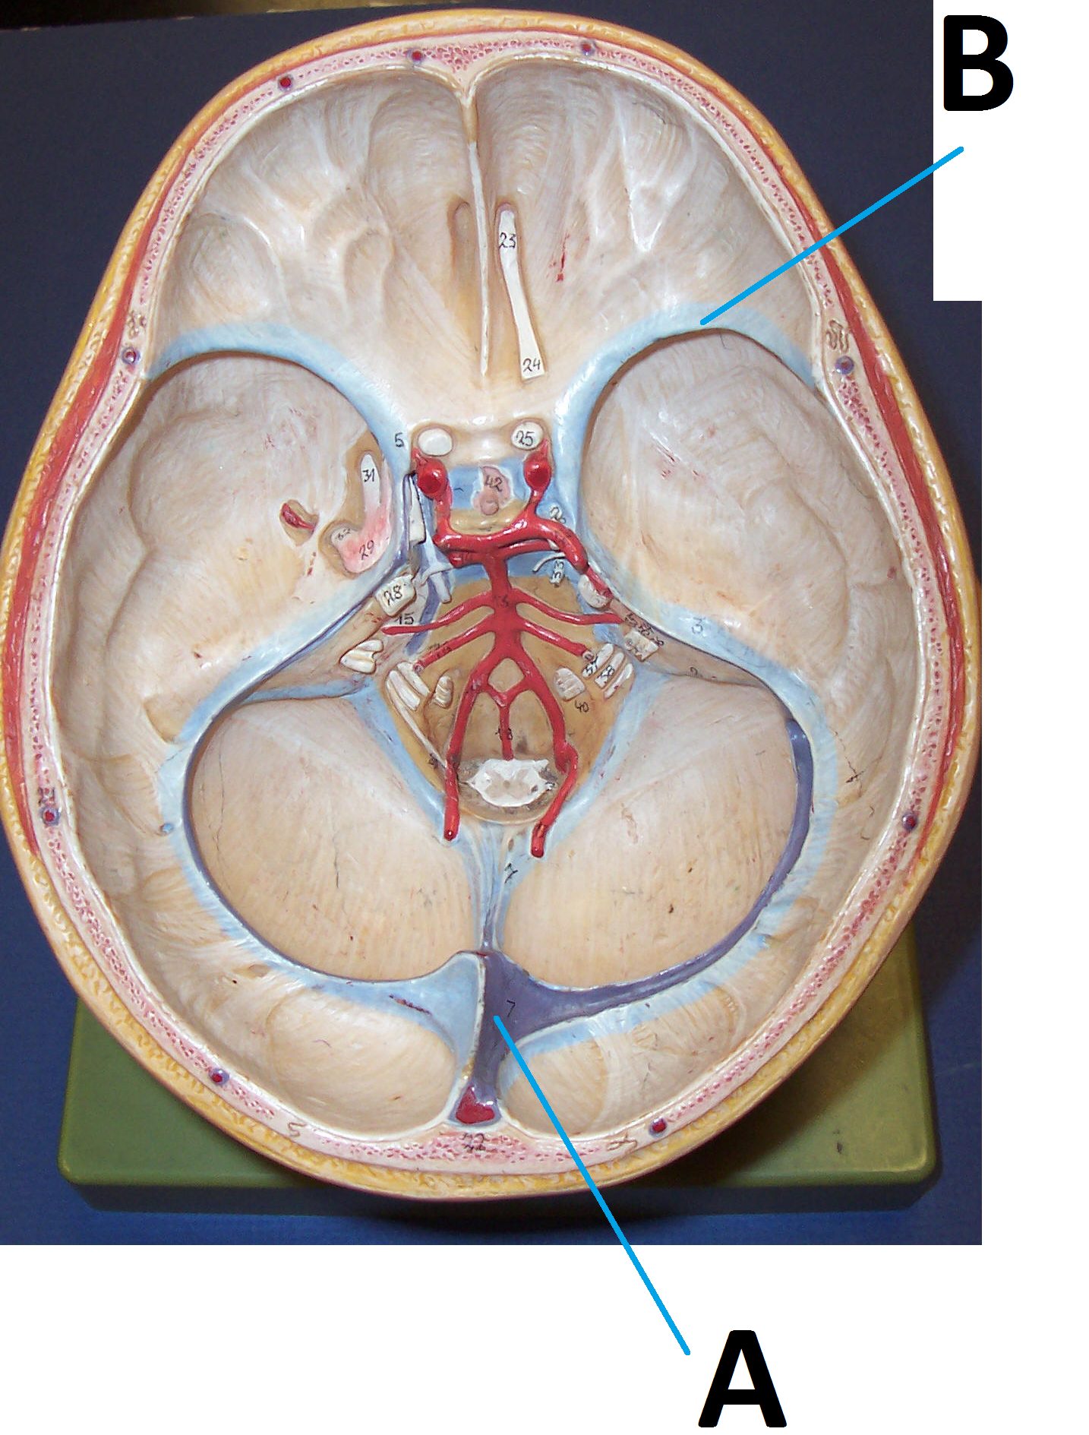
19 (a) Identify the dural sinuses labelled A and B (2 marks) (b) State the main nerve that supplies the tentorium cerebelli (1 mark) (b) State the main artery that supply the posterior cranial dura (1 mark)

Slide 22
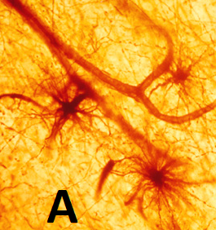
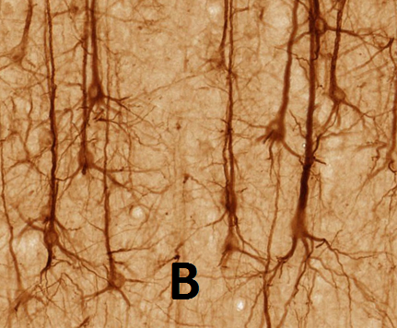
20 (a) State two functions of the cells in A (2 marks) (b) Name the cells in B and state where they are found (2 marks)

Slide 23
21 – Outline the following regarding the spinal cord:
External features (5 marks)
Support structures (3 marks)
Arterial blood supply (8 marks)
Venous drainage (5 marks)
Extents pre and post-natally (4 marks)
Internal features at the level of T2 (illustrate) (10 marks)
Development and congenital anomalies (10 marks)

Slide 24
THE END

