Slide 1
Histology Slideshow Marathon
Beda Otieno

Slide 2
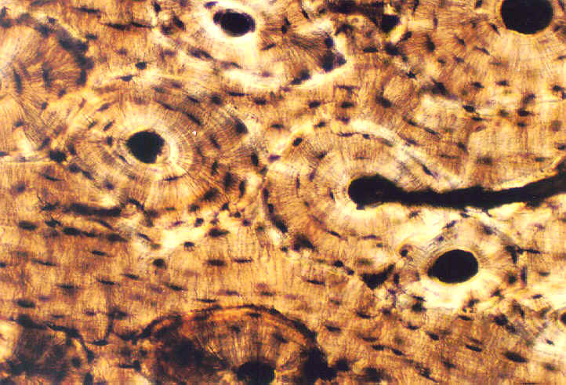
1
Identify the slide shown and give two reasons
List the main cell types in this tissue and specify their functions
Name the various lamellae systems found in this tissue
Name two modes of formation of this tissue
Name two layers of the covering of this tissue

Slide 3
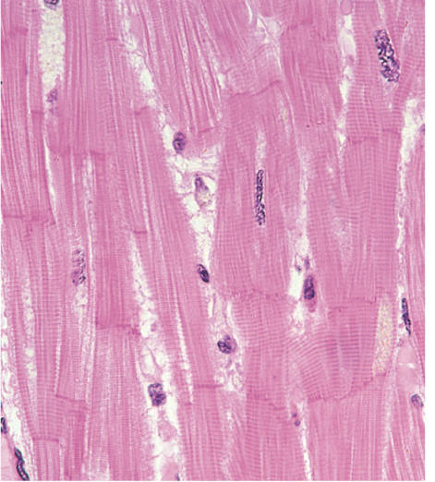
2
Identify the propulsion tissue shown and give two reasons
List two structural and two functional properties of propulsion tissue
Give two ultrastructural features of smooth muscle
Name two other cell types with propulsive properties

Slide 5
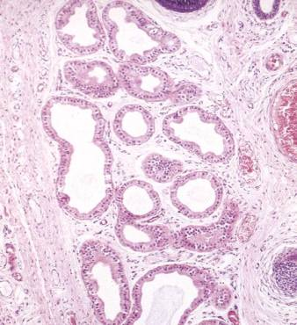
3
Identify the structures shown and give two reasons
Give two classes of these structure according to the mode of secretion

Slide 6
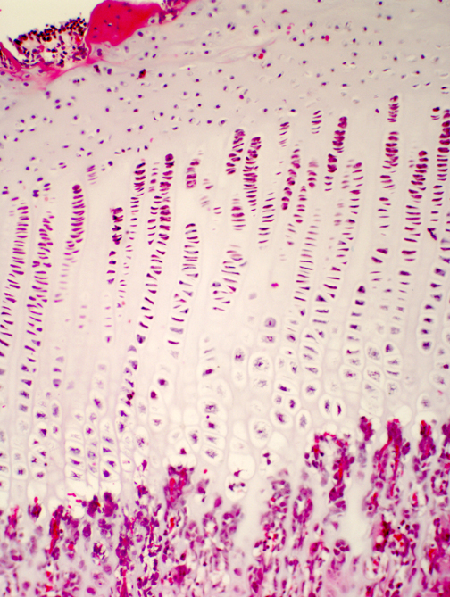
4
Identify the structure shown and give two reasons
Name one congenital anomaly affecting this structure
Name the layer of this structure that is more prone to injury

Slide 7
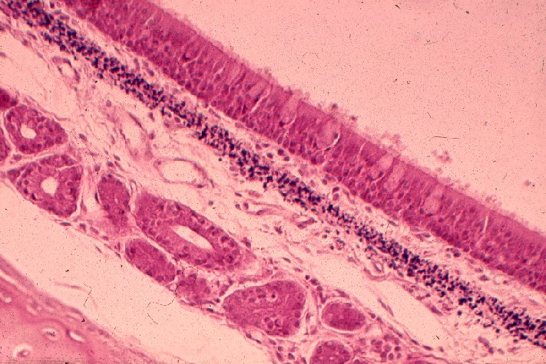
5
Identify the type of epithelium shown and give two reasons
State the distribution of this type of this epithelium

Slide 8
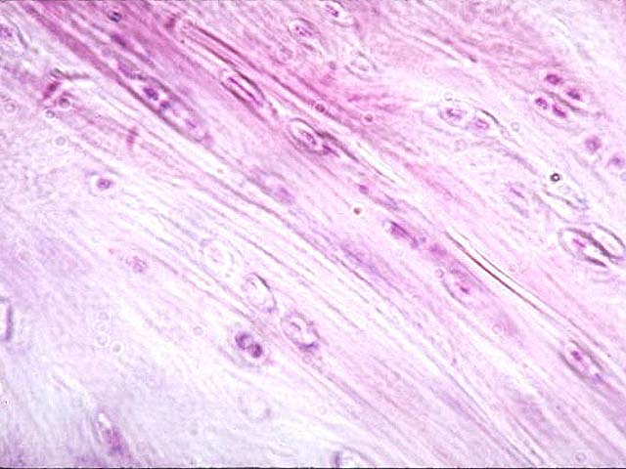
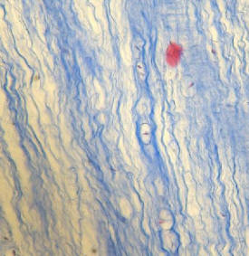
6
Identify the type of cartilage shown and give one reason
Name two parts of the intervertebral disc and state the embryological origin of each

Slide 9
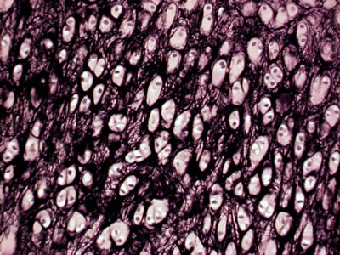
7
Identify the structure shown and give two reasons
State the distribution of this tissue

Slide 10
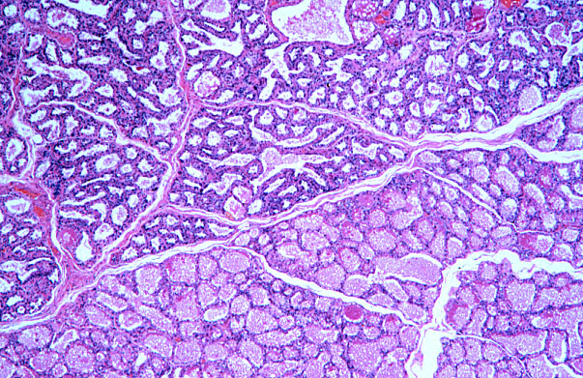
8
Identify the functional state of the mammary gland shown
Give three differences between a lactating and a non lactating mammary gland

Slide 11
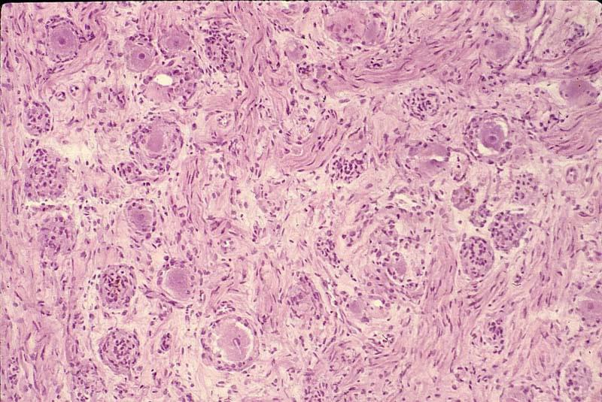
9
Identify the structure shown and give three reasons
Name on disease that affects this structure

Slide 12
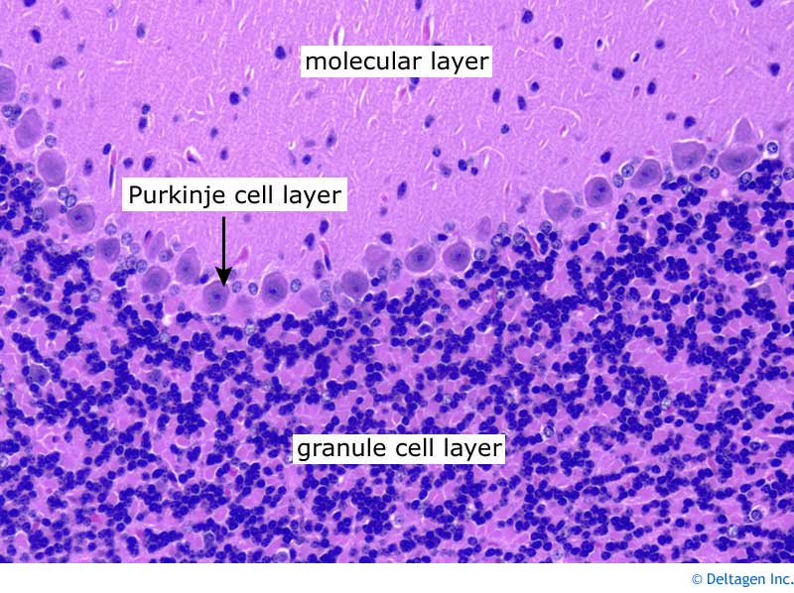
10
A
B
C
Identify the slide shown and give two reasons
Name the layers shown

Slide 13
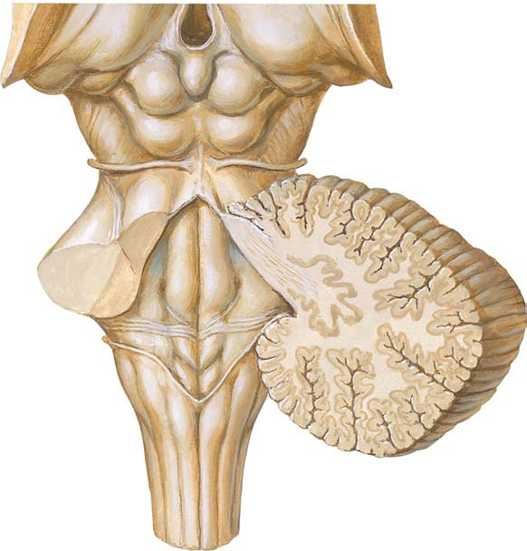
11. Name the structures labeled M, N and H
M
H
N
Name two Efferent fibres from H

Slide 14
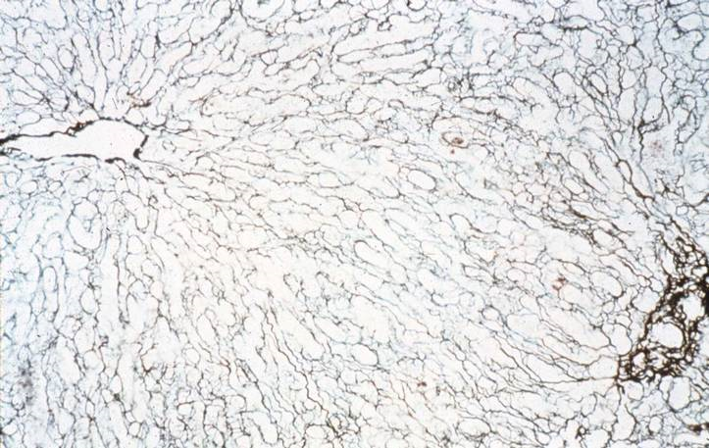
12
Identify the connective tissue fibre shown and state its distribution

Slide 15
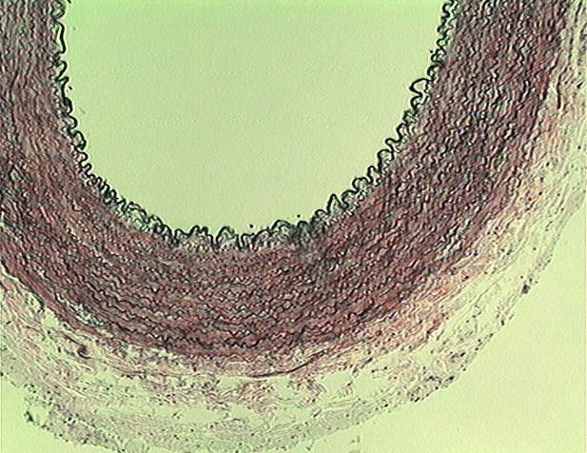
13
Identify the type of blood vessel shown and give a reason

Slide 16
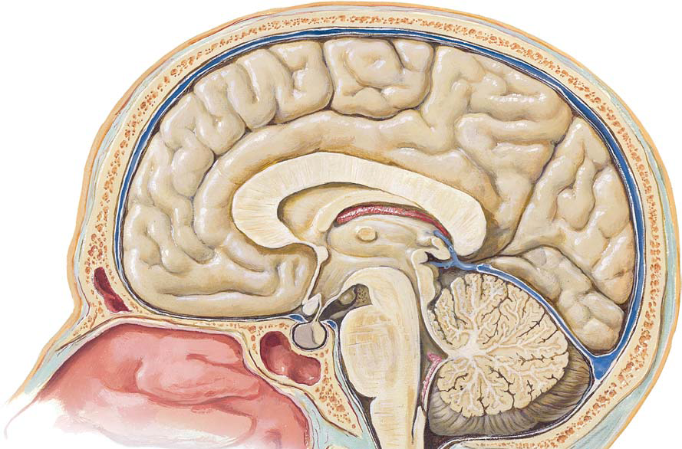
14. Name the structures labeled K and L
L
B
K
15. Classify the type of fibres found in B

Slide 17
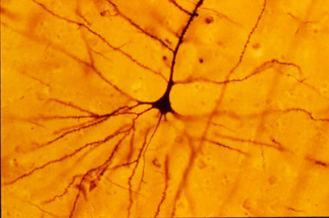
15
Identify the cell type shown and state where it is located
Name the layers of this region

