Slide 1
Anatomy Marathon III
Beda Otieno

Slide 2
SCOPE
Neuroanatomy
Abdomen
Histology
Gross anatomy

Slide 3
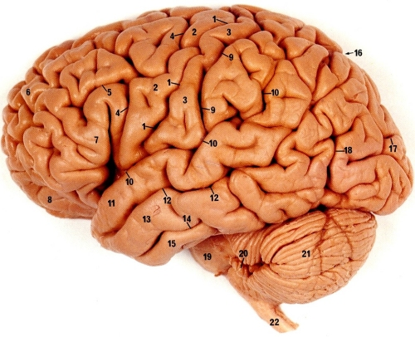
1
A
B
Give the blood supply to the regions labeled A and B
Name the CNS structures affected in superior alternating hemiplegia

Slide 4
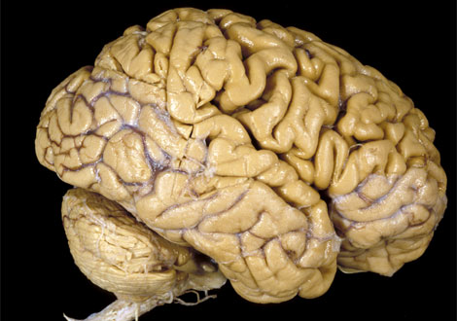
2
G
a. State two functional areas located in the gyrus labeled G
b. Name 2 contents of the spinal epidural space

Slide 5
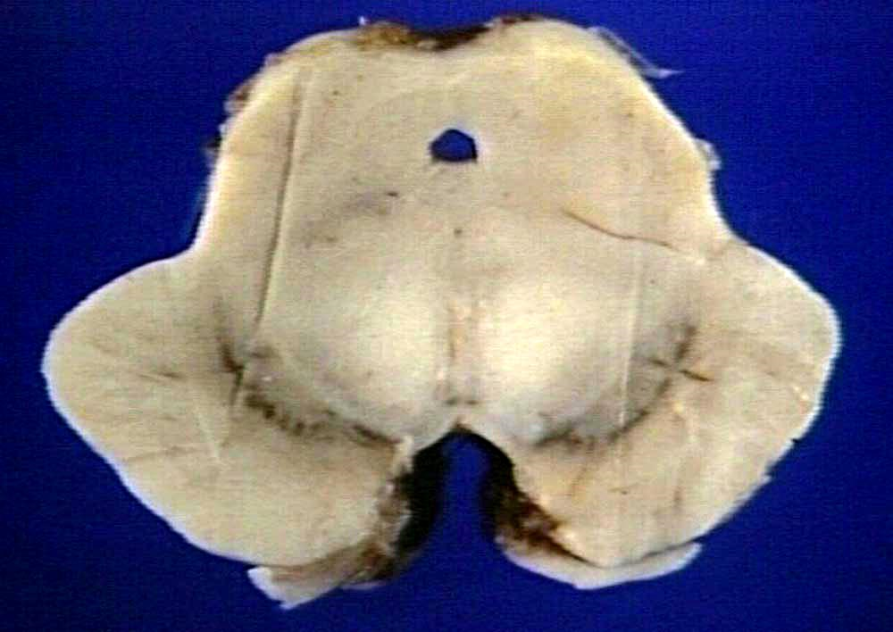
3
L
L
X
X
a. Name two parts of the structure labeled X
b. Name one afferent and one efferent of L

Slide 6
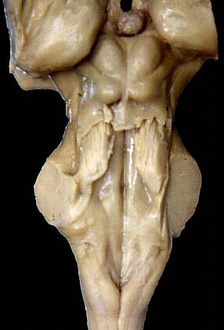
4
N
M
Identify M
Name two secretions from N

Slide 7
5
D
P
Identify P and give the destination of fibers from it
Name the structures which contribute to the elevation marked D

Slide 8
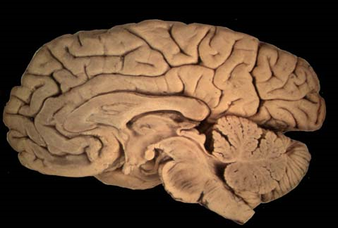
6
R
U
Give two clinical manifestation of lesions affecting region R
Identify and classify the type of fibers in the structure labeled U

Slide 9
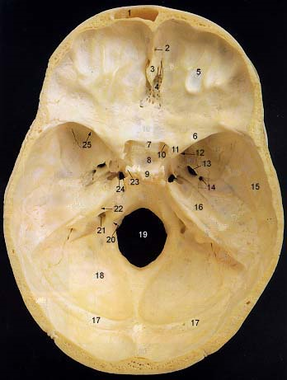
7
Give two vessels that traverse H
Name two sinuses housed by the tentorium cerebelli apart from the transverse
H

Slide 10
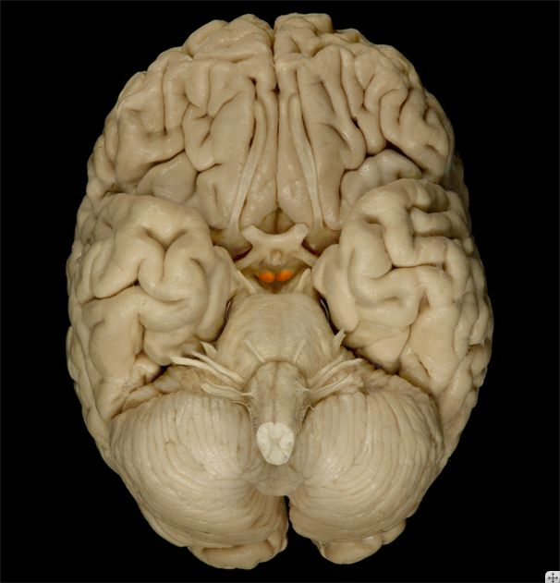
8
A
Name two efferents from the structure marked ……………….that color!
Name the components of the limbic lobe apart from the one labeled A

Slide 11
9
a. State two clinically important communications of the cavernous venous sinus
b. List two functions of the brainstem reticular formation

Slide 12
10
Draw and label the cross section of the internal capsule at the level of the genu of corpus callosum
Indicate the descending fiber tracts than traverse the various parts

Slide 13
10
Draw and label the cross section of the internal capsule at the level of the genu of corpus callosum
Indicate the descending fiber tracts than traverse the various parts

Slide 14
11
State the anterior and lateral boundaries of the interpeduncular fossa
Anterior
Lateral
Name the components of the corpus striatum

Slide 15
12 Indicate true or false
Lesion of the frontal lobe results in gaze disturbance
The basal ganglia forms the lateral wall of the third ventricle
The rextiform body is found in the middle cerebellar peduncle
The mesencephalic nucleus of CN V contains cell bodies of 1st order neurons

Slide 16
13
Name the openings through which CSF leaves the 4th ventricle
Name the hypothalamic nuclei concerned with secretion of ADH and oxytocin

Slide 17
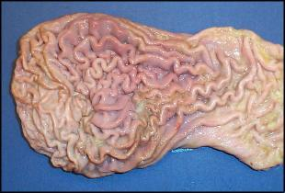
14
Identify and give one common congenital anomaly this organ
Name two structures that pass through the diaphragmatic opening at the level of T8 vertebra

Slide 18
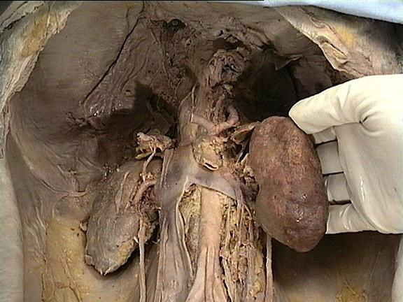
15
N
M
Identify the abdominal organs related to the regions of the kidney marked M and N
State the blood supply to the lower ureter

Slide 19
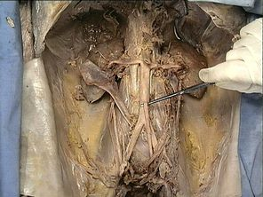
16
List the branches of the vessel tagged
Name the condition of the pylorus in early childhood that leads to projectile vomiting and suggest a mode of treatment

Slide 20
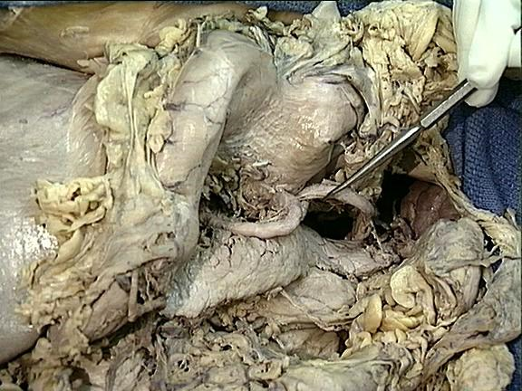
17
D
State the blood supply of D
Name four structures that are overlain by the attachment of the small bowel mesentery

Slide 21
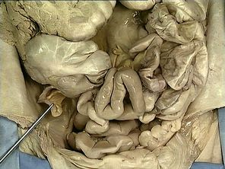
18
Give one common clinical condition of the organ tagged and suggest one mode of treatment
Name 2 medial relations of the second part of the duodenum

Slide 22
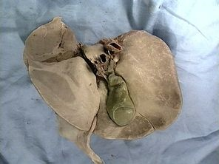
19
H
Name the parts of H
State the function and fate of ductus venosus during development

Slide 23
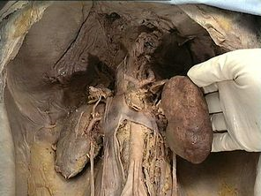
20
U
T
Name two tributaries of U
Give two constrictions of T

Slide 24
21
Name two situations in which the ureter is commonly injured
Indicate true or false
Peripheral nerves regenerate better when they are sectioned far from the cell body
In all receptors, the first order neuron synapses with the receptor cells

Slide 25
22
Indicate two structures that may be felt anteriorly during a digital rectal examination of a male patient
Name the nerve that supplies the perineum, and state its root value
Nerve ___________
Root value _______

Slide 26
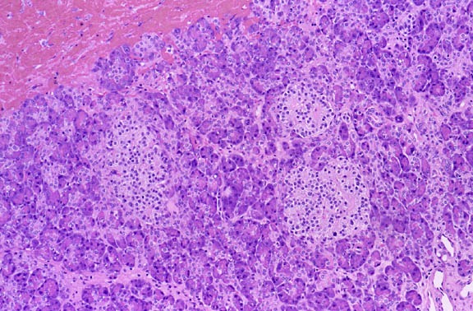
23
B
Identify the organ shown and give one reason
Give two cell types found in B and indicate their function

Slide 27
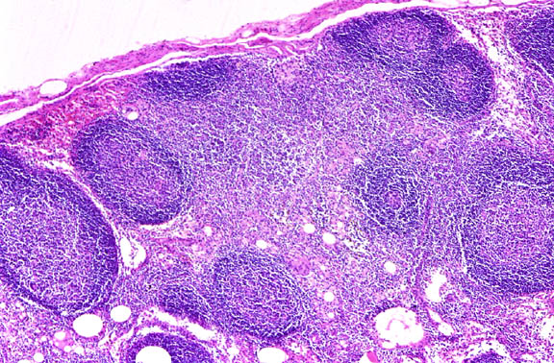
24
Identify the structure shown and give one reason
Name 2 distinct gross anatomic features of the large intestine.

Slide 28
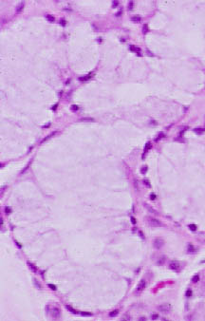
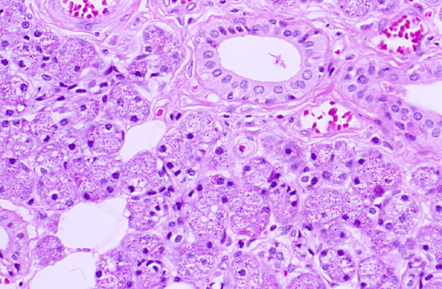
25
A
B
Identify the salivary glands labeled A and B
Name the layers of the GIT mucosa

Slide 29
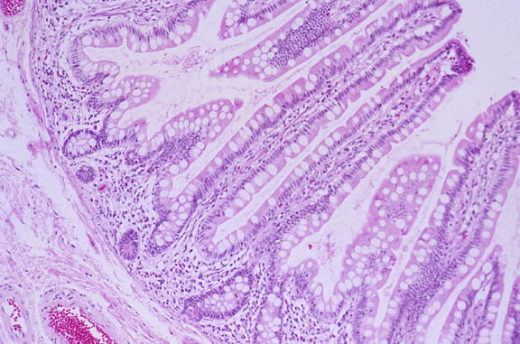
26
State 2 distinguishing features of a histological section of the duodenum
Identify the organ shown and give two reasons

Slide 30
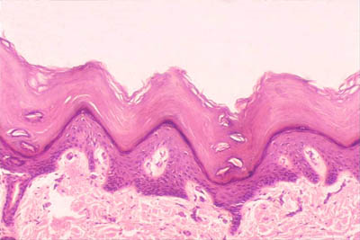
27
Identify the type of epithelium depicted
Name the layers of this organ

Slide 31
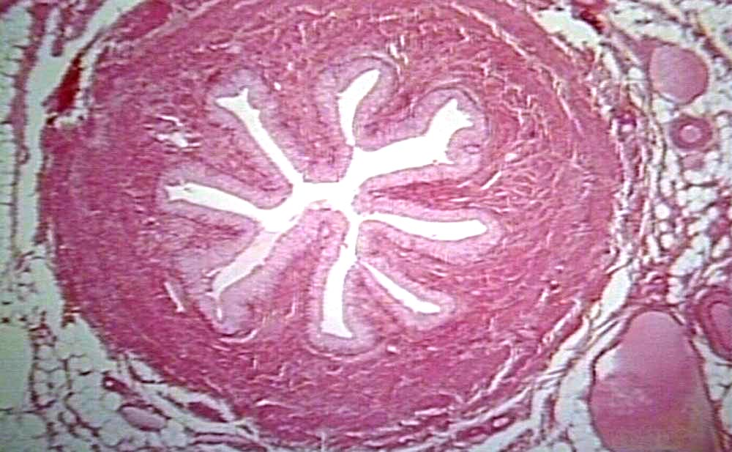
28
Identify the organ shown and give two reasons
Name the components of the juxtaglomerular apparatus

Slide 32
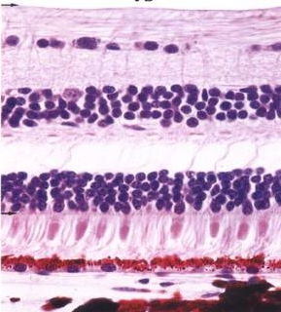
29
R
Name the cell types found in region R
State the commonest region of detachment and give a basis for this

Slide 33
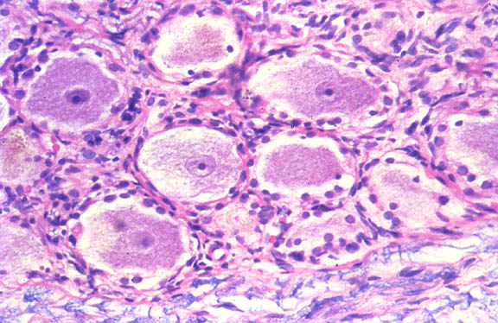
30
Identify the structure shown and give two reasons
Name the three broad categories of cells in the adenohypophysis

Slide 34
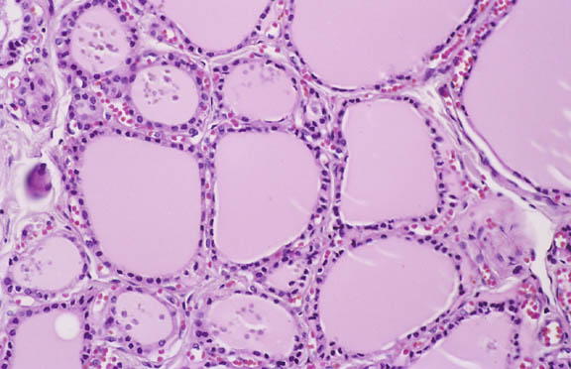
31
Identify the gland shown and give two reasons
Illustrate by means of a labeled diagram, the classical liver lobule

Slide 35
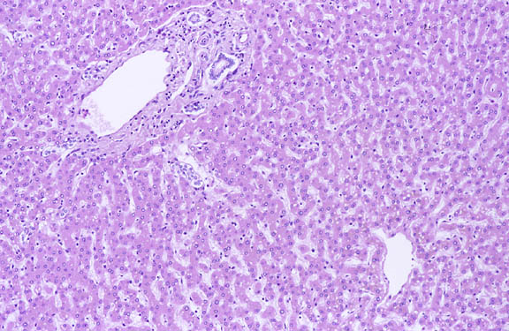
32
Name the cell types found in this organ and give their functions

Slide 36
33
Name the components of the renal corpuscle

Slide 37
34
2 year old child presented with prolonged constipation and distension since birth. Investigations show hugely dilated descending colon.
What is the name of this abnormality?
What is its possible mechanism
Name two congenital malformations of the anal canal.

Slide 38
36
Name the products produced by the following cells
i. Parietal cells of stomach
ii) Chief cells of stomach
b. Name the layers of the periosteum and indicate the role of each

Slide 39
37
a. Name the member of the monocyte phagocyte system found in these organs
i. Spleen
ii. Skin
b. Name the cells found in the posterior pituitary, and indicate one function for each

Slide 40
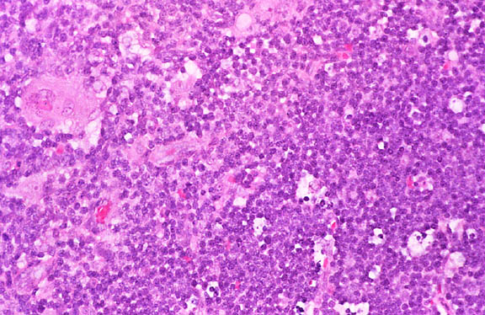
END

