Slide 1
NEUROANATOMY REVIEW

Slide 2
SPINAL CORD

Slide 3
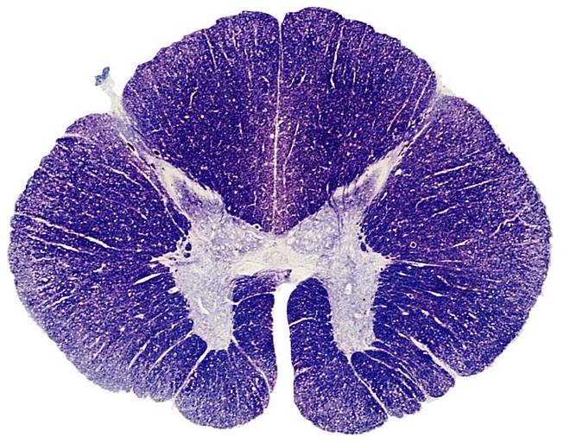
Q1
With reasons identify the spinal cord segment shown
Illustrate the internal structure of C5 spinal cord segment

Slide 4
Q2
Discuss the effects of left sided hemi section of spinal cord at T1
State 2 other spinal cord syndromes and the anatomical basis of their presentation

Slide 5
Q3
Discuss the pattern of blood supply to the spinal cord and its surgical significance

Slide 6
Q4
State the connections of internal vertebral venous plexus and their clinical relevance

Slide 7
Q5: Developing spinal cord
a)Name the structures labelled A,B,C
b) What functional components are associated with X in the spinal cord

Slide 8
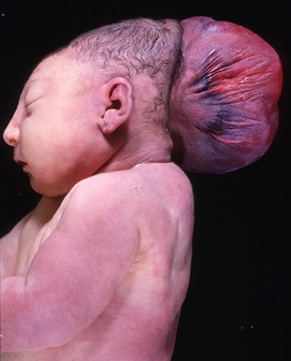
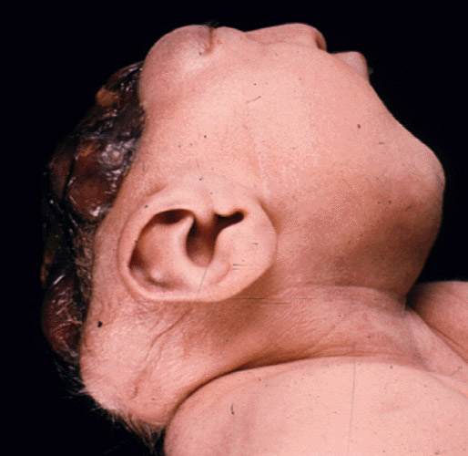
Q6: a) Identify the malformations A&B B)State the varieties of spinal dysraphisms
B)
A)

Slide 9
Q7
State why deep cuts of the scalp:
Gape
Bleed profusely
State the anatomical basis for raccoon eyes

Slide 10
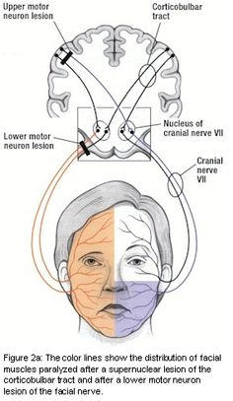
Q8
State the anatomical basis for sparing of the frontalis muscle in some facial nerve palsies

Slide 11
Q10
State the anatomical considerations when making scalp incisions on the frontotemporal region

Slide 12
SKULL

Slide 13
Q11: Name A, B. State the varieties of craniosynostosis & their embryological basis

Slide 14
Q12: State the structures that pass through foramina 2, 3,5 and 6

Slide 15
Meninges & Dural sinuses

Slide 16
Q13: Carvenous sinus.
Name A-F and state the anatomical basis for the presentation in cavernous sinus thrombosis
E
F

Slide 17
Q14
State the extents of the superior sagittal sinus and their surgical significance
State the anatomical basis for stiff neck in meningitis

Slide 18
BRAIN STEM

Slide 19
Qn 15: blood supply to brain
Name the blood vessels labelled 1, 2, 4, 7
State the anatomical basis for the presentation in medial medullary syndrome

Slide 20
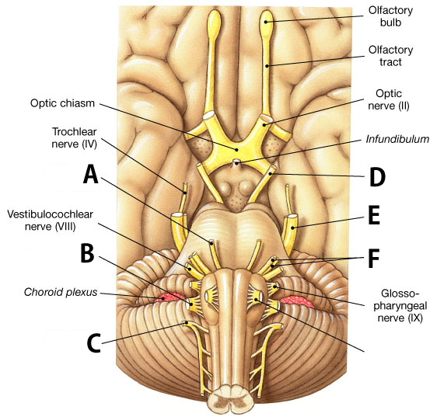
Q16: Cranial nerves
Name nerves A-F.
Name the nuclei associated with CN 7 and 9, and state their functional components

Slide 21
Qn 17
State the anatomical basis for:
Pupillary dilatation in brain stem death
Pupillary constriction in pontine haemorrhage

Slide 22
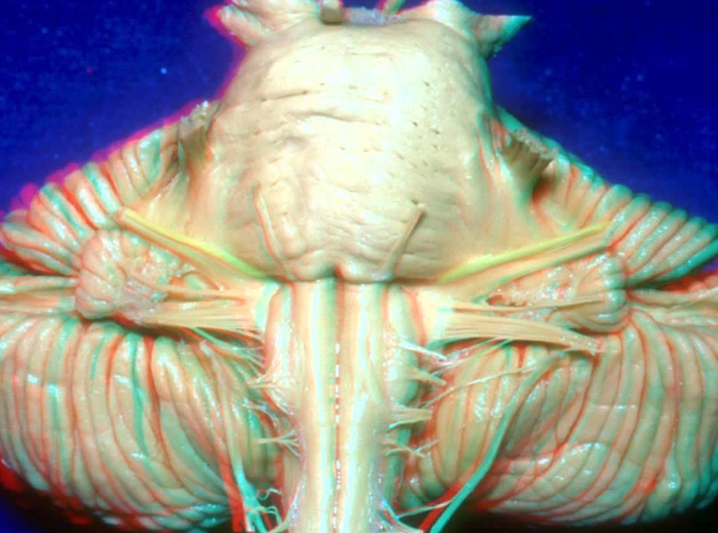
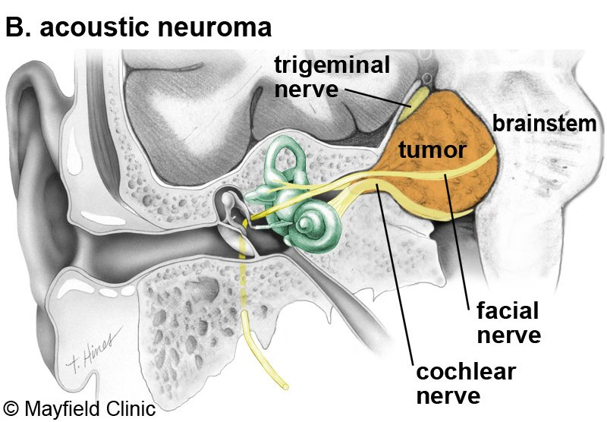
Qn 18
State the anatomical basis for the presentation in CP (cerebellopontine) angle lesions

Slide 23
Qn 19
Illustrate the internal features of the midbrain at the level of superior colliculus

Slide 24
VENTRICULAR SYSTEM

Slide 25
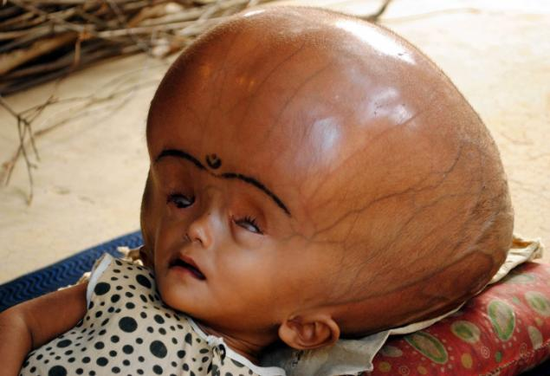
Qn 20: State the anatomical basis for the presentation below (sunset eyes)

Slide 26
Qn 21
State the anatomical considerations during ventriculoperitoneal shunt placement

Slide 27
Qn 22
Name five areas of the brain where the blood-brain barrier is absent, and state the significance of absence of this barrier in these areas.

Slide 28
CEREBELLUM

Slide 29
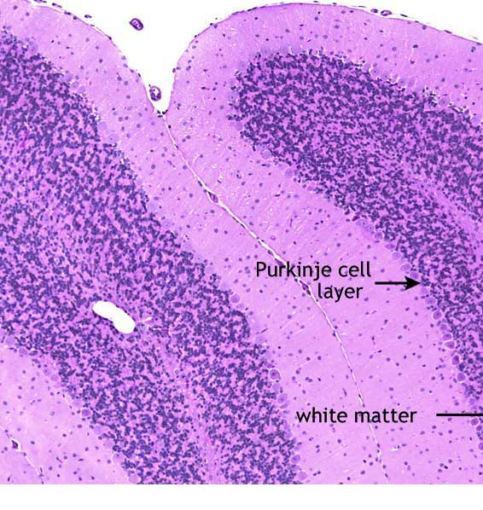
Qn 23
state the cells found in the molecular layer of this organ
State one afferent and one efferent tract located in the following:
Superior cerebellar peduncle
Inferior cerebellar peduncle

Slide 30
Qn 24
State the anatomical basis for the difference in presentation between a patient with midline and that with eccentric cerebellar lesions

Slide 31
Qn 25: Name cerebellar nuclei A-C

Slide 32
CEREBRUM & DIENCEPHALON

Slide 33
Qn 26
State the characteristics of a cortical module
State the anatomical basis of the presentation in temporal lobe lesions

Slide 34
Qn 27
Account for difference in motor deficits seen in occlusion of MCA and structure X
X

Slide 35
Qn 28
With aid of a diagram illustrate the parts of the internal internal capsule and associated tracts

Slide 36
Q29: a) Name areas labeled A-E & state their function. b) State the characteristics of frontal lobe syndrome

Slide 37
Qn 30: a) name the parts of structure labelled X. b) name two association fibres and regions they connect

Slide 38
31. Name the parts labelled A-H and state the connections of B

Slide 39
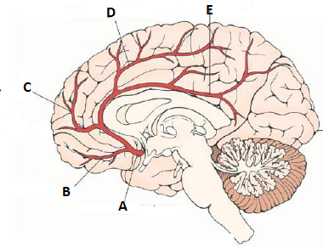
32: Name A -E and state the effect of occlusion of D

Slide 40
Qn 33
Regarding the pituitary gland:
Anatomical basis for presentation of pituitary tumors
Outline the microscopic organization of neurohypophysis

Slide 41
Qn 34
State the embryological basis for the following congenital anomalies
i) Microcephaly:
ii) Chiari malformation
iii) Holoprocencephaly
iv) Craniopharyngioma

Slide 42
THE END

