Slide 1
PANCREAS ESSAY
DR. BEDA OLABU

Slide 2
DEFINITION/INTRODUCTION
LARGEST DIGESTIVE GLANDS
BOTH ENDOCRINE AND EXOCRINE FUNCTIONS
LIES WITHIN THE CURVE THE DUODENUM

Slide 3
LOCATION/EXTENTS
EPIGASTRIUM
RETROPERITONEAL
BEHIND THE STOMACH
CURVE OF THE DUODENUM
HILUM OF THE SPLEEN

Slide 4
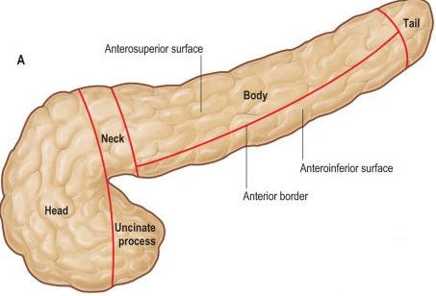
GROSS
COLOUR
LOBULATED
SHAPE
5 GROSS PARTS
BORDERS
SURFACES
DUCTS

Slide 5
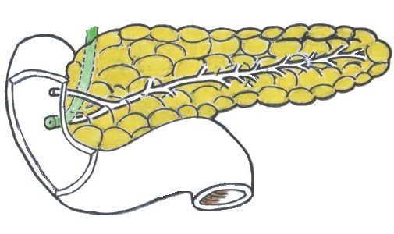
PANCREATIC DUCTS

Slide 6
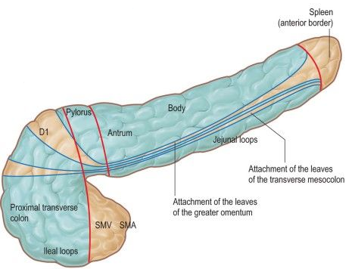
ANTERIOR

Slide 7
ANTERIOR
GASTRODUODENAL ARTERY

Slide 8
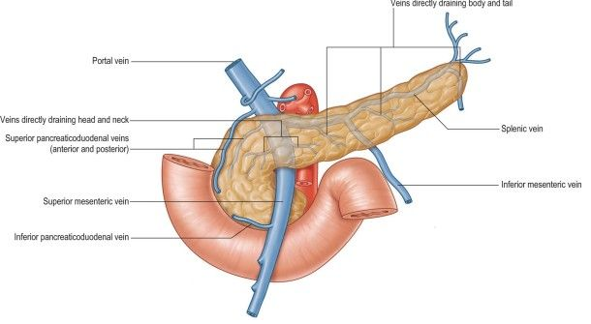
POSTERIOR

Slide 9
POSTERIOR
RIGHT RENAL VEIN
RIGHT CRUS OF THE DIAPHRAGM
ORIGIN OF THE RIGHT GONADAL VEIN IVC
IVC
AORTA
ORIGIN OF SUPERIOR MESENTERIC ARTERY
LEFT CRUS OF DIAPHRAGM
LEFT SUPRARENAL GLAND
LEFT KIDNEY
LEFT RENAL VESSELS
SPLENIC VEIN

Slide 10
INFERIOR
4TH PART OF THE DUODENUM
DUODENOJEJUNAL FLEXURE
COILS OF JEJUNUM

Slide 11
SUPERIOR
COELIAC ARTERY
COMMON HEPATIC ARTERY
SPLENIC ARTERY

Slide 12
TO THE RIGHT
DUODENUM
LIVER

Slide 13
TO THE LEFT
SPLEEN

Slide 14
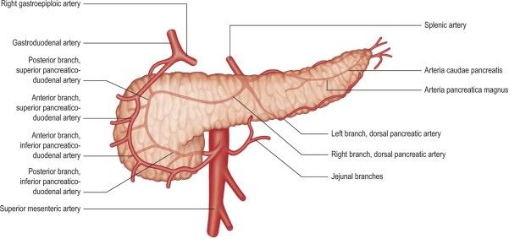
BLOOD SUPPY

Slide 15
ARTERIAL
BOTH FOREGUT AND MIDGUT VESSELS
PANCREATICODUODENAL ARTERIES
PANCREATIC BRANCHES
DORSAL ARTERY
ARTERIA PANCRAETICA MAGNA
ARTERIA CAUDAE PANCREATIS
UNNAMED
RICH ANASTOMOSIS

Slide 16
VENOUS
PANCREATICODUODENAL VEINS
SPLENIC VEIN
PORTAL VEIN
RETROPERITONEAL VEINS - LUMBAR VEINS
PORTOSYSTEMIC ANASTOMOSIS

Slide 17
LYMPHATIC DRAINAGE
EXTENSIVE
DRAIN THE ACINAR
PANCREATICOSPLENIC
PRE-AORTIC
PANCREATICODUODENAL
SUPERIOR MESENTERIC
HEPATIC
COELIAC AXIS

Slide 18
STRUCTURE
EXOCRINE AND ENDOCRINE
LOBULATED
THIN CAPSULE
PANCREATIC ACINAR
ACINAR CELLS, ZYMOGEN GRANULES
CENTROACINAR CELLS
PANCREATIC STELLATE CELLS
ISLETS OF LANGERHANS
CELL TYPES ANS SECRETORY PRODUCTS

Slide 19
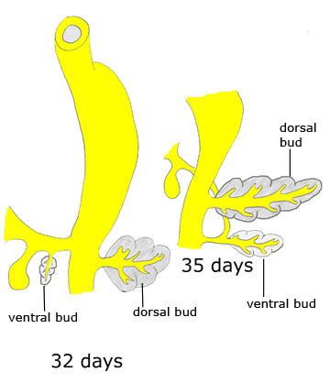
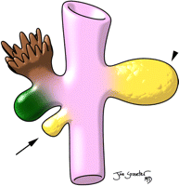
DEVELOPMNET
PANCREATIC BUDS
ROTATION
FUSION

Slide 20
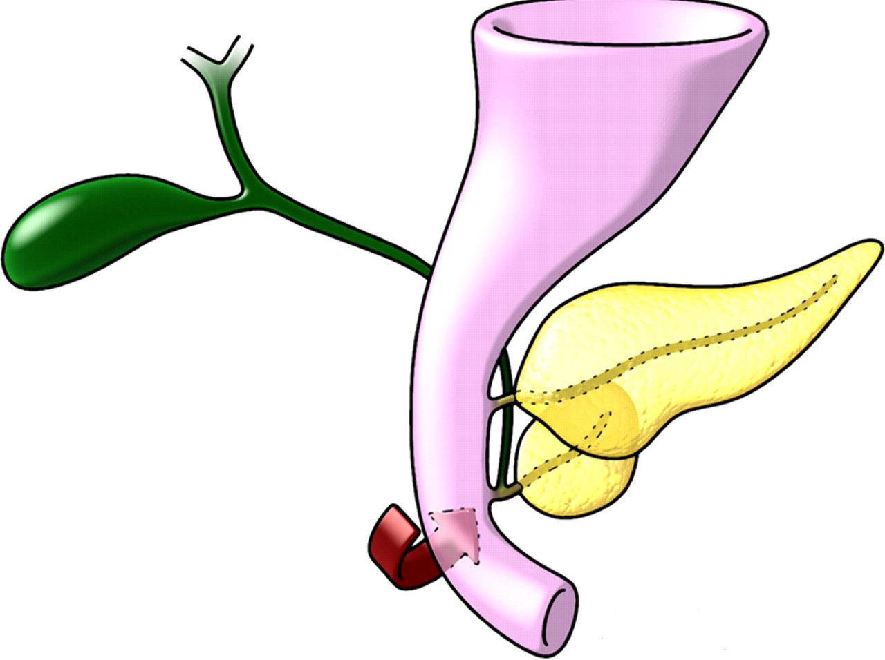
DEVELOPMENT

Slide 21
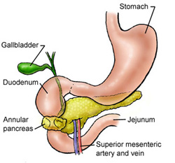
ANOMALIES
ANNULAR PANCREAS
ACCESSORY PANCREATIC TISSUE

Slide 22
APPLIED ANATOMY
pancreas divisum
poor prognosis following resection of pancreatic tumours
PAIN REFERRAL

