Slide 1
PROGRESS ASSESSMENT TEST III
LEVEL I MBChB & BDS
DEPARTMENT OF HUMAN ANATOMY
UNIVERSITY OF NAIROBI

Slide 2
A young boy is playing “monster” by flipping his eyelids upward and chasing after his sister. What structure is being locked upon itself to keep the boys eyelids inverted?
a. Tendon of levator palpebrae superioris muscle
b. Orbital septum
c. Superior conjunctival fornix
d. Conjunctiva
e. Tarsal plate

Slide 3
2. Horner syndrome leads to ptosis due to sympathetic nervous disruption. Lesion to what cranial nerve would lead to an even more severe ptosis?
Optic
Oculomotor
Trochlear
Abducens
Facial

Slide 4
3. What structure is a thickening of fascia that supports the underside of the eye?
Suspensory ligament
Lateral check ligament
Medial check ligament
Tenon’s capsule
Tendon of levator palpebrae superioris

Slide 5
4. The superior rectus muscle moves the eye in which two directions?
Superior and medial
Superior and lateral
Inferior and medial
Inferior and lateral
Anterior and posterior

Slide 6
5. Creating a more disc-shaped (flattened) lens requires ____ of the zonular fibers and is used to accommodate for ____ objects.
Tension; Near
Tension; Distant
Laxity; Near
Laxity; Distant

Slide 7
6. Which of the following nerves is NOT a branch of the trigeminal nerve?
Supratrochlear
Supraorbital
Zygomaticotemporal
Auriculotemporal
Lesser occipital

Slide 8
7. Which of the following facial sensory nerves comes from C2-3 of the cervical plexus?
Great auricular
Mental
Buccal
Infraorbital
Supratrochlear

Slide 9
8. Which of the following veins drains into the common facial vein?
Occipital
Posterior retromandibular
Anterior retromandibular
Posterior auricular
Superior ophthalmic

Slide 10
9. A patient presents with impingement of the lesser petrosal nerve after the nerve has exited foramen ovale and before it has reached the otic ganglion. Which of the following is the most likely clinical presentation?
Increased salivation
Reduced salivation
Increased lacrimation
Decreased lacrimation
Denervation of the platysma muscle

Slide 11
10. Which of the following is the least likely to be damaged during a paratoidectomy?
Facial artery and vein
Transverse facial artery and vein
CN VII
Retromandibular vein
External carotid artery

Slide 12
11. The primary fissure of the cerebellum separates the:
a. Superior surface from the inferior surface.
b. Anterior lobe from the posterior lobe.
c. Posterior lobe from the flocculonodular lobe.
d. Paleocerebellum from the neocerebellum.
e. None of the above.

Slide 13
12. The facial colliculus is formed by the:
a. Facial nerve only.
b. Facial nucleus only.
c. Facial and vagus.
d. Facial nerve and abducent nucleus.
e. Facial and trigeminal.

Slide 14
13. One of the following is not present in the interpeduncular fossa:
a. Tuber cinereum.
b. Infundibulum of the pituitary gland.
c. Mamillary bodies.
d. Posterior perforated substance.
e. Trochlear nerve

Slide 15
14. Nuclei of the limbic system include all of the following EXCEPT:
a. Hippocampus.
b. Amygdaloid nucleus.
c. Mamillary body.
d. Caudate nucleus.
e. Anterior thalamic nucleus

Slide 17
15. Regarding the parasympathetic nuclei of the brainstem, all are correct EXCEPT:
a. The Edinger-Westphal nucleus is located in the midbrain opposite the inferior colliculus.
b. Fibers from Edinger-Westphal nucleus relay in the ciliary ganglion.
c. The superior salivatory nucleus is located in the pons.
d. The inferior salivatory nucleus is located in the medulla oblongata.
e. The dorsal motor nucleus of the vagus is located in the medulla oblongata.

Slide 18
16. All are the actions of Tensor fascia lata except:
Hip flexion
B) Hip adduction
C) Knee flexion
D) Knee extension

Slide 19
17. Optic radiation arises from
A) Lateral geniculate body
B) Superior colliculus
C) Inferior colliculus
D) Medial geniculate body

Slide 20
18. In homonymous hemianopia due to occipital lobe infarction there is macular sparing because of blood supply from
A) Posterior cerebral
B) Opposite posterior cerebral
C) Middle cerebral
D) Anterior choroidal

Slide 21
19. Since the ____ artery branches from the internal carotid artery near the cavernous sinus, a cavernous sinus thrombus or thrombophlebitis could cause enlarged arteriole vessels in the ____.
Posterior communicating; cerebral arterial circle (of Willis)
Anterior cerebral; cerebral arterial circle (of Willis)
Ascending pharyngeal; throat
Opthalmic; eyes
Lingual; tongue

Slide 22
20. Which of the following would NOT occur with a CN VII lesion (Bell Palsy)?
Eyelid droop and inability to close eyelid
Atrophy of facial expression muscles
Food falls out of mouth due to orbicularis oris muscle
Chewing is inefficient due to buccinator muscle
Sounds may appear quieter due to stapedius muscle

Slide 23
21. State 2 cell types in the structure displayed

Slide 24
22. Name two regions where this tissue is found

Slide 25
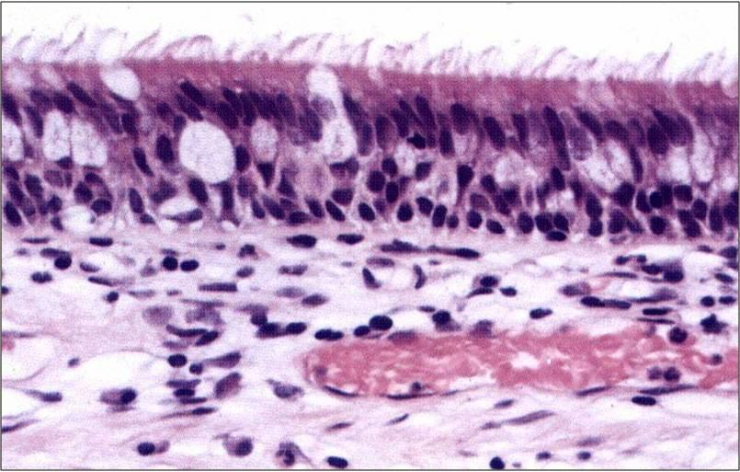
23 a) Identify the structure displayed b)state one neuroendocrine cell in (a) above

Slide 26
24. State two cell types in part X

Slide 27
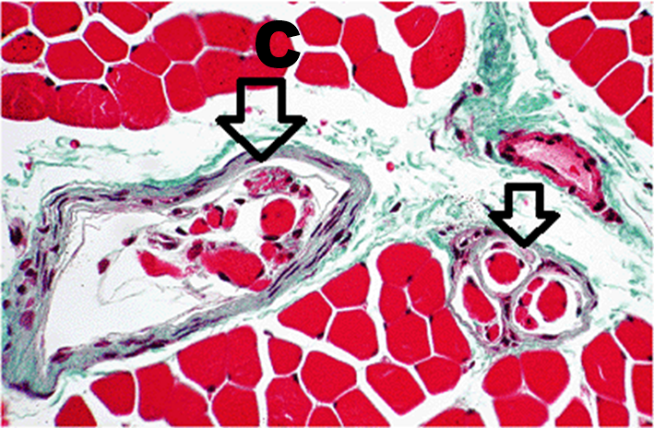
25 a) Identify structure labelled C b) State one muscle where structure C is abundantly found

Slide 28
26. State the spinal cord segment below and give a reason

Slide 29
27. State two unique features of the structure displayed

Slide 30
28. Identify the structure displayed and state its location

Slide 31
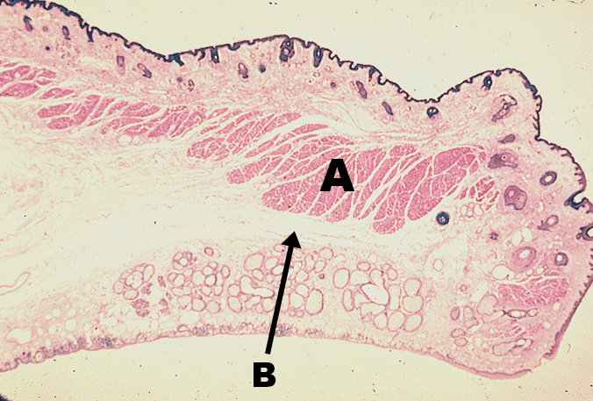
29. State structure labelled A & B

Slide 32
30. a)Name part A & C (1 mark) b)state the fibers in part B (1 mark)

Slide 33
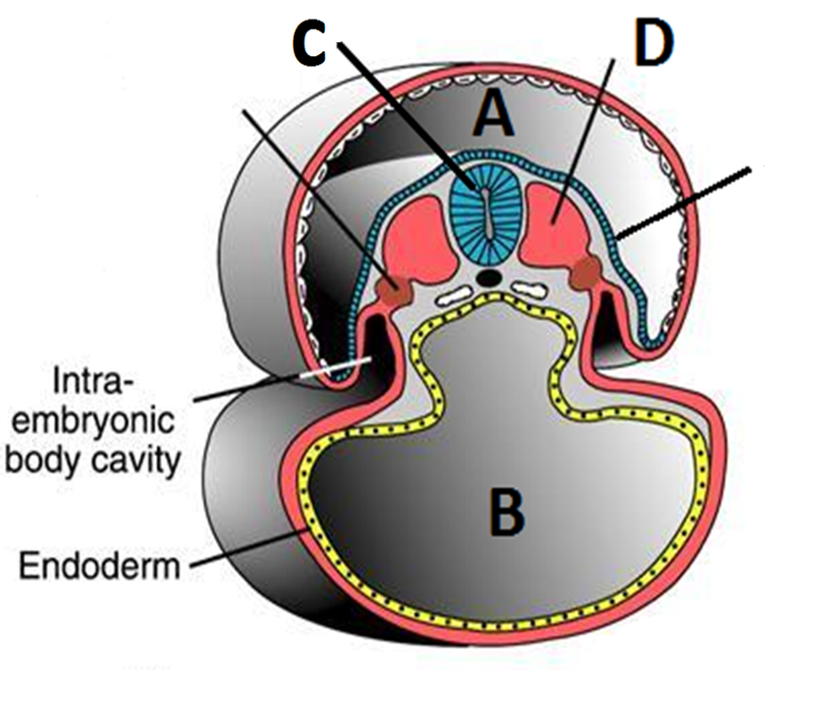
31. State two sources of the fluid that fills cavity A

Slide 34
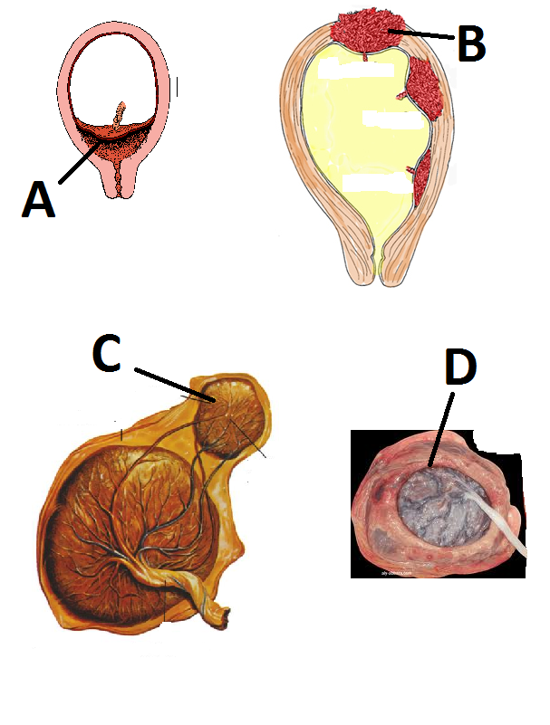
32. Name the anomalies A-D

Slide 35
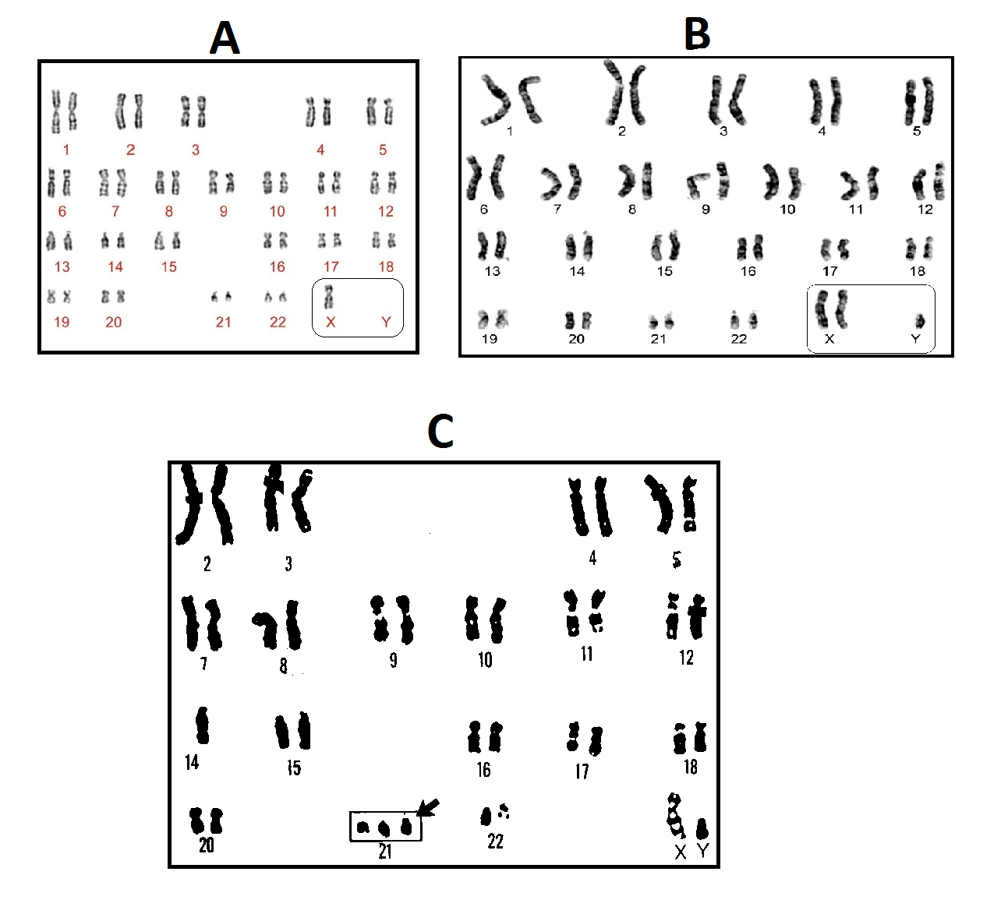
33. Name the genotypic conditions represented in the karyotype A and C

Slide 36
34. State the date of closure of A and C

Slide 37
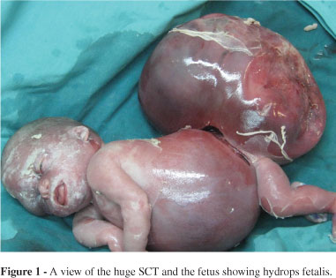
35. a) Identify the congenital anomaly
b) State one anomaly associated with the notochord

Slide 38
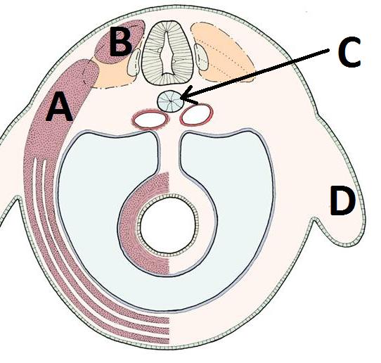
36. Name parts A-D

Slide 39
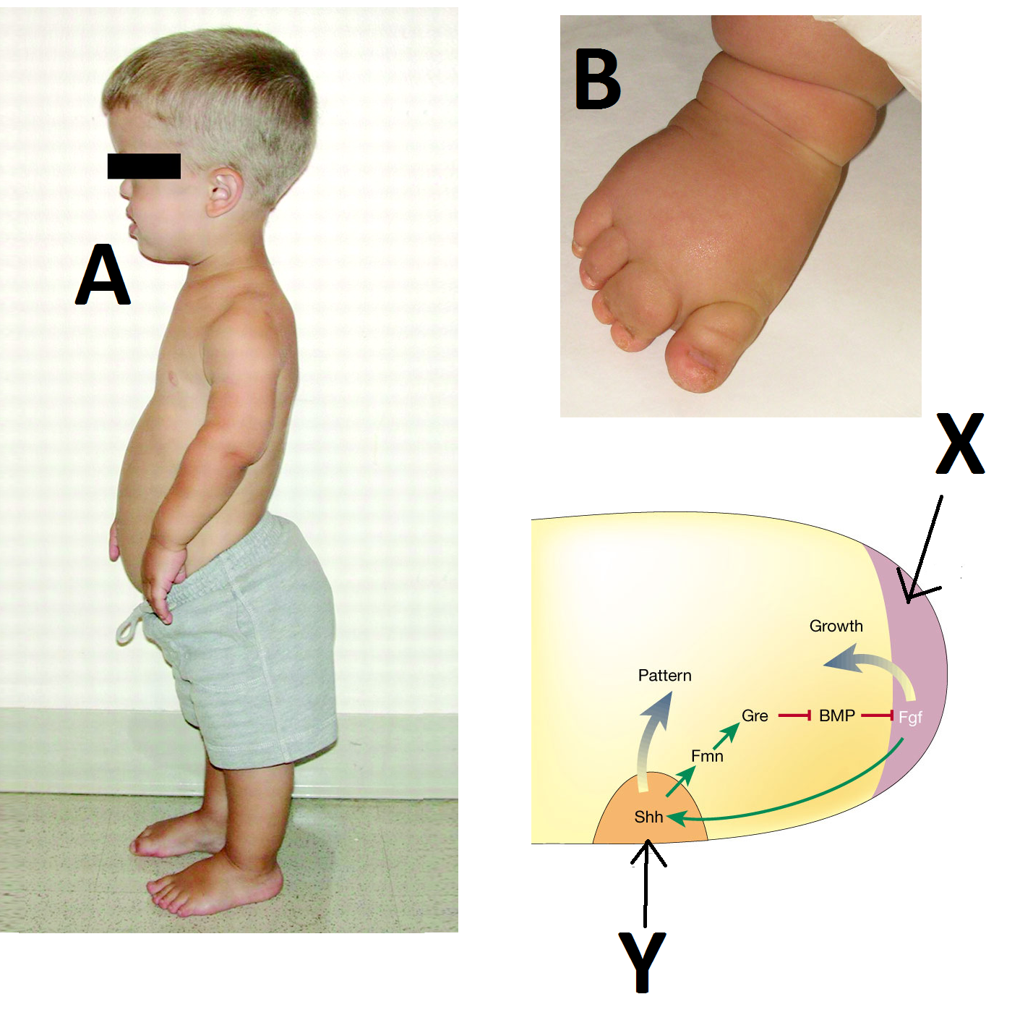
37.Identify the congenital malformation A and B and
parts X and Y shown

Slide 40
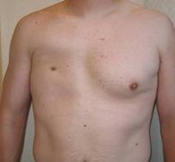
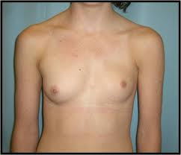
38 a)Identify the congenital malformation shown
b) State the embryological basis

Slide 41
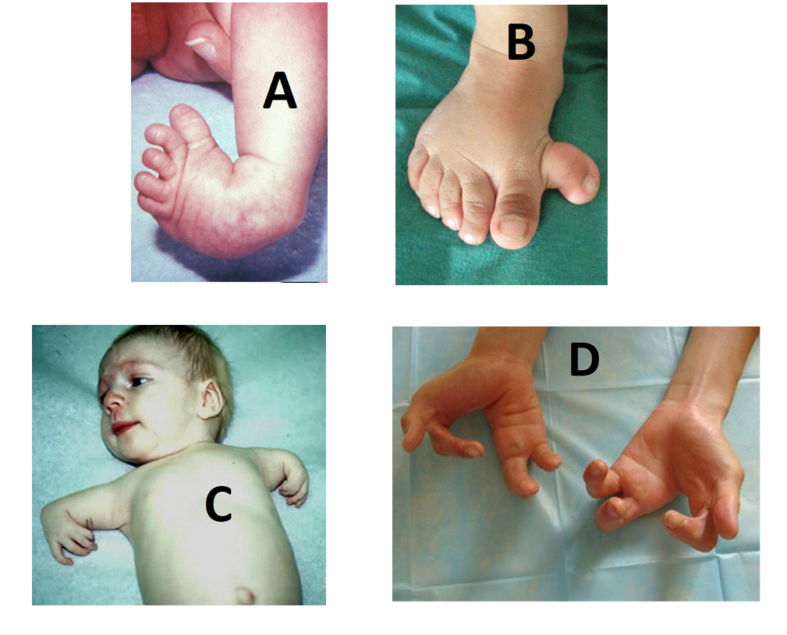
39. Identify the congenital malformation shown

Slide 42
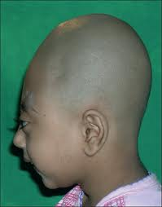
40. Identify the congenital malformation shown and state the embryological basis

