Slide 1
INTRODUCTION TO THE SKELETAL SYSTEM
NGWAZI, DR K.O. AWORI

Slide 2
SKELETAL SYSTEM Components
OSTEOLOGY: Study of bones
ARTHROLOGY: Study of joints

Slide 3
BONE: As an organ
Is living: has blood vessels & nerves.
Grows
Is plastic (remodels in response to
biomechanical demands)

Slide 4
BONE Functions
Support
Movement (levers for muscles)
Protection e.g cranium, rib cage, vertebral column
Storage of ions (calcium & phosphate)
Houses red marrow (blood synthesis)

Slide 5
BONE Classification modes
Developmental
Regional
Shape

Slide 6
BONE: CLASSIFICATION
DEVELOPMENTALLY
ENDOCHONDRAL (develops in a cartilage model)
INTRAMEMBRANOUS (bone precursor cells form a
‘membrane’ & transform into
bone forming cells that
deposit bone)

Slide 7
ENDOCHONDRAL

Slide 8
INTRAMEMBRANOUS

Slide 9
CLASSIFICATION Shape
Long versus Short bones
Flat
Irregular

Slide 10
SHAPE
LONG BONE
SHORT BONES

Slide 11
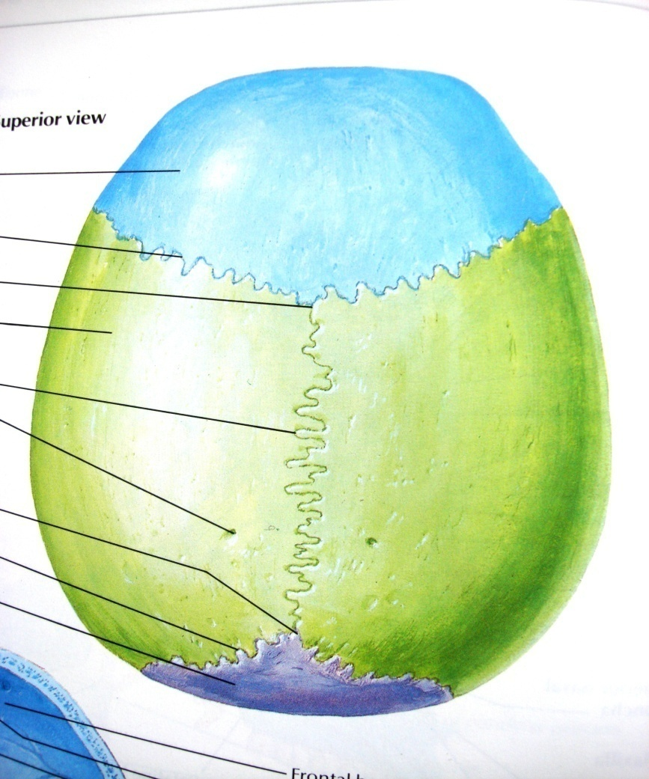
SHAPE Flat bone
E.g., bones of the
Calvaria.

Slide 12
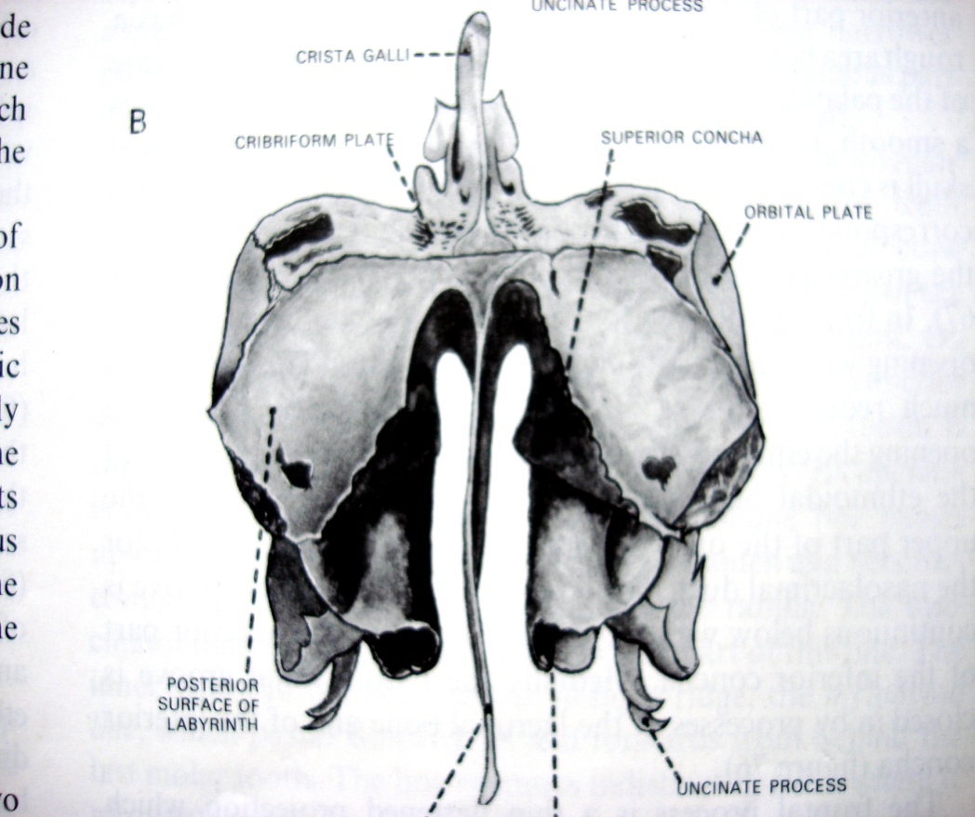
SHAPE Irregular bone
ETHMOID BONE

Slide 13
SPECIAL CATEGORY
Pneumatic bones– with air spaces (found in the skull)
Sesamoid bones – seed-like (found in certain tendons)
e.g. PATELLA (knee cap)

Slide 14
PNEUMATIC BONES
These have air spaces within
Frontal
Sphenoid
Maxillary
Ethmoid etc.

Slide 15
SESAMOID BONE
PATELLA

Slide 16
CLASSIFICATION Regionally
AXIAL SKELETON
APPENDICULAR SKELETON

Slide 17
BONE: CLASSIFICATION Regionally
AXIAL SKELETON
SKULL
Components
Neurocranium (calvaria)
Viscerocranium (facial bones)
Chondrocranium (skull base)
MANDIBLE

Slide 18
CALVARIA
FACIAL BONES

Slide 19
BONE: CLASSIFICATION Regionally
2. VERTEBRAL COLUMN
Vertebra

Slide 20
VERTEBRA
INTERVERTEBRAL DISC

Slide 21
BONE: CLASSIFICATION Regionally
VERTEBRAL COLUMN
Bone number
Cervical (7)
Thoracic (12)
Lumbar (5)
Sacral (5 and fused)
Coccygeal (1-4 and fused)

Slide 22
VERTEBRAL COLUMN (SPINE)
SACRUM

Slide 23
BONE: CLASSIFICATION Regionally
RIBS
COSTAL CARTILAGES

Slide 24
BONE: CLASSIFICATION Regionally
4. STERNUM
MANUBRIUM
BODY
XIPHOID
PROCESS

Slide 25
BONE: CLASSIFICATION Regionally
B. APPENDICULAR SKELETON
Upper limb
Shoulder girdle (Scapula and clavicle)
Humerus (arm)
Radius & Ulna (forearm)
Carpal bones, Metacarpals and Phalanges (Hand)

Slide 26
ULNA
CLAVICLE
HUMERUS
SCAPULA
RADIUS
SHOULDER GIRDLE & HUMERUS
RADIUS & ULNA

Slide 27
HAND
PHALANGES
METACARPALS
CARPAL BONES

Slide 28
BONE: CLASSIFICATION Regionally
APPENDICULAR SKELETON
2. Lower limb
Pelvic girdle (Ilium, ischium and pubis)
Femur (thigh)
Tibia & Fibula (leg)
Tarsal bones , metatarsals and phalanges.

Slide 29
ILIUM
PUBIS
ISCHIUM
PELVIS
HIP BONE

Slide 30
BONE ORGANIZATION
LONG BONE
Tubular (medullary cavity has an isthmus.
Parts include diaphysis, epiphysis & metaphysis
EPIPHYSIS
DIAPHYSIS
METAPHYSIS

Slide 31
BONE ORGANIZATION
SESAMOID BONES
Bone nodules that develop in certain tendons where they rub on convex bony surfaces.
E.g. Patella (largest) in quadriceps femoris tendon

Slide 32
BONE ORGANIZATION
BLOOD SUPPLY
Nutrient artery
Through vessels in the periosteal sleeve from muscles attached to the bone.
Vessels penetrate the bone ends

Slide 35
SKELETALLY IMMATURE BONE
Presence of the growth (epiphyseal) plate.

Slide 36
CARTILAGE
TYPES
Hyaline
Fibrocartilage
Elastic
Cellular

Slide 37
JOINTS
A junction between two or more bones.

Slide 38
JOINTS Classification
DEGREE OF MOBILITY
MODE OF FORMATION

Slide 39
JOINTS Classification
MOBILITY
SYNARTHROSES (No mobility)
AMPHIARTHROSES (Little mobility)
DIARTHROSES (Highly mobile)

Slide 40
JOINTS Classification
2. MODE OF FORMATION
Fibrous
Cartilaginous
Synovial (have joint space)

Slide 41
JOINTS Classification
FIBROUS
There is a layer of fibrous tissue between the
bones.
Are amphiarthroses.
Syndesmoses (distal tibiofibular joint)
Sutures (skull)
Gomphoses (gums)

Slide 43
Fibrous joints
SUTURES
GOMPHOSIS: PERIODONTAL MEMBRANE

Slide 44
JOINTS Classification
CARTILAGINOUS JOINTS
Synchondroses (primary cartilaginous)
hyaline cartilage between the bones
e.g. Epiphyseal plates

Slide 45
SYNCHONDROSIS (Primary cartilaginous)

Slide 46
JOINTS Classification
CARTILAGINOUS JOINTS
Symphyses (secondary cartilaginous)
fibrocartilage between the bones
e.g. Pubic symphysis, symphysis menti &
intervertebral discs.

Slide 47
SYMPHYSIS
PUBIC SYMPHYSIS

Slide 48
SYNOVIAL JOINTS
Allow free movement
CHARACTERISTICS
Joint space
Articular cartilage
Joint capsule
Synovial membrane
Some have pads of fibrocartilage (articular discs)

Slide 49
SYNOVIAL JOINT
CAPSULE
SYNOVIAL MEMBRANE
ARTICULAR CARTILAGE

Slide 50
SYNOVIAL JOINTS Classification
PLANE OF MOVEMENT
SHAPE OF ARTICULAR SURFACE

Slide 51
SYNOVIAL JOINTS Classification
PLANE
Uniaxial (e.g. Hinge and pivot)
Biaxial (e.g. Condyloid & ellipsoid)
Multiaxial (e.g. Ball & socket, Sella or saddle)

Slide 52
SYNOVIAL JOINTS Classification
BALL AND SOCKET (shoulder and hip joints)

Slide 53
SYNOVIAL JOINTS Classification
2. SELLA
(1st carpo-metacarpal, Sterno-clavicular, Patello-femoral)

Slide 54
SYNOVIAL JOINTS Classification
3. PLANAR
(Acromio-clavicular)

Slide 55
SYNOVIAL JOINTS Classification
4. CONDYLOID/CONDYLAR
(Metacarpophalangeal, Tibio-femoral)

Slide 56
SYNOVIAL JOINTS Classification
5. HINGE
(Elbow)

Slide 57
SYNOVIAL JOINTS Classification
6. TENON & MORTISE
(Talocrural or ankle joint)
MORTISE

Slide 58
TENON

Slide 59
SYNOVIAL JOINTS Classification
7. PIVOT
(Proximal radio-ulna, Atlanto-axial)

Slide 60
SYNOVIAL JOINTS Classification
8. ELLIPSOID
(Radio-carpal or wrist joint)

Slide 61
JOINT Innervation
HILTONS LAW:
The nerves that supply a joint are the same as
the nerves that supply muscles that cause
movement around the joint.

