Slide 1
SPINAL CORD & PERIPHERAL NERVES
Dr Mwachaka PM

Slide 2
Lab activities
Describe the features of the slides presented
HD 18 – CERVICAL SPINAL CORD
HD 20A – CERVICAL SPINAL CORD
HD 20B – THORACIC SPINAL CORD
HD 20C – LUMBAR SPINAL CORD
HD 11, 12 – PERIPHERAL NERVE

Slide 3
Objectives
Understand the basic structure of spinal cord
State the regional differences in the structure of SC
Understand the organization of spinal cord tracts
Review the microscopic features of spinal meninges
Understand the microscopic features of peripheral nerves

Slide 4
Introduction

Slide 6
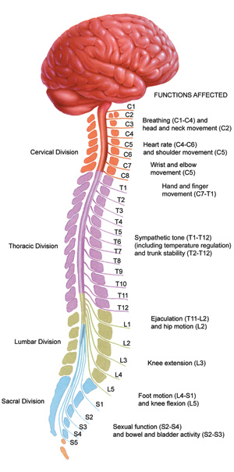
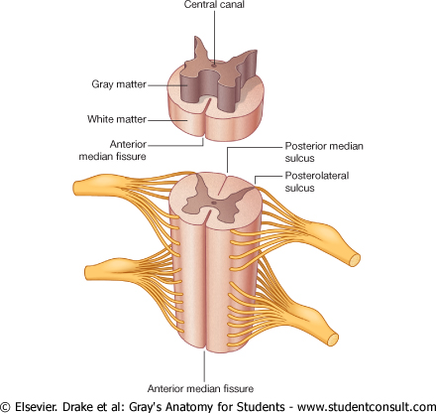
Spinal cord – general features

Slide 8
Gray matter
Horns & Rexed laminae

Slide 9
Rexed lamina
I: Noxious stimuli
II: Noxious stimuli
III & IV: position & light touch
V: noxious stimuli
VI: joint and skin sensations
VII: intermediolateral nucleus, Clarkes column
VIII & IX: Ventral horn cells

Slide 10
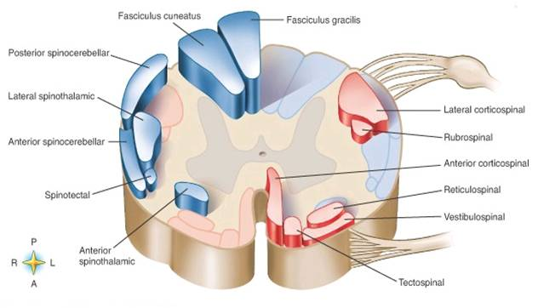
White matter
Funiculi/columns Tracts

Slide 12
Segmental organization of the tracts

Slide 13
Regional differences
White matter
cervical > sacral
ascending pathways
F. Cuneatus above T6
Gray matter
Enlargements: C, L, S
Lateral horns

Slide 15
Spinal meninges

Slide 17
Dura
simple squamous epithelial (SSE) lining
Dense regular connective tissue
Arachnoid matter
SSE in contact with dura
Trabeculae: fibroblasts & collagen
Pia matter
SSE, contains blood vessels

Slide 18
PERIPHERAL NERVOUS SYSTEM

Slide 19
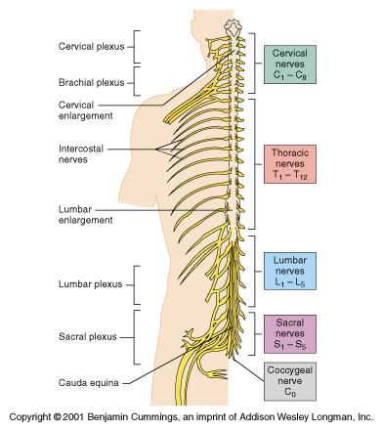
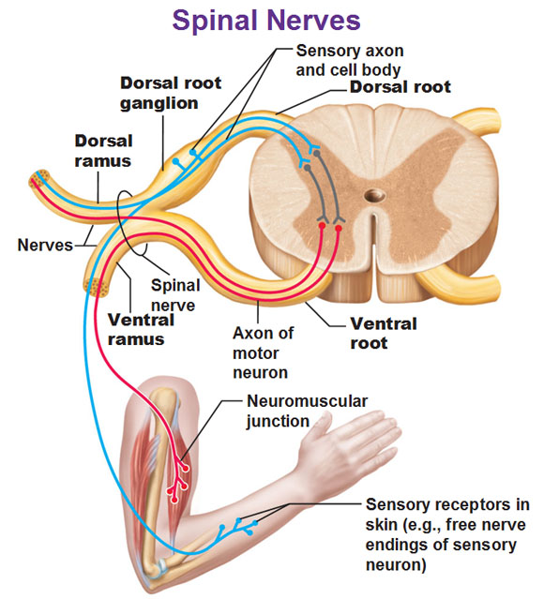
Spinal nerves

Slide 20
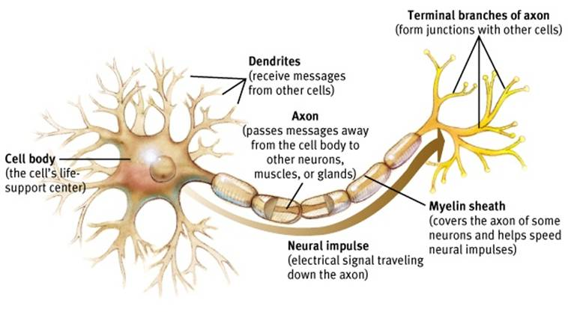
Functional domains of a neuron

Slide 21
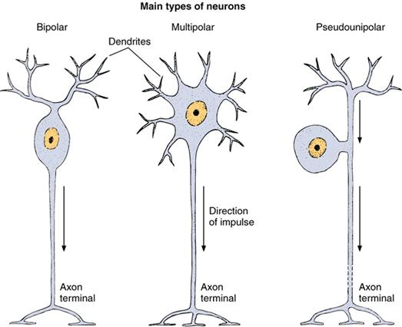

Slide 22
Sensory Vs Motor neurons

Slide 23
Associated connective tissue

Slide 24
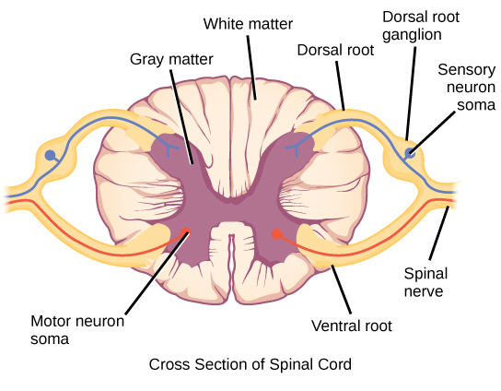
Sensory ganglia
Vascular connective tissue capsule
Sensory neuron cell bodies
Supporting cells

Slide 25
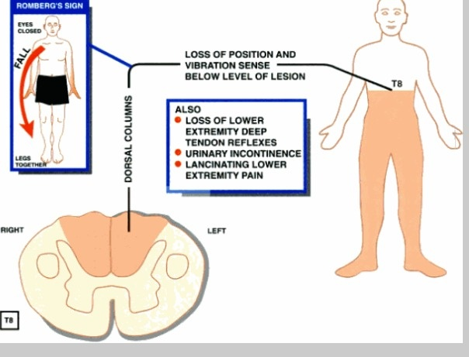
Clinical relevance – Tabes dorsalis (Neurosyphilis)
Damage to dorsal root & dorsal column

Slide 26
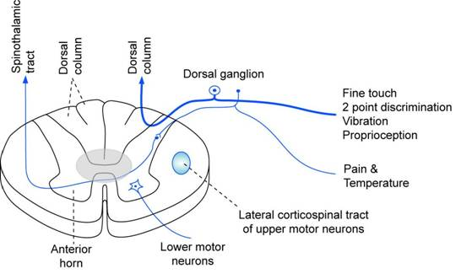
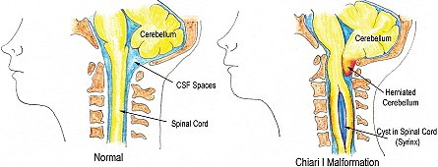
Syringomyelia
central part of the spinal cord
decussating spinothalamic tracts
segmental loss of pain & temperature sense.
Touch, pressure, vibration & position sense spared

Slide 27
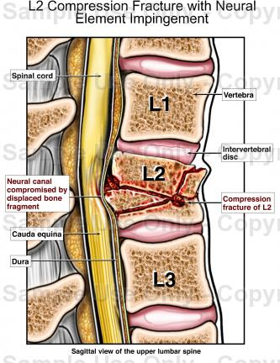
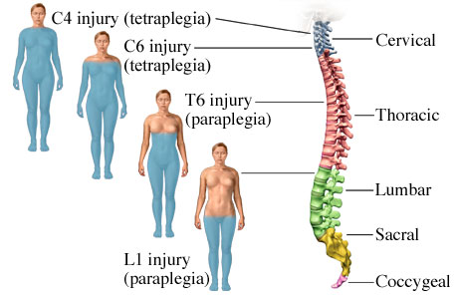
Spinal Cord Compression

Slide 28
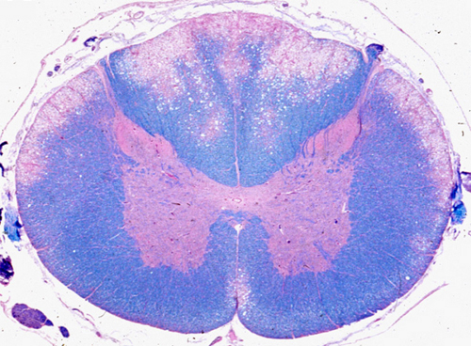
vitamin B12 deficiency
degeneration of dorsal & lateral columns.
Loss of position sense, two-point discrimination, & vibratory sensation.
UMNL features

Slide 29
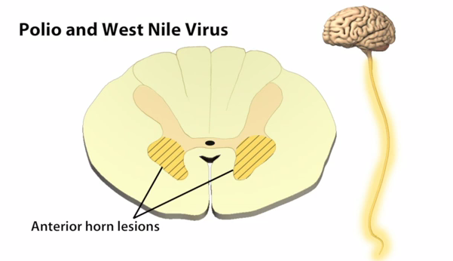
Anterior horn lesions
Anterior horn cells
Lower motor neuron lesion features

Slide 30
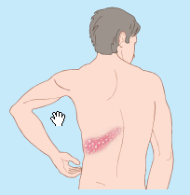
Herpes Zoster

Slide 31
The End

