Slide 1
The Basal ganglia
Dr Paul Bundi Karau
    BSc, MBChB
    Resident, Internal Medicine
    UoN
16° Dec 2016

Slide 2
Key objectives
- Components of the basal ganglia
- Functions of the basal ganglia
- Functional connections of the basal ganglia
e.g., direct and indirect pathways, transmitters
Common disorders of the basal ganglia and
their anatomical basis

Slide 3
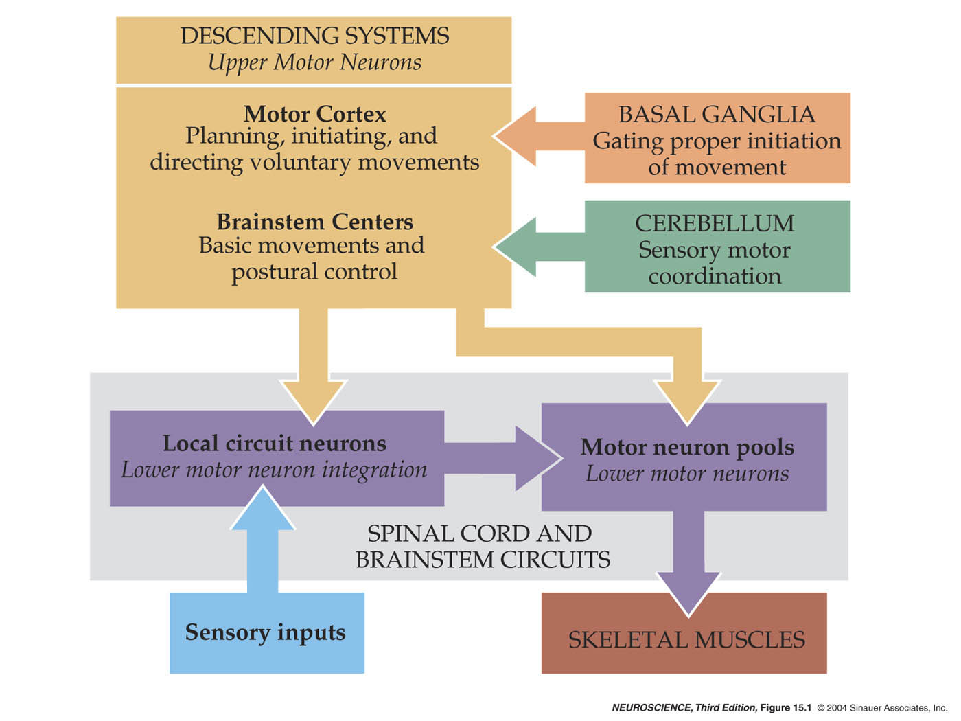
Neural structures involved in the control of movement

Slide 4
What is basal ganglia?
A group of subcortical nuclei engaged primarily in motor control, AND
  motor learning
  Executive functions and behavior
  emotions.

Slide 5
What are the COMPONENTS of the basal ganglia?

Slide 6
Basal Ganglia
Neostriatum
Caudate nucleus
Putamen
Ventral striatum (nucleus accumbens)
2. Paleostriatum
Globus pallidus external segment (GPe)
Globus pallidus internal segment (GPi)
3. Substantia Nigra
Pars compacta (SNc)
Pars reticulata (SNr)
4. Subthalamic nucleus (STN)

Slide 7
Kandel –
Principles of Neural Science
Anatomical nomenclature tips:
caudate nucleus + putamen: striatum
putamen + globus pallidus: lentiform nucleus

Slide 8
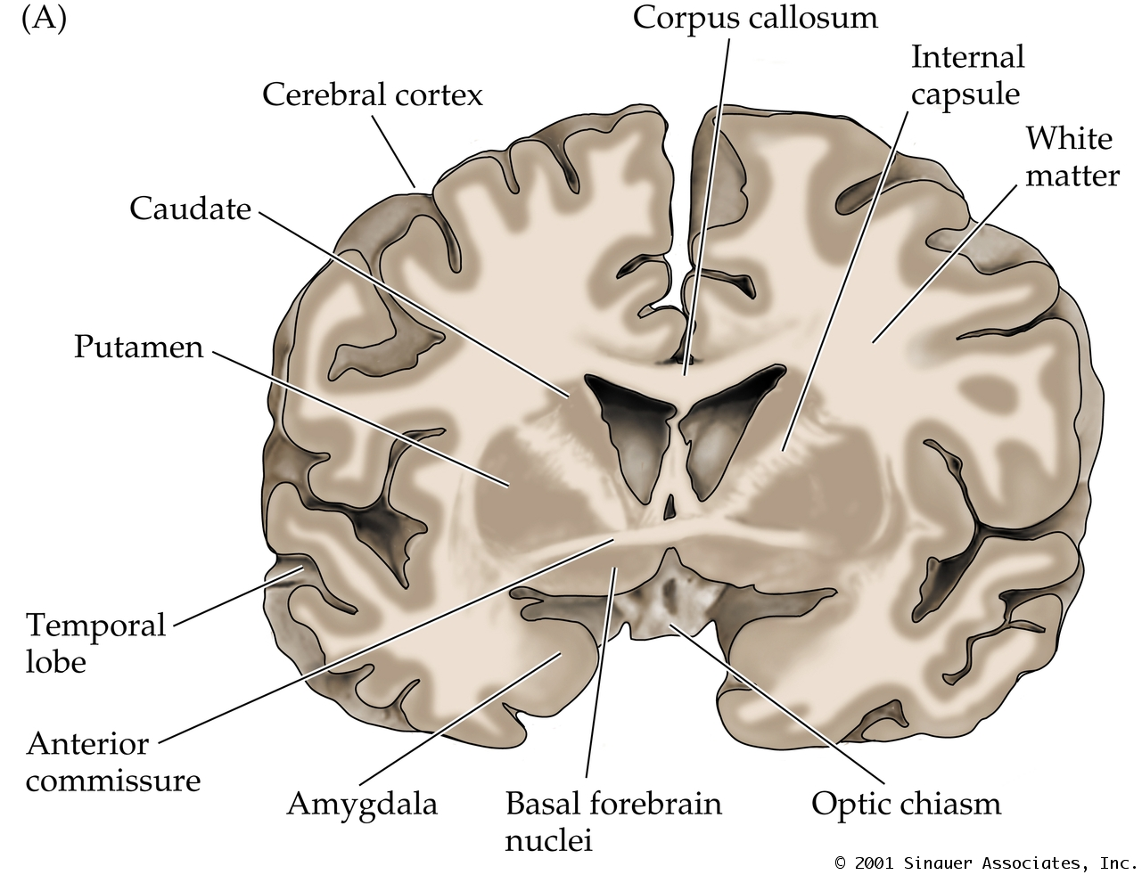

Slide 9
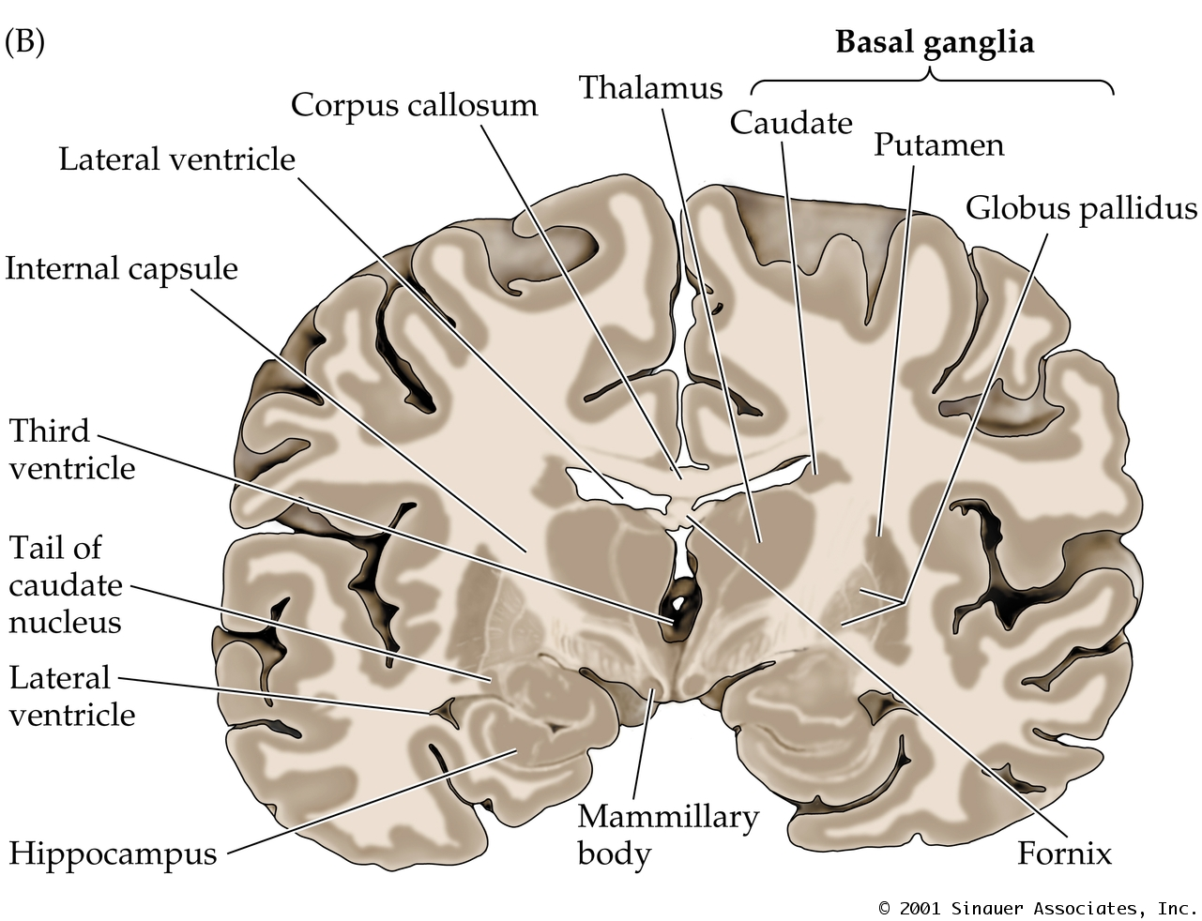

Slide 10
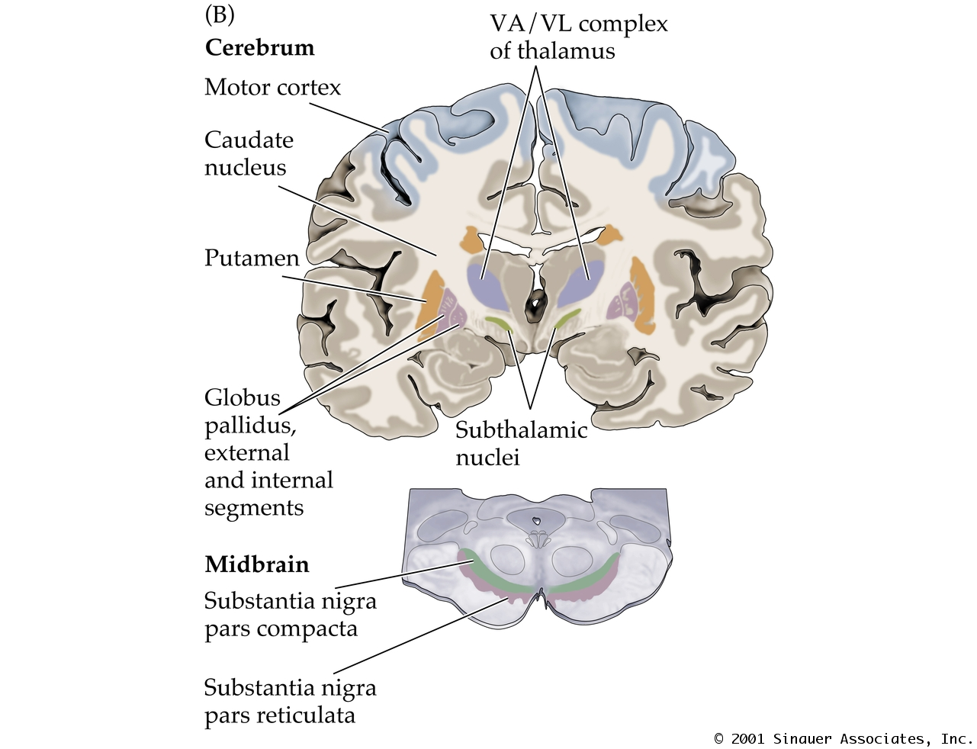
Forebrain
Midbrain

Slide 11
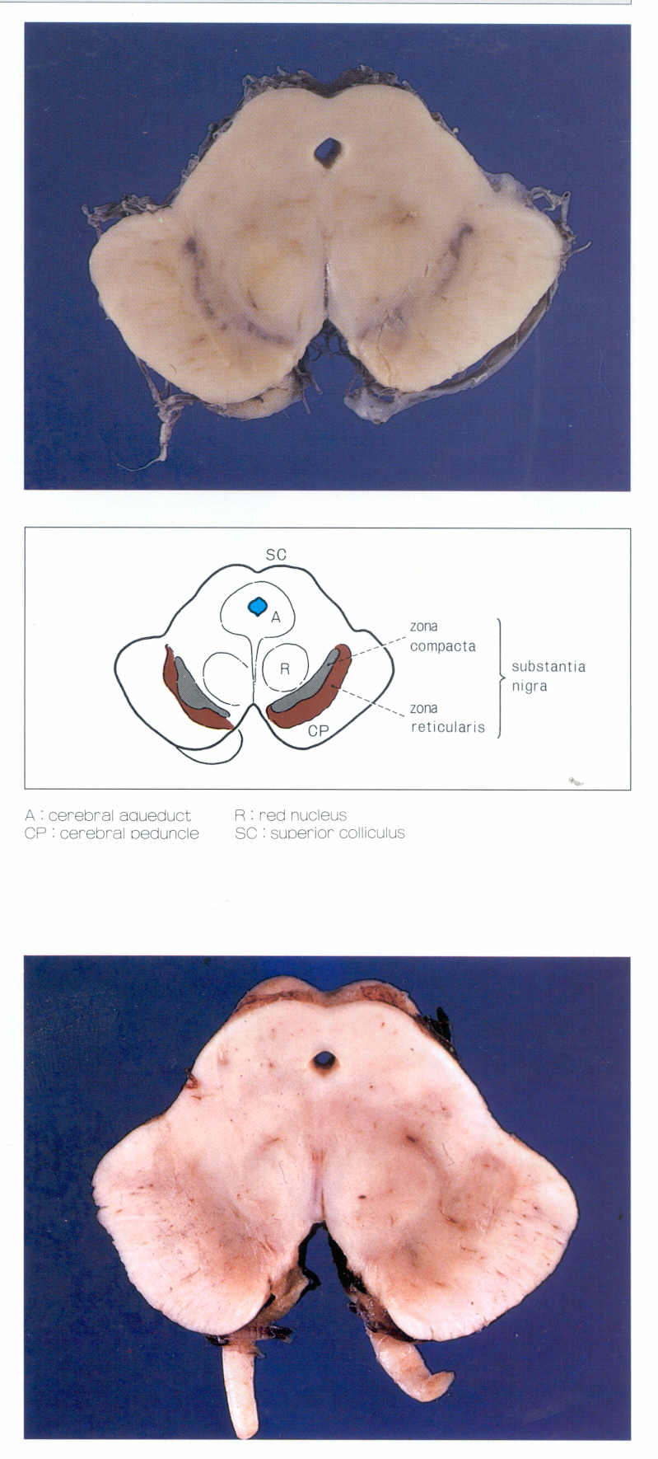
Substantia Nigra
Compacta
SNC
Reticulata
SNC
can be recognized with the naked eye
because SNC neurons contain neuromelanin in humans
Pars compacta: SNC (cell-rich part): dopamine
Pars reticulata: SNR (cells intermixed with fibers and sparse):
GABA

Slide 12
What are the functions of the basal ganglia?

Slide 13
Major functions
1. Basal ganglia are involved in generation of goal-directed voluntary movements:
  Motor control
  Motor pattern selection
2. Motor learning
3. Executive functions and behavior
4. Emotions.

Slide 14
Basal ganglia connections

Slide 15
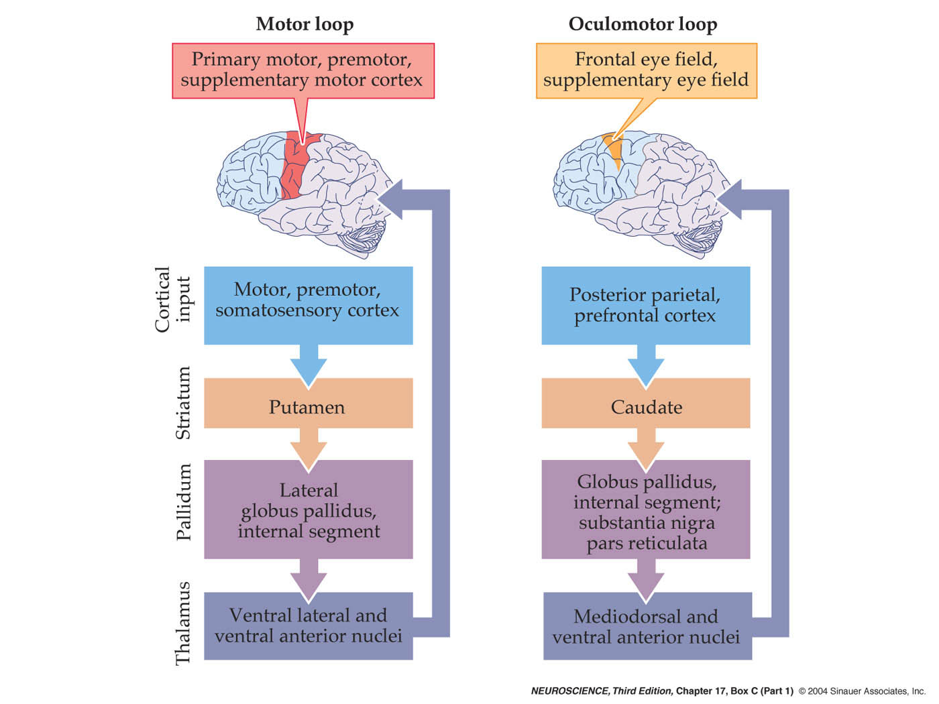
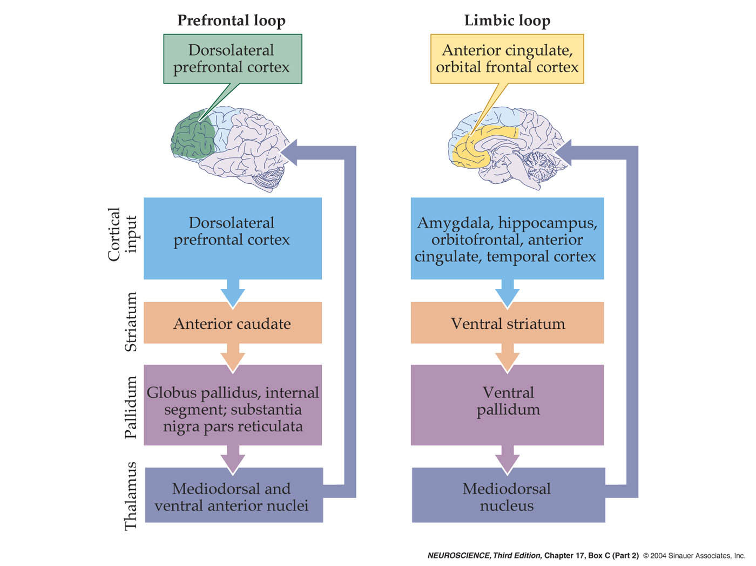
Basal ganglia loops – motor and non-motor
Prefrontal loop
(Associative)
Motor loop
Limbic loop

Slide 16
Cortex
Direct pathway
Striatum
Excitation (glutamate)
Inhibition (GABA)
*
VA/VL
GPe
STN
*
* tonically active
~100 Hz
GPi/SNr
Modified from Wichmann and Delong, Curr Opin Neurobiol. 6:751-758, 1996.

Slide 17
Cortex
Direct pathway
Direct pathway:
facilitates
movement
Striatum
Excitation (glutamate)
Inhibition (GABA)
*
VA/VL
GPe
Disinhibition
STN
*
* tonically active
~100 Hz
GPi/SNr
Brain stem/
Spinal cord
Modified from Wichmann and Delong, Curr Opin Neurobiol. 6:751-758, 1996.

Slide 18
Cortex
Striatum
Indirect pathway:
inhibits
movement
Indirect pathway
*
VA/VL
GPe
Excitation (glutamate)
Disinhibition
Inhibition (GABA)
STN
*
* tonically active
~100 Hz
GPi/SNr
Brain stem/
Spinal cord
Modified from Wichmann and Delong, Curr Opin Neurobiol. 6:751-758, 1996.

Slide 19
Cortex
Direct pathway:
facilitates
movement
Striatum
D₂
D₁
Indirect pathway:
inhibits
movement
SNc
*
VA/VL
GPe
Excitation (glutamate)
Inhibition (GABA)
STN
*
* tonically active
~100 Hz
GPi/SNr
Brain stem/
Spinal cord
Modified from Wichmann and Delong, Curr Opin Neurobiol. 6:751-758, 1996.

Slide 20
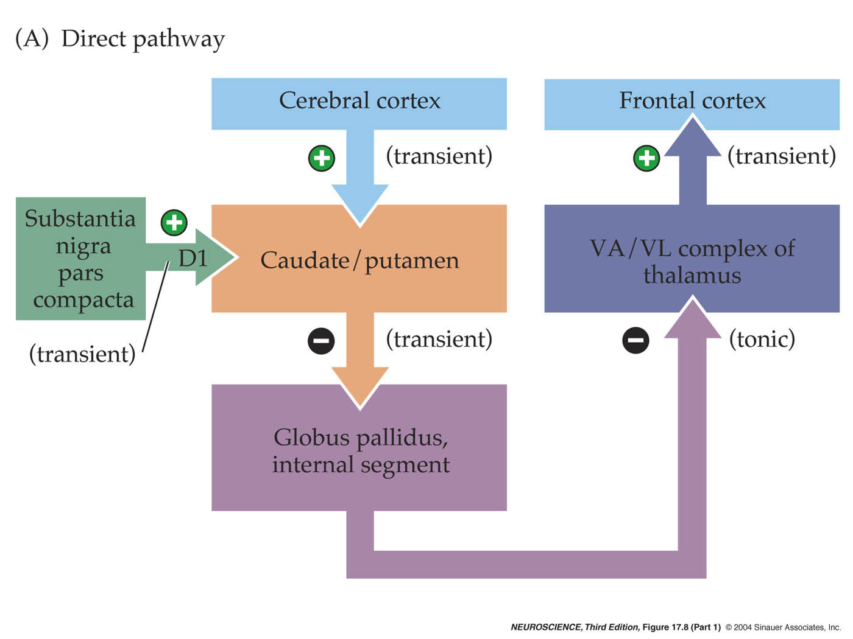
Direct pathway

Slide 21
Release of DA in substantia nigra, as well as in striatum is required for control of movement by the basal ganglia

Slide 22
Motor behavior is determined by the balance between direct/indirect striatal outputs
  Hypokinetic disorders
  insufficient direct pathway output
  excess indirect pathway output
Hyperkinetic disorders
  excess direct pathway output
  insufficient indirect pathway output

Slide 23

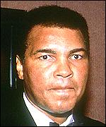
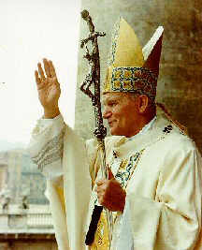
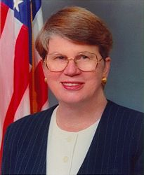

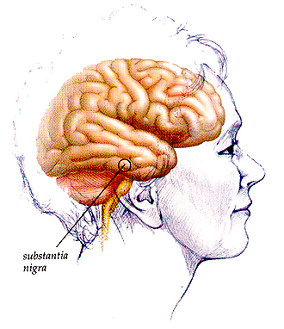
Parkinson’s disease
Michael J. Fox
Muhammad Ali
Pope John Paul II
Janet Reno
Katherine Hepburn
Striatum
Pathophysiology
  Primary: loss of nigrostriatal Dopamine projection
SNc

Slide 24
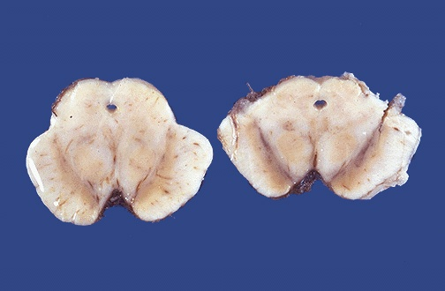
Human midbrain
Parkinson’s
disease
Normal

Slide 25
Parkinson’s disease
Symptoms
  Motoric
    Tremor (~4-5 Hz, resting)
    Bradykinesia
    Rigidity
    Loss of postural reflexes
  Depression
  Dementia

Slide 26
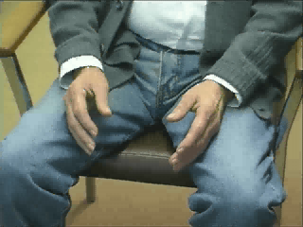
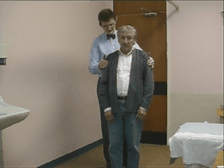
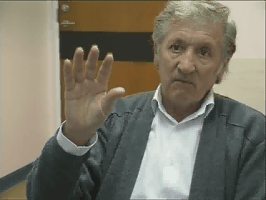
Parkinson’s disease
Loss of postural reflexes
…even with mild tremor
and bradykinesia

Slide 27
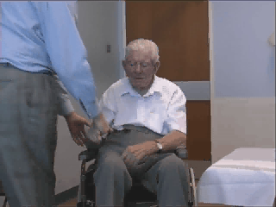
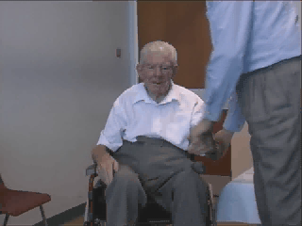
Parkinson’s disease
Rigidity

Slide 28
Hyperkinetic disorders: choreatic syndromes
Causes:
Genetic (autosomal dominant)
Genetic or idiopathic
Chronic neuroleptic use
Parkinson’s therapy
Unilateral stroke,
typically subthalamic nucleus
Excessive D2-subtype
DA receptor expression(?)
1. Huntington’s chorea
2. Dystonia
3. Tardive dyskinesia
4. DOPA-induced dyskinesia
5. Hemiballismus
6. Tourette’s syndrome

Slide 29
Choreatic symptoms
Involuntary (unwanted) movements
Chorea (dance-like). Lesion in putamen. Causes flicking movement of hand, face or any other body part
Athetosis (changeable or writhing movements). Lesion in globus pallidus
Hemiballismus- Flailing movements of entire limb. Lesion in subthalamic nucleus

Slide 30
Huntington’s disease
Pathophysiology
  Atrophy of striatum
  Loss of striatal GABAergic neurons
  Neuropathological sequence
    1st: loss of striatal GABA/enkephalin/D2-R neurons (indirect pathway)
    2nd: loss of striatal GABA/dynorphin/D1-R neurons (direct pathway) & cortical atrophy

Slide 31
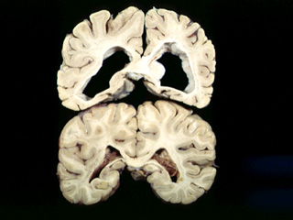
Huntington’s disease pathology
Huntington’s
Normal

Slide 32
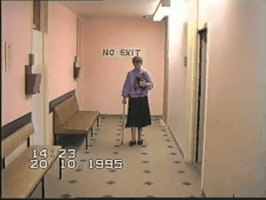
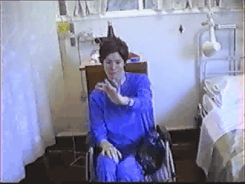
Huntington’s disease
Choreatic gait
Symptoms
  Early motor signs
    chorea (brief, involuntary movements)
    dystonia (abnormal postures)
Dystonic movements

Slide 33
In a nutshell

Slide 34
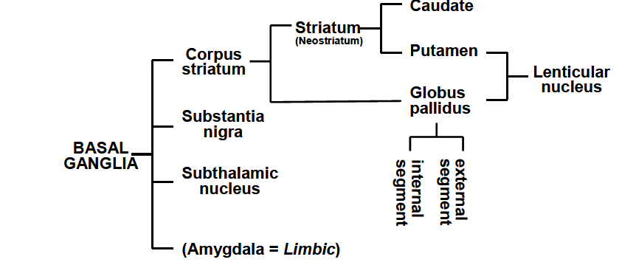

Slide 35
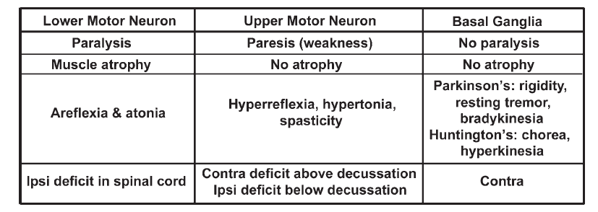

Slide 36
Thank you!

