Slide 1
The Cerebellum
Dr Bundi Karau

Slide 2
Key messages
Surface and internal anatomy of the cerebellum
Cerebellar functions
Cerebellar connections
Applied anatomy

Slide 3
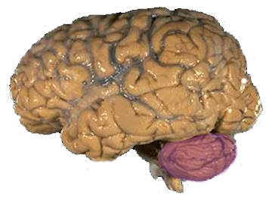
GROSS ANATOMY OF CEREBELLUM
Location:
The term cerebellum is from “latin meaning” the little brain.It is a part of the hindbrain situated in the posterior cranial fossa.
covered by tentorium cerebelli and is connected to brain stem by three cerebellar peduncles.

Slide 4
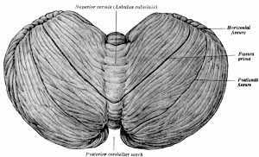
Anatomy of cerebellum......contd.
Consists of two laterally, large hemisphere which are united by midline vermis.
Cerebellar surface is divided by numerous curve transverse fissures giving it a laminated appearance
One conspicious fissure “horizontal fissure”extends around dorsolateral border of each hemisphere from middle cerebellar peduncle to vallecula,seperating superior and inferior surface
Horizontal fissure
Hemisphere
Superior surface
Vermis

Slide 5
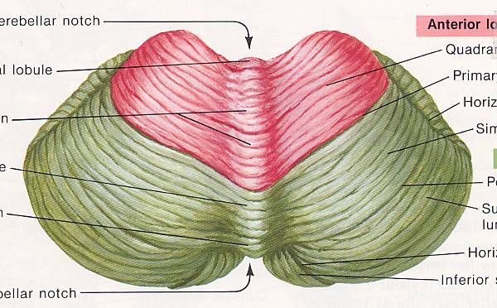
External surface of cerebellum
Primary fissure
The deepest fissure in the vermis is primary fissure, which curves ventrolaterally in the superior surface of the cerebellum to meet horizontal fissure.
Primary fissure divides the cerebellum into anterior and posterior lobe.
Anterior lobe
Primary fissure
Posterior lobe

Slide 6
External surface of cerebellum
Horizontal fissure
Anterior lobe
Primary fissure
Posterior lobe
vermis
Hemisphere

Slide 7
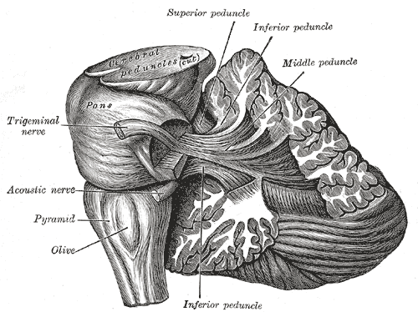
The cerebellum is connected to
Brain stem by three peduncles
Superior cerebellar peduncle
Midbrain
Middle cerebellar peduncle
Pons
Inferior cerebellar peduncle
Medulla ablongata

Slide 8
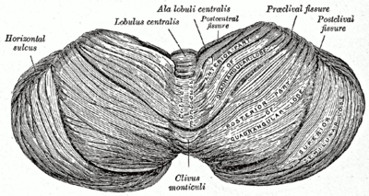
Parts of the cerebellum
Vermis
Hemisphere

Slide 9
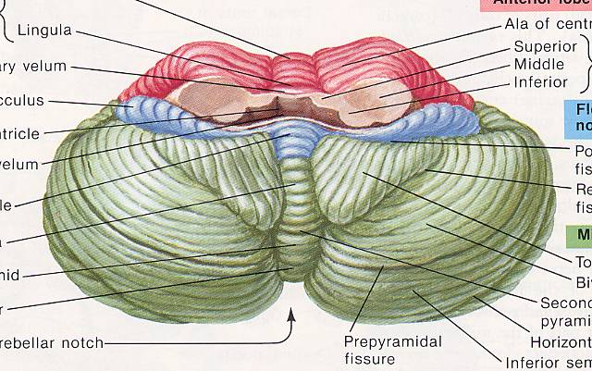
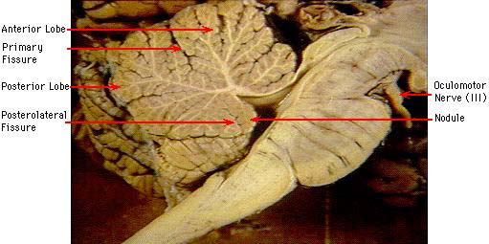
LOBES OF CEREBELLUM
Inferior surface
Anterior lobe
Divisions of lobes
Anatomical
Flocculonodular lobe
Anterior lobe
Posterior lobe
Posterior lobe
Flocculonodular lobe
Superior surface
Anterior lobe
Posterior lobe

Slide 10
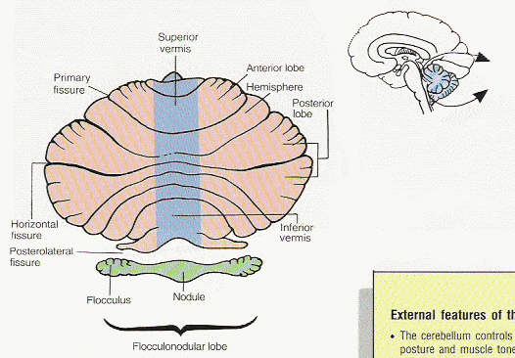
Division of lobes…..contd.
Functional(Evolutionary)
Paleocerebellum
Neocerebellum
Archicerebellum

Slide 11
Archi-cerebellum (Vestibular part)
•It is formed of the flocculo-nodular lobe + associated fastigial nuclei,
•Embryologically, it is the oldest part of cerebellum.
•It receives afferent Fibres. From vestibular apparatus of internal ear Via vestibulo-cerebellar tracts
•It is concerned with EQUILIBRIUM
Neocerebellum
Archicerebellum
Paleocerebellum

Slide 12
Archicerebellum …….contd.
It has connections with vestibular & reticular nuclei of brain stem through the inferior cerebellar peduncle.
Efferent cortical (purkinje cell) Fibres. Project to fastigial nucleus, which projects to vestibular nuclei & reticular formation.

Slide 13
Paleo-cerebellum (spinal part) :
•formed of midline vermis + surrounding paravermis + globose & emboliform nuclei.
•It receives afferent proprio-ceptive impulses from Ms.& tendons Via spino-cerebellar tracts (dorsal & ventral) mainly.
•it sends efferents to red nucleus of midbrain.
•it is concerned with MUSCLE TONE & POSTURE
Paleocerebellum

Slide 14
Neo-cerebellum (cerebral part)
•It is the remaining largest part of cerebellum.
•It includes the most 2-cerebellar hemispheres + dentate nuclei.
•It receives afferent impulses from the cerebral cortex+pons Via cerebro-ponto- cerebellar pathway.
•it sends efferents to Ventro lateral nucleus of thalamus.
•it controls VOLUNTARY MOVEMENTS (MUSCLE COORDINATION).
Neocerebellum

Slide 15
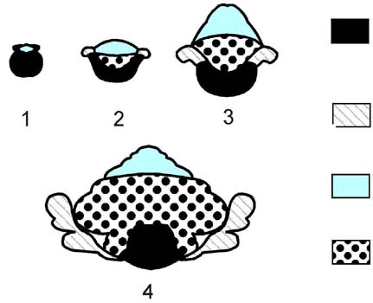
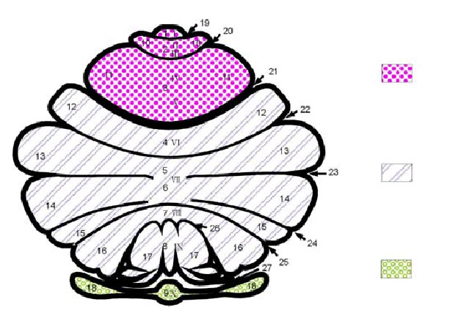
Summary of classification
Archicerebellum
Nodulus
Classification by phylogenetic
Ontogenic development
Archicerebellum
Paleocerebllum
Neocerebellum
Classification by Afferent Connection
Vestibulocerebellum
Spinocerebellum
Pontocerebellum
Classification by Efferent Connection
Vermis
Paravermal Region
Cerebellar Hemisphere
Archicerebellum
flocculus
Palaeocerebellum
Neocerebellum
Spinocerebellum
Pontocerebellum
Vestibulocerebellum

Slide 17
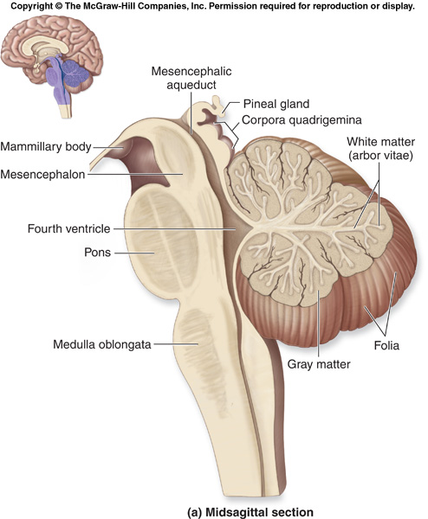
Structure
Cerebellum consists of outer layer of grey matter known as cortex and inner layer of white matter known as medulla.
The medullary core is composed of incoming and outgoing fibres projecting to and from the cerebellar cortex.
Medullary core also contain the nuclei of the cerebellum which are four in number.

Slide 18
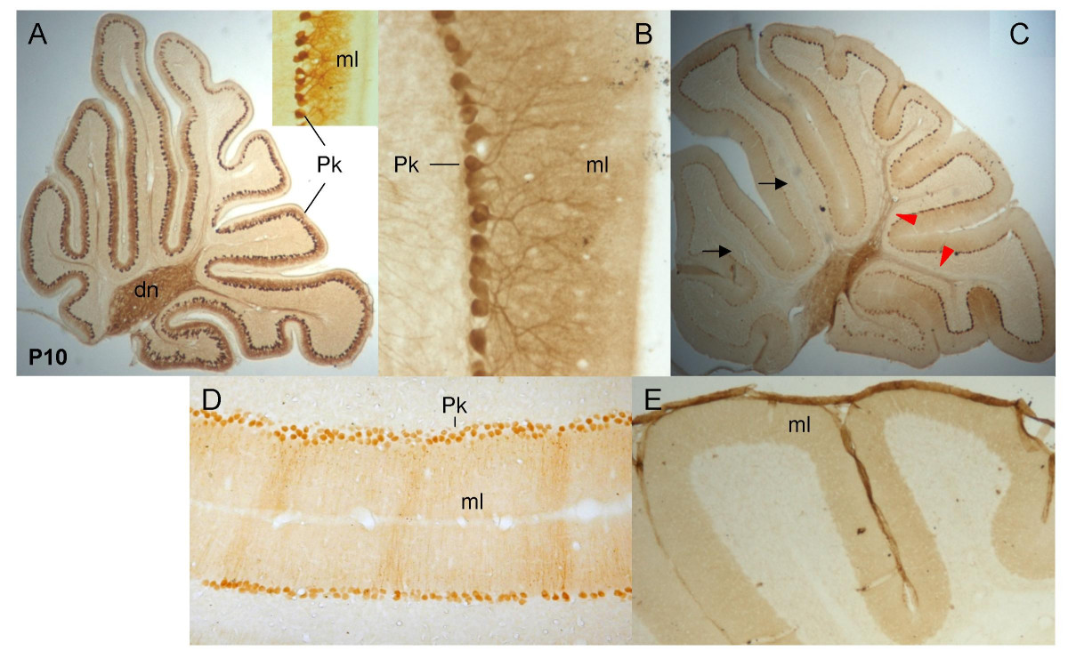
Structure of cerebellum
Medulla
Cortex

Slide 19
Structure of cerebellar……contd.
Cerebellar Cortex
Molecular Layer
Purkinje Cell Layer
Granular Layer
Corpus Medullare (Medullary Center)
Deep Cerebellar Nuclei
Fastigial Nuclei
Nucleus Interpositus
Emboliform Nucleus
Globose Nucleus
Dentate Nucleus

Slide 20
CEREBELLUM cortex
Cerebellar Cortex
I. Molecular Layer
Stellate Cell --- taurine (inhibitory)
afferent: parallel fiber
efferent: Purkinje cell dendrite
Basket Cell ---- GABA (inhibitory)
afferent: parallel fiber
efferent: Purkinje cell soma
Parallel Fiber
granule cell axon
Purkinje Cell Dendrite

Slide 21
Cerebellum layers……contd.
II. Purkinje Cell Layer
Purkinje Cell
-- 15,000,000 in number
-- GABA (inhibitory)
afferent: parallel fiber
climbing fiber
stellate cell
basket cell
efferent: deep cortical nuclei
Bergman’s glial cell

Slide 22
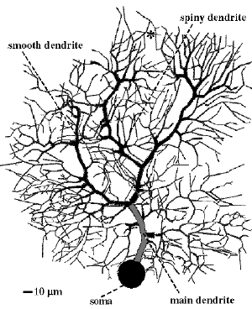
Purkinje cells
flaskshaped cell, single layered Dendrites
Molecular layer - profuse branching - dendritic spines Axon - synapse with deep cerebellar nucleus - basket & stellate cells - vestibular nuclei

Slide 23
Cerebellum layers……..contd.
III. Granular Layer
Granular Cell
-- 50,000,000,000 in number
-- glutamic acid (excitatory)
afferent: mossy fiber
efferent: Purkinje cell axon
basket cell, stellate cell
Golgi cell
Golgi Cell
-- GABA (inhibitory)
afferent: parallel fiber, mossy fiber rosette
efferent: granule cell dendrite

Slide 24
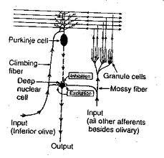
Climbing fibres
- from inferior olivary complex
- direct action on individual Purkinje cell
- powerful , sharply localised
- Basket cells, stellate cells, Golgi cells act as inhibitory interneurons.
Mossy fibres
-from spinal cord / brain stem centres
-indirect action on Purkinje cells via granule cells
-diffuse
( thousands of Punkinje cells may be excited )

Slide 25
White matter of the cerebellum
Consists of three types of nerve fibres in the white matter
Axons of purkinje cells
The only axons to leave cerebellar cortex to end in deep
cerebellar nuclei specially dendate nucleus.
Mossy fibres
They end in the granular layer.
Climbing fibres
They end in the molecular layer

Slide 26
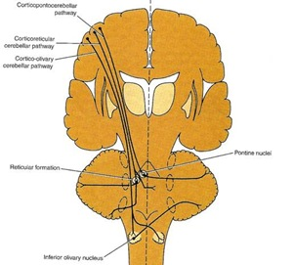
Cerebellar AFFERENT pathway
From cerebral cortex
cortico-ponto-cerebellar fibres
cerebro-olivo-cerebellar fibres
cerebro- reticulo- cerebellar fibres
From spinal cord
anterior spinocerebellar tract
posterior spinocerebellar tract
cuneocerebellar tract
From vestibular nucleus
vestibulocerebellar tract [ flocculonodular lobe ]
From other areas
red nucleus, tectum

Slide 27
Afferent pathway | origin | Destination via
Corticopontocerebellar | Frontal,parietal, temporal, occipital | Pontine nuclei & mossy fibres to cerebellar cortex
Cerebroolivocerebellar |  | INF olivary N & climb fibres to cerebellar cortex
Cerebroreticulocerebellar | Sensorimotor areas | Reticular formation
Ant spinocerebellar | Muscle spindles,tendons, joints | Mossy fibres to cerebellar cortex
Post spinocerebellar
Cuneocerebellar
Vestibular nerve | Utricle, saccule,semicircular canals | Mossy fibres to cortex of FN node
others | Red nuc, tectum | cerebellar cortex

Slide 28
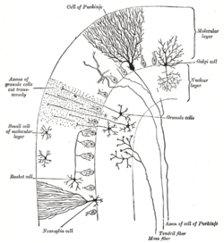
Cerebellar EFFERENT pathways
Axons of Purkinje cells
synapse with the cerebellar nuclei.
Axons of the neurones form the efferent pathways
Connect with
Red nucleus
Thalamus
Vestibular nuclei
Reticular formation

Slide 29
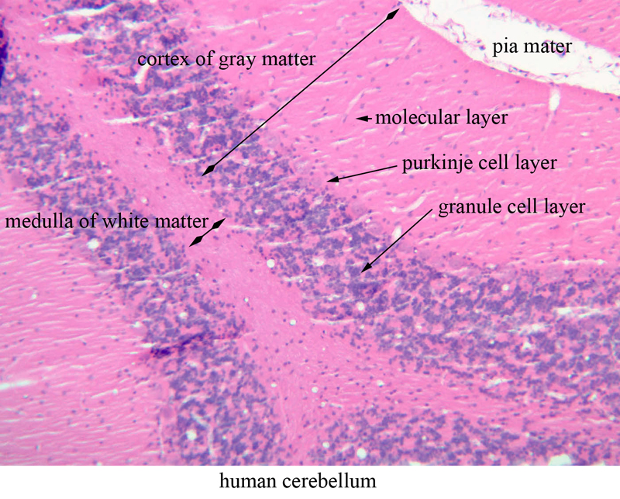
Histological structure of cerebellum

Slide 30
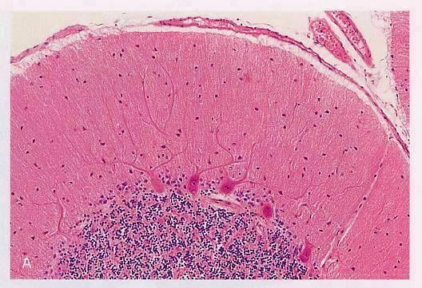
Histology of the cerebellum…..contd
Molecular layer
Purkinje layer
Granular layer

Slide 31
Functions of cerebellum
❖ Maintenance of Equilibrium
- balance, posture, eye movement
❖ Coordination of half-automatic movement of
walking and posture maintenace
- posture, gait
❖ Adjustment of Muscle Tone
❖ Motor Leaning – Motor Skills
❖ Cognitive Function

Slide 32
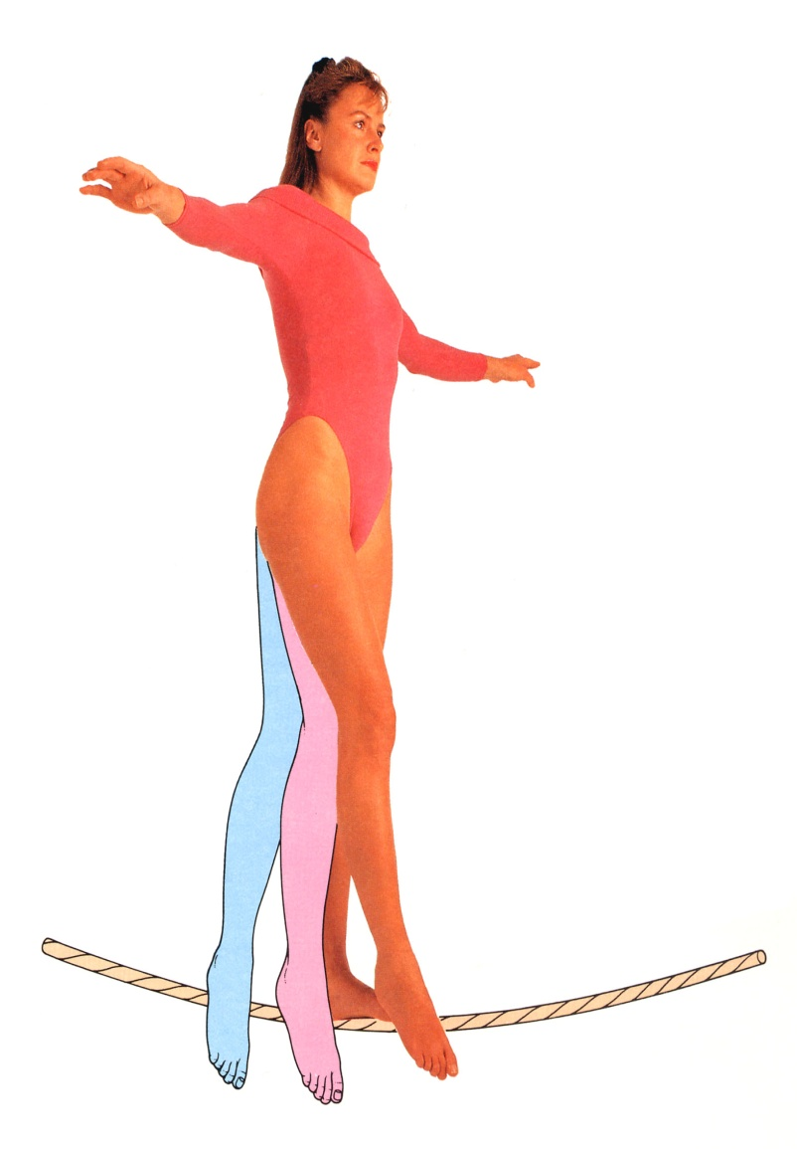
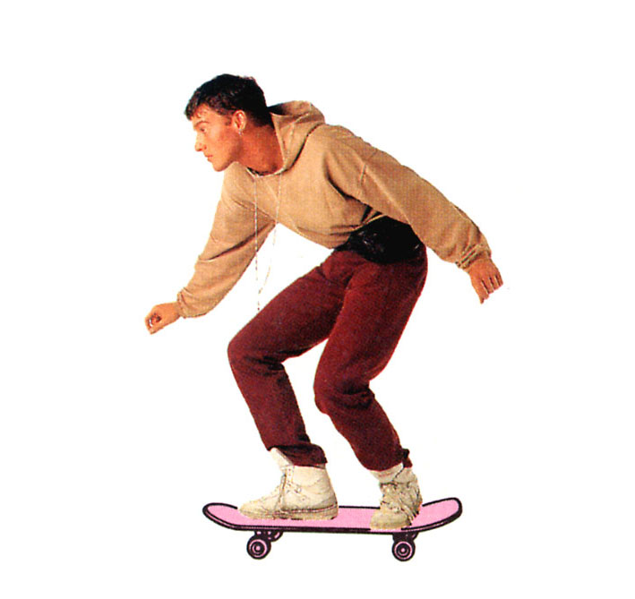
Balance

Slide 33
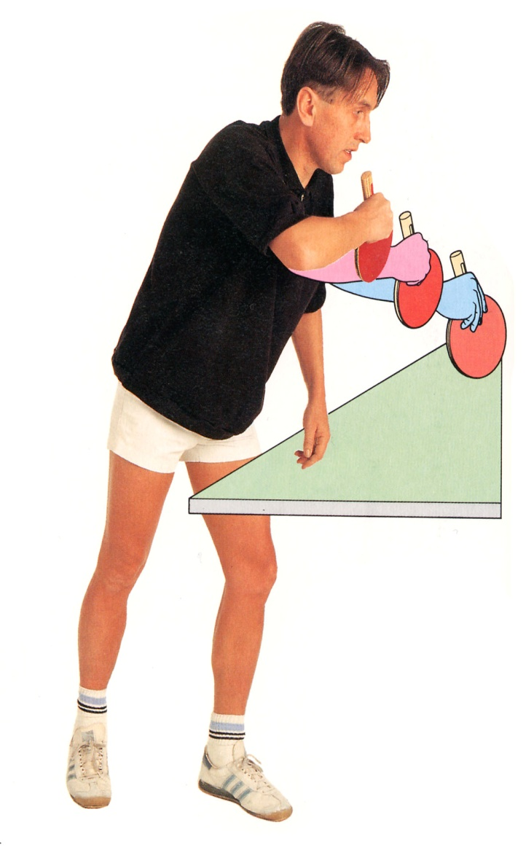
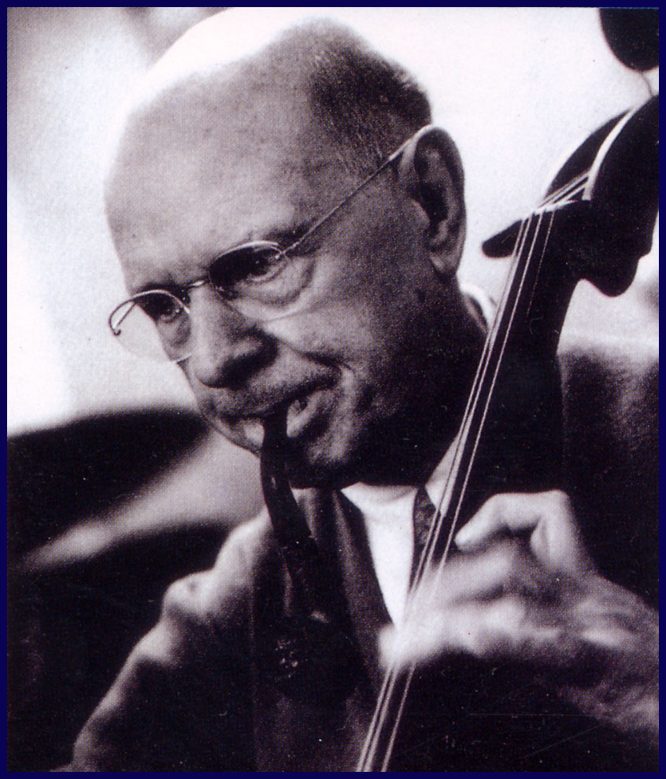
Motor skills

Slide 34
Think about this…
You are on a ship, in rough seas. As you walk about the ship, which functional subdivisions of the cerebellum become activated?

Slide 35
Think about this…
You are on a ship, in rough seas. As you walk about the ship, which functional subdivisions of the cerebellum become activated?
- vestibulocerebellum, to maintain proper balance while walking
- spinocerebellum, to step precisely and maintain posture while walking
- cerebrocerebellum, to plan where you want to walk and if you need to change your step height and length

Slide 36
Syndromes
Ataxia: incoordination of movement
- decomposition of movement
- dysmetria, past-pointing
- dysdiadochokinesia
- rebound phenomenon of Holmes
- gait ataxia, truncal ataxia, titubation
Intention Tremor
Hypotonia, Nystagmus

Slide 37
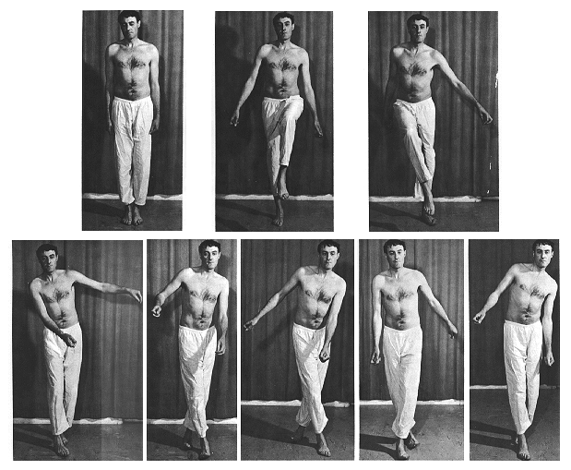
Cerebellar Ataxia
Ataxic gait and position:
Left cerebellar tumor
a. Sways to the right in
standing position
b. Steady on the
right leg
c. Unsteady on the
left leg
d. ataxic gait

Slide 38
Cerebellar lesions
Are usually vascular, may be traumatic or tumour.
Manifestations of unilateral cerebellar lesions : 1-ipsilateral incoordination of (U.L) arm = intention tremors : it is a terminal tremors at the end of movement as in touching nose or button the shirt. 2-Or ipsilateral cerebellar ataxia affects (L.L.) leg, causing wide-based unsteady gait.
Manifestations of bilateral cerebellar lesions (caused by alcoholic intoxication, hypothyrodism, cerebellar degeneration & multiple sclerosis) 1-dysarthria : slowness & slurring of speech.
2-Incoordination of both arms.= intention tremors.
3-Cerebellar ataxia : intermittent jerky movements or staggering ,wide-based, unsteady gait 4-Nystagmus : is a very common feature of multiple sclerosis. It is due to impairment coordination of eye movements /so, incoordination of eye movements occurs and eyes exhibit a to-and-fro motion.
Combination of nystagmus+ dysarthria + intension tremors constitutes Charcot’triad, which is highly diagnostic of the disease.

Slide 39
What’s the functional difference between basal ganglia and cerebellum?

Slide 40
Basal ganglia lesions produce contralateral signs. Cerebellar lesions produce ipsilateral signs.

Slide 41
Most movement disorders produced by cerebellar and basal ganglia pathology disappear during sleep. Cerebellar and basal ganglia signs are usually not present if the corticospinal tract is damaged.

Slide 42
The cerebellum is the great comparator: 1. It compares cortical willful command with muscle tension, joint position, & tone (via ipsilateral spinocerebellar tracts) 2. Advises the cortex on how much, how many, how fast 3. The motor cortex sends the revised command down the corticospinal tract

Slide 43
The BASAL GANGLIA are the autopilot for procedural movements. The CEREBELLUM is the refiner of finely controlled movements (particularly of fingers).

Slide 44
COMPARISON OF MOTOR SYSTEMS

Slide 45
THANK YOU

