Slide 1
CLINICAL ANATOMY OF THE ORBIT, EYEBALL & VISUAL PATHWAY
Dr Mwachaka P
Dept. Human Anatomy,
University of Nairobi-Kenya

Slide 2
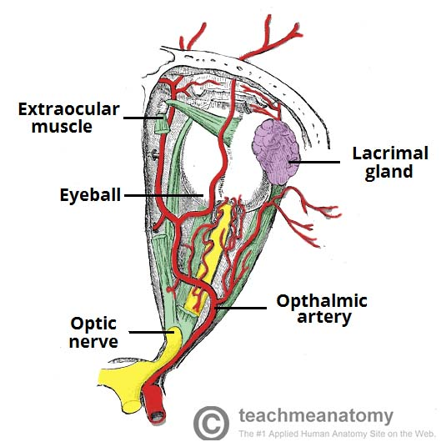
ORBIT ANATOMY
Bilateral cavities in upper ½ of the face
Contents
Eyeball
optic nerve
extraocular muscles
lacrimal apparatus
adipose tissue
nerves and vessels

Slide 3
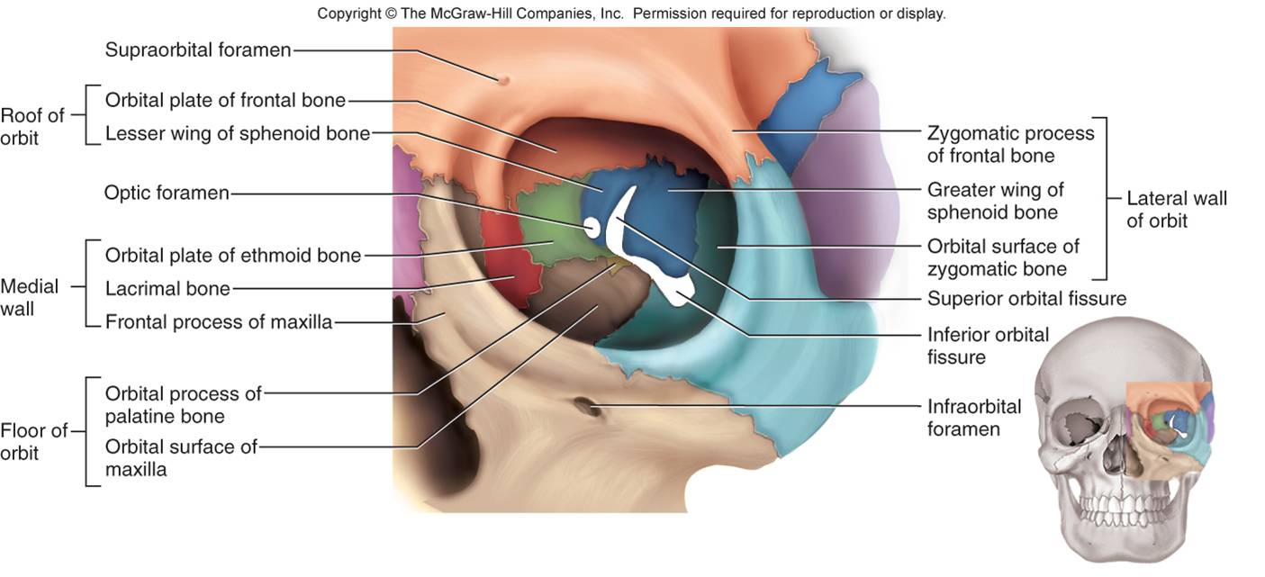
Bony Orbit

Slide 4
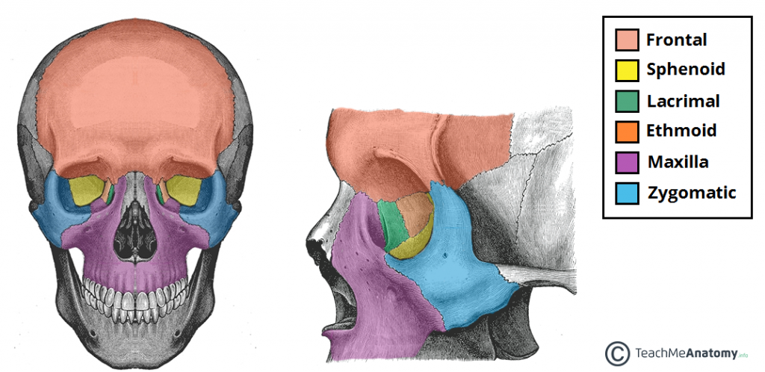

Slide 5
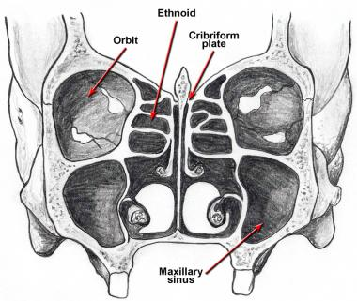
Relations
Superior:
Anterior cranial fossa
Frontal sinus.
Inferior: Maxillary sinus.
Medial:
Ethmoid and sphenoid air sinuses.
Lateral:
Temporal fossa anteriorly
Middle cranial fossa posteriorly

Slide 6
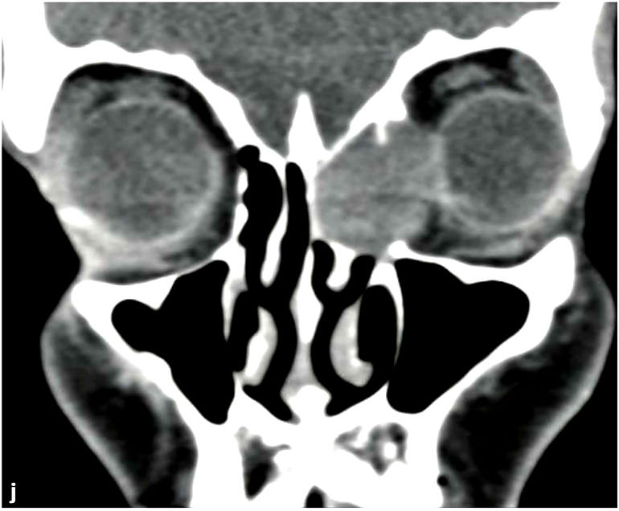
Applied Anatomy – Medial wall
Ethmoidal mucocele displacing the globe laterally

Slide 7
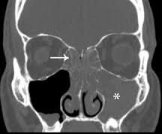
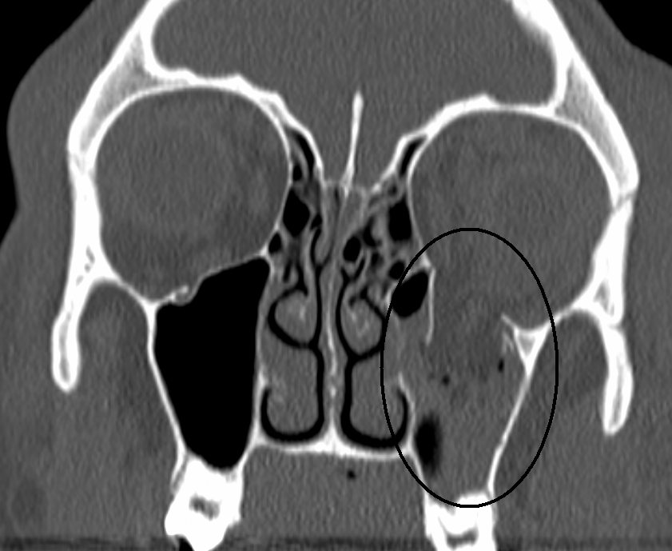
Applied Anatomy – Floor
Maxillary sinusitis Orbital floor fractures

Slide 8
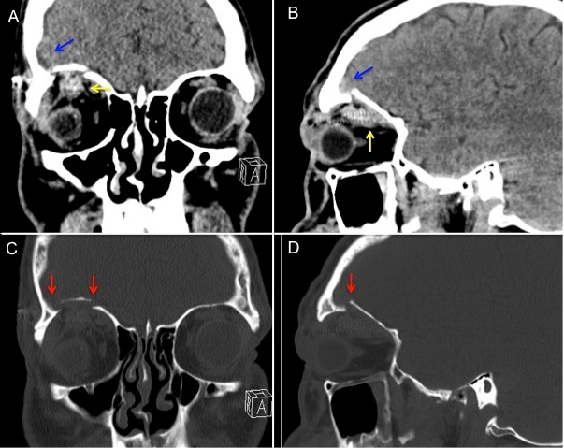
Applied Anatomy - roof

Slide 9
Ophthalmic nerve

Slide 10
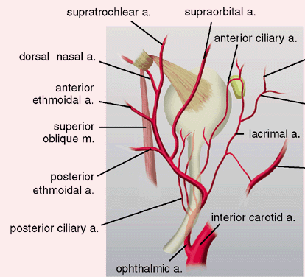
Ophthalmic artery and its branches

Slide 11
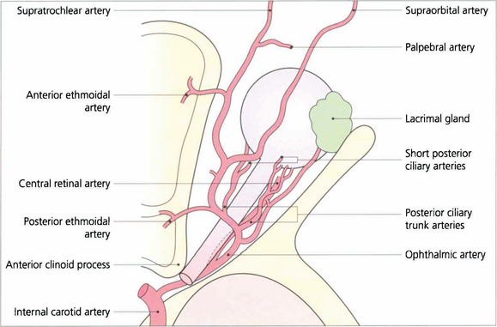

Slide 12
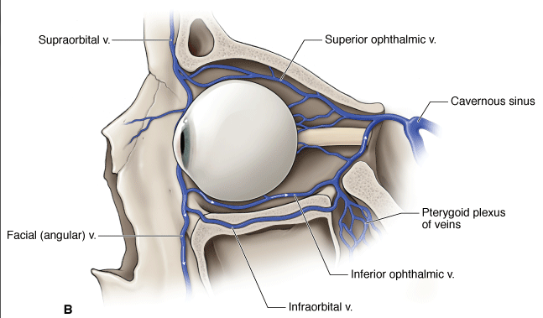
Ophthalmic veins

Slide 13
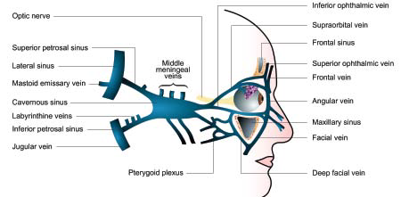

Slide 14
Applied anatomy – venous drainage
Exophthalmos with Carotid-cavernous fistula, Cavernous sinus thrombosis

Slide 15
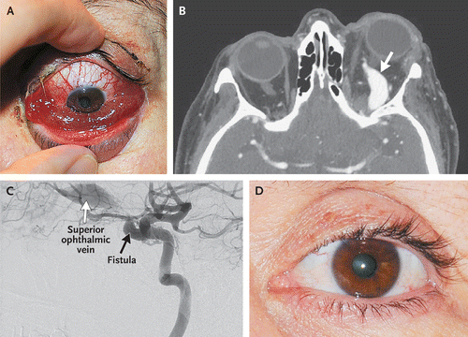

Slide 16
Eyeball
Walls of eyeball
Refractive media
Chambers
Anterior
Posterior
Vitreous

Slide 17
Transparent refractive media (lens system)
Cornea, aqueous humor, lens, vitreous humor

Slide 18
Eye ball tunics

Slide 19
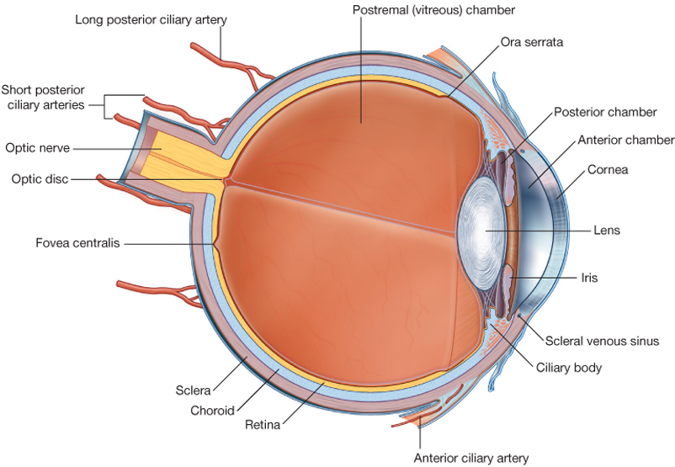
Sclera
Dense regular connective tissue
Tendons of EOM are attached to it
Anteriorly: continuous with cornea
Post: perforated by
optic nerve, ciliary arteries, veins

Slide 20
Cornea
Epithelium:
non keratinized stratified squamous
Marked regenerative capacity
Bowman’s (anterior basement) membrane
acellular, collagen fibres
Barrier to spread of infections
Stroma
Well organized, parallel collagen lamellar
Responsible for corneal transparency
Descemet’s (posterior basement)membrane
Basal lamina of endothelial cells
Fine collagen filaments
Endothelium
Simple squamous
Metabolic exchange btn cornea and aqueous humor

Slide 21
Clinical application
Corneal epithelium
Marked regenerative capacity>>> good healing of superficial corneal wounds
Corneal opacification
Invasion of corneal stroma by immune cells leading to disruption of collagen lamellar
corneal endothelium has a limited proliferative capacity
Severely damaged endothelium can only be repaired by corneal transplant

Slide 22
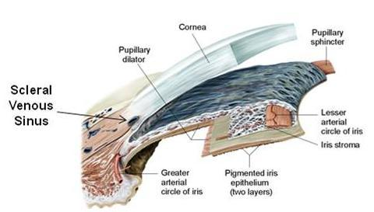
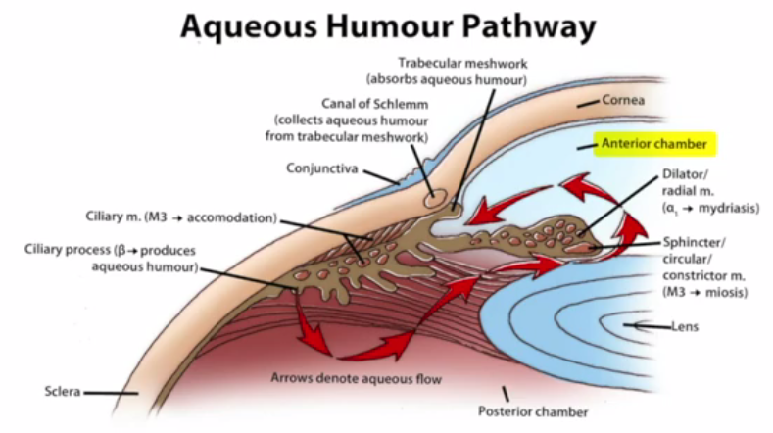
Corneoscleral junction (limbus)
Highly vascularized: corneal nutrition
Contains corneal stem cells: healing of corneal ulcers
Canal of Schlemn: drainage of aqueous humor into venous system
Blockage results in glaucoma

Slide 23
Vascular tunic (Uveal tract)

Slide 24
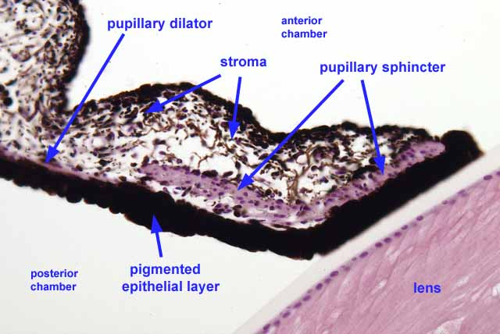
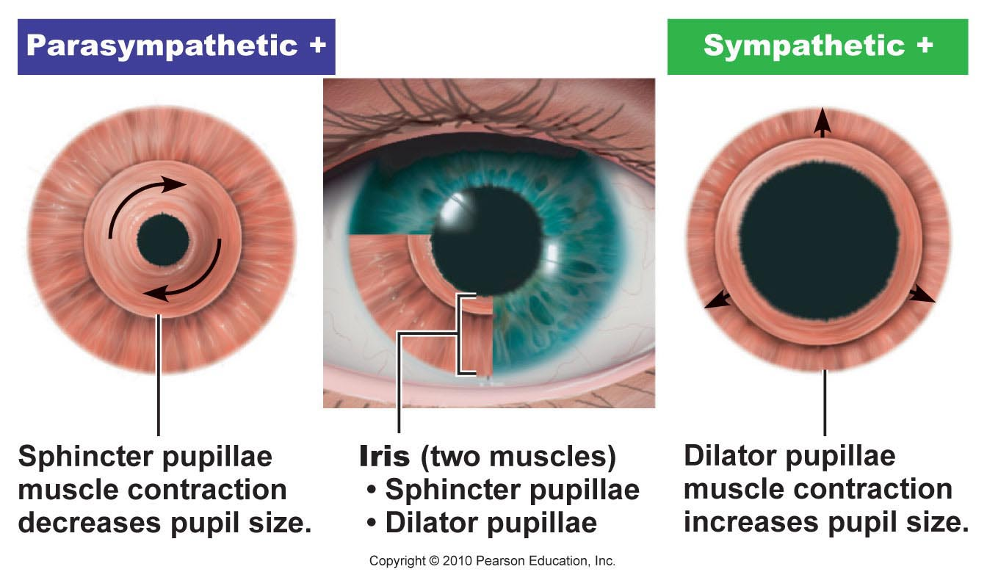
Iris
Controls size of pupil
2 layers:
Fibrovascular stroma (anterior)
Pigmented epithelium (posterior)
Dilator and sphincter pupillae
Melanocytes present

Slide 25
Eye color
Light reflected from the pigment epithelium
Usually blue but shade depends on density of pigmented cells
As the amount of pigment increases
blue to greenish blue, gray, and, finally, brown

Slide 26
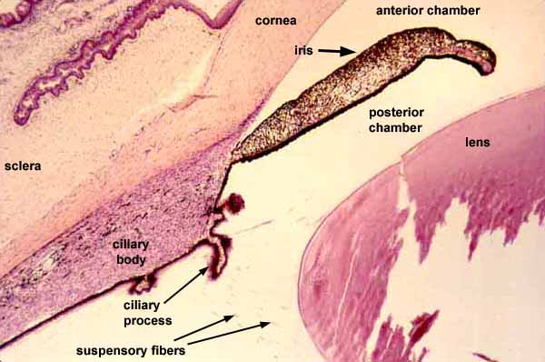
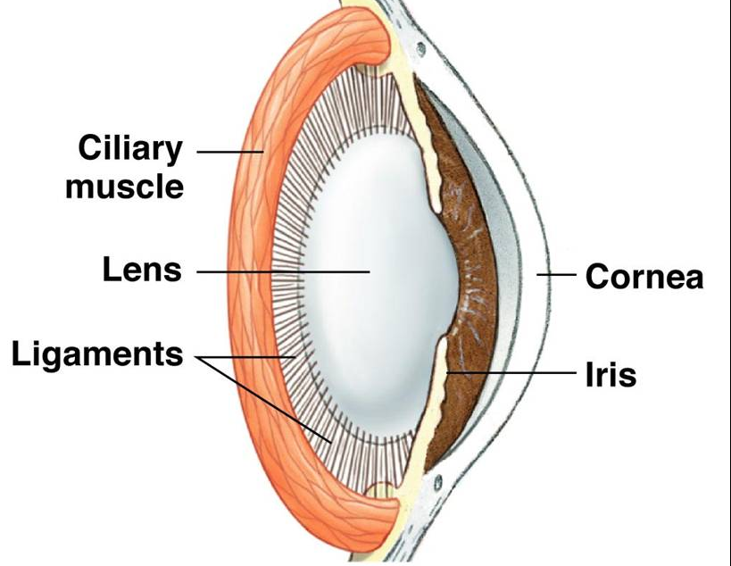
Ciliary body
Layers similar to iris
Stroma has 2 layers
Inner vascular
Outer muscular (ciliary muscle)
Ciliary epithelium
Pdn of aqueous humor
Blood-aqueous barrier
Anchorage of zonular fibres
Ciliary processes
ridge like extensions
Attachment of zonular ligaments

Slide 27
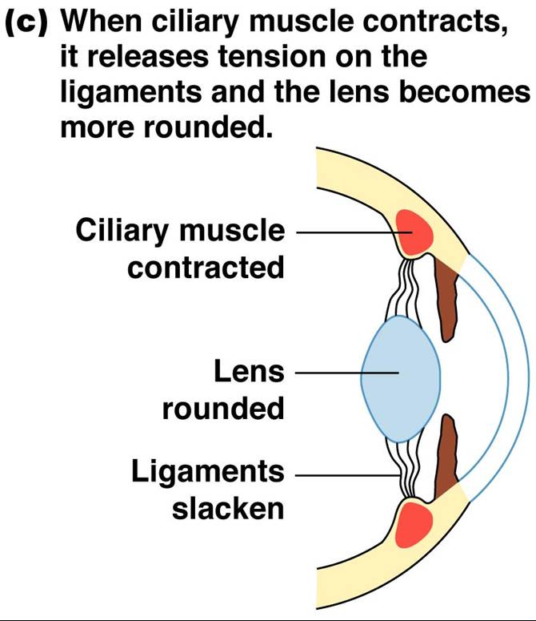

Slide 28
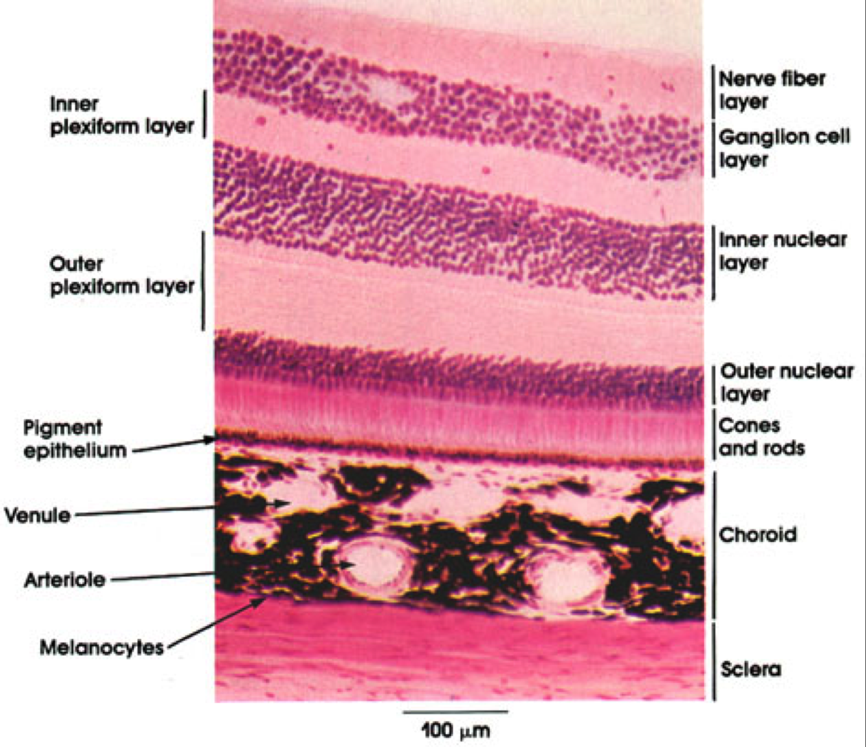
Choroid
dark brown vascular sheet

Slide 29
Transparent refractive media (lens system)
Cornea, aqueous humor, lens, vitreous humor

Slide 30
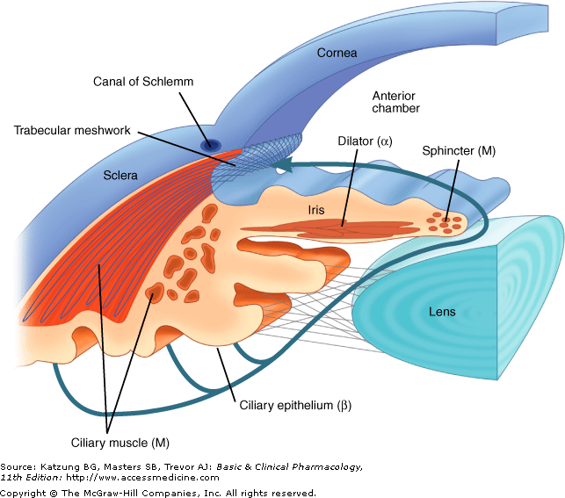
Aqueous humor
Produced by ciliary processes
Similar to plasma
containing low protein
Functions
Maintains the intraocular pressure
Nutrition for the avascular ocular tissues
Role in immunity (has immunoglobulins)
Refractive index

Slide 31
Lens
Biconvex, avascular, transparent
Components:
Lens capsule : Type IV collagen and proteoglycans
Subcapsular epithelium: cuboidal cells on anterior surface
Lens fibres:
from lens epithelial stem cells
lose their nuclei and other organelles

Slide 32
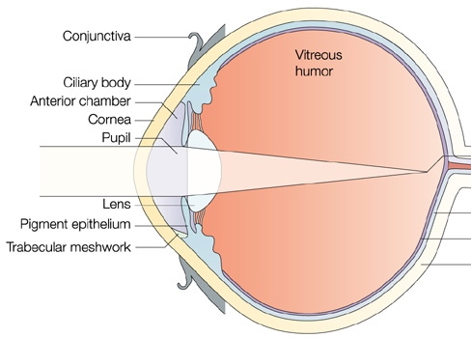
Vitreous body
Transparent, 98% water
type IV collagen
glycosaminoglycans (hyaluronan)
Functions
Refractive index
Keeps retina in place

Slide 33
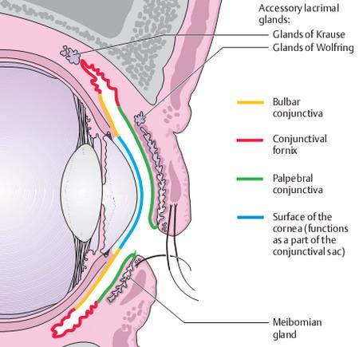
Accessory structures
Conjuctiva
Eye lids
Lacrimal apparatus

Slide 34
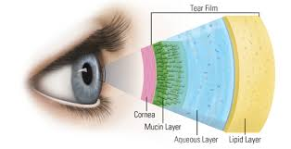
Conjunctiva
From limbus
Lines posterior surface of the eyelid
Stratified columnar epithelium
Has goblet cells:
Produce mucin layer of tear film

Slide 35
Eye lid
Skin
Muscle layer
Orbicularis oculi
Levator palpebrae superioris
Tarsal plate
Conjuctiva

Slide 36
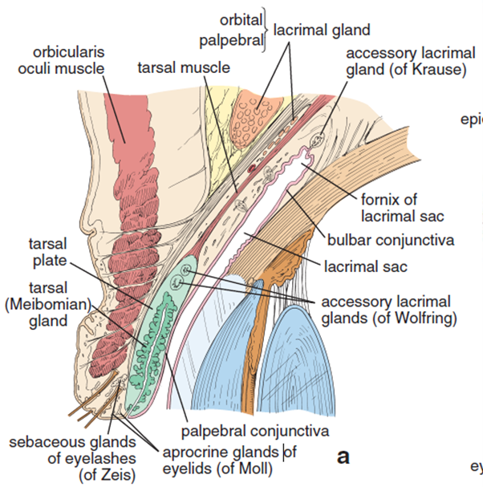
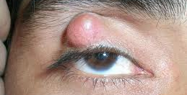
Eyelid glands I
Meibomian/Tarsal glands
Sebaceous glands
oily layer of tear film
Blockage leads to Chalazion
Sebaceous glands of Zeis
empty into hair follicles
Infection leads to stye

Slide 37
Eyelid glands II
Apocrine sweat glands of Moll
Accessory lacrimal glands
Compound tubuloalveolar
Glands of Wolfring & Krause

Slide 38
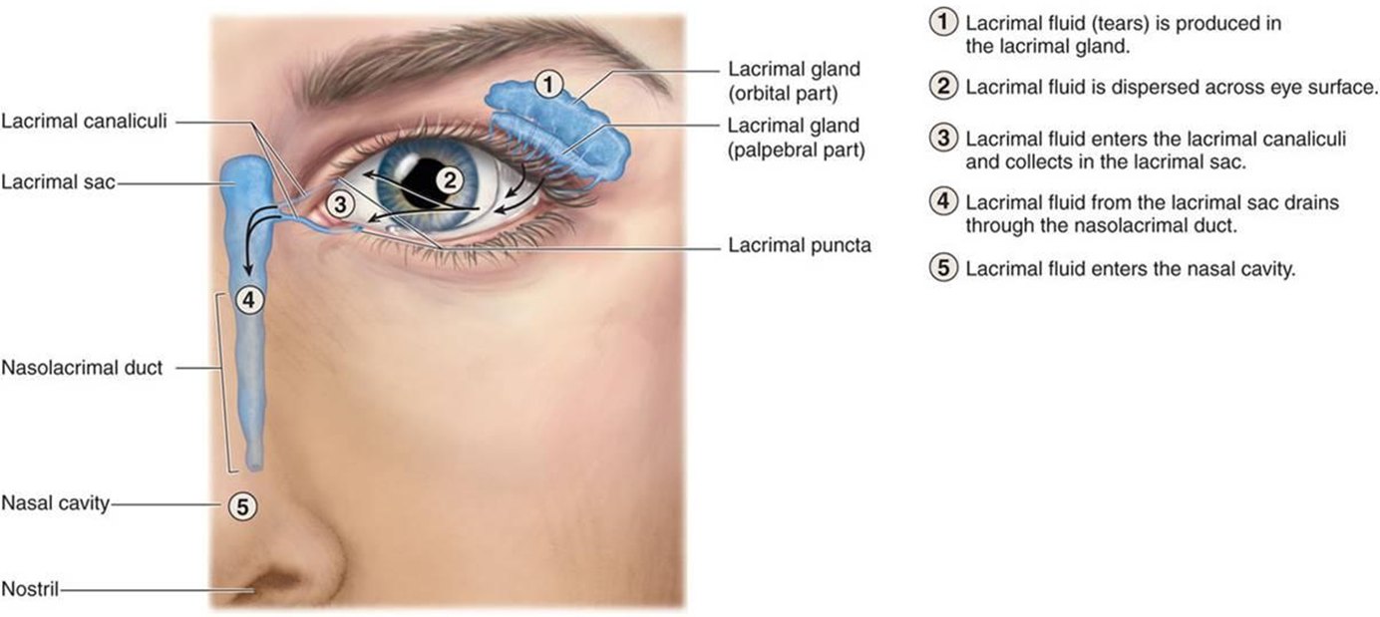
Lacrimal apparatus
Lacrimal gland
Tubuloacinar serous gland
Water/aqueous layer of tear film

Slide 39
Tear film layers

Slide 40
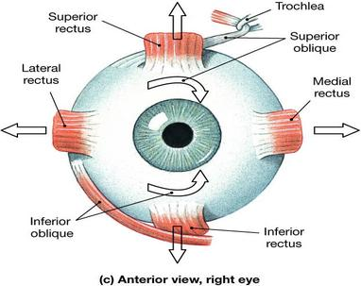
Muscles
Intrinsic (intraocular)
ciliary muscle, sphincter pupillae, dilator pupillae
Extrinsic (extraocular)

Slide 41
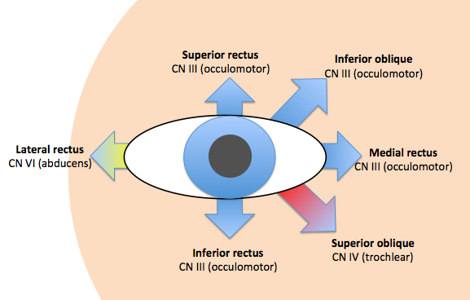

Slide 42
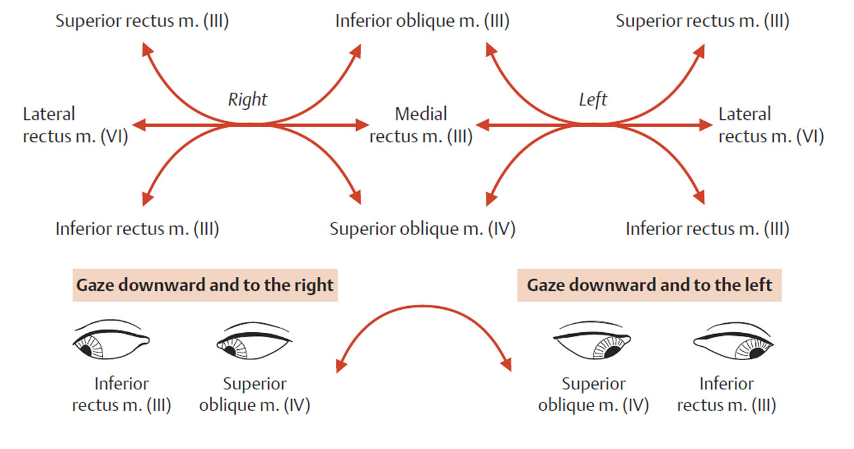
Extraocular muscles

Slide 43
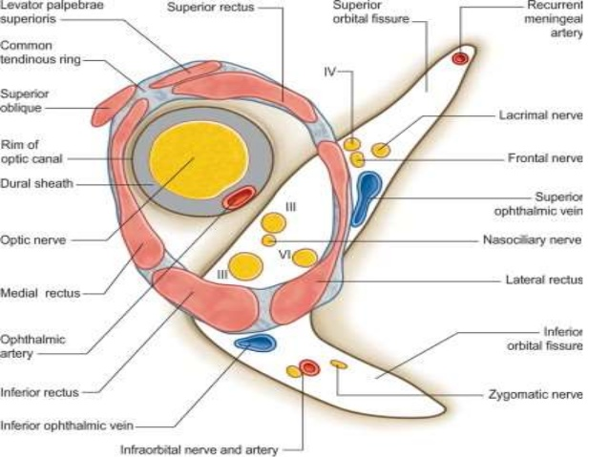
Applied Anatomy EOM & nerves
Medial rectus and optic neuritis

Slide 44
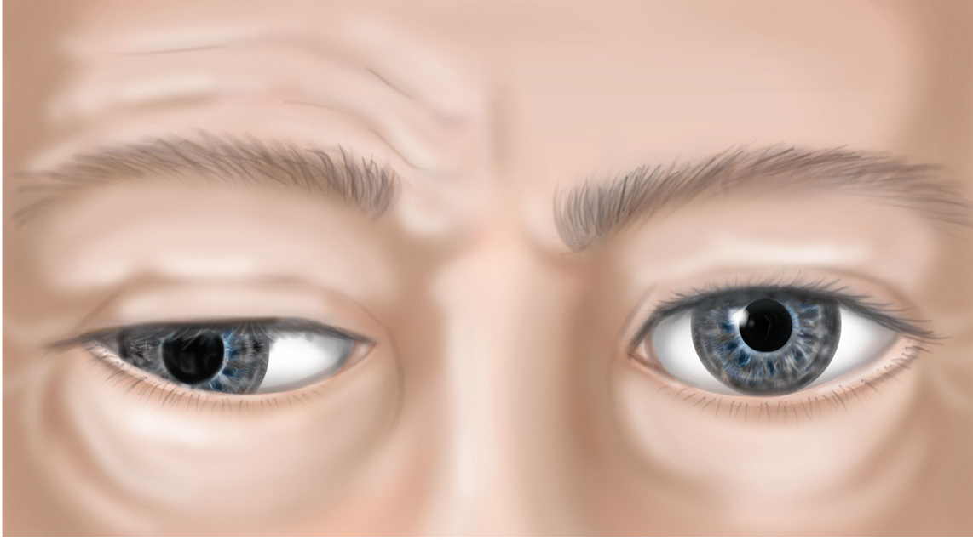
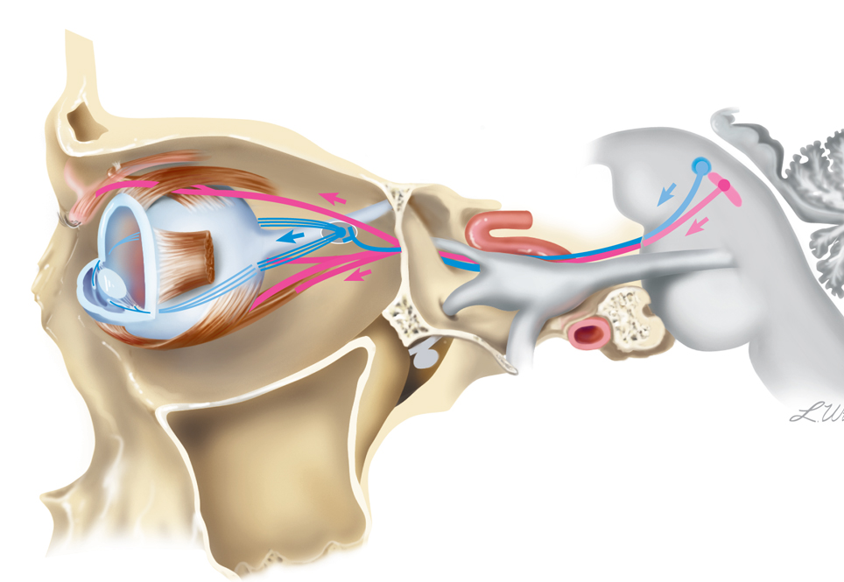
Oculomotor nerve palsy

Slide 45
Trochlear nerve palsy

Slide 47
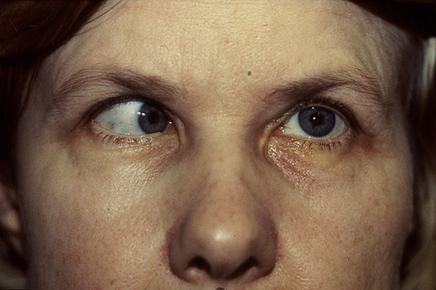
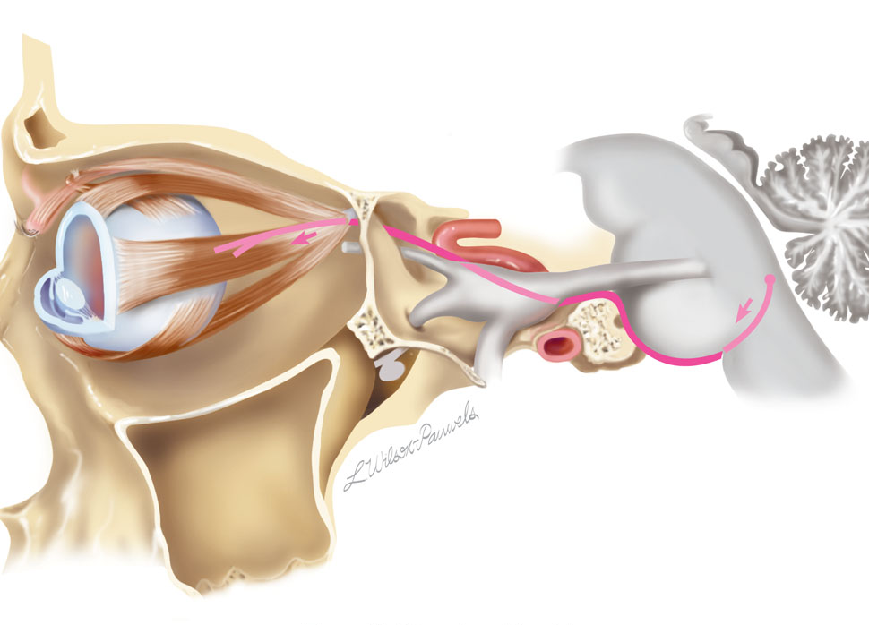
Abducens nerve palsy

Slide 48
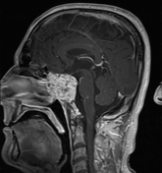
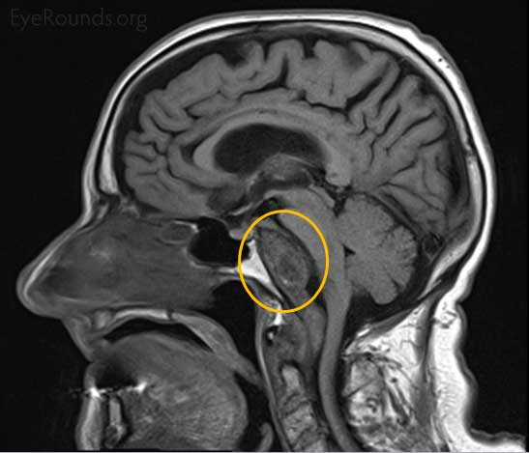

Slide 49
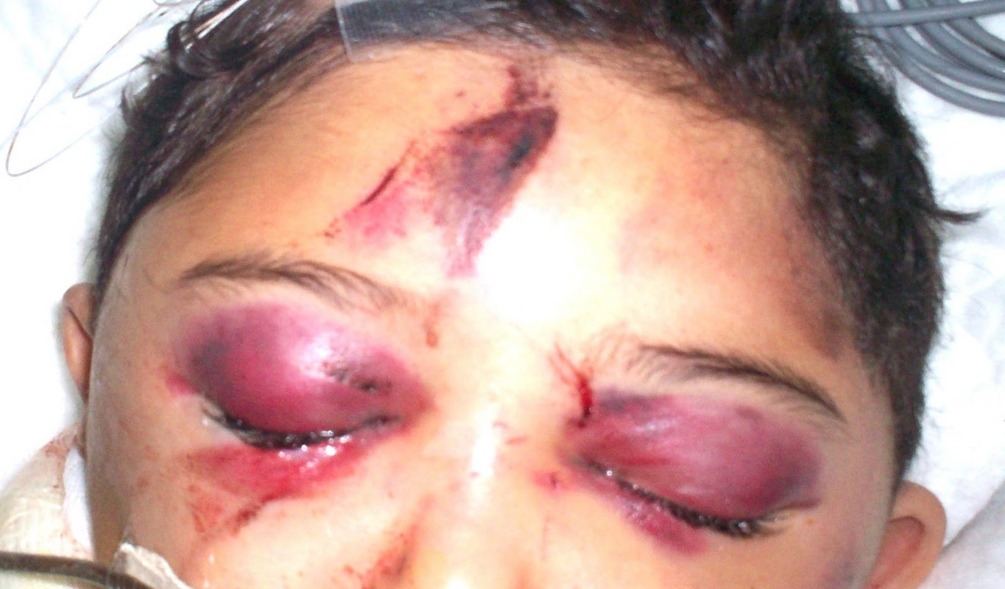
Periorbita

Slide 50
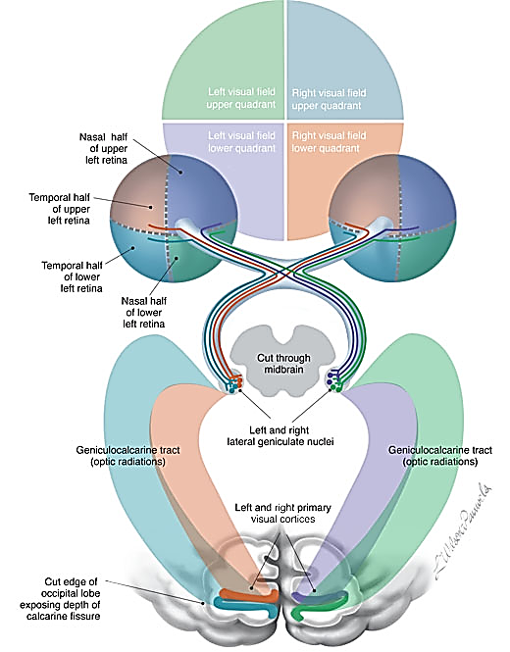
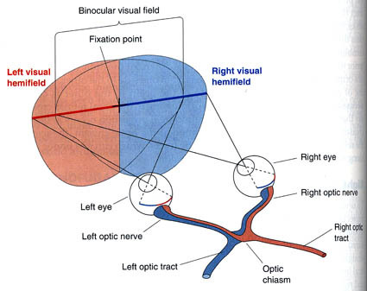
VISUAL PATHWAY

Slide 52
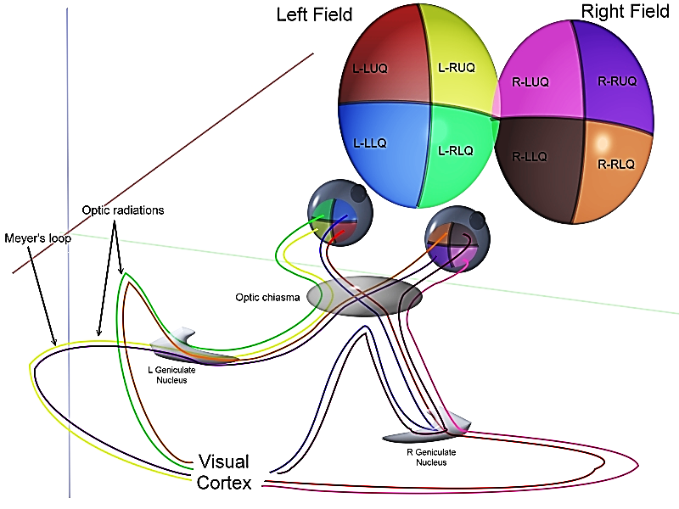
Visual pathway

Slide 53
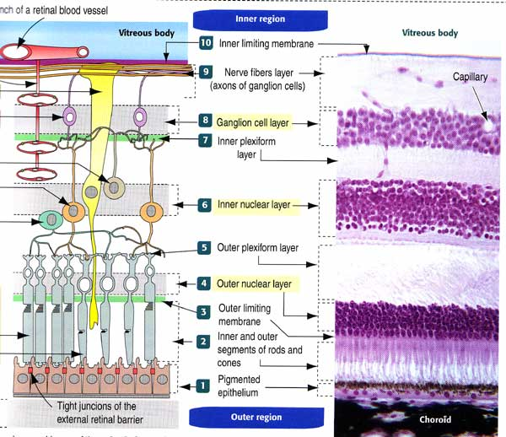
Retina

Slide 54
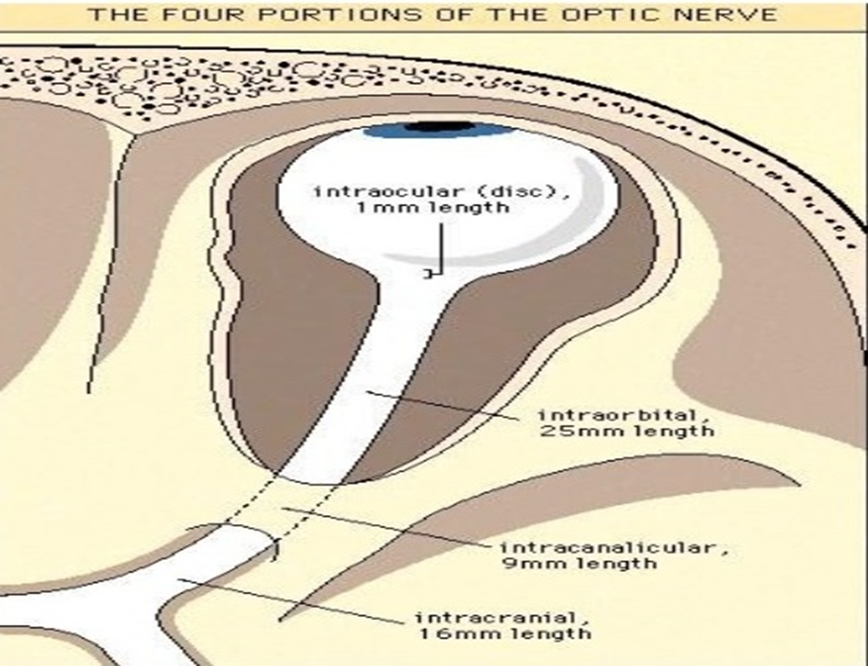
Optic nerve parts

Slide 55
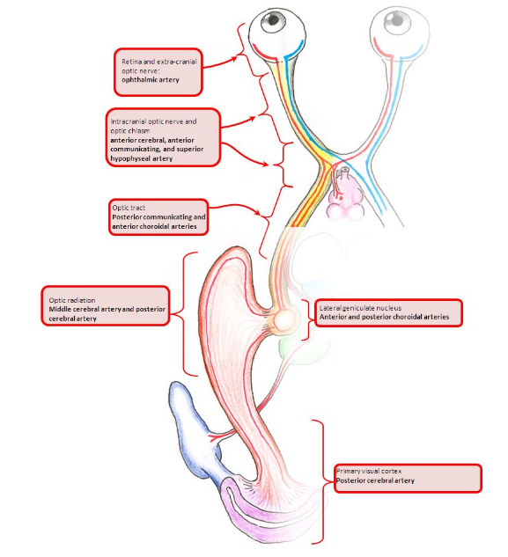

Slide 56
Visual field defects
Central scotoma
Inflamed optic disc (neuritis)
Total blindness Rt eye
Bitemporal hemianopia
Rt nasal hemianopia
Rt homonymous hemianopia
Rt homonymous superior quandrantanopsia
Rt homonymous inferior quandrantanopsia
Rt homonymous hemianopia
Rt homonymous hemianopia with macular sparing

Slide 57
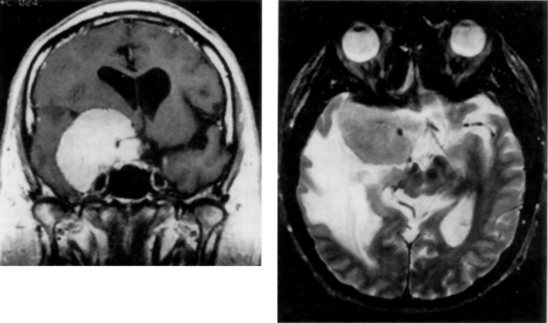
Case 1
This 57 year old man presented with worsening vision in the right eye and increasing difficulty with recent memory and judgment.

Slide 58
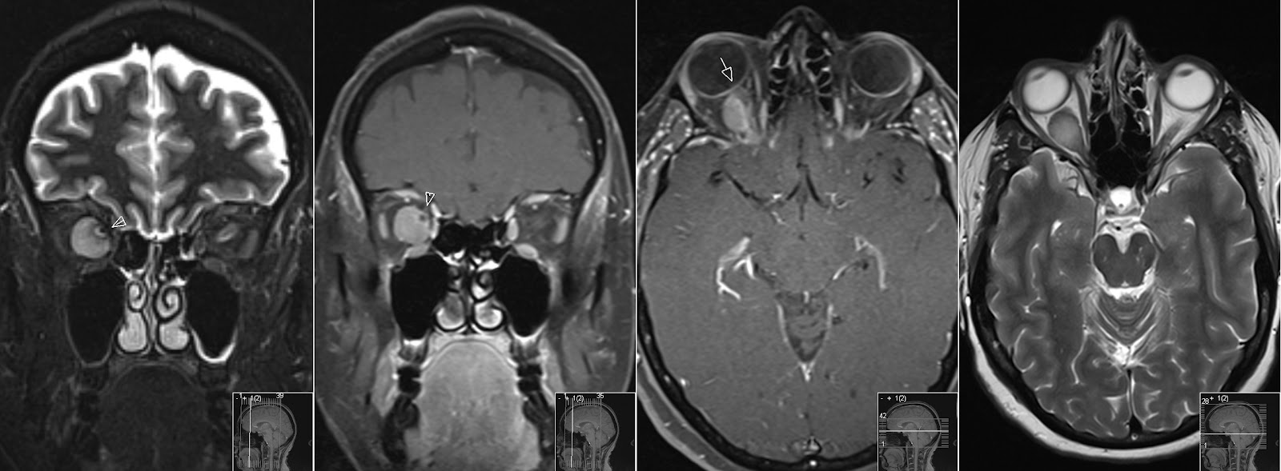
Monocular visual loss
Intraorbital masses & visual loss

Slide 59
Trauma
Fracture in the posterior part of the lateral wall of the right orbit with a fragment is causing compression on the optic nerve at the optic canal (arrow)
Notes:
Axial CT section
Fracture in the posterior part of the lateral wall of the right orbit
The fracture fragment is causing compression on the optic nerve at the optic canal (arrow)
Note the normal wide optic canal on left side (arrow head).

Slide 60
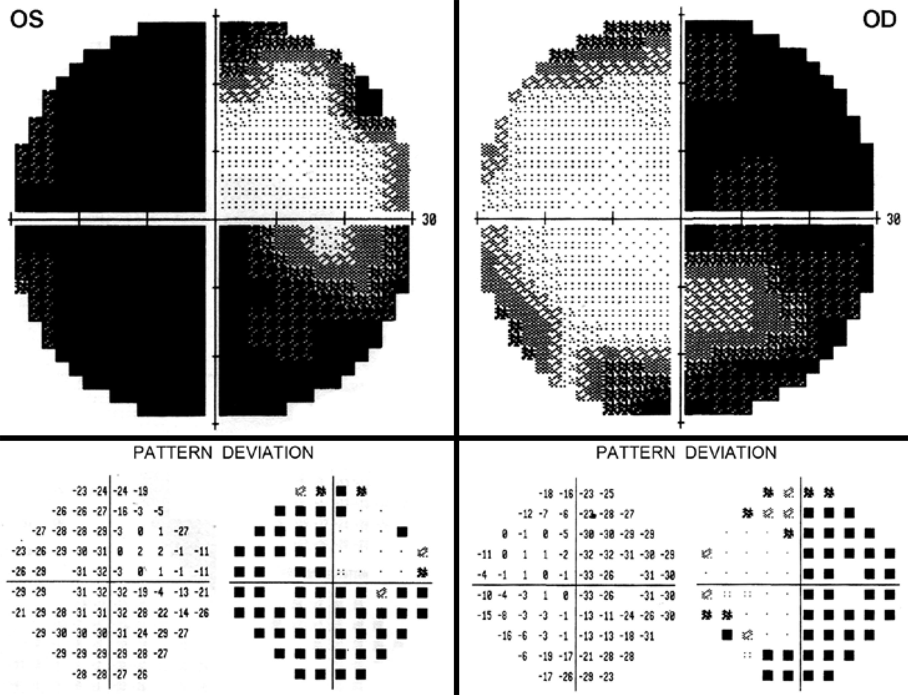
Case 2
A 47-year-old man with 6 month history of progressive bilateral visual loss, most severe in the left eye (OS).

Slide 61
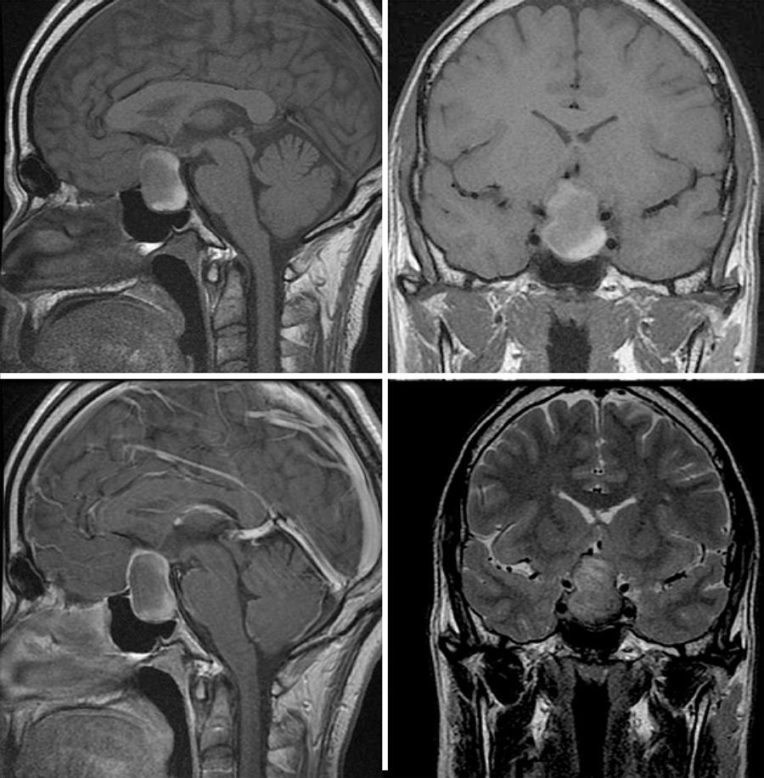

Slide 62
2 wks post surgery

Slide 63
Case 3
35yr old with progressive visual loss worse on the left eye. Also reports headache

Slide 64
Junctional scotoma = prechiasmatic compression

Slide 65
Case 4
A 56-year-old man with a history of atrial fibrillation is evaluated after he became aware of trouble parking his car because of difficulty seeing to the left.

Slide 66
PCA infarct

Slide 67
Occipital tumor

Slide 68
Thank you

