Slide 1
LECTURE MBCHB V
CRISIS INTERVENTION
Dr. Sobbie A. Z. Mulindi – Dept of Psychiatry
Senior Lecturer & Consultant

Slide 2
Introduction
Crisis intervention is a type of psychiatric treatment in which individuals and/or their families are helped in their efforts to forestall the process of mental decompensation in reaction to severe emotional stress by direct and immediate supportive approaches.

Slide 3
Characteristics of Crisis Intervention
Acute, sudden onset related to a stressful precipitating event of which the individual is aware but which immobilizes previous coping abilities.
Responsive to brief therapy with focus on immediate problem

Slide 4
Characteristics of Crisis Intervention cont’d
C. Focus shifted from the psyche in the individual to the individual in the environment. De-emphasis on intrapsychic aspects
D. Crisis period is time-limited (usually upto six weeks)

Slide 5
Concepts and Principles Relating to Crisis Intervention
Crises are turning prints where changes in behaviour patterns and life styles can occur; individuals in crisis are most amenable altering old and unsuccessful coping mechanisms and are most likely to learn new and more effective functional behaivours.

Slide 6
Concepts and Principles Relating to Crisis Intervention Cont’d
B. Social milieu and its structure are contributing factors in both the development of psychiatric symptoms and eventual recovery.
C. If a crisis is handled effectively, the person’s mental stability will be maintained, individual may return to a pre-crisis state or better.

Slide 7
If a crisis is not handled effectively, individual may progress to a worse state with .exacerbations of earlier conflicts, (future crises may not be handled well.
There are a number of universal developmental crisis periods in every individual’s life.

Slide 8
F. Each person tries to maintain equilibrium through use of adaptive behaviours (defense mechanisms).
When individuals face a problem, they cannot solve tension, anxiety, narrowed perception and disorganized thinking and function occur.
Immediate relief of symptoms produced by crisis is more urgent than exploring their cause

Slide 9
Approaches to Crisis Intervention
Goals
Avoid hospitalization
Return to pre-crisis level and preserve ability to function
Assist in problem solving, with here-and-now focus.

Slide 10
B. Assess the Crisis
Identify stressful precipitation events, duration, problem created and degree of significance.
Assess amount of disruption in individual’s life and effect on significant others.
Assess suicidal and homicidal risk.
Assess current coping skill, strengths and general level of functioning.

Slide 11
Intervention Approach
Help patient to relate the crisis event to current feelings.
Encourage expression of all feelings related to disruption.
Explore past coping skills and reinforce adaptive ones.
Use all means available in social network to take care of patients immediate needs (significant others, law enforcement agencies, housing, welfare, employment, medical and school for example).
Encourage the person to talk about the losses and changes involved.
Clarify the person’s perception of current difficulties.
Explain to the person the relationship between the crisis situation and his/her present behaviour and feelings.
Recognize denial as a normal reaction during defensive retreat from the crisis.
Help him/her find facts.

Slide 12
Intervention Approach Cont’
Give the person time to experience the feelings and to fully express them.
Avoid giving false reassurance
Do not encourage the person to blame or shove responsibility for the crisis event on others.
Help the person to confront the crisis in amounts or “doses” that can be managed.
Encourage the person to do what he/she can for self, explore coping mechanisms to assist the person in examining alternative ways of coping.
Strengthen or reinforce previously learned patterns that can be effective but are not being used.
Involve the client in decision making and working on specific tasks.
Reinforce useful suggestions.
Assist the person in seeking and accepting help.
Be familiar with community resources to which the person or family can be referred for additional service.

Slide 13
Types of crises
Developmental crises
Situation crisis
The crisis of separation and loss
Entry in school, puberty, leaving home, graduation from school, pregnancy, childbirth, middle age, menopause, retirement and facing death of others and self are developmental crises.
Situational crises include natural disasters, hurricane, tornado, earthquake or tsunami, floods, loss through separation, divorce or death of a loved one, loss of one’s job, money, valuable possession or job change.
Additions in the family, unwanted pregnancy, return of prisoner of war or mental patient, adoption of child.

Slide 14
Types of crises cont’
Death, separation, divorce, threat to one life or physical integrity.
Illness, hospitalization, a power struggle on the job, a sudden change in role responsibilities, forced geographical relocation.
Rape, suicide, homicide, imprisonment, diagnosis of a fatal illness HIV/Ca, heart problem etc can also be classified as this type of crisis.
Motor vehicle accidents, airplane crashes, collapse of physical structures.
Bombing, suicide bombers, terrorist attacks, ethnic clashes, ethnic cleansing, xenophobic violence, homicide, genocide, post election violence.

Slide 15

GENOCIDE- RWANDA

Slide 16
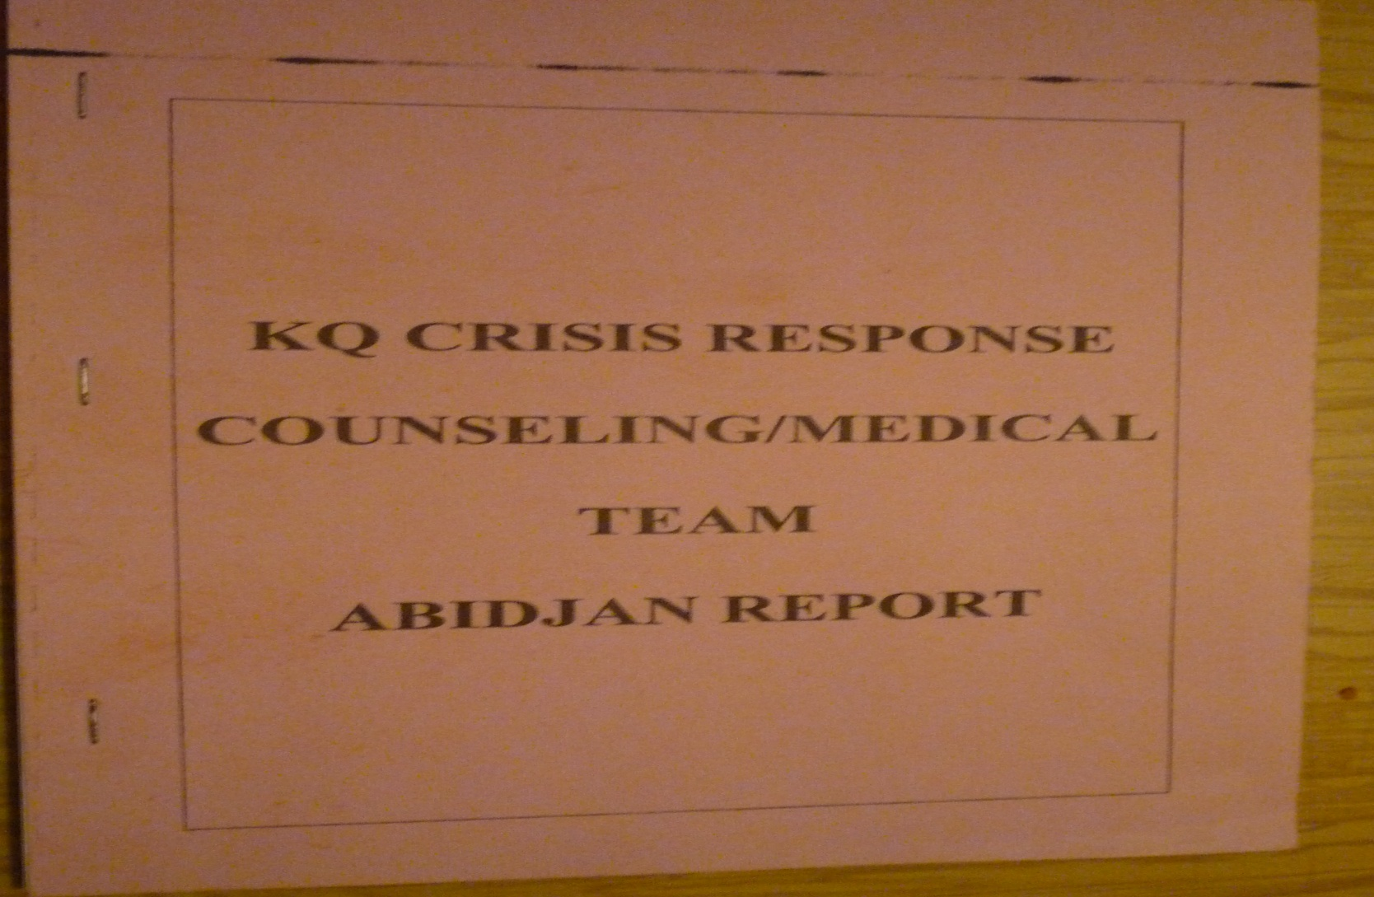
KQ CRASH ABIDJAN

Slide 17

POST-ELECTION VIOLENCE, KENYA.

Slide 18
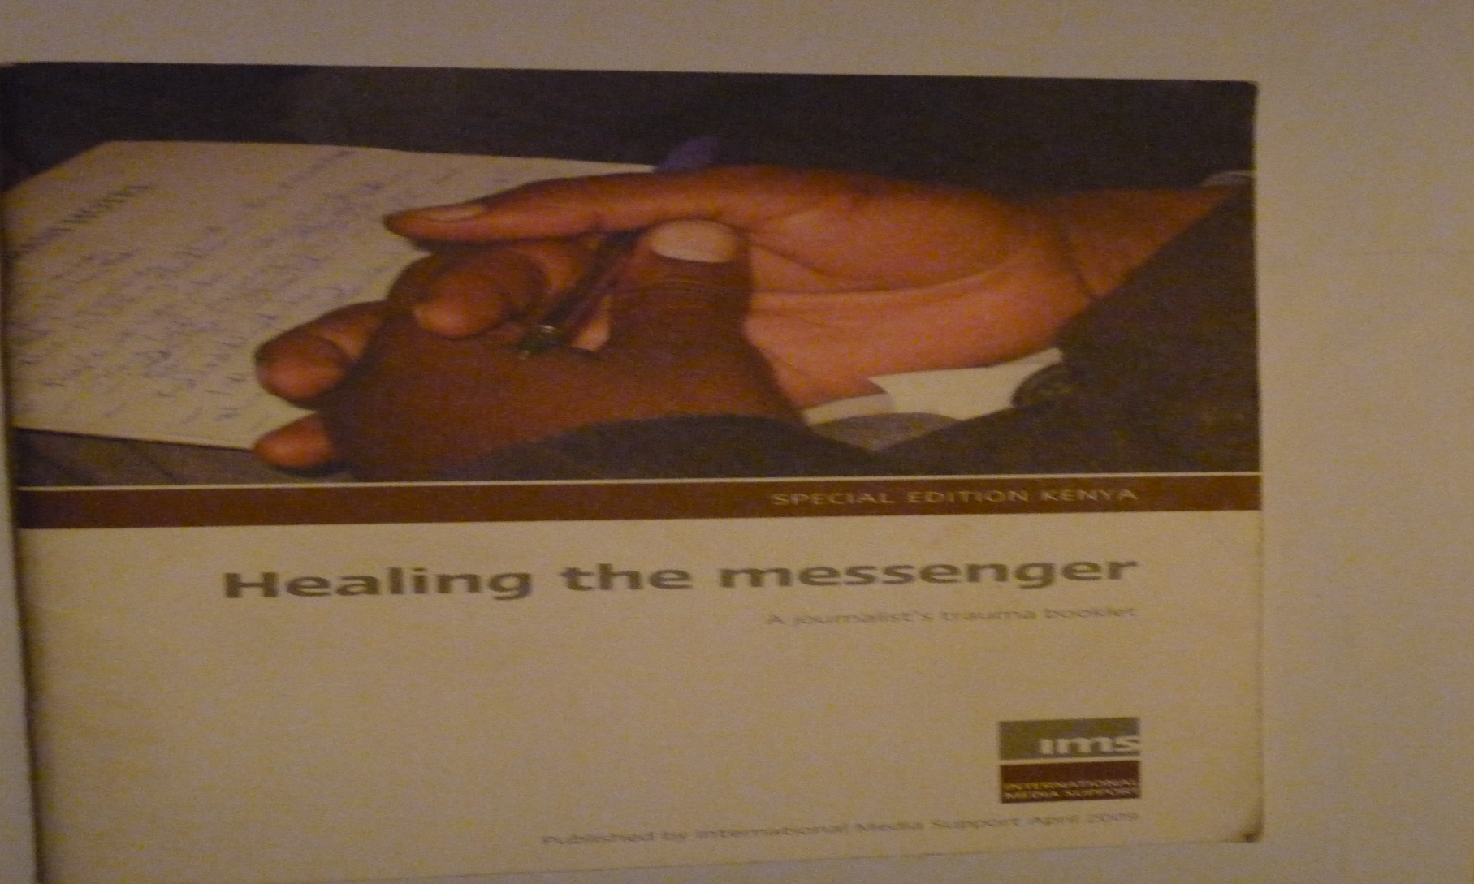
POST ELECTION VIOLENCE, KENYA

Slide 19

POST ELECTION VIOLENCE KENYA

Slide 20

PSYCHO-SOCIAL STRESSORS

Slide 21
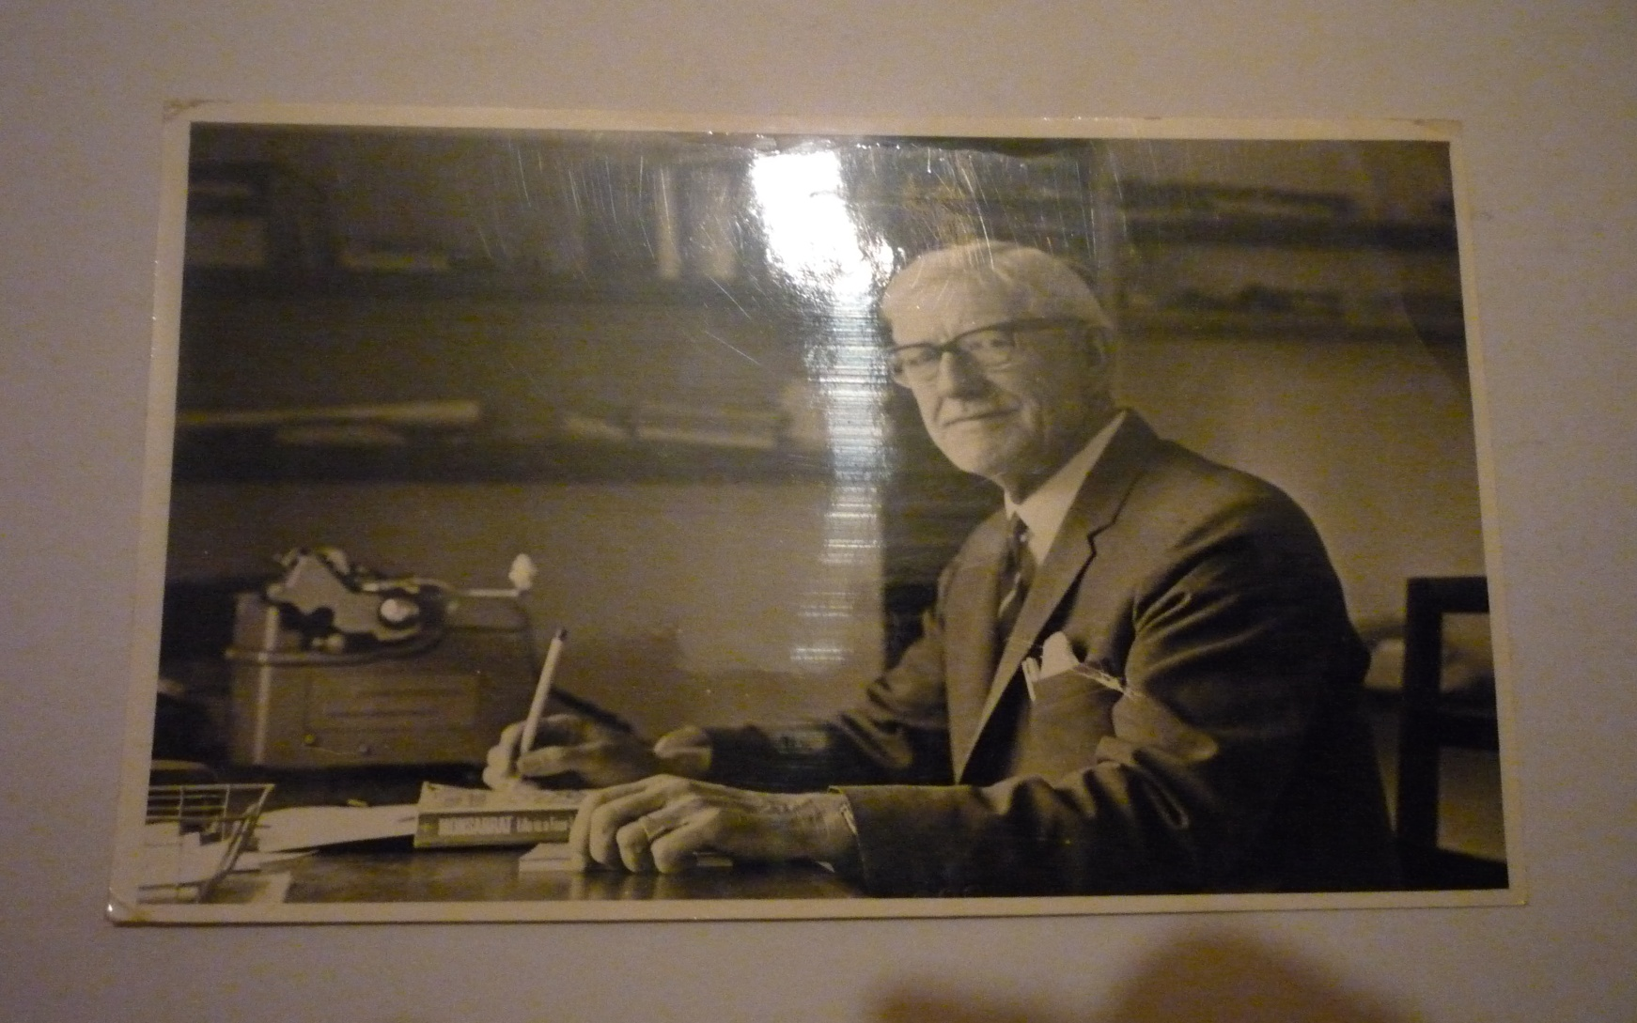
EVEN THE BRILLIANT ONES WERE TAUGHT, J.S SMITH (AHS, 1965)

