Slide 1

AARON BECK

Slide 2

SCOTT PECK

Slide 3

RICK FOSTER & GREG HICKS

Slide 4

STEVE HARVEY

Slide 5

CHARLIE AND LINDA BLOOM

Slide 6

JOHN GOTTMAN

Slide 7

JUDITH ORLOFF

Slide 8

CINDY MESTON & DAVID BUSS

Slide 9

RICHARD B STUART AND BARABARA JACOBSON

Slide 10

CONT’D

Slide 11

GAVIN ANDREWS AND RACHEL JENKINS

Slide 12

JOHN H. GREIST, JAMES W. JEFFERSON AND ROBERT SPITZER

Slide 13

KENYA WOMEN’S HIV PREVENTION SYMPOSIUM

Slide 14
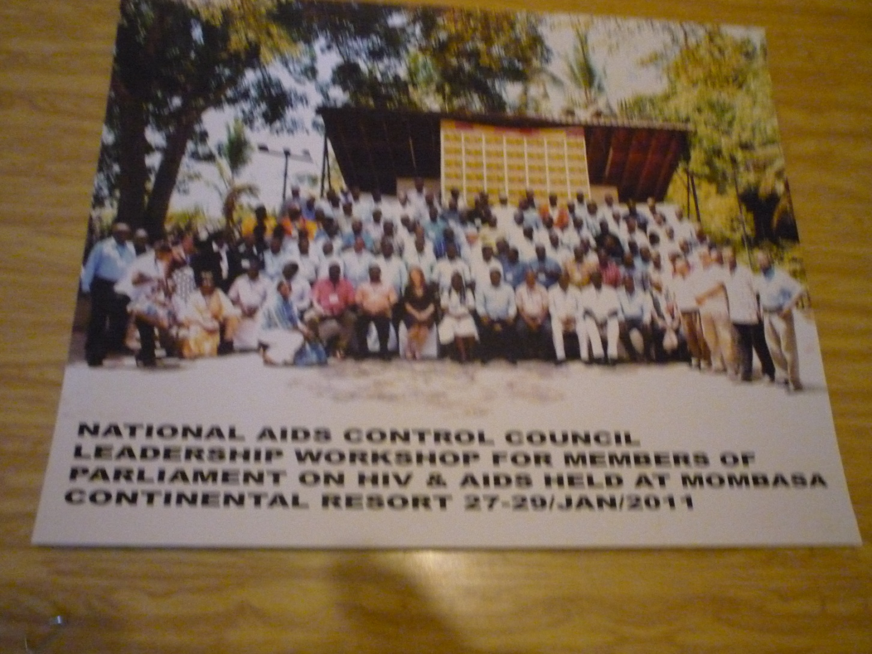
MEMEBERS OF PARLIAMENT

Slide 15
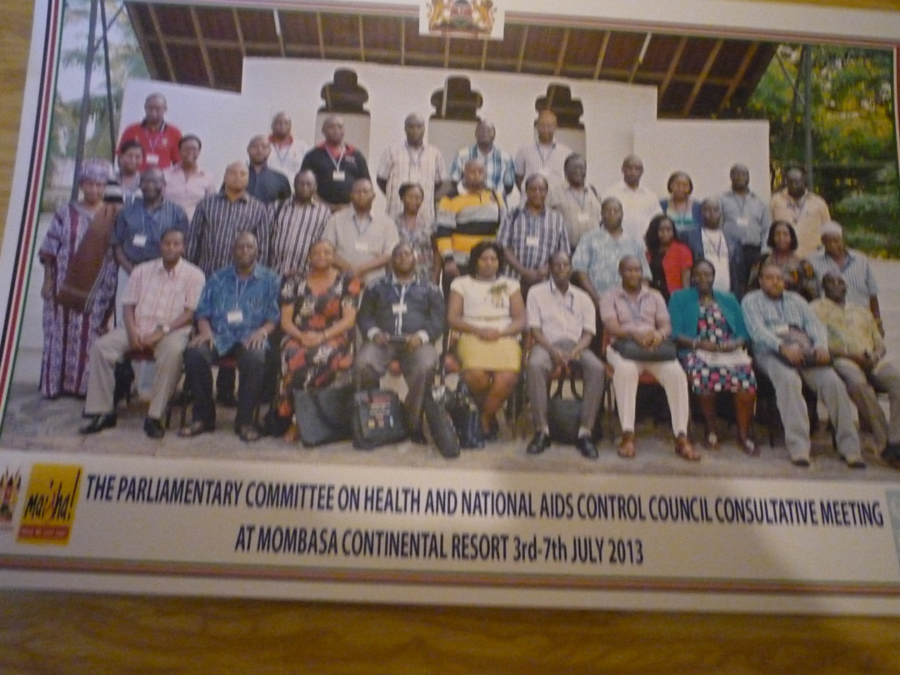
PARLIAMENTARY COMMITTEE FOR HEALTH

Slide 16

COUNTY FIRST LADIES

Slide 17

MOTHER- CHILD TRANSMISSION

Slide 18
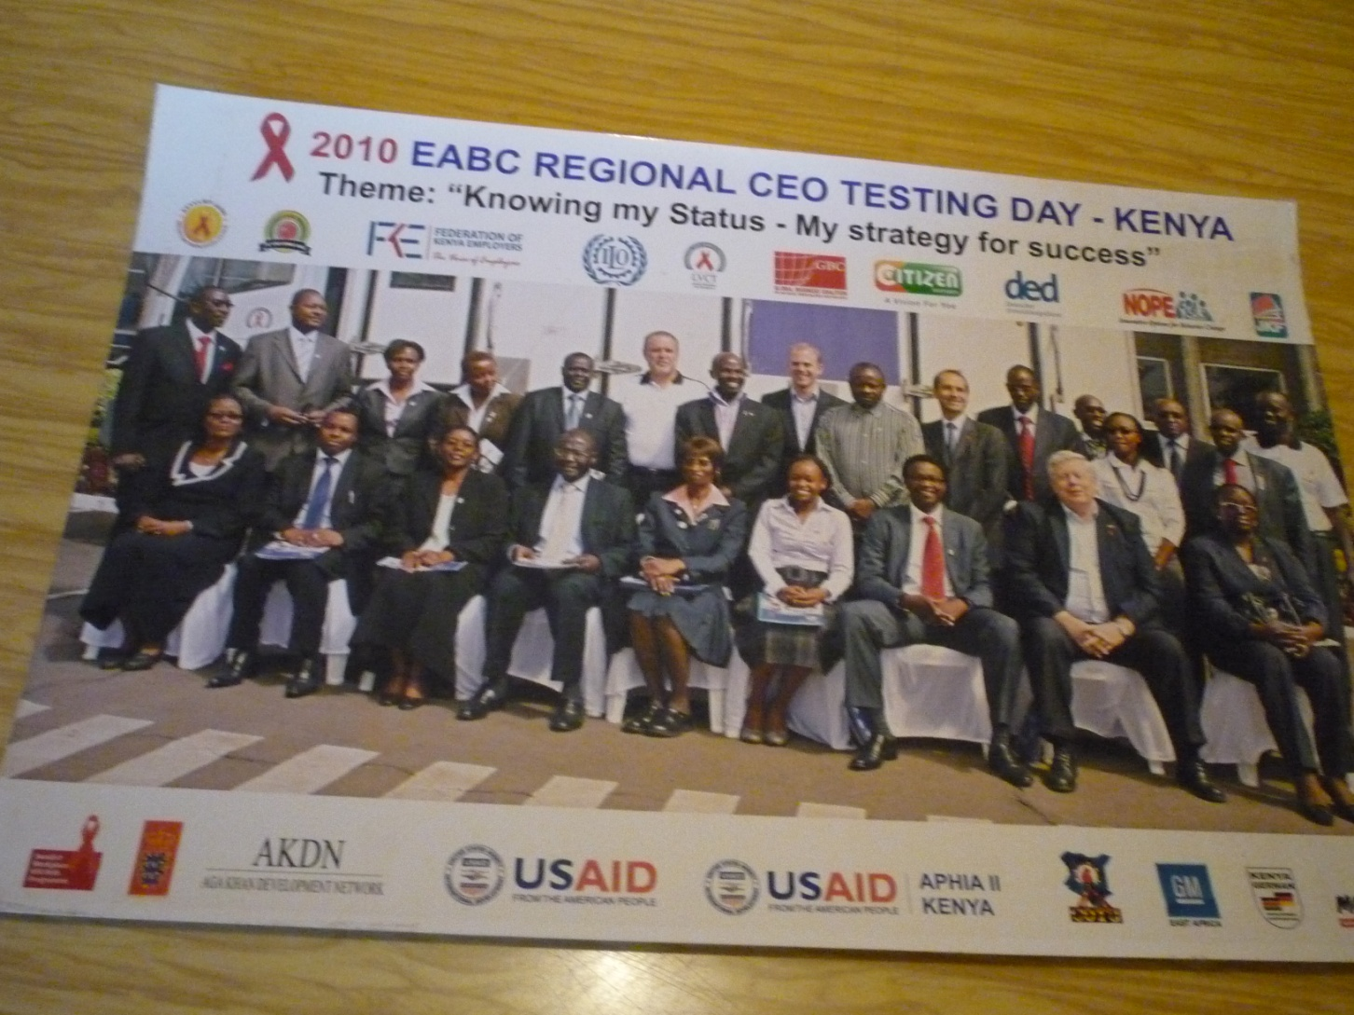
EABC REGIONAL CEO TESTING DAY

Slide 19
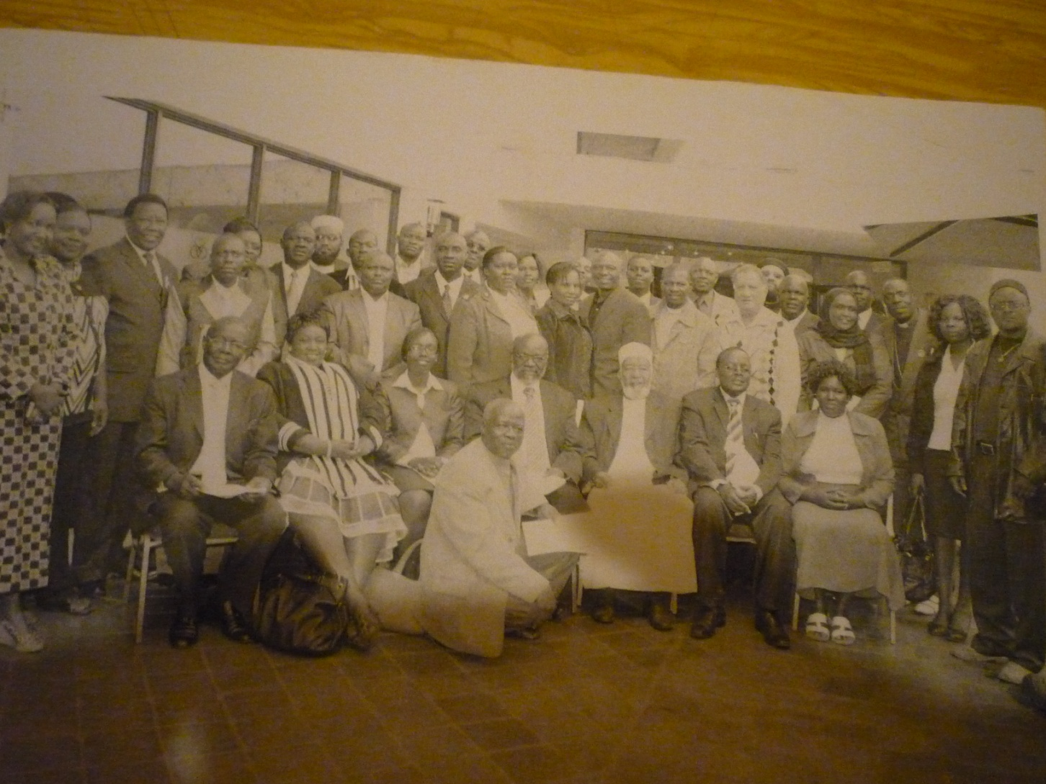
RELIGIOUS LEADERS

Slide 20
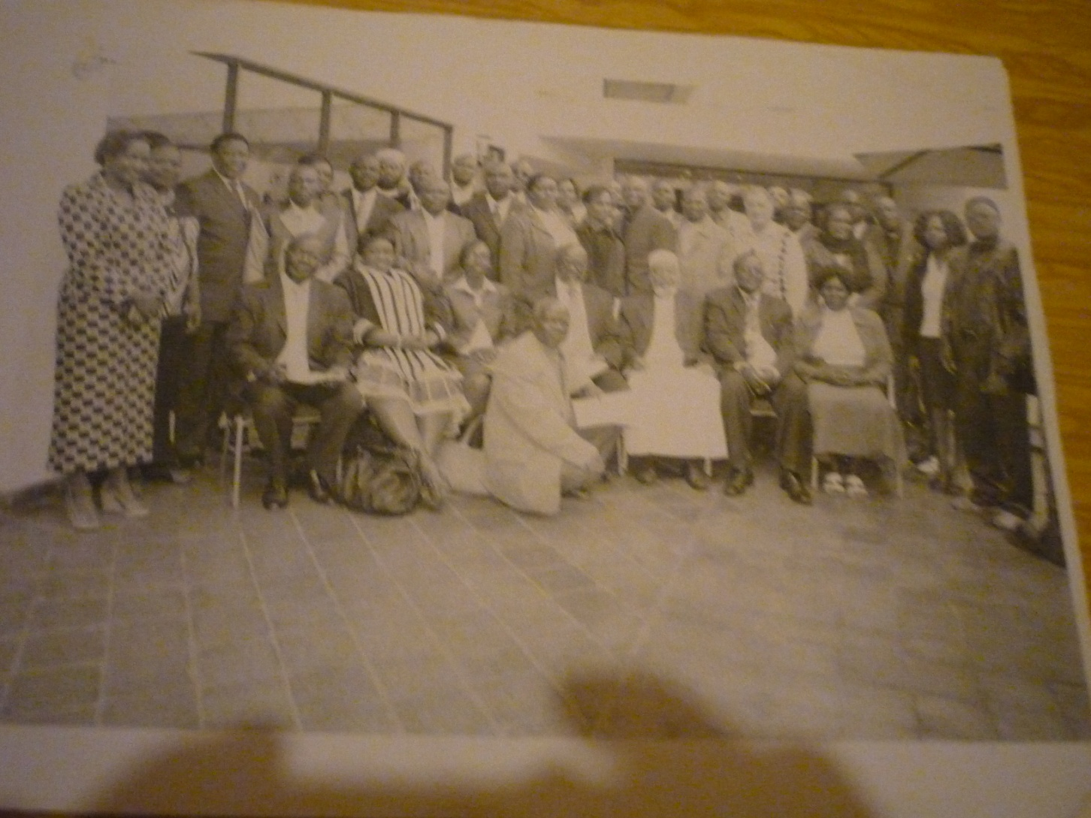
RELIGIOUS LEADERS

