Slide 1
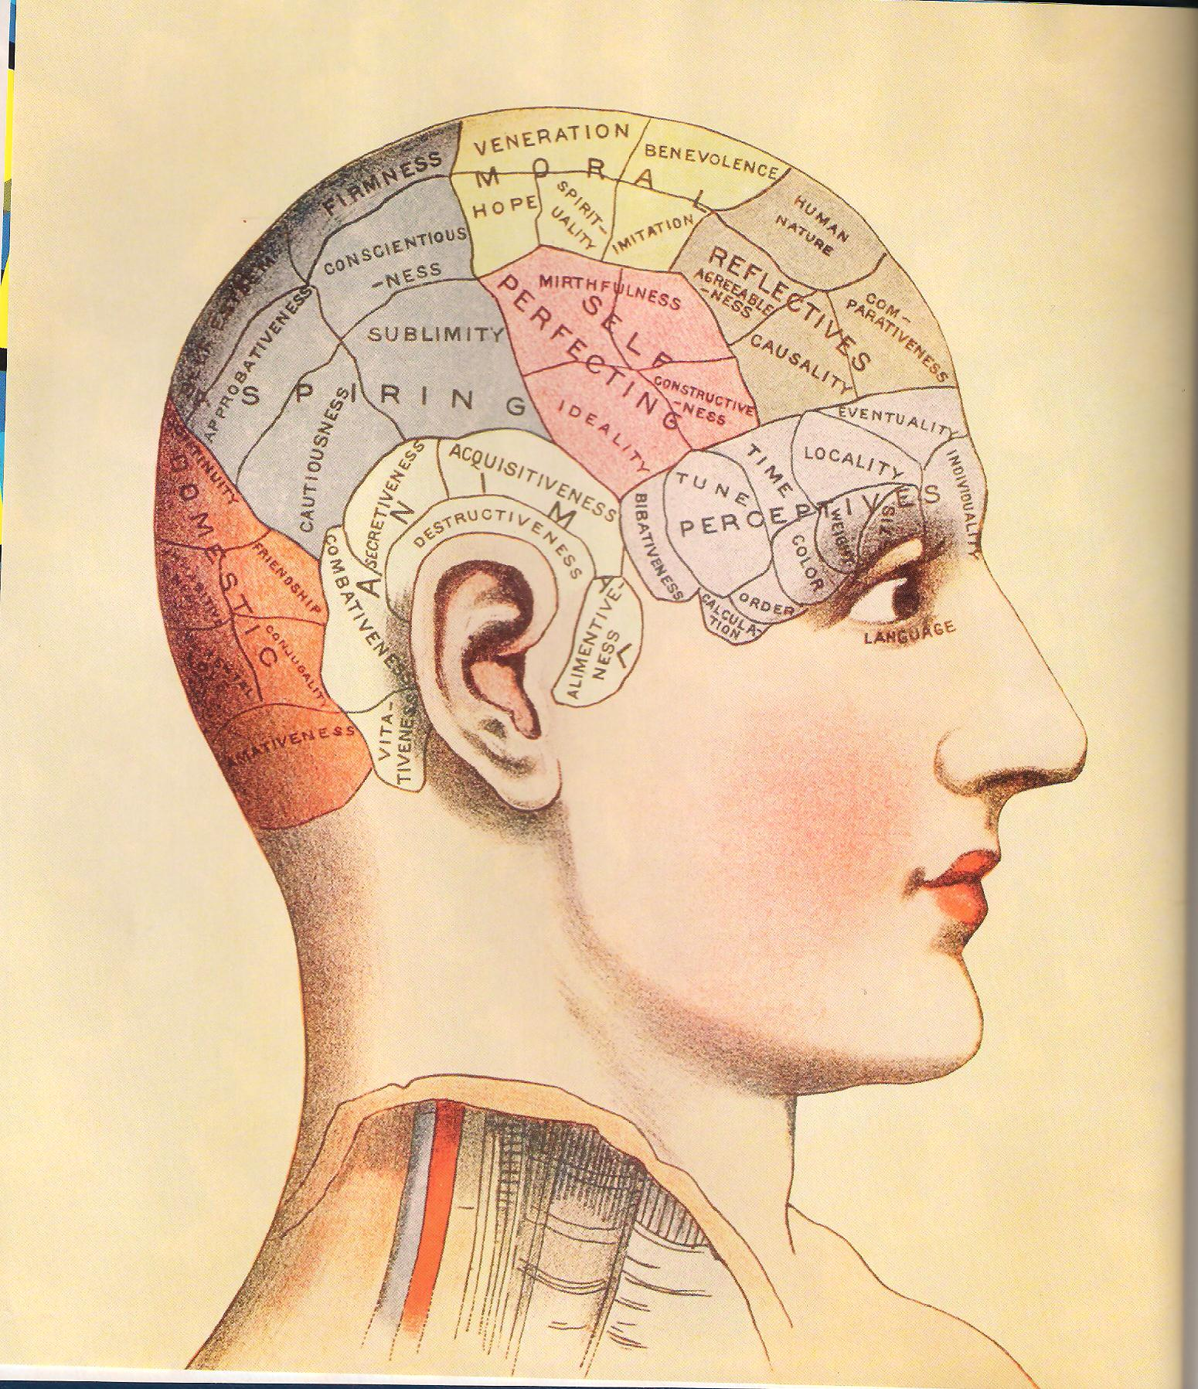
PHRENOLOGY

Slide 2
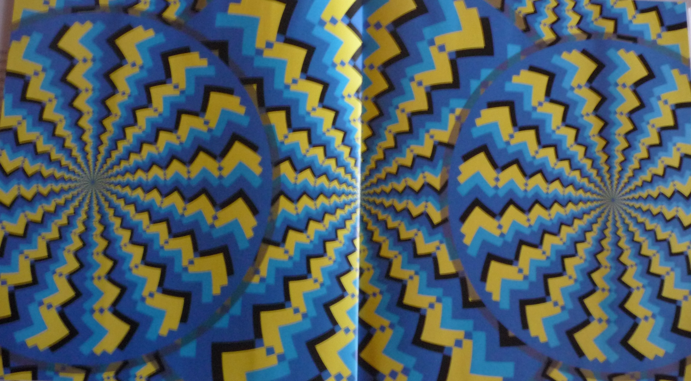
ZIGZAG AND PERIPHERAL VISION

Slide 3
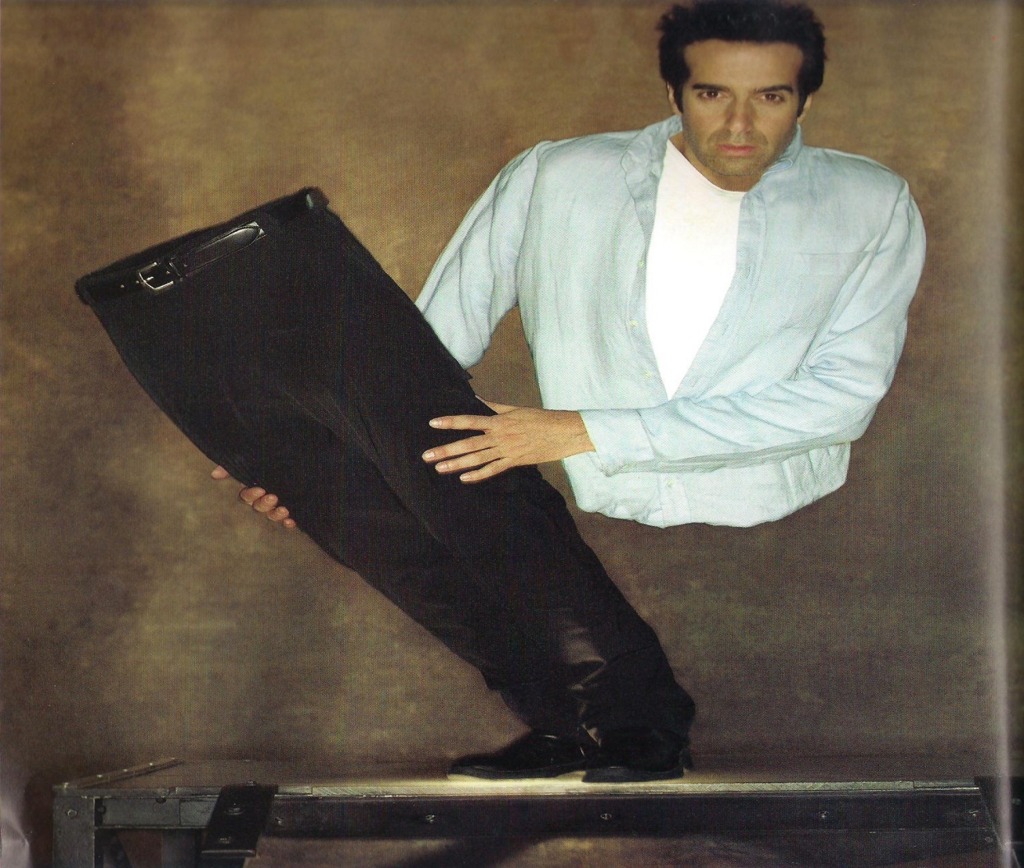
BRAIN BENDER

Slide 4
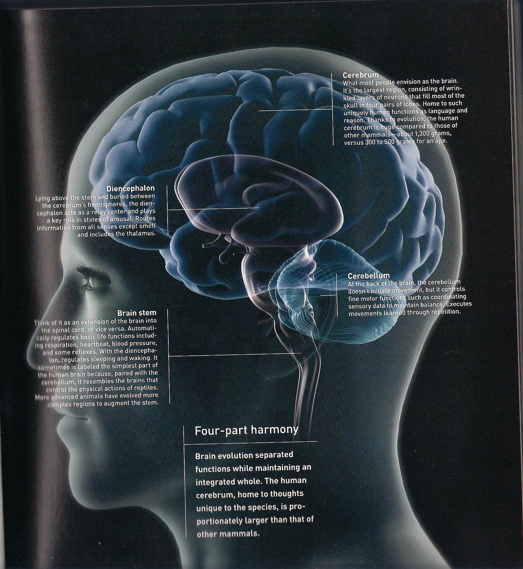
THE BRAIN

Slide 5

OPTICAL ILLUSIONS

Slide 6
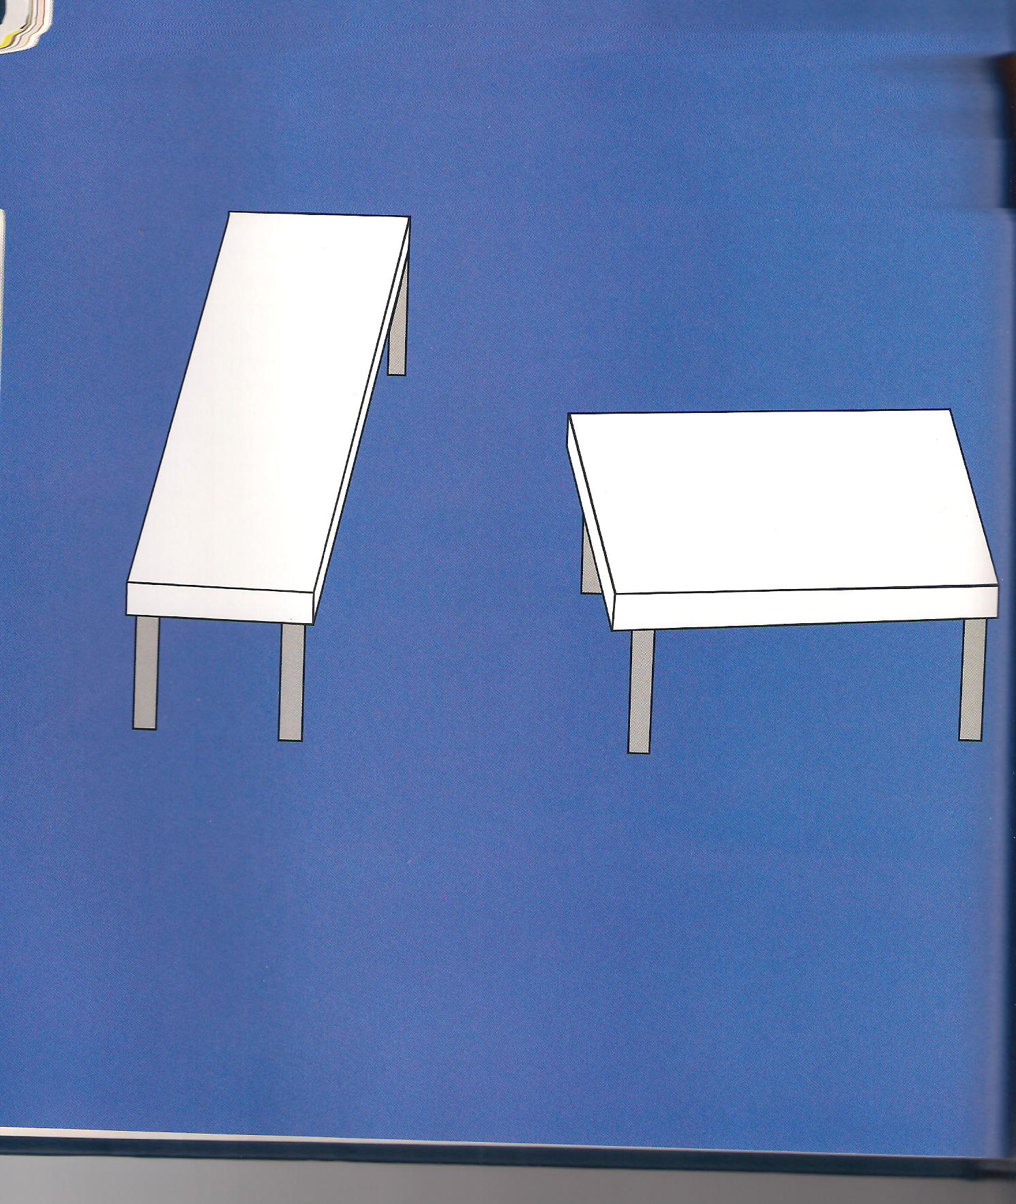
PERSPECTIVE CUES

Slide 7
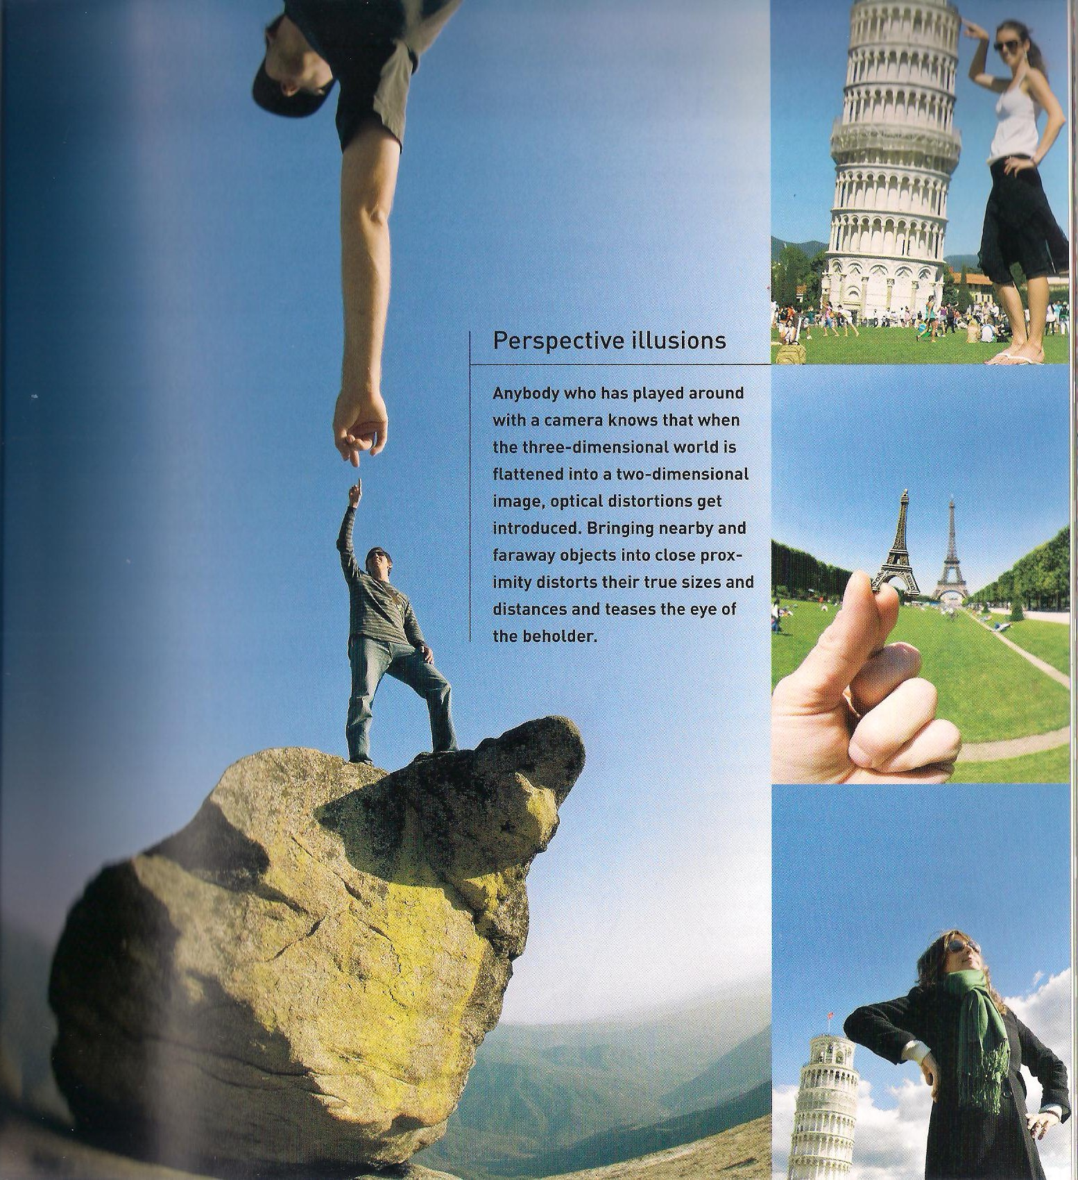
PERSPECTIVE ILLUSIONS

Slide 8
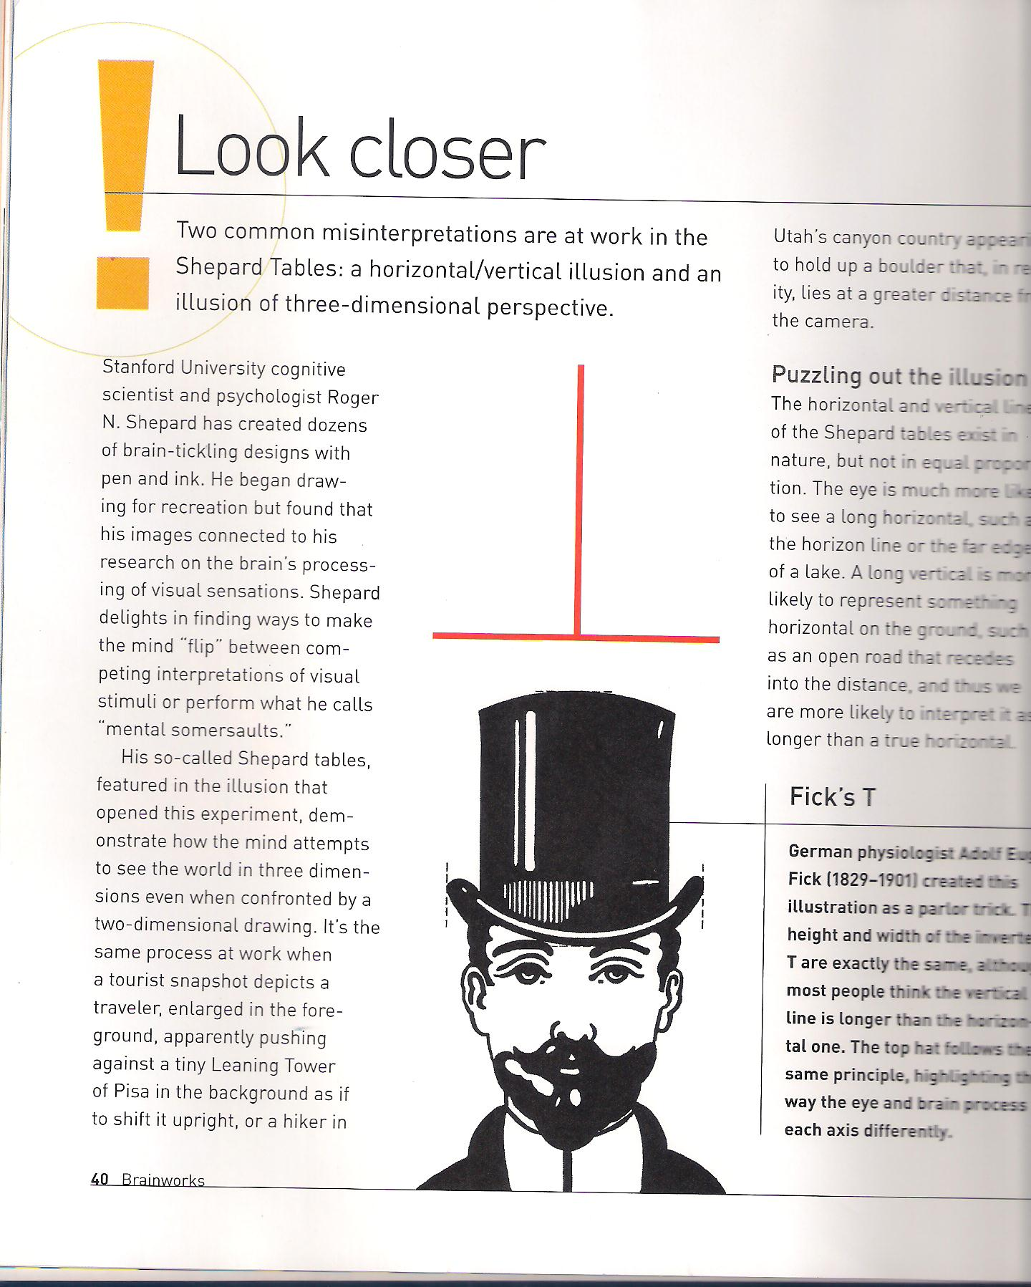
FICK’S T

Slide 9
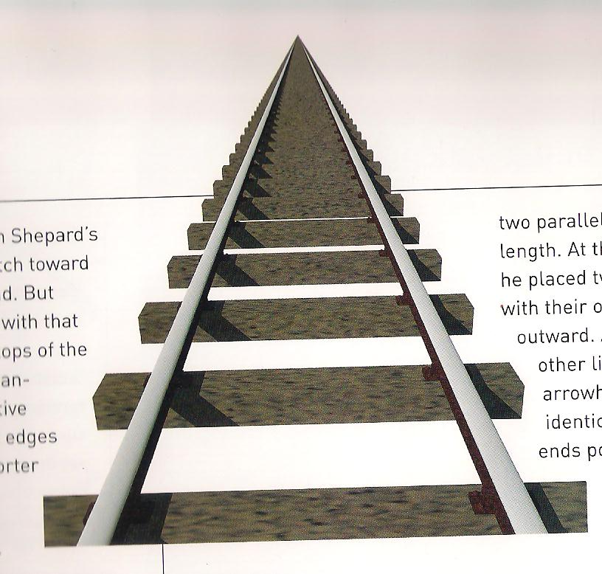
RAILROADING

Slide 10
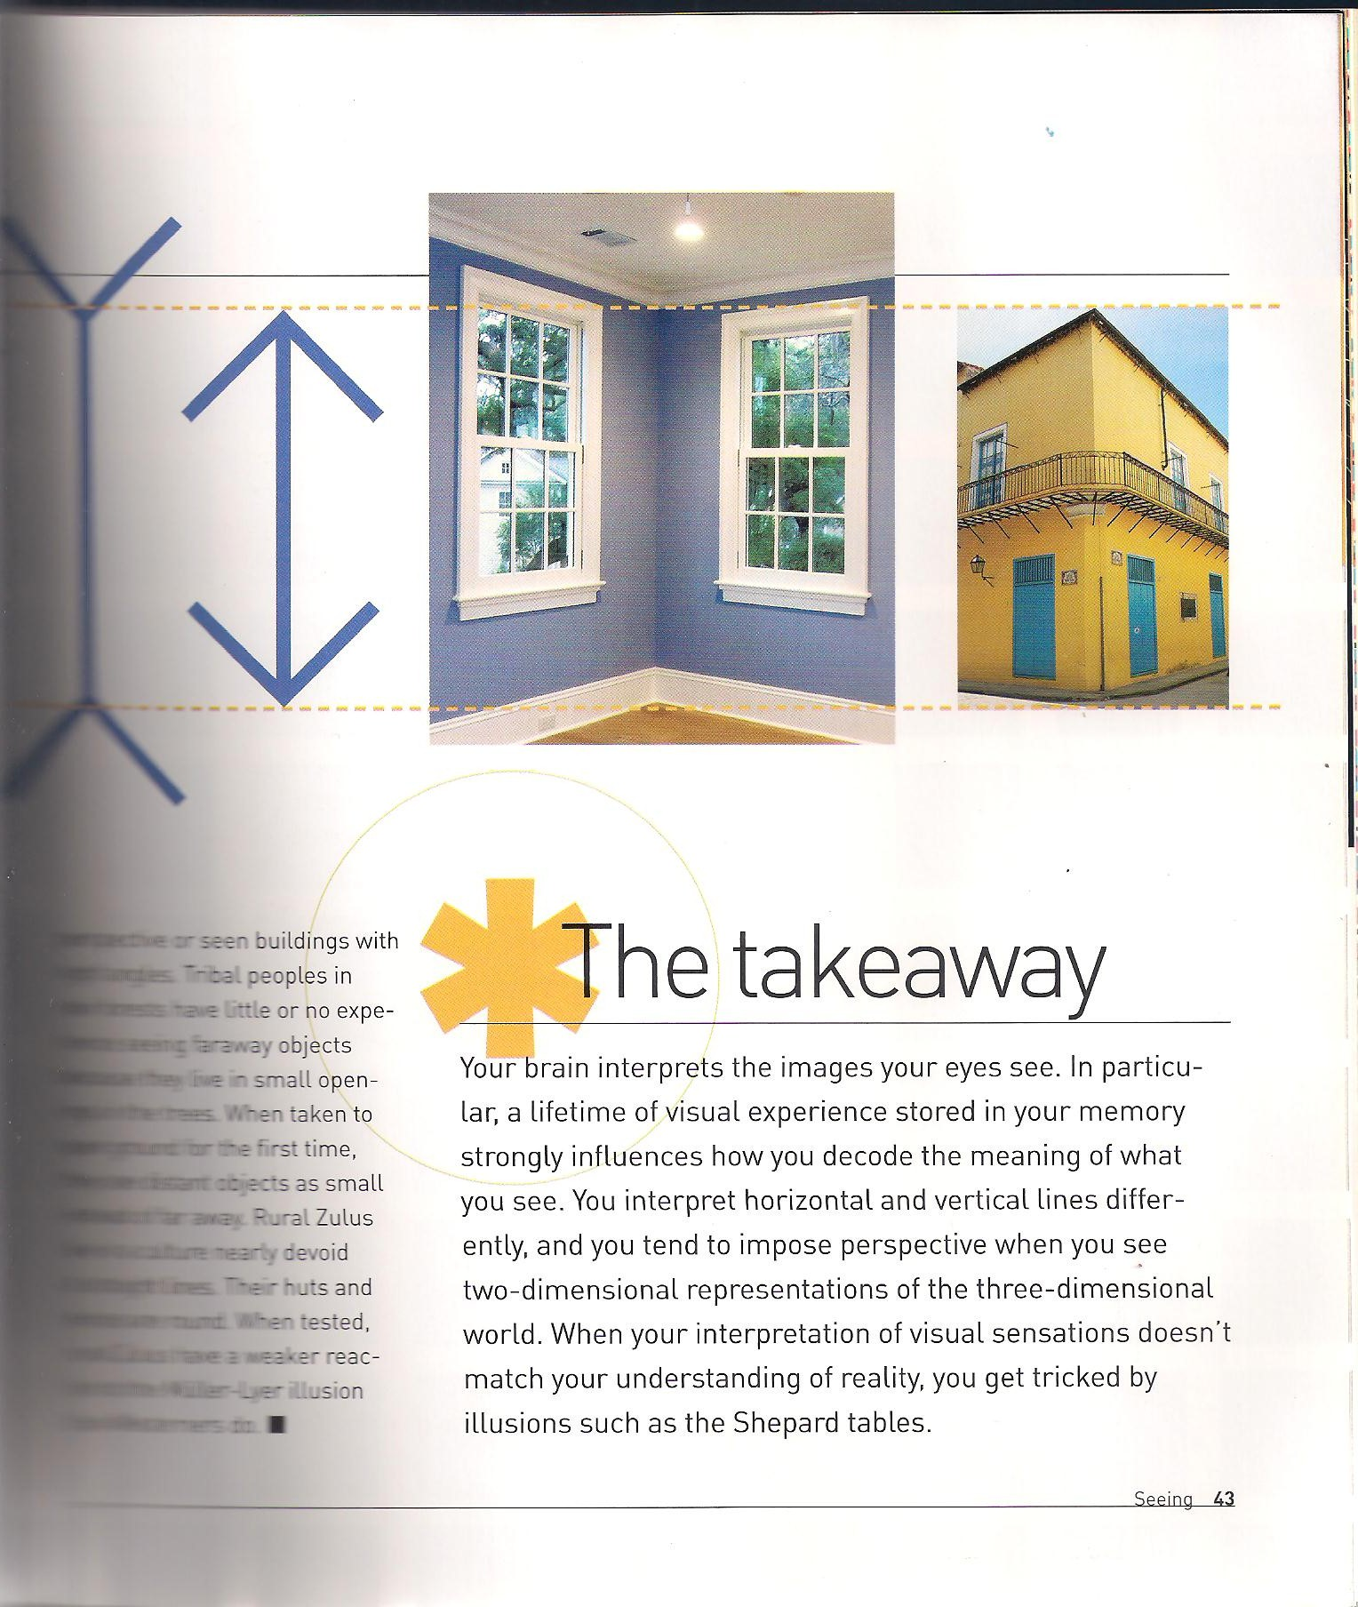
CORNERING THEORY

Slide 11

BLACK AND WHITE LINES

Slide 12
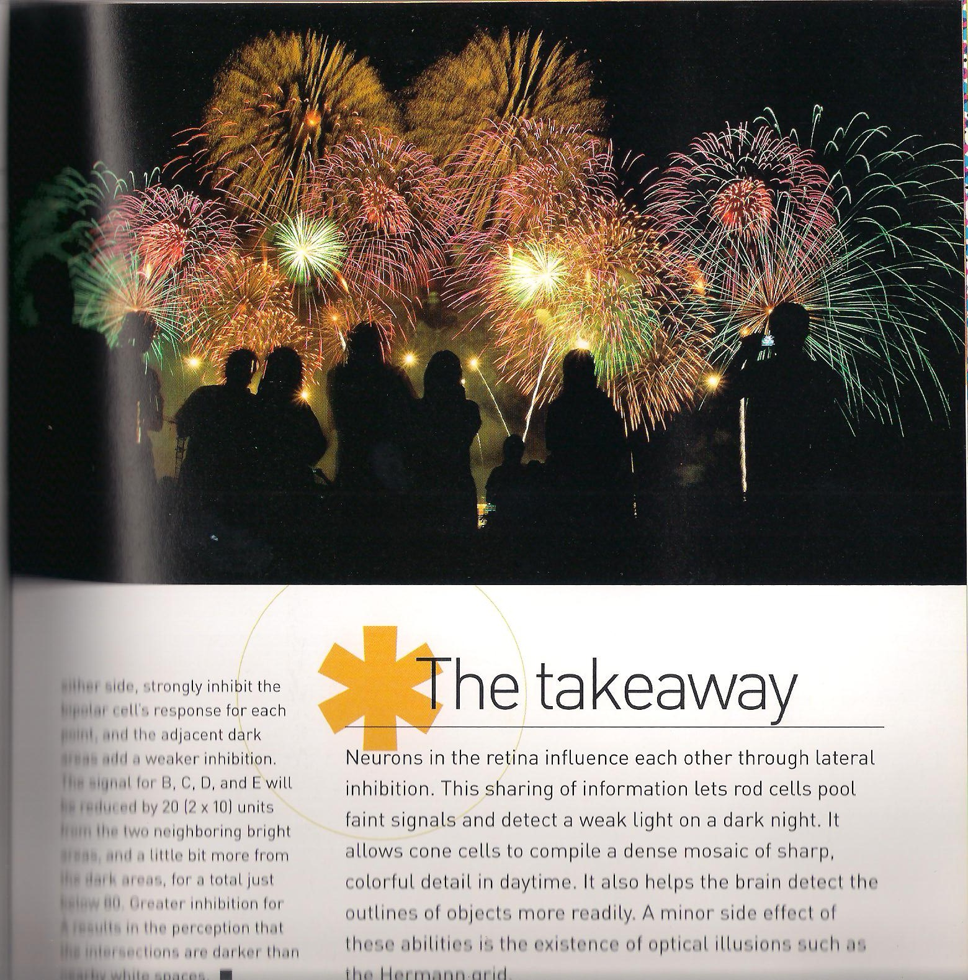
FIREWORKS

Slide 13
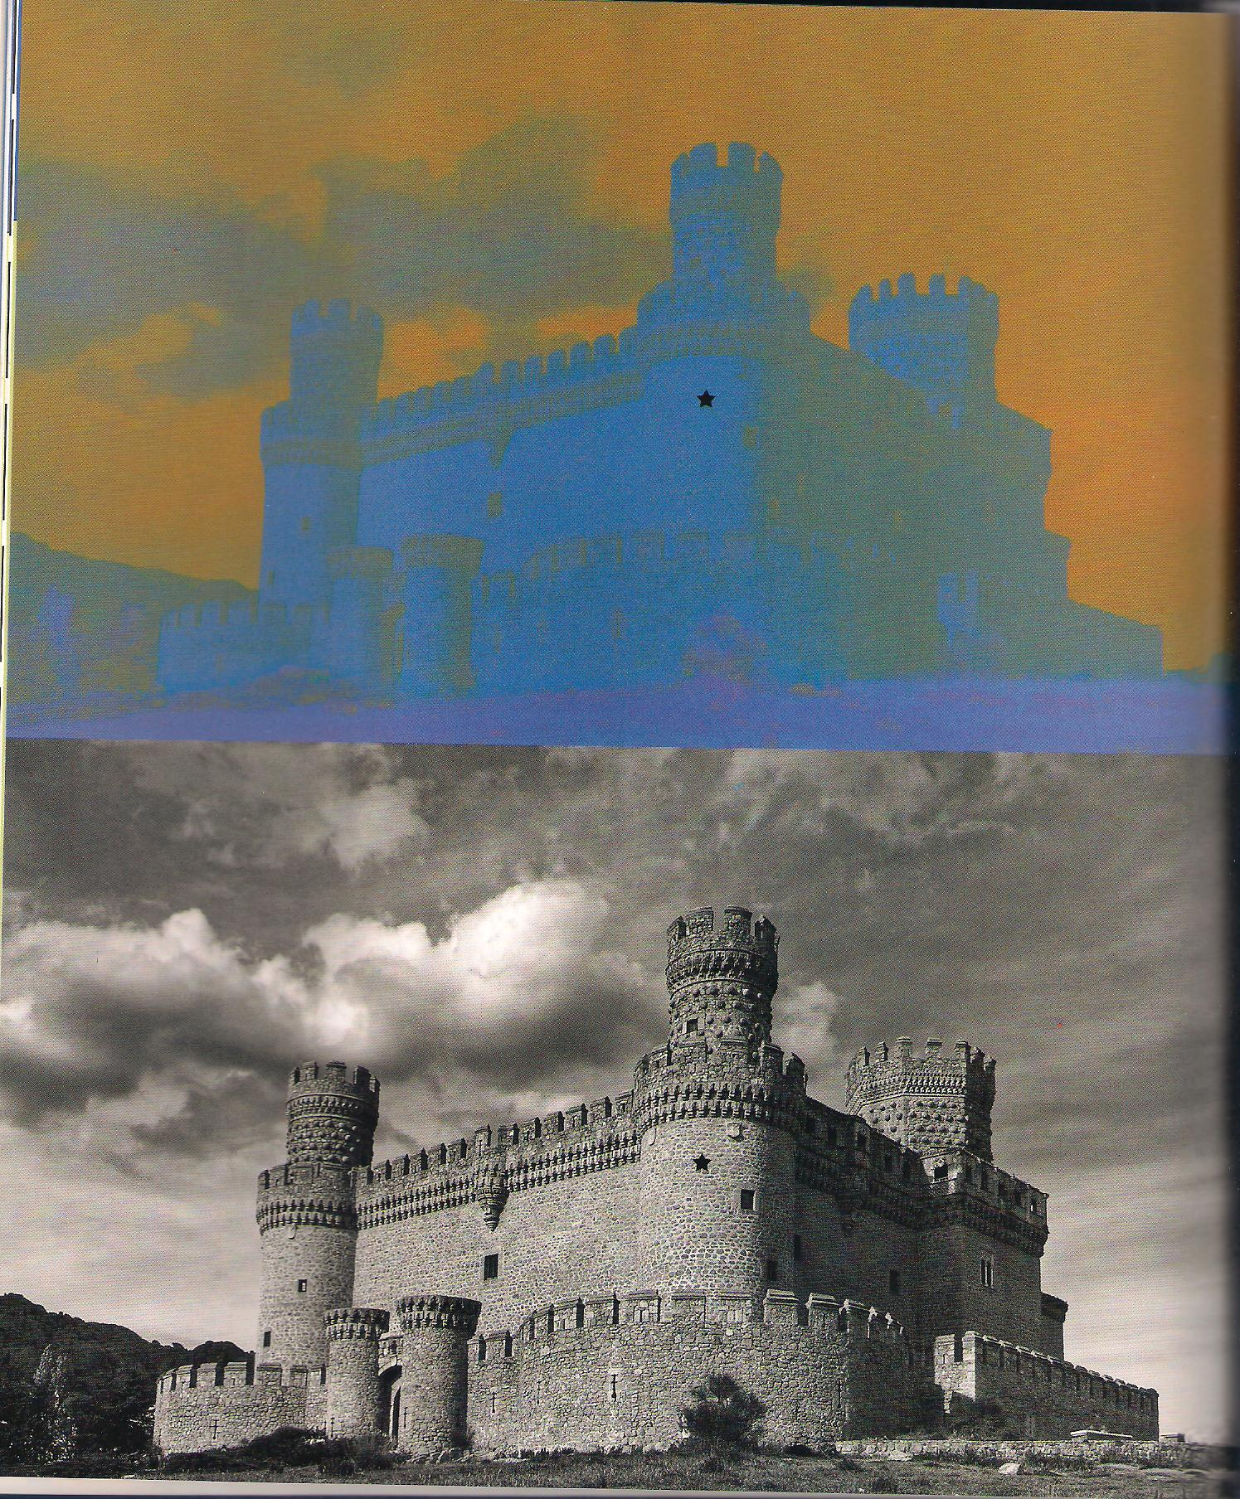
SPANISH CASTLE

Slide 14
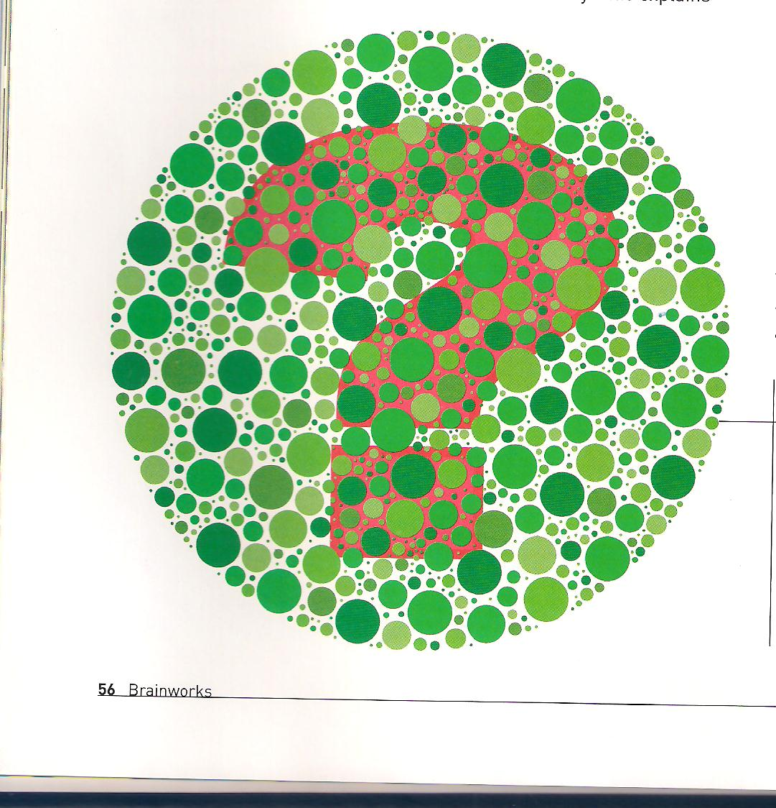
COLOUR BLINDNESS

Slide 15
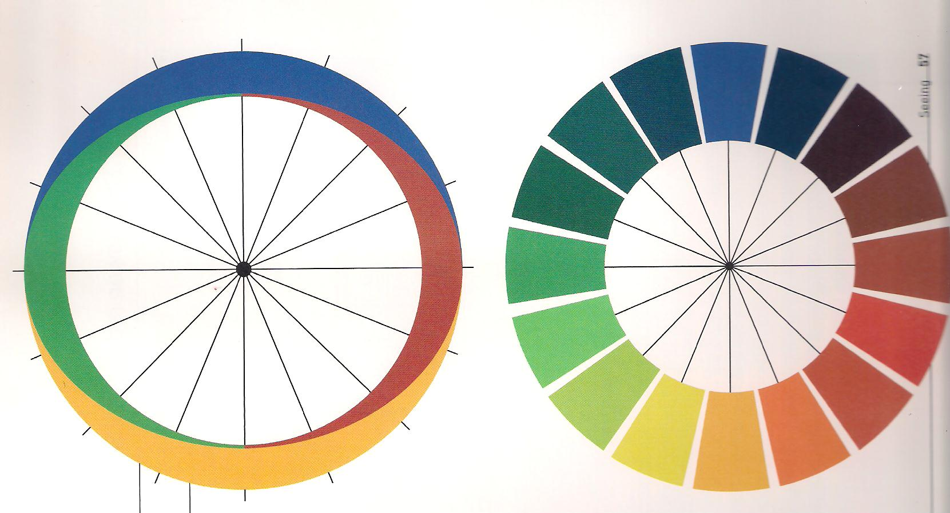
OPPONENT COLOURS

Slide 16
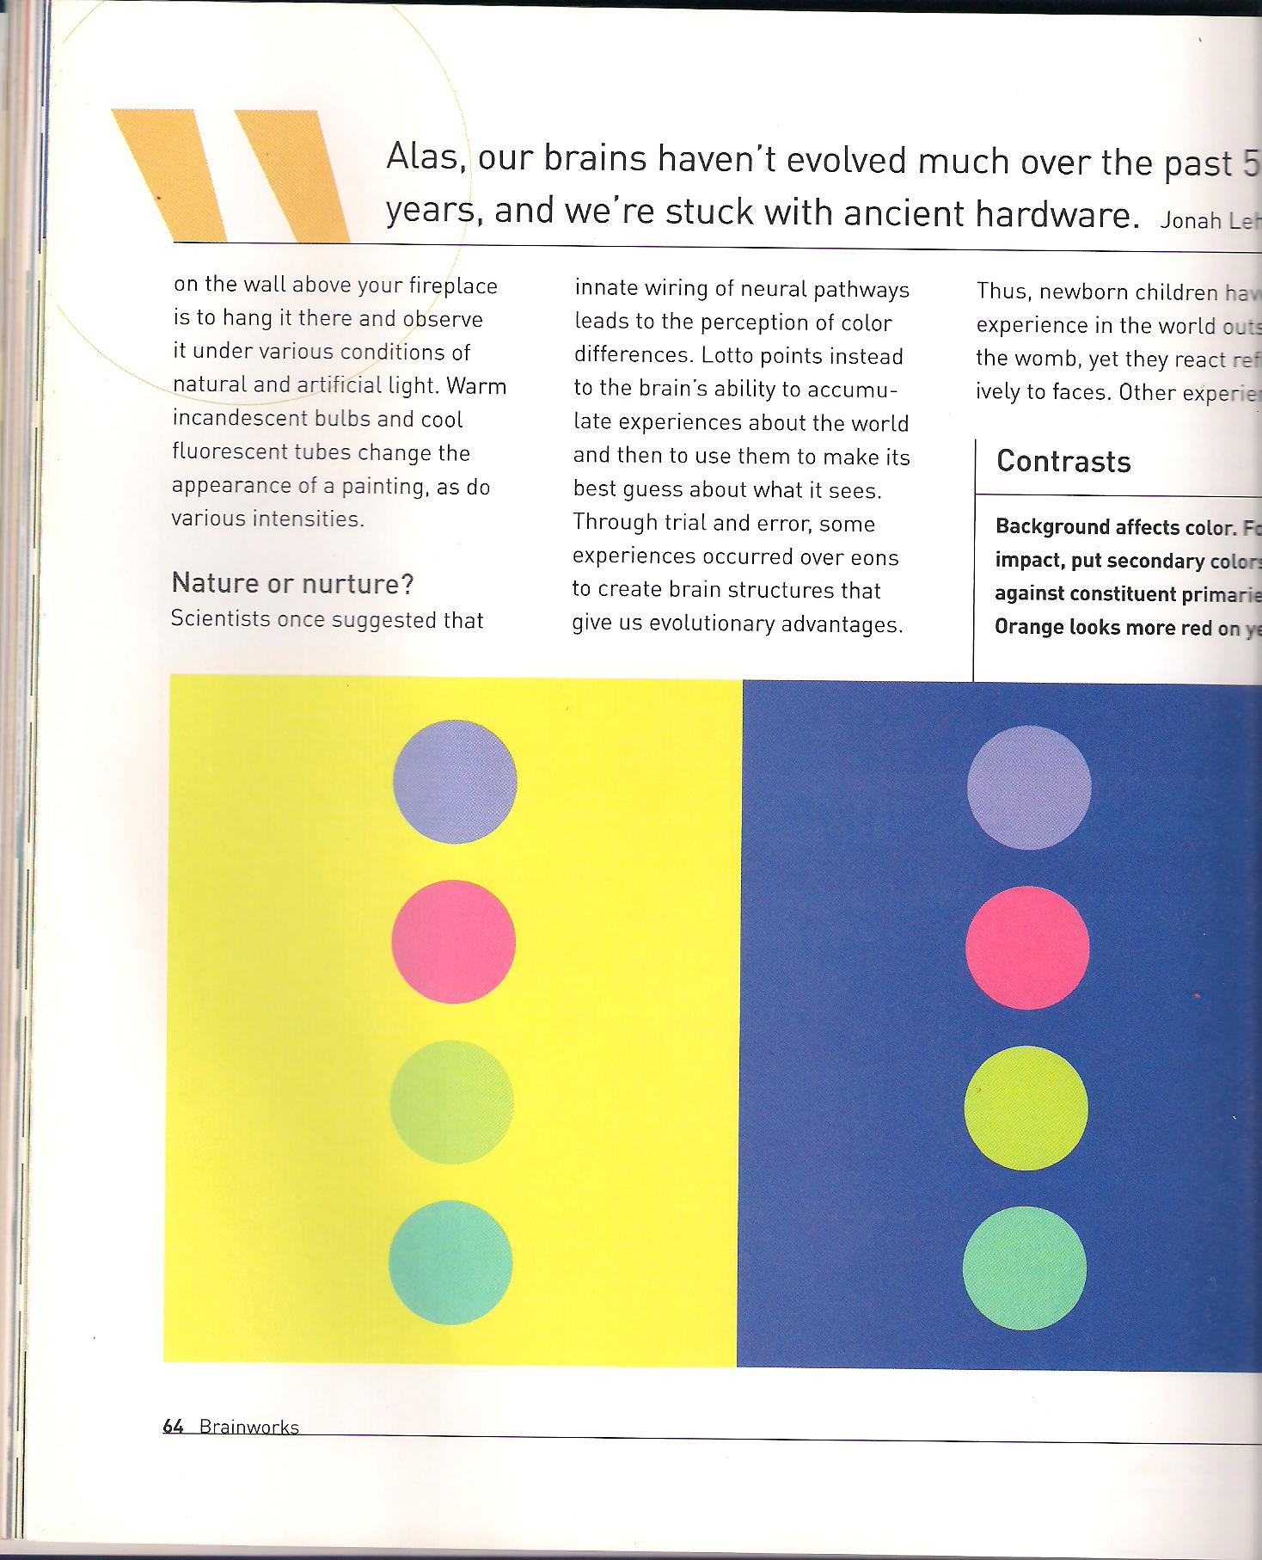
CONTRASTS

Slide 17

FUSING COLOUR AND LINE

Slide 18
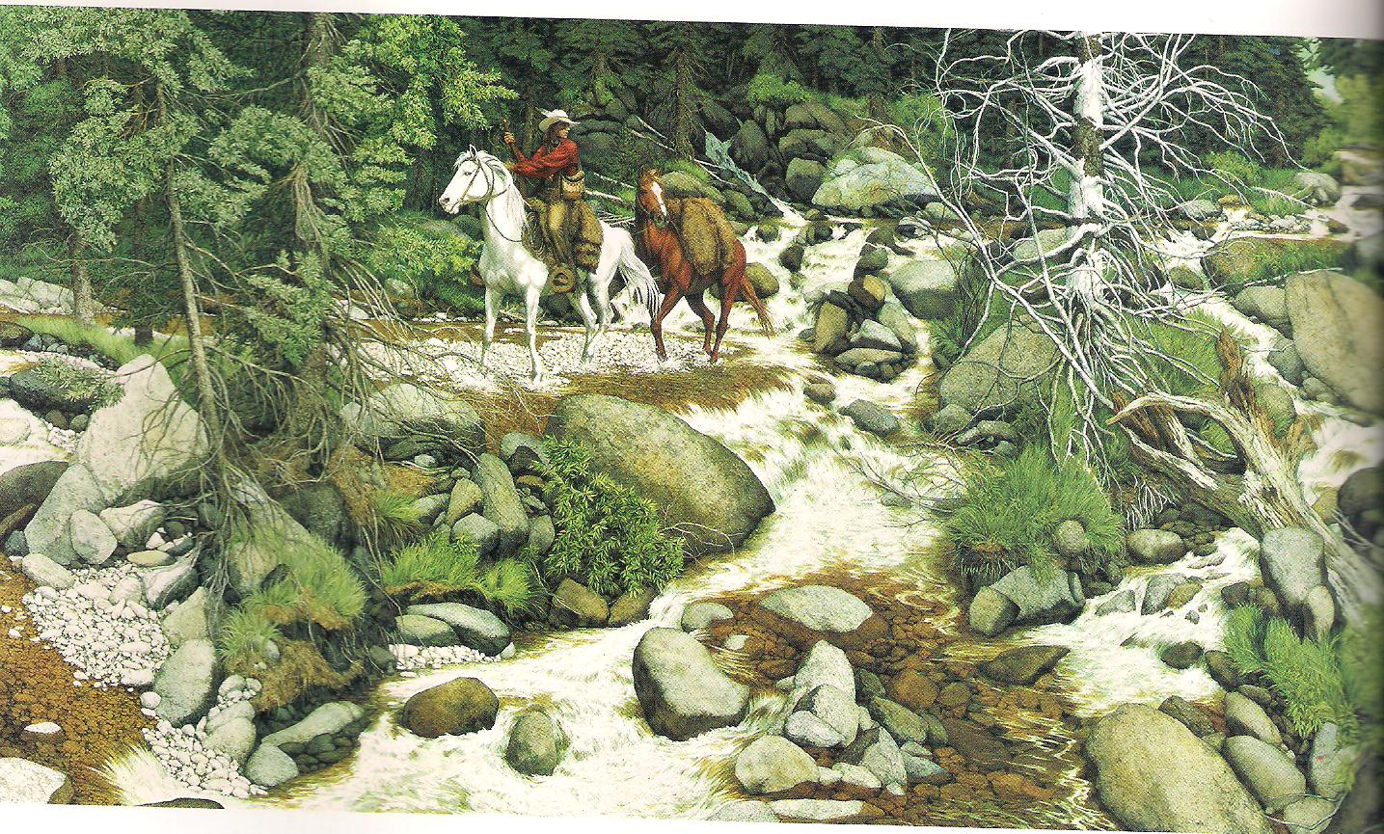
WHAT IS HIDING AMONG THE ROCKS AND TREES?

Slide 19
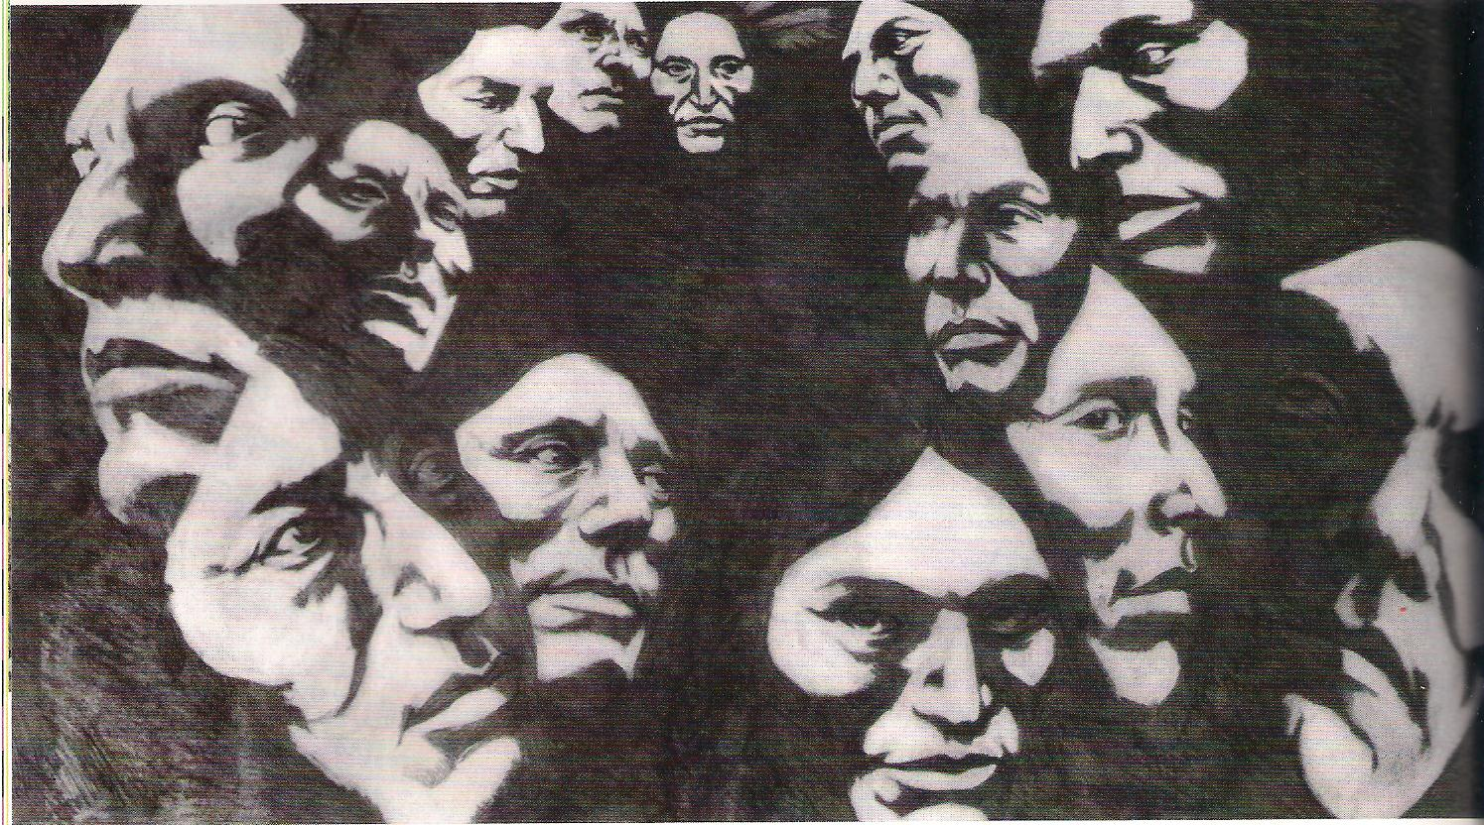
WHAT IS HIDING AMONG THE ROCKS AND TREES?

Slide 20


WHAT IS HIDING AMONG THE ROCKS AND TREES?

Slide 21
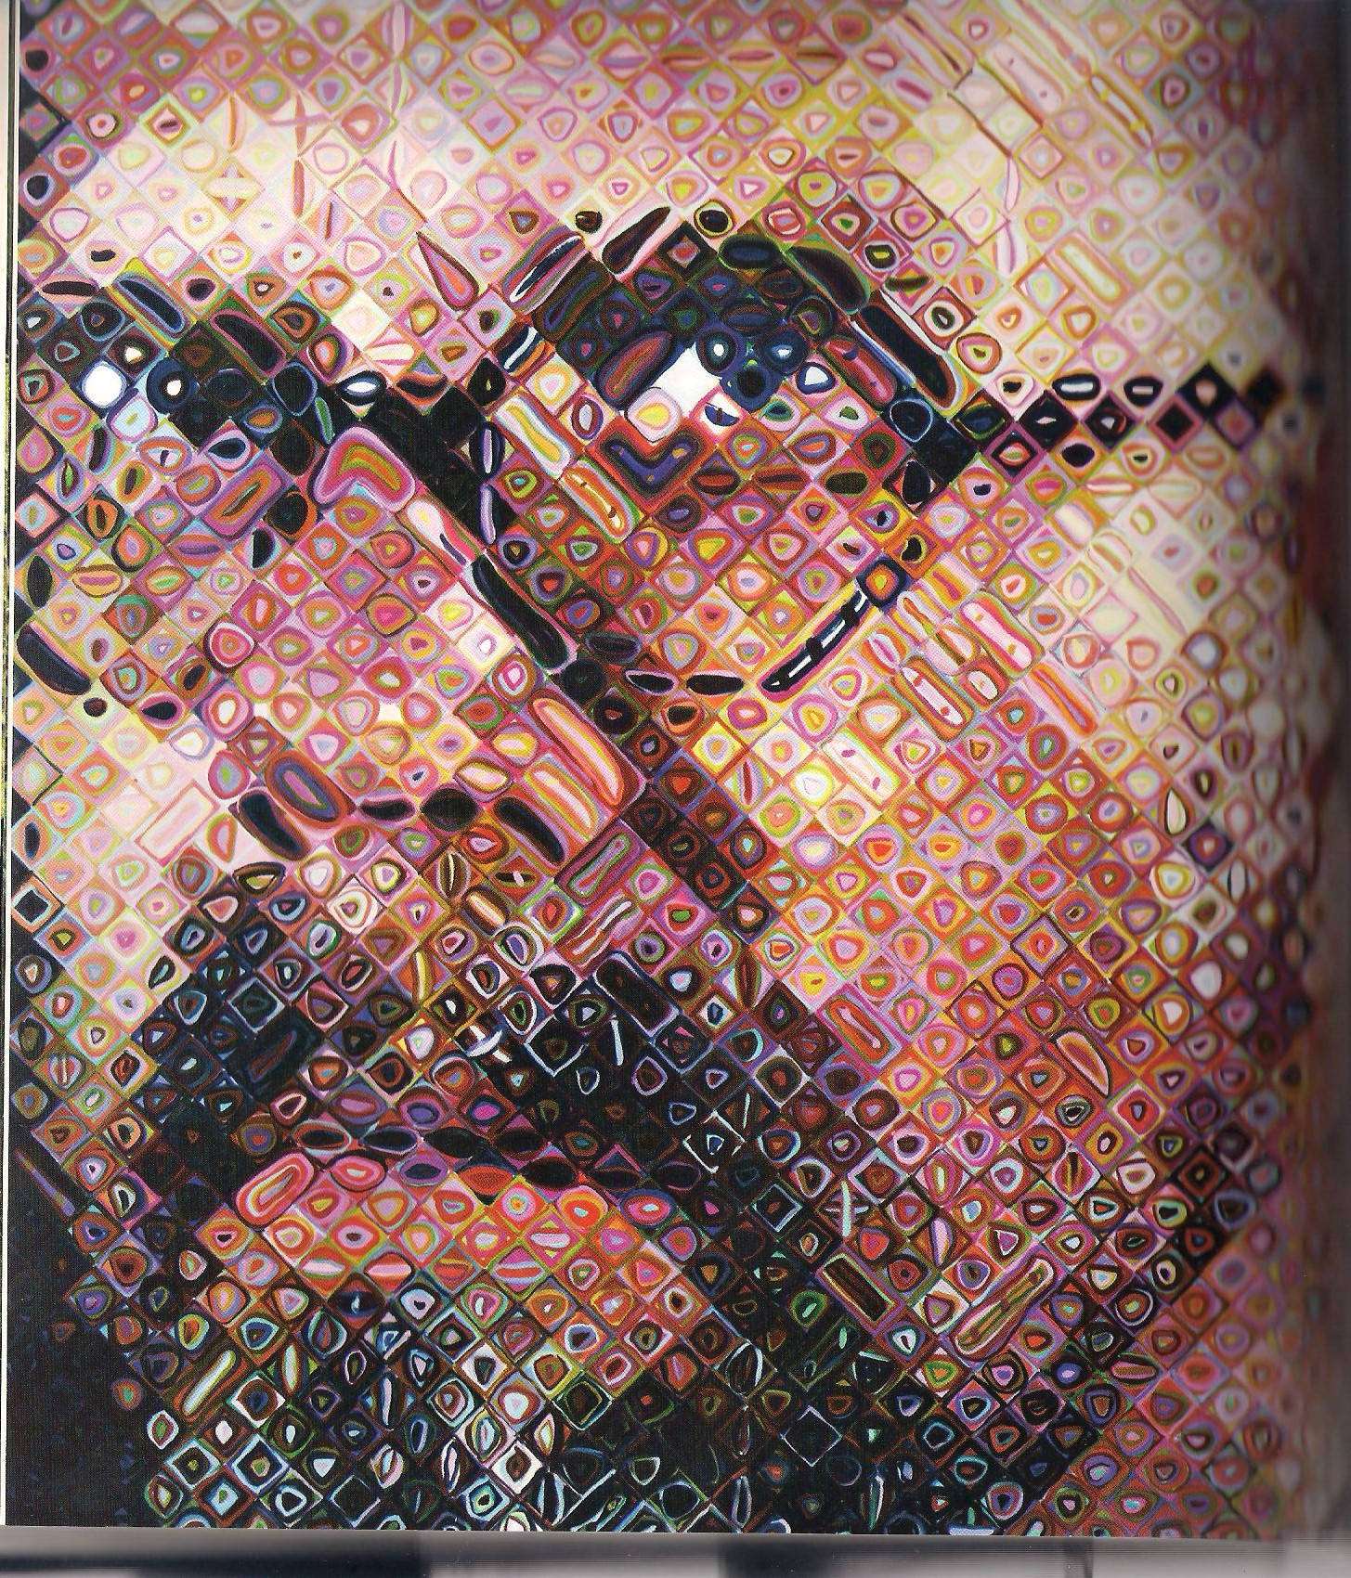
POTRAIT PARTS

Slide 22
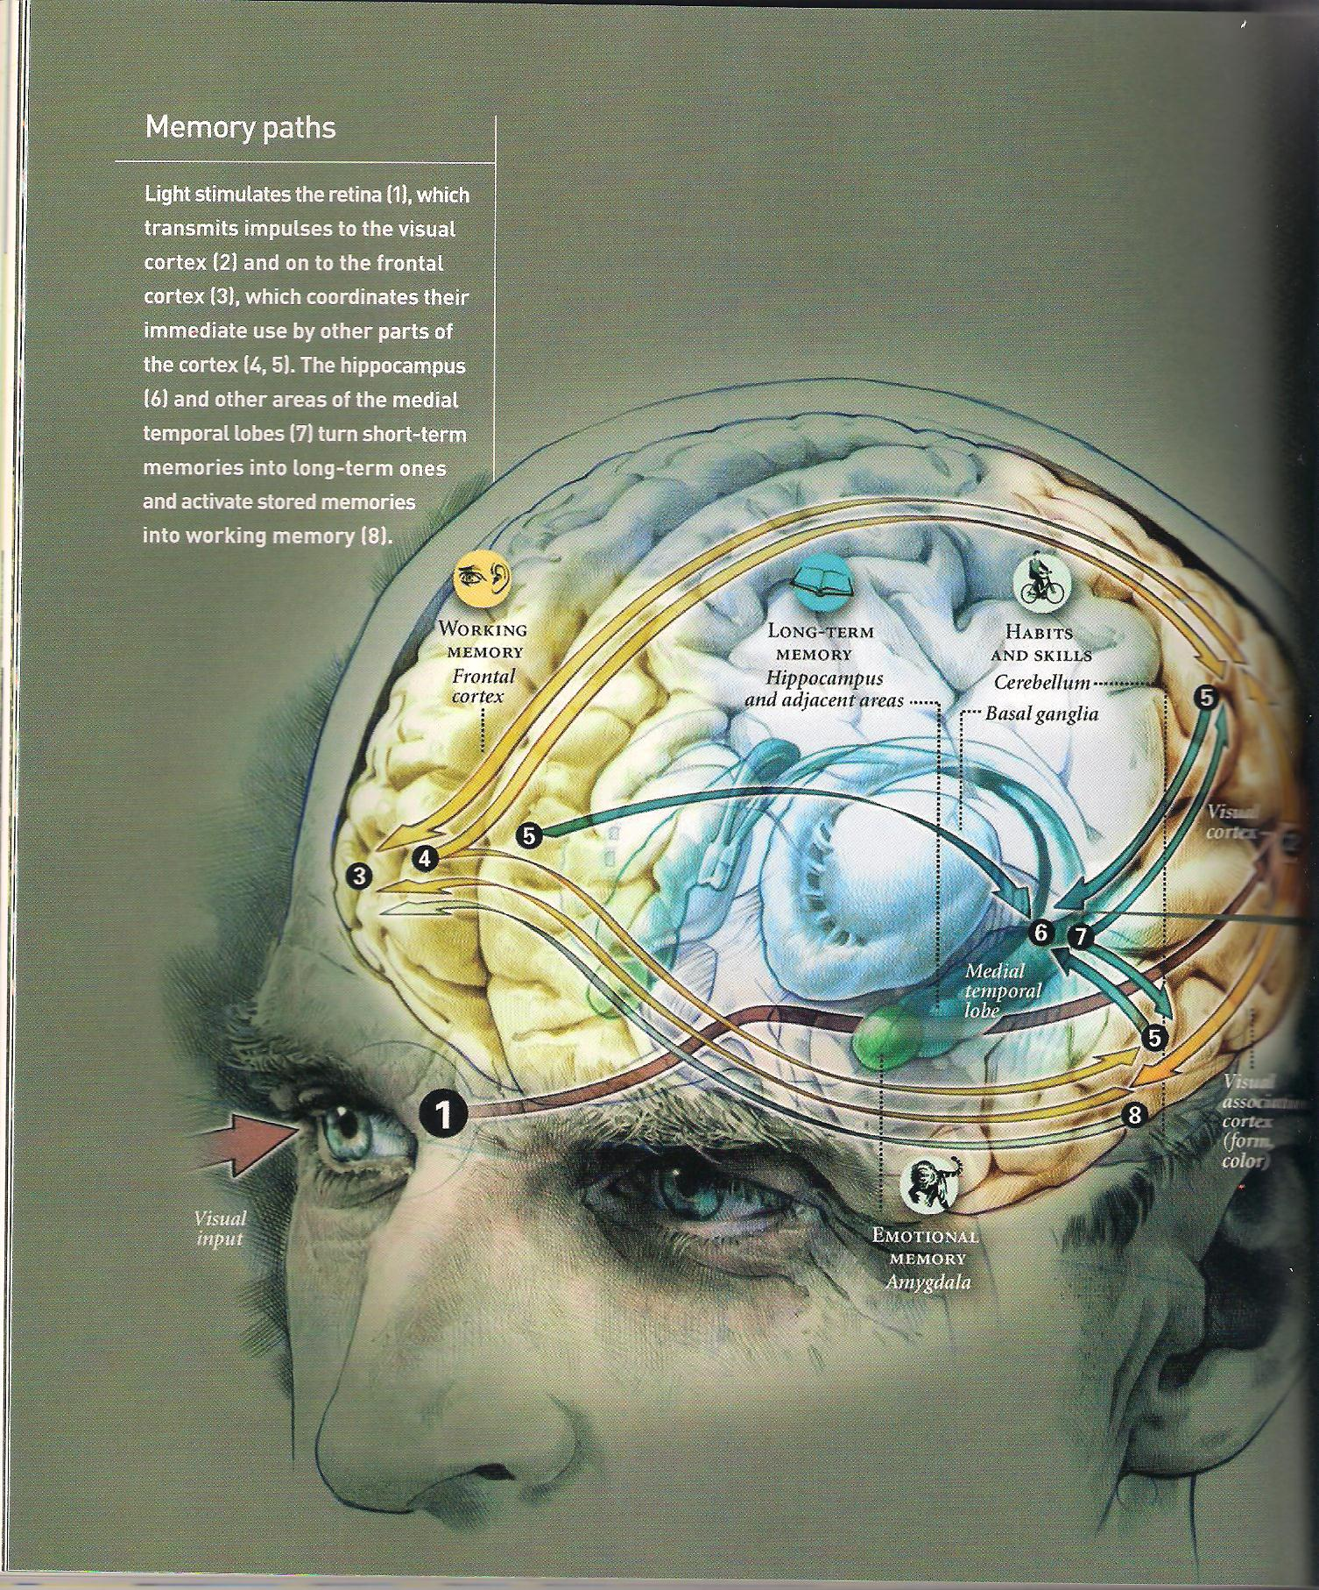
MEMORY PATHS

Slide 23
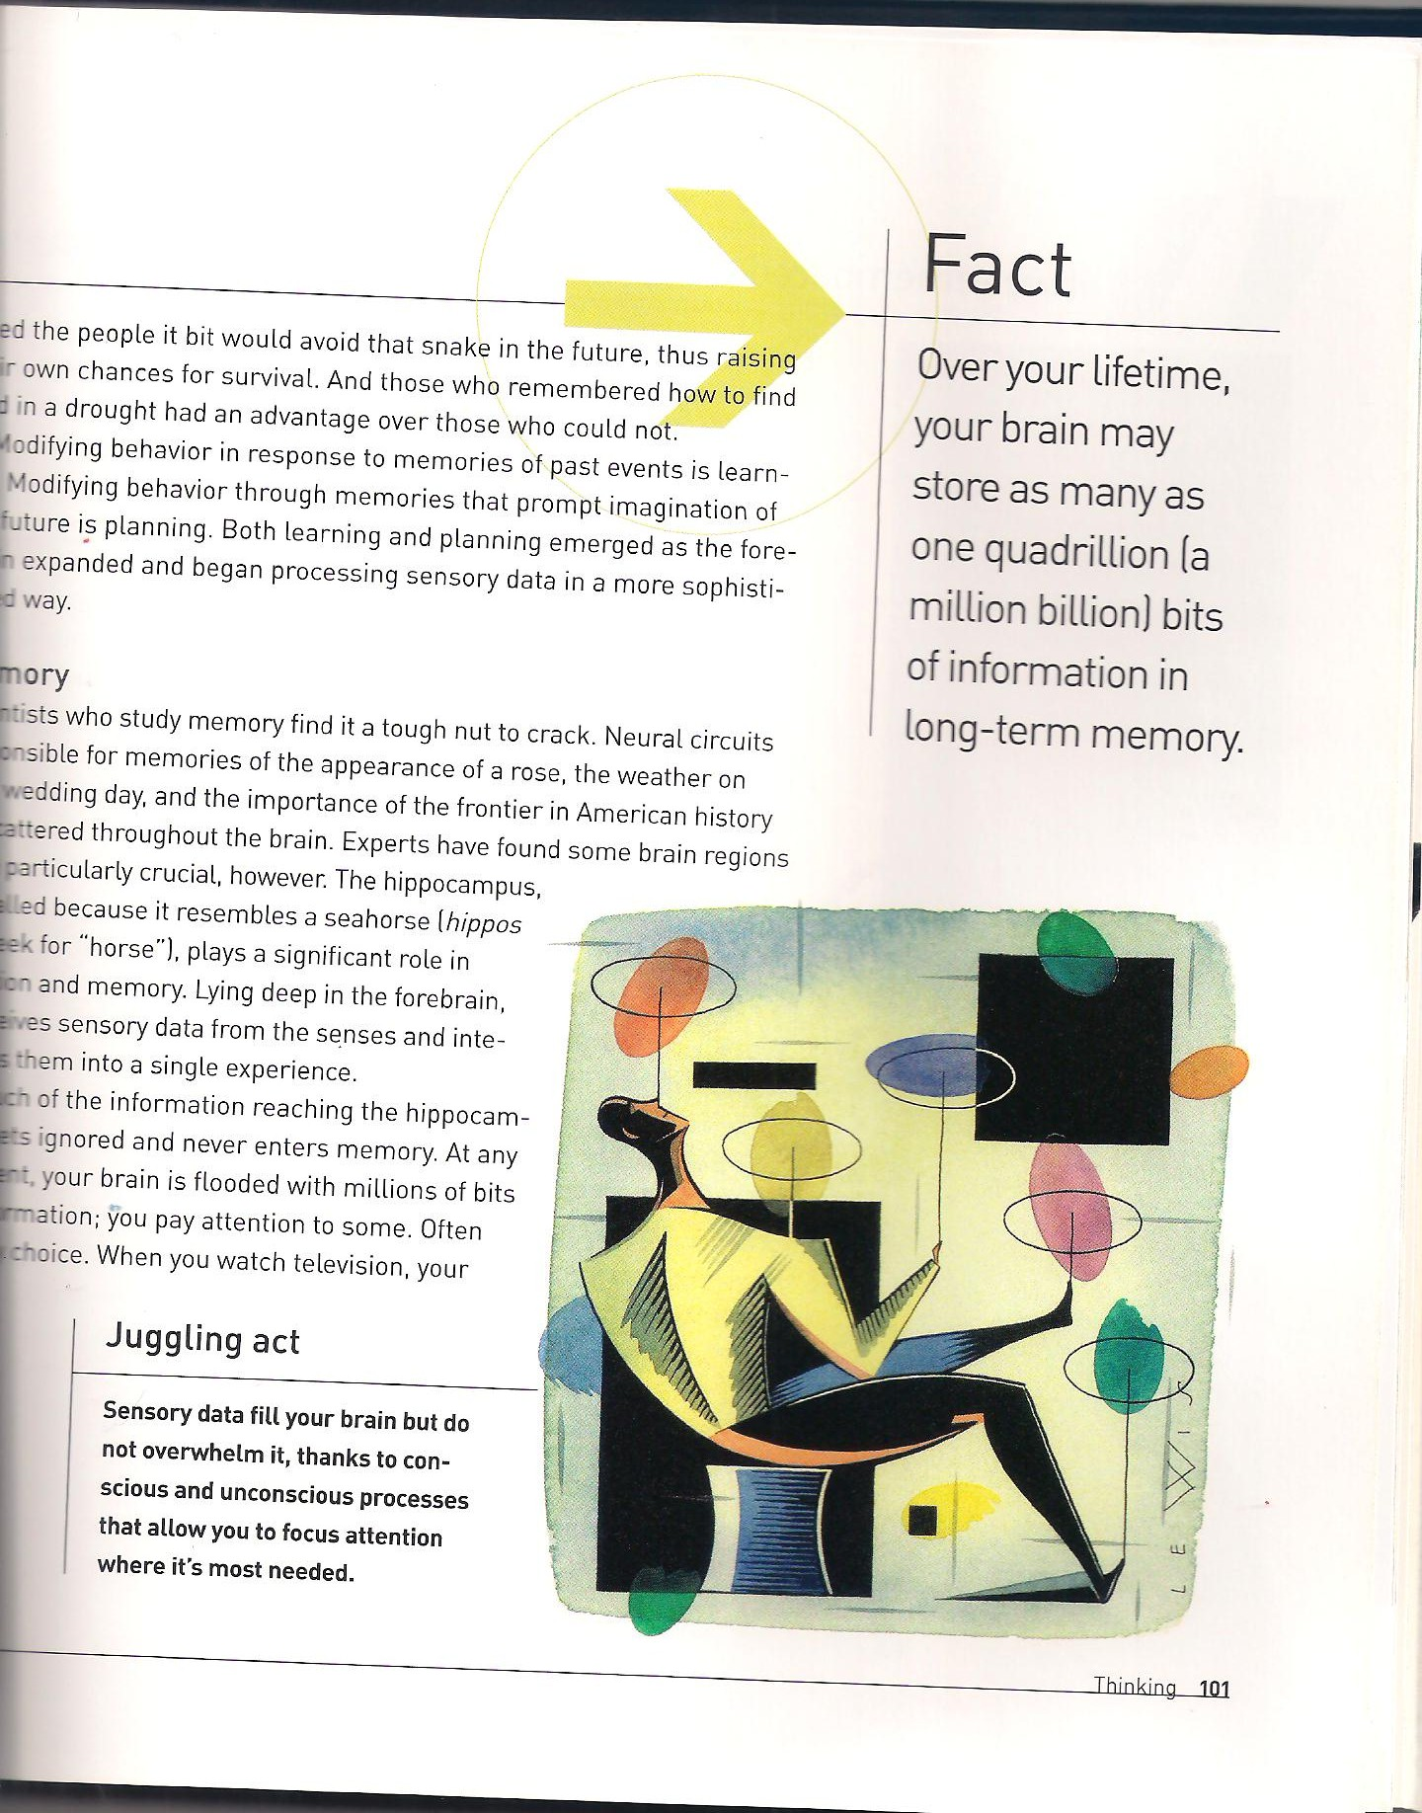
JUGGLING ACT

Slide 24
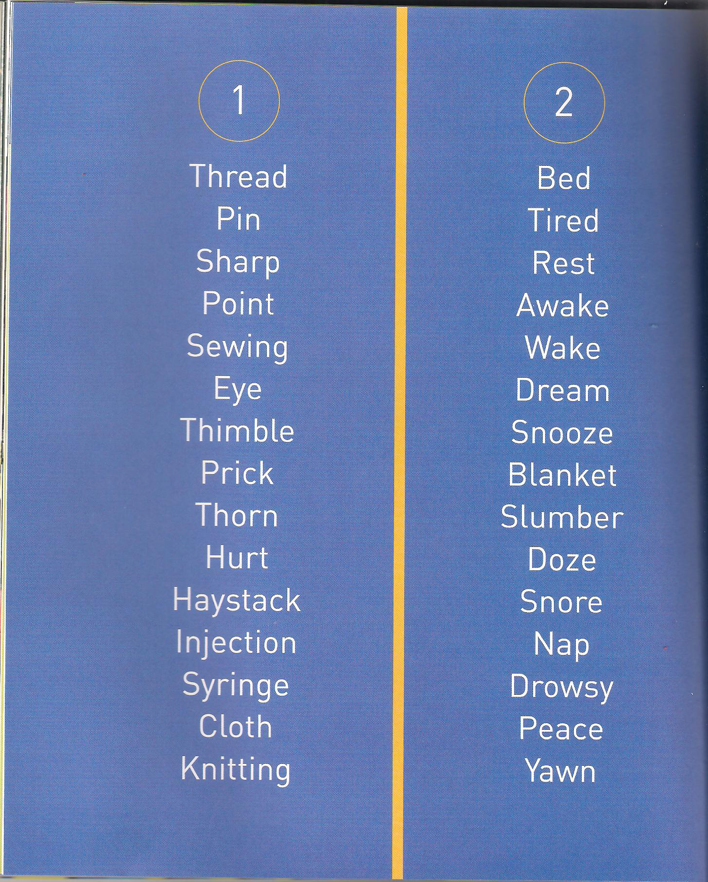
REMEMBERING WORDS

Slide 25
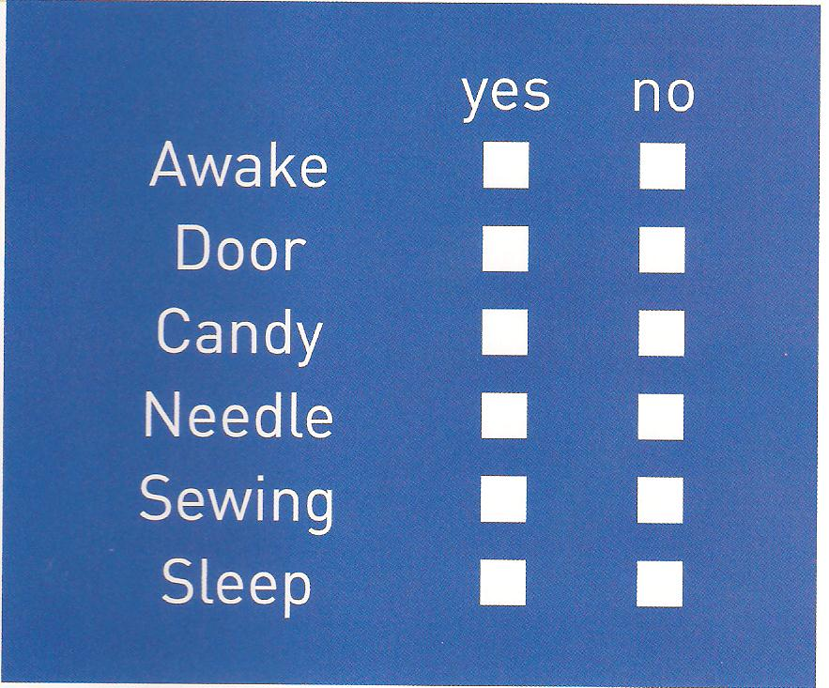
REMEMBERING WORDS

Slide 26
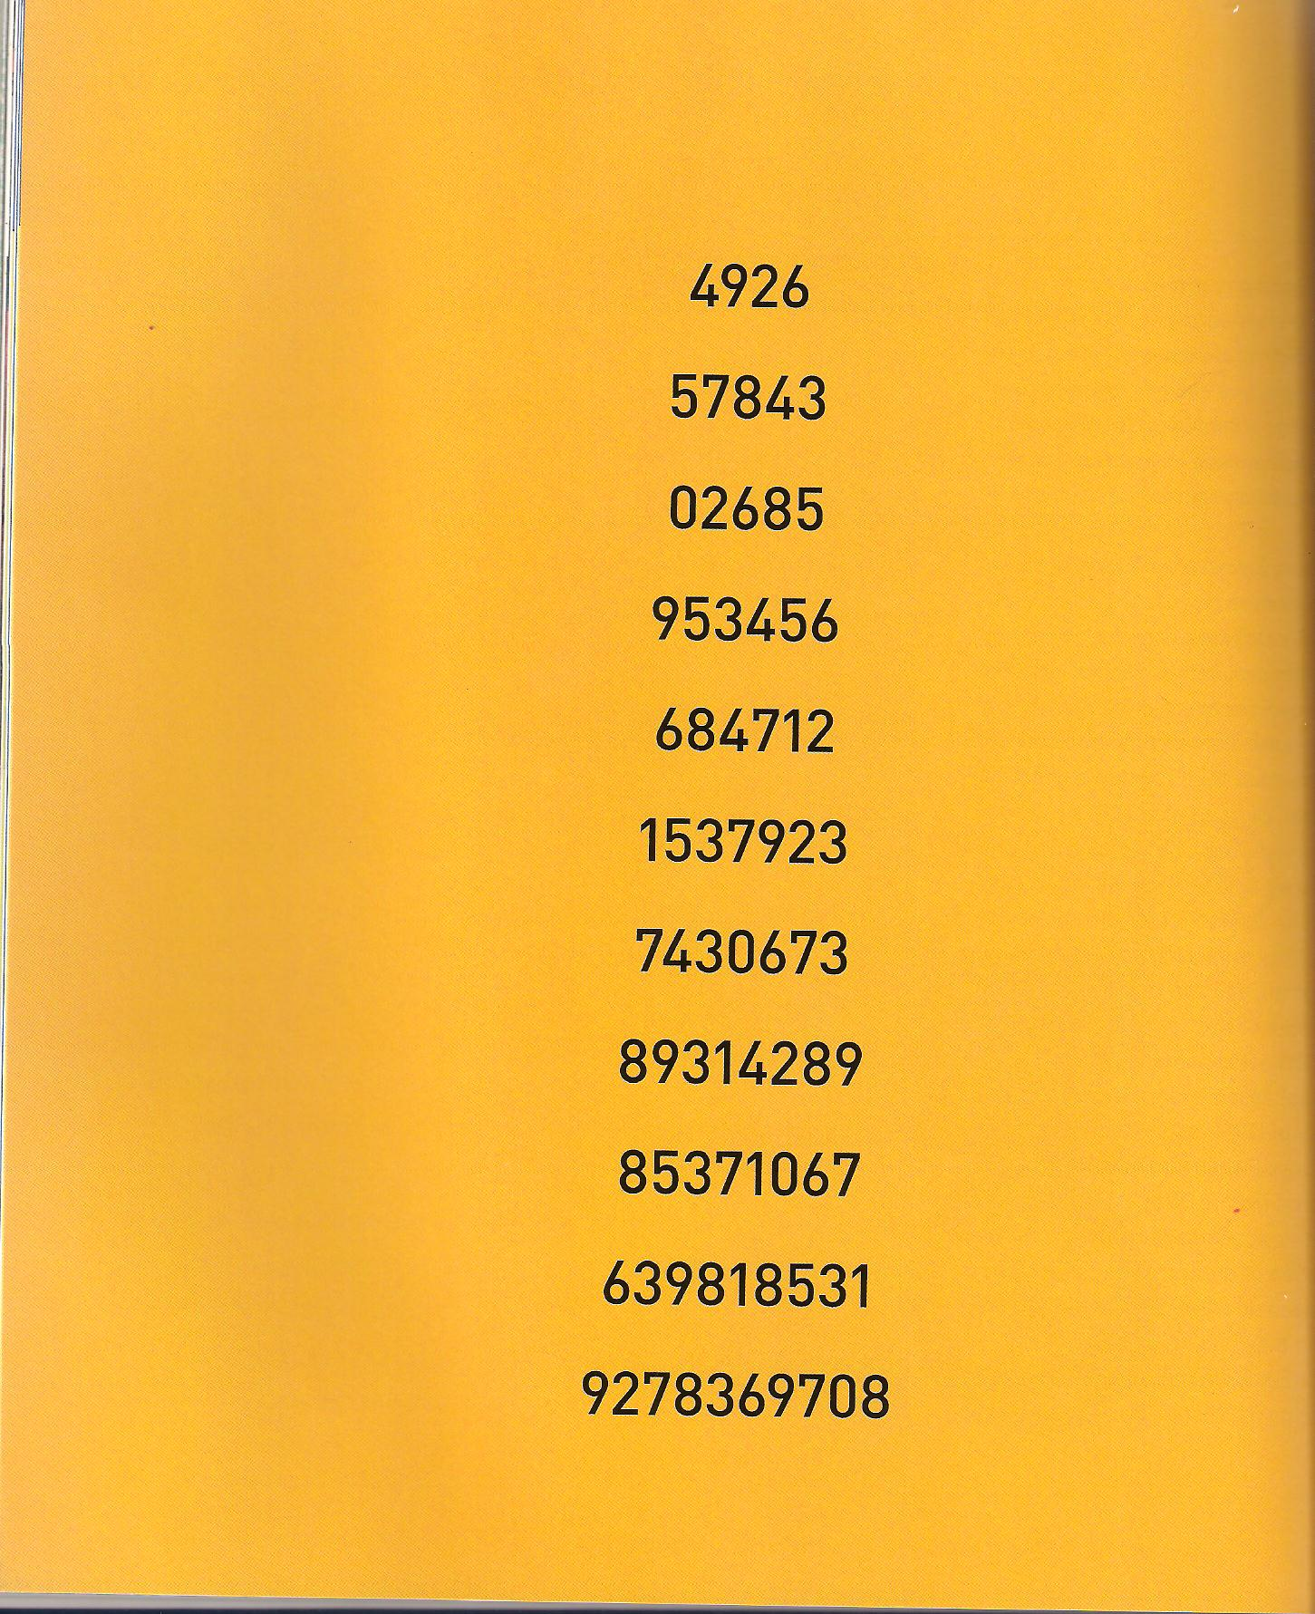
THE POWER OF SEVEN

Slide 27
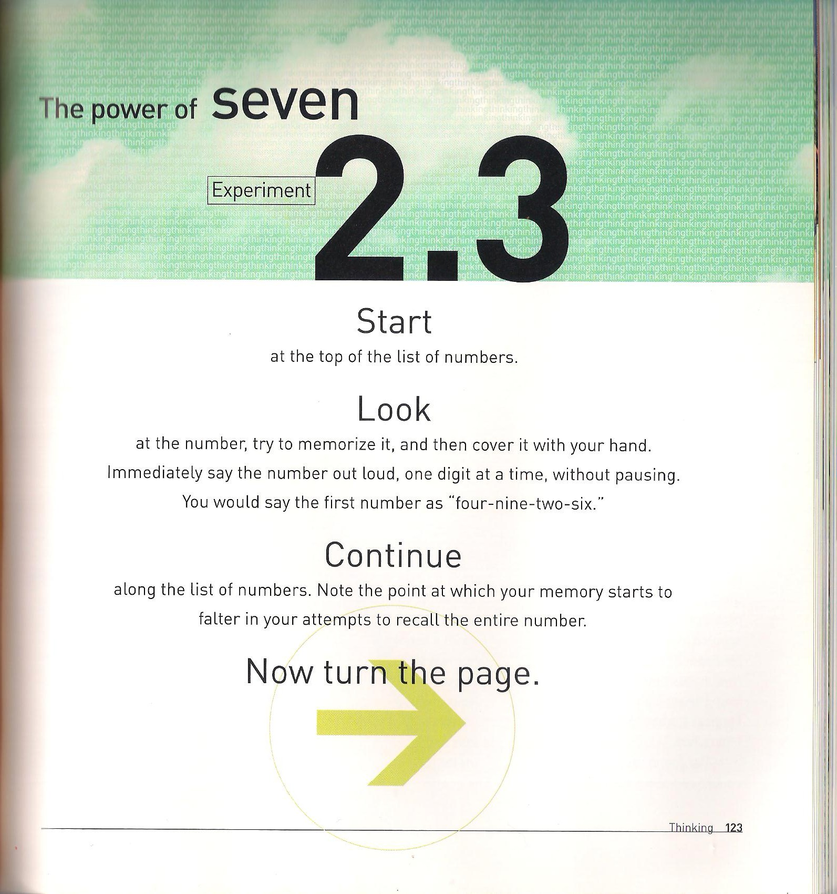
THE POWER OF SEVEN

Slide 28
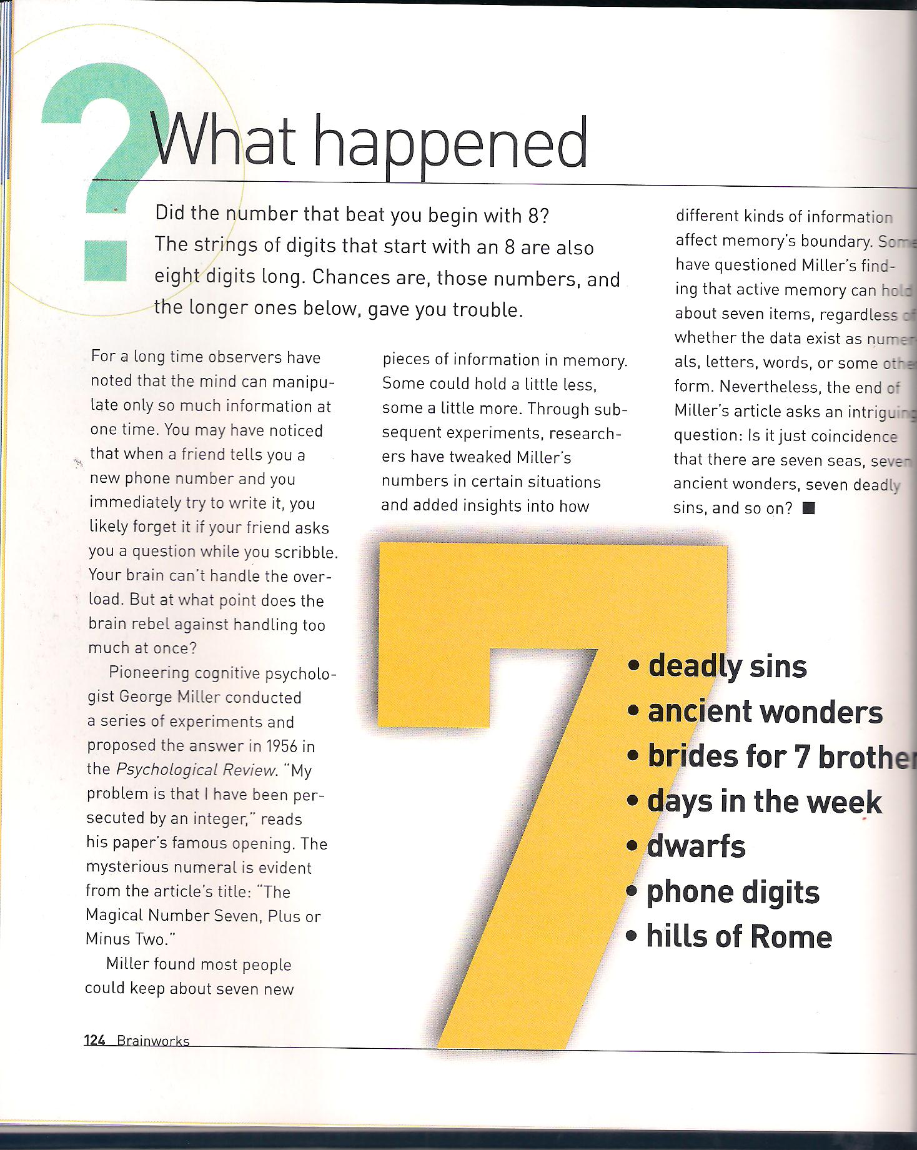
THE POWER OF SEVEN

Slide 29
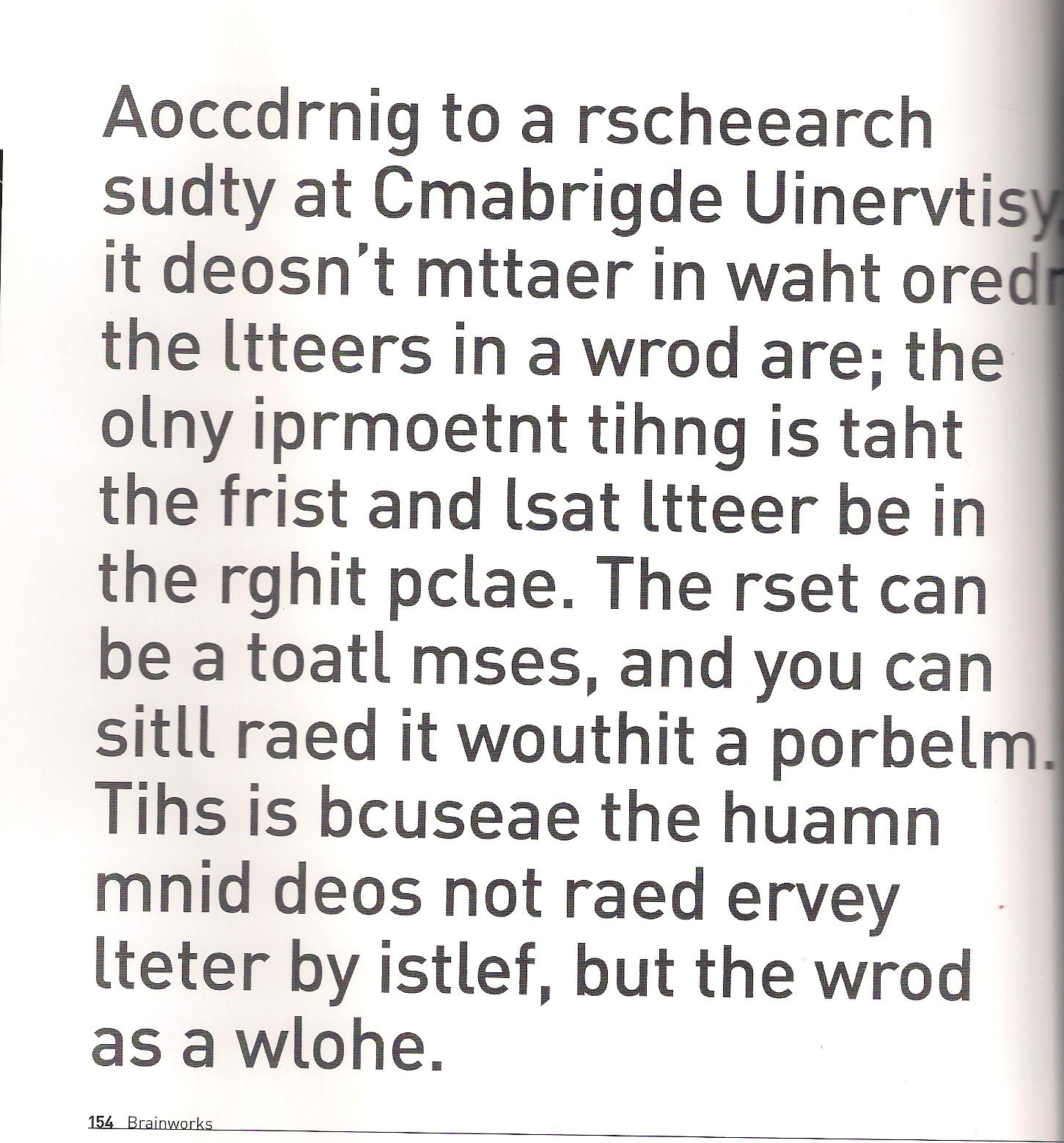
HOW WE READ

Slide 30

ILLUSION OF INTENTION

Slide 31
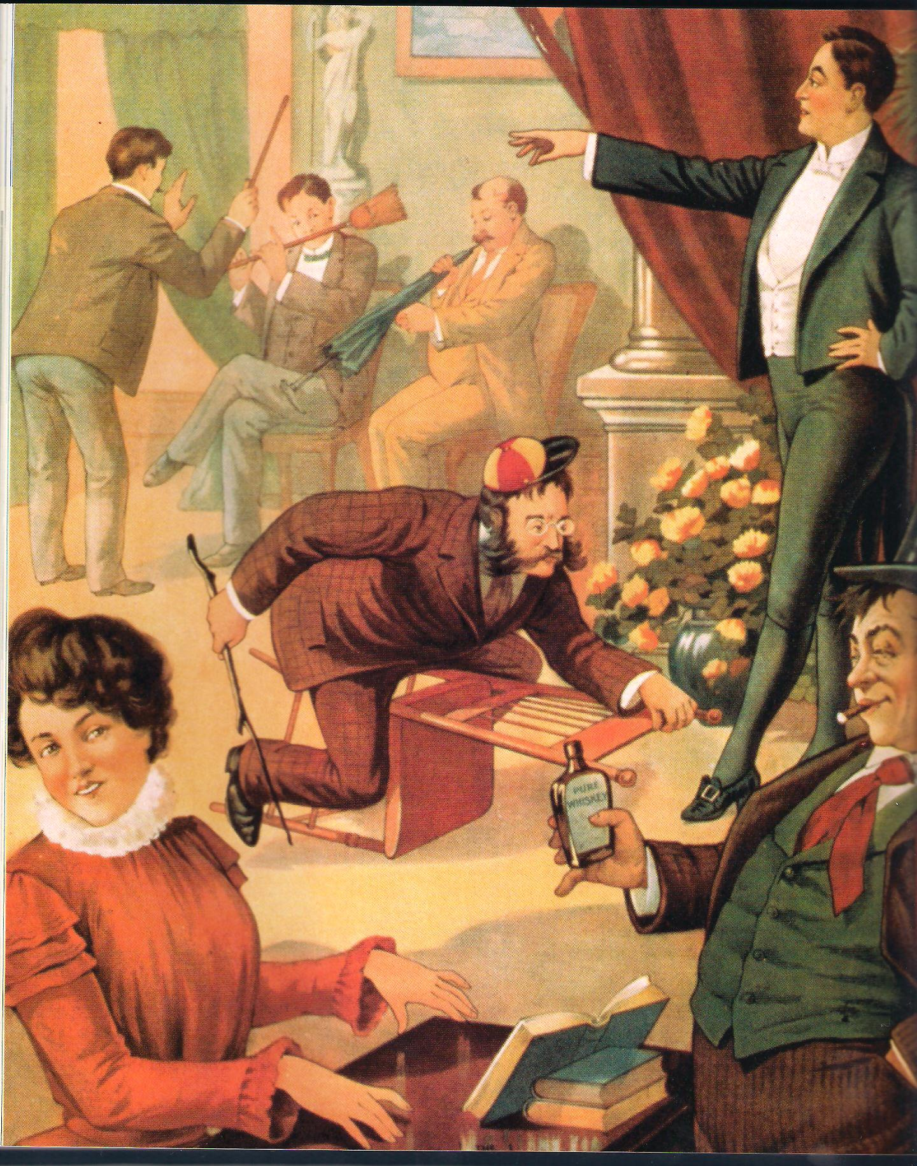
CAUSAL RELATIONSHIPS

Slide 32
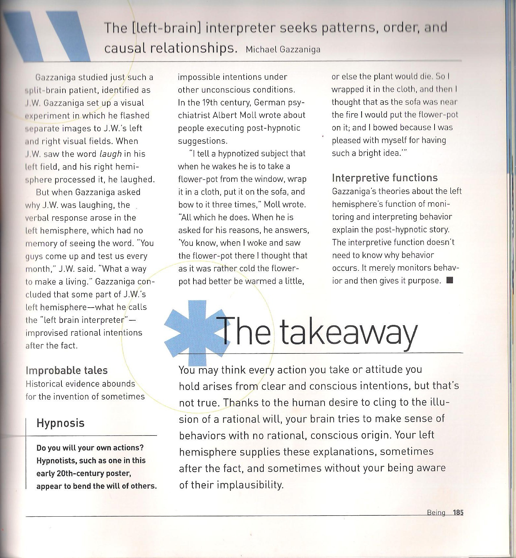
CAUSAL RELATIONSHIPS

Slide 33
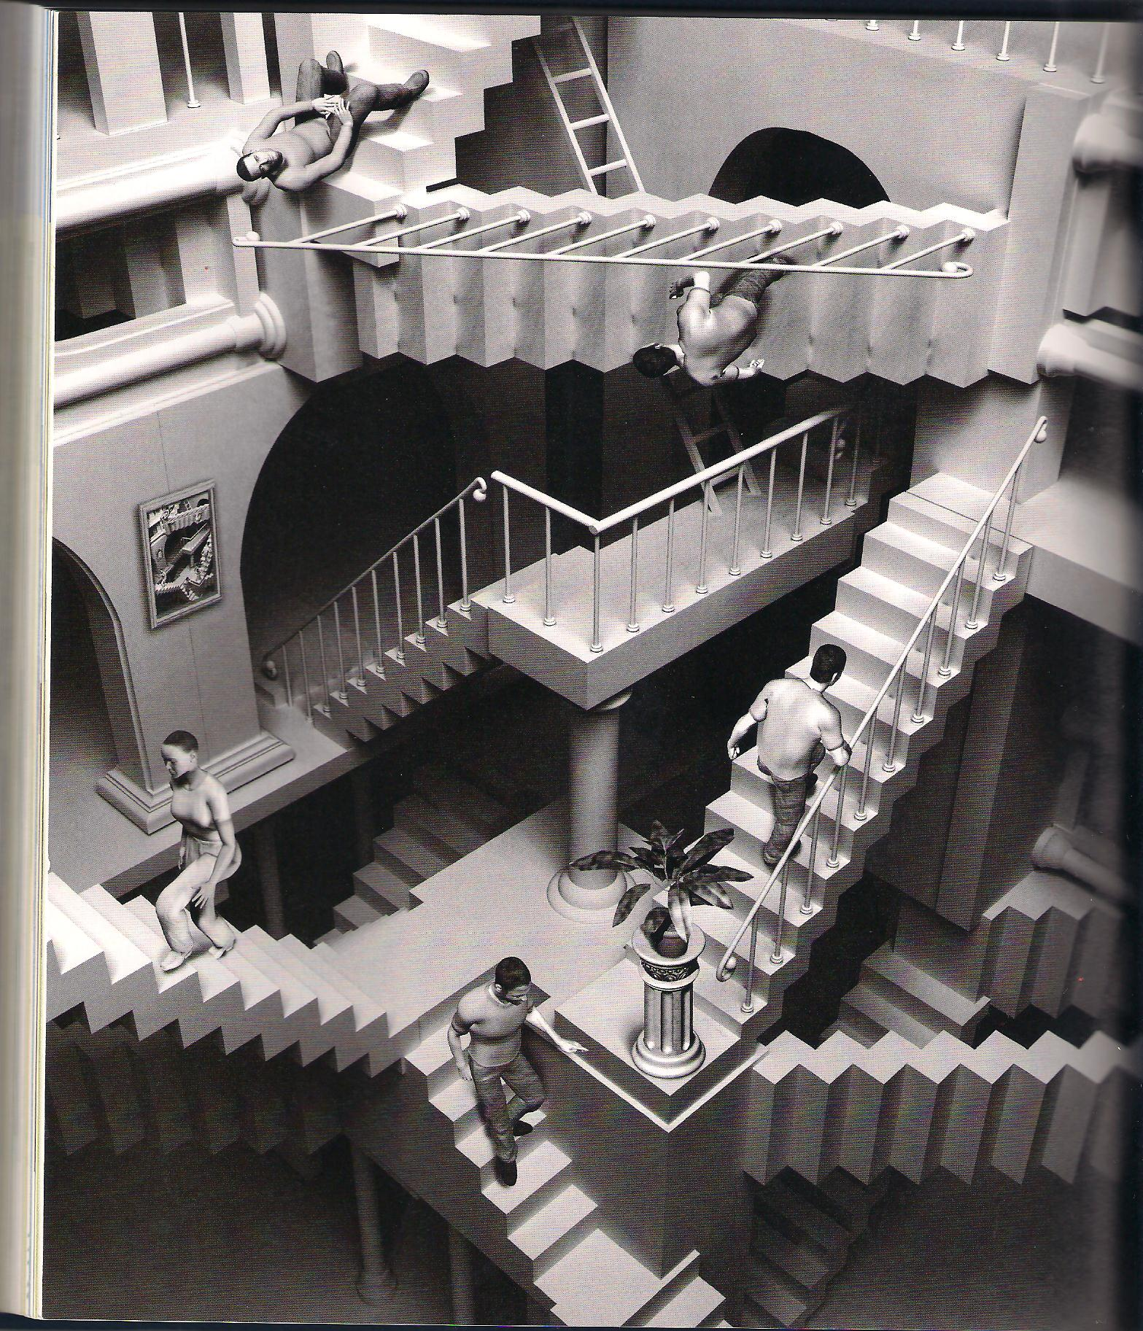
A FINAL THOUGHT

Slide 34
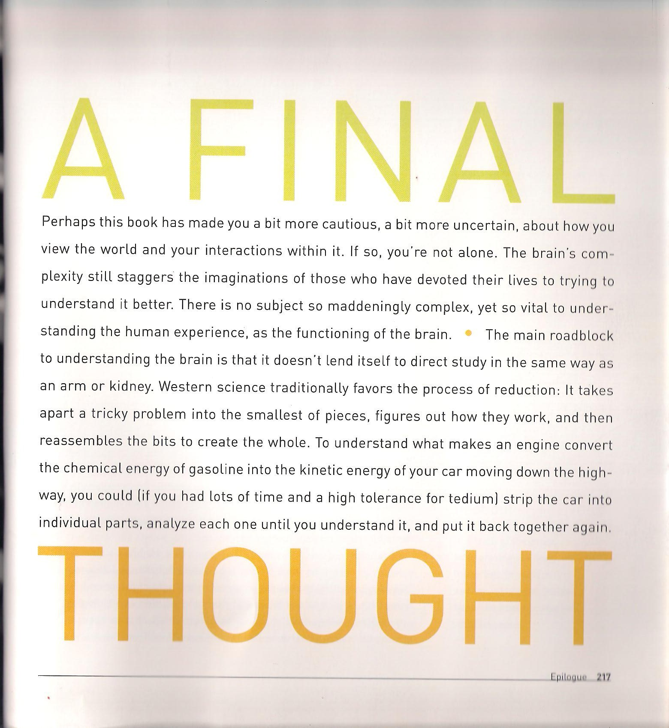
A FINAL THOUGHT

Slide 35
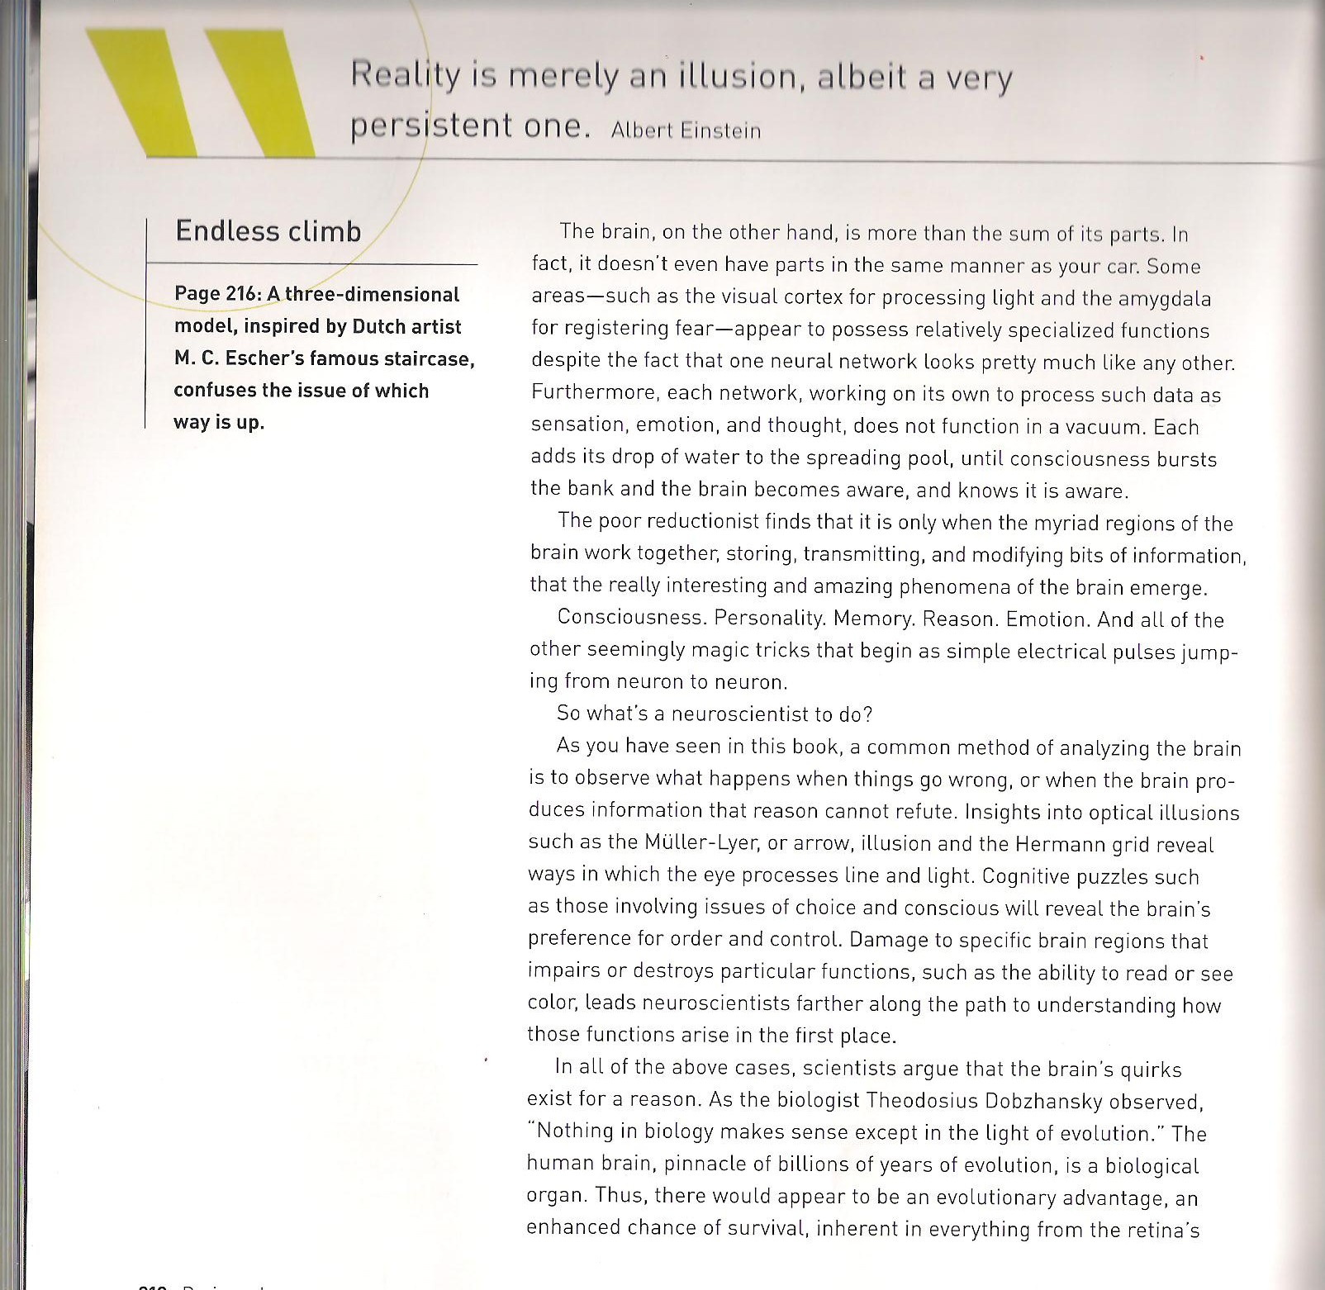
A FINAL THOUGHT

Slide 36
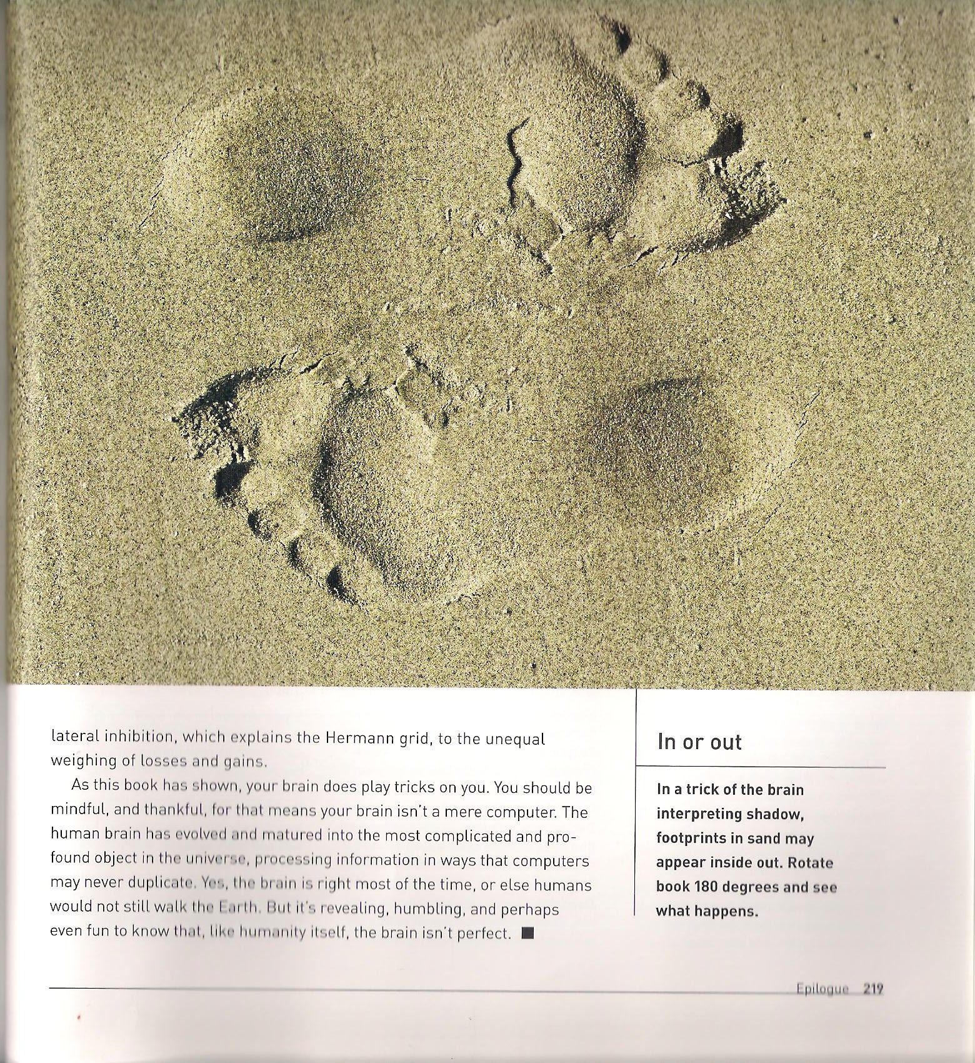
A FINAL THOUGHT

