Slide 1
PERCEPTION & ATTENTION
DR CHITAYI B. MURABULA
LECTURER: DR SOBBIE MULINDI

Slide 2
SCOPE OF PRESENTATION
INTRODUCTION
SENSATION
PERCEPTION
ATTENTION
DISORDERS OF ATTENTION & PERCEPTION

Slide 3
INTRODUCTION
SENSATION – Awareness of stimuli. The stimulation of receptors & transmission of information to the CNS.
PERCEPTION – Organisation of sensory experiences into a meaningful, orderly arrangement of objects and events in time and space.

Slide 4
INTRODUCTION
ATTENTION – Amount of effort exerted on focussing on a certain portion of experience. Ability to sustain focus on one activity. Ability to concentrate.

Slide 5
SENSATION
ATTRIBUTES OF SENSATION
Quality – What distinguishes one sensation from another(generic or specific)
Intensity – strength of stimulus
Duration – how long the sensation lasts
Localization

Slide 6
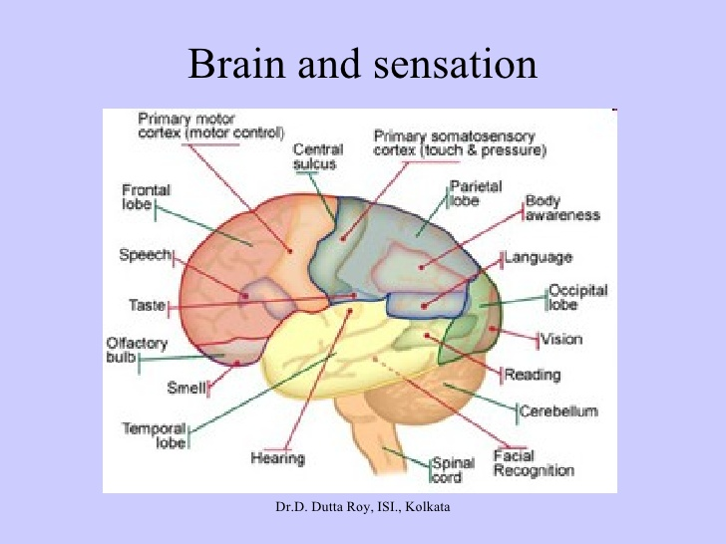
SENSATION
BRAIN AND SENSATION

Slide 7
ORGAN OF VISION

Slide 8
ORGAN OF HEARING

Slide 9
ORGAN OF SMELL

Slide 10
ORGAN OF TASTE

Slide 11
SKIN

Slide 12
SENSATION
STIMULUS detection depends on stimulus intensity.
Stimulus intensity must cross the threshold
3 TYPES OF THRESHOLD
ABSOLUTE – The weakest stimulus which can be detected from no stimulus
DIFFERENTIAL – Individual able to make a difference in magnitude between two stimuli
TERMINAL – Very high intensity of stimulus beyond which no detection is possible.

Slide 13
SIGNAL TRANSDUCTION THEORY
Considers human aspect of perception & sensation
A signal can be distinguished from the background by interaction of the following factors
PHYSICAL – Stimulus intensity
BIOLOGICAL – sensory receptors limitation/fatique
PSYCHOLOGICAL – motivation, expectations and learning

Slide 14
FOUR CONDITIONS FOR SIGNAL DETECTION

Slide 15
PERCEPTION
Functions of the processes of perception – Organise, identify and impose meaning on sensory input.
Organisation of sensory experiences into a cognition – PERCEPT. The outcome of an active process
Individuals organizes perception according to certain principles of pattern perception.

Slide 16
PERCEPTION
The tendancy to organise sensations into a meaningful whole or pattern is called a GESTALT.
Many parts of the sensorium may be added, altered or omitted in the process of forming a gestalt.

Slide 17
FIGURE AND GROUND

Slide 18
FIGURE AND GROUND
We organise the perceptual field according to stimuli that stand out ( figure) and those that are left over ( ground)
Figure – ground segmentation is probabilistic.
Brain takes all relevant cues into account in order to generate a probabilistic best-guess.

Slide 19
CLOSURE

Slide 20
PROXIMITY

Slide 21
SIMILARITY

Slide 22
LINEAR PERSPECTIVE

Slide 23
LINEAR PERSPECTIVE
The further an object is from the viewer the less space it takes up in the visual field.
As an object recedes in the back ground, parallel lines in the object converge.

Slide 25
TEXTURE GRADIENT

Slide 26
INTERPOSITION

Slide 27
INTERPOSITION
An object that partially conceals or overlaps another is perceived to be closer

Slide 28
CONTINUITY

Slide 29
VALUE OF PERCEPTION
SURVIVAL VALUE – Ability to organise sensations into meaningful percept influenced by past experience can enable adaptive action to occur. Eg an object flying towards a person.
ORIENTATION OF INDIVIDUAL IN SPACE – This helps the indovidual to protect himself and take advantage of the external environment.
HELP INDIVIDUAL SUSTAIN ONESELF (combined with memory)– a hunter leaves his shelter and recognises his game when he sees it despite not having seen that animal before

Slide 30
ATTENTION
It [attention] is the taking possession by the mind, in clear and vivid form, of one out of what seem several simultaneously possible objects or trains of thought.
Focalization, concentration, of consciousness are of its essence. It implies withdrawal from some things in order to deal effectively with others, and is a condition which has a real opposite in the confused, dazed, scatterbrained state. – william James (1890)

Slide 31
ATTENTION
Attentional enhancement can be demonstrated for objects, actions, perception of our internal states, thoughts, space and time.
Due to a limited capacity of our information – processing system, its essential that total input is restricted to a manageable level..
Irrelevant information screened out.

Slide 32
SELECTIVE ATTENTION
Selection partly done by stimuli eg loud noises/bright light – attract attention(intesnsity).
Variable stimuli eg flashing lights.
A choice to attend certain stimuli often made eg a safe driver who ignores a scene.

Slide 33
THE SHADOWING EXPERIMENT
Different messages are played into the right and left ear simultaneously
One has to repeat out loud the message in one ear while ignoring the other.
The ‘rejected’ message is not noticed (only physical qualities such as loudness/ softness) but not content.
The limit of the attention determined by the ability of the brain to process information.
If attention is given to a nursery rhyme played in one ear, more content of the rejected message is noticed.

Slide 34
THE COCKTAIL PARTY PHENOMENON
In a cocktail party one will follow a conversation amidst the noise.
However if a person calls out your name, its noticed.
This suggests that the ‘rejected’ input is not entirely excluded.
The brain briefly retains and analyses a great deal of information that we are unaware.
If the analysis indicates that the information is important in some way, its allowed into consciousness.
We monitor our environment for ‘important’ stimuli without our awareness

Slide 35
DIVIDED ATTENTION
Many real life situations impose the need to attend to several inputs at once.
Driving a car while listening to a radio is easier when the music is familiar and the traffic is clear.
In this case there is enough information processing capacity to attend both tasks.
If we have to attend to one fully eg traffic increases/ a down pour ensues, we may not notice the radio.
Attention can also be switched fully from one task to the next in about one second.

Slide 36
ATTENTION & EXPERIENCE
Sensory input that is familiar is processed with little conscious effort
When a skill is learnt thoruoghly it becomes ‘automatic’ requiring less attention
Certain stimuli are important to us hence are likely to be detected
Our experience teaches us what to expect hence what to look out for
This helps us to use our limited capacity to best advantage but unexpected events may not be noticed or attended.

Slide 37
DISORDERS OF PERCEPTION
LOSS OF CONSCIOUSNESS – transient confusion of sensory organisation eg : due to anaesthesia.
ALTERED CONSCIOUSNESS – Can results in misidentification of other persons or believing that one is in a different environment.
Brain damage can lead to disorders of perception eg:
DYSPRAXIA – Difficulty in carrying out coordinated voluntary movements
AGNOSIA – Objects cannot be identified correctly in the absence of peripheral sensory deficit

Slide 38
DISORDERS OF PERCEPTION
CONSTRUCTIONAL DYSPRAXIA – Inability to reproduce visual patterns by copying or the completion of a jig saw.
HALLUCINATION – Perceptual experience without the presence of appropriate sensory stimulation
Depressed persons – may complain that food has no taste and colours are dull.
PHOBIC PATIENTS – regularly have illusory experiences that trigger their fears
NB – First visual impressions are of primary importance in our perception of others

Slide 39
DISORDERS OF ATTENTION
CONFUSIONAL STATE(DELIRIUM) - a global change in mental status wherein the principal cognitive deficit is a change in the overall attentional tone.
Symptoms : incoherent thinking, distractibility, perceptual disturbances(hallucinations, delusions), dyscoordination, delusions, impaired judgement, poor insight & agitation.
Associated cognitive deficits – anomia, dysgraphia, dyscalculia, constructional difficulties

Slide 40
DISORDERS OF ATTENTION
CONFUSIONAL STATE(DELIRIUM)
usually No lateralizing neurological signs
primary motor & sensory functions intact
focal neurological signs if delirium due to intrinsic CNS disease eg stroke
Focal anatomical regions associated with delirium – parahippocampal-fusiform-lingual gyrus.

Slide 41
DISORDERS OF ATTENTION
DIAGNOSTIC CLASS | EXAMPLES AND ADDITIONAL INFORMATION
Toxic metabolic encephalopathy | Renal insufficiency, liver failure , Sepsis, endocrine disorders, severe anemia, water/electrolyte disturbance, drug withdrawal & intoxication
Environmental stressors | Circadian rhythm disturbances(eg ICU), Immobilization, sensory deprivation (eg sudden change in hearing/vision
Multifocal Brain Lesions | Meningitis, encephalitis, closed head injury, multiple strokes (eg shower of embolism), SAH
Epilepsy | After a generalized seizure or during non-convulsive status epilepticus.
Space Occupying Lesion | Subdural hematoma
Focal Brain Lesions | Lesions of the parahippocampal-fusiform-lingual gyri in either cerebral hemisphere, or right-sided lesions of the posterior parietal and inferior prefrontal cortex

Slide 42
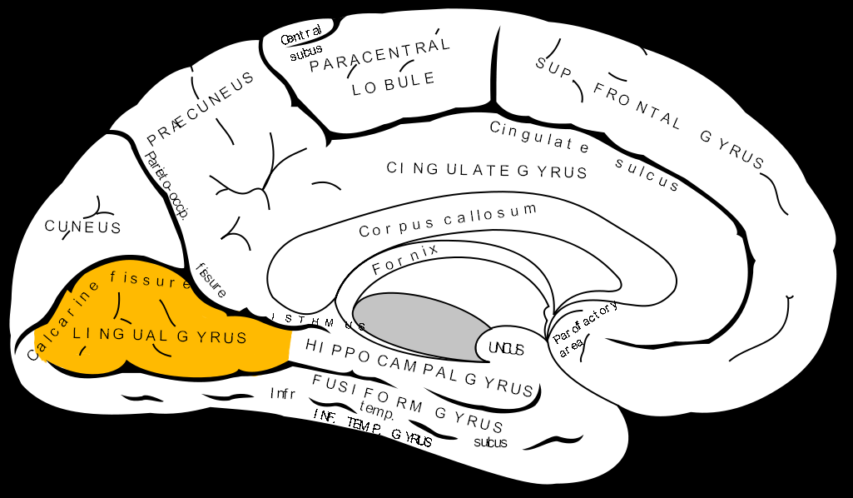
DISORDERS OF ATTENTION
PARAHIPPOCAMPAL-LINGUAL-FUSIFORM GYRUS

Slide 43
DISORDERS OF ATTENTION
PARTIAL ATTENTIONAL SYNDROMES
Present as reduced performance in any of the cognitive domains.
Changes in visual based attention – result in reduced detection of stimuli in the environment
changes in language-based attention could present as reduced verbal fluency

Slide 44
DISORDERS OF ATTENTION
HEMI-SPATIAL NEGLECT
inability of the patient to orient towards, respond to, or report on, stimuli on the contralesional side of space
Neglect is a multimodal deficit and may affect any or all sensory modalities, motor behaviours or even the internal representations of memories and other thoughts
More severe & frequent following a right hemisphere injury.
When accompanied by a motor deficit , the patient may deny any problem with affected limb – anosognosia.
Lesions in posterior parietal cortex/temporoparietal junction, frontal eye fields, cingulate and supplementary motor cortex, basal ganglia, thalamus, midbrain and superior colliculus.

Slide 45
ATTENTION DISORDERS
ATTENTION DEFICIT HYPERACTIVE DISORDER - a neurodevelopmental disorder affecting both children and adults. It is described as a “persistent” or on-going pattern of inattention and/or hyperactivity-impulsivity that gets in the way of daily life or typical development. Individuals with ADHD may also have difficulties with maintaining attention & executive function
There are three presentations of ADHD: Inattentive Hyperactive-impulsive Combined inattentive & hyperactive-impulsive

Slide 46
ATTENTION DISORDERS
INATTENTIVE SYMPTOMS IN ADHD
Fails to give close attention to details or makes careless mistakes.
Has difficulty sustaining attention.
Does not appear to listen.
Struggles to follow through on instructions.
Has difficulty with organization.
Avoids or dislikes tasks requiring a lot of thinking.
Loses things.
Is easily distracted.
Is forgetful in daily activities.

Slide 47
ATTENTION DISORDERS
HYPERACTIVE-IMPULSIVE SYMPTOMS IN ADHD
Fidgets with hands or feet or squirms in chair.
Has difficulty remaining seated.
Runs about or climbs excessively in children; extreme restlessness in adults.
Difficulty engaging in activities quietly.
Acts as if driven by a motor; adults will often feel inside like they were driven by a motor.
Talks excessively.
Blurts out answers before questions have been completed. Difficulty waiting or taking turns.

