Slide 1
Structure of Biomolecules
Biomolecules -organic cpds of the various parts of the cell
Formed from key elements (C, H, N, O, P, S)
Varies in chemical structure & reactivity based on the type of elements
Most bio-molecules have more than one functional group – determines the chemical and physical properties .
Biomolecules important
carry out the chemical reactions for an organism to grow,
maintain and reproduce
use and store energy.
Appr.10, 000 kinds bio-molecules in animal and plant cells

Slide 2
Hierarchy of biological organization
Five level of biomolecular organisations
Level 1: Elements
Made up by combination of various elements (C, H, N, O, P, S)
Level 2: Micromolecules (monomeric units)
Amino acids
Sugars
Fatty acids
Nucleotides
Level 3: Macromolecules (polymeric units) :
Protein
Lipids
Carbohydrates
Nucleic acids
Level 4: Supramolecular complexes e.g.
Chromosomes
Plasma membrane
Cell wall
Level 5: The cell and its organelles

Slide 3
Hierarchy of biological organization
Elements
about 28 chemical elements occur naturally in biological material
Three major categories of elements based on importance:
Major elements
found in bulk form -make up 92% of the dry wt of organisms
are essential for life:
Include C, H, O, N, P, S
Trace elements
Found in trace quantities
very likely essential for life:
Include Ca, Mn, Fe, I.
Others like As, Br, Mo. may also be essential for life

Slide 4
Hierarchy of biological organization
Micromolecules
building block (monomeric) units of polymers
made up from simple elements-
C, O, N & H are the major elements
versatile but limited in number in most organisms
Each performs different function in the cells.
Organisms share the same micromolecules
Organisms are unique based on the arrangement of micromolecules into polymers
An immense variety of polymers can be built from a small set of monomers

Slide 5
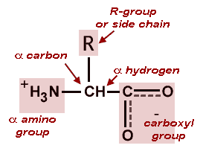
MAJOR CLASSES OF MICROMOLECULES
Amino acids
Building blocks of proteins.
20 commonly occurring amino acids.
Consist of an amino carboxyl & R-group
R-group (side chains) determines
a.a chemical properties
protein folding & its biological function.
Nucleotides
Building blocks of nucleic acids- DNA &RNA
Consists of nitrogenous bases, pentose sugar and a phosphate group
Notes:
5

Slide 6
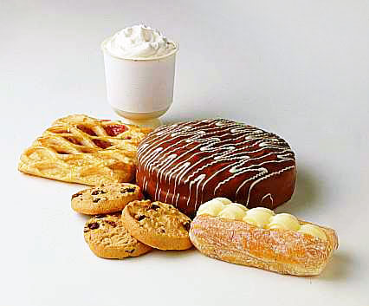
MAJOR CLASSES OF MICROMOLECULES
Sugars
Basic unit is the monosaccharide
most abundant organic molecules.
Initially synthesized in plants -photosynthesis.
polymerises to form polysaccharides e.g. glycogen, starch or cellulose.
Fatty acids
Long chain monocarboxylic acids with even number C atoms
Two types: saturated or unsaturated (C-C db)
Notes:
6

Slide 7
Hierarchy of biological organization: Macromolecules
long complex molecules consisting of identical monomeric subunits joined by covalent bonds
Major cellular macromolecules include:
Carbohydrates/ polysaccharides –
chains of simple re-curing sugar units.
Functions of polysaccharides
Store energy in the form of starch or glycogen (in animals & humans respectively.
Energy provision thro. metabolic pathways &cycles.
Supply carbon for synthesis of other cpds
Form structural components in cells & tissues.
Involved in intercellular communications

Slide 8
Hierarchy of biological organization
Proteins-
chains made from 20 different kinds of amino acids
Individual a.a in protein connected by peptide bond to form a polypeptide
Proteins are act as
transport proteins
structural proteins
enzymes
Antibodies
cell receptors

Slide 9
MACROMOLECULES
Lipids
Lipids are formed from fatty acids
several lipid molecules:-triacylglycerol, streiods (cholestrol esters), fat soluble vitamins phospholipids
Functions of lipids
Storage of energy in the form of fat
Membrane structures
Insulation (thermal blanket)‏
Synthesis of hormones Nucleic acids-
polymer of different types of nucleotides units
Nucleic acids and proteins -informational macromolecules –the sequence of their monomers determines the genetic individuality of species.
Non-informational – Polysaccharides consist of single repeating units.

Slide 10
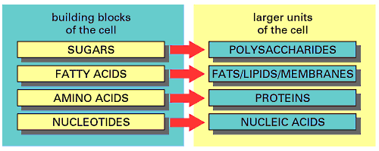
Monomers and their polymers

Slide 11
Supramolecular complexes
Organized clusters of macromolecules such as
Cell membranes: complexes of proteins & lipids.
Chromatin: complexes of DNA and proteins.
Ribosomes: complexes of RNA and proteins.
Viruses: single DNA or RNA molecule in a protein package.
Association of macromolecules in supramolecular complexes , are held by intermolecular interactions eg
H-bonds (between polar groups)‏
Ionic interactions (between charged groups)‏
Hydrophobic interactions (among non polar groups in aqueous solutions)‏
Van der-waals interactions
Notes:
11

Slide 12
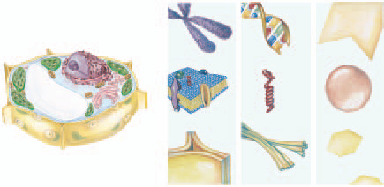
HIERARCHY OF BIOMOLECULES
Level 5 :
The cell & its organelles
Level 4 : supramolecules
Level 3: Macromolecules
Level 2: Biomolecules

Slide 13
Hierarchy of biomolecular organisation :
Cells
Basic structural units of living organisms
Highly organized structures
Requires constant source of energy to maintain the ordered state.
Each cell
produces and uses energy
communicates with other cells in various ways
undertakes building projects
removes waste products.

Slide 14
Hierarchy of biomolecular organisation :
Cells
Living processes contains thousands of chemical rxns.
Precise regulation and integration of these rxns are required to maintain life
Certain important rxns, e.g. glycolysis is found in almost all organisms.
All organisms use the same type of polymers: CHO, proteins, lipids & nucleic acids.
Instructions for growth, reproduction and developments for each organism is encoded in their DNA

Slide 15
ENERGY FOR CELLS
Living cells are inherently unstable.
Constant flow of energy prevents them from becoming disorganized.
Cells obtains energy mainly by the oxidation of bio-molecules (e- transferred from 1 molecule to another and in doing so they lose energy)
This energy captured by cells & used to maintain highly organized cellular structure and functions
Notes:
15

Slide 16
HOW DO COMPLEX STRUCTURE OF CELLS MAINTAIN HIGH INTERNAL ORDER?
Synthesis of new bio-molecules
Transport Across Membranes
Cell membranes regulate the passage of ions and molecules from one compartment to another.
3. Cell Movement
Organised movement- most obvious characteristics of living cells. The intricate and coordinated activities required to sustain life require the movement of cell components.
4. Waste Removal
Animal cells convert food molecules into CO2, H20 & NH₃. If these not disposed properly can be toxic.
Notes:
16

Slide 17
BIOCHEMICAL REACTIONS
Metabolism:
total sum of enzyme catalyzed reactions in a living organism
Two types
Anabolism- energy requiring biosynthetic pathways
Catabolism- degradation of fuel molecules for production of energy for cellular function
The primary functions of metabolism are:
Acquisition & utilization of energy
Synthesis of biomolecules (i.e. proteins, nucleic acids, lipids, & CHO ) needed for cell structure& functioning
Removal of waste products
Notes:
17

Slide 18
COMMON REACTIONS IN BIOCHEMICAL PROCESSES
The types of biochemical reactions are few with simple reaction mechanisms
Reactions of central importance (for energy production & synthesis and degradation of major cell components) are relatively few in number
Nucleophilic Substitution
One atom of group substituted for another
Elimination Reactions
One or more atoms may be removed from a molecule creating a double or triple bond
Addition Reactions:
Two molecules combine to form a single product.
Hydration Reactions
Water added across a double bond
Eg addition of water on db of an alkene to generate an alcohol
Notes:
18

Slide 19
COMMON REACTIONS IN BIOCHEMICAL PROCESSES
Isomerization Reactions.
intramolecular shift or rearangement of atoms or groups within a compound to generate isomeric forms
Redox (oxidation-reduction) reactions
transfer of e- from a donor to an electron acceptor
Hydrolysis reactions
Cleavage of double bond by water.
Notes:
19

Slide 20
Making or Breaking Polymers
Similar chemical mechanisms for making and breaking of all cellular macromolecules
Condensation
A chemical reaction that joins monomers into polymers by covalent bonds.
Reactions occurs between a hydroxyl group of one monomer and the hydrogen of the other
water is formed and released in the process
An enzyme catalysed reactions
An energy requiring process

Slide 21
Making macromolecules
Condensation reaction

Slide 22
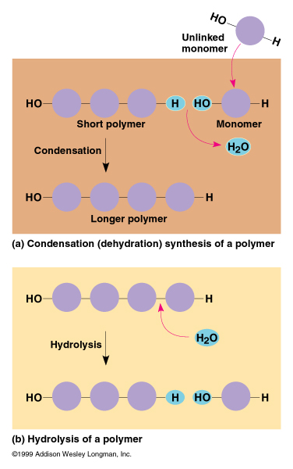
Condensation reaction

Slide 23
Hydrolysis
Hydro- water , Lysis - to split
Breakdown of macromolecular polymers into monomers by adding water across the bond.
Involves disassembling of covalent bonds in a polymer to form monomers
the covalent bond is broken
a hydrogen and hydroxyl groups from a split water molecule attaches across the cleaved bond
important in the the digestive process
specific enzyme catalysed reactions

Slide 24
Hydrolysis.

Slide 25
