Slide 1

Amino Acids, Polypeptides & Proteins

Slide 2
Amino Acids
building blocks of proteins
Joined in a long structure to form proteins
20 amino acids make-up proteins
Known as standard, primary, common or normal
The sequence of a.a in proteins is determined genetically
Several other amino acids and amino acid derivatives are also found in the body
These other a.a can be found in free or in combined states
    i.e. not associated with peptides or proteins.

Slide 3
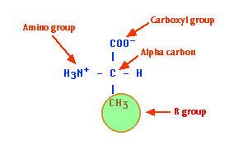
Basic structure of an Amino Acid
Central α-carbon covalently bonded to the following
Hydrogen atom
  An amino (-NH2) group
  Carboxyl (-COOH) group
  Variable R group also known as the side chain specific to each amino acid

Slide 4
Basic structure of an Amino Acid
Distinguishes an a.a from one another
properties of a.a differ due to side chains/R groups
Variation of the side group accrues from
      Shape
      Size
      Hydrogen bonding
      capacity,
      Charge density
COO⁻
+
H₃N
C
H
CH₃
Alanine
Ala

Slide 5
Abbreviations and Codes for 20 primary amino acids
Leucine Leu
Lysine Lys
Methionine Met
Phenylalanine Phe
Proline Pro
Serine Ser
Threonine Thr
Tryptophan Trp
Tyrosine Tyr
Valine Val
Alanine Ala
Arginine Arg
Asparagine Asn
Aspartic acid Asp
Cysteine Cys
Glutamine Gln
Glutamic Acid Glu
Glycine Gly
Histidine His
Isoleucine Ile

Slide 6
Classification of amino acids
Polarity of the R group
  4-main groups
Hydrophobic amino acids
  Nonpolar (hydrophobic)
  side chains are mainly hydrocarbons ( made of C and H only)
  Reside/hidden predominantly in the interior of protein structure to minimize exposure to water.
  not ionize nor participate in the formation of H-bonds.
  Include amino acids with
      hydrocarbons -Ala, Met, Val, Leu, and Ile
      Aromatic nonpolar amino acids-Trp & Phe
      Imino acid- proline
6

Slide 7
Aliphatic nonpolar amino acids:
Ala, Met, Pro
COO⁻
COO⁻
COO⁻
+
+
+
H₃N
C
H
H₃N
C
H
H₂N
C
H
CH₃
CH₂
CH₂
CH₂
CH₂
CH₂
Alanine
Ala
S
Proline
Pro
CH₃
Methionine
Met

Slide 8
Aliphatic nonpolar amino acids:
Val, Leu, and Ile
COO⁻
COO⁻
COO⁻
+
+
+
H₃N
C
H
H₃N
C
H
H₃N
C
H
CH
CH₂
H
C
CH₃
CH₃
CH₃
CH
CH₂
Valine
Val
CH₃
CH₃
CH₃
Leucine
Leu
Isoleucine
Ile
Notes:
Valine has 2 methyl groups added to Ala
Leu has 4 carbons in the side chain.
Ile is a structural isomer of Leu (4 carbons in the side chain, but is bulkier than Leu near the base of the side chain while Leu is bulkier than Ile farther out on the side chain. Ile has a second chiral center.

Slide 9
Aromatic nonpolar amino acids: Tyr, Trp and Phe
COO⁻
COO⁻
COO⁻
+
+
H₃N
C
H
+
H₃N
C
H
H₃N
C
H
CH₂
CH₂
CH₂
C
CH
NH
Amphipathic-
polar group- NH- H-bonds
OH
Phenylalanine
Phe
Amphipathic-
OH group
Tyrosine
Tyr
Tryptophan
Trp
Most hydrophobic

Slide 10
Hydrophilic (polar amino acids)
Have no net charge at physiolgical pH
tend to interact with water- have R-groups that can form H- bonds with H2O
more soluble in water except Tyr
predominantly found on the exterior surfaces proteins or in the enzyme active sites.
Polar, uncharged amino acids
Includes amino acids with
  Alcohol ( hydroxyl R-groups (Ser, Thr, Tyr)
  Amide groups: Asn and Gln
  Sulfhydryl group: Cys .
    Cys can form a disulfide bond (2 cysteines can make one cystine trough a disulfide link)

Slide 11
Polar, uncharged amino acids
COO⁻
COO⁻
COO⁻
COO⁻
+
+
+
+
H₃N
C
H
H₃N
C
H
H₃N
C
H
H₃N
C
H
H
CH₂
H
C
OH
CH₂
Glycine
Gly
OH
CH₃
Serine
Ser
Threonine
Thr
OH
Polarity of Ser, Thr & Tyr is due to the hydroxyl group
Tyrosine
Tyr

Slide 12
Polar, uncharged amino acids
COO⁻
COO⁻
+
+
H₃N
C
H
H₃N
C
H
CH₂
CH₂
C
CH₂
O
NH₂
C
Asparagine
Asn
N
O
NH₂
Glutamine
Gln
Q
12

Slide 13
Functions of polar uncharged groups
Polar a.a are important since they
  provide chemical groups that can interact with water.
  Able to form H-bonds the key in forming protein structures.
  the ionic bonding character of charged polar a.a is also important in maintaining protein structures.
  provide chemically reactive groups in proteins.

Slide 14
Acidic Amino acids
  Also known as dicarboxylic acids
  R-group contains a carboxyl group
  Polar with a net negative charge at physiological pH(negatively charged pH > 3)
  Include Asp and Glu
  Negative charges play roles such as
    Metal-binding sites during enzyme catalysis
    Carboxyl groups may act as nucleophiles in enzymatic interactions
    Electrostatic bonding interactions

Slide 15
Charged polar (acidic) side chains
COO⁻
COO⁻
+
+
H₃N
C
H
H₃N
C
H
CH₂
CH₂
CH₂
C
O
O⁻
C
O
O⁻
Aspartic acid
Asp
Glutamic acid
Glu

Slide 16
Basic amino acids
  R-group have net positive charges at pH 7
  Include His, Lys, and Arg
  Lys and Arg are fully protonated at pH 7
    Participate in electrostatic interactions
  His containing peptides are important biological buffers

Slide 17
Charged polar (basic) side chains
COO⁻
COO⁻
+
+
COO⁻
C
H₃N
C
H
H₃N
H
+
H₃N
C
H
CH₂
CH₂
CH₂
CH₂
CH₂
CH₂
CH₂
HC
C
CH₂
NH
H⁺N
NH
C
NH₃⁺
CH
NH₂⁺
NH₂
Lysine
Lys
Histidine
His
Arginine
Arg

Slide 18
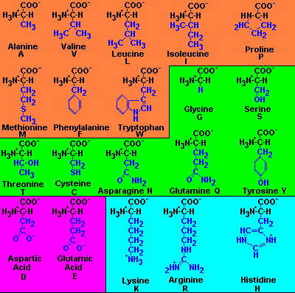
Structure of the 20 Amino acids
18
18
18
Copyright Cmassengale
18

Slide 19
Amino acid classifications
Grouping based on the composition of the R- group
  Aliphatic Chain Amino Acids : Gly, Ala, Val, Leu, Ile
  Non-Aromatic Amino Acids with –OH: Ser, Thr
  Sulfur-containing R-Groups : Cys, Met
  Acidic Amino Acids : Asp, Glu,
  Basic Amino Acids : Arg, Lys, His
  Amino Acids with Aromatic Rings: Phe, Trp, Try, Pro
  Amines: Arg, His, Lysine, Tryptophan
  Neutral Hydrocarbon side chains:
  Amide containing group: Gln, Asn,

Slide 20
Essential and Non essential Amino Acids
All 20 of the amino acids are necessary for protein synthesis
Essential : a.a required for protein synthesize but not synthesised by the body
  must be obtained exogenously from the diet
  8 (or 9 or 10) are essential
Essential Non essential
  Isoleucine Leucine Glycine Alanine
  Valine Phenylalanine, Serine Threonine
  Tryptophan Threonine Glutamate Asarpate
  Lysine Methionine Glutamine Asparagine
  Histidine, Arginine Proline Cystine
Histidine and arginine are partially essentially – cannot be synthesized in appreciable amounts by the body

Slide 21
Amino acid derivatives-
derived from the primary amino acids
Obtained thro. modification of a standard amino acid after a polypeptide has been synthesized.
amino acids derivatives are components of proteins
Nonstandard amino acids play a variety of roles:
  structural,- maintain the protein
  antibiotics
  signals
  hormones
  neurotransmitters
  intermediates in metabolic cycles, etc.

Slide 22
Amino acid derivatives
Structural roles
4-hydroxyproline and 5-hydroxylysine: structural components of collagen a structural protein
N-formyl methionine: the N-terminal ( starting amino acide) residue of all prokaryotic proteins but is usually removed as the protein matures
Gamma-carbocyglutamate is part of proteins involved in blood clotting
Methylated and acetylated amino acids: are important parts of ribosomal proteins and chromosomal proteins called histones (important for chromatin formation in eukaryotes)

Slide 23
Amino acid derivatives
Signal and neurotransmitters
Gama aminobutyric acid (GABA): a glutamate decarboxylation product of dopamine and glycine used as neurotransmitters
Histamine : is a mediator of allergic reactions
Thyroxine :is an iodine-containing hormone that stimulates metabolism
Intermediates in metabolic processes
Citrulline and ornithine : are important in urea biosynthesis
Homocysteine : an intermediate in amino acid metabolism
S-adnosylmethionine: is methylating agent (adds methyl groups to other compounds)
Beta-cyanoalanine : is an intermediate in cyanide production in plants.
Azaserine: is an antibiotic

Slide 24
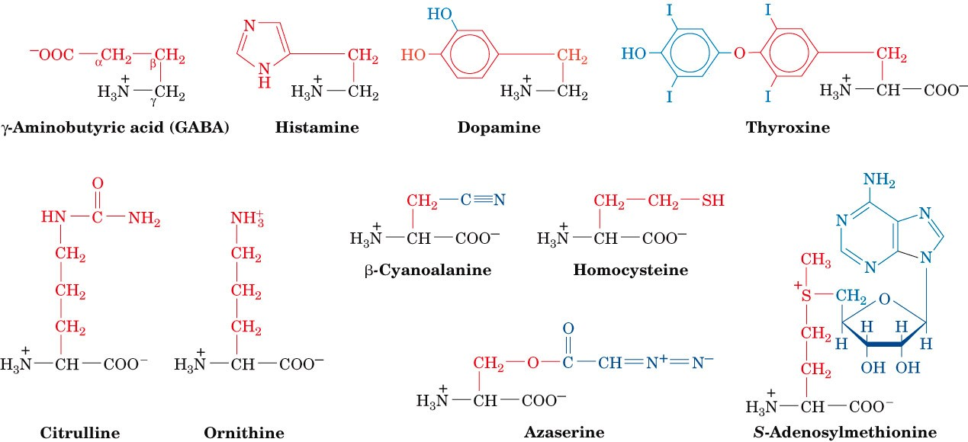
Nonstandard amino acids

Slide 25
Peptides
A sequence of a.a joined together
Amino acids are joined via peptide bonds
Reaction occurs btwn the amino (-NH₃⁺) and carboxyl (-COO⁻) groups
  Elimination of a water molecules
  Formation of covalent amide linkage (peptide bond)
Many different peptides
  2 amino acid (aa) residues - dipeptide
  3 aa residues - tripeptide
  A few aa residues - oligopeptide
  Many aa residues - polypeptide
  Polypeptides range from 40 to 33,000 amino acids (most = 1500 aa)
  Proteins consits of one or more polypeptide chains

Slide 26
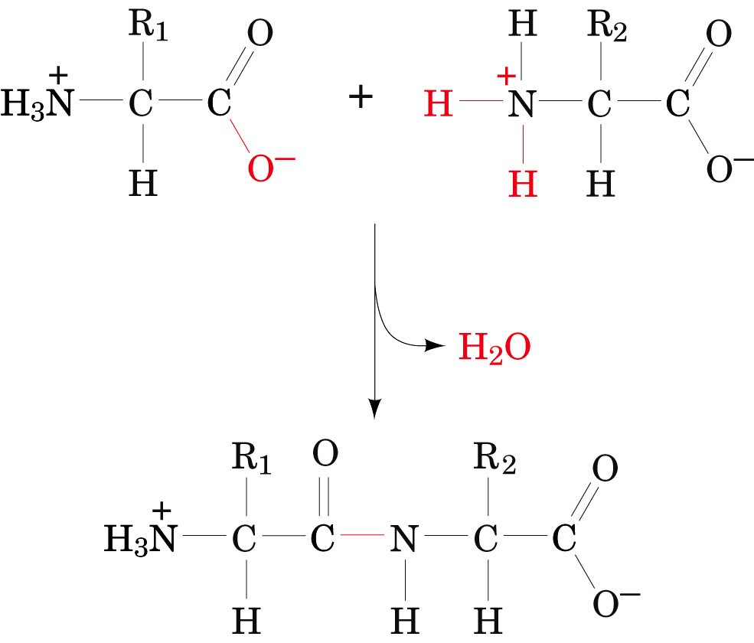
Condensation of two amino acids to form peptide bond

Slide 27
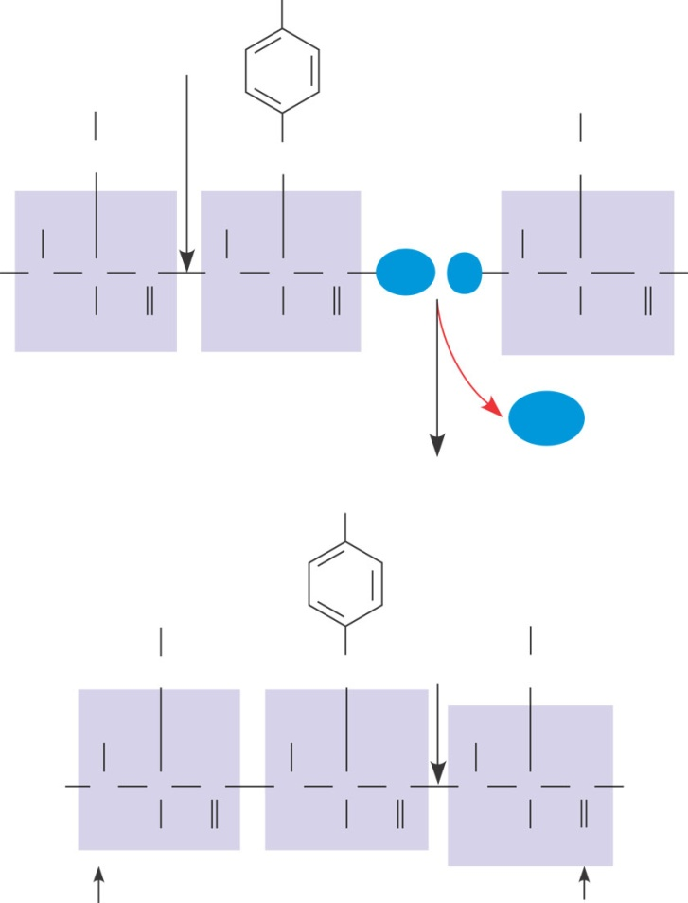
Amino Acid Polymers
Amino acids are linked by peptide bonds
Peptide
bond
OH
OH
SH
CH₂
CH₂
CH₂
H
H
H
H
N
C
C
N
C
C
OH
H
N
C
C
OH
H
O
H
O
H
DESMOSOMES
O
(a)
H₂O
OH
DESMOSOMES
DESMOSOMES
OH
Peptide
bond
SH
Side chains
CH₂
CH₂
CH₂
H
H
H
H
N
C
C
N
C
C
N
C
C
OH
Backbone
H
O
H
O
H
O
Amino end
(N-terminus)
Carboxyl end
(C-terminus)
(b)

Slide 28
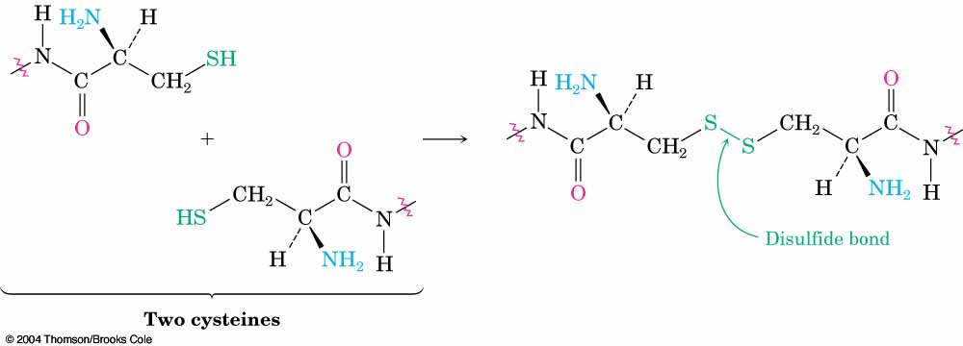
Disulfides
Thiols in adjacent chains can form a disulfide RS–SR through spontaneous oxidation
A disulfide bond between cysteine residues in different peptide chains links the otherwise separate chains together, while a disulfide bond between cysteine residues in the same chain forms a loop

Slide 29
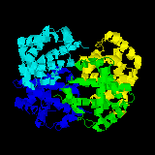
Proteins
Consist of many chains of a.a linked by peptide bonds
Made from 20 possible amino acid monomers
The order of a.a in a polypeptide is genetically determined
Polypeptide fold in a specific sequence to form a a 3 dimensional globular shape
Notes:
29

Slide 30
Functions of Proteins
Enzymes: accelerate specific chemical reactions up to 10 billion times faster than they would spontaneously occur.
Structure: Structural materials, including keratin (the protein found in hair and nails) and collagen (the protein found in connective tissue).
Antibodies: Specific binding, such as antibodies that bind specifically to foreign substances to identify them to the body's immune system.
Transport: Specific carriers, including membrane transport proteins that move substances across cell membranes, and blood proteins, such as hemoglobin, that carry oxygen, iron, and other substances through the body.
Movement : Contraction, such as actin and myosin fibers that interact in muscle tissue.
Hormones and Receptors: Signaling, including hormones such as insulin that regulate sugar levels in blood.
Notes:
30

Slide 31
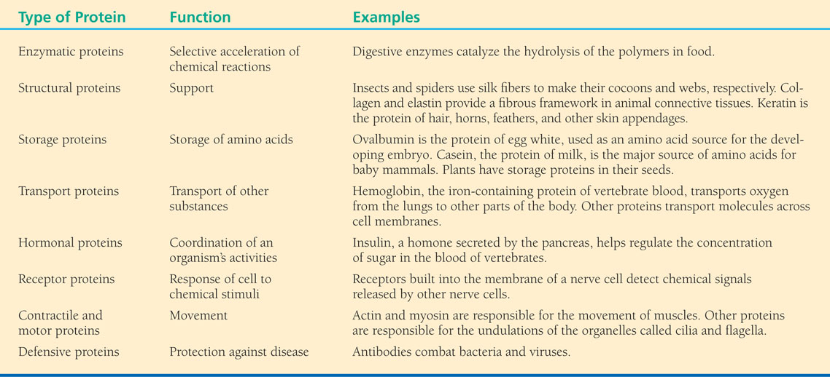
Notes:
31

Slide 32
Protein Conformation and Function
  Folding of a long polypeptide to give a specific 3-D structure.
A protein’s specific conformation determines how it functions
There are four Levels of Protein Structure that determines function

Slide 33
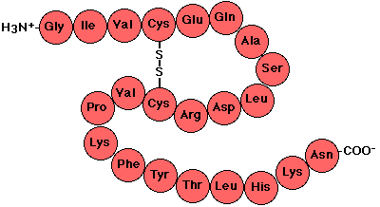
Primary Structure
Linear amino acid sequence, the order of amino acids and the location of disulfide bonds if available in a protein
Describes the covalent connections within the protein
Determined genetically
Unique sequence of amino acids in a polypeptide
Slight change in primary structure can alter function
Notes:
33

Slide 34
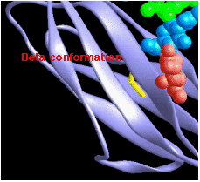
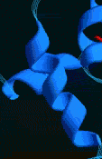
Secondary Structure
Repeated folding of the polypeptide backbone without reference to the R-groups
R-groups do not take part in the folding
Folding is stabilized by H bonds between peptide linkages in the protein’s backbone
2 types, alpha helix, beta pleated sheets
Notes:
34

Slide 35
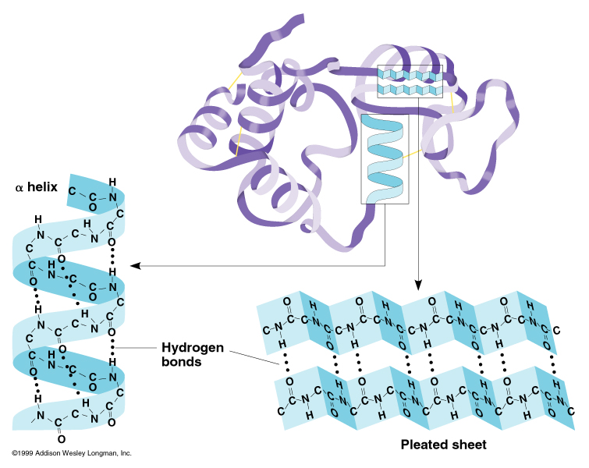
Notes:
35

Slide 36
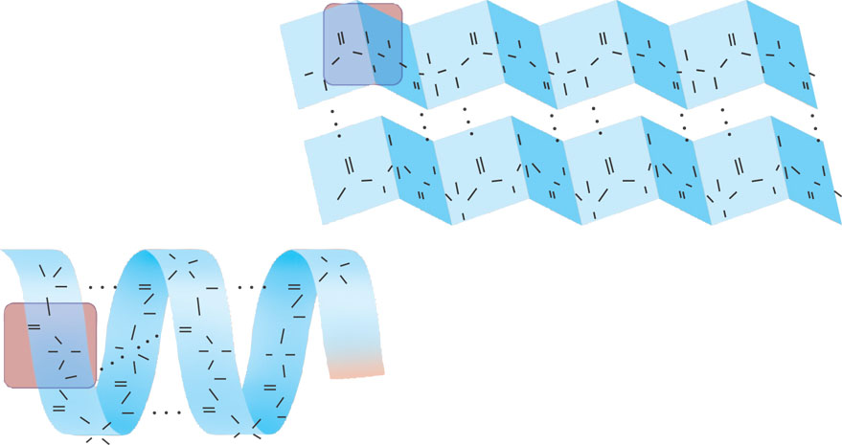
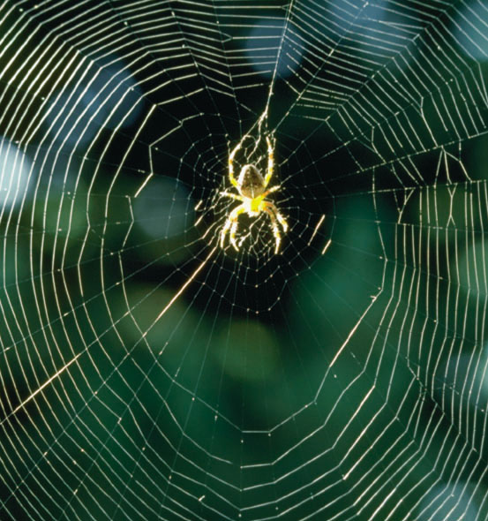
β pleated sheet
O
H
H
O
H
H
O
H
H
O
H
H
Amino acid
subunits
C
C
R
C
C
N
R
C
C
R
C
C
N
N
N
N
C
N
C
C
N
C
C
N
C
C
R
C
R
R
R
C
H
O
H
O
H
O
H
O
H
H
H
R
R
R
R
O
C
O
C
O
C
O
C
H
H
H
H
H
H
C
N
C
H
C
N
C
C
N
C
C
N
C
N
H
N
H
N
H
N
H
C
H
O
C
H
O
C
H
O
C
H
O
C
R
R
R
R
H
R
C
C
H
N
H
O
C
N
H
O
C
N
H
N
H
α helix
O
C
O
C
H
C
R
H
C
H
C
R
C
R
R
H
N
H
O
C
N
H
O
C
O
C
N
H
O
C
N
H
C
C
R
R

Slide 37
Tertiary Structure
Overall folding of the protein
both the backbone and the R-groups participate in the folding
Results from interactions between a.a backbone and the R groups
3-D structure maintained by weak bonds including:
  H bonding between polar side chains
  ionic bonding between charged side chains
  hydrophobic
  van der Waals interactions
Strong bonds:
  disulfide bridges form strong covalent linkages
3 structures results in the formation of domains/subunits
Notes:
37

Slide 38
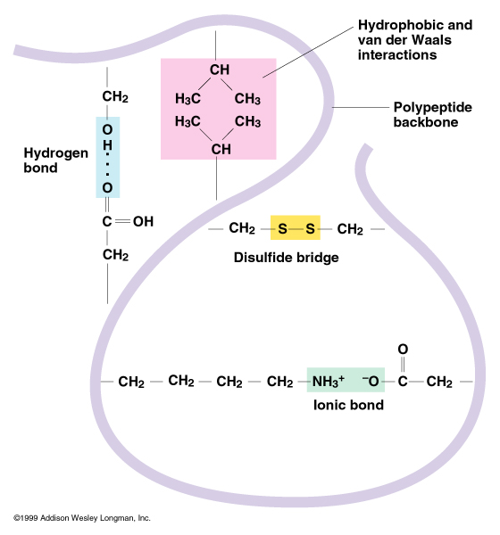
Notes:
38

Slide 39
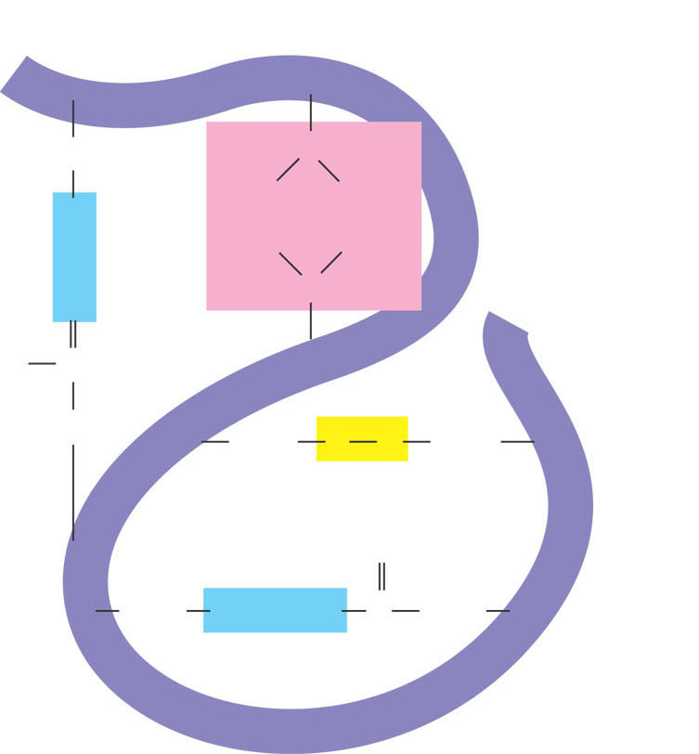
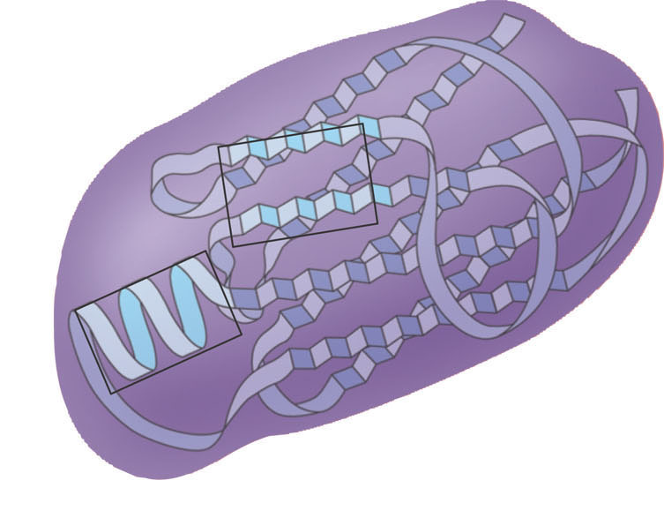
Hydrophobic
interactions and
van der Waals
interactions
CH₂
CH
CH₂
H₃C
CH₃
O
H
H₃C
CH₃
Polypeptide
backbone
Hyrdogen
bond
O
CH
HO
C
CH₂
CH₂
S
S
CH₂
Disulfide bridge
O
C
CH₂
⁻O
CH₂
NH₃⁺
Ionic bond

Slide 40
Quaternary Structure
The degree of associations of two or more polypeptide chains/ subunits
  Subunits are stabilized by
    non-covalent forces -
    intrachain disulfide bond
  Results in domains, subunits, monomers
  Dimers or tetramers
  Homo- dimers, heterodimers
  Possible for oligomeric proteins

Slide 41
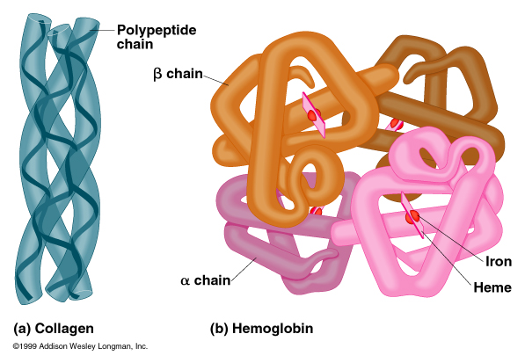
Notes:
41

Slide 42
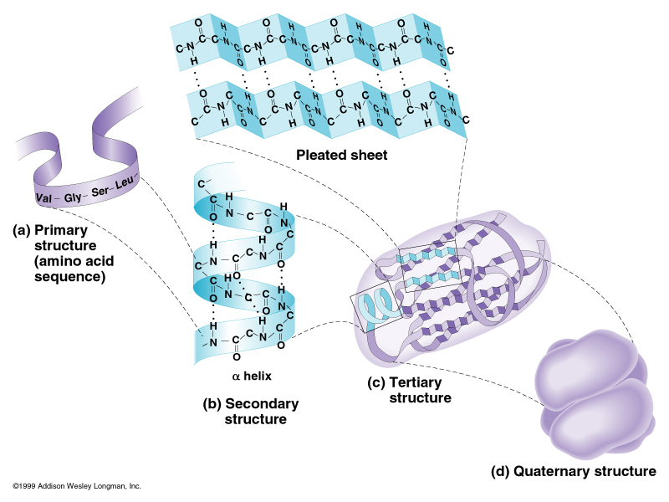
Notes:
42

Slide 43
Sickle-Cell Disease:
  A Simple Change in Primary Structure
  Results from a single amino acid substitution in the protein hemoglobin

Slide 44
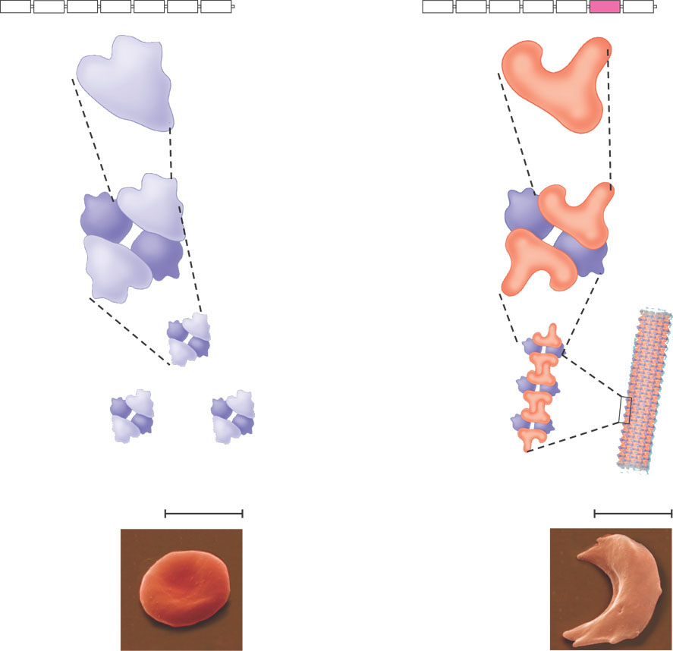
Hemoglobin structure and sickle-cell disease
Normal hemoglobin
Sickle-cell hemoglobin
Primary
structure
. . .
Primary
structure
. . .
Exposed hydrophobic region
Val
His
Leu
Thr
Pro
Glul
Glu
Val
His
Leu
Thr
Pro
Val
Glu
5
6
3
7
5
4
6
7
1
1
2
2
3
4
Secondary
and tertiary
structures
Secondary
and tertiary
structures
β subunit
β subunit
α
β
Quaternary
structure
Hemoglobin A
α
β
Quaternary
structure
Hemoglobin S
α
β
β
α
Molecules
interact with
one another to
crystallize into a fiber, capacity to carry oxygen is greatly reduced.
Function
Function
Molecules do
not associate
with one
another, each
carries oxygen.
10 μm
10 μm
Red blood
cell shape
Normal cells are
full of individual
hemoglobin
molecules, each
carrying oxygen
Red blood
cell shape
Fibers of abnormal
hemoglobin deform cell into sickle shape.

Slide 45
Protein Classification
Simple proteins
Also known as Fibrous proteins
Pure made of pure a.a- yield only amino acids on hydrolysis
polypeptide chains arranged side by side in long filaments
generally have structural roles-
  Examples of Fibrous Proteins:
  keratin (hair, feathers, claws, wool, skin); silk
    Consists of repeating units of gly-ser-gly-ala-gly-ala

Slide 46
Conjugated proteins
Also known as globular proteins
proteins conjugated to a non-protein component
    Have a non-protein component as part of their structure
    carbohydrates,fats,
    nucleic acids
    Lipids
    Metal ions etc
classified based on the type of conjugated group- eg
  Phosphoproteins- have a phosphate group
  Glycoproteins- have a carbohydrate moeity
  lipoproteins – have a lipid group
much more common than simple proteins,

Slide 47
Globular proteins are
coiled into compact, roughly spherical shapes
hydrophobic inside and hydrophilic outside
  Example:
  insulin
  plasma albumins
  globulins,
  hemoglobin,
  most enzymes

Slide 48
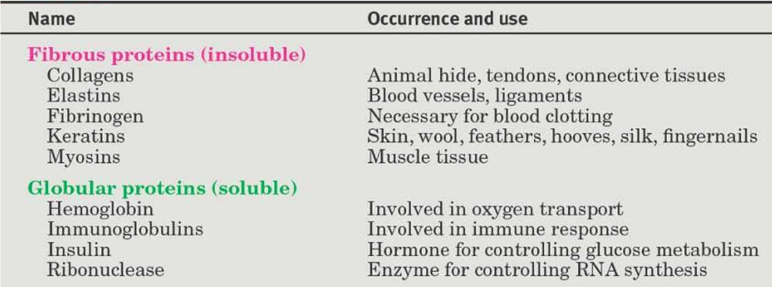
Some Common Fibrous and Globular Proteins

Slide 49
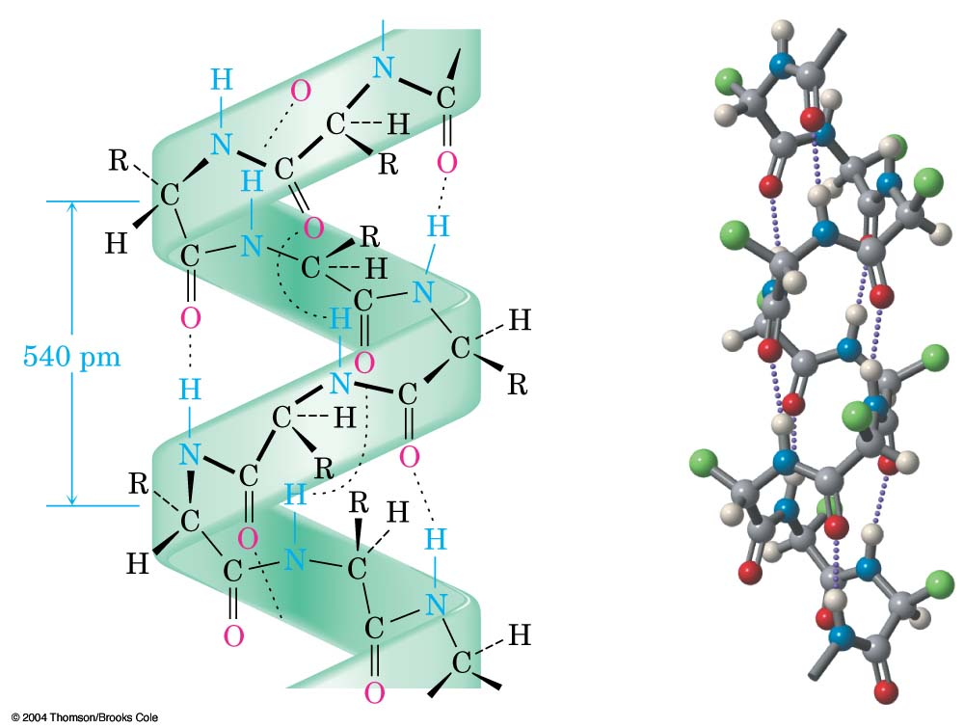
α-Keratin
A fibrous structural protein coiled into a right-handed helical secondary structure,
α-helix stabilized by H-bonds between amide N–H groups and C=O groups four residues away a-helical segments in their chains

Slide 50
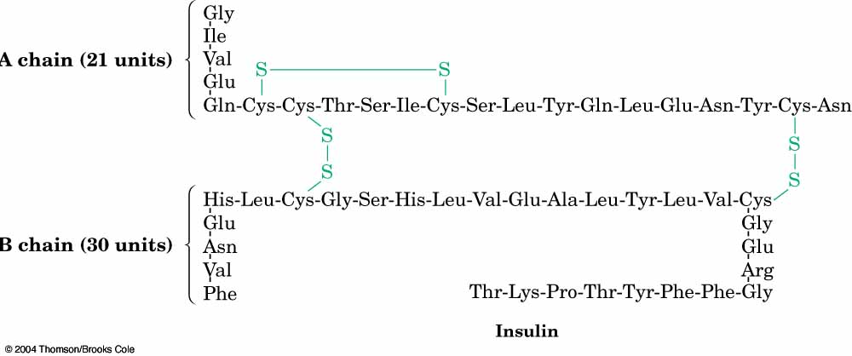
Fibroin
Fibroin has a secondary structure called a b-pleated sheet
the polypeptide chains line up in a parallel arrangement held together by hydrogen bonds between chains

Slide 51
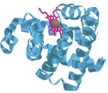
Myoglobin
Myoglobin is a small globular protein containing 153 amino acid residues in a single chain
8 helical segments connected by bends to form a compact, nearly spherical, tertiary structure

Slide 52
Collagen:
  Triple helix of 25% glycine, 25% proline and hydroxyproline
    Proline is inflexible because it is an imino acid with side chain attached to backbone in two locations
    Therefore it is a long extended helix
    It can’t bend as much as a chain of amino acids
  skin, cartilage, bone, intercellular glue

Slide 53
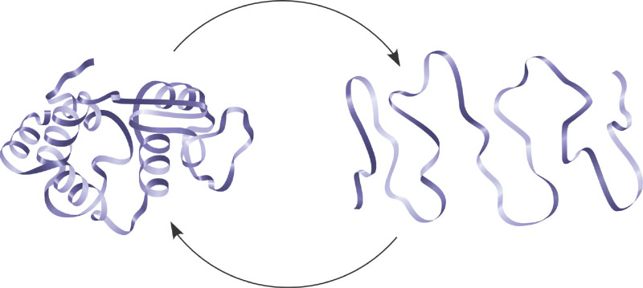
Protein denaturation
  partial or complete unfolding of the polypeptide chain
  A protein unravels and loses its native conformation
  Affects only the intermolecular forces that maintain the secondary, tertiary and quaternary structures only
  Different from digestion- affects also the primary structure
  Digestion also results in the breakdown of peptide bonds
Denaturation
Normal protein
Denatured protein
Renaturation

Slide 54
AGENTS OF PROTEIN DENATURATION
Alteration in pH:- .
Alters the ionic states of ionisable group of the protein
  -NH2, COO - & some ionisable groups of side chains
this breaks the H- bonds & other weak forces creating regions of charge repulsions
Also disrupts the ionic pairs that are likely to associate
affects proteins, 2,3 & 4, leading to protein denaturation.
large net positive or large negative charges on the protein leads to the repulsion among the ionasable groups
this places the molecules under strain leads to denaturation

Slide 55
Temperature
High temp increase the thermal energy of a protein
leads to an increase in vibrational and rotational energy
this upsets the delicate balance of weak interactions maintaining the 2, 3 & 4 quaternary structures
destabilise the functional folded conformation of protein.
high temp can cause irreversible inactivation through covalent changes e.g.
  deammination of asn or gln residues.
Heat denaturation usually results in eventual protein precipitation due to the destruction of 2 structure
advantage of heat denaturation
    Sterilization of surgical instruments
    Canning of foods
    Cooking of foods

Slide 56
Chaotropic agents:­
Cpds such as urea and quanidine hydrochloride
used in high concentrations e.g. 4M or 8M.
Allows water molecule to penetrate into the hydrophobic interior of the proteins and solvate the non-polar side chains
disrupts the hydrophobic interaction
Disrupts & weaken the hydrophobic interactions that normally stabilise the native conformation in the proteins
Hence interfers with 2, 3 and 4 protein structures
.also form a competing hydrogen bond with the amino acids residues of the peptide
    Destabilises the internal H- bonding that stabilizes the native structure.
This denaturation is usually reversed when the concentration of the competitive H- bonding agent is lowered by dialysis (sieving) or by dilution.

Slide 57
Detergents
hydrophobic tails of detergents penetrate into the hydrophobic interior of proteins
Once inside they disrupts the hydrophobic interior causing denaturation
also disrupts association between polypeptide chains
Example of detergent-Sodium dodecyl sulphate (SDS)
Thiol reagents
cleave the disulfide bonds of the protein
Reduce the disulfide bonds to their thiol (SH)l groups
also disrupts the thiol reagent structure
Also disrupts both the hydrophobic and H-bonds interaction . Examples of thiol reagents
    Dithiothreitol (DTT)
    β-mercaptoethanol ( SH CH2 CH20H).

Slide 58
Miscible organic solvents.
lowers the dielectric constant of the protein
competes with proteins for the H₂O of hydration
cause protein- protein interaction causing precipitation.
Examples of organic solvents used to denature proteins are
    alcohols
    phenol
    acetone.
Heavy metal ions.
Reacts with SH- side groups of cysteine either on the same or different polypeptide chains
Thiol groups react with heavy metal ions to alter the protein 2 , 3 & 4 structures
Results in protein precipitation
Eg Ag+ Hg+ Pb²⁺

