Slide 1
LIPIDS: STRUCTURE &FUNCTION
Heterogeneous group hydrophobic of organic molecules mainly made of C,H,O
No general formula- no common functional group
physical and not structurally characterised
Naturally appear greasy or oily
Hydrophobic – “water-fearing”
lipophilic – “fat-loving”
More soluble in organic solvents than in water
Solubility varies
Naturally exists as
Fats - solid at room temperature.
Oils - liquid at room temperature

Slide 2
Functions of lipids
Major source of energy:
Stored in form of TAG in adipose
form highly concentrated source of energy for man.
Energy is released by the oxidative break down of fat
Produce 2X more energy per gram as do the -CHO
2. Food reserves:
TAGs are important food reserves in plants &animals.
stored in plant seeds & provide nourishment for the embryo during germination.
Extracted seed oils used for cooking & other purposes.
Eg: Oil seeds ground nut, mustard, coconut &castor.

Slide 3
Functions of lipids
3. Structural component of cell membrane
Phospholipids, Glycolipids and sterols are important components of biomembranes.
Some glycolipids are found in myelin sheath.
Waxes form a protective coat on plant parts and animal furs.
4. Protection and Insulation:
Fats are stored in adipose in animal cells.
Deposited beneath the skin and around the internal organs.
Cushion- serve as blanket for
Thermal insulation against cold-prevent the loss of body heat
shock absorbing cushions around the eye ball, kidney and gonads.
desiccation (drying out).
Electric insulation to allow rapid propagation of depolarization wave long myelinated nerves.
About 4% of the total body fat is reserved for this critical function

Slide 4
Functions of lipids
5. Precursors of hormones and hormone derivatives
Cholesterol is the precursor of steroid hormones vitamin D , bile salts.& common contraceptives
Eicosanoids eg PGs , PGI and TX are synthesised from arachidonic acid (20:4).
Prostaglandins are hormone like compounds derived from fatty acids like arachidonic acid
6. Carriers of essential components in the body
lipoproteins & the glycoproteins carries fat soluble .
Lipophilic bile acids aid in lipid solubilisation
7. Precursors of lipid soluble vitamins
Include vitamin (A,D E and K)
play a major role in the regulation of several critical biological processes, eg blood clotting and vision.

Slide 5
Functions of lipids
8. Activation of some enzymes
9. Vitamin absorption:
Dietary fat serves as a carrier of the lipid soluble vitamins.
transported into cells of the small intestine in association with fat molecules.
a diet that is too low in fat can result in a deficiency of the four vitamins ADE&K.
10. Mechanical protection to many organisms
11. Adjust buoyancy in marine animals.
12. Precursors for detergents in industry
13. Makes food tastier and palatable

Slide 6
Fatty acids
Key building (manomeric) units of lipids
Determine the characteristics of the fat
Serve the following major roles in the body
Constituents of complex membrane lipids-
phospholipids
Glycolipids
sphingolipids
Major components of triacylglycerols- (stored fat)
Target proteins to membranes
High energy source of fuel
F.a derivatives are used as hormones & intracellular messengers

Slide 7
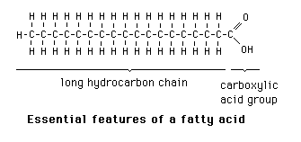
STRUCTURE FATTY ACIDS
Linear chains of long hydrocarbon chain (C₄ to C₃₆)
Monocarboxylic acids– one end has
a hydrocarbon tail (CH₃) (fat)
a hydrophilic carboxyl group ( -COOH)

Slide 8
STRUCTURE FATTY ACIDS
The hydrocarbon chain length varies from C4 to C36
Common fatty acids have C₁₂- C₂₄ carbon atoms
The hydrocarbon chains have even numbered C- atoms
Short chain f.a = < C8– usually liquid
Medium chain f. a = C8- C10 carbons- most common
Long chain f.a > C12 -usually solid
The carboxyl group ionized at physiological pH, COO⁻
Imparts a net negative charge on a f.a
Represented as long flexible tails when part of lipids
known as acyl groups in lipids

Slide 9
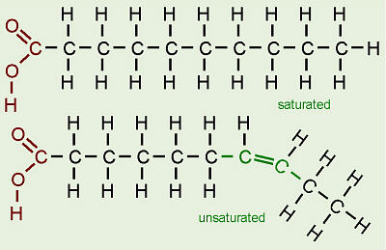
TYPES OF FATTY ACIDS:
Saturated & Unsaturated f.a
Fatty acids exists as
“free fatty acids ” or combined-attached to another compound
Saturated fatty acids – have C-C single bonds
Unsaturated fatty acids – have atleast a C-C db
The degree of unsaturation varies
Monounsaturated- one db
Polyunsaturated – more than one db

Slide 10
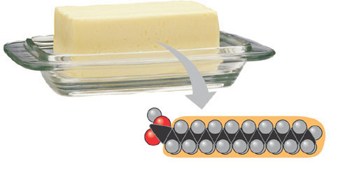
TYPES OF FATTY ACIDS
Saturated fatty acids
Exhibit maximum number of hydrogen atoms possible
No double bonds but single C-C bonds in hydrocarbon tails
solid at room temp
most found in animal fats
.
Stearic acid
(a) Saturated fat and fatty acid

Slide 11
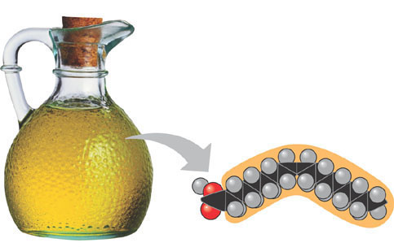
Unsaturated fatty acids
one or more C=C bonds in their structure.
Vary in the length and number and locations of d.b
D. b cause “kinks” in the hydrophobic tails molecule’s shape.
I.e d-b pushes the molecules apart, lowering the density & MP
liquid at room temp
Unsaturated fatty acids are common plant
Oleic acid
(b) Unsaturated fat and fatty acid
cis double bond
causes bending

Slide 12
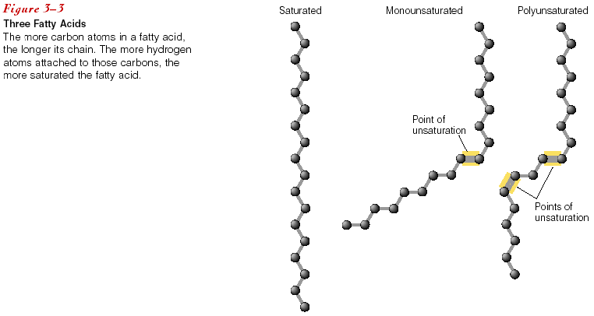
TYPES OF FATTY ACIDS:
UNSATURATED
One double bond= monounsaturated f.a
Two or more double bonds = poly- unsaturated fatty acid

Slide 13
TYPES OF FATTY ACIDS:
Unsaturated f.a have two types of double bonds
Cis d.b:- H on the carbons joined by a d.b are on the same side
the carbon chain is bent
Trans d.b:- H on the carbons joined by a d.b are on the opposite side
the carbon chain is straighter

Slide 14
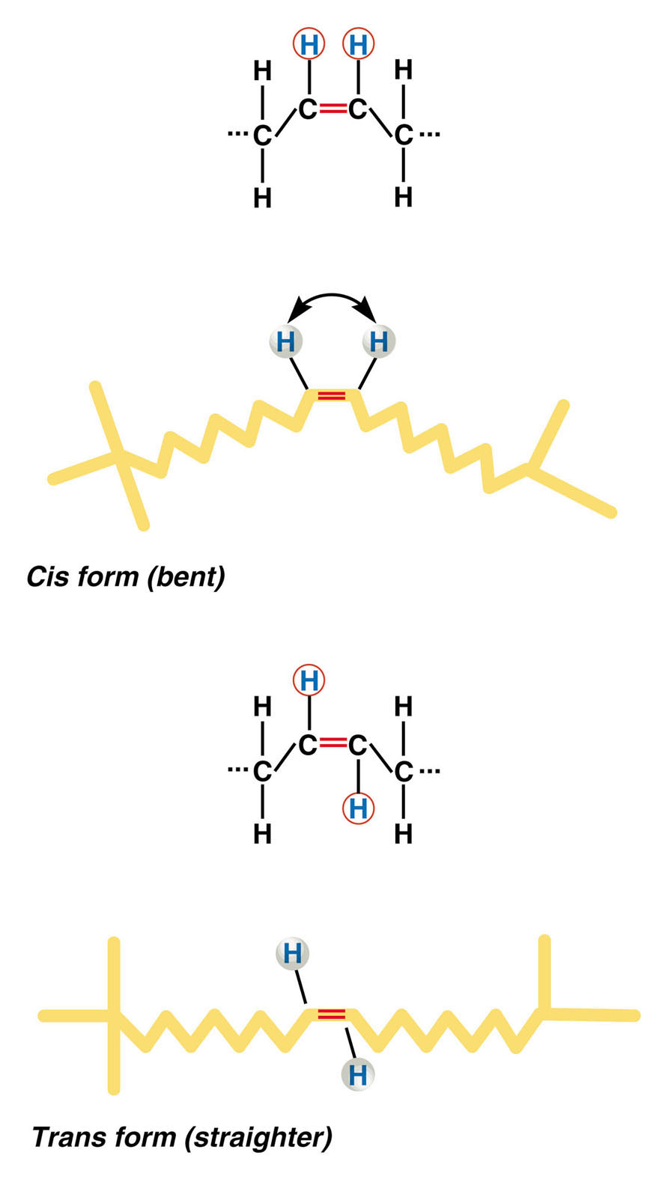
TYPES OF FATTY ACIDS:

Slide 15
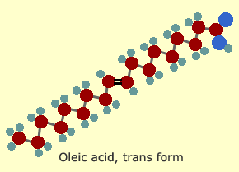
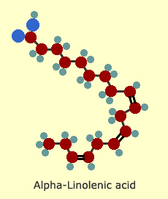
TYPES OF FATTY ACIDS:
the "kink" / bend, in the Hydrocarbon chains unsaturated fats prevents close packing of f.a
makes the fatty acid stay fluid at r.t
kinks in the structure make cell membranes flexible & permeable
Some mono-unsaturated fats, eg olive oil will solidify when refrigerated due less number of unsaturation .
Poly-unsaturated fats, stay fluid even when refrigerated due to many kinks in their structures.
kinks in the structure make cell membranes flexible & permeable and nutrients to enter the cell and waste products to leave.

Slide 16
UNSATURATED FATTY ACIDS
Most unsaturated f.a have cis rather than trans d.b
The presence of d.bs in f.a lowers the mp of F.a
Fatty acids with Cis d.b
forms a rigid kink/bend in the f.a carbon chain
prevents close packing hence f.a don’t stack compactly
Intermolcecular forces are less effective leading to low b.p and m.p
Most are liquid at room temp
Fatty acids are diverse f.a due to chain length & degree of saturation.

Slide 17
Saturated and Unsaturated fatty acids

Slide 18
Saturated and Unsaturated fatty acids in dietary fats

Slide 19
SATURATED FATTY ACIDS
Common | Systematic name | Structure | Abb.
Laurate |  | CH₃(CH₂)10COO⁻ | 12:0
Myristate | Tetradecanoate | CH₃(CH₂)12COO⁻ | 14:0
Palmitate | n-hexadecanoate | CH₃(CH₂)14COO⁻ | 16:0
Stearate | n-octadecanoate | CH₃(CH₂)16COO⁻ | 18:0
Arachidate | n-eicosanoate | CH₃(CH₂)18COO⁻ | 20:0
Behenoate | n-docosanoate | CH₃(CH₂)20COO⁻ | 22:0
Lignoceate | n-tetracosanoate | CH₃(CH₂)22COO⁻ | 24:0

Slide 20
UNSATURATED FATTY ACIDS
Oleate | Cis9-octadecenoate | CH₃(CH₂) CH=CH(CH₂)7COO- | 18:1 ∆ ⁹
Vaccenate | Cis11-Octadecenoate | CH₃(CH₂)5CH=CH(CH₂)9COO- | 18:1 ∆¹
Linoleate | Cis9,Cis12-Octa-decadienoate | CH₃(CH₂)4CH=CHCH₂CH=CH (CH₂)7COO- | 18: 2∆^{9, 12}

Slide 21
Nomenclature of fatty acids
Trivial
Conventional numbering
Carbon atoms -numbered from the carboxylate group
carboxylate group taking position 1
Each C atom is designated with numerical number
Carboxy group is C1, then C2, C3, C4 C5…….etc
β α O
H₃C - (CH2)_{n} - C – C – C - OH
3 2 1

Slide 22
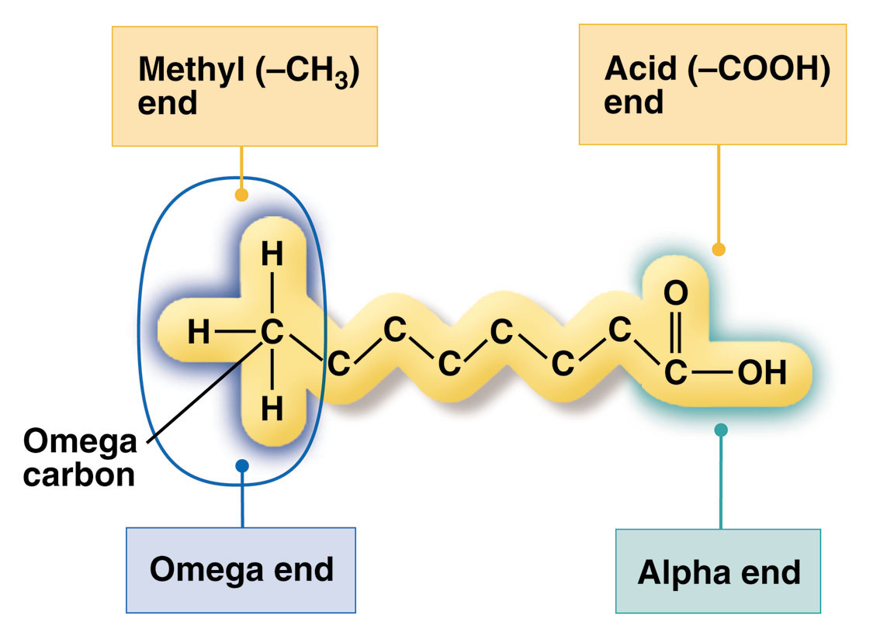
Nomenclature of fatty acids
Greek lettering system
C2 & C3 from the carboxyl end referred to as α- and β-carbon atoms respectively
Similarly , there are gama, delta, theta carbon atoms etc
Distal (methyl) carbon – the omega carbon
3 2 1

Slide 23
Nomenclature of fatty acids
Omega fatty acids:
C-atoms counted from the methyl C end of a f.a (omega)
α–carbon- C2 from the carboxyl end
ω - carbon- distal carbon atom
Position of db from the omega carbon indicates the type of omega f.a
ω – 3 Fatty Acid – double bond at carbon 3
ω - 6 Fatty Acid – double bond at carbon 6
ω - 9 Fatty Acid – double bond at carbon 9
Abreviated as
18:0, 18:1, etc.

Slide 24
Omega 3
Omega 6
Omega 9

Slide 25
Nomenclature of Fatty acids
Systemic ( IUPAC)
Name derived from name of parent hydrocarbon (alkane)
Substitution of a final e with oic acid
Eg octadecanoic acid -C18 saturated f.a -parent octadecane
Unsaturated f.a with d.bs ends with enoic acid – eg octadecadienoic acid, octadecatrienoic acids – 3 d.b etc

Slide 26
Fatty acid Nomenclature
Numeric designations of d.b come from the numeric number of carbon - followed by the number of sites of unsaturation
E.g, palmitic acid, a saturated C16-carbon f.a with is designated as16:0).
Unsaturation site indicated by the symbol ∆ and the superscript number of the first carbon of the d.b
e.g. palmitoleic acid a C-16 f.a with one site of unsaturation between carbons 9 and 10, and is designated by 16:1 ∆⁹).
20: 0 C20 saturated fatty acid
20: 2 ∆^{9, 12} a C20 unsaturated f.a with 2db, between C9 &C10 & C12& C13
Hence Cis 20: 1 ∆^{9 cis} db between C9 and C10
Trans 20: 1 ∆⁹ _{trans db between C9 and C10}

Slide 27
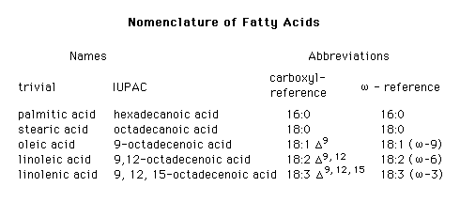
Nomenclature of fatty acids

Slide 28
Physiologically Relevant Fatty Acids
Numerical Symbol | Common Name | Structure | Comments
14:0 | Myristic acid | CH₃(CH₂)₁₂COOH | Often found attached to the N-term. of plasma membrane-associated cytoplasmic proteins
16:0 | Palmitic acid | CH₃(CH₂)₁₄COOH | End product of mammalian fatty acid synthesis
16:1^{9} | Palmitoleic acid | CH₃(CH₂)₅C=C(CH₂)₇COOH
18:0 | Stearic acid | CH₃(CH₂)₁₆COOH
18:1^{9} | Oleic acid | CH₃(CH₂)₇C=C(CH₂)₇COOH
18:2^{9,12} | Linoleic acid | CH₃(CH₂)₄C=CCH₂C=C(CH₂)₇COOH | Essential fatty acid
18:3^{9,12,15} | Linolenic acid | CH₃CH₂C=CCH₂C=CCH₂C=C(CH₂)₇COOH | Essential fatty acid
20:4^{5,8,11,14} | Arachidonic acid | CH₃(CH₂)₃(CH₂C=C)₄(CH₂)₃COOH | Precursor for eicosanoid synthesis

Slide 29
Essential and Nonessential Fatty Acids
Non essential:
Easily synthesized by the body
not a requisite component of the diet
Essential Fatty Acids
required for normal body function
Cannot be synthesized by the body
Derived mainly from exogenous ( dietary ) sources
Essentially f.a with C= C before 9th carbon– omega-3 & Omega-6
Humans cannot make C-C d.b before the 9th carbon from omega C)
Examples of essential fatty acids
Omega-3:
Alpha-Linolenic Acid (ALA),
Eicosapentaenoic Acid (EPA),
Docosahexaenoic Acid (DHA)
Omega-6 fatty acids
linoleic acid
alpha-linolenic acid
Arachidonic Acid

Slide 30
Sources of Omega Fatty Acids
Omega-3 Fatty Acids
soybean oil,
walnuts,
some leafy dark green vegetables
Fatty fish: salmon, tuna, and mackerel,
fish oils (EPA and DHA)
Omega-6 Fatty Acids
Seeds
Nuts
common vegetable oils
Corn
safflower
cottonseed
sunflower seed
peanut (linoleic acid)
Meat (arachidonic acid)

Slide 31
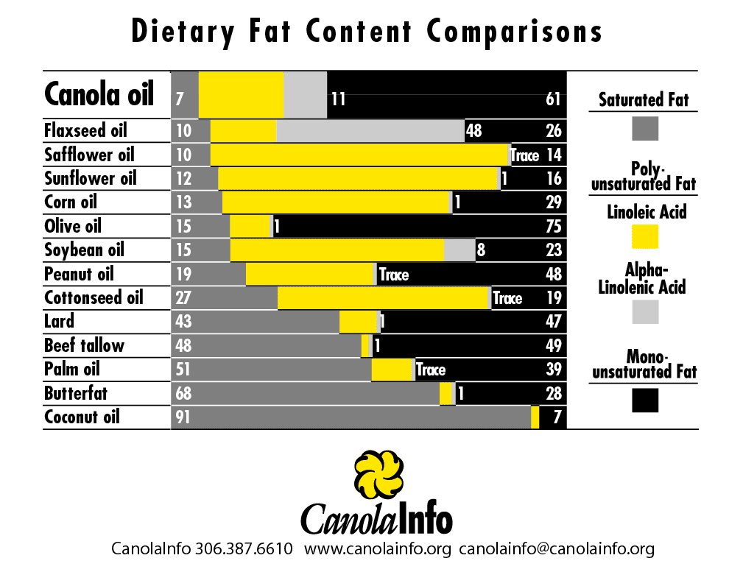

Slide 32
FATTY ACIDS
EICOSANOIDS
A small % of fatty acids become eicosanoids
Eicosanoids consists of 20 or more carbons
Important in the
inflammatory process
blood vessel dilation and constriction
blood clotting
Omega-6s
Linoleic acid is converted to arachidonic acid
Involved in constricting blood vessels, promoting inflammation and blood clotting
Omega-3s
Alpha-linolenic acid is converted to eicosapentanoic acid (EPA) and docosahexanoic acid (DHA)
Involved in the dilation of blood vessels, discouraging blood clotting, and reducing inflammation

Slide 33
Classification of lipids
Classification based on
Solubility
Water soluble ( polar) Vs fat soluble (nonpolar)
Water soluble –lipids
Short chain f.a
ethanoate, pronanoate, & butanoate
ketone bodies,
acetoacetate β- hydroxybutryate & acetone
appreciable water solubility
Solubility decreases progressively as the hydrocarbon chain increases.

Slide 34
Classification of lipids
Chemical reactions
Saponifiable Vs nonsaponifiable lipids
Saponification –hydrolysis of lipids
Can be catalysed by bases eg NaOH, acid (HCl) or enzyme.
Saponifiable lipids contain ester group -undergo hydrolysis
cleaves a saponifiable lipid into two or more smaller molecules.
Saponifiable lipids are not derivatives of long chain fatty acids, and are more soluble in organic solvents than in water.
Non-saponifiable lipids do not undergo hydrolytic cleavage into smaller molecules in presence of acids or bases.
Common examples of nonsaponifiable lipids include, sterols, terpenes, leukotrienes and prostaglandins

Slide 35
Saponification
Soaps and detergents are manu by saponification
Base saponification of TG yields salts of carboxylic acids and glycerol.
The carboxylate salts formed have considerable high water solubility.
important in biological systems since the body must solubilise cpds with COOH group.
drugs are usually administered in the form of carboxylate salt instead of the carboxylate acid to achieve faster absorption into the body.
salts of carboxylic acids are known as soaps.
used to remove off greasy dirt from surfaces from
machinery clothing floors and other surfaces.

Slide 36
Saponifiable lipids
SAPONIFIABLE
COMPOUND
SIMPLE LIPIDS
ACYLGLCEROLS
PHOSPHOLIPIDS
PLASMALOGENS
WAXES
PHOSPHOGLYCERIDES
FATS
OILS
SPHINGOLIPIDS
GLYCOLIPIDS
SPHINGOMYELIN

Slide 37
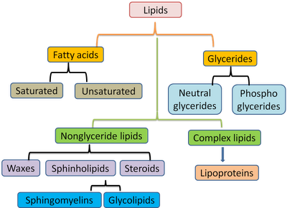

Slide 38
Classification of lipids
Chemical compositions
Simple lipids –
F.a or esters of f.a with alcohol groups
Complex –compound-
esters of f.a with alcohol and other groups
Derived lipids-
Derivatives of simple or complex lipids

Slide 39
Classification of lipids: Simple lipids
Include :
fatty acids
Fatty acid esters (acylglycerols)
Waxes
Occur in plants and animals(adipose tissue) .
Fatty acid esters
Known as acylglycerols or neutral fats.
Esters of f.a with alcohol groups
Commonly occurring ester of f.a with glycerol
acyl group-esterified fatty acid

Slide 40
Classification of lipids: Simple lipids
Three types of acylglcerols.
Monoacylglcerols (Monoglycerides)
consist of one acyl group esterified to a glycerol backbone.
one fatty acid +glycerol
Diacyglyerols (Diglycerides)
two fatty acids (acyl groups) esterified to a glycerol
two fatty acids +glycerol
Triacylglycerols
three fatty acids attached to a glycerol backbone
TAGs are the common lipids in the body, MAG and DAG are derived from the hdrolysis of TAGs

Slide 41
Monoacylglcerols consist of an acyl group esterified to a glycerol backbone. | Diacyglyerols (diglycerides) Consist of two acyl groups esterified to twohydroxyl groupsof a glycerol backbone. | Triacylglycerols Triacylglycerols consist of three acyl groups esterified to the three hydroxyl groups of glycerol backbone.

Slide 42
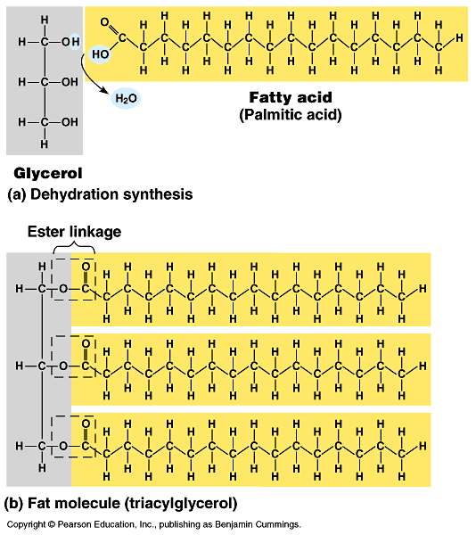
Triacylglycerols
Formed via esterification of 3f.a with glycerol
Acid
Fat

Slide 43
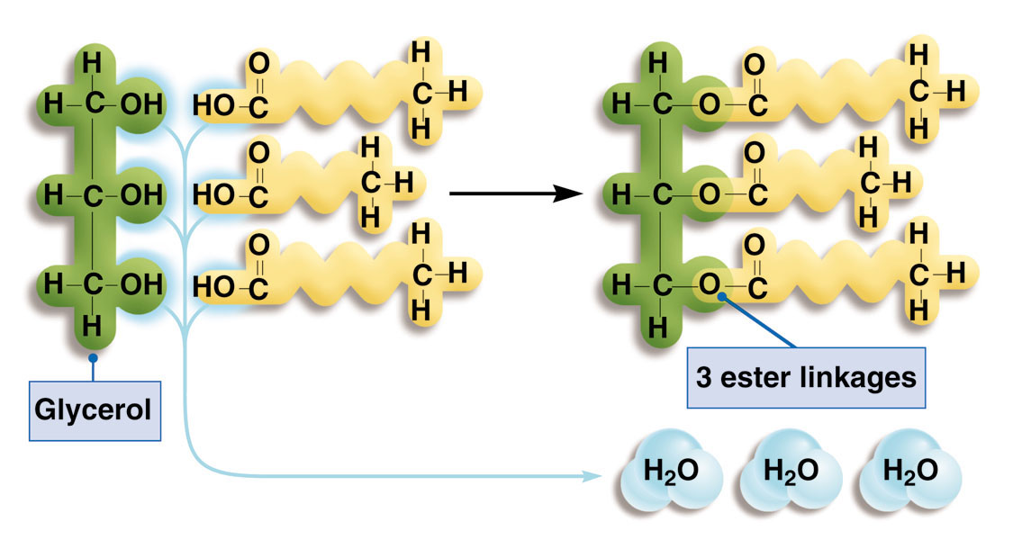
Triacylglycerols
Also known as neutral Fats
Formed via esterification of 3f.a with glycerol
Glycerol + 3 fatty acids Triacylglycerol
Triacylglycerol
Fatty Acids

Slide 44
Structure of Triacylglycerols

Slide 45
Triacylglycerols
3 ester linkages are formed between a hydroxyl group of the glycerol and a carboxyl group of the fatty acid.
TAGs are the most common in the body
MAG and DAG are intestinal hydrolytic products of TAG
Simple TAG has similar acyl (R) groups
Mixed TAG have different acyl (R) groups
differ in fatty acids composition
Used for energy storage,
Cushions for organs,
Insulation.
Provide more energy per mass.

Slide 46
Triacylglycerols
Stored in the adipose tissue
Colourless but becomes coloured on a mixture with other substances
MAG and DAG form micelles unlike TAG
Micelles are structures –
polar head groups point to the polar surface –
hydrocarbon tails sequestered inside
MAG and DAG have both polar and nonpolar groups
Polar groups interacts with sorrounding aqueous phase
TAG is only hydrophobic and hydrophobic prefers interaction with each other

Slide 47
Triacylglycerols
FUNCTIONS
Major lipid in the body and diet
Stored fat provides about 60% of the body’s resting energy needs – compactly!
Insulation and protection
Carrier of fat-soluble compounds
Sensory qualities – flavor and texture

Slide 48
Waxes
Esters of made of long chain monohydric alcohols& long chain f.a
unbranched with even carbon numbers
Chain length varies from C16 to C36
mixtures of esters although some are ketones.
Examples - triacontaylhexadecanoate
Function
serve as form natural coatings on fruits, leaves, furs, feathers and skin.
Offer protective functions against physical damage
water repellence functions.
Natural waxes used commercially in polishers, cosmetics and ointments.

Slide 49
Reactions of fatty acid esters
Undergo most reactions of C=C
Hydrolysis
reverse of esterification reaction
Hydrolysed to f.a and glycerol
Accomplished by
Acids
Bases
Enzymes (lipases)
Saponification - TAG hydrolysis by base
Important reactions for soap formation

Slide 50
Reactions of fatty acid esters
Reduction
Hardening /hydrogenation process
Not important in vitro
hydrogen is passed through fats under pressure
requires a suitable catalyst
(finely divided nickel/ Ramney nickel
Unsaturated oil is converted to a solid saturated fats
Process improves colour, odour and taste of oils
hydrogenated oils are used for the manufacture of
margarine
soaps
candles.

Slide 51
Reactions of fatty acid esters
Oxidation (Rancidification)
direct attack of a lipid by molecular oxygen
frequent in vivo.
Results in the formation of peroxide s as an initial product
Peroxides – further hydrolysed to diols
The long chain breaks to produce short chain f.a
characteristic smells in food,- rancid food.
long storage of fats in contact with air & moisture- rancidity.
slow decomposition and develop unpleasant smell.

Slide 52
Reactions of fatty acid esters
Rancidification process
Enzymatic hydrolysis of fats by microbial enzymes
short chain f. a with bad smell are produced
Aerial oxidation of short chain unsaturated f. a to
aldehydes
ketones with unpleasant odour.
β - oxidation and decaboxylation of saturated f.a products
ketones with unpleasant flavour.
anti-oxidants eg tocopherol prevents rancidificaiton
Oxidation of polyunsaturated membranes lead to significant decrease action and rigidity

Slide 53
Reactions of fatty acid esters
Hydrogenolysis
Passage of excess H₂ thro oil under pressure
cop per or chromium are used as catalyst,
TAG is split up into
Glycerol
higher aliphatic alcohols.
Addition
Water easily adds across a d.b of f.a in vivo
Known as hydration reaction

Slide 54
Complex/compound lipids
Esters of f.a with other groups in addition to alcohol& f.a
Glycerol + 2 fatty acids + phosphate group.
Consists of a hydrophilic “head” and hydrophobic “tails”
glycerol or sphingosine are common alcohol moieties
Examples of complex lipids
Phospholipids
Glycolipids.
Phospholipids –
major class of membrane lipids.
two acyl groups on glycerol backbone
A phosphate group is on third OH

Slide 55
Complex/compound lipids
two types of phospholipids
based on the alcohol backbone usually
glycerol
sphingosine.
Phosphoglycerols-
also known as acylphosphoglycerols, phosphoglycerides
have a glycerol backbone
Phosphosphingolipids
have sphingosine as the alcohol backbone

Slide 56
Complex/compound lipids
Glycerol based phosholipids –
have glycerol as the alcohol backbone
two acylgroups esterified on 1st and 2nd OH of glycerol
phosphate group esterified on the 3-OH -phosphatidate,
A phosphatidate is a precursor of other phospholipids
Specific phospholipids occur by the esterification of an hydrophilic amino alcohol to phosphate group
Examples of amino alcohols
ethanolamine
serine
choline
inositol
PO₃-²group is hydrophilic ; fatty groups are lipophilic

Slide 57
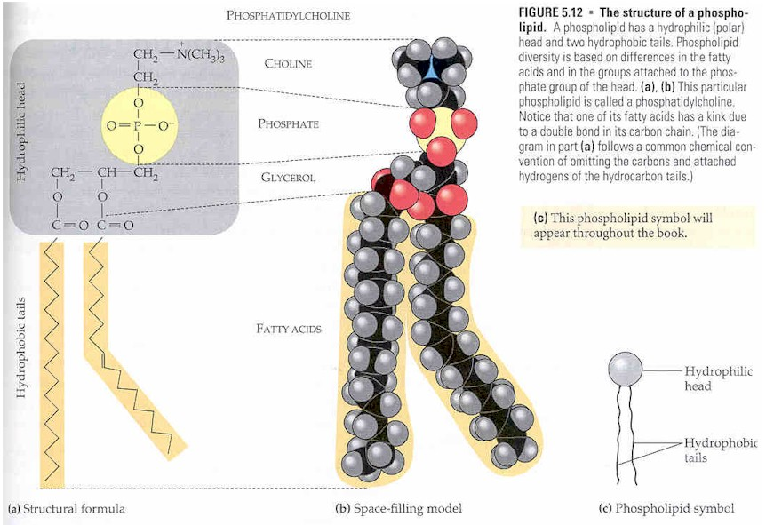
Complex/compound lipids
Phospholipid structure

Slide 58
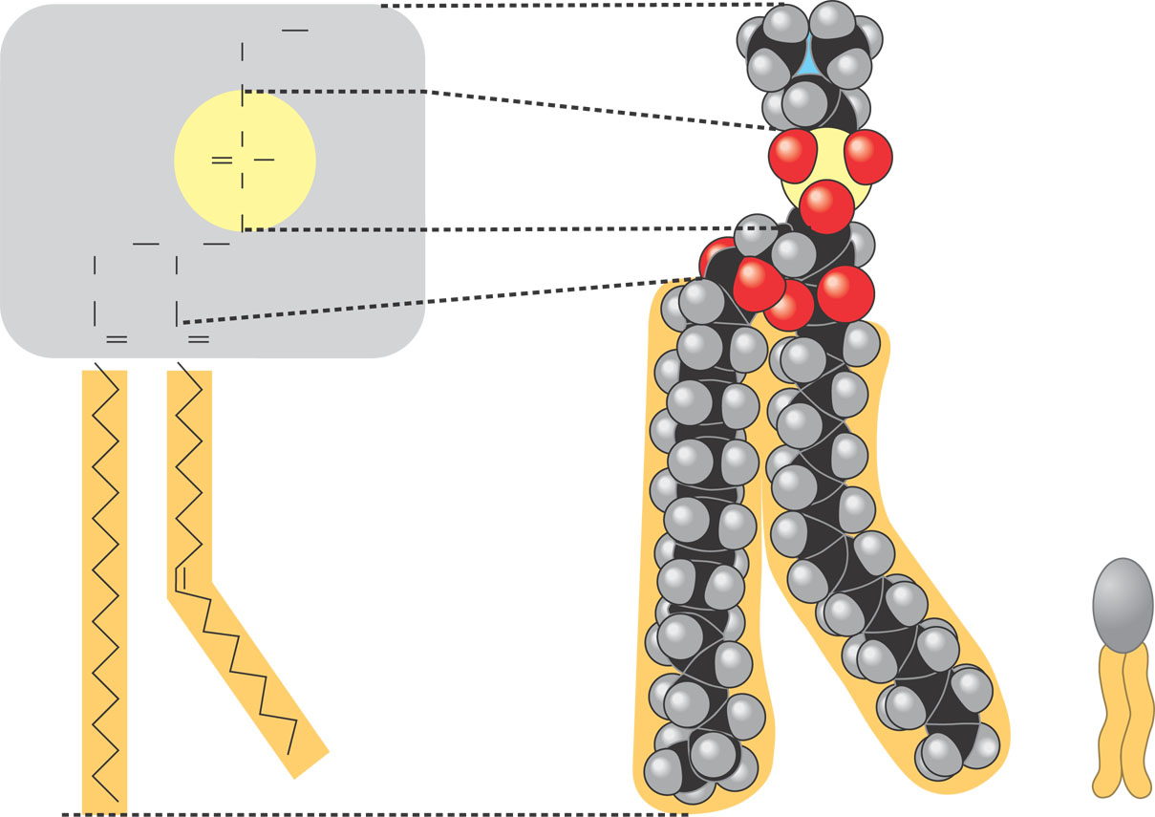
CH₂
+
N(CH₃)₃
Choline
CH₂
Hydrophilic head
O
Phosphate
O
P
–
O
O
CH₂
CH
CH₂
Glycerol
O
O
C
O
O
C
Fatty acids
Hydrophobic tails
Hydrophilic
head
Hydrophobic
tails
(b) Space-filling model
(c) Phospholipid
symbol
Figure 5.13
(a) Structural formula

Slide 59
Complex/compound lipids
Phospholipid named by
Phosphatidyl placed before the amino alcohol name , eg
phosphatidyl inositol
phosphatidyl serine
phosphatidylcholine,
phosphatidylethanolamine
Can be named as a derivative if acyl group is known, eg
1, 2 dipalmitoylglycerolphosphatidyl choline

Slide 60
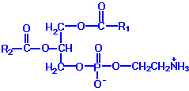
Complex/compound lipids
PC:/ Lecithins.
neutral at physiological pH.
palmitic or stearic acidprimarily at C 1
C2- oleic, linoleic or linolenic acid
dipalmitoyllecithin is a component of lung or pulmonary surfactant.
PC -(80%) lines the pulmonary alveoli.
PC : Liver, egg yolk, soybeans, peanuts, legumes, spinach, and wheat germ
Usually lost during food processing
PE: Cephalins
neutral zwitterions at physiological pH.
C1- primarily palmitic or stearic acid
C2- long chain unsaturated fatty acid (e.g. 18:2, 20:4 and 22:6) on carbon 2.
Phosphatidylcholine (PC)
Phosphatidylethanolamine (PE)

Slide 61
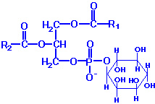
Complex/compound lipids
PS:
net -ve 1 charge at physiological pH
C1- primarily palmitic or stearic acid
C2- long chain unsaturated fatty acid (e.g. 18:2, 20:4 and 22:6) on carbon 2.
PI:
C I stearic acid & C2-arachidonic acid exclusively
composed of non-phosphorylated inositol
exhibit a net -ve charge at physiological pH.
exist in membranes as polyphosphoinositides- phosphorylated inositol.
polyphosphoinositides are
intracellular transducers of signals emanating from the plasma membrane.
Phosphatidylserine (PS)
Phosphatidylinositol (PI)

Slide 62
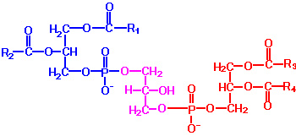
Complex/compound lipids
PG
a net charge of -1 at neutral pH.
high levels in mitochondrial membranes.
Components of pulmonary surfactant. A precursor for cardiolipin synthesis
precursor for diphosphatidylglycerols (DPGs).
Phosphatidylglycerol (PG)
very acidic,
exhibits a net charge of -2 at neutral pH.
Primarily found in the inner mitochondrial membrane
components of pulmonary surfactant.
Diphosphatidylglycerol (DPG)

Slide 63
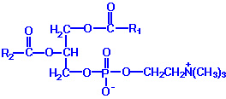
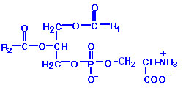
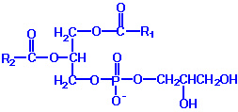
 | Phosphatidylcholine (PC) lecithin –contain glycerol and fatty acids and choline esterified to a phosphate
 | Phosphatidylethanolamine (cephalins) They occur in tissue in association lecithin
 | Phosphatidylserine (PS) .
 | Phosphatidyl inositol (lipositol) acts as a second massager in a Ca²⁺. Dependent hormone action they are more acidic than other phospholipids
 | Phosphatidylglycerol (PG)

Slide 64
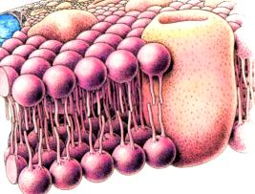
Functions of Phospholipids
Protein Channel
Structure of the cell membranes
Main structural component of membranes, arranged in bilayers.
Self-assembles into micelles or bilayers, an important part of cell membranes
Fatty acids, choline, etc are bound in the phospholipid bilayer layer
participate in the lipoprotein comp
Lipoproteins -matrix of cell walls &membranes,the myelin sheath, mitochondria and microsomes.
impart physical characteristics – selective permeability towards certain non polar (hydrophobic) molecules.
Hydrophilic
Hydrophilic
Hydrophilic

Slide 65
Functions of Phospholipids
lipid absorption in the intestine –
– lecithin involved emulsificaiton of lipids by lowering the surface tension of water and f. a. / water mix.
prerequisite in digestion and adsorption of lipids from G1 tract.
Lipid Transport
Carry lipid-insoluble cpds from stomach/ intestine to bloodstream, and the lymphatic system
Endogenous TG carried from liver to various tissue chylomicrons, lipoprotein complexes etc
PL is required for the formation of the lipoprotein complex.
transportation of lipids from liver to various tissues.

Slide 66
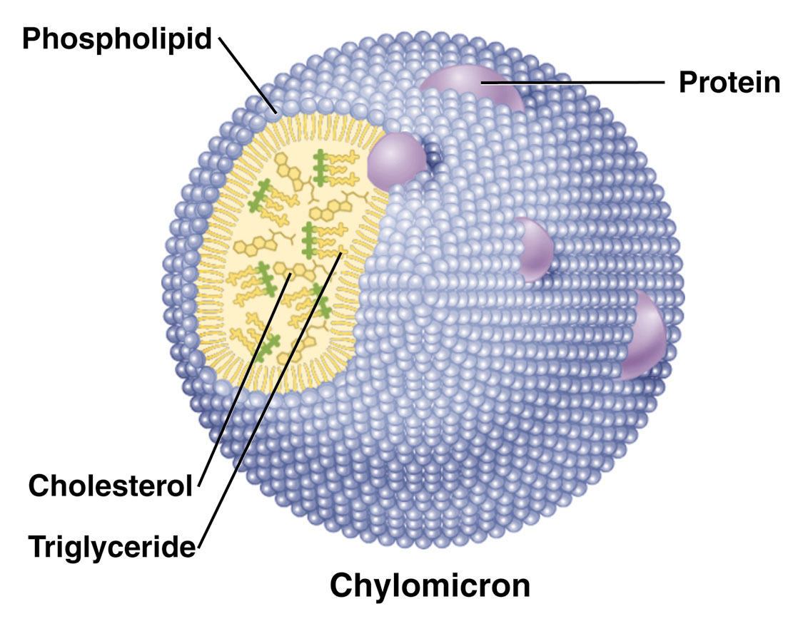
Chylomicrons are lipoproteins

Slide 67
Functions of phospholipids
Emulsifiers
ideal emulsifiers, due to their structure
Lecithins are used by the food industry to:
Combine foods that wouldn’t normally mix
Increase dispersion and reduce fat separation
Increase shelf-life, prolong flavor release,
prevent such products as gum from sticking to teeth
A typical diet contains only about 2 grams per day

Slide 68
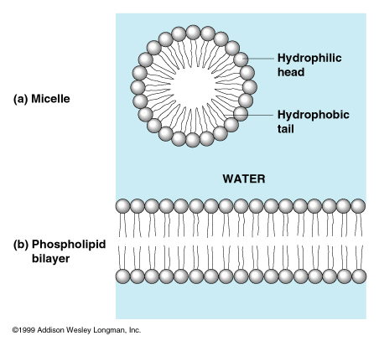
Phospholipids in Water

Slide 69
Functions of phospholipids
Role in enzyme action
Certain enzyme require tightly bound phospholipids for their action
eg enzymes involved in oxidative phosphorylation.
Role in blood coagulation.
Required at the stage of conversion of prothrombin to thrombin by active factor x
possibly also in the activation of factor IX.

Slide 70
Functions of Phospholipids
Role in electron transport; -
PL help to couple oxidation with phosphorylation
maintain electron transport enzymes in active state
Lipotropic action of lecithin –
choline acts as a lipotropic agent
Prevent formation of fatty liver.
Ion transport and secretion
Membrane phospholipids are sources of arachidonic acid
utilized in the synthesis of prostaglandins.
Insulation –
phosphoglycerides of myelin sheath provide the insulation around the nerve fibres.

Slide 71
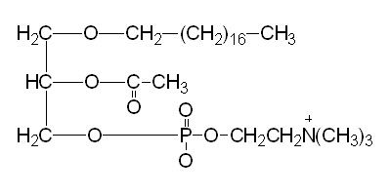
Phospholipids
Plasmalogens
glycerol ether phospholipids.
two types,
alkyl ether (-O-CH₂-)
alkenyl ether (-O-CH=CH-)
DHAP-precursor glycerol ether phospholipids.
3major classes of plasmalogens : choline, ethanolamine & serine
Ethanolamine- prevalent in myelin.
Choline - is abundant in cardiac tissue.
platelet activating factor, PAF. plasmalogen (1-O-1'-enyl-2-acetyl-sn-glycero-3-phosphocholine)-
powerful biological mediator,
induce cellular responses at conc (10⁻¹¹ M. )
A mediator of hypersensitivity,
acute inflammatory reactions
anaphylactic shock.
Platelet activating factor (PAF)

Slide 72
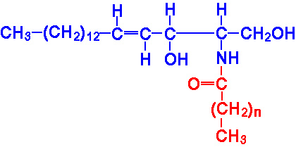
Sphingolipids
Sphingosine is the alcohol moeity
a long-chain amino alcohol
has a polar head group and two nonpolar tails.
are a component of all membranes
abundant in the myelin sheath
Sphingomyelins
structural lipid components of nerve cell membranes.
the only sphingolipid that are a phosphate group
a ceramide results from amino acylation, with a long chain fatty acid, at carbon 2 of sphingosine
Sphingosine
Ceramide

Slide 73
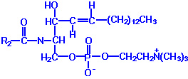
Sphingolipids
Examples of sphingolipids
Sphingomyelins
the only phosphate containing sphingolipid a
component of all membranes- esp myelin sheath.
structural lipid components of nerve cell membranes.
contain palmitic or stearic acid N-acylated at carbon 2 of sphingosine.
synthesized by the transfer of phosphorylcholine from phosphatidylcholine to a ceramide in a reaction catalyzed by sphingomyelin synthase.

Slide 74
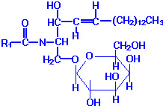
Sphingolipids
2. Glycosphingolipids
A lso known as glycolipids
composed of a ceramide backbone with a various –CHO (mono- or oligosaccharides)
CHO are attached to carbon 1 of sphingosine.
Include
cerebrosides
sulfatides
globosides
gangliosides
A Galactocerebroside

Slide 75
Sphingolipids
Cerebrosides
have a single sugar group linked to ceramide.
common is galactose or glucose
galactocerebrosides-
Made from galactose
Predominantly found in neuronal cell membranes
synthesized from ceramide and UDP-galactose
glucocerebrosides-
Made from glucose (minor).
not normally found in membranes,
intermediates in the synthesis or degradation of more complex glycosphingolipids.
Excess glucocerebrosides accumulation -gauchers diseases

Slide 76
Sphingolipids
Sulfatides:
sulfuric acid esters of galactocerebrosides
synthesized from galactocerebrosides and activated sulfate, 3'-phosphoadenosine 5'-phosphosulfate (PAPS).
Excess accumulation of sulfatides leads to sulfatide lipidosis (metachromatic leukodystrophy).
Globosides:
cerebrosides that contain additional carbohydrates, predominantly galactose, glucose or GalNAc.
Lactosyl ceramide is a globoside found in erythrocyte plasma membranes.
Globotriaosylceramide (also called ceramide trihexoside) contains glucose and two moles of galactose and accumulates, primarily in the kidneys, of patients suffering from fabry’s disease

Slide 77
Sphingolipids
Gangliosides:
similar to globosides
except also contain NANA in varying amounts.
specific names for gangliosides are a key to their structure.
Each has letter G refers to ganglioside,
the subscripts M, D, T and Q indicate that the molecule contains mono-, di-, tri and quatra(tetra)-sialic acid.
The numerical subscripts 1, 2 and 3 refer to the carbohydrate sequence that is attached to ceramide
1 stands for GalGalNAcGalGlc-ceramide,
2 for GalNAcGalGlc-ceramide and
3 for GalGlc-ceramide.
lysosomal enzyme difficiency for the degradation of the carbohydrate portions of various gangliosides, lipid storage diseases

Slide 78
Derived lipids
Derivatives of hydrolysis of simple or compound lipids. Examples
glycerol
fatty acids
steroids &sterols
fatty aldehydes
ketone bodies
fatty soluble vitamins
steroid hormones.
Common are sterols and steriods

Slide 79
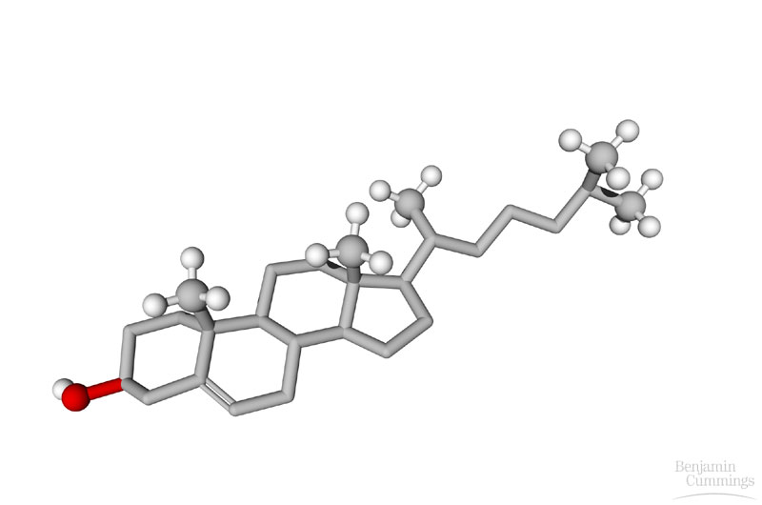
Sterols and Steroids
Lipids with 4 fused rings carbon skeleton structure
Differ in the functional groups attached to the rings.
hydrophobic & lipophilic but no fatty acids
Examples:
cholesterol
sex hormones

Slide 80
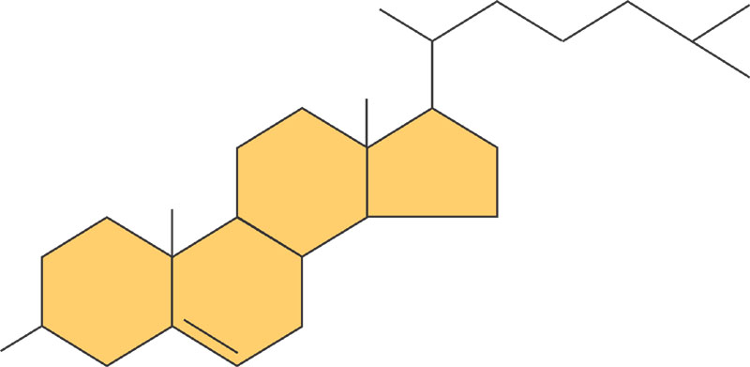
Cholesterol
Cholesterol-best-known sterol
found only in animal products
Four carbon rings with no fatty acid tails
Component of animal cell membranes
Modified to form sex hormones
H₃C
CH₃
CH₃
CH₃
CH₃
HO

Slide 81
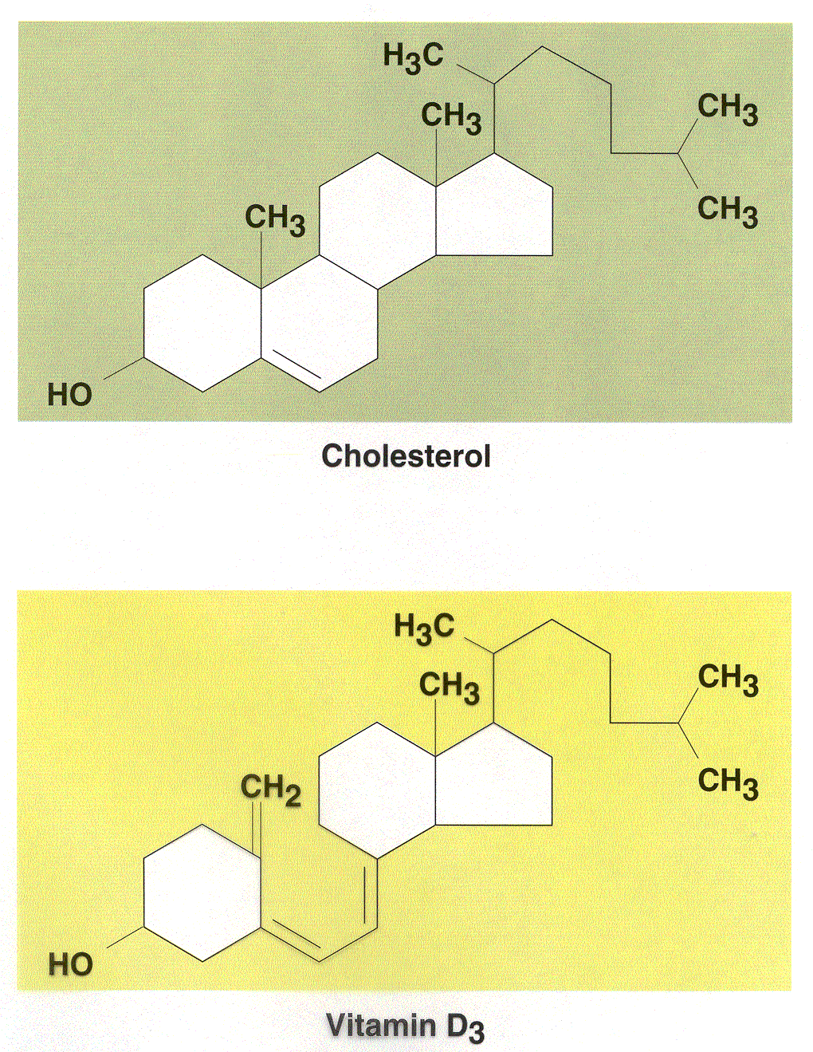

Slide 82
CHOLESTEROL
Major component of cell membranes
abundant in nerve and brain tissue
Precursor molecule:
Vitamin D
estrogen are synthesized from cholesterol
Important in the synthesis of bile acids
The liver manufactures most of the cholesterol in the body
The intestine and all cells contribute a small amount
Overall, the body produces about 1000 mg per day
Serum cholesterol levels are homeostatically controlled (set-point)

