Slide 1
THE EICOSANOIDS

Slide 2
Eicosanoids
Autocoids:
a large group of physiologically active substances
Derivative of a C₂₀ unsaturated f.a (eicosanoic acids)
Greek, eikosi, which means twenty
Produced mostly from arachidonic acid
a C₂₀ polyunsaturated f.a (5,8,11,14-eicosatetraenoic acid).
Potent physiological effects on virtually every tissue in the body

Slide 3
Properties of eicosanoids
Only synthesised when required
Autocrine - they act on cells producing them- local effects-"local hormones’’
Rapidly degraded
intercellular and intracellular signaling actions

Slide 4
CLASSIFICATION OF EICOSANOIDS
Two groups
Prostanoids
Prostaglandins ( PG)
Thromboxanes (TX)
Prostacyclins (PGI)
Leukotrienes
hydroperoxyeicosatetraenoic acids (HPETEs)
hydroxyeicosatetraenoic acids (HETEs).

Slide 5
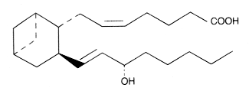
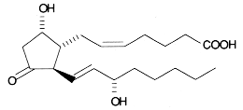
Eicosanoid
Prostanoid
Leukotrienes
TXA₂
Prostaglandins
Prostacyclin
Thromboxane
PGD₂

Slide 6
STRUCTURE OF THE PROSTANOIDS
Oxygenated C₂₀ carbon fatty acids
Cyclic ring
trans–double bond C-13
OH group at C-15
PGD₂

Slide 7
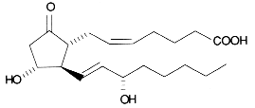
STRUCTURE OF THE PROSTANOIDS
Prostaglandins (PG)
large family of cpds formed from prostanoic acid consists of
20 carbon atoms
cyclo-pentane ring
two aliphatic chains
a double bond between carbon atom 13 and 14,
a terminal carboxyl group
a hydroxyl group at carbon atom 15
abbreviated as PG
PGE₂

Slide 8
Nomenclacture of Prostaglandins
Named as PG- (A-J)
Names based on nature/modifications of a cyclopentane ring with
Hydroxyl group
Keto groups
Unsaturated
A numerical
subscript indicate the number of d.b the side chains.
Eg PGE₂–subscript 2 indicates no. of C=C on side chains attached to cyclo-pentane ring
PG-A,B,C & J are metabolites of other PGs- do not occur naturally
PGD, PGE, PGF and PGI are stable occurs naturally
PGG and PGH intermediates in eicosanoid synthesis

Slide 9
Thromboxanes:
contain a cyclo-hexane ring
Named as TXA and TXB
TxB stable metabolite of TxA
TXA₂

Slide 10
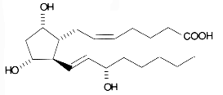
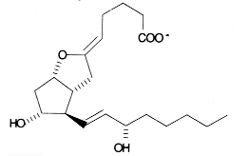
PGD₂
PGF_{2α}
PGE₂
PGH₂
PGG₂
TXA₂
PGI₂

Slide 11
The Leukotrienes
Leukotrienes – first found in leukocytes
4 double bonds but 3 are conjugated.
Leukotriene B₄ (LTB₄)
Leukotriene C₄ (LTC₄)
Leukotriene D₄ (LTD₄)
Leukotriene E₄ (LTE₄)
Leukotrienes C, D and E are cysteinyl leukotrienes

Slide 12
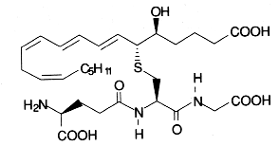
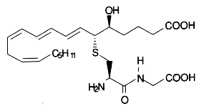
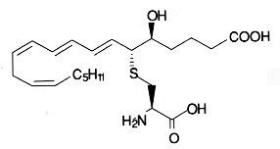
LTB₄
LTC₄
C, D and E known as cysteinyl-leukotrienes due groupto sulphur
LTD₄
LTE₄

Slide 13
SOURCES OF EICOSANOIDS
Arachidonic acid, (C20 f.a) the common precursor
acyl group esterified on OH of C2 of most membrane phospholipids esp phosphatidyl inositol
released from membrane phospholipids by 2 enzymes
Phospholipase 2 (PLA₂)
hydrolyse acyl group on C₂ of the glycerol backbone
Products are fatty acid & a lysophospholipid
inhibited by glucocorticoids.
Phospholipase C (PLC)

Slide 14
Action of Phospholipase A2 and C

Slide 15
Inhibitors of PLA₂
Corticosteroids
inhibit the production of phospholipase A₂
prevents arachidonic acid release from membrane
Corticosteroids are ‘anti-inflammatory’
stop the inflammation reactions associated with eicosanoids

Slide 16
Indirect Production of Arachadonic Acid
Indirectly released from Phosphatidyl inositol 4,5-bisphosphate (PIP₂)
membrane phospholipids
PIP₂ has arachidonic acid possess a f.a
PIP₂ is cleaved by phospholipase C (PLC) into
inositol triphosphate (IP₃)
diacylglycerol (DAG)
can be lipase hydrolyseDAG to arachidonic acid

Slide 17
Arachidonic Acid Production
Membrane phospholipids
PIP₂ in membrane
Phospholipase C (PLC)
Phospholipase A (PLA₂)
Diacylglycerol
IP₃
Diacylglycerol lipase
Arachidonic acid

Slide 19
Physiological Functions of Eicosanoids
Prostanoids have diverse roles
Control-reproductive processes & tissue growth
Inflammation
Fever
Regulation of blood pressure
Blood clotting
Immune system modulation
Regulation of sleep/wake cycle.

Slide 20
Physiological functions
Female reproductive system
Steroidogenesis.
PGE₂ stimulate the activity of adenylate cyclase
raise the concentration of cyclic AMP.
stimulates formation of progesterone in the ovary
Ovulation
PGE & PGF
Produced by ovary & endometrial cells
Response to decreased level of blood LH
Initiates regression of the corpus luteum
Menstruation
PGS intiate menstruation
increasing the contraction of myometrium smooth muscles
Results in ischaemia.

Slide 21
Physiological Functions of Eicosanoids
Used as arbortificients.
increased level of PGs causes increased myometrium contractility
Prevents implantation.
PG synthesis inhibitors can treat disorders like:
dysmenorrhoea (painful menstruation)
menorrhagia (execessive or prolonged menstruation)
IUD
Effectiveness depends on the stimulation of local PG production

Slide 22
Physiological Functions of Eicosanoids
Parturition
In labour, amniotic fluid PGS levels increases >10X
reflects a conc change in the myomentrium.
PG initiates the contractile activity of the myometrium
cause relaxation of uterine &cervix smooth muscles.
pregnant women
PGE₂ and PGF_{2a} cause contraction of uterine smooth muscle
nonpregnant uterus
has a more variable response to prostaglandins
PGF_{2a} causes contraction
PGE₂ causes relaxation

Slide 23
Physiological Functions of Eicosanoids
Gastrointestinal tract
PGE and PGA regulates secretion of
gastric
histamine.
High levels PGE & A decrease protons & pepsin secretion
PGE₂ and PGI₂
inhibit acid and pepsinogen secretion in the stomach.
PGE₂ and PGF_{2a}
increase the rate of longitudinal contraction in the gut and decrease transit time.

Slide 24
Physiological Functions of Eicosanoids
Gastrointestinal tract
The leukotrienes
are potent stimulators of gastrointestinal smooth muscle.
Prostaglandins
increase mucus, water, and electrolyte secretion in the stomach and the intestine.

Slide 25
Physiological Functions of Eicosanoids
Control of blood pressure
PGs have vasodilatory effects on the kidney.
increase renal blood flow
increase the rate of renin release
increase sodium excretion.
Hypertension
kidney inability to synthesis PGs in sufficient amounts

Slide 26
Physiological Functions of Eicosanoids
Pain and Inflammation
vasodilation and increased vascular permeability.
High levels of PGs cause pain by direct action on pain receptors
PGE₂ and PGI₂
cause an increase in blood flow
promote, but do not cause edema.
HETEs (5-HETE, 12-HETE, 15-HETE) & leukotrienes
cause chemotaxis of neutrophils and eosinophils.

Slide 27
Physiological Functions of Eicosanoids
Fever
Hypothamus is temp regulatory centre
fever results from raised levels of PGs in the hypothalamus
Presence of PGE₁ in 3rd third venricle induces fever
Raised pyrogen levels CFS induces fever.
Fever drugs asprin, paracetamol & indomethacin. inhibit PG syn
Asprin inhibit brain COX
-very effective at reducing body temperatures.

Slide 28
Physiological Functions of Eicosanoids
Blood clotting
platelets aggregation intiates blood clotting
PGs, TX and PGI produced by platelets
potent inducers of platelet aggregation.
Blood PGI
Formed in endothelial cells of arterial wall
the lungs
inhibit platelet aggregation.
PGI are produced in sufficient levels to overide TX effects normally.
No significant platelet aggregation
Arterial wall damage reduces the rate of PGI synthesis & release
thromboxane effect predominates
Initiates platelets aggregation and of clotting
Atherosclerotic plague reduce the rate of PGI synthesis & realese
increases chance of thrombus formation in an undamaged artery
May lead to fatal consequences.

Slide 29
Physiological Functions of Eicosanoids
Blood clotting
TXA₂ is a potent inducer of platelet aggregation.
PGI₂ and PGE₂ -inhibit platelet aggregation.
PGEs -stimulates the renal release of erythropoietin.
induce erythropoiesis by
5-HPETE - stimulates release of histamine
PGI₂ and PGD-inhibit histamine release.

Slide 30
Physiological functions
Vascular smooth muscle
PGE₂ and PGI₂
potent vasodilators in most vascular beds.
Thromboxane is a potent vasoconstrictor.

Slide 31
Physiological functions
Bronchial smooth muscle
PGFs cause smooth muscle contraction.
PGEs cause smooth muscle relaxation.
Leukotrienes and thromboxane are potent bronchoconstrictors and are the most likely candidates for mediating allergic bronchospasm.

Slide 32
Therapeutic uses
Induction of labor at term.
Induction of labor is produced by infusion of:
PGF_{2a} (carboprost tromethamine) [Hemabate] or
PGE₂ (dinoprostone) [Prostin E].

Slide 33
Therapeutic abortion:
Inducing abortion in the second trimester:
Infusion of carboprost tromethamine
Administration of vaginal suppositories containing dinoprostone
inducing first-trimester abortion:
these prostaglandins are combined with mifepristone (RU486)

Slide 34
Therapeutic applications
Maintenance of ductus arteriosus
is produced by PGE₁ [Prostin VR] infusion
PGE₁ will maintain patency of the ductus arteriosus,
ductus arteriosus may be desirable before surgery.

Slide 35
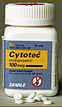
Treatment of peptic ulcer.
Misoprostol [Cytotec]
a methylated derivative of PGE₁
approved for use in patients taking high doses of nonsteroidal antiinflammatory drugs (NSAIDs)
Eg asprin, paracetamol
reduces gastric ulceration.

Slide 36
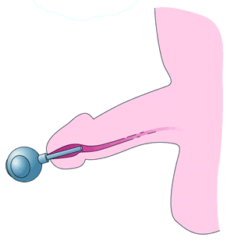
Therapeutic applications
Erectile dysfunction:
Alprostadil (PGE₁) can be injected
directly into the corpus cavernosum
administered as a transurethral suppository
cause vasodilation and enhance tumescence.
Transurethral suppository
Injected directly into
the corpus cavernosum

Slide 37
Adverse effects of Eicosanoids
local pain and irritation
bronchospasm
gastrointestinal disturbances:
nausea
vomiting
Cramping
diarrhea.

Slide 38
SYNTHESIS OF THE EICOSANOIDS
Two biosynthetic pathways:
Cyclic/cyclooxgenase pathway for prostanoids
Linear/ Lipooxygenase pathway for leukotrienes
Cyclic / cyclooxgenase pathway produces:
Thromboxane (TX)
Primary prostaglandins (PG)
prostaglandin E, or PGE
prostaglandin F, or PGF
prostaglandin D, or PGD)
Prostacyclin (PGI₂)

Slide 39
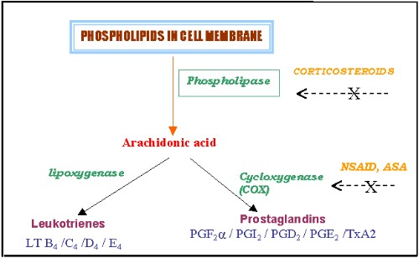

Slide 40
Eicosanoid Biosynthesis
Membrane phospholipids
Phospholipase A (PLA₂)
Arachidonic acid
Leukotrienes
Lipo-oxygenase
Cyclooxygenase 1/2
PGH₂ synthase has 2 activities
Peroxidase
cyclo-oxygenase – often known as COX enzyme
PGG₂/PGH₂
PGES
PGIS
PGDS
PGFS
TxS
PGD₂
PGE₂
PGF_{2α}
PGI₂
TxA₂

Slide 41
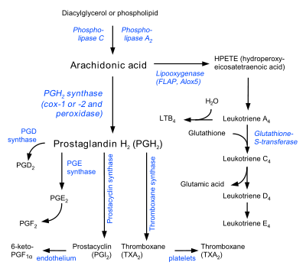

Slide 42
Eicosanoid Biosynthesis

Slide 43
Cyclic Pathway for Prostanoids
Also known as the cyclooxygenase pathway.
Local action -synthesized in the cells upon which they act
Precursor is arachidonic acid
a component of membrane phospholipid
Made available by the action of PLA2
free arachidonic acid oxidized by molecular oxygen to PGG₂ then to PGH₂
Catalysed by PGH₂ /(prostaglandin H) synthase
Found in mammalian microsomes.
has 2 activities:
cyclooxygenase (COX)
peroxidase

Slide 44
Cyclooxygenase activity:
formation of the cyclopentane ring
addition of 4 oxygen atoms to the ring
Peroxidase activity:
2 electron reduction of the 15 hydroperoxy (OOH) group to a 15 hydroxyl group (OH)
isomerisaiton of PGH2 give rise to
PGGE₂
thromboxanes A2
prostacylin

Slide 45
The Cyclic Pathway
Haem containing dioxygenase bound to smooth endoplasmic reticulum.
Cyclo-oxygenase – cyclopentane ring is formed and 4 oxygen atoms are added
Peroxidase – 2e- reduction of the 15 hydroperoxy group to a 15 –OH group.
Aspirin and NSAID (inhibit COX activity of enzyme, acetylates serine hydroxyl group near active site) – anti-inflammatory and anti-thrombotic.
Long lasting effect – platelets lack a nucleus so can’t make more COX.

