Slide 1
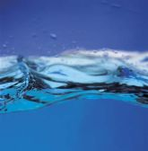
WATER

Slide 2
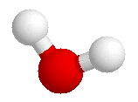
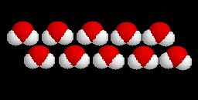
STRUCTURE OF WATER MOLECULE
Water molecule is made up of 3 atoms
    one oxygen
    two hydrogen.
H
H
O
H

Slide 3
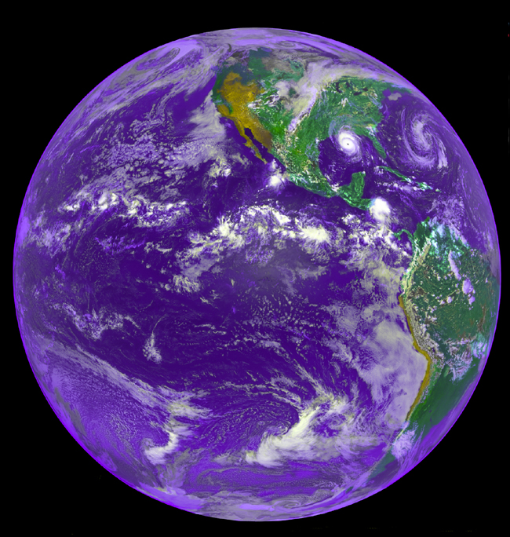
Introduction
most abundant substance in living systems & environment
2/3 of the globe
2/3 of all cells
Greater 70 % dry weight of most organisms
Occurs in all 3 states.
    Solid-ice
    Liquid: liquid water
    Gas: water vapor
Freezes at 0C and boils at 100 C.

Slide 4
WATER : INTRODUCTION
Water is critical in the chemistry of all life
Functions of biomolecules, cells & organisms are directly related to chemical properties of water
Biomolecules including proteins, nucleic acids & polysaccharides and supramolecular assemblies such as &membranes assume their characteristic shapes in response to water

Slide 5
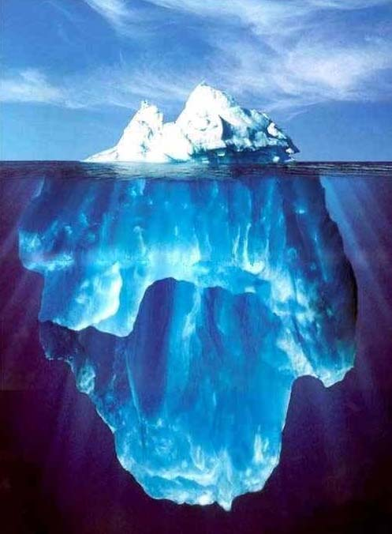
Properties of Water
Water has many characteristics vital to living systems.
Small sized molecule
High boiling points
High melting points
Cohesion
Adhesion
High specific heat
High heat of vaporization
Less dense than a solid
Notes:
1

Slide 6

Characteristics of water
1. Size
  water is a very small molecule
  Makes it move fast
  can squeeze into tiny crevasses between other molecules
Polarity
  H-O bonds is polar
  due to differences in electronegativity btwn H & O
  Polarity of H-O is due to the uneven charge distribution
      Hydrogen is positively charged (d⁺),
      Oxygen is slightly negatively charged. (d⁻)
  Polarity makes it easy for water to interact with a variety of other charged molecules, dissolving them.
  This makes water a universal solvent

Slide 7
Characteristics of water Cont.
3. Shape
a bond angle of 104.5º which is slightly less than the 109.5º of a perfect tetrahedron
Angle reduction due to the crowding by the nonbonding orbital / electrons of the oxygen atom.
Angled arrangement of polar bonds creates a permanent dipole for a water molecule
Essential for many polar properties

Slide 8
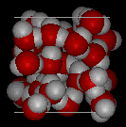
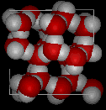
Characteristics cont.
Water
  4. Crystal structure
  H2O forms a crystal structure due to polarity,
  Water is closely packed- Liquid water has H- bonds that are constantly being formed& broken
  Ice is loosely packed- forms a crystal-like lattice whereby molecules are set at fixed distances.
  Ice is less dense & floats on liquid water.
H-bond provides cohesive forces that makes water a liquid at room temperature
favours the extreme ordering of molecules that is typical of crystalline water.
Ice

Slide 9
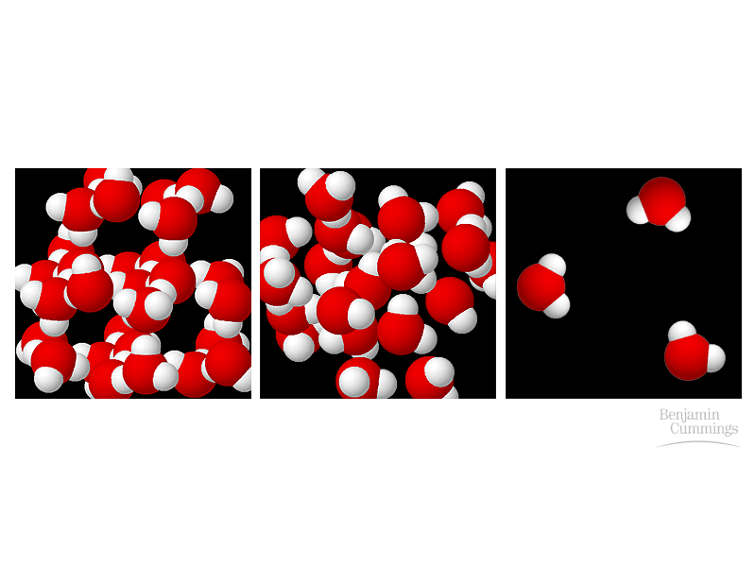
Characteristics of water Cont.
Ice water vapor

Slide 10
Characteristics of water Cont.
  4. Heat capacity
  Water -absorbs and releases heat energy slowly
  helps organisms maintain their body temp in the safe range.
Specific heat capacity: heat needed to raise or lower 1g of a substance by 1° C.
Water absorb or release large amounts of heat energy
resists changes in temp both during heating or cooling.
Heat of vapourisation:
energy required to convert 1g of a substance from a liquid to a gaseous form
Water has high heat of vaporization- (540 Cal/g)
Due to numerous H-bonds which must be broken down.
Cooling effect- as water evaporates, it removes a lot of heat with it

Slide 11

High boiling points:
  pure water boils at 100 °C and freezes at 0 °C at sea level.
  Due to extensive hydrogen bonds that must be broken to turn water into the gaseous state
  The high boiling temperature decreases at higher elevations (lower atmospheric pressure).
  Hence an egg will take longer to boil at higher than at low altitudes

Slide 12
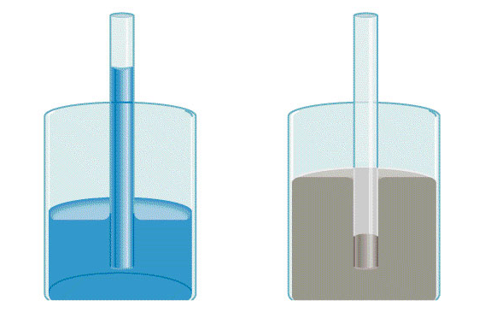
Characteristics of water cont.
es
  5. Cohesion and adhesion
  Cohesion is the intermolecular attraction between like molecules. Adhesion is an attraction between unlike molecule
Adhesion
attracted to glass
Cohesion
attracted to each other

Slide 13
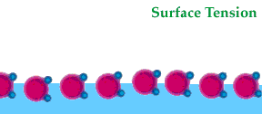
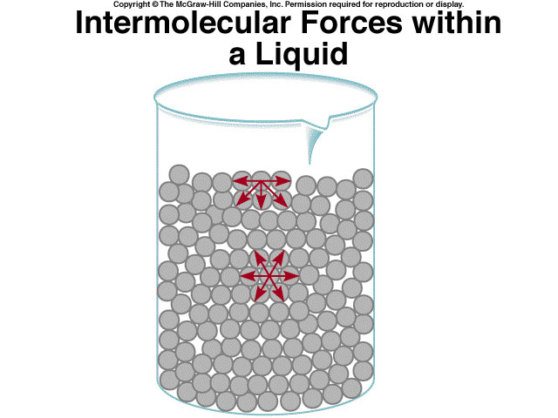
Cohesion
Forces of attraction between particles of the same substance
attractions between adjacent water molecules
gives liquid water great internal cohesion
Presence of hydrogen bond
Cohesion results in surface tension
  a measure of the water’s surface’s strength
  the amount of energy required to stretch or increase the surface of a liquid by a unit area.
Produces a surface film on water that allows insects to walk on the surface of water
Strong intermolecular forces- High surface tension
Notes:
1

Slide 14
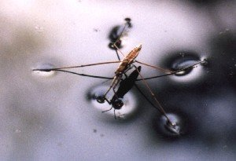
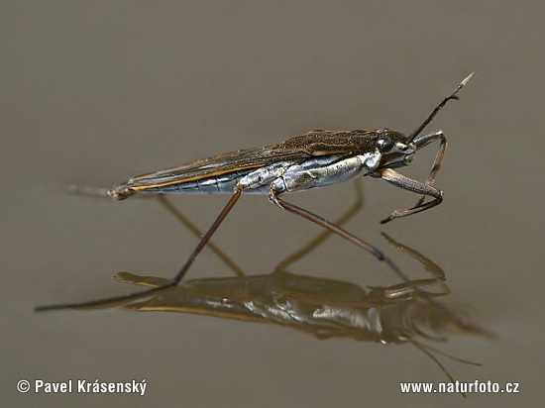
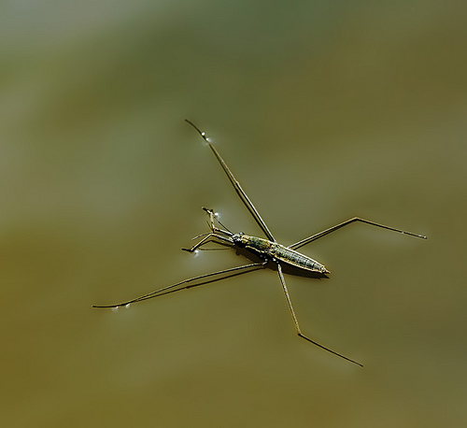
Cohesion …
Helps insects walk across water

Slide 15
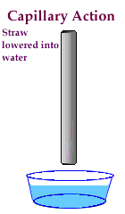
Adhesion
Attraction between two unlike/different substances.
Water molecules will interact with other surfaces such as glass, soil, plant tissues, and cotton via hydrogen bonds.
Capillary action-water molecules will “tow” each other along when in a thin glass tube is due to adhesive forces.
Example: transpiration process which plants and trees remove water from the soil, and paper towels soak up water.
Adhesion Causes Capillary Action- gives water the ability to “climb” structures
Notes:
1

Slide 16
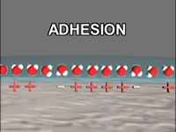
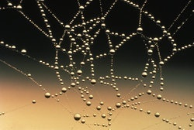
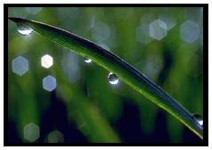
Adhesion Also Causes Water to …
Attach to a silken spider web
Form spheres & hold onto plant leaves

Slide 17
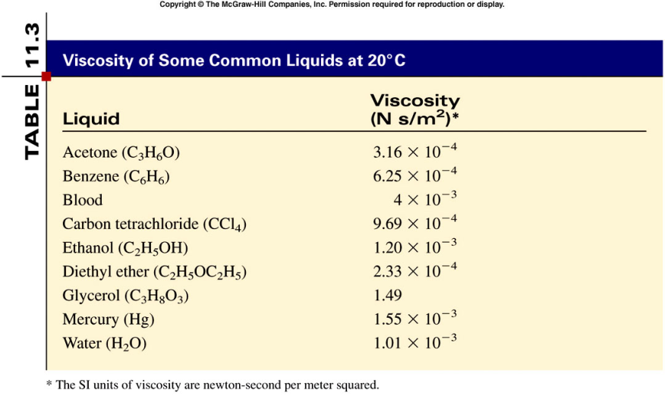
Viscosity
A measure of a fluid’s resistance to flow.
Strong intermolecular forces
High viscosity
Water is ralatively viscous due to H-bonding

Slide 18
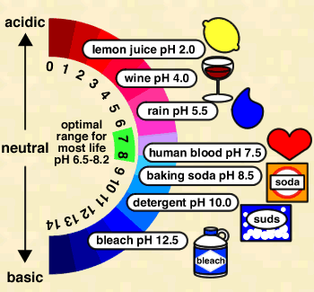
Characteristics Cont.
  Buffer
  Water can act as either an acid or as a base,
  maintains a stable body pH
  Environmental buffer
  Water vapor forms a kind of global ‘‘blanket” which helps to keep the earth warm.
  Heat radiated from the sun warms the earth surface and is held by the vapour.

Slide 19

Biological importance of water
Water As A Solvent
Water In Organisms
Water As A Reactant
Water As A Way Of Transport
Water As A Lubricant
Water As A Way Of Support
Water For Constant Temperature
Water In Sexual Reproduction
Marine Life During Winter
Water As A Habitat

Slide 20
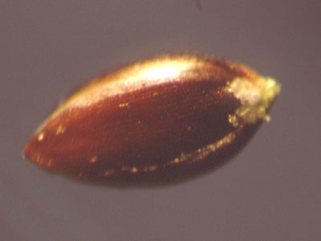
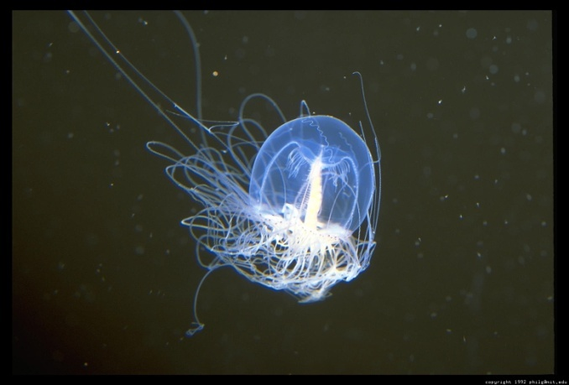
Water In Organisms
Organisms usually contain 60% to 90% water.
Lowest- Plant Seed (20%)
Highest- Jellyfish (99%)
Water helps all organisms with metabolism, and specifically helps plants with photosynthesis and support.
20% Water
99% Water

Slide 21
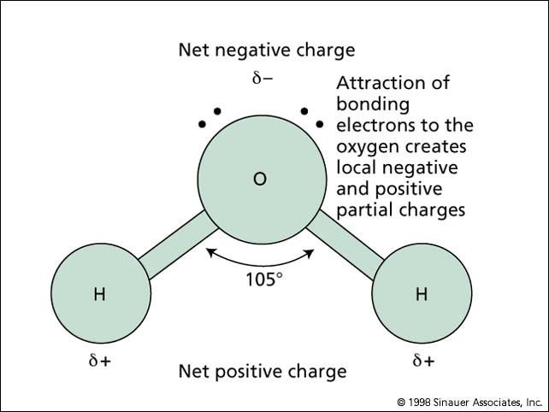
Water As A Solvent
Water contains 1 covalently bonded oxygen atom and 2 hydrogen atoms.
water molecule ispolar, because electrons are not equally shared.
Due polarity water can ionize substances easily, making it a good solvent.
Water is know as ‘The Universal Solvent’.

Slide 22
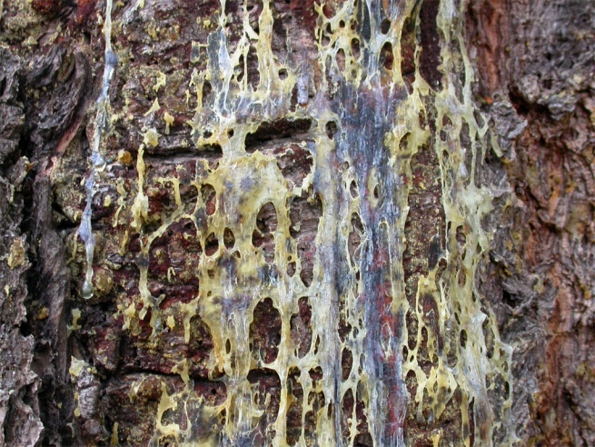
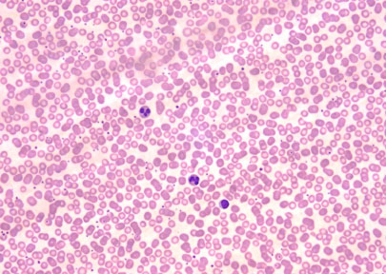
Water As A Way Of Transport
Tree Sap
Many different substances, such as blood and sap, are transported by water.
Sap and blood contain high amounts of water making them good solvents.
Being good solvents allows them to dissolve the substances they are transporting.
Human Blood Cells

Slide 23
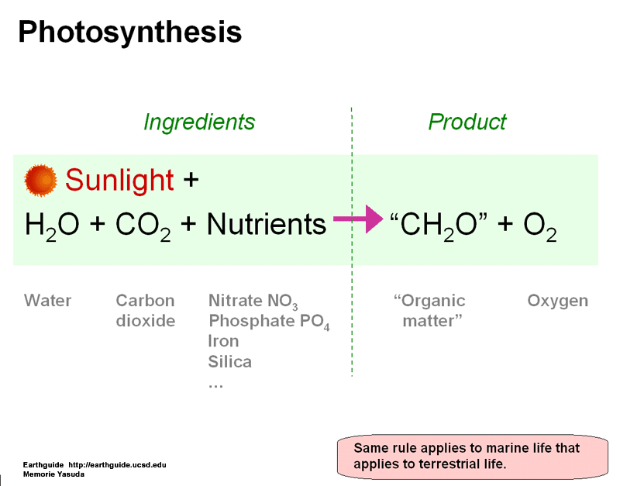
Water As A Reactant
Water, being a good solvent, allows many reactions to occur.
Water is used in photosynthesis to make NADPH2, and ultimately sugar.
These reactions release oxygen gas, which is vital to human life.
Without water in photosynthesis, organisms would not be able to obtain energy, and life as we know it would be impossible.

Slide 24
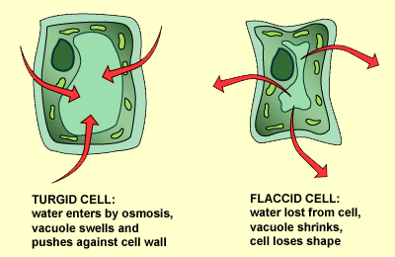
Water As A Way of Support
When water enters the cell by osmosis, the water fills up the cell so much that the cell prevents other water intake.
This makes the cell turgid, or stiff.
The cell must be turgid to support the plant’s leaves.
Also, organisms that live in the water have weaker skeletons than organisms that live on land because of the water’s buoyancy effect.

Slide 25
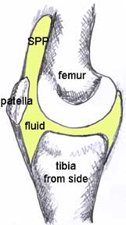
Water As A Lubricant
When bones meet at a joint, they need a fluid between the bones to prevent scraping against each other.
That fluid is called a synovial fluid, which is made mainly of water.
Many internal organs have fluid around them to keep them protected. Examples:
Brain: Cerebro-spinal fluid
Lungs: Pleural Fluid
Eyes: Mix of fluids.
Synovial Fluid

Slide 26
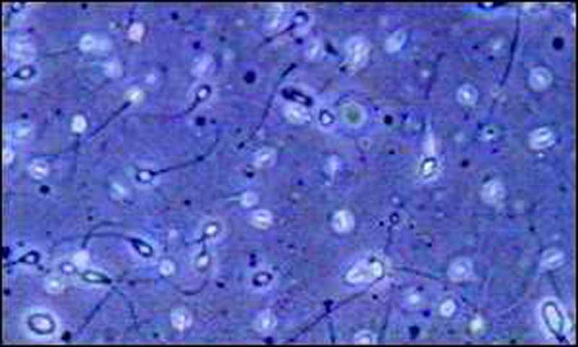
Water In Sexual Reproduction
During fertilization, the sperm, must get to, the ovum in order to make the zygote, which makes a new individual.
In organisms adapted for internal fertilization, the sperm is transported in semen which contains mostly water.
In organisms using external sperm can be transported in the water habitat.
Sperm Cells

Slide 27
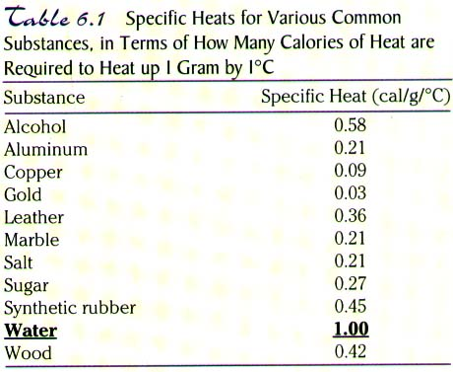
Water For Constant Temperature
Water has a very high specific heat. (4200J/kg0C)
much energy is required to change the temperature of water by a single degree.
That provides a perfect habitat for marine mammals, because of the non-changing temperature.
Another way water helps mammals maintain their body temperature is by sweating.
Mammals sweat when their body temperature is too high.
Sweat is made of mostly water.
When the water evaporates from the organism it creates a cooling effect, therefore lowering the organisms body temperature.

Slide 28
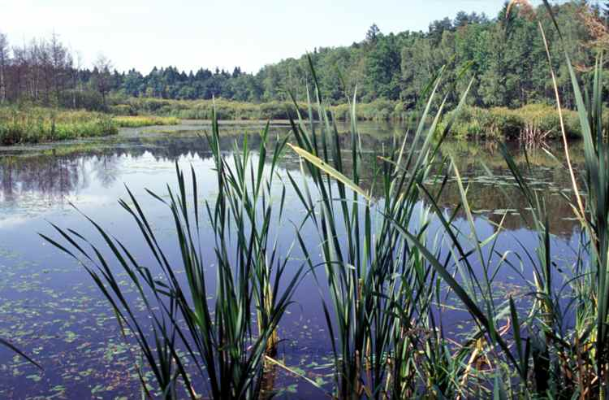
Water As A Habitat
Here are some good reasons why water is a good habitat:
Water can provide a good protective layer for organisms in it.
Water provides buoyancy and support for organisms in the water.
Dissolved oxygen can be plentiful in water, for use in respiration.
Fertilization is easier in water.
Water helps maintain a constant temperature.
Water keeps out UV rays from the sun.

Slide 29
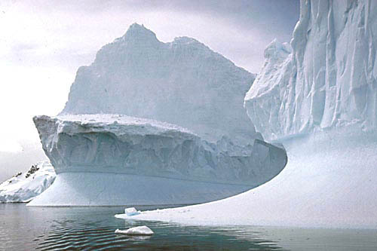
Marine Life During Winter
The solid form of water (ice) is less dense than the liquid water.
This is very unusual.
Water has its highest density at 4C.
That means that at the bottom of a body of water the water will usually be at least 4C.
This allows aquatic organisms to be able to live, even in the winter.

Slide 30
Homeostasis
Ability to maintain a steady state despite changing conditions
Water is important to this process because:
  a. Makes a good insulator
  b. Resists temperature change
  c. Universal solvent
  d. Coolant
  e. Ice protects against temperature extremes (insulates frozen lakes)

Slide 31
Bonding in water: Weak interactions
Each H- atom shares an electron pair with oxygen atom.
The oxygen nucleus is electronegative-attracts e- more strongly than the more electropositive hydrogen nucleus ( a proton),
  electrons are more often in the vicinity of the oxygen atom-becomes partially negative (2d-) than the hydrogen (d+) which “acts” as a positive
  - unequal sharing of electrons results in water molecule being polar
H-bond results due to an electrostatic attraction between the oxygen atom of one water molecule and the hydrogen of another
unusual properties of water -due to hydrogen bonding

Slide 32
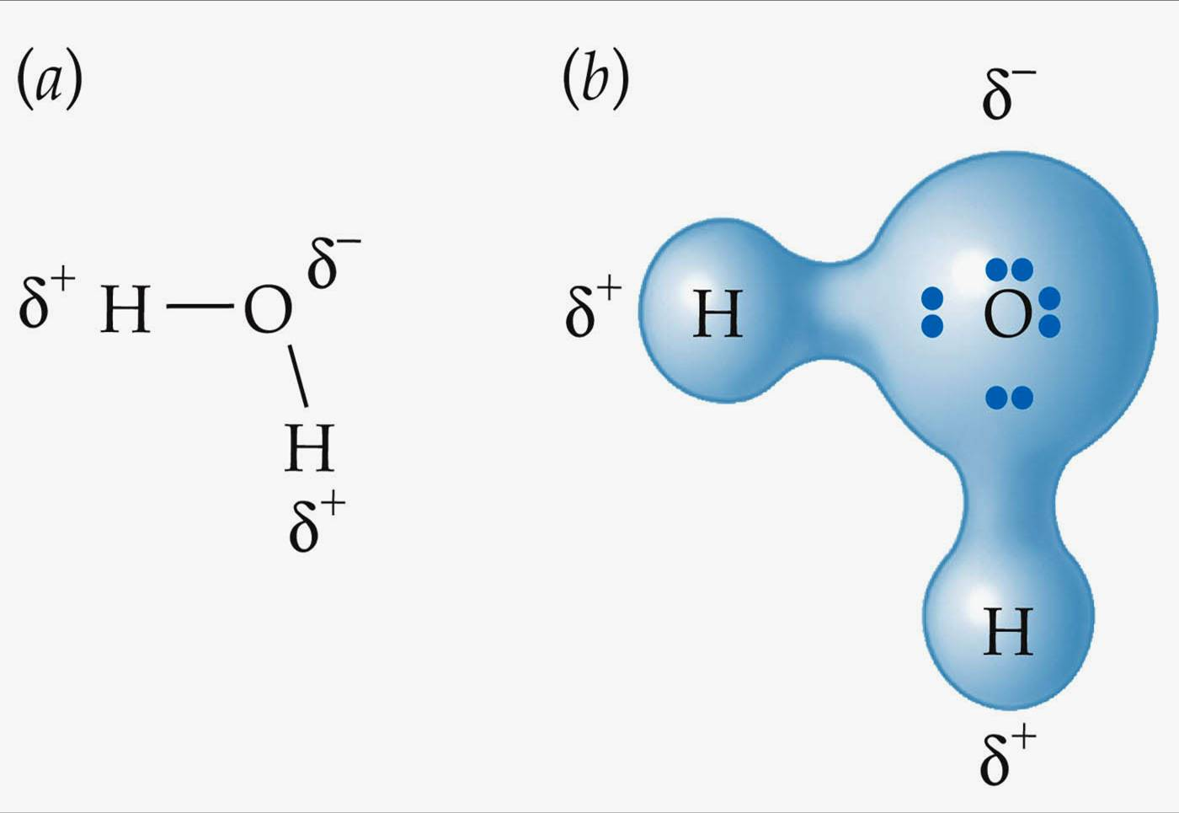
The attraction forces between water molecule
The sharing of electrons between H and O is unequal;
the electrons are more in the vicinity of oxygen atom than of hydrogen.
The result of the unequal electron sharing is two electric dipole in the water molecule , one along each of the H-O bond; the oxygen atom bears a partial negative charge ( ) and each hydrogen a partial positive charge ( )
As a result there is an electrostatic attractions between the oxygen atom of one water molecule and the hydrogen of the other called a hydrogen bond

Slide 33
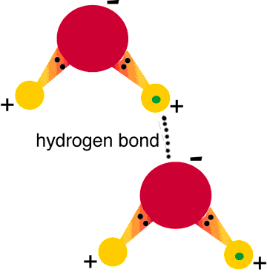
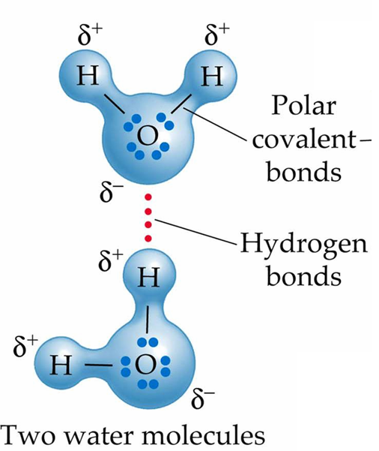
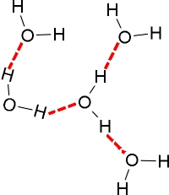

Slide 34
Hydrogen Bonding in water
H-bonds form between highly electronegative atom of a polar molecule and a hydrogen attached to another electronegative atom
formed when a partially positive hydrogen atom attracts a partially negative oxygen atom of a second water molecule
H- bond forms in water molecules as s result of their polarity

Slide 35
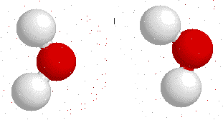
H- Bonds in Water Molecules
Negative Oxygen end of one water molecule becomes attracted to the positive hydrogen end of another water molecule

Slide 36
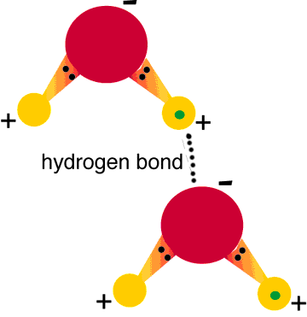
Hydrogen bonding between two water molecules

Slide 37
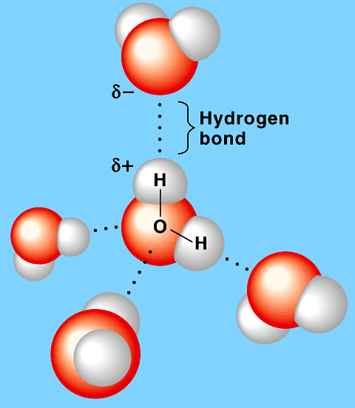
Hydrogen bonding

Slide 38
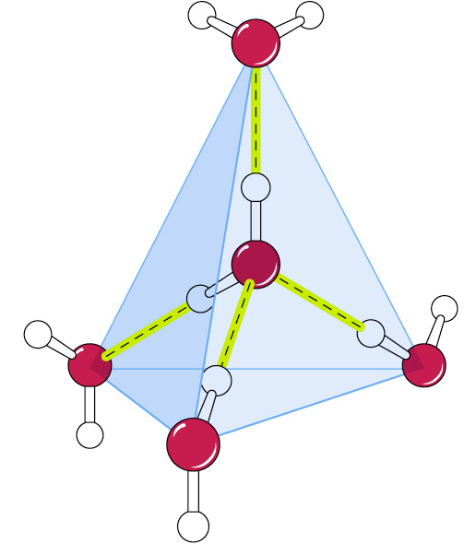
Hydrogen bonding by a water molecule
A water molecule can form up to four hydrogen bonds
Hydrogen bonds shown in yellow

Slide 39
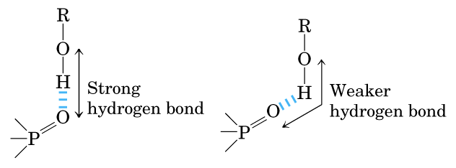
Directionality of the hydrogen bond
H- bonds are strongest when the bonded molecules oriented to maximize electrostatic interaction,
occurs when the hydrogen atom and the two atoms that share it are in a straight line
when the acceptor atom is in line with the covalent bond between the donor atom and H - holding two hydrogen bonded molecules or groups in a specific geometric arrangement.

Slide 40
Hydrogen bonding in ice & water
Ice Exists as a regular crystal lattice.
each water molecule forms the maximum of 4H- bonds
ice crystal lattice makes it less dense than liquid water
At room temperature and atmospheric pressure, each water molecule H-bonds with an average of 3.4 other water molecules
thus ice floats on liquid water.

Slide 41
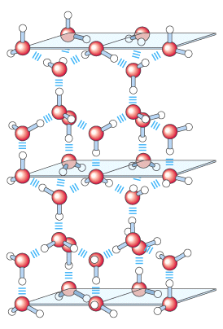
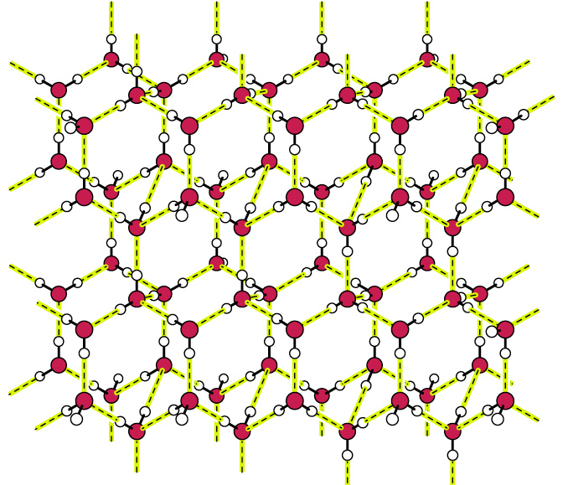
Structure of ice.

Slide 42
Solubility of molecules in water
Solubility in water depends upon the ratio of polar to nonpolar groups in a molecule
The larger the portion of nonpolar groups the less soluble the molecule will be
The larger the portion of polar groups (e.g. hydroxyl groups (-OH) the more soluble the molecule is
Polar biomolecules dissolve readily in water because they can replace the water-water interactions with more energetically favourable water-solute interactions.

Slide 43
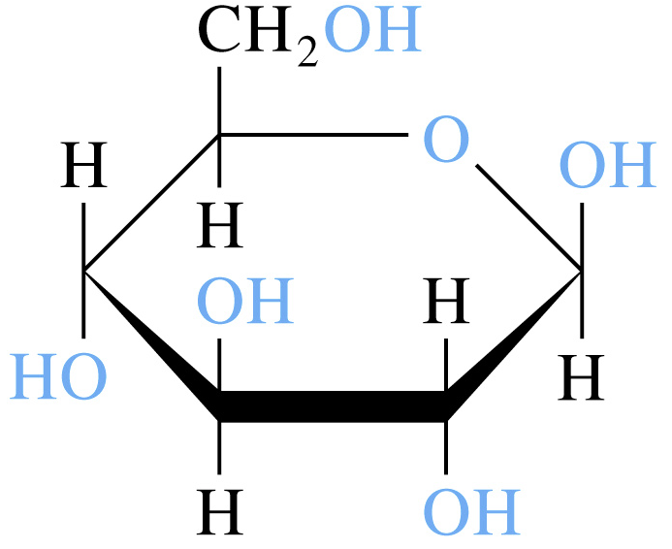
Solubility of molecules in water
Hydrophilic (water-loving)-substances that readily dissolve in H₂O
  polar substances
  ionic (electrolytes)
Solvation occurs during dissolution:
A process whereby a molecule or an ion becomes surrounded by solvent molecules
Polar water molecules align themselves around ions or other polar molecules and becomes solvated
When the solvent is water the molecules or ions are said to be hydrated hydrated

Slide 44
Water as solvent.
Water dissolves many crystalline salts by hydrating their component ions.
The NaCl crystal lattice is disrupted as water molecules cluster about the Cl and Na ions.
The ionic charges are partially neutralized & the electrostatic attractions necessary for lattice formation are weakened.
Entropy increases as crystalline substances dissolve

Slide 45
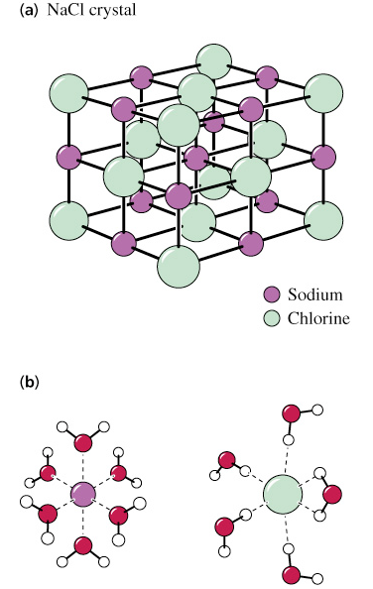
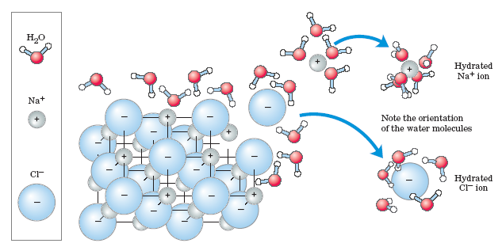
Solubilities of molecules in water
Dissolution of NaCl in water
Electrostatic forces hold ions together in crystalline sodium
Water molecules form solvation spheres around Na⁺ and Cl⁻
Entropy increases as crystalline substances dissolve

Slide 46
Solubulity of Nonpolar Substances
Hydrophobic (water-fearing) molecules
  insoluble in Water
  Exhibit a hydrophobic effect –
    the exclusion of nonpolar substances by water & critical for
  protein folding
  self-assembly of biological membranes
Amphipathic molecules
    have both hydrophobic chains and ionic or polar ends. Detergents (surfactants) are examples.

Slide 47
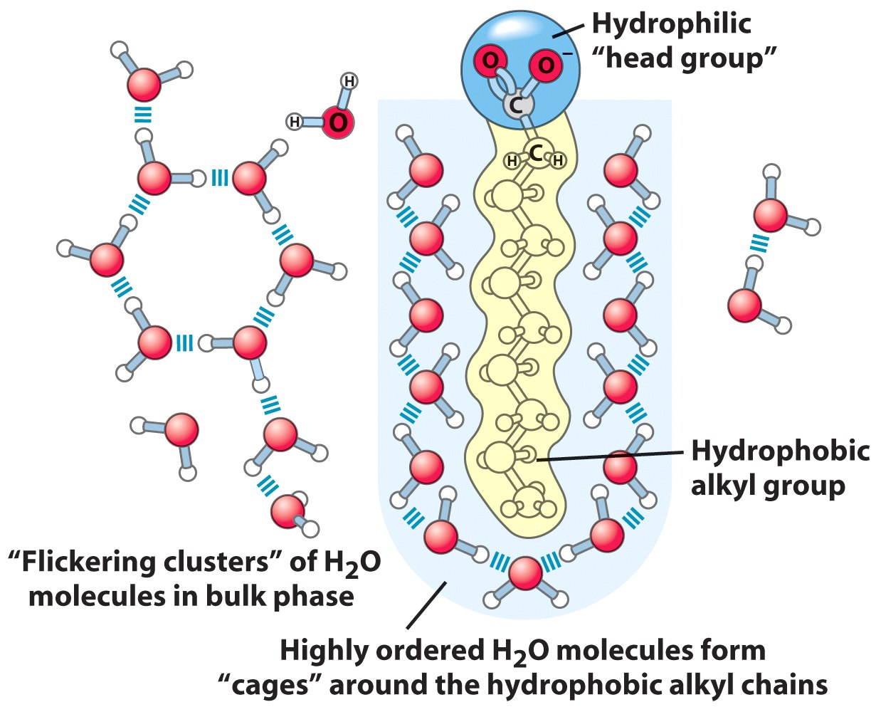
Solubility of Nonpolar compounds
Amphipathic cpds
Long-chain fatty acids
have very hydrophobic alkyl chains,
each alkyl group is surrounded by a layer of highly ordered water molecules.

Slide 48
A micelle is formed when a variety of molecules including soaps and detergents are added to water.
The molecule may be a fatty acid, a salt of a fatty acid (soap), phospholipids, or other similar molecules.
The molecule must have a strongly polar "head" and a non-polar hydrocarbon chain "tail".
When this type of molecule is added to water, the non-polar tails of the molecules clump into the center of a ball like structure, called a micelle, because they are hydrophobic or "water hating".
The polar head of the molecule presents itself for interaction with the water molecules on the outside of the micelle.

Slide 49
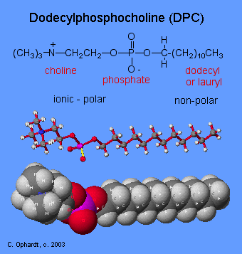
Structure of
Dodecylphosphocholine (DPC):
An example of a micelle uses
DPC is a synthetic phosphodiester.
The phosphoric acid group has
ester bonds between
1) choline, (CH₃)₃N(CH₂)₂OH,
2) dodecyl (or lauryl) alcohol,
CH₃(CH₂)₁₁OH.
The choline,which contains a
quaternary amine with
a positive charge,
and the phosphate are ionic
and polar.
The dodecyl part is the
non-polar hydrocarbon chain.

Slide 50
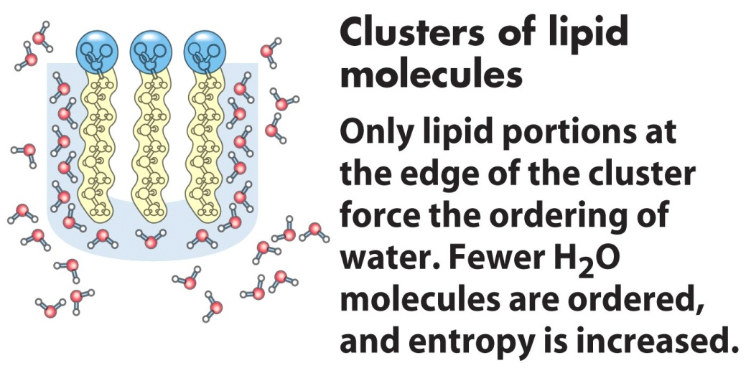
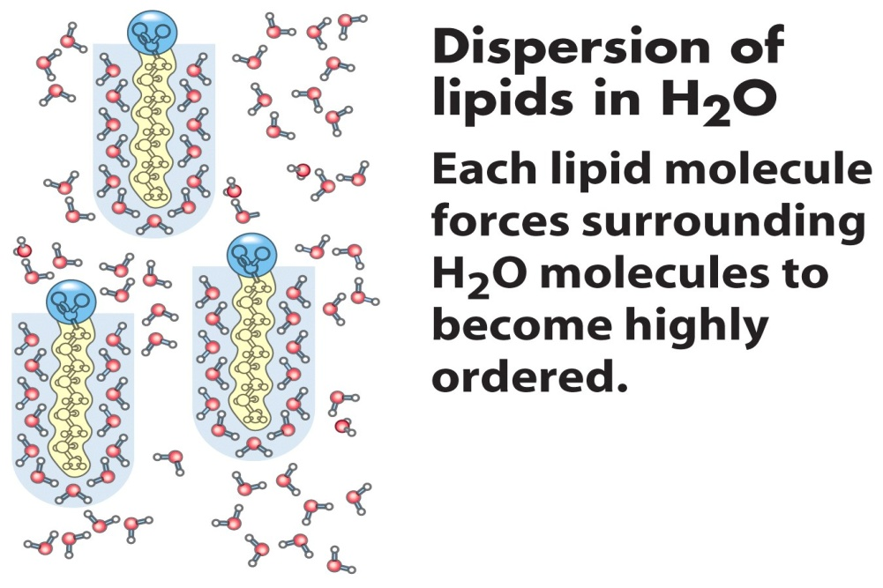

Amphipathic compounds in aqueous solution.
(b) By clustering together in micelles, the fatty acid molecules expose the smallest possible hydrophobic surface area to the water, and fewer water molecules are required in the shell of ordered water.
The energy gained by freeing immobilized water molecules stabilizes the micelle.

Slide 51


Release of ordered water favors formation of an ES-complex
While separate, both enzyme and substrate force neighboring water molecules into an ordered shell.
Binding of substrate to enzyme releases some of the ordered water, and the resulting increase in entropy provides a thermodynamic push toward formation of the enzyme-substrate complex.
Biological Applications

Slide 52

Sodium dodecyl sulfate (SDS)
A synthetic detergent
A 12-carbon tail
Polar sulfate group

Slide 53

Detergents in water
Monolayers can form on the surface
At higher concentrations detergents can form micelles

Slide 54

Charged or polar molecules are dissolved easily in water (Hydrophilic).
Nonpolar solvents are poor solvents for polar molecule but easily dissolved hydrophobic compound (lipid or waxes).
Amphipathic compounds contain regions that are polar or (charged) and nonpolar

Slide 55
Solutions & Suspensions
Water is usually part of a mixture.
There are two types of mixtures:
Solutions
  Ionic compounds disperse as ions in water
  Evenly distributed
SOLUTE: Substance that is being dissolved
SOLVENT:
  Substance into which the solute dissolves
Suspensions
Notes:
55

Slide 56

Solution
Notes:
56

Slide 57
Water Is Nucleophilic
Nucleophiles - electron-rich atoms or groups seeking positively charged groups
Electrophiles - electron-deficient atoms or groups
Water is a relatively weak nucleophile
Due to its high cellular concentration, hydrolysis reactions in water are thermodynamically favored

Slide 58

Hydrolysis of a peptide

Slide 59
Ionization of Water
Pure water is slightly ionized
The Ionization of Water Is Expressed by an Equilibrium Constant
The pH Scale Designates the H⁺ and OH⁻ Concentrations
Weak Acids and Bases Have Characteristic Dissociation Constants
Titration Curves Reveal the pKa of Weak Acids

Slide 60
Ionization of water
Water molecules have a slight tendency to ionize
undergo reversible ionization to form hydrogen ion ( proton) and a hydroxide ion giving an eqillibrium.
Hydrogen Ion Hydroxide Ion
Acid Base
One water molecule in 550 million naturally dissociates into a Hydrogen Ion (H+) and a Hydroxide Ion (OH-
H₂O  H⁺ + OH⁻

Slide 61



Hydronium ions and proton hopping
Hydrogen ions formed in water becomes immediately hydrated to hydronium ions (H₃O⁺).
No individual proton moves very far through the bulk solution,
but a series of proton hops between hydrogen bonded water molecules causes the net movement of a proton over a long distance in a remarkably short time.

Slide 62


Dissociation” of water
H₂O + H⁺ H₃O⁺

Slide 63
Ionization of Water
Pure water consists of a low concentration of
  hydronium ions (H₃O⁺) and
  hydroxide ions (OH⁻)
Acids are proton donors (e.g. H₃O⁺) and
Bases are proton acceptors (e.g. OH⁻)

Slide 64
Ionization of water can be quantitatively expressed by an equilibrium constant (K_{eq})
For the reaction:
The equilbrium constant is obtained by the expression ( law of mass action)

Slide 65

Ionization of Water
Consider the ionization of water
The Keq for the ionization of water will be expressed as
The concentration of water epressed in moles/litre will be
MOLARITY = no of moles/volume =18/1000= 55.5 M (1 litre)
Substituting this value in the equation
Cross multiplying the equation
H₂O  H⁺ + OH⁻

Slide 66

Ionization of Water
The value of Keq has been determined by electric conductivity measurements , (1.8X 10⁻¹⁶M) at 25⁰c hence considered as a constant
Substituting the value of Keq in the equation
For neutral solution such as water,
        [H⁺] =[OH⁻]

Slide 67
The ionization of water
The ionization process is reversible.
In neutral water,
  ratio of either [H⁺] or [OH⁻ ]to [H₂O] is very small = (10⁻⁷ M)
Since Keq of water is constant, thus, if the level of [H⁺] increase, then the level of [OH⁻] must decrease, & vice-versa.
For neutral water, the Keq is 1 x 10⁻¹⁴ M and the concentrations of [H⁺] and [OH⁻] are each 1 x 10⁻⁷ M
(10⁻⁷ = 0.0000001 M)

Slide 68
As [H⁺] rises, [OH⁻] falls
OH⁻
OH⁻
OH⁻
H⁺
H⁺
H⁺
0 1 2 3 4 5 6 7 8 9 10 11 12 13 14
Acidic Neutral Basic

Slide 69
Relationships
H⁺
H₂O
OH⁻
[H⁺] >[OH⁻]
[H⁺] =[OH⁻]
[H⁺] <[OH⁻]
Acidic solution
Neutral solution
Basic solution
pH < 7
pH = 7
pH > 7

Slide 70

The pH scale
Values of [ H+ ]and [OH] are very small in soln
can be magnified by being expressed in terms of neg log .
Thus instead of [H⁺] being1 x 10⁻⁷ M, it is said that the negative logarithm of [H⁺] concentration is 7,
Negative log of [ H+] also called pH
pH is the negative logarithm of [H⁺], Mathematically,
The term p- means negative of if , Keq, [H+] or [OH-]

Slide 71
The pH scale
Similarly the negative log of [OH] is pOH mathematically expressed as
pOH = -log [OH⁻]
Hence for water
[H+]=10⁻⁷M, pH= log 1/ 1.0*10⁻⁷M, pH= 7
[OH-]= 10⁻⁷M, pOH= log 1/ 1.0*10⁻⁷M,

Slide 72
The pH scale
Thus for the ionic product of water equation
Kw = [H+] [OH-],
obtaining the –log of the equation
- log Kw= -log [H+] + -log [OH-]
= PKw = pH + pOH
pH = – log [H+] ; Similarly pOH = – log [OH-]
For water, [H+]= [OH-], = 1 X 10⁻⁷, Kw = 1X10⁻¹⁴
Hence -log 1X10⁻¹⁴ = -log 1X 10⁻⁷ + 1X 10⁻⁷
14= 7 + 7

Slide 73
The pH Scale
The pH of a solution is simply the negative logarithm of [H⁺]
pH scale ranges from 0 – 14
Indicates the concentration of H⁺ ions in a solution
pH of 7 is neutral
pH 0 up to 7 is acid … [H⁺ ]
pH above 7 – 14 is basic… [OH^{-]}
Acidic solutions have a pH of less than 7 and basic solutions have a pH greater than 7.
Water is neutral with a pH = 7.
Log scale means 10X change per unit!- each pH unit represents a factor of 10X change in concentration
pH 3 is 10 x 10 x 10 (1000) stronger than a pH of 6

Slide 74

The pH Scale

Slide 75

The pH Scale
[H+]= 10⁻¹M
Lower values are acidic fluids
Higher values are basic fluids
[H+]= 10⁻⁹ M

Slide 76


Slide 77
Importance of pH
Pharmaceutical preparations
  Extraction stability
  Therapeutic stability
    Eg extraction of insulin from pancreas requires a pH of btwn 3-3.5
    Vitamin B preparations senstive to pH an optimum of 3.5-4.5
    Many antiseptics acts well at Loweried ph values
Industrial applications
  Manufacture of drugs
Analytical preparations-
  Proper adjustment of pH is important in volumetric & gravimetric analysis

Slide 78
Importance of pH
Physiological applications
Normal pH – 7.4
Marked deviations of pH from normal – an indicator of diverse conditions and complications
Ketoacidosis- lowered pH; Alkalosis- increased pH than normal
Diabetic comma – pH drop to 6.82
  Solutions Intravenous injections must be buffered to normal pH
  Eye drops with pH values more or less than normal causes much irritation to the eye
  PH of gastric juice is 2 and an increase pH may cause vomiting
  The pH of GIT must be maintained for their efficiency since they are pH specific

Slide 79
Acid-Base Definitions
Bases
  generate OH⁻ in water
  Proton (H⁺ )acceptors
  Produces excess OH⁻
Acids
generate H⁺ in water
a proton (H⁺)donors
Produces excess H⁺
Acid /base reactions common types of equilibrium encountered in living systems
can dessociate contributing to the total [H+] & [OH-]
HA <-----> A- + H+
two types
Strong acids and bases- ionize completely in aqueous solutions
Weak acids and bases-ionize partially in aqueous solutions

Slide 80

Strong Acids
Undergo 100% dissociation in aqueos soln
good H⁺ donor
equilibrium lies far to right
HA → H⁺ + A⁻
Before dissociation
After dissociation
Relative # moles
HCl H⁺ Cl⁻
HCl H⁺ Cl⁻

Slide 81
Strong acid-strong base titrations
Strong acids and bases dissociate completely in water
HCl + H₂O Cl⁻ + H₃O⁺
Cl⁻ is the conjugate base of HCl
H₃O⁺ is the conjugate acid of H₂O
Think about this: given 25 mL of a unknown concentration of HCl, a solution of 0.100 M NaOH and a burette, how could you determine the concentration of the HCl?
What would happen to the pH of the solution of HCl as the NaOH was added to it?

Slide 82
Titrations / pH curves
Experimental method to determine the concentration of an acid (or base).
Titration curves are used to determine pK_{a} values
pH
mL base added

Slide 83


Titrations
Neutralisation is attained by use of
pH paper strips
pH meter
pH indicator solutions eg
  Methyl orange; yellow in basic solution and red in acidic solution
  Bromothymol blue (yellow in acidic solution), slight green tint as base is added, and blue form in basic solution
Many other indicators available

Slide 84

Titrations / pH curves

Slide 85

Acid Dissociation Constants: Weak Acids
Weak acids and bases do not fully dissociate in solution
An equilibrium exists btn the acid and its conjugate base.
An example of a weak acid is the Acetic acid
The dessociation constant Ka can be quantatively expressed in a negative logarithmic form as
–logKa ie pKa = -logKa

Slide 86
Titration curves of weak acids (acetic acid)
The conc. of the acid in the original solution can be calculated from the volume and concentration of base (NaOH) added
Can be effected by the titration curve.
Titration curves of weak acids reveals the pKa of weak acids
At the midpoint of the titration, at which exactly 0.5 equivalent of NaOH has been added,
[CH3COOH]=[CH3COO-] and pH=pKa
Titration curves are used to determine pK_{a} values

Slide 87

Titration curve of acetic acid (CH₃COOH)

Slide 88

Titration curve of acetic acid (CH₃COOH)

Slide 89

Comparison of the titration curves of weak acids
The T curves of these acids have the same shape,
are displaced along the pH axis because the 3 acids have different strengths.
Acetic acid, with the highest Ka (lowest pKa) of the three, is the strongest (loses its proton most readily);
it is already half dissociated at pH 4.76.
Dihydrogen phosphate loses a proton less readily, being half dissociated at pH 6.86.
Ammonium ion is the weakest acid of the three and does not become half dissociated until pH 9.25.

Slide 90
Acid Dissociation Constant: A hypothetical case
Weak acids and bases do not fully dissociate in solution
An equilibrium exists btn the acid and its conjugate base.
Consider the dissociation of a weak acid HA:
This equilibrium can be expressed as
Smaller K_{a}→ weaker acid
Larger pK_{a}→ weaker acid
←amount dissociated
←amount undissociated
Ka = the equilibrium constant or the dissociation constant
it pertains to the dissociation of protons from acids and bases.

Slide 91
Acid Dissociation Constant: A hypothetical case
Expressing the equation in terms of [H+]
Since the [H+] is very small , the equation is expressed in terms of -log
The equation hence simplifies to,
log(xy) = log x + log y
–log(x/y) = +log (y/x)
HA= the weak acid- proton donar, A- = base – proton acceptor, hence
Conjugated base
Conjugated acid

Slide 92
For buffer system only
considerable [HA],[A⁻]

Slide 93
Henderson-Hasselbach Equation- Derivation
In terms of acid and base conc
pH = pKa + log [Base]
[Acid]
Physiologically bases exists as salts, hence the equation is expressed as
pH = pKa + log [Salt]
[Acid]
This is the Henderson Hasselbalch equation for the weak acid

Slide 94

The Henderson-Hasselbalch Equation
[HA ]- the undessociated acid; [A-]– conjugate base
Defines the pH of a solution in terms of:
(1) The pK_{a} of the weak acid
(2) the log of the ratio of conc of the conjugate base [A⁻] to the weak acid [HA]
HH equation allows for the calculation of
    Molar ratio of base ( proton acceptor)to acid ( proton donar)
    buffer pH when the conc. of weak acid (HA) and conjugate base (A⁻) are known

Slide 95
Henderson-Hasselbach Equation- Derivation
Buffers are solns able to resist changes in pH when considerable amount of acid or base is added
Max buffering occur when the [base] = [acid] ie, when pH= Pka
E.g Buffered solution contains 0.50 M HC₂H₃O₂ (K_{a} = 1.8x10⁻⁵) and 0.50 M NaC₂H₃O₂. Calculate pH of solution..

Slide 96
RELATIONSHIP [H⁺], pH and K_{a}, [A⁻], [HA]
H-H eqn is of great predictive value
[A⁻] < [HA] →
[A⁻] > [HA] →
[A⁻] = [HA] →
→ pH < pK_{a}
→ pH > pK_{a}
→ pH = pK_{a}
If the eqn is evaluated for several ratios of [A]/[HA] btwn the limits 10-3 to 103 and the calculated pH values plotted the titration curve is obtained

Slide 97


Slide 98
Clinical Significance H-H EQUATION
Blood Buffering
Cells can only survive in very narrow pH range, thus constant blood pH is vital.)
The pH of blood is maintained in a narrow range 7.4.
Even relatively small changes in blood pH value can lead to severe metabolic consequences.
Hence blood buffering is extremely important in order to maintain homeostasis

Slide 99
Buffer solutions
aqueous systems that tend to resist changes in pH when small amounts of acids [H+ ]or base [OH- ] is added.
mixtures of weak acids and their conjugate bases-contain weak acids & salts or weak bases & salts
Example a mixture of equal conc of acetic acid and acetate ion,
the salt provides a reservoir of A- to replenish [A-] when A- is removed by reaction with H+.
Buffers are produced naturally by the body to maintain homeostasis in cells and tissues against pH changes
Strong acids / bases cannot be used as buffer

Slide 100
Buffered Solutions Resist Changes in pH
Buffer capacity is the ability of a solution to resist changes in pH
Amount of H⁺/OH⁻ a buffer can absorb without a considerable change in pH
Most effective buffering occurs where:
solution pH = buffer pK_{a}
At this point: [weak acid] = [conjugate base]
Effective buffering range is usually at pH values equal to the pKa ± 1 pH unit

Slide 101

Titration curve for phosphoric acid (H₃PO₄)

Slide 102

Mechanisms of buffer Action
Contain relatively large amounts of weak acid and corresponding base.
Added H⁺ reacts to completion with weak base, A⁻ to form HA
Added OH reacts to completion with weak acid, HA.
pH is determined by ratio of concentrations of weak acid and weak base.

Slide 103

Mechanisms of buffer Action
donate hydrogen ions after being depleted by a rise in pH
accept hydrogen ions from the solution when in excess

Slide 104
The Major Body Buffer Systems
Site | Buffer System | Comment
ISF | Bicarbonate | For metabolic acids
 | Phosphate | Not important because concentration too low
 | Protein | Not important because concentration too low
Blood | Bicarbonate | Important for metabolic acids
 | Haemoglobin | Important for carbon dioxide
 | Plasma protein | Minor buffer
 | Phosphate | Concentration too low
ICF | Proteins | Important buffer
 | Phosphates | Important buffer
Urine | Phosphate | Responsible for most of 'Titratable Acidity'
 | Ammonia | Important - formation of NH₄⁺
Bone | Ca carbonate | In prolonged metabolic acidosis

Slide 105

Physiological biological buffer systems
The phosphate buffer system
NOT an important blood buffer as its concentration is too low
effective buffer in biological fluids including
  extracellular fluids
  most cytoplasmic compartments
  Urine
important buffers intracellularly and in urine where their concentration is higher.
Acts primarily in the cytoplasm of all cells.
Maintains pH in the range of about 5.9 & 7.9.
maximally effective at a pH close to its pKa of 6.86

Slide 106
Physiological biological buffer systems
The phosphate buffer system
triprotic weak acid and has a pKa value for each of the three dissociations:
      pK_{a1} = 2 pK_{a2} = 6.8 pK_{a3} = 12
H₃PO₄ <= = = >H⁺ + H₂PO₄⁻ <= = =>H⁺ + HPO₄⁻²< = = = > PO₄⁻³ + H⁺
in most biological systems, monohydrogen phosphate (HPO₄⁻²) and dihydrogen phosphate (H₂PO₄⁻) are the two species present.
The pKa2 is 6.8 and this makes the closed phosphate buffer system a good buffer intracellularly and in urine.
phosphate IS more effective intracellularly and in urine because its concentration is much higher here than in extracellular fluid.

Slide 107
Bicarbonate buffer system
major buffer system in the ECF
Operates primarily in the blood plasma
responsible for about 80% of extracellular buffering
most important ECF buffer for metabolic acids but it cannot buffer respiratory acid-base disorders.
the buffer system consists of:
carbon dioxide /carbonic acid /bicarbonate
bicarbonate ion is formed in in blood by reaction of CO2 and H2O
    CO2 + H2O <------> H2CO3
    H2CO3 <-------> H+ + HCO3-
The pK'a is derived from the Ka value of the following reaction:
CO₂ + H₂O <=> H₂CO₃ <=> H⁺ + HCO₃- (where CO₂ refers to dissolved CO₂)

Slide 108
Bicarbonate buffer system
The concentration of carbonic acid is very low compared to the other components so the above equation is usually simplified to:
CO₂ + H₂O <=> H⁺ + HCO₃-
By the Law of Mass Action:
Ka = [H⁺] . [HCO₃-] / [CO₂] . [H₂0]
The concentration of H₂O is so large hence considered as a constant

Slide 109
THE BICARBONATE BUFFER SYSTEM
Buffer capacity depends upon equilibria between:
(1) Gaseous CO₂ (air spaces of the lungs)
(2) Aqueous CO₂ (dissolved in the blood)
(3) Carbonic acid
(4) Bicarbonate
The system allows the transfer of relatively insoluble CO2 from the tissues to the lungs, to be expelled
Tissue-CO2 comes from the oxidation of ingested carbon compounds

Slide 110

Carbonate buffering equilibria

Slide 111



Slide 112
Bicarbonate system
Reaction 1: When H is added to blood as it passes through the tissues,- proceeds toward a new equilibrium, in which the concentration of H₂CO₃ is increased.
Reaction 2 :This increases the concentration of CO₂(d) in the blood plasma
Reaction 3: thus increases the pressure of CO₂(g) in the air space of the lungs
The extra CO₂ is exhaled.
Conversely, when the pH of blood plasma is raised (i.e. by NH₃ production during protein catabolism),
The H concentration of blood plasma is lowered, causing more H₂CO₃ to dissociate into H and HCO₃. This in turn causes more CO₂(g) from the lungs to dissolve

Slide 113
Bicarbonate system
If blood is not adequately buffered, the result may be metabolic
  acidosis or
  alkalosis.
Conditions physiologically reached due to metabolic defect that results in the inappropriate accumulation or loss of acidic or basic cpds
These compounds may be ingested, or may accumulate as metabolic by-products such as acetoacetic acid and lactic acid.
cpds ionize, thereby increasing the level of H+ ions
these in turn remove bicarbonate ions from the blood and alter blood pH.

Slide 114
The predominant defect in acid or base elimination arises when the excretory system of the kidneys is impaired.
Alternatively, if the lungs fail to expel accumulated CO2 adequately and CO2 accumulates in the body, the result will be respiratory acidosis.
If a decrease in PCO2 within the lungs occurs, as during hyperventilation, the result will be respiratory alkalosis.

