Slide 1
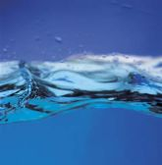
WATER

Slide 2
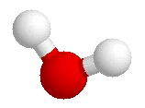
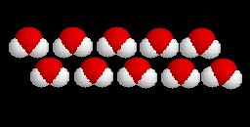
STRUCTURE OF WATER MOLECULE
Water molecule is made up of three atoms
    one oxygen
    two hydrogen.
H
H
O
H

Slide 3
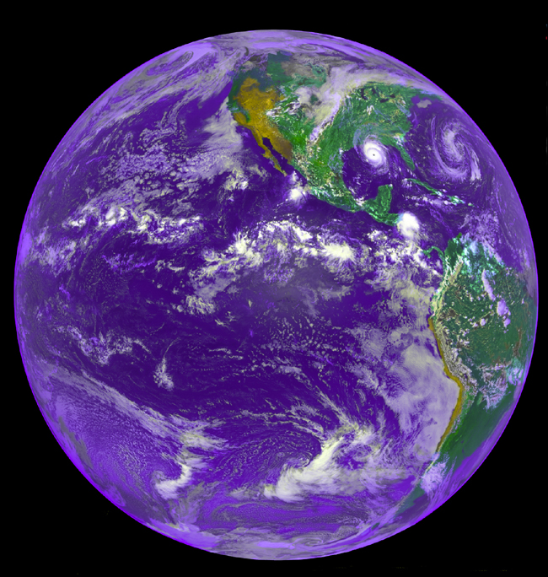
Introduction
Most abundant substance in living systems &environment
  2/3 of the globe is covered in water.
  2/3 of all cells contain water.
  70 % or more of the weight of most organisms
Occurs naturally in all 3 states of matter
  (Solid: Ice
  Liquid: Water
  Gas: Water Vapor.
Water freezes at 0C and boils at 100C.

Slide 4
Introduction
Water plays a central role in the chemistry of all life
The chemical properties of water are related to the functions of biomolecules, entire cells,and organisms
Biomolecules (Proteins, polysaccharides, nucleic acids) and membranes all assume their characteristic shapes in response to water

Slide 6
Bonding in water: Weak interactions
H-bonds form between highly electronegative atom of a polar molecule and a H-atom attached to another electronegative atom
H- bond forms in water molecules as s result of their polarity
formed when a partially positive hydrogen atom attracts a partially negative oxygen atom of a second water molecule
Each H- atom shares an electron pair with oxygen atom.
The oxygen nucleus is electronegative-attracts e- more strongly than the more electropositive hydrogen nucleus ( a proton),

Slide 7
Bonding in water: Weak interactions
  electrons are more often in the vicinity of the oxygen atom-becomes partially negative (2d-) than the hydrogen (d+) which “acts” as a positive
  - unequal sharing of e- results in water molecule being polar
H-bond results due to an electrostatic attraction between the oxygen atom of one water molecule and the H-atom of another
unusual properties of water occur -due to H- bonding ie

Slide 8
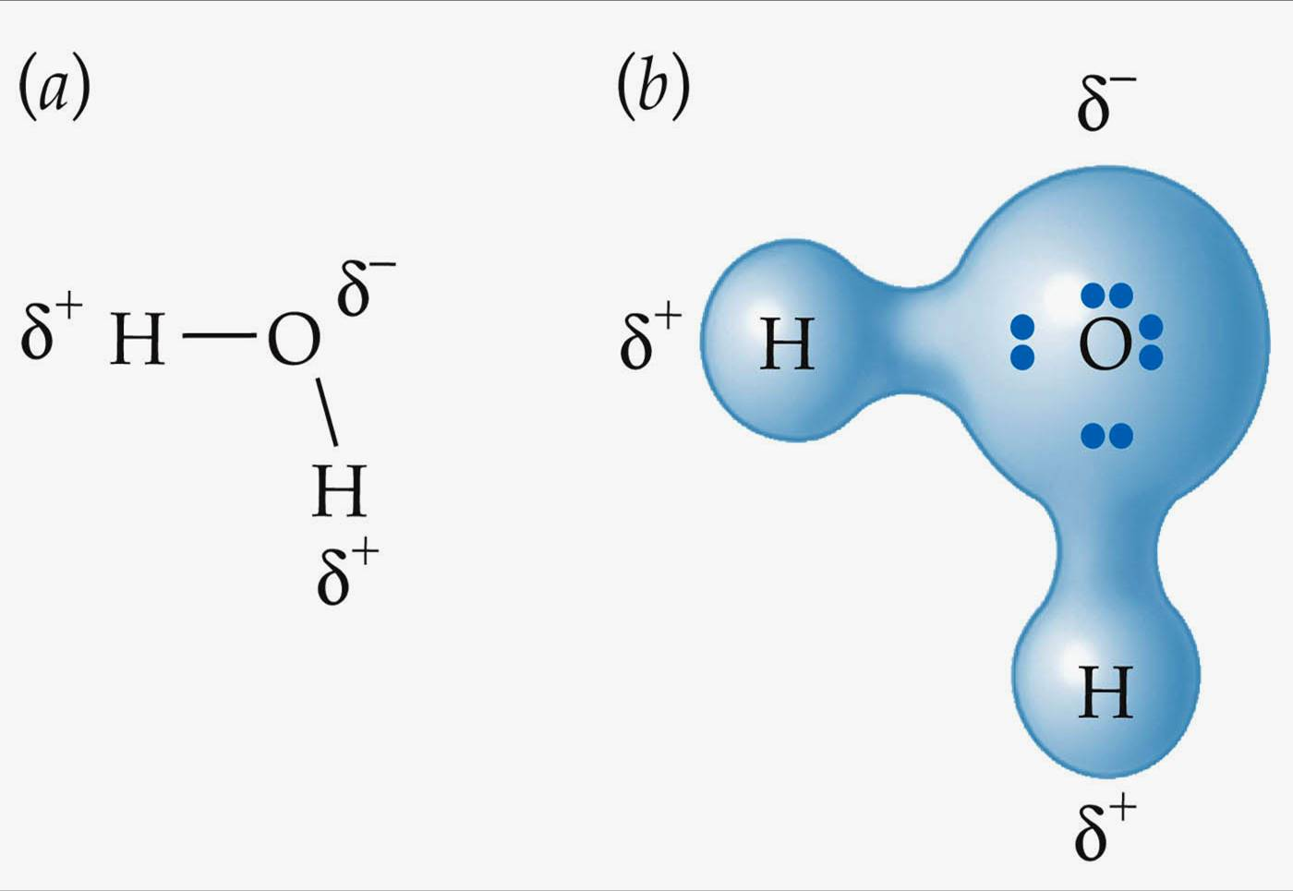
The attraction forces between water molecule
The sharing of electrons between H and O is unequal;
the electrons are more in the vicinity of oxygen atom than of hydrogen.
The result of the unequal electron sharing is two electric dipole in the water molecule , one along each of the H-O bond; the oxygen atom bears a partial negative charge ( ) and each hydrogen a partial positive charge ( )
As a result there is an electrostatic attractions between the oxygen atom of one water molecule and the hydrogen of the other called a hydrogen bond

Slide 9
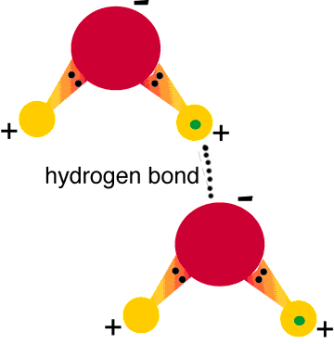
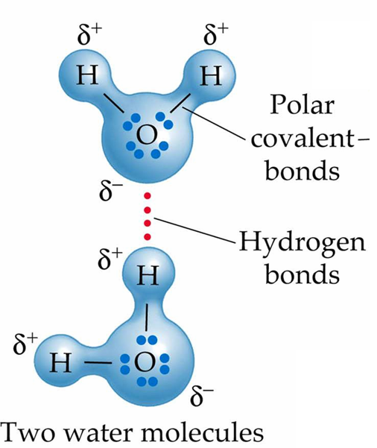
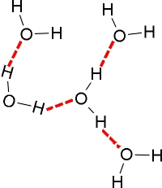

Slide 10
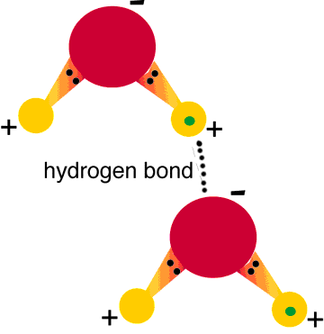
Hydrogen bonding between two water molecules

Slide 11
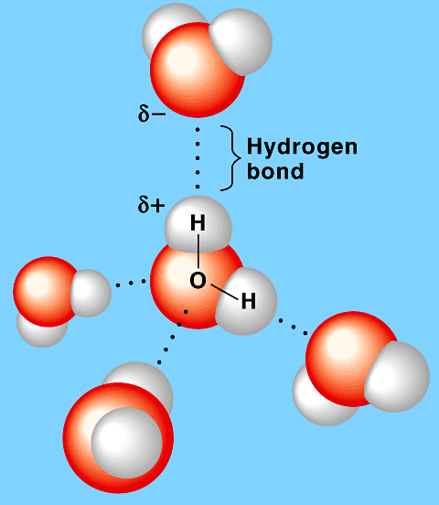
Hydrogen bonding

Slide 12
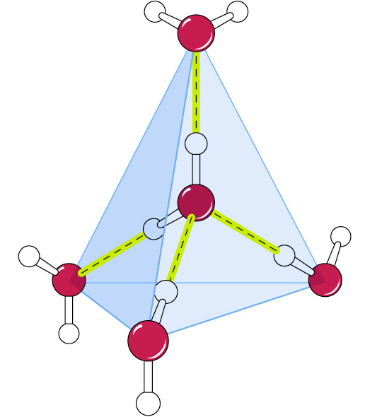
Hydrogen bonding by a water molecule
A water molecule can form up to four hydrogen bonds
Hydrogen bonds shown in yellow

Slide 13
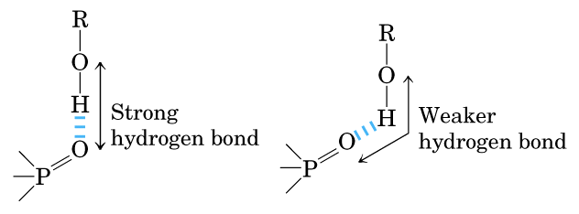
Directionality of the hydrogen bond
H- bonds are strongest when bonded molecules oriented to maximize electrostatic interaction
occurs when the H-atom and the two atoms that share it are in a straight line
when the acceptor atom is in line with the covalent bond between the donor atom and H - holding two H-bonded molecules or groups in a specific geometric arrangement.

Slide 14
Hydrogen bonding in ice & water
Ice Exists as a regular crystal lattice.
each water molecule forms the maximum of 4H- bonds
ice crystal lattice makes it less dense than liquid water
At room temperature and atmospheric pressure, each water molecule H-bonds with an average of 3.4 other water molecules
thus ice floats on liquid water.

Slide 15
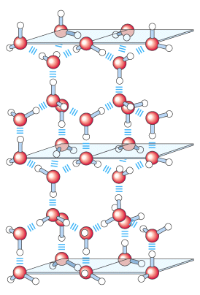
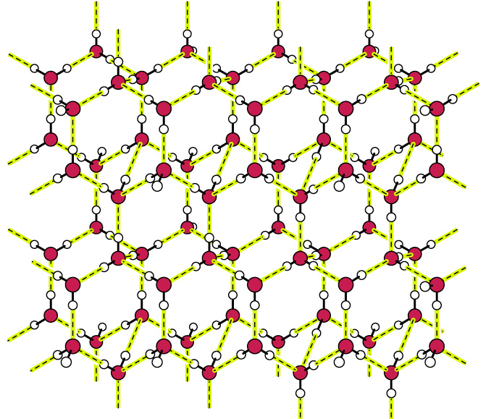
Structure of ice.

Slide 16
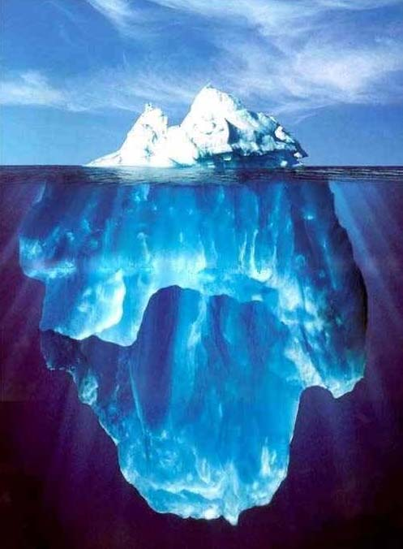
Properties of Water
Water has many characteristics vital to living systems.
the unique and unusual properties physical properties related to chemical properties
Polarity
Small sized molecule
High boiling points
High melting points
Cohesion
Adhesion
High specific heat
High heat of vaporization
Less dense than a Solid
Notes:
1

Slide 17
Properties of water
Polarity
  H-O bonds is polar due to differences in electronegativity btwn O & H
  Polar O-H bonds is due to the uneven distribution of charge in the water
  H- is positively charged (d⁺), oxygen is slightly negatively charged. (d⁻)
  The water molecules form H- bonds, giving shape to water as a liquid.
  Each single water molecule can form bonds with 4 other water molecules in a tetrahedral arrangement -lead to many other unique properties.
  The polarity of water allows it to bind with other molecules, & itself.
  Polarity makes it easy for water to interact with other charged molecules, dissolving them.
  hence water is a universal solvent

Slide 18
Properties of water resulting from H-bonding
Ice is less dense than liquid water:- ice floats, insulating water below.
High specific heat:- amount of heat needed to raise 1g of substance by 1°C. Multiple H-bonds must be broken to increase kinetic energy of water molecules. This minimizes temperature fluctuations in cells and on earth.
High heat of vaporization:- H-bonds must be broken to allow water molecules to dissociate from one another and enter gas phase. Perspiration effective mechanism for decreasing body temp.
Good solvent :- Ionic and polar compounds dissolve in water
Solubility depends on ability of solvent to interact with solute more strongly than solute particles interact with each other. Due to its polarity, water dissolves other polar compounds and compounds that ionize (electrolytes). Substances that readily dissolve in water are known as hydrophilic = (water-loving).

Slide 19

Characteristics of water
1. Size
  water is a very small molecule
  can squeeze into tiny crevasses between other molecules
  Makes it move fast

Slide 20
Characteristics of water Cont.
3. Shape
a bond angle of 104.5^{o ,} slightly less than the 109.5º of a perfect tetrahedron
Angle reduction due to the crowding by the nonbonding orbital/ electrons of the oxygen atom.
Angled arrangement of polar bonds creates a permanent dipole for a water molecule
The V-shape of the water molecule is also important because it allows for other configurations of water to be formed.
Ice, for instance, has a very ordered lattice structure.
Super cooled water (water below the freezing point) also has water molecules that are structured in a certain way.
Snowflakes have yet another shape.

Slide 21
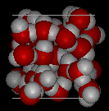
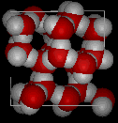
Characteristics cont.
Water
  4. Crystal structure
  H2O forms a crystal structure due to polarity,
  Water is closely packed- Liquid water has H- bonds that constantly formed. & broken
  Ice is loosely packed- forms a crystal-like lattice whereby molecules are set at fixed distances.
  Ice is less dense & floats on liquid water.
H-bond provides cohesive forces that makes water a liquid at room temperature
favours the extreme ordering of molecules that is typical of crystalline water.
Ice

Slide 22
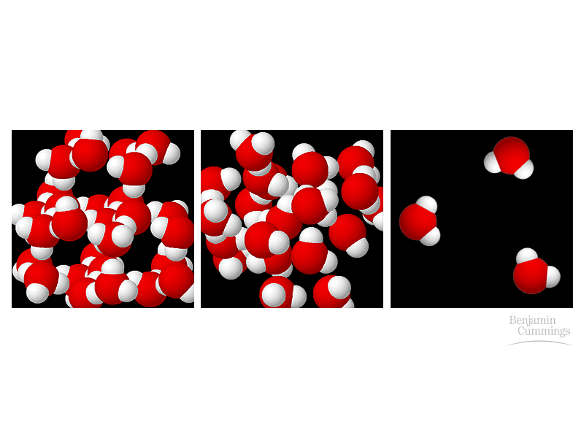
Characteristics of water Cont.
Ice water vapor

Slide 23
Characteristics of water Cont.
  4. Heat capacity–the capacity to absorb or release heat
  Has large heat capacity-absorbs and releases heat energy slowly
Multiple H-bonds must be broken to increase kinetic energy of water molecules.
This minimizes temperature fluctuations in cells and on earth.
resists changes in temp both during heating or coolin
Specific heat capacity: amount of heat required to raise / lower 1g of a substance by 1° C.
  The large heat capacity and high water content in organisms contribute to thermal regulation and prevent local temperature fluctuations.
  helps organisms maintain their body temperature in the safe range.
  The large heat capacity of the oceans and seas allows them to act as heat reservoirs such that sea temp vary only a third as much as land temp and so moderate our climate.
High latent heat of vaporization:
energy required to convert 1g of a substance from a liquid to a gaseous state
Water has high heat of vaporization appro. 540 cal/g
Due numerousH-bonds must be broken to allow water molecules to dissociate from one another and enter gas phase
The high latent heat of evaporation gives resistance to dehydration and considerable evaporative cooling.
As water evaporates, it removes a lot of heat with it (cooling effect).

Slide 24
High boiling and melting points:
  Has high boiling and melting point
  pure water boils at 100 °C and freezes at 0 °C at sea level.
  The high boiling temp decreases at higher elevations (lower atmospheric pressure).
  Unusually high Mp and Bp:- a lot of energy is needed to disrupt H-bonds in ice crystal lattice/in liquid water,
  H-bonds break and reform frequently giving it fluidity.

Slide 25
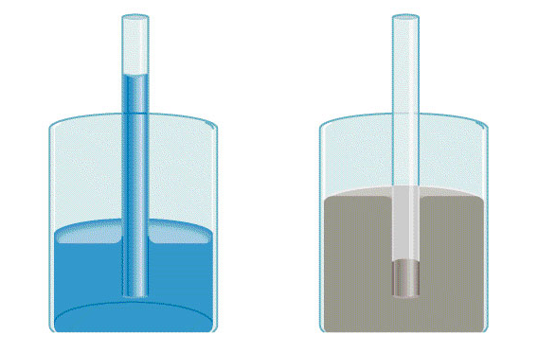
Characteristics of water cont.
  5. Cohesion and adhesion
Cohesion -intermolecular attraction between like molecules
Adhesion is an attraction between unlike molecule
Adhesion
attracted to glass
Cohesion
attracted to each other

Slide 26
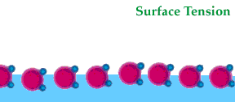
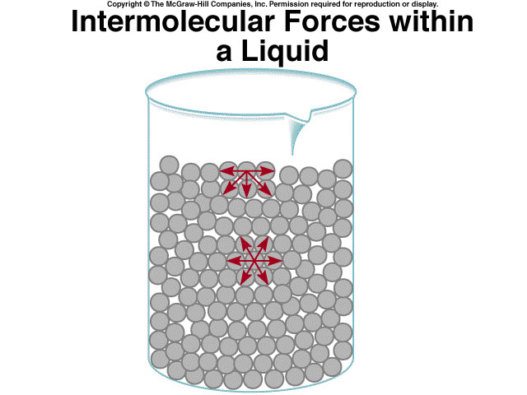
Cohesion
Forces of attraction between particles of the same substance-eg among adjacent water molecules
gives liquid water great internal cohesion
Due to presence of hydrogen bond
Cohesion results in surface tension
  the amount of energy required to stretch or increase the surface of a liquid by a unit area.
  a measure of the water’s surface’s strength
Surface tension results in a surface film on water that allows insects to walk on the surface of water
Strong intermolecular forces- High surface tension
Notes:
1

Slide 27
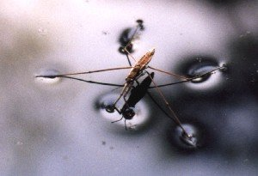
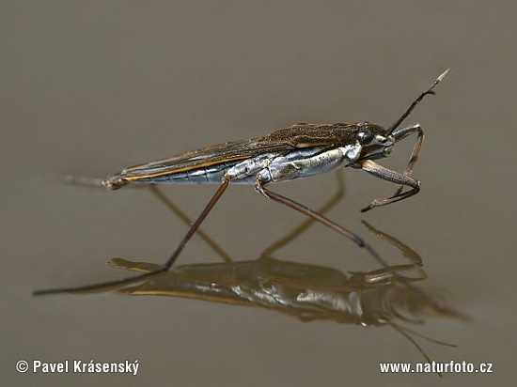
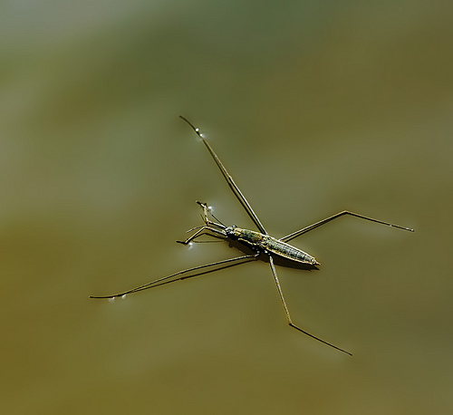
Cohesion …
Helps insects walk across water

Slide 28
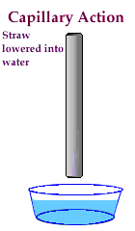
Adhesion
Attraction btwn two unlike/different substances.
Water molecules interact with other surfaces such as glass, soil, plant tissues, and cotton via H- bonds.
Capillary action-water molecules will “tow” each other along when in a thin glass tube is due to adhesive forces.
Example: transpiration process which plants and trees remove water from the soil, and paper towels soak up water.
Adhesion causes Capillary Action- gives water the ability to “climb” structures
Notes:
1

Slide 29
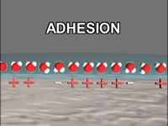
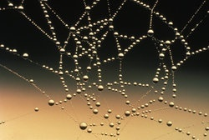
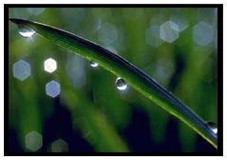
Adhesion Also Causes Water to …
Attach to a silken spider web
Form spheres & hold onto plant leaves

Slide 30
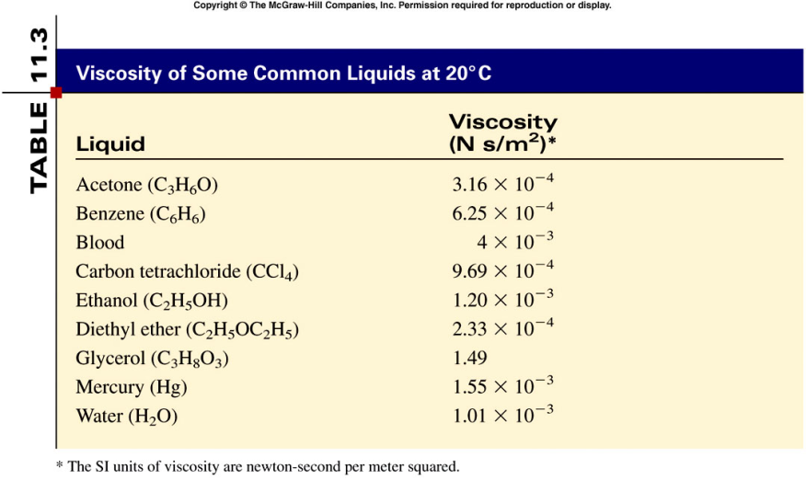
Viscosity
A measure of a fluid’s resistance to flow.
strong intermolecular forces
High viscosity
Water is relatively viscous due to H-bonding

Slide 31
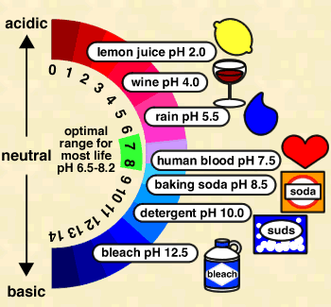
Characteristics Cont.
  Buffer
  Water can act as an acid /base.
  Buffers-maintains a stable body pH
  Environmental buffer
  Water vapor forms a kind of global ‘‘blanket” which helps to keep the earth warm.
  Heat radiated from the sun warms the earth surface and is held by the vapour.
Oceans and seas have large h/c
  Acts as heat reservoirs
  sea temp vary only a 1/3 as much as land temp
  Important in climate moderation.

Slide 32
Properties of water
Hydration
unique hydration properties towards biomolecules
Esp lipids, proteins and nucleic acids
Defines 3-dimensional structures,-hence their functions, in solution.
hydration forms gels that can reversibly undergo the gel-sol phase transitions that underlie many cellular mechanisms.

Slide 33
Properties of water
Ionisation
Water ionizes and allows easy proton exchange btn molecules,
contributes to the richness of the ionic interactions in biosystems
The density maximum at 4°C
Low ice density means that all of a body of water (not just its surface) is close to 0°C before any freezing can occur.
Rivers, lakes and oceans freeze from the top down,
Insulates inner mass of water from further freezing
This allows rapid thawing, and density driven thermal convection causing seasonal mixing in deeper temperate waters.

Slide 34
Summary Table of Physical Properties of water
Property Value
Molar mass 18.015
Molar Volume 55.5 moles/liter
Boiling Point (BP) 100°C at 1 atm
Freezing point (FP) 0°C at 1 atm
Triple point 273.16 K at 4.6 torr
Surface Tension 73 dynes/cm at 20°C
Vapor pressure 0.0212 atm at 20°C
Heat of vaporization 40.63 kJ/mol
Heat of Fusion 6.013 kJ/mol
Heat Capacity (cp) 4.22 kJ/kg.K
Dielectric Constant 78.54 at 25°C
Viscosity 1.002 centipoise at 20°C
Density 1 g/cc
Density maxima 4°C
Specific heat 4180 J kg-1 K-1 ( T=293…373 K)
Heat conductivity 0.60 W m-1 K-1 (T=293 K)
Melting heat 3.34 x 105 J/kg
Evaporation heat 22.6 x 105 J/kg
Critical Temperature 647 K
Critical pressure 22.1 x 106 Pa
Speed of sound 1480 m/s (T=293 K)
Relative permittivity 80 (T=298 K)
index of refraction (relative to air)
1.31 (ice; 589 nm; T=273 K; p=p0)
1.34 (water; 430-490 nm; T=293 K; p=p0)
1.33 (water; 590-690 nm; T=293 K; p=p0)

Slide 35

Biological importance of water
Water as a solvent
Water in organisms
Water as areactant
Water as a way of transport
Water as a lubricant
Water as a way of support
Water for constant temp
Water in sexual reproduction
Marine life during winter
Water as a habitat

Slide 36
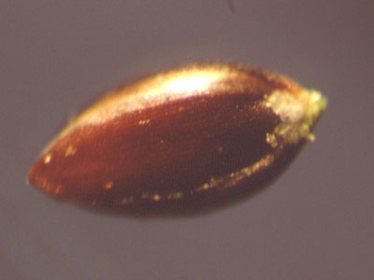
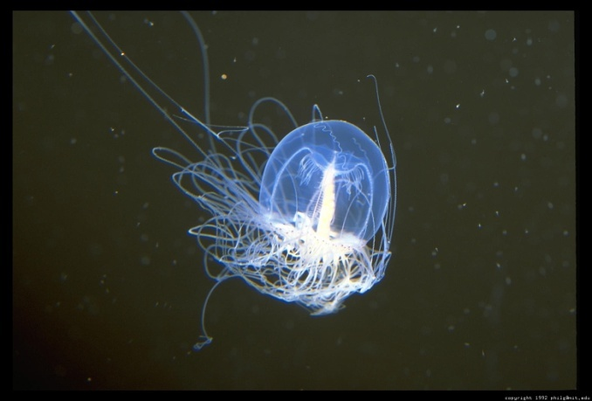
Water In Organisms
Organisms usually contain 60% to 90% water.
Lowest- Plant Seed (20%)
Highest- Jellyfish (99%)
Water helps all organisms with metabolism, and specifically helps plants with photosynthesis and support.
20% Water
99% Water

Slide 37
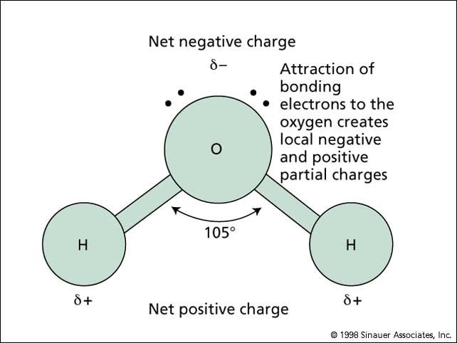
Water As A Solvent
Water has an angular shape
  contains 1 covalently bonded oxygen atom and 2 hydrogen atoms.
  Angled arrangement makes water a polar molecule, due to an equall electron sharing btn the bonding atoms
  creates a permanent dipole for a water molecule
Due its polarity, high dielectric constant and small size water can ionize substances easily
Makes water it an excellent solvent- ‘The Universal Solvent’. particularly for polar and ionic compounds and salts.

Slide 38
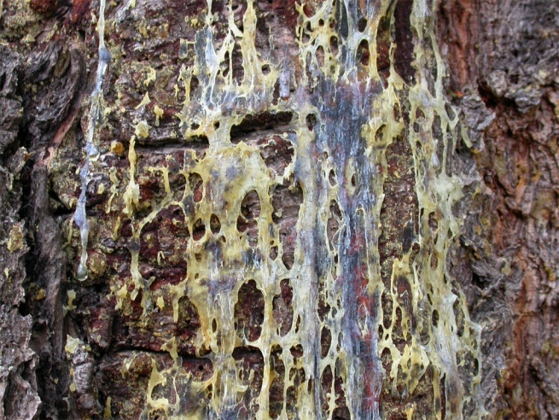
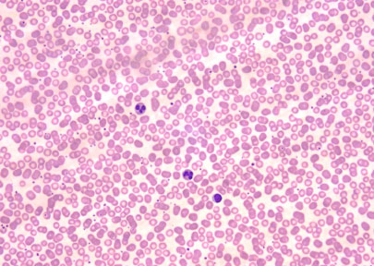
Water As A Way Of Transport
Tree Sap
Many different substances, such as blood and sap, are transported by water.
Sap and blood contain high amounts of water making them good solvents.
As good solvents water dissolves substances being transported
Human Blood Cells

Slide 39
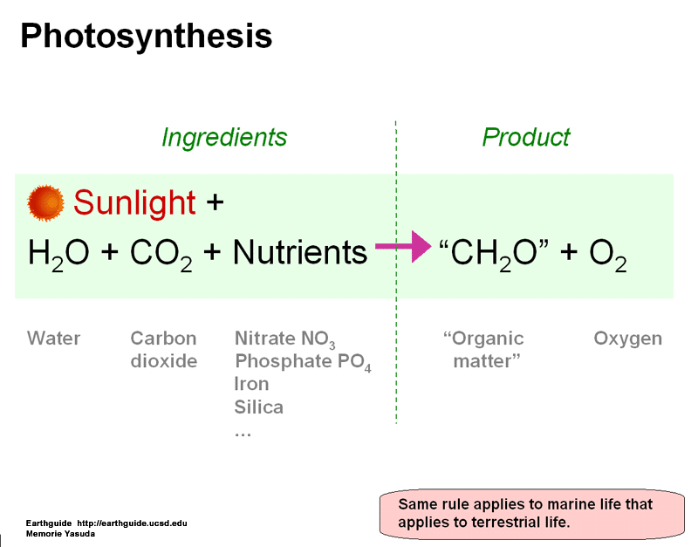
Water As A Reactant
Water, being a good solvent, allows many reactions to occur.
Water is used in photosynthesis to make NADPH2, and ultimately sugar.
These reactions release oxygen gas, which is vital to human life.
Without water in photosynthesis, organisms would not be able to obtain energy, and life as we know it would be impossible.

Slide 40
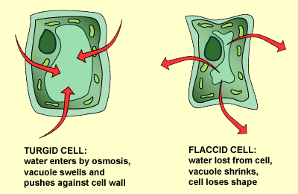
Water As A Way of Support
When water enters the cell by osmosis, the water fills up the cell so much that the cell prevents other water intake.
This makes the cell turgid, or stiff.
The cell must be turgid to support the plant’s leaves.
Also, organisms that live in the water have weaker skeletons than organisms that live on land because of the water’s buoyancy effect.

Slide 41
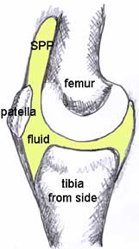
Water As A Lubricant
When bones meet at a joint, they need a fluid between the bones to prevent scraping against each other.
That fluid is called a synovial fluid, which is made mainly of water.
Many internal organs have fluid around them to keep them protected. Examples:
  Brain: Cerebro-spinal fluid
  Lungs: Pleural Fluid
  Eyes: Mix of fluids.
Synovial Fluid

Slide 42
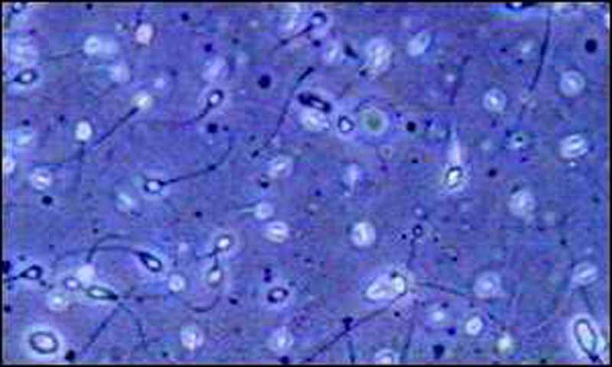
Water In Sexual Reproduction
During fertilization, the sperm, must get to, the ovum in order to make the zygote, which makes a new individual.
In organisms adapted for internal fertilization, the sperm is transported in semen which contains mostly water.
In organisms using external sperm can be transported in the water habitat.
Sperm Cells

Slide 43
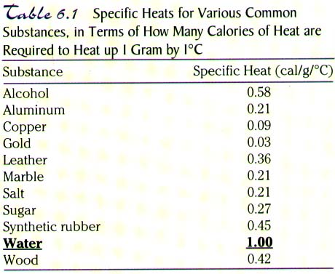
Water For Constant Temperature
Water has a very high specific heat. (4200J/kg0C)
much energy is required to change the temperature of water by a single degree.
That provides a perfect habitat for marine mammals, because of the non-changing temperature.
Another way water helps mammals maintain their body temperature is by sweating.
Mammals sweat when their body temperature is too high.
Sweat is made of mostly water.
When the water evaporates from the organism it creates a cooling effect, therefore lowering the organisms body temperature.

Slide 44
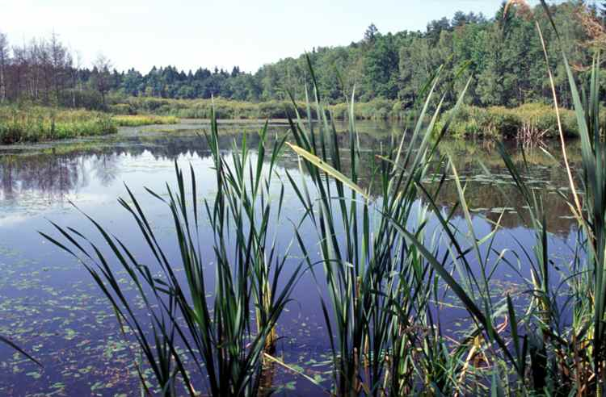
Water As A Habitat
Water is a good habitat due to :
Provide a good protective layer for organisms living in it.
Provide buoyancy and support for organisms
Has plentiful dissolved oxygen for use in respiration.
Fertilization is easier in water.
Helps maintain a constant temp.
Keeps out UV rays from the sun.

Slide 45
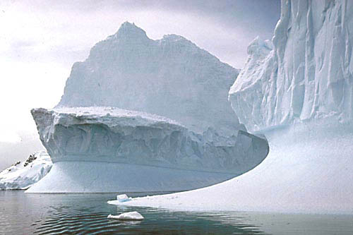
Marine Life During Winter
The solid form of water (ice) is less dense than the liquid water.
This is very unusual.
Water has its highest density at 4C.
That means that at the bottom of a body of water the water will usually be at least 4C.
This allows aquatic organisms to be able to live, even in the winter.

Slide 46
Homeostasis
Ability to maintain a steady state despite changing conditions
Water is important to this process because:
  a. Makes a good insulator
  b. Resists temperature change- high specific heat capacity
  c. Universal solvent
  d. Coolant
  e. Ice protects against temperature extremes (insulates frozen lakes)

Slide 48
Solubility of molecules in water
Solubility in water depends upon the ratio of polar to nonpolar groups in a molecule
The larger the portion of nonpolar groups the less soluble the molecule will be
The larger the portion of polar groups (e.g. hydroxyl groups (-OH) the more soluble the molecule is
Polar biomolecules dissolve readily in water because they can replace the water-water interactions with more energetically favourable water-solute interactions.

Slide 49
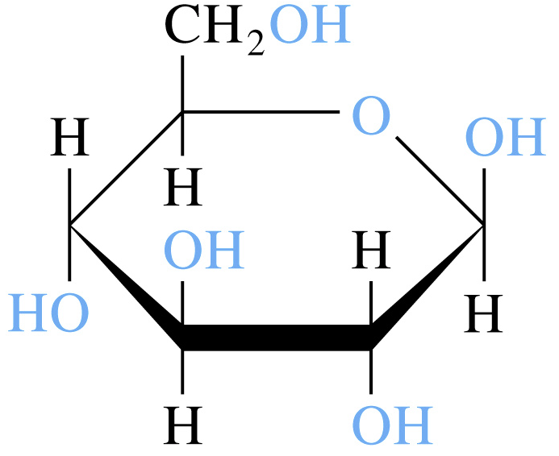
Solubility of molecules in water
Hydrophilic (water-loving)-substances that readily dissolve in H₂O
  polar substances
  ionic (electrolytes)
Solvation occurs during dissolution:
A process whereby a molecule or an ion becomes surrounded by solvent molecules
Polar water molecules align themselves around ions or other polar molecules and becomes solvated
When the solvent is water the molecules or ions are said to be hydrated hydrated

Slide 50
Water as solvent.
Water dissolves many crystalline salts by hydrating their component ions.
The NaCl crystal lattice is disrupted as water molecules cluster about the Cl and Na ions.
The ionic charges are partially neutralized & the electrostatic attractions necessary for lattice formation are weakened.
Entropy increases as crystalline substances dissolve

Slide 51
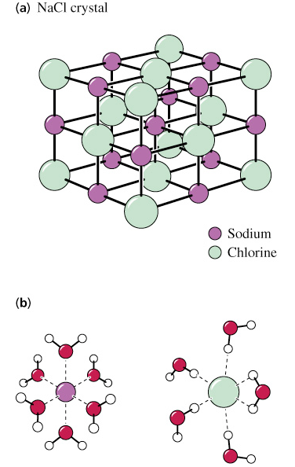
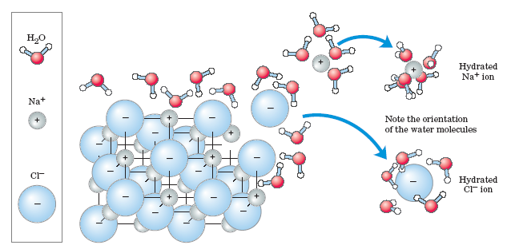
Solubilities of molecules in water
Dissolution of NaCl in water
Electrostatic forces hold ions together in crystalline sodium
Water molecules form solvation spheres around Na⁺ and Cl⁻
Entropy increases as crystalline substances dissolve

Slide 52
Solubulity of Nonpolar Substances
Hydrophobic (water-fearing) molecules
  insoluble in Water
  Exhibit a hydrophobic effect –
    the exclusion of nonpolar substances by water & critical for
  protein folding
  self-assembly of biological membranes
Amphipathic molecules
    have both hydrophobic chains and ionic or polar ends. Detergents (surfactants) are examples.

Slide 53
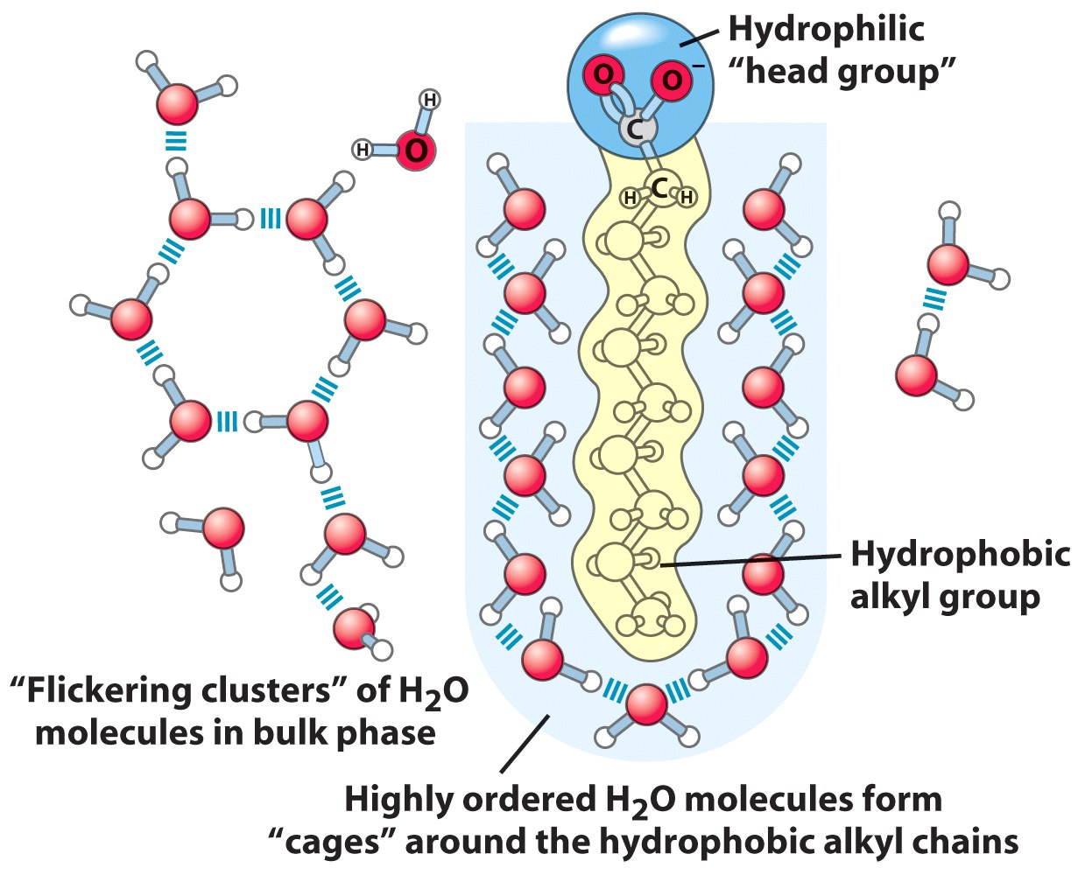
Solubility of Nonpolar compounds
Amphipathic cpds
Long-chain fatty acids
have very hydrophobic alkyl chains,
each alkyl group is surrounded by a layer of highly ordered water molecules.

Slide 54
A micelle is formed when a variety of molecules including soaps and detergents are added to water.
The molecule may be a fatty acid, a salt of a fatty acid (soap), phospholipids, or other similar molecules.
The molecule must have a strongly polar "head" and a non-polar hydrocarbon chain "tail".
When this type of molecule is added to water, the non-polar tails of the molecules clump into the center of a ball like structure, called a micelle, because they are hydrophobic or "water hating".
The polar head of the molecule presents itself for interaction with the water molecules on the outside of the micelle.

Slide 55
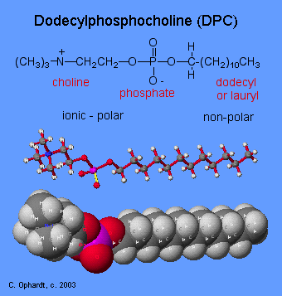
Structure of
Dodecylphosphocholine (DPC):
An example of a micelle uses
DPC is a synthetic phosphodiester.
The phosphoric acid group has
ester bonds between
1) choline, (CH₃)₃N(CH₂)₂OH,
2) dodecyl (or lauryl) alcohol,
CH₃(CH₂)₁₁OH.
The choline,which contains a
quaternary amine with
a positive charge,
and the phosphate are ionic
and polar.
The dodecyl part is the
non-polar hydrocarbon chain.

Slide 56
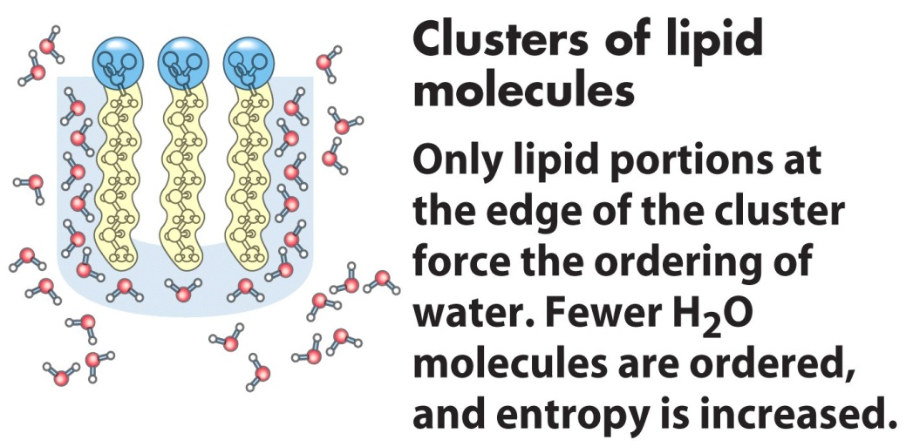
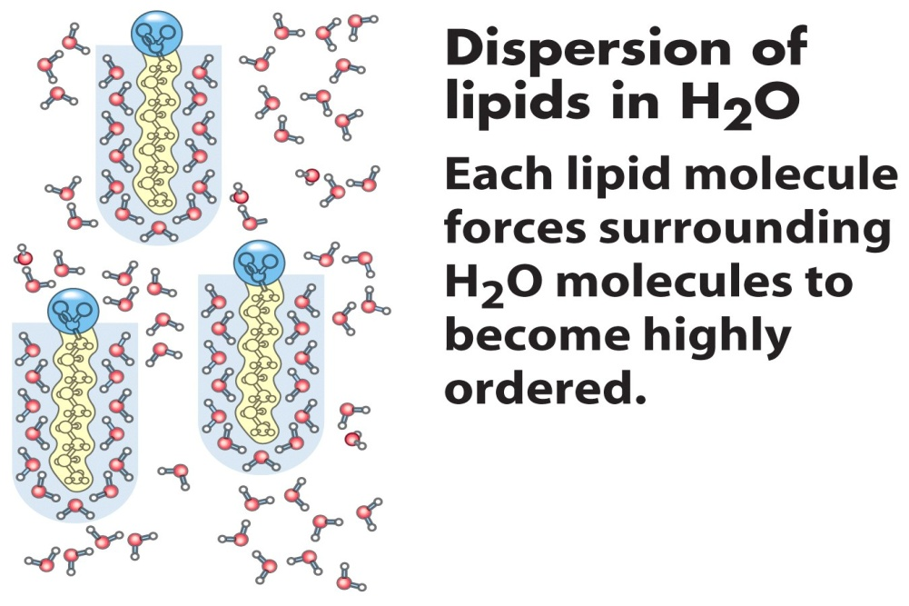
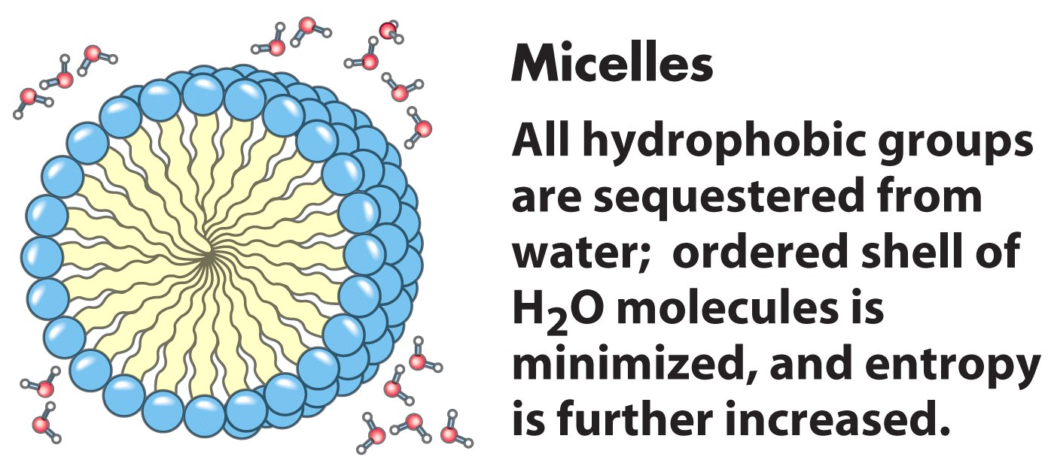
Amphipathic compounds in aqueous solution.
(b) By clustering together in micelles, the fatty acid molecules expose the smallest possible hydrophobic surface area to the water, and fewer water molecules are required in the shell of ordered water.
The energy gained by freeing immobilized water molecules stabilizes the micelle.

Slide 57


Release of ordered water favors formation of an ES-complex
While separate, both enzyme and substrate force neighboring water molecules into an ordered shell.
Binding of substrate to enzyme releases some of the ordered water, and the resulting increase in entropy provides a thermodynamic push toward formation of the enzyme-substrate complex.
Biological Applications

Slide 58

Sodium dodecyl sulfate (SDS)
A synthetic detergent
A 12-carbon tail
Polar sulfate group

Slide 59

Detergents in water
Monolayers can form on the surface
At higher concentrations detergents can form micelles

Slide 60

Charged or polar molecules are dissolved easily in water (Hydrophilic).
Nonpolar solvents are poor solvents for polar molecule but easily dissolved hydrophobic compound (lipid or waxes).
Amphipathic compounds contain regions that are polar or (charged) and nonpolar

Slide 61
Solutions & Suspensions
Water is usually part of a mixture.
There are two types of mixtures:
Solutions
  Ionic compounds disperse as ions in water
  Evenly distributed
SOLUTE: Substance that is being dissolved
SOLVENT:
  Substance into which the solute dissolves
Suspensions
Notes:
61

Slide 62

Solution
Notes:
62

Slide 63
Water Is Nucleophilic
Nucleophiles - electron-rich atoms or groups seeking positively charged groups
Electrophiles - electron-deficient atoms or groups
Water is a relatively weak nucleophile
Due to its high cellular concentration, hydrolysis reactions in water are thermodynamically favored

Slide 64

Hydrolysis of a peptide

Slide 65
Ionization of Water
Pure water is slightly ionized
Ionization of Water Is Expressed by an Equilibrium Constant
the H⁺ and OH⁻ Concentrations of a sol is The pH Scale designated by the pH.
Weak acids and bases have characteristic dissociation Constants
Titration Curves Reveal the pKa of Weak Acids

Slide 66
Ionization of water
Water molecules have a slight tendency to ionize
undergo reversible ionization to form hydrogen ion ( proton) and a hydroxide ion giving an eqillibrium.
Hydrogen Ion Hydroxide Ion
Acid Base
One water molecule in 550 million naturally dissociates into a Hydrogen Ion (H+) and a Hydroxide Ion (OH-
H₂O  H⁺ + OH⁻

Slide 67



Hydronium ions and proton hopping
Hydrogen ions formed in water becomes immediately hydrated to hydronium ions (H₃O⁺).
No individual proton moves very far through the bulk solution,
but a series of proton hops between hydrogen bonded water molecules causes the net movement of a proton over a long distance in a remarkably short time.

Slide 68


Dissociation” of water
H₂O + H⁺ H₃O⁺

Slide 69
Ionization of Water
Pure water consists of a low concentration of
  hydronium ions (H₃O⁺) and
  hydroxide ions (OH⁻)
Acids are proton donors (e.g. H₃O⁺) and
Bases are proton acceptors (e.g. OH⁻)

Slide 70
The ionization of water
Ionization of water can be quantitatively expressed by an equilibrium constant (K_{eq})
For a hypothetical reaction:
The equilbrium constant is obtained by the expression ( law of mass action)

Slide 71

Ionization of Water
Consider the ionization of water
The Keq for the ionization of water will be expressed as
The concentration of water expressed in moles/litre is given by
Molarity= no of moles/volume =18/1000= 55.5 M (1 litre)
Substituting this value in the equation
Cross multiplying the equation
H₂O  H⁺ + OH⁻

Slide 72

Ionization of Water
The value of Keq has been determined by electric conductivity measurements , (1.8X 10⁻¹⁶M) at 25⁰c hence considered as a constant
Substituting the value of Keq in the equation
For neutral solution such as water,
        [H⁺] =[OH⁻]

Slide 73
The ionization of water
The ionization process is reversible.
In neutral water,
  ratio of either [H⁺] or [OH⁻ ]to [H₂O] is very small = (10⁻⁷ M)
Since Keq of water is constant, thus, if the level of [H⁺] increase, then the level of [OH⁻] must decrease, & vice-versa.
For neutral water, the Keq is 1 x 10⁻¹⁴ M and the concentrations of [H⁺] and [OH⁻] are each 1 x 10⁻⁷ M
(10⁻⁷ = 0.0000001 M)

Slide 74
As [H⁺] rises, [OH⁻] falls
OH⁻
OH⁻
OH⁻
H⁺
H⁺
H⁺
0 1 2 3 4 5 6 7 8 9 10 11 12 13 14
Acidic Neutral Basic

Slide 75
Relationships
H⁺
H₂O
OH⁻
[H⁺] >[OH⁻]
[H⁺] =[OH⁻]
[H⁺] <[OH⁻]
Acidic solution
Neutral solution
Basic solution
pH < 7
pH = 7
pH > 7

Slide 76

The pH scale
Values of [ H+ ]and [OH] are very small in soln
can be magnified by being expressed in terms of neg log
Thus instead of [H⁺] being1 x 10⁻⁷ M, it is said that the negative logarithm of [H⁺] concentration is 7,
Hence negative log of [ H+] also called pH
pH is the negative logarithm of [H⁺], Mathematically,
The term p- means negative of if , Keq, [H+] or [OH-]

Slide 77
The pH scale
Similarly the negative log of [OH] is pOH mathematically expressed as
pOH = -log [OH⁻]
Hence for water
[H+]=10⁻⁷M, pH= log 1/ 1.0*10⁻⁷M, pH= 7
[OH-]= 10⁻⁷M, pOH= log 1/ 1.0*10⁻⁷M,

Slide 78
The pH scale
Thus for the ionic product of water equation
Kw = [H+] [OH-],
obtaining the –log of the equation
- log Kw= -log [H+] + -log [OH-]
= pKw = pH + pOH
pH = – log [H+] ; Similarly pOH = – log [OH-]
For water, [H+]= [OH-], = 1 X 10⁻⁷, Kw = 1X10⁻¹⁴
Hence -log 1X10⁻¹⁴ = -log 1X 10⁻⁷ + 1X 10⁻⁷
14= 7 + 7

Slide 79
The pH Scale- Summary
The pH of a solution is simply the negative logarithm of [H⁺]
pH scale ranges from 0 – 14
Indicates the concentration of H⁺ ions in a solution
pH of 7 means the soln is neutral
pH 0 up to 7 the soln is acidic … more [H⁺ ]
pH above 7 – 14 is basic… more [OH^{-]}
Acidic solutions have a pH of less than 7 and basic solutions have a pH greater than 7.
Water is neutral with a pH = 7.
Log scale means 10X change per unit!-
Ie each pH unit represents a factor of 10X change in concentration
pH 3 is 10 x 10 x 10 (1000) stronger than a pH of 6

Slide 80

The pH Scale

Slide 81

The pH Scale
[H+]= 10⁻¹M
Lower pH values are acidic
Higher pH values are basic fluids
[H+]= 10⁻⁹ M

Slide 82


Slide 83
Importance of pH
Pharmaceutical preparations
  Extraction and therapeutic stability of drugs depends on pH
    eg extraction of insulin from pancreas requires a pH of 3-3.5
    Vitamin B preparations are sensitive to pH optima of 3.5-4.5
    Many antiseptics acts well at Lowered (acidic) pH values
Industrial applications
  Manufacture of drugs
Analytical preparations-
  volumetric & gravimetric analysis require proper pH adjustment

Slide 84
Importance of pH
Physiological applications
  Normal pH – 7.4
  Marked deviations of pH from normal – an indicator of adverse conditions and complications
  Ketoacidosis- lowered pH; Alkalosis- increased pH than normal
Diabetic comma – pH drop to 6.82
  Solutions Intravenous injections must be buffered to normal pH
  Eye drops with pH values more or less than normal causes much irritation to the eye
  pH of gastric juice is 2 and an increase pH may cause vomiting
  The pH of GIT must be maintained for their efficiency since they are pH specific

Slide 85
Acid-Base Definitions
Bases
  generate OH⁻ in water
  Proton (H⁺ )acceptors
  Produces excess OH⁻
Acids
generate H⁺ in water
a proton (H⁺)donors
Produces excess H⁺
Acid /base reactions are the common types of equilibrium encountered in living systems
can dissociate to contribute to the total [H+] & [OH-]
HA <-----> A- + H+
two types of acids/bases
Strong acids and bases- ionize completely in aqueous solutions
Weak acids and bases-ionize partially in aqueous solutions

Slide 86

Strong Acids
Undergo 100% dissociation in aqueous soln
good H⁺ donor
equilibrium lies far to right
HA → H⁺ + A⁻
Before dissociation
After dissociation
Relative # moles
HCl H⁺ Cl⁻
HCl H⁺ Cl⁻

Slide 87
Strong acid-strong base titrations
Strong acids and bases dissociate completely in water
HCl + H₂O Cl⁻ + H₃O⁺
Cl⁻ is the conjugate base of HCl
H₃O⁺ is the conjugate acid of H₂O
Think about this: Given 25 mL of a unknown concentration of HCl, a solution of 0.100 M NaOH and a burette, how could you determine the concentration of the HCl?
What would happen to the pH of the solution of HCl as the NaOH was added to it?

Slide 88


Titrations
Perform a neutralisation of an acid ans a base
Neutralisation is attained by use of
  pH paper strips
  pH meter
  pH indicator solutions eg
    Methyl orange; yellow in basic solution and red in acidic solution
    Bromothymol blue (yellow in acidic solution), slight green tint as base is added, and blue form in basic solution
Many other indicators available

Slide 89

Titrations / pH curves

Slide 90
Titrations / pH curves
Experimental method to determine the concentration of an acid (or base).
Titration curves are used to determine pK_{a} values
pH
mL base added

Slide 91

Acid Dissociation Constants: Weak Acids
Weak acids and bases do not fully dissociate in solution
An equilibrium exists btn the acid and its conjugate base.
An example of a weak acid is the Acetic acid
The dissociation constant Ka can be quantatively expressed in a negative logarithmic form as
–logKa ie pKa = -logKa

Slide 92
Titration curves of weak acids (acetic acid)
The conc. of the acid in the original solution can be calculated from the volume and concentration of base (NaOH) added
Can be effected by the titration curve.
Titration curves of weak acids reveals the pKa of weak acids
At the midpoint of the titration, at which exactly 0.5 equivalent of NaOH has been added,
[CH3COOH]=[CH3COO-] and pH=pKa
Titration curves are used to determine pK_{a} values

Slide 93

Titration curve of acetic acid (CH₃COOH)

Slide 94

Titration curve of acetic acid (CH₃COOH)

Slide 95

Comparison of the titration curves of weak acids
The T curves of these acids have the same shape,
Curves are displaced along the pH axis since the 3 acids have different strengths.
Acetic acid, with the highest Ka (lowest pKa) of the three, is the strongest (loses its proton most readily);
it is already half dissociated at pH 4.76 ie its pKa
Dihydrogen phosphate loses a proton less readily, being half dissociated at pH 6.86.
Ammonium ion is the weakest acid of the three and does not become half dissociated until pH 9.25.

Slide 96
Acid Dissociation Constant: A hypothetical case
Weak acids and bases do not fully dissociate in solution
An equilibrium exists btn the acid and its conjugate base.
Consider the dissociation of a weak acid HA:
This equilibrium can be expressed as
Smaller K_{a}→ weaker acid
Larger pK_{a}→ weaker acid
←amount dissociated
←amount undissociated
Ka = the equilibrium or the dissociation constant
it pertains to the dissociation of protons from acids and bases.

Slide 97
Acid Dissociation Constant: A hypothetical case
Expressing the equation in terms of [H+]
Since the [H+] is very small , the equation is expressed in terms of -log
log(xy) = log x + log y
–log(x/y) = +log (y/x)
The equation hence simplifies to,
HA= the weak acid- proton donar, A⁻ = base – proton acceptor,
hence
Conjugated base
Conjugated acid

Slide 98
Henderson-Hasselbach Equation- Derivation
In terms of acid and base conc
pH = pKa + log [Base]
[Acid]
Physiologically bases exists as salts, hence the equation is expressed as
pH = pKa + log [Salt]
[Acid]
This is the Henderson Hasselbalch equation for the weak acid

Slide 99

The Henderson-Hasselbalch Equation
[HA ]- the undessociated acid; [A-]– conjugate base
Defines the pH of a solution in terms of:
(1) The pK_{a} of the weak acid ( pH when acid is half dessociated
(2) the log of the ratio of conc of the conjugate base [A⁻] to the weak acid [HA]
HH equation allows for the calculation of
    Molar ratio of base ( proton acceptor)to acid ( proton donar)
    buffer pH when the conc. of weak acid (HA) and conjugate base (A⁻) are known

Slide 100
Henderson-Hasselbach Equation- Derivation
Buffers are solns able to resist changes in pH when considerable amount of acid or base is added
Max buffering occur when the [base] = [acid] ie, when pH= pka
E.g Buffered solution contains 0.50 M HC₂H₃O₂ (K_{a} = 1.8x10⁻⁵) and 0.50 M NaC₂H₃O₂. Calculate pH of solution..

Slide 101
RELATIONSHIP [H⁺], pH and K_{a}, [A⁻], [HA]
H-H eqn is of great predictive value in ptotonic equilbria
[A⁻] < [HA] →
[A⁻] > [HA] →
[A⁻] = [HA] →
→ pH < pK_{a}
→ pH > pK_{a}
→ pH = pK_{a}
If the eqn is evaluated for several ratios of [A]/[HA] btwn the limits 10⁻³ to 10³ and the calculated pH values plotted the titration curve is obtained

Slide 102


Slide 103
H-H Equation
H-H equation can be used to calculate the following
The pH of the solution-
. The dependance of many reactions, as well as biological functions depends upon the pH of the solution in which the chemistry occurs.
able to calculate the pH of a solution of a chemical by knowing its pKa and ratio of ionized and unionized chemical.
The pKa of a chemical in solution-
The pKa of a solution determines the acidity of the compound and the amount of ionization of a molecule in a solution of particular pH.
The [A-] or salt concentration or the amount of ionized chemical and the [HA] or acid concentration or the amount of unionized chemical-
important for certain reactions as well as for pharmaceutics related problems as a lot of biological functions such as absorption and excretion of drugs depends upon the ionized/unionized state of the drug.

Slide 104
Calculations involving H-H equation
Calculate the pH of a buffer composed of 0.1M acetic acid (CH3COOH) and 0.6M acetate (CH3COO-) knowing that the acid dissociation constant Ka is 1.8 x 10-5.
Calculate the pH of a buffer solution prepared by dissolving 363 mg of Tris in 10 mL of 0.2M HCl and diluting to 100 mL with water. [Tris: mw 121 g/mol and pKa = 8.08 for the conjugate acid]
Aspirin (acetylsalicylic acid) has a pK_{a} of 3.5. (i) Calculate the ratio of ionized/unionized of the drug in the stomach where pH is 1. (ii) Calculate the ratio of ionized/unionized in the intestine where pH is 6. (iii)Based on these calculations- where is aspirin absorbed within the body?

Slide 105
Clinical Significance H-H EQUATION
Blood Buffering
Cells can only survive in very narrow pH range, thus constant blood pH is vital.)
The pH of blood is maintained in a narrow range 7.4.
Even relatively small changes in blood pH value can lead to severe metabolic consequences.
Hence blood buffering is extremely important in order to maintain homeostasis

Slide 106
Buffer solutions
aqueous systems that tend to resist changes in pH when small amounts of acids [H+ ]or base [OH- ] is added.
mixtures of weak acids and their conjugate bases-contain weak acids & salts or weak bases & salts
Eg a mixture of equal conc of acetic acid and acetate ion,
the salt provides a reservoir of A- to replenish [A-] when A- is removed by reaction with H+.
Buffers are produced naturally by the body to maintain homeostasis in cells and tissues against pH changes
Strong acids / bases cannot be used as buffer

Slide 107
Buffered Solutions Resist Changes in pH
Buffer capacity is the ability of a solution to resist changes in pH
Amount of H⁺/OH⁻ a buffer can absorb without a considerable change in pH
Most effective buffering occurs where:
solution pH = buffer pK_{a}
At this point: [weak acid] = [conjugate base]
Effective buffering range is usually at pH values equal to the pKa ± 1 pH unit

Slide 108

Titration curve for phosphoric acid (H₃PO₄)

Slide 109

Mechanisms of buffer Action
Contain relatively large amounts of weak acid and corresponding base.
Added H⁺ reacts to completion with weak base, A⁻ to form HA
Added OH reacts to completion with weak acid, HA.
pH is determined by ratio of concentrations of weak acid and weak base.

Slide 110

Mechanisms of buffer Action
donate hydrogen ions after being depleted by a rise in pH
accept hydrogen ions from the solution when in excess

Slide 111
The Major Body Buffer Systems
Site | Buffer System | Comment
ISF | Bicarbonate | For metabolic acids
 | Phosphate | Not important because concentration too low
 | Protein | Not important because concentration too low
Blood | Bicarbonate | Important for metabolic acids
 | Haemoglobin | Important for carbon dioxide
 | Plasma protein | Minor buffer
 | Phosphate | Concentration too low
ICF | Proteins | Important buffer
 | Phosphates | Important buffer
Urine | Phosphate | Responsible for most of 'Titratable Acidity'
 | Ammonia | Important - formation of NH₄⁺
Bone | Ca carbonate | In prolonged metabolic acidosis

Slide 112

Physiological biological buffer systems
The phosphate buffer system
NOT an important blood buffer as its concentration is too low
effective buffer in biological fluids including
  extracellular fluids
  most cytoplasmic compartments
  Urine
important buffers intracellularly and in urine where their concentration is higher.
Acts primarily in the cytoplasm of all cells.
Maintains pH in the range of about 5.9 & 7.9.
maximally effective at a pH close to its pKa of 6.86

Slide 113
Physiological biological buffer systems
The phosphate buffer system
triprotic weak acid and has a pKa value for each of the three dissociations:
      pK_{a1} = 2 pK_{a2} = 6.8 pK_{a3} = 12
H₃PO₄ <= = = >H⁺ + H₂PO₄⁻ <= = =>H⁺ + HPO₄⁻²< = = = > PO₄⁻³ + H⁺
in most biological systems, monohydrogen phosphate (HPO₄⁻²) and dihydrogen phosphate (H₂PO₄⁻) are the two species present.
The pKa2 is 6.8 and this makes the closed phosphate buffer system a good buffer intracellularly and in urine.
phosphate IS more effective intracellularly and in urine because its concentration is much higher here than in extracellular fluid.

Slide 114
Bicarbonate buffer system
major buffer system in the ECF
Operates primarily in the blood plasma
responsible for about 80% of extracellular buffering
most important ECF buffer for metabolic acids but it cannot buffer respiratory acid-base disorders.
the buffer system consists of:
carbon dioxide /carbonic acid /bicarbonate
bicarbonate ion is formed in in blood by reaction of CO2 and H2O
    CO2 + H2O <------> H2CO3
    H2CO3 <-------> H+ + HCO3-
The pK'a is derived from the Ka value of the following reaction:
CO₂ + H₂O <=> H₂CO₃ <=> H⁺ + HCO₃- (where CO₂ refers to dissolved CO₂)

Slide 115
Bicarbonate buffer system
The concentration of carbonic acid is very low compared to the other components so the above equation is usually simplified to:
CO₂ + H₂O <=> H⁺ + HCO₃-
By the Law of Mass Action:
Ka = [H⁺] . [HCO₃-] / [CO₂] . [H₂0]
The concentration of H₂O is so large hence considered as a constant

Slide 116
THE BICARBONATE BUFFER SYSTEM
Buffer capacity depends upon equilibria between:
(1) Gaseous CO₂ (air spaces of the lungs)
(2) Aqueous CO₂ (dissolved in the blood)
(3) Carbonic acid
(4) Bicarbonate
The system allows the transfer of relatively insoluble CO2 from the tissues to the lungs, to be expelled
Tissue-CO2 comes from the oxidation of ingested carbon compounds

Slide 117

Carbonate buffering equilibria

Slide 118



Slide 119
Bicarbonate system
Reaction 1: When H is added to blood as it passes through the tissues,- proceeds toward a new equilibrium, in which the concentration of H₂CO₃ is increased.
Reaction 2 :This increases the concentration of CO₂(d) in the blood plasma
Reaction 3: thus increases the pressure of CO₂(g) in the air space of the lungs
The extra CO₂ is exhaled.
Conversely, when the pH of blood plasma is raised (i.e. by NH₃ production during protein catabolism),
The H concentration of blood plasma is lowered, causing more H₂CO₃ to dissociate into H and HCO₃. This in turn causes more CO₂(g) from the lungs to dissolve

Slide 120
Bicarbonate system
If blood is not adequately buffered, the result may be metabolic
  acidosis or
  alkalosis.
Conditions physiologically reached due to metabolic defect that results in the inappropriate accumulation or loss of acidic or basic cpds
These compounds may be ingested, or may accumulate as metabolic by-products such as acetoacetic acid and lactic acid.
cpds ionize, thereby increasing the level of H+ ions
these in turn remove bicarbonate ions from the blood and alter blood pH.

Slide 121
The predominant defect in acid or base elimination arises when the excretory system of the kidneys is impaired.
Alternatively, if the lungs fail to expel accumulated CO2 adequately and CO2 accumulates in the body, the result will be respiratory acidosis.
If a decrease in PCO2 within the lungs occurs, as during hyperventilation, the result will be respiratory alkalosis.

