Slide 1
Overview: The Digestive System and Nutrition
Dr Anne W MURIITHI
1st Year – MBChB, BPharm, BDS
September 2016

Slide 2
Let food be your medicine and medicine be your food
Hippocrates

Slide 3
Functions
The digestive system : anatomy and physiology
  different organs
    Mouth, oesophagus, stomach, intestines, rectum
  regional specialization
    Mechanical digestion
    Chemical digestion
    Absorption of nutrients
    Expulsion of remnants

Slide 4
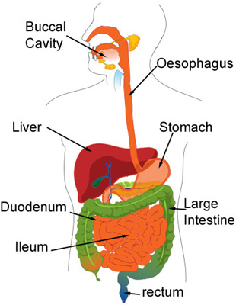

Slide 5
Gut function is very well co-ordinated, with its own complex and relatively independent nervous system - gut brain (Enteric Nervous System)
Gut processes are sub-conscious. We are usually aware of them only when things go wrong

Slide 6
“You are what you eat”
Functions of the digestive system
  Basically : digestion (mechanical and chemical)
  and absorption
  By means of our digestive system, we process organic matter, extract nutrients, building materials and fuel, and eliminate the rest
  Many drugs are administered orally. How do they work? (at the cellular level)

Slide 7
When our digestive system is healthy, it functions well and this determines our energy level, our longevity and state of body and mind.
Stress alters the balance of the Autonomic Nervous System; and thus indirectly, the ENS
Why are meals usually preceded by prayer?

Slide 8
Why do we eat?
Reasons for eating differ
  There are those that eat to live
  There are those that live to eat
Gluttony is one of the 7 deadly sins
Eating is a social event
    Culinary and hospitality industries
    Agriculture, horticulture
    Industries producing artificial colorings, flavorings

Slide 9
It matters:
  what you eat balanced diet
  how you eat it fast, slow
  when you eat time of day, how often?
  where you eat on the run? ‘safe’ atmosphere?
  how you prepare what you eat

Slide 10
Some facts about the digestive system:
  10 metre long tube
  lined with mucous membrane; guarded by an immune system
  surface area: similar to that of a small football pitch – villi and microvilli
  the epithelial cells of this barrier are renewed every 4 days gut stem cells

Slide 11
How important is water?
Our body is one large aqueous medium arranged in several body compartments
Water is required (necessary) for chemical reactions
Fluid in the lumen of the digestive tract is absorbed primarily into the vascular compartment via the intracellular and extracellular ones
Nutrients will eventually find their way into the intracellular compartment. Whilst toxins and metabolites move from the intracellular to the extracellular compartment for elimination.

Slide 12
The human body is made up of 73 trillion cells
The gut microflora totals about 730 trillion cells
  Respiratory tract, genitourinary tract, skin
Human microbiome project
Fat is not digested in the same way as protein or carbohydrate. Fat is hydrophobic!
Fat absorption and assimilation also differs
  Fat-soluble vitamins are absorbed with lipids
Drinking water with vs in between meals?

Slide 13
Regulation and control of gut function:
How does the pancreas know when and which enzymes to secrete?
What happens when you eat a large meal and immediately go to bed?
Is there any harm in nibbling? Chewing gum?
Issues of hunger and satiety. Obesity. Anorexia Nervosa
What is the relationship between asthma, eczema, cancer, arthritis and ideal digestive function?

Slide 14
In the body, the digestive system does not function in isolation
The special senses
  Sight, smell, taste, hearing, touch and feel
Pain
  Loss of appetite
  Vomiting
Moods: depression, pleasure
Exercise
Brain-gut axis

Slide 15
Do not assume that because one has chewed properly, swallowed and digested the food, that it is readily available for body metabolism.
For this to happen, the food needs to be absorbed and then assimilated
Chemical digestion involves hydrolysis [H₂O is required]
Growth, repair and regeneration involve condensation [production of water from metabolism]

Slide 16
As houses well stored with provisions are most likely to be full of mice, so the bodies of those that eat much are full of disease
Laertius Diogenes
Greek author, 3rd century CE

Slide 17
Let us write and speak proper English
He bought for his dog 6 iPods
She was kept by a sponsor

Slide 18
Thank you

