Slide 1
PROPAGATED OR NERVE ACTION POTENTIALS - NEW

Slide 2
COMMUNICATION IN THE NERVOUS SYSTEM
The nervous system is an electro-chemical machine
The communication system of nervous system in form of nerve impulses travel to and fro up and down the nervous system
All functions in this system involve nerve impulses
A nerve impulse is also called an action potential

Slide 3
NERVE ACTION POTENTIAL
Is a rapid transmitted change in the resting membrane potential
In less than a half millisec potential changes from resting value of -90mV goes up to +35 mVolts and returns back to -90mV
Action pot travels fro point of initiation to the end of the nerve
(describe method of measurement and observation)

Slide 4
VOLTAGE-GATED Na+ and K+ MEMBRANE CHANNELS
An action potential arises when a nerve is stimulated chemically, electrically or physically
Stimuli affect state of these voltage-gated Na+ and K+ channels
The N+ channels have two gates
One on the outside (the activation gate)
One on the inside (the inactivation gate)
The K+ channels have only one internal gate
Stages of the action potential are: rapid depolarization; slowing down and switching off of the process; and membrane recovery to resting potential

Slide 5
STAGES OF THE ACTION POTENTIAL-I
Initial Depolarization Stage
Na+ activation gates open and Na+ rushes in making the membrane increasingly +ve
The more it becomes positive the more the gates that open a positive feedback mechanism rapidly pushes the potential towards+35 mV
Slowing down and switching of the positive feed-back depolarization process
As membrane potential approaches zero, the Na+ inactivation gates start opening
As membrane reaches positive value all Na+ inactivation gates open and stop any more Na+ entering the cell

Slide 6
STAGES OF ACTION POTENTIAL -II
Recovery phase the role of Voltage-gated K+ channels
As membrane potential approaches zero, Voltage gated K+ channels start opening and K+ starts rushing OUT
As membrane becomes more depolarized, all of these channels open, K+ rapidly rushes OUT thus making the membrane negative again
Voltage-gated K+ channels remain open until the resting potential is restored
Na+ inactivation gates remain closed until the resting potential is restored
Above events worked out by Alan Hodgkin and Andrew Huxley for which they got Nobel in Medicine using their invention “the Voltage Clamp Technique”

Slide 10
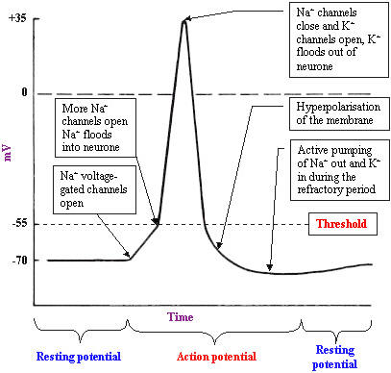

Slide 11
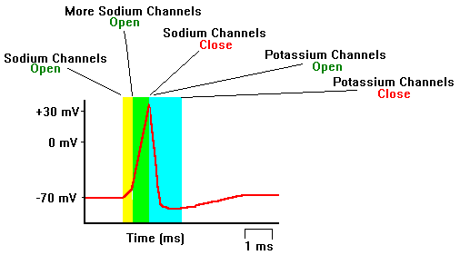

Slide 12
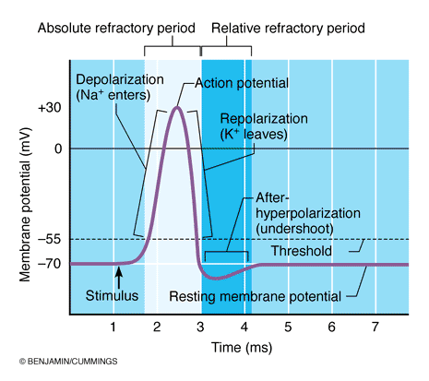

Slide 13
VOLTAGE CLAMP METHOD OF STUDYING ** VOLTAGE GATED Na+ AND K+ CHANNELS
Hodgkin and Huxley at University College London worked on giant squid axon
Voltage clamp machine has
Voltage measuring intracellular electrode
Current supplying intracellular electrode which can be used to supply current in such a way as to fix the voltage at any pre-set level i.e. to clamp the voltage at any selected value
** ---onwsards: Not covered in Mon 28th Nov 2016 Lecture

Slide 14
SIR ANDREW HUXLEY – NOBEL LAURIATE IN PHYSIOLOGY AND MEDICINE

Slide 17
PUFFER FISH

Slide 18
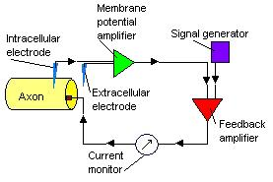
VOLTAGE CLAMP DIAGRAM AND EXPLANATION
The voltage clamp operates by negative feedback.
The membrane potential amplifier measures membrane voltage and sends output to the feedback amplifier (GREEN);
A signal generator is used for generating any desired voltage and sending it to the second amplifier (RED)
This amplifier subtracts the membrane voltage from the command voltage, which it receives from the signal generator (PURPLE BOX).
The signal is amplified and output is sent into the axon via the current electrode.
This output corrects the measured electrode and makes it equal to the pre-set voltage sent by the signal generator

Slide 20
SELECTIVE BLOCKCKAGE OF Na+ AND K+ CHANNELS
TETRODOTOXIN (a neurotoxin from puffer fish and some newts –produced by their “bacterial commensals”)
Claimed to be used(among other unknown “mumbo jumbo”) for ages by “Vodoo priests” for turning their victims into “zombies” in West Africa and Haiti (explain)
Applied on the surface of the axon selectively blocks voltage gated Na+ channels
TETRAETHYLAMMONIUM
Injected into axon selectively blocks voltage-gated K+ channels

Slide 21
SELECTIVE MEMBRANE CONDUCTANCE FOR K+
At -90mV, K+ channels remain closed
At +10 mV, K+ channels open gradually then completely and remain open
K+ channels remain open as long as the membrane is held at +10mV
At -90mV, the K+ channels start closing first rapidly and then more gently till they all close
K+ channels remain closed as long as the membrane is clamped at -90mV.
THUS HODGKIN AND HUXLEY EXPLAINED THE ACTION POTENTIAL AND GOT THEIR NOBEL INMEDICINE

Slide 22
SELECTIVE MEMBRANE CODUCTANCE FOR Na+
Membrane voltage clamped at
-90mV; +10mV and -90mV again
If K+ channels blocked
Conductance measurements show that
At -90mV, Na+ channels remain closed
At +10mV, Na+ channels open fully and then close on their own while the voltage is still clamped at +10

Slide 23
EFFECTS OF VOLTAGE CLAMP ON SODIUM ON POTASSIUM IONS FLOW

Slide 24
HISTORICAL NOTES ON SIR ANDREW HUXLEY
SIR ANDREW FIELDING HUXLEY,
Won the 1963 Nobel Prize in Physiology or Medicine for his experimental and mathematical work with Sir Alan Lloyd Hodgkin on the basis of nerve action potentials, the electrical impulses that enable the activity of an organism to be coordinated by a central nervous system.
Hodgkin and Huxley shared the prize that year with John Carew Eccles, who was cited for research on synapses. Hodgkin and Huxley's findings led the pair to hypothesize the existence of ion channels, which were isolated only decades later.
Andrew was educated at University College School (1925-1930) and Westminster School (1930-1935, King's Scholar); and went up to Trinity College, Cambridge in 1935 with a major entrance scholarship.
For the first year of the war Huxley was a clinical student, but when medical teaching in London was stopped by air attacks, he changed to work of more immediate application, and spent the rest of the war on operational research in gunnery, first for Anti-Aircraft Command and later for the Admiralty.
He continued to hold college and university posts in Cambridge until 1960, when he became head of the Department of Physiology at University College London. In 1969 he was appointed to a Royal Society Research Professorship which he holds in the Department of Physiology at University College London.

Slide 25
ROLE OF CA++
Ca++ has pump mechanism that keeps Ca++ out of cells or pumps it into sarcoplasmic reticulum in muscles reaches gradient of 1:10,000
ROLE OF Ca++ ACTION POTENTIALS:
Ca++ can work with Na+ in causation of action potential
Ca++ act on its own to cause action potentials in some cells
Ca++ stabilizes Na+ activation gates by attaching to outside of channel
Lowering extracellular [Ca++] by 50% causes tetany i.e. nerves produce action potentials repetitively on their own or at slightest provocation

Slide 26
VOLTAGE GATED Ca++ CHANNELS
Initiation of depolarization also stimulates these gates to open
Gates very slow (x20 slower) in comparison to Na+ hence term SLOW CHANNELS
They open for much longer causing a prolonged depolarization of up fractions of a second
Voltage gated Ca++ channels abundant in
Cardiac muscle
Smooth muscle where they predominate hence very slow and prolonged depolarization there.

Slide 27
INITIATION AND PROPAGATION
Normal and experimental initiation of the action potential (examples)
Threshold of stimulation
Membrane potential reduced by 15 to 30mV causes positive feedback depolarization
Action potential’s depolarized section causes current to flow from neighbouring region of membrane
Neighbouring region is thus also depolarized to threshold level and so action potential spreads along the membrane
Direction of propagation depends on Neuronal anatomy and site of initial stimulation (explain)

Slide 28
EFFECT OF ACTION POTENTIALS ON OVERALL IONIC CONCENTRATION
Action potentials a membrane phenomenon membrane only 7.5 nanometres thick (two phospholipid molecules thick)
Ionic changes involved very tiny
Large nerve fibre can transmit up to 50 million impulses before ionic imbalance interferes with the transmission
Na+/K+ ATPase pump restores and maintains the normal ionic gradients
Some of the Energy dissipated as heat and raises temp of very active nerves
The more N+ concentration rises inside cell or nerve fibre the faster the pump works
Doubling intracellular [Na+] make pump work x8 faster

Slide 29
SHAPE OF ACTION POTENTIAL
Spike in nerves (explain)
Spike and plateau in cardiac cells
Spike caused by Na+
Plateau caused by Ca++ (explain)
Role of K+ in cardiac muscle spike;
Channels very slow
Still causes potential recovery

Slide 31
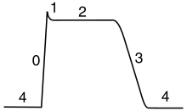
CARDIAC ACTION POTENTIAL
Phases of a cardiac action potential. The sharp rise in voltage ("0") corresponds to the influx of sodium ions, whereas the two decays ("1" and "3", respectively) correspond to the sodium-channel inactivation and the repolarizing eflux of potassium ions. The characteristic plateau ("2") results from the opening of voltage-sensitive calcium channels.

Slide 32
CARDIAC ACTION POTENTIAL SUMMARY OF ION FLOWS

Slide 33
RHYTHMIC REPETITIVE DISCHARGE
Occurs in
Heart
Most smooth muscle
Many CNS neurons e.g. for “biological clock”
Factors causing repetitive discharge of action potentials
Membrane permeable to Ca++ and Na+ continually at rest. Thus resting potential keeps drifting\ to threshold value for excitation
Low resting membrane potential (-60mV to -70mV) e.g. in pacemaker heart cells which encourages continuous drifting of Na+ and Ca++ ions thus causing positive feedback depolarization
Physiological importance of slow events in heart
Role of slow waves of K+ conductance which ensures slow recovery because of hyper polarization which blocks starting of next action potential.

Slide 34
PACE MAKER POTENTIALS

Slide 35
EFFECT OF MYELIN ON CONDUCTION
Conduction velocity depends on size of nerve fibre (range <0.25m/sec to 120m/sec
Unmyelinated and myelinated nerves
Myelin laid down by Schwann cells (explain)
Myelin as electrical insulator
Saltatory conduction (explain)
Mainly saves energy but speeds up conduction a bit

Slide 37
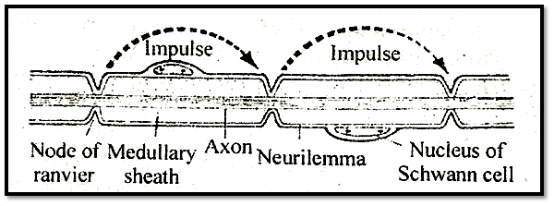
SALTATORY CONDUCTION

Slide 38
STIMULATION OF NERVES
Experimental set up (explain the electronics etc)
Electrical stimulation done at –ve surface electrode (cathode)
+ve surface electrode (anode) hyperpolarizes
Stimulation and transmission block (see slide in the presentation on classification of peripheral nerves)
Local anaesthesia {procaine, tetracaine (amethocaine) etc}
Pressure
Hypoxia
Central and psychological, (acupuncture etc)

Slide 39
END

