Slide 1
NONPROPAGATED POTENTIALS-NEW
MEMBRANE RESPONSE TO SUB THRESHOLD STIMULI

Slide 2
CATHODAL STIMULATION
By NEGATIVE surface electrode
Stimulating electrode (cathode) set at sub-threshold level
Recording electrode placed nearby
Stimulation causes local depolarizing potential change characterized by:
  Sharp rise
  Exponential decay
Only affects small area of membrane next to stimulating electrode
Length of area affected depends on peak magnitude of the depolarization exponentially

Slide 3
ANODAL STIMULATION
By positive surface electrode
Causes hyper polarization
Potential changes mirror those of cathodal stimulation
Potential changes obey same exponential decay rule

Slide 4
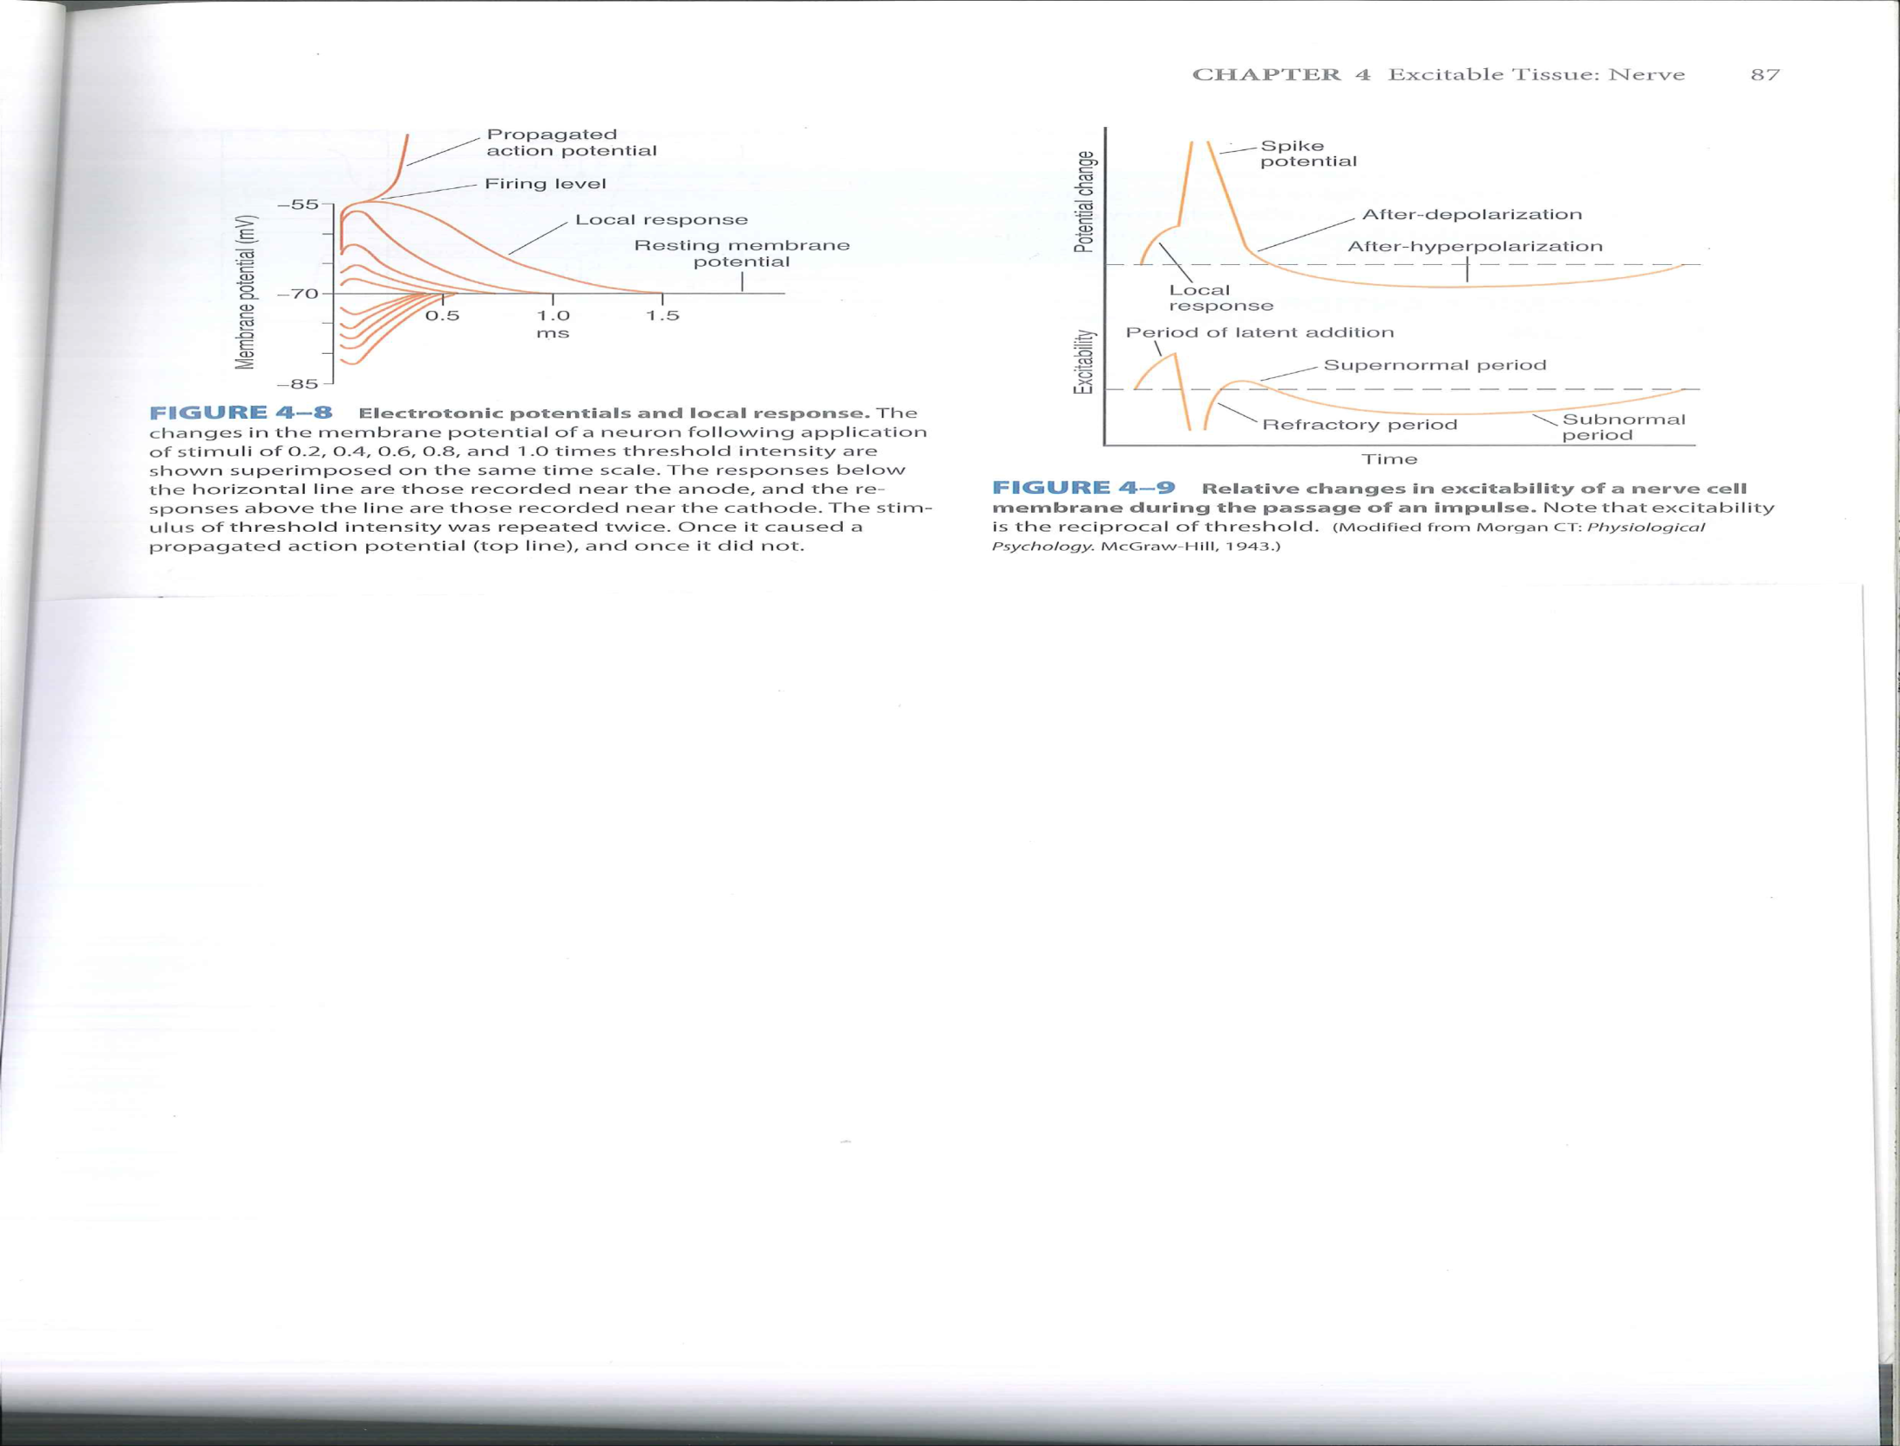
Ganong 23rd ed. p87

Slide 5
ELECTROTONIC POTENTIALS
CATHODAL STIMULATION
Sub threshold depolarization
Increased strength of sub-threshold stimulation causes a few Na+ channels to open leading to larger sub-threshold depolarization
Further increase eventually induces a threshold level depolarization of the membrane
LOCAL RESPOSE OF MEMBRANE
+ve feed back opening of some activation channels of Na+ occurs and an action potential is produced
FIRING LEVEL
Exact depolarization needed for threshold varies with different neurons, about 7mV to 15mV

Slide 6
FIRING THRESHOLD
THRESHOLD SHIFT
Occurs both during the
  electrotonic potential and
  the local response to stimulation
Pre-existing hyper polarization responses raise the threshold level
Pre-existing depolarization responses lower the threshold
Local response lowers the threshold

Slide 7
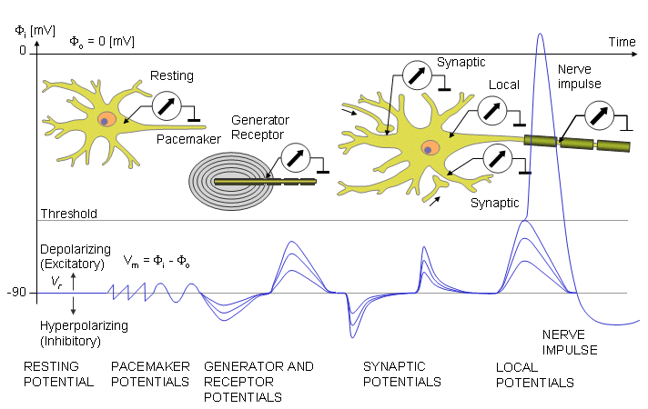

Slide 8
REFRACTORY PERIOD-1
ABSOLUTE REFRACTORY PERIOD:
Starts from the time the threshold level is reached
Ends when re-polarization is on third complete i.e. in the last section of the downward lope of the action potential
No stimulus can excite the nerve membrane
Therefore, the Neuron is refractory to further stimulation during:
The rising phase of the spike (propagated) potential
During most of the falling phase of the spike potential

Slide 9
REFRACTOTY PERIOD-2
RELATIVE REFRACTORY PERIOD
Starts from point (in time) in which re-polarization is one third complete
Ends at the start of “after hyper-polarization” i.e. when the sharp slope of the curve of re-polarization stars slowing (see fig 4-9, Ganong p87)
Very strong supra-threshold stimulus can stimulate the membrane and cause an additional action potential
NB:
Refractory period stops action potential from being transmitted backwards
Na+ and or C++ gates inactivation responsible for the Absolute Phase

Slide 10
END

