Slide 1
Endocrinology
Introduction
Lecture 2

Slide 2
Storage and Secretion
Most hormones are stored, often in large quantities, in their glands of origin, a factor that facilitated their original isolation and characterization (except steroids)
Protein and peptide hormones and the tyrosine derivatives, epinephrine and norepinephrine, are stored as dense granules in membrane-bound vesicles and are secreted in response to an external stimulus by the process of exocytosis

Slide 3
Storage and Secretion
Synthesis of hormones must be coupled in some way with secretion, so that cells can replenish their supply of hormone
In general, the same cellular events that signal secretion also signal synthesis
In addition, some cells may be able to monitor how much hormone is stored and adjust rates of synthesis or degradation accordingly

Slide 4
Storage and Secretion
In contrast to the peptide hormones, there is little storage of steroid hormones in their cells of origin
Therefore, synthesis and secretion are aspects of the same process, and the lipid-soluble steroid hormones apparently diffuse across the plasma membrane as rapidly as they are formed
The synthetic process proceeds sufficiently rapidly
increased secretion can be observed as soon as a minute or two after the secretory stimulus has been applied,
the maximal rate of secretion is not reached for at least 10 to 15 minutes
In contrast, stored peptide and amine hormones may be released almost instantaneously

Slide 5
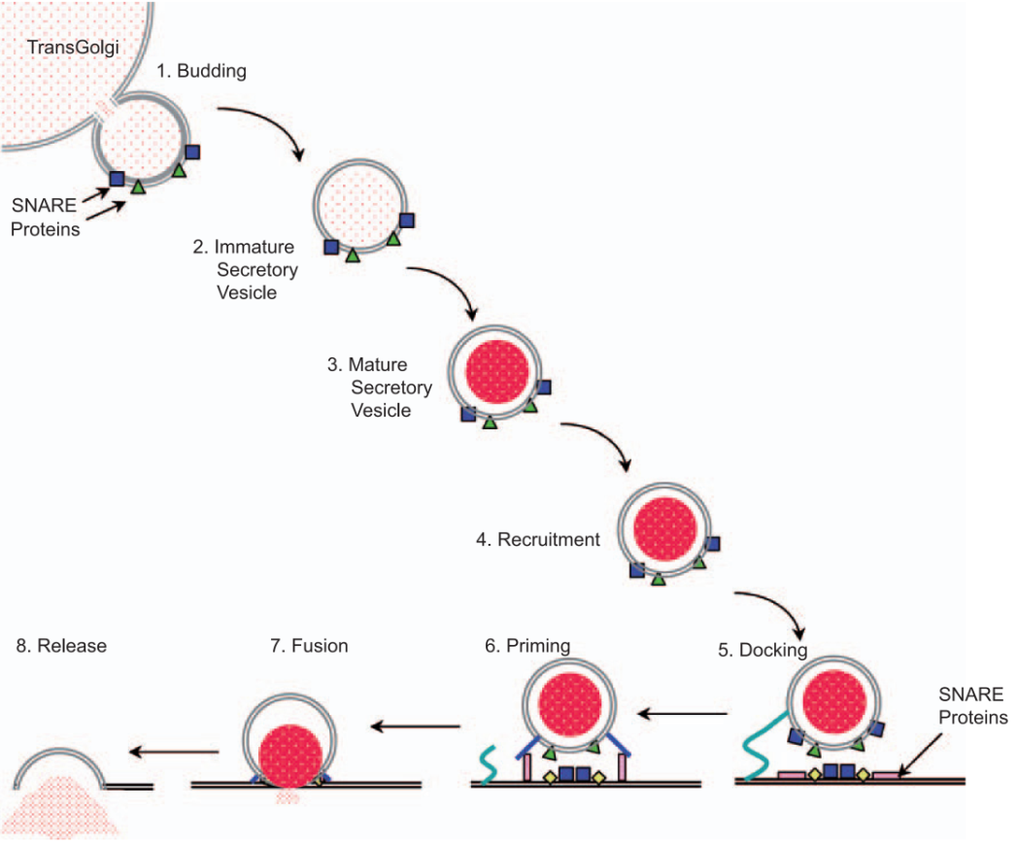
Mechanism of Hormone Release
Immature secretory vesicles bud off the Golgi stacks.
Maturation of the vesicle includes extrusion of some proteins and water, acidification of vesicle contents, and condensation of enclosed proteins to form dense core granules.
Mature vesicles residing deep in the cytosol as a reserve pool await a signal for recruitment to the readily releasable pool adjacent to the plasma membrane.

Slide 6
Mechanism of Hormone Release
& 5. In preparation for secretion, the vesicles become tethered to the membrane (docking).
Loose association of special proteins (SNARE proteins) in the membranes of the vesicles with counterparts in the plasma membrane, “ priming ” the vesicles to respond to a secretory stimulus
Secretion is triggered by an increase in cytoplasmic calcium that produces conformational changes in the SNARE proteins that brings the membranes of the vesicles into such close apposition to the plasma membrane that fusion occurs and a secretory pore is formed
Expansion of the pore as the vesicle membrane is incorporated into the plasma membrane releases vesicular contents into the extracellular fluid

Slide 7
Transport of Hormones
Most hormones circulate in blood in free solution at low concentrations {nanomolar (10⁻⁹ M) or even picomolar (10⁻¹² M)}
Steroid hormones and thyroid hormones, whose solubility in water is limited, circulate bound specifically to large carrier proteins synthesized in the liver (specific plasma globulins or albumin)
Some protein and peptide hormones also circulate complexed with specific binding proteins
Bound hormones are in equilibrium with a small fraction, sometimes less than 1%, in free solution in plasma

Slide 8
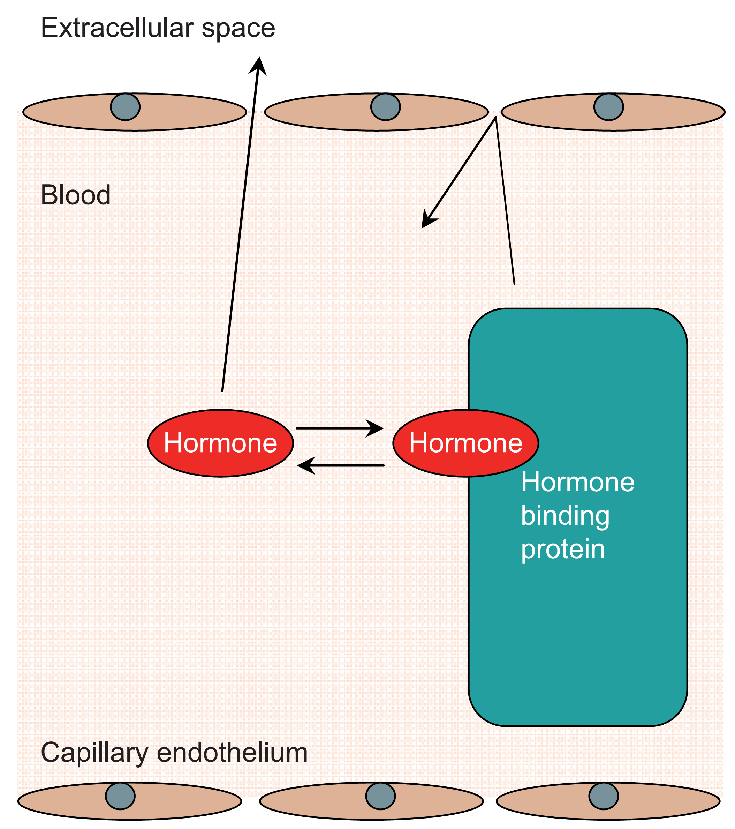
Transport of Hormones
It is generally accepted that it is the unbound or free hormone that is biologically active and that hormone binding delays metabolism and provides a circulating reservoir of hormones

Slide 9
Transport of Hormones
As a result, situations may arise in which assays of total hormone concentrations do not reflect changes in free hormone concentrations
Measurement of biologically relevant free hormone concentrations is generally more difficult than measuring total hormone concentrations
Notes:
Pregnancy, Kidney disease and liver disease

Slide 10
Transport of Hormones
In normal thyroid function, as the concentrations of the proteins changes, the total triiodothyronine (T3) level also changes, but the free T3 concentration remains constant
Measurements of free T3 concentrations, correlate more reliably with the clinical status than total T3 levels
For example, the increase in total T3 levels associated with pregnancy, oral contraceptives and estrogen therapy result in higher total T3 levels while the free T3 concentration remains unchanged

Slide 11
Facts about thyroid hormone
Thyroxine is formed by iodination of tyrosine.
The ratio of t3:t4 secretion by thyroid gland is 1:14 and 1:20
The thyroid hormones, triiodothyronine (T₃) and its prohormone, thyroxine (T₄), are tyrosine-based hormones produced by the thyroid gland that are primarily responsible for regulation of metabolism.
T₃and T₄ are partially composed of iodine .A deficiency of iodine leads to decreased production of T₃ and T₄, enlarges the thyroid tissue and will cause the disease known as simple goitre.
The major form of thyroid hormone in the blood is thyroxine (T₄), which has a longer half-life than T₃.

Slide 12
Facts about thyroid:
T₄ is converted to the active T₃ (three to four times more potent than T₄)
Dietary selenium is also important for T3 production
Thyroid have cytosolic receptors.
They increase the body’s sensitivity to catecholamines by permissiveness.
Thyroid hormones (T₄ and T₃) are produced by the follicular cells of the thyroid gland and are regulated by TSH made by the thyrotropes of the anterior pituitary gland
About 95% is protein bound:
70%-thyroid binding globulin
15-20% -albumin
10-15%-bound to transthyretin or "thyroxine-binding prealbumin" (TTR or TBPA

Slide 13
Random facts
Calcitonin(produced by parafollicular cells of thyroid gland) reduces plasma levels of calcium
Parathyroid increases plasma levels of calcium and decreases phosphate levels.
Calcium regulation in the human body. The role of vitamin D is shown in orange. Vitamin D is carried in the bloodstream to the liver, where it is converted into the prohormone calcidiol. Circulating calcidiol may then be converted into calcitriol, the biologically active form of vitamin D, in the kidneys.
Glucagon and insulin are peptide hormones
Steroid and thyroid interact with intracellular receptors.

Slide 14
Hormone Degradation
The rates of metabolism of hormones in the circulation vary but generally speaking the half life (t_{½}) of:
catecholamines from the adrenal medulla is in the order of seconds,
minutes for protein and peptide hormones
and hours for steroid and thyroid hormones
The half-life of a hormone in blood must be distinguished from the duration of its hormonal effect.

Slide 15
Hormone Degradation
Degradation of hormones and their subsequent excretion are processes that are just as important as secretion
Inactivation of hormones occurs enzymatically
in blood
or intercellular spaces,
in liver or kidney cells,
as well as the target cells themselves

Slide 16
Hormone Degradation
Additionally, the time for decay of a hormonal effect is also highly variable; it may be only a few seconds, or it may require several days
Some responses persist well after hormonal concentrations have returned to basal levels
Understanding the time course of a hormone’s survival in blood as well as the onset and duration of its action is obviously important for understanding normal physiology, endocrine disease, and the limitations of hormone therapy

Slide 17
Mechanisms of Hormone Action

Slide 18
Receptors Specificity and Characteristics
Hormonal actions mediated by intracellular receptors
Hormonal actions mediated by surface receptors
Regulation of hormone secretion

Slide 19
The ultimate mission of a hormone is to change the behavior of its target cells
Hormonal messages must be converted to biochemical events that influence gene expression, biochemical reaction rates, and structural changes

Slide 20
Receptors Specificity
Because all hormones travel in blood from their glands of origin to their target tissues, all cells must be exposed to all hormones.
Under normal circumstances cells respond only to their appropriate hormones.
Such specificity of hormone action resides primarily in the ability of receptors in the target cells to recognize only their own signal

Slide 21
Characteristics of Receptors
Hormone receptors are proteins or glycoproteins that are able to:
Distinguish their hormone from other molecules that may have very similar structures
Bind to the hormone even when its concentration is exceedingly low
Undergo a conformational change when bound to the hormone
Catalyze biochemical events or transmit changes in molecular conformation to adjacent molecules that produce a biochemical change

Slide 22
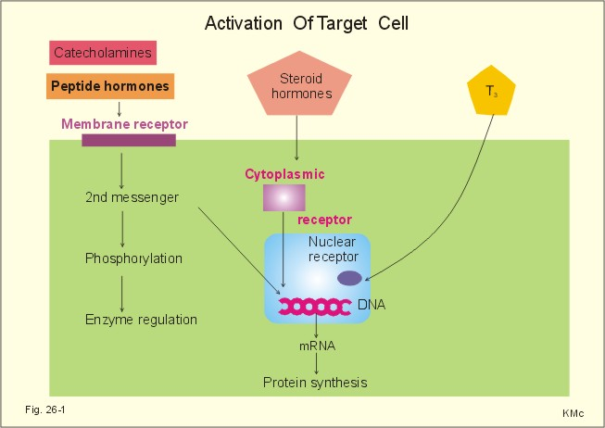
Characteristics of Receptors
Hormone receptors are found on:
the surface of target cells,
in the cytosol,
or in the nucleus

Slide 23
Characteristics of Receptors
Only a few thousand receptor molecules are usually present in a target cell, but the number is not fixed
Cells can adjust the abundance of their hormone receptors, and hence their responsiveness to hormones according to changing physiological circumstances

Slide 24
Regulation of Receptors
Many cells adjust the number of receptors they express in accordance with the abundance of the signal that activates them
Frequent or intense stimulation may cause a cell to decrease or downregulate the number of receptors expressed
Conversely, cells may upregulate receptors in the face of rare or absent stimulation or in response to other signals

