Slide 1
PRIONS &VIROIDS
By;
Wallace Bulimo PhD

Slide 2
Objectives
Describe the history of the discovery of Prions and viroids
Define prions and viroids
Describe the properties of prions and viroids
Describe replication of these sub viral particles
Elucidate diseases caused by these sub viral particles
Explain the mechanism these sub viral particles use to cause disease
Give examples of diseases caused by these sub viral particles
Compare characteristics of viruses, prions and viroids

Slide 3
PRIONS
Prion is a short infectious particle that lacks nucleic acid & is a type of infectious agent, made only of protein.
At the most basic level, the lack of nucleic acids distinguishes prions from viruses and viroids .
The functionality of a protein is dependent upon its ability to fold into a precise three-dimensional shape.
Proteins rapidly fold into the correct shape despite the innumerable possible configurations.
Prions can refold abnormally and converting normal proteins into their configuration.

Slide 4
Properties of prions
Mutation - different folding properties
Mutated protein resistant to proteases
Normal protein sensitive
Resists UV light and nucleases
Due to lack of nucleic acid
Inactivated by chemicals that denature proteins

Slide 5
History
Tikvah Alper and J. S. Griffith in 1960s - transmissible spongiform encephalopathies (TSEs) are caused by an infectious agent made solely of protein.
This theory was developed to explain the discovery that the mysterious infectious agent causing the diseases scrapie and Creutzfeldt-Jakob Disease resisted ultraviolet radiation (which breaks down nucleic acids—present in viruses and all living things) yet responded to agents that disrupt proteins.
A breakthrough occurred in 1982 - Stanley B. Prusiner of the University of California, San Francisco purified infectious material and confirmed that the infectious agent consisted mainly of a specific protein.

Slide 6
Prusiner coined the word "prion" as a name for the infectious agent, by combining the first two syllables of the words "proteinaceous" and "infectious.“
While the infectious agent was named a prion, the specific protein that the prion was made of was named PrP, an abbreviation for "protease-resistant protein.“
Prusiner received the Nobel Prize in Physiology or Medicine in 1997 for this research.

Slide 7
Mode of infection
All known prions are believed to infect and propagate by formation of an amyloid fold, in which the protein polymerizes into a fiber with a core consisting of tightly packed beta sheets.

Slide 8
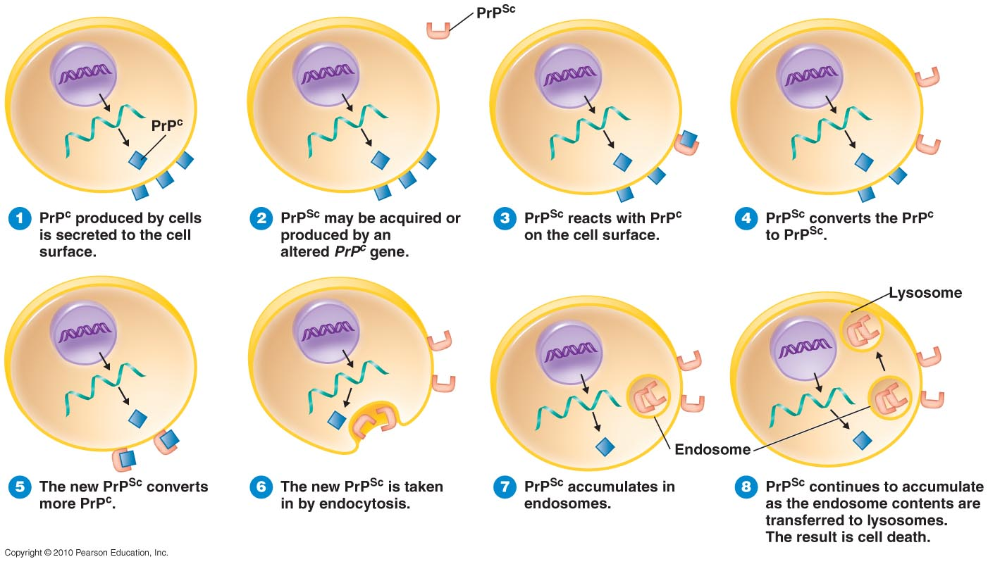
How a Protein Can Be Infectious
Figure 13.22

Slide 10
The prion proteins are found throughout the body, even in healthy people and animals.
The infectious prion protein has a different structure & is resistant to proteases.
The normal form of the protein is called PrP^{C}, while the infectious form is called PrP^{Sc}—the "C" refers to "cellular" PrP, while the "Sc" refers to "scrapie," the prion disease occurring in sheep.
Normal prion protein (common or cellular) is found on the membranes of cells, though its function has not been fully resolved.
A gene for the normal protein has been isolated, the PRNP gene.

Slide 11
Some prion diseases (TSEs) can be inherited, and in all inherited cases there is a mutation in thePrnp gene.
Many different Prnp mutations have been identified and it is thought that the mutations somehow make PrP^{C} more likely to spontaneously change into the PrP^{Sc} (disease) form.
TSEs are the only known diseases that can be sporadic, genetic, or infectious.

Slide 12
It is often assumed that the diseased form directly interacts with the normal form to make it rearrange its structure .
The "Protein X" hypothesis”, is that an as-yet unidentified cellular protein (Protein X) enables the conversion of PrP^{C} to PrP^{Sc} by bringing a molecule of each of the two together into a complex.
The” prion hypothesis” was initially highly controversial, because it seemed to contradict the so-called "central dogma of molecular biology," which asserts that all living organisms use nucleic acids to reproduce.
The "protein-only hypothesis"—that a protein structure could reproduce itself in the absence of DNA.

Slide 13
Prions in human disease
There are four principal disease syndromes associated with prions in humans: Creutzfeld-Jakob Disease (CJD), variant Creutzfeld-Jakob Disease (vCJD), Kuru, and Fatal Familial Insomnia.
Of these, only Kuru and vCJD are transmissible, the other two being either heritable or sporadic (i.e., caused by some unknown event, possibly a mutation, that occurs during the life of the affected individual).
Kuru and vCJD are known to be transmitted to humans who have eaten the meat or brains of infected animals (or, in the case of Kuru, infected humans).

Slide 14
PATHOGENESIS
First of all, prions resist digestion in the gut.
They remain as intact proteins and accumulate in the distal ileum.
They resist digestion because they are extremely resistant to all forms of degradation (proteases).
They also resist destruction by high-temperature autoclave and by formaldehyde.

Slide 15
Cases of vCJD have been known to be contracted from properly sterilized surgical instruments.
In fact, they circumvent the normal process of intestinal absorption by passing into the Gut-Associated Lymphoid Tissue (GALT).
Related to this, it seems that chronic inflammation predisposes to prion infectivity, e.g., in rheumatoid arthritis, type-I diabetes, or Crohn’s disease.

Slide 16
Prions in yeast and other fungi
Prion-like proteins that behave in a similar way to PrP are found naturally in some fungi and non-mammalian animals.
A group at the Whitehead Institute - fungal prions are not associated with any disease state and have a useful role.
However, researchers at the National Institutes of Health have also provided strong arguments demonstrating that fungal prions should be considered a diseased state.

Slide 17
Research into fungal prions provided strong support to the protein-only hypothesis for mammalian prions, as it has been demonstrated that seeds extracted from cells with the prion state can convert the normal form of the protein into the infectious form in vitro, and in the process, preserve the information corresponding to different strains of the prion state.
It has also shed some light on prion domains, which are regions in a protein that promote the conversion.
Fungal prions have helped to suggest mechanisms of conversion that may apply to all prions.

Slide 18
Molecular properties
Molecular level properties comes from detailed biochemical analysis of yeast prion proteins.
A typical yeast prion protein contains a region (protein domain) with many repeats of the amino acids glutamine (Q) and asparagine (N).
These Q/N-rich domains form the core of the prion's structure.
yeast prion domains are flexible and lack a defined structure.
When they convert to the prion state, several molecules of a particular protein come together to form a highly structured amyloid fiber.

Slide 19
The end of the fiber acts as a template for the free protein molecules, causing the fiber to grow.
Small differences in the amino acid sequence of prion-forming regions lead to distinct structural features on the surface of prion fibers.
As a result, only free protein molecules that are identical in amino acid sequence to the prion protein can be recruited into the growing fiber.
This "specificity" phenomenon may explain why transmission of prion diseases from one species to another, such as from sheep to cows or from cows to humans is a rare event.

Slide 20
The mammalian prion proteins do not resemble the prion proteins of yeast in their amino acid sequence.
The basic structural features (formation of amyloid fibers and a highly specific barrier to transmission between species) are shared between mammalian and yeast prions.
The prion variant responsible for mad cow disease has the remarkable ability to bypass the species barrier to transmission.

Slide 21
Prions and long-term memory
Maglio and colleagues have shown that mice without the genes for normal cellular prion protein have altered hippocampal Long-term potentiation (LTP).
There is evidence that prions may have a normal function in maintenance of memories over a long period of time.

Slide 22
The following diseases are now believed to be caused by prions.
In animals:
Scrapie in sheep
Bovine Spongiform Encephalopathy (BSE) in cattle
Transmissible mink encephalopathy (TME) in mink
Chronic Wasting Disease (CWD) in elk and mule deer
Feline spongiform encephalopathy in cats
Exotic ungulate encephalopathy (EUE) in nyala, oryx, and greater kudu

Slide 23
In humans:
several varieties of Creutzfeldt-Jakob Disease (CJD), such as Iatrogenic Creutzfeldt-Jakob disease, Variant Creutzfeldt-Jakob disease, Familial Creutzfeldt-Jakob disease, and Sporadic Creutzfeldt-Jakob disease
Gerstmann-Sträussler-Scheinker syndrome (GSS)
Fatal Familial Insomnia (FFI)
Kuru
Alper’s Syndrome

Slide 24
Replication of prions
The prion is a product of a human gene, termed the PrP gene, found on chromosome 20.
This gene contains two exons separated by a single intron.
Exon I and Exon II are transcribed and the two RNAs ligated into a single mRNA.
This mRNA contains an open reading frame (ORF) or protein coding region which is translated into the PrP protein.
The PrP protein is a precursor of the prion protein. It is termed PrP 33-35.

Slide 25
STRUCTURE OF A PRION

Slide 26
REPLICATION CYCLE

Slide 27
The PrP 33-35 undergoes several post-translational events to become the prion protein (PrP 27-30):
1. Glycosylation - at two sites.
2. Formation of a disulfide bond between two cysteine residues.
3. Removal of the N-terminal signal peptide.
4. Removal of the C-terminal hydrophobic segment.
5. Addition of a phosphatidylinositol glycolipid at the C-terminal.
6. Removal of the N-terminal first 57 amino acids.

Slide 28
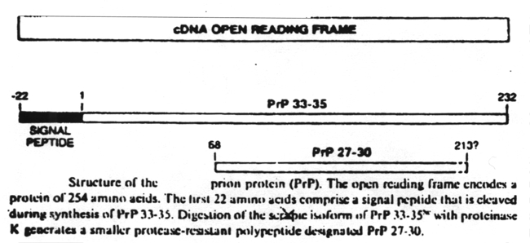

Slide 29
In normal cells only the PrP 33-35 protein is synthesized.
It is found in the neural cell membrane where it's function is to sequester Cu++ ions.
In abnormal ("infected") cells, the PrP 27-30 is produced from the PrP 33-35 protein.
The PrP 27-30 triggers a series of reactions that produce more PrP 27-30 proteins, i.e., PrP 27-30 induces its own synthesis.

Slide 30
In addition to the post translational modifications, the PrP 27-30 protein differs from the PrP 33-35 protein in a single amino acid residue.
Residue 178 in the PrP 27-30 contains an asparagine residue whereas the PrP 33-35 protein has an aspartate residue at this position.

Slide 31
This causes a conformational change in the PrP 27-30 protein from an a-helix to a b-sheet. This conformational change in the PrP 27-30 protein has three effects:
It imparts to the PrP 27-30 protein the ability to induce the same a-helix to b-sheet conformation in the PrP 33-35 protein. This is a permanent conformational change. It thus induces its own "replication.“
The b-sheet-forming peptides aggregate to form amyloid fibrils.
The amyloid fibrils kill thalamus neurons through apoptosis, a programmed series of events that leads to cell death.

Slide 32
SYMPTOMS
All pathological features are confined to the central nervous system.
The prion protein accumulates selectively and abnormally in CNS nerve cells during the course of the disease.
PrP 27-30 accumulates within the neuropil where it causes:
1. Astrocyte gliosis (an increase in the number of astrocytes).
2. Depletion of dendritic spines in neurons.
3. Formation of numerous vacuoles in the cerebellar cortex (spongiform encephalopathy).
4. Amyloidosis - deposition of amyloid in the cerebellar cortex, thalamus, brain stem and in the lumen of blood vessels within the brain. These amyloid plaques consist of discrete eosinophilic glassy-appearing masses, often having radiating amyloid fibrils at their periphery. The plaques are primarily subependymal, subpial and perivascular.

Slide 33
The pathology does not include any signs of inflammation or fever.
This is evidence that the immune system does not respond to the prion protein.
Since the prion protein is derived from self this is what you would expect.
These pathologies give rise to the clinical symptomology seen in these patients. These are:
1. A long incubation period (several years) which has given rise to the term "slow infection."
2. Loss of muscle coordination which leads to a difficulty in walking, indicating a functional disorder of the cerebellum.
3. Dementia characterized initially by loss of memory, diminished intellect and poor judgement.
4. Progressive insomnia characterized by a marked reduction or loss of the slow-wave and rapid-eye-movement phases.

Slide 34
Transmission
Spread of the disease is via horizontal transmission, i.e., transmission from one person to another, either directly or by fomites or by ingestion of contaminated meat.

Slide 35
Diagnosis
In the past, diagnosis of prion disease was made through examination of brain biopsies taken from patients in advanced stages of the disease or, more commonly, after they had died.
In January of 1999 it was found that the prion protein accumulated in the tonsils and could be detected by an immunofluorescence test on tonsilar biopsies.
A second test was simultaneously developed which was based on a Western blot.
Later that year a third test was developed that had the high sensitivity necessary to detect the prion protein in blood. This test is based on capillary electrophoresis with laser-induced fluorescence.
It detects as little as 10⁻¹⁸ mole.

Slide 36
FOUR TYPES OF KNOWN PRION
Notes:
Transmissible Spongiform Encephalopathies (TSEs) are a group of diseases that affect the brain and nervous system of humans and animals. The diseases are characterised by a degeneration of brain tissue giving it a sponge-like appearance.
The [URE3] nonchromosomal genetic element is a prion of Ure2p, a regulator of nitrogen catabolism in Saccharomyces cerevisiae
PSI is a Saccharomyces cerevisiae amyloid-based prion of Sup35p, a subunit of the translation termination factor.
The HET-s protein of Podospora anserina, a fungal prion.
Soluble oligomers of the amyloid-β (Aβ) peptide cause neurotoxicity, synaptic dysfunction, and memory impairments that underlie Alzheimer disease (AD). The cellular prion protein (PrP^{C}) was recently identified as a high affinity neuronal receptor for Aβ oligomers.

Slide 37
VIROIDS
A viroid is a submicroscopic infectious agent, smaller than a virus, that consists of a short section (a few hundred nucleobases) of highly complementary, circular, single-stranded RNA without the protective protein coat that is typical for viruses.
They are known to cause important diseases in plants. The nucleic acid is not known to code for specific proteins, but viroids can replicate themselves by using host enzymes.

Slide 38
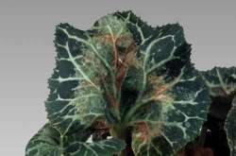
Viroids
Small, circular RNA molecules without a protein coat.RNA does not code any protein.
Infect plants
Resemble introns cut out of eukaryotic

Slide 39
Plants such as tomatoes, potatoes, avocados, coconuts, peaches, pears, apples, chrysanthemums, and cucumbers are known to be infected with viroids, which can be transmitted by pollen or seed.
Viroids were discovered and given this name by Theodor O. Diener, a plant pathologist at the Agricultural Research Service in Maryland, in 1971 .

Slide 40
Viroid Structure.
The closed single-stranded RNA circle
has extensive intrastrand base pairing and interspersed unpaired loops.
Viroids have five domains. Most changes in viroid pathogenicity seem to arise from variations in the P and TL domains.

Slide 41
Viroids consist of short strands of the nucleic acid RNA without a protein coat. They lack any DNA.
Viroids differ from viruses in that viruses, at their most basic level, consist of genetic material (DNA or RNA) contained within a protective protein shell.
Viroids differ from prions, another type of subviral infectious agent, in that prions are made only of protein, lacking nucleic acid.

Slide 43
The smallest viroid identified so far is a 220 nucleobase scRNA (small cytoplasmic RNA) associated with the rice yellow mottle sobemovirus (RYMV) (Collins et al. 1998).
In comparison, the genome of the smallest known viruses capable of causing an infection by themselves are around two kilobases in size.
Many viroids consist of only 300 to 400 nucleotides.

Slide 44
Viroid RNA does not code for any known protein; some even lack the AUG initiation codon.
Nonetheless, they replicate autonomously in host cells.
The replication mechanism involves interaction with RNA polymerase II, an enzyme normally associated with synthesis of messenger RNA, and "rolling circle" synthesis of new RNA.

Slide 45
Some viroids are ribozymes, having RNA enzyme properties that allow self-cleavage and ligation of unit-size genomes from larger replication intermediates. It has been proposed that viroids are "escaped introns."
Not all viroids are known to be pathogenic, but some are serious pathogens of plants. Viroids are usually transmitted by seed or pollen, but may be transported by farm implements as well.
Infected plants can show distorted growth and sometimes are killed by the viroid.

Slide 46
The first viroid to be identified was the Potato spindle tuber viroid (PSTVd). Some 33 species of viroids have been identified.
PSTVd is commonly used in research experiments in viroids. A total of 359 nucleotides are included in this viroid (Davis et al. 1999).

Slide 47
Structure-viroid ribozymes
Viroids are infectious agents composed exclusively of a single piece of circular single stranded RNA which has some double-stranded regions.
Because of their simplified structures both prions and viroids are sometimes called sub viral particles. Viroids mainly cause plant diseases but have recently been reported to cause a human disease (hepatitis D). This disease is caused by a viroid enclosed in a hepatitis B virus capsid.
Catalytic RNAs are those that have the intrinsic ability to break and form covalent bonds; Viroids are catalytic RNA's (ribozymes) that cleave RNA to produce fragments containing a 5'-hydroxyl and a 2', 3'-cyclic phosphate.
This is a nonhydrolytic reaction in which the same number of phosphodiester bonds are maintained and the transesterification reaction is theoretically reversible. This reaction is considered to play an essential role in the replication of these RNAs in vivo. Such reactions are all intramolecular and hence quasi-catalytic with single turnover. These RNAs can be manipulated, however, to provide true catalytic cleavage in trans-reactions.

Slide 48
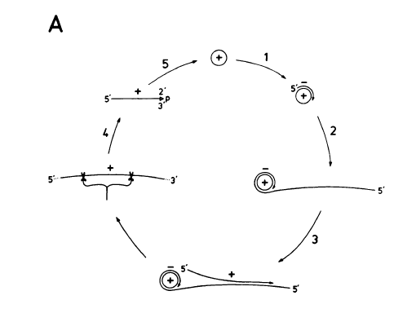
Viroid Replication:
A: Asymmetric Model
Asymmetric model of rolling-circle replication. An infecting circular plus strand (+) becomes a template for minus-strand (-) synthesis (step 1). A multimeric linear minus strand is copied into a multimeric plus-strand precursor (step 3), and the plus-strand precursor is cleaved (step 4) and circularized (step 5).

Slide 49
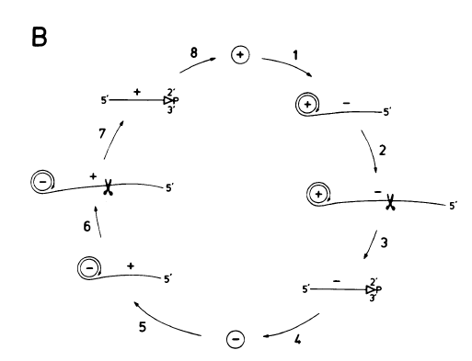
Viroid Replication Cont….
B: Symmetric Model
In the symmetric model, the multimeric minus strand is first cleaved to unit length (step 3) and circularized (step 4). The circular minus strand then serves as a rolling-circle template for the synthesis of a plus-strand precursor (step 5), and this precursor is cleaved (step 6) and ligated (step 8).

Slide 50
Human pathologies induced by viroids
The only human disease known to be caused by a viroid is hepatitis D. This disease was previously ascribed to a defective virus called the delta agent.
However, it now is known that the delta agent is a viroid enclosed in a hepatitis B virus capsid.
For hepatitis D to occur there must be simultaneous infection of a cell with both the hepatitis B virus and the hepatitis D viroid.

Slide 51
There is extensive sequence complementarity between the hepatitis D viroid RNA and human liver cell 7S RNA, a small cytoplasmic RNA that is a component of the signal recognition particle, the structure involved in the translocation of secretory and membrane-associated particles.
The hepatitis D viroid causes liver cell death via sequestering this 7S RNA and/or cleaving it.

Slide 52
Transmission
The hepatitis D viroid can only enter a human liver cell if it is enclosed in a capsid that contains a binding protein.
It obtains this from the hepatitis B virus.
The delta agent then enters the blood stream and can be transmitted via blood or serum transfusions.

Slide 53
Viroids and RNA silencing
There has long been confusion over how viroids are able to induce symptoms on plants without encoding any protein products within their sequences. Evidence now suggests that RNA silencing is involved in the process.
Firstly, changes to the viroid genome can dramatically alter its virulence (Dickson et al. 1979). This reflects that fact that any siRNAs produced would have less complementary base pairing with target messenger RNA.
Secondly, siRNAs corresponding to sequences from viroid genomes have been isolated from infected plants (Papaefthimiou et al. 2001).
Finally, transgenic expression of the noninfectious hpRNA of potato spindle tuber viroid develop all the corresponding viroid like symptoms (Wang et al. 2004).

Slide 54
This evidence indicates that when viroids replicate via a double stranded intermediate RNA, they are targeted by a dicer enzyme and cleaved into siRNAs that are then loaded onto the RNA-induced silencing complex.
The viroid siRNAs actually contain sequences capable of complementary base pairing with the plant's own messenger RNAs and induction of degradation or inhibition of translation is what causes the classic viroid symptoms.

Slide 55
Comparison of Viruses, Viroids, Prions
CHARACTERISTIC | Virus | Viroid | Prion
Nucleic Acid | ssDNA,dsDNA,ssRNA, dsRNA | ssRNA | no
Presence of capsid or envelop | yes | no | no
presence of protien | yes | no | yes
Need for helper viruses | yes/no(needed by some of the smaller viruses) | (blank) | (blank)
Viewed by | Electron microscopy | Nucleotide sequence identification | host cell damage
Affected by heat & protein denaturing agents | yes | no | no
Affected by radiation of enzymes that digest DNA or RNA | yes | yes | no
Host | Bacteria, plants & animals. | plants | mammals

