Slide 1
CHEMICAL NEUROTRANSMITERS
KIMAIGA H.O,
1st Year MBChB (UoN)

Slide 2
CHEMICAL NEUROTRANSMITERS
Neuron-neuron interaction is achieved in two ways:
via electrical synapses-allow more rapid transfer of signals from cell to cell
via chemical synapses-allow various levels of versatility in cell-cell communications.

Slide 3
Chemical Neurotransmitters act on ion channels. Therefore Two types of chemical neurotransmitters exist:
those that bind directly to an ion channel and cause it to open or close.
those that bind to a receptor and lead to release of a second messenger that ­­­­­­­­­subsequently reacts with the ion channel causing it to open or close.

Slide 4
Chemical neurotransmitters may be excitatory or inhibitory.
Excitatory neurotransmitters: include compounds such as Acetyl Choline and Cetecholamines (Dopamine, epinephrine, norepinephrine).
Inhibitory neurotransmitters: include compounds such as ɤ-amino butyric acid/ GABA / 4-aminobutyric acid, glycine and of the two major inhibitory neurotransmitters,
Glycine predominately acts in spinal chord and brain
GABA predominately acts in other parts of the brain.

Slide 5
Receptors of GABA also react with variety of pharmacologically active agents such as benzodiazepines and barbiturates.
Receptors Glycine in CNS also are binded by strychnine, a highly poisonous alkaloid obtained from nux vomica and related plants of the genus strychnos. This poison has been used in very small amounts as a CNS stimulant (How could it possibly work?).

Slide 6
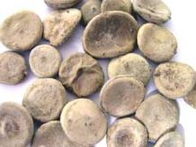
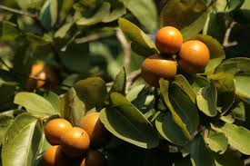
Strychnine
Strychnine is obtained from nux vomica and is a stimulant causing excitation of all portions of the CNS by blocking postsynaptic inhibition of neural impulses hence increased reflex excitability .It primarily cause loss of inhibition on the motor nerves in the spinal cord causing muscles to contraction simultaneously i.e. convulsions. It also stimulates the cerebral cortex

Slide 7
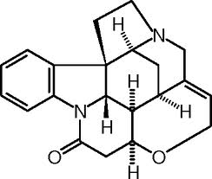
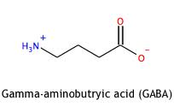
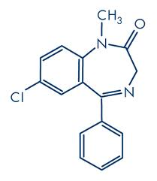
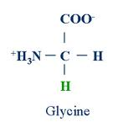
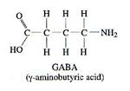
There is little structural similarity between:
Strychnine and glycine,
GABA and benzodiazepines
Strychnine
Diazepam

Slide 8
Classification of compounds as neurotransmitters is based on:-
Found in pre-synaptic axon terminal.
Enzymes for their synthesis are in pre-synaptic of neuron.
Their stimulation under physiologic conditions cause their release.
There are mechanisms in the synaptic junction that cause rapid termination of their action.
Their direct application to post synaptic terminal mimic action of nerve stimulation.
Drugs that modify metabolism of neurotransmitter should have predictable physiologic effect on them in vivo, assuming that the drug was transported to appropriate site where the neurotransmitter acts.

Slide 9
Synthesis, storage and release
All neurotransmitters are synthesized and stored in the pre-synaptic neuron and are only released on stimulation of the neuron.
They then traverse the synapse and bind to specific receptors on the post-synaptic membrane and in effect excite the next cell leading to appropriate response.
Excitatory neurotransmitters cause depolarization of the membrane.
Inhibitory neurotransmitters cause hyperpolarization- They bind to channel-linked receptor leading to conformational change in protein components of the channel. This leads to opening of pores to admit negatively charged ions (specifically Cl-ions) into the cell. This in turn leads to an increase in chloride conductance of the post synaptic membrane thereby making it more difficult for the cell to become depolarized; thus, inhibitory transmitters effectively.

Slide 10
Chemical neurotransmitter synthesis and release
Non peptide neurotransmitters may be synthesized in almost any part of the cell, in the cytoplasm in vicinity of nucleus as well as in the axon.
Most non-peptide neurotransmitters are amino acids, derivatives of amino acids or other intermediary metabolites.
These neurotransmitters are stored in pre-synaptic vesicles.
When an electrical impulse reaches pre-synaptic terminal, voltage gated Ca²⁺ channels and Na⁺ channels open to increase the concentration of Ca²⁺ ions in the cell .
Calcium ions then bind to pre-synaptic vesicles and initiate a cascade of events that convert the electrical impulse to a chemical event.

Slide 11
Calcium also activates a calcium- calmodulin dependent protein kinase that phophorylates a protein called synapsin I, attached to surface of presynaptic membrane.
Upon phosphorylation, synapsin I dissociates from the presynaptic membrane allowing synaptic vesicles attach to pre-synaptic membrane, leading to release of the neurotransmitter by a process of exocytosis.
Presumably, synapsin I is dephosphorylated thereafter and displaces synaptic vesicles so that synaptic resides can take up more neurotransmitters and start the cycle over again.
The released neurotransmitter travels across the synaptic gap (junction ̴ 20nm) to receptors on the post synaptic membrane where they induce conformational changes on the membrane and start the process of electrical impulse propagation in the synaptic cell

Slide 12
Termination of signals at the synaptic junction
Action of neurotransmitter action can be terminated in three ways:-
Metabolism
Re-uptake
Diffusion
Chemical neurotransmitters for fast responses are disposed off by metabolism or re-uptake or both.
Mechanisms of synthesis and degradation of chemical neurotransmitters are illustrated in the following examples.

Slide 13
SYNTHESIS AND DEGRADATION OF ACETYL CHOLINE

Slide 14
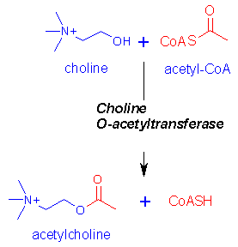
SYNTHESIS AND DEGRADATION OF ACETYL CHOLINE
Acetyl Choline is synthesized by condensation of choline and acetlyl CoA in a reaction catalyzed by the enzyme Choline acetyl transferase.
Synthesis of acetyl CoA takes place inside mitochondria then it crosses mitochondrial membranes into cytosol where acetyl transferase is found for synthesis of acetyl choline.
₊
(CH₃)₃N(CH)₂OH
CH₃CO – SCoA
₊
(CH₃)₃NCH₂OCOCH₃

Slide 15
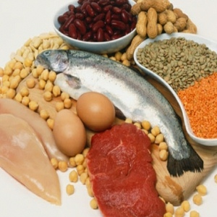
Source of Choline –Diet and reabsorbtion from synaptic junction or other metabolic sources
Source of acetyl CoA –Mainly decarboxylation of pyruvate by pyruvate dehydrogenase complex. Other sources include shunting some of it from TCA cycle.

Slide 16
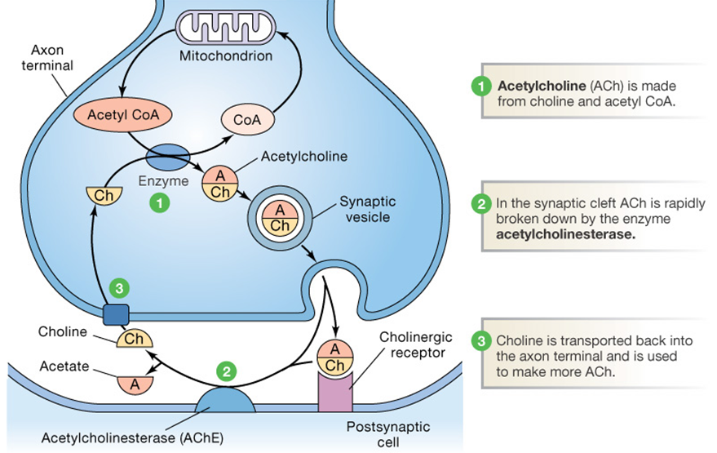
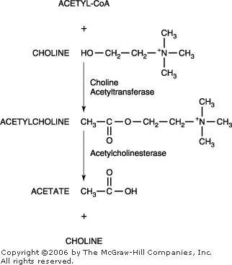
On release, acetylcholine reacts with nicotinic-acetyl choline receptors on post synaptic membrane. Action of a acetylcholine on post synaptic membranes is terminated by enzyme acetyl cholinesterase that hydrolyses acetylcholine to acetate and choline.

Slide 17
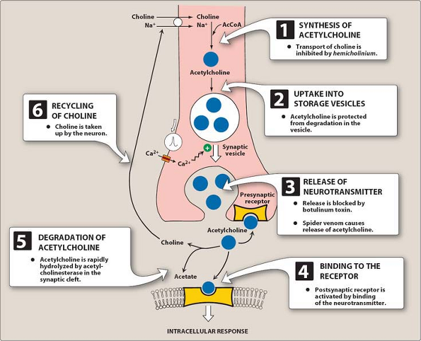
Choline is taken up by pre-synaptic membranes and re-used for synthesis of more acetyl choline
Acetate may is re-absorbed into blood and metabolized by tissues other than nerve tissue

Slide 18
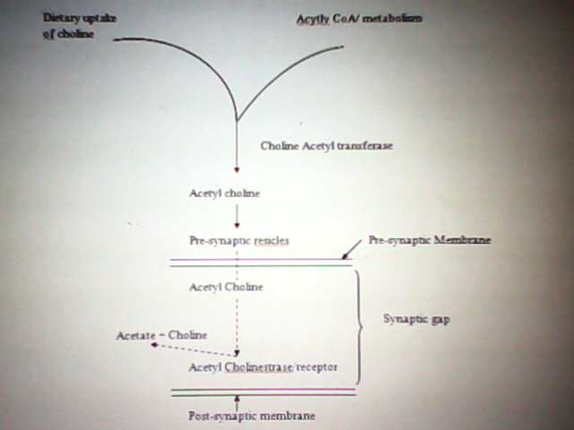

Slide 19
CATECHOLAMINES
Catecholamine neurotransmitters are namely
Epinephrine (Adrenaline),
Nor-epinephrine (nor-adrenaline)
Dopamine (3,4-dihroxyhlphenylethl amine)
Action of catecholamines may be terminated in by
Methylation of one among OH groups of catechol.
Oxidative deamination of side chain.
Re-uptake into pre-synaptic neuron.
Norepinephrine is metabolised into normetanephrine , Vanillyl mandelic acid (VMA), and Homovanillic acid (HMA)

Slide 20
Catechol-O-methyl transferase in cytoplasm of the cell catalyses transfer of a methyl group from S- adenosyl methionine (SAM) to one of the phenolic OH groups.
Mono amino oxidase catalyses oxidative deamination of amines to aldehydes and ammonium ion.It can act on amines whether or not they have been subjected to alteration by the methyl transferase reaction.
Degraditive enzymes are located in cytosol hence amines must be taken up by the cells before degradation.
For dopamine, there’s a transporter protein that is responsible for its re-uptake into pre-synaptic neuron.
Cocaine binds to dopamine transporter protein and blocks dopamine re-uptake hence dopamine remains within the synapse for extended periods of time and continue to stimulate the receptors of post-synaptic neurons.

Slide 21
SEROTONIN
Synthesized and stored at several sites in the body with largest amounts being found in cells of intestinal mucosa and smaller amounts in platelets and CNS.
Serotonin besides acting as a neurotransmitter in brain, also has several physiologic roles including regulation of blood pressure.

Slide 22
SYTHESIS AND DEGRADATION FO SEROTONIN
It is synthesized by hydroxylation of tryptophan to 5-hydroxy tryptophan which is subsequently decarboxylated to serotonin. Serotonin unlike catecholamines is primarily degraded by oxidative deamination to corresponding acetaldehyde in a process catalyzed by mono-amino oxidase. The aldehyde is further oxidized to 5-hydroxy indole-3-acetate by an aldehyde dehydrogenase

Slide 23
4-aminobutyric acid (ɤ-aminobutyric acid GABA)
GABA can be made and degraded through a series of reactions called the GABA shunt. In these reactions, α-Kg of TCA cycle is transaminated to produce glutamate whose 1-carboxyl group is subsequently removed by glutamate decarboxylase to form GABA.
GABA is catebolized by deamination and oxidation reaction to produce succinate that can enter TCA cycle.
GABA an inhibitory neurotransmitter and glutamate, an excitatory neurotransmitter may share some common routes of metabolism involving astrocytes that takes them up and converts them to glutamine which is then transported back to pre-synaptic vesicles. In the excitatory nerve, glutamine is converted to GABA with glutamate as an intermediate.

Slide 24
NEUROPEPTIDES
Synthesized as larger proteins then undergo specific cleavage to produce smaller peptide molecules. They are synthesized in cell body of axon then travel down the axon to pre-synaptic region.
They are transported by two mechanisms namely:
fast axonal transport ̴ 400 millimeters per day.
slow axonal transport ̴ 1-5 millimeters per day.

Slide 25
Given that axons vary in length from 1mm to 1 meter, theoretically, the total transit time could vary from 150 milli seconds to 200 days theoretically although the latter transit time would be highly unlikely under normal physiologic conditions thus, the upper limit would probably be more likely to be hours rather than days.
Neuropeptides are involved in mediation of sensory and emotional responses such as those associated with hunger, thirst, sex, pleasure and pain etc.

Slide 26
CLINICAL ENZYMOLOGY
Enzymes, catalytic agents found in cells are useful tools in diagnosis, assessment of prognosis and in therapy. Inflammation or injuries to cell membranes would lead to leakages into plasma, the extent of which would be directly proportional to that of the injury.
Measurement of enzyme activities often give an idea as to:
rate of leakage from cells
rate at which the cells producing the enzymes are being damaged
rate of utilization of the enzyme by other cells.
Thus, changes in activities of plasma enzymes or their isoenzymes and their kinetic analysis would predict changes associated to injuries or otherwise in respective tissues or organs. In particular, specific enzyme tests are essential especially in paediatrics given that neonates do not talk. Following is a non-exhaustive list of disease conditions associated with alterations in activities of certain enzymes.

Slide 27
1.Myocardial infarction
In this condition, a section of coronary vessels may be blocked by factors such as excess cholesterol that may be trapped within the vessels and lead to narrowing or blockage of the vessels. This may lead to death of a section of heart muscles due to necrosis. In such cases, a section of heart muscles would not work at all or may work inefficiently as they would be getting inadequate supplies of oxygen hence the rest of the heart muscles would be working extra hard to compensate for the loss of activity in a section of the heart. This condition is associated with
Faster utilization of creatine phosphate hence increased levels of creatine phosphokinase 2 (CPK2) within six to eight hours of injection. This condition would also lead to increased activities of serum glutamate oxolo-acetate trans aminase (S GOT) & serum glutamate pyruvate transaminase (SGPT) for high rates of transmination.
a switch in LDH isoenzyme composition, thus
Normal circumstances: LDH2 > LDH1
Infarction: LDH2 < LDH1
Thus a switch in LDH isoenzymes 1 & 2 coupled with increased activity of CPK2 is diagnostic of myocardial infarction.

Slide 28
2.Shock trauma/tumors
Shock or trauma due to major surgical operations or accidents also lead to an increase in LDH1, SGOT & Creatine phosphokinase. However, in the absence of a physiologic condition like shock or trauma, there may be increased production of these enzymes due to presence of tumors or cancers. In the latter case, destruction of cells synthesizing respective enzymes lead to leakage of these enzymes.
In prostate carcinoma (usually associated in men > 65 years of age) for example;
Prostate glands enlarge for no apparent reason rather than the fact that it has been used for too long. Symptoms include urination for too long as every drop of excess urine must be removed from bladder. This condition is associated with tremendous increase of serum acid phosphateses. Patients respond well to ordinary pills but often tend to become woman like thereby losing beards and developing high frequency notes.

Slide 29
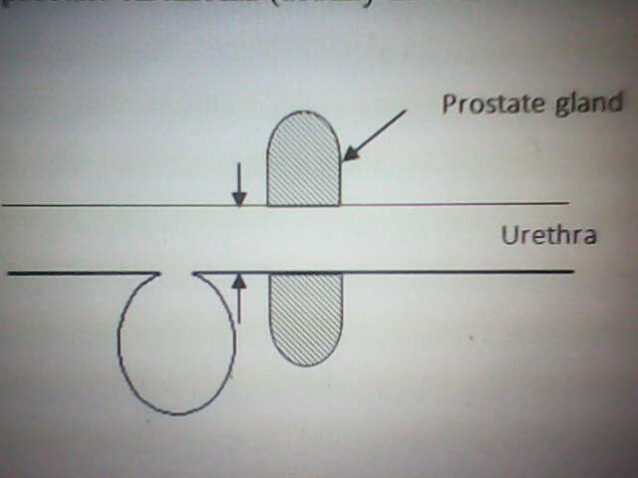

Slide 30
3.Acute pancreatitis
An inflammation of pancreas leads to appearance of cold sweat on the face, high levels of serum amylase and lipase.

Slide 31
4.Tetarus
Occurs in association with heavy work especially when having wounds leads to hardening of jaws so that the subject cannot close the mouth leading to lock jaw disease and paralysis. This condition is associated with an increase in 3 isoenzymes of CPK.

Slide 32
5.Liver congestion
Is a secondary complication of heart failure usually associated with an increase in LDH5

Slide 33
6. Neoplastic disease
New life is associated with increased metabolism hence there is a high degree of protein and enzyme synthesis and breakdown to facilitate formation of new cells. Neoplastic diseases such as cancer are associated with increases in activities of enzymes associated with muscle wasting to give way for rapid growth of new cells.

Slide 34
7.Paralysis
High cholinesterase leads to paralysis e.g. in epileptic fits due to premature degradation of acetyl choline before it passes impulse to post synaptic receptors.

Slide 35
8.Determination of metabolic disorders
When babies are born, it is important to check galactose-1-phosphate uridyl transferase. Accumulation of gal-1-phosphate in blood leads to golactosemia. This can be corrected by giving the baby glactose free diet. If not, the baby develops into an imbecile.

Slide 36
9.Follow up disease/progress of pregnancy
Pregnancy leads to increased uterine wall contraction which is associated with increases in such enzymes as alkaline phosphatase, usually arising during the third trimester. Levels of such enzymes can be used to monitor or estimate the day of delivery.
Serial determination of enzymes like SGPT give a guide on condition of patients with pancreatitis for example. Thus, if SGPT starts to go down as drugs are administered, a patient is doing well. However, a generalized increase in LDH isoenzyms is indicative of a disease that is worsening and would usually lead to death of the patient.

Slide 37
BACTERIAL CELL WALL SYNTHESIS AND FUNCTIONS
Bacterial unlike animal cells are surrounded by a cell wall that confers mechanical support. Thus, due to high concentration of metabolites, osmotic pressure may reach 20 atmospheres in a bacterial cell and this can lead to lysis in ordinary media unless the cells are surrounded by cell walls.
Bacterial cell walls are extremely important in medicine because
Characteristic bacterial antigens are located on their cell walls.
Clinical symptoms and bacterial virulence are associated with cell wall and associated substances.
Consequently, many antibiotics including penicillin kill or slow down bacterial growth by preventing proper synthesis of bacterial cell wall.

Slide 38
Classification
Bacteria are on the basis of cell wall structure, classified into gram positive and gram negative bacteria.
Whereas gram positive bacteria are surrounded by a thick cell wall, typically 500A^{O} wide, composed of peptidoglycan and teichoic acid, the surface of gram negative bacteria is more complex, containing a mosaic of proteins, lipids and lipolysacharides beyond the peptidoglycan layer.

Slide 39
Bacterial cell wall structure
The cell wall comprises a peptidoglycan (cell wall macromolecule) consisting of peptide and sugar units.
The peptidoglycan is extensively cross-linked, giving rise to a single enormous bag-shaped macro-molecule.

Slide 40
Composition of peptidoglycan
Peptidoglycan consists of three repeating units namely;
a disaccharide of N-acetyl glucosamin (NAG) and N-acetyl muramic acid (NAM) in a β- 1,4 – glycosidic linkage.
a tetra-peptide of L-alanine, D-glutamine, L-lysine and D-alanine and;
a penta-glycine bridge.
The tetra-peptide is unique in two ways
it contains D-amino acids which are never found in proteins.
the D-glutamine residue forms a peptide linkage via its side chain ɤ-carboxyl group.
In the intact peptidoglycan, NAG & NAM alternate in sequence to form a linear polysaccharide chain and the penta-glycine bridge cross-links NAM residues on different polysaccharide strands by forming a peptide bond with the carboxyl group of D-alanine while the carboxyl group of penta-glycine bridge forms a peptide bond with the side chain Є-amino group of L-lysine.

Slide 41
Biosynthesis of the peptido-glycan (5 stages)
A peptide unit is built on NAM while the sugar is attached to uridine-diphosphate (UDP).
The NAM-peptide unit is transferred to a carrier lipid because;
while the final polymeric product lies outside the cell membrane, precursors are formed inside the cell.
UDP is too polar to cross the membrane but the non-polar carrier lipid functions as a trans-membrane shuttle for the partly synthesized polymer.
NAG and the penta-glycine bridge are added to the NAM-peptide unit while attached to carrier lipid.
The disaccharide peptide unit is transferred from the carrier lipid to a growing polysaccharide chain.
Different polysaccharide strands are cross-linked by a transpeptidation reaction involving the penta-glycine bridge.

Slide 42
SYNTHESIS OF A UDP-SUGAR PEPTIDE UNIT
Peptidoglycan biosynthesis starts with formation of activated sugars. In this process, Uridine diphosphate-N-acetyl glucosamine (UDP-NAG) is synthesized from N-acetyl glucosamine-1-phosphate and UTP in a reaction that is driven forward by hydrolysis of ppi.
In a subsequent step, uridine diphosphate-N-acetyl muramic acid (UDP-NAM) is formed from UDP-NAG and phosphoenol pyruvate (PEP)

Slide 44
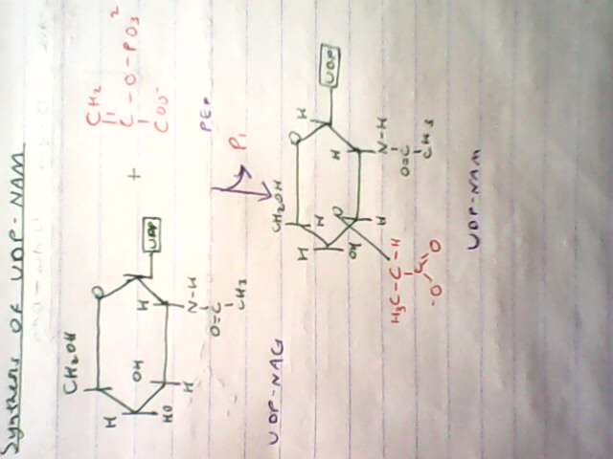
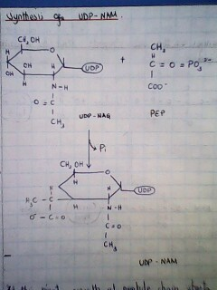

Slide 45
At this point, growth of peptide chain starts with formation of a peptide bond between the amino group of L-alanine and carboxyl group of N-acetyl muramic acid moiety of UDP-NAM. Subsequently, D-glutamate, L-lysine and the dipeptide D-alanyl-D-alanine are successively attached.
Notably, a peptide of this kind cannot be synthesized by the usual mechanisms of protein biosynthesis because it contains D-amino acids (formed from their L-isomers by racemases) and ɤ-peptide bond.

Slide 46
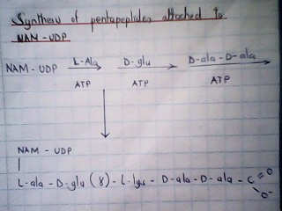
synthesis of pentepeptide attached to UDP-NAM

Slide 47
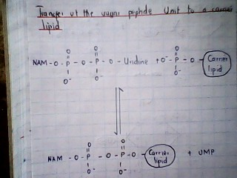
Transfer of the sugar peptide unit to a carrier lipid

Slide 48
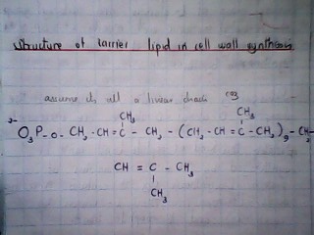
structure of carrier lipid in cell wall biosynthesis

Slide 49
SYNTHESIS OF A DISECCHARIDE-PEPTIDE UNIT ATTACHED TO A CARRIER LIPID
Step 3 involves addition of NAG to the NAM-moiety of the sugar-peptide and carrier lipid unit. UDP-NAG, the activated sugar donor reacts with C-4 of the NAM unit to form a β-1,4 glycosidic linkage between these sugars and the free α-carboxyl group of D-glutamic acid in the peptide is amidated by N⁺H4 in a reaction that is driven by hydrolysis of ATP. A penta-glycine bridge is then added to the ϵ-amino group of the peptide lysine residue. This chain of five glycine residues is formed by successive transfer of single glucine residues from glycyl-tRNA. This reaction is unique in that tRNA otherwise serves as an amino acid donor only in protein synthesis on robosomes. Construction of the basic structural unit of the cell wall is now complete.

Slide 50
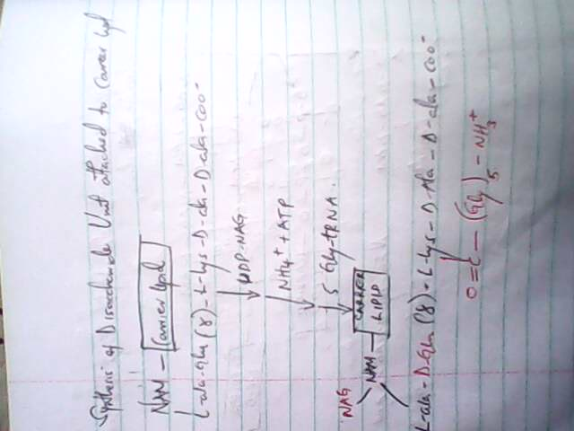
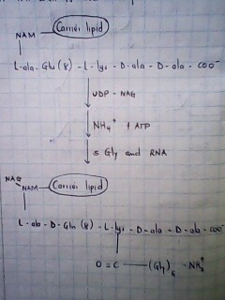
synthesis of disaccharide peptide unit attached to carrier lipid

Slide 51
TRANSFER OF THE DISACCHARIDE-PEPTIDE UNIT TO A GROWING POLYSACCHARIDE CHAIN
The disaccharide peptide unit is transferred from the carrier lipid to the non-reducing end of the growing plysccharide chain. In this process, the C-1 carbon of the NAM moiety is activated because it is linked to carrier by a pyrophosphate bond. The C-1 carbon atom of the activated NAM unit reacts with C-4 of the NAG terminal of a growing polysaccharide chain to form a β-1,4 glycosidic bond

Slide 52
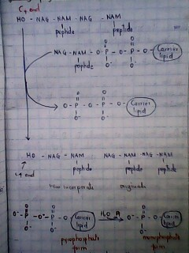
Transfer of the disaccharide-peptide unit to a growing polysaccharide chain]

Slide 53
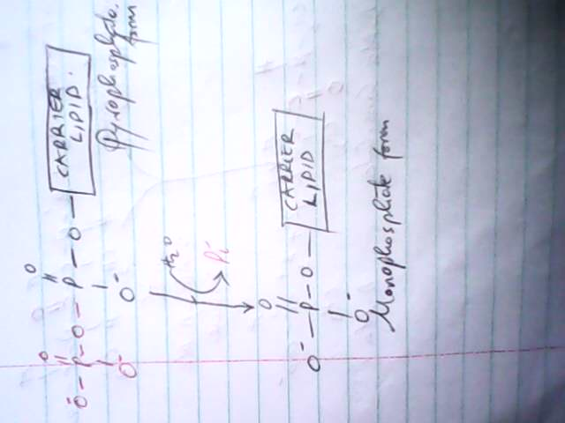

Slide 54
The lipid carrier is released in the pyrophosphate form. It is then hydrolysed to monophosphate form by a specific pyrophosphatese. This dephosphorylation step is essential for regeneration of the species that accept the sugar peptide unit from UDP. Bacitracin, a peptide antibiotic inhibits cell wall synthesis by blocking this step

Slide 55
POLYSACCHARIDE CHAINS ARE CROSS-LINKED BY TRANSPEPTIDATION
Different polysaccharide chains are cross-linked by transpeptidation, thereby forming one enormous bag-shaped molecule. The amino-group at the end of one pentaglycine interacts with the peptide bond between the D-Ala-D-Ala residues in another peptide unit. A peptide bond is formed between glycine and one of the D-alanine residues whereas the other D-ala residue is released. This reaction is catalysed by glycopeptide transpeptidase and no ATP is consumed and reaction uses free energy preserved in the D-ala-D-ala bond. This unusual formation of a peptide bond is necessary since the reaction takes place outside the cell membrane beyond the reach of ATP.

Slide 56
½ page [cross linking of polysaccharide chains]

Slide 57
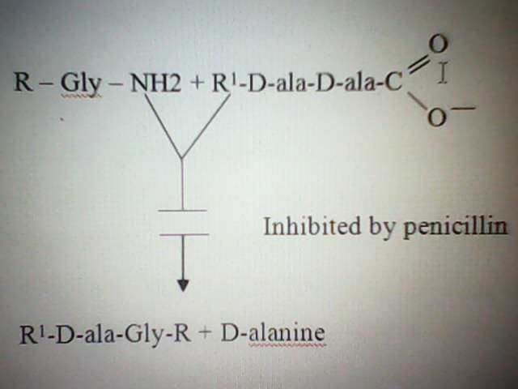
PENICILLIN INGIBITS BACTERIAL CELL WALL SYNTHESIS
(0.25 page)Penicillin inhibits activity of the transpeptidase that cross-links different peptidoglycan strands.

Slide 58
Usually, the transpeptidase forms an acyl intermediate with the penuthmate D-ala residue of the peptide. This acyl-enzyme intermediate then reacts with amino group of the terminal glycine in another peptide
Thus, penicillin inhibits transpeptidase by forming a covalent bond with a residue at the active site of the enzyme giving rise to an acyl-enzyme intermediate (penicillinoyl-enzyme complex) that does not undergo deacylation hence the transpeptidase is irreversibly inhibited by penicillin. Thus, penicillin is a transition-state enzyme analog.

Slide 59
¼ page [structure of penicillin

Slide 60
½ page [formation of acyl-enzyme intermediate during transpeptidation]

Slide 61
Penicillin (a transition-state analog) is an effective inhibitor of transpeptidase because
penicillin resembles R?D-ala-D-ala, one of the substates for transpeptidase enzyme
the four membered β-lactam ring of penicillin is strained, making this peptide bond highly reactive.
Due to resemblance of penicillin to D-ala-D-ala terminus of the nascent strands of peptidoglycan, reactivity of penicillin is precisely targeted hence its low toxicity.
Since there is no known human enzyme that recognizes D-ala-D-ala, penicillin does not interfere with our own enzyme machinery.

Slide 62
RESISTANCE TO PENICILLIN
Some bacteria are resistant to penicillin because they secrete penicillinase, an enzyme that cleaves the amide bond in the β-lactem ring of penicillin to form penicillioc acid which is inactive as antibiotic

Slide 63
Conversion of penicillin to penicillioic acid

Slide 64
To date, semi synthetic forms of penicillins have been made with R-groups that render them not susceptible to penicillinase. Notably, the gene that codes for synthesis of penicillinase is an extra-chromosomal genetic element and is readily lost or acquired by some bacterial species. Penicillinase is thought to have evolved as a detoxification mechanism since it is only found in organisms with peptidoglycan wall. This enzyme therefore probably does not have a function other than to destroy penicillin since loss of the gene has no deleterious effect in absence of the antibiotic. Furthermore, there is a good correlation between the degree of resistance to penicillin and the amount of penicillinase activity.

