Slide 1
Introduction to Statistical Inference
By
Erastus K Njeru

Slide 2
Introduction
Foundation for statistical inference (for means and proportions)
  Population distribution curve
  Probability & Probability distributions
  Normal distribution
  Sampling distribution of the mean
  Decision errors

Slide 3
From Sample to population
Recall: Histogram for continuous data
  When constructing histogram, we may use as many bars as we would like, without distorting picture
  if number of observations infinite, we can have infinite no of bars – we get smooth curve.
  Curve is called population distribution curve
If symmetric, then population follows normal distribution.

Slide 4
Population distribution curve and histogram

Slide 5
Characteristics of the Normal Curve
The curve is bell-shaped and symmetrical.
The mean, median, and mode are all equal.
The highest frequency is in the middle of the curve.
The frequency gradually tapers off as the scores approach the ends of the curve.
  The curve approaches, but never meets, the abscissa at both high and low ends (Extends from - ∞ to + ∞).

Slide 6
Example Normal Curves (Heights: males vs females)
Women:
µ = 63.6
σ = 2.5
Men:
µ = 69.0
σ = 2.8
63.6
69.0
Height (inches)

Slide 7
Normal Curve
Mean ± 1sd limits include 68.27%
Mean ± 2sd limits include 95.45%
Mean ± 1.96sd limits include 95%
Mean ± 3sd limits include 99.73%
Mean ± 2.58sd limits include 99%

Slide 8
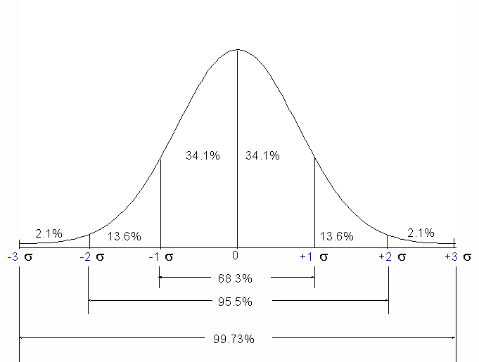
Normal Curve

Slide 9
Standardization
For every population with mean μ and variance σ² there is a normal distribution
To compare different populations, we define the standard normal distribution
      x_{i} - μ
    Z_{i} = ----------
    σ
i.e. for every observation x_{i} subtract population mean and divide by the std deviation. The resulting Z_{i} value is known as the z-score or standard normal deviate

Slide 10
Standardizing the Normal Distribution
Normal
Distribution
Standardized Normal Distribution

Slide 11
Standard Scores
To convert any value x to a z-score:
A z-score measures the number of standard deviations that a value falls from the mean.

Slide 12
Standard Normal Distribution
µ = 0 σ = 1
0 x
z
Notes:
Emphasize that Table A-2 gives the area (probability) from the mean (=0) to the z-score only. Students will need to be reminded of this often in the initial stages of this topic.

Slide 13
Z- Score
If an obs ht is 165cm, mean is 160cm and SD is 5cm, then Z is +1
Then obs above +1Sd is 16% (as per the normal curve)
Thus probability of having ht above 165cm is 0.16
Z tabulated in bks as “Table of Unit Normal Distribution” (Normal Probability Integral)

Slide 14
The Empirical Rule
Standard Normal Distribution: µ = 0 and σ = 1
99.7% of data are within 3 standard deviations of the mean
95% within
2 standard deviations
68% within
1 standard deviation
34%
34%
2.4%
2.4%
0.1%
0.1%
13.5%
13.5%
x - 3s
x - 2s
x - s
x
x + s
x + 2s
x + 3s
Notes:
These percentages will be verified by the concepts learned in Chapter 5.
Emphasize the Empirical Rule is appropriate for data that is in a BELL-SHAPED distribution.

Slide 15
Standard Scores (z-score)
Once the mean (µ) and SD (σ) have been specified, finding probabilities is a simple process for a normal random variable.
Convert the endpoints of an interval of interest to z-scores, look up probabilities associated with the z-score

Slide 16
Example Standard Scores for Height
For a population of college women, the z-score corresponding to a height of 62 inches is
This z-score tells us that 62 inches is 1.11 standard deviations below the mean height for this population.

Slide 17
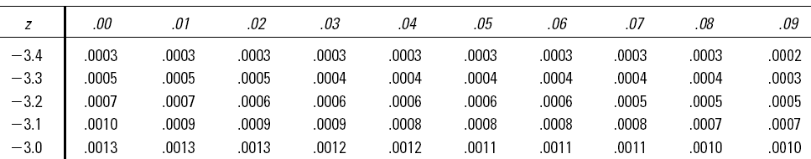
Finding Probabilities for z-scores
Standard Normal (z) Probabilities (Above/below)
Body of table contains P(Z ≤ z*).
Left-most column of table shows algebraic sign, digit before the decimal place, the first decimal place for z*.
Second decimal place of z* is in column heading.
The values in the body of Table (next) refer to the region under the curve.

Slide 18
Standard Normal (z) Distribution (under)
z
.00 .01 .02 .03 .04 .05 .06 .07 .08 .09
0.0
0.1
0.2
0.3
0.4
0.5
0.6
0.7
0.8
0.9
1.0
1.1
1.2
1.3
1.4
1.5
1.6
1.7
1.8
1.9
2.0
2.1
2.2
2.3
2.4
2.5
2.6
2.7
2.8
2.9
3.0
.0000
.0398
.0793
.1179
.1554
.1915
.2257
.2580
.2881
.3159
.3413
.3643
.3849
.4032
.4192
.4332
.4452
.4554
.4641
.4713
.4772
.4821
.4861
.4893
.4918
.4938
.4953
.4965
.4974
.4981
.4987
.0040
.0438
.0832
.1217
.1591
.1950
.2291
.2611
.2910
.3186
.3438
.3665
.3869
.4049
.4207
.4345
.4463
.4564
.4649
.4719
.4778
.4826
.4864
.4896
.4920
.4940
.4955
.4966
.4975
.4982
.4987
.0080
.0478
.0871
.1255
.1628
.1985
.2324
.2642
.2939
.3212
.3461
.3686
.3888
.4066
.4222
.4357
.4474
.4573
.4656
.4726
.4783
.4830
.4868
.4898
.4922
.4941
.4956
.4967
.4976
.4982
.4987
.0120
.0517
.0910
.1293
.1664
.2019
.2357
.2673
.2967
.3238
.3485
.3708
.3907
.4082
.4236
.4370
.4484
.4582
.4664
.4732
.4788
.4834
.4871
.4901
.4925
.4943
.4957
.4968
.4977
.4983
.4988
.0160
.0557
.0948
.1331
.1700
.2054
.2389
.2704
.2995
.3264
.3508
.3729
.3925
.4099
.4251
.4382
.4495
.4591
.4671
.4738
.4793
.4838
.4875
.4904
.4927
.4945
.4959
.4969
.4977
.4984
.4988
.0199
.0596
.0987
.1368
.1736
.2088
.2422
.2734
.3023
.3289
.3531
.3749
.3944
.4115
.4265
.4394
.4505
.4599
.4678
.4744
.4798
.4842
.4878
.4906
.4929
.4946
.4960
.4970
.4978
.4984
.4989
.0239
.0636
.1026
.1406
.1772
.2123
.2454
.2764
.3051
.3315
.3554
.3770
.3962
.4131
.4279
.4406
.4515
.4608
.4686
.4750
.4803
.4846
.4881
.4909
.4931
.4948
.4961
.4971
.4979
.4985
.4989
.0279
.0675
.1064
.1443
.1808
.2157
.2486
.2794
.3078
.3340
.3577
.3790
.3980
.4147
.4292
.4418
.4525
.4616
.4693
.4756
.4808
.4850
.4884
.4911
.4932
.4949
.4962
.4972
.4979
.4985
.4989
.0319
.0714
.1103
.1480
.1844
.2190
.2517
.2823
.3106
.3365
.3599
.3810
.3997
.4162
.4306
.4429
.4535
.4625
.4699
.4761
.4812
.4854
.4887
.4913
.4934
.4951
.4963
.4973
.4980
.4986
.4990
.0359
.0753
.1141
.1517
.1879
.2224
.2549
.2852
.3133
.3389
.3621
.3830
.4015
.4177
.4319
.4441
.4545
.4633
.4706
.4767
.4817
.4857
.4890
.4916
.4936
.4952
.4964
.4974
.4981
.4986
.4990
*
*
Notes:
Practice finding some areas (probabilities) for various z scores.
Again remind students that these areas will be from the mean to the particular z score. Drawing the correct graph and shaded area is very helpful in learning this concept.

Slide 19
Example
1. The population of neonates in a certain hospital is known to have birth weights that are normally distributed with mean 3.2kg and variance 2.5kg.
What is the probability of getting a neonate with BW > 3.6kg
What is the prob of getting a neonate with BW between 2.0 and 2.5kg

Slide 20
Bernoulli trials
Suppose an experiment (observing an individual) has two possible outcomes: Y/N; 0/1; +ve/-ve; Present/absent; success/failure
Referred to as Bernoulli trial
Ex. Is the baby a boy?
Does the patient have cholera?
Is the client positive?
Does the toss of coin result in ‘head’
Notes:
20

Slide 21
Binomial distribution
Note that its possible to have Bernoulli process from non-binary variable:
Ex. Does patient have severe oedema?
Does roll of die result in a ‘2’?
Series of Bernoulli trials - this can be viewed as a series of observations) gives rise to Binomial distribution

Slide 22
Sampling distribution of the mean
Suppose we have a population, normally distributed, with mean µ and variance σ²
From this population we select a random sample of size n, and calculate the sample mean
Repeat an infinite number of times
Result:
  A population of sample means

Slide 23
Sampling distribution of the mean
Normally distributed
2. The mean of the population of sample means will be the population mean µ
3. a) The variance of the population of sample means will be σ²/
b) The standard deviation of the sample means will approach σ/
n
n

Slide 24
Central Limit Theorem
The sampling distribution of sample mean will be normal even if the original population deviates from normality, as long as the sample size n is large enough.
30 considered large enough???
Not to be confused with the sample size required to carry out statistical inference!!!

Slide 25
Statistical Inference
“In God we trust, others we investigate’’
Inference - Drawing conclusions about a population (or populations) based on the observation of a sample (or samples)
Conclusion: Make a hypothesis and use statistical methods to decide whether hypothesis is true or not

Slide 26
Hypothesis
Definition: Statement about (the distribution of) a population or populations
Examples:
Mean (number) of sex partners of HIV positive clients is higher than that of HIV –ve clients
Level of development is related to political party affiliation
Females have higher blood pressure than males
These statements are preceded by research questions!

Slide 27
Types of hypothesis
Two types of hypothesis:
H_{o}: (Null hypothesis) - to be tested
H_{A}: (Alternative hypothesis) - what is true if null hypothesis is not true
The necessity to test compels us to state null hypothesis in particular way – null!

Slide 28
Types of errors
When test is carried out two types errors may occur:
True situation
(in population)
H₀ True H_{o} False
Test H_{o} True (Accept) OK Type II
Decision H_{o} False (Reject) Type I OK
α = Prob of making Type I error = significance level
1- α = confidence coefficient {(1- α)*100% = conf level}
β = Prob of making Type II error
1- β = Power of test

Slide 29
Notes
α and β are probabilities of committing errors, not errors
Would like α and β to be small – researchers set α = 0.05 as reasonable, then β is made smaller by larger sample size

