Slide 1
PRINCIPLES OF COMMUNICABLE DISEASES PREVENTION AND CONTROL

Slide 2
Definition of communicable diseases
A communicable disease is an illness due to a specific infectious (biological) agent or its toxic products capable of being directly or indirectly transmitted from man to man, from animal to man, from animal to animal, or from the environment (through air, water, food, etc..) to man.

Slide 3
Terminology and Definitions -Assignment
Exotic
Sporadic
Attack rate
Primary/secondary cases
Zoonosis, epizootic and enzootic
Nosocomial infection
Opportunistic infection
Eradication
Elimination
Infection
Contamination
Infestation
Contagious disease
Incidence and prevalence of infectious diseases
Epidemic
Endemic
Hyperendemic
holoendemic
Pandemic

Slide 4
Terminology and Definitions - Assignment
Virulence
Reproductive rate of infection
Host
Vector (source)
Reservoir
Incubation period
Infectivity period
Serial interval
Latent period
Transmission Probability ratio

Slide 5
BASIC PRINCIPLES OF CDC
DR TOM H.A.M. OLEWE

Slide 6
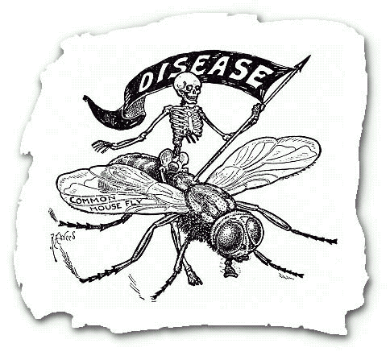
Communicable Disease Basics

Slide 7
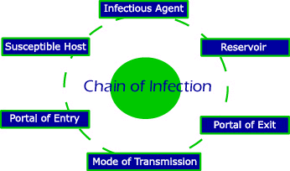
Chain of Infection

Slide 8
Chain of Infection
Model used to understand the infection process
Each link represents step in transmission of infection
Each link has to be present and in order for an infection to occur

Slide 9
1 - The Infectious Agent
-any disease causing microorganism (pathogen)

Slide 10
Infectious agents are:
Bacterial
Viral
Fungal
Parasitic

Slide 11
2 - The Reservoir
-Where a microorganism normally lives and reproduces

Slide 12
Examples of reservoirs:
Humans
Animals
Water
Food

Slide 13
3 - The Portal of Exit
-route of escape of the pathogen from the reservoir.

Slide 14
Examples of portals of exit:
Flu or cold - mucous secretions
West Nile Virus - when the mosquito bites and feeds on the bird’s blood
Hepatitis A - stool
SARS - droplet, contact

Slide 15
4 - The Route of Transmission (Spread)
-the way the pathogen gets from the reservoir to the new host

Slide 16
5 - The Portal of Entry
-route through which the pathogen enters its new host

Slide 17
Respiratory System
Inhale germs

Slide 18
Other Portals of Entry
Sexual contact
Ingestion
Breaks in Protective Skin Barrier

Slide 19
6 - The Susceptible Host
-A person who can get sick when they are exposed to a disease causing pathogen

Slide 20

How to Break the Chain of Infection

Slide 21
Diseases
Infectious
Contagious
Tropical
Communicable
Non-communicable

Slide 23
Disease terminologies
Infectious disease
  Indirectly transmitted
Contagious disease
  Transmitted directly or nearly so
Communicable disease
  Specific agent or its products
  Transmission of that agent
  Agent in reservoir

Slide 24
Communicable disease
“A communicable disease can be said to be one due to a specific agent or its products that arises through the transmission of that agent or its products from a reservoir to a susceptible host. The transmission is either directly or indirectly through the agency of an intermediate host, vector or inanimate environment”.

Slide 25
Major points; agent
Cause of the disease
  Chiefly a micro-organism
  Also helminthes
Capable of producing the disease

Slide 26
Major points; reservoir
Human, animal or arthropod
Soil or inanimate matter
  Normal habitat of agent
  Optimal conditions necessary for
    Multiplication, Survival
    Reproduction of agent

Slide 27
Reservoir; carrier
Special reservoir
Infected people
No discernible clinical disease
Serve as potential source of infection for others.
Types
  Incubating
  Acute
  Chronic
  Convalescent
  Intermittent

Slide 28
Major point; escape
The respiratory route
  Natural function of breathing, or coughing.
Gastro-intestinal route
  Fecal mater
Genital route
  Transmitted sexually
Urinary route
  Agents appear in the urine
Abnormal route
  No physiological function

Slide 29
Major point; transmission
Agent
  In natural secretions, discharges or evacuations
  In medium of biting insect.
  Most vulnerable
Length of route between hosts crucial
Time and space important
Survival mechanisms
  Bacteria form spores
  Protozoa form cysts.

Slide 30
Transmission; direct
Reservoir to the new host
  Sexually transmitted diseases
  Respiratory diseases
Physical environmental conditions important
Proximity of people

Slide 31
Indirect transmission, passive
Vehicle
  Contaminated material or objects
    Handkerchiefs, toys, soiled clothes, bedding,
    Water, food or milk
    Biological products such as blood.
Intermediate means of transport
Agent may or may not multiply

Slide 32
Indirect transmission, active
Another host utilized
Definitive host
  Adult or sexually mature forms
Intermediate host
  Intermediate forms

Slide 33
Vector-borne disease
Blood-sucking vectors
  Agent of dissemination or inoculation
Biological transmission
  Essential part of the life cycle of the parasite
  Extrinsic incubation period
    Interval of time
    Temperature dependent
  Prevalence of certain parasitic diseases affected
    Altitudes and latitudes.

Slide 34
Major point; entry of agent
Routes of entry
  Virtually the same as those of escape of the agent
Portal of entry and development of the disease synonymous
  Pulmonary tuberculosis
  Gastrointestinal tuberculosis

Slide 35
Major point; development of disease
Host susceptibility
  Host resistance or immunity
Agent factors
  Infectivity, virulence, pathogencity and antigenicity
Pathogenic infection.
Incubation period

Slide 36
Concept of transmission of communicable diseases
Agent inside the reservoir
Escape of the agent from the reservoir
Transmission of the agent
Entry of the agent into a new host
Development of the agent inside the reservoir.

Slide 37
AGENT
RESERVOIR
HOST
1
2
3
4
5

Slide 38
Levels of prevention or control of communicable diseases.
1. At the level of the reservoir
2. Exit from the reservoir
3. In the mechanism of transmission
4. At the level of entry into the host.
5. Inside the host.

Slide 39
At the level of the reservoir
Depends on
  The disease
  The reservoir
Destruction of the reservoir
  E.g. rodents for plague
Treat the reservoir with drugs
  E.g. Tuberculosis

Slide 40
Exit from reservoir
Few measures feasible
Physiological processes by the reservoir
Abnormal route exception.

Slide 41
Mechanisms of transmission
Many public health measures taken
In combination or separately.
i) Isolation of the reservoir
ii) Interference with the life-cycle of vectors and intermediate host.
iii) Sterilization of the vehicle of spread
  Treatment of water with chlorine
iv) Sterilization of fomites

Slide 42
Entry into the host
Interrupt entry of the organisms
Barrier methods
  ITNs,
  House screening
  Wearing of shoes

Slide 43
Level of susceptible host
General health of the body
Specific immunity for specific diseases:
  Specific antigens administered
  Produce antibodies against the diseases
Specify drugs capable of prevention of development of diseases
  Taken before a specified agent gets inside the body
  Chemoprophylactic agents

Slide 44
Public health control measures
Several measures applied
  More than one level at the same time.
Measure chosen will depend on
  Type of agent
  Mode of transmission
  Host susceptibility
  Socio-economic factors.

Slide 45
In summary!!!

Slide 46
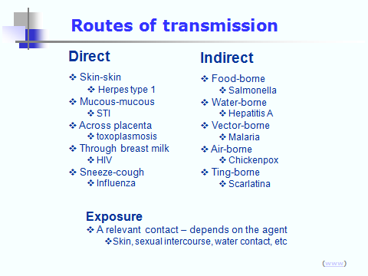
Routes of Transmission

Slide 47
Chain of Infection
A model to conceptualize the transmission of a
communicable disease from its source to a susceptible hose

Slide 48
Chain of Infection
Pathogen
• is the disease causing agent

Slide 49
Chain of Infection
Pathogen
Reservoir
• is the habitat in which an infectious
agent normally lives & grows
• Human: symptomatic or asymptomatic
• Animal: called zoonoses
• Environmental: plants, soil, and water

Slide 50
Chain of Infection
Pathogen
Portal
of exit
Reservoir
- is the path by which an agent leaves the source host

Slide 51
Chain of Infection
• how pathogens
are passed
Pathogen
Portal
of exit
Reservoir
Trans-
mission
Modes of Transmission
Direct
- Direct contact
- Droplet spread
Indirect
- Airborne
- Vehicleborne
- Vectorborne

Slide 52
Chain of Infection
Pathogen
Portal
of exit
Portal
of entry
Reservoir
Trans-
mission
• agent enters
susceptible host
Respiratory
Oral
Skin
Intravenous
Gastrointestinal

Slide 53
Chain of Infection
Pathogen
Portal
of exit
Portal
of entry
New
Host
Reservoir
Trans-
mission
• Final link is
a susceptible host

Slide 54
FORMAT OF PRESENTATION
1. BRIEFLY DESCRIBE THE DISEASE, INCLUDING ANY DEFINITION
2. PREVALENCE OF THE DISEASE IN KENYA
3. CAUSATIVE AGENT
4. AGENT’S RESERVIOR
5. ROUTE OF EXIT FROM THE RESERVIOR
6. MODE OF TRANSMISSION, INCLUDING LIFE CYCLE OF THE AGENT WHERE APPLICABLE.
7. DISCUSS THE VECTOR(S) WHERE APPLICABLE
8. ROUTE OF ENTRY INTO THE SUSCEPTIBLE HOST
9. DESCRIBE THE SUSCEPTIBLE HOST AND IT’S RESPONSE TO THE AGENT OR ITS TOXINS (HOST – AGENT INTERACTION)
10. BRIEF DESCRIPTION OF THE DISEASE, INCLUDING SIGNS AND SYMPTOMS
11. USING THE PRINCIPLES OF PREVENTION AND CONTROL OF COMMUNICABLE DISEASES, PROPOSE STRATEGIES TO PREVENT AND CONTROL THE COMMUNICABLE DISEASE

Slide 55
FINALLY,
PREVENTION AND CONTROL OF DISEASES IS EVERYBODY’S BUSINESS!!

