Slide 1
Topic 1: Definition and concepts in Demography
Sam Wafula (PhD)
E-mail: sam.wangila@gmail.com

Slide 2
Demography defined [Narrow definition]
Demography is the study of human populations in relation to the changes brought about by the interplay of births, deaths, and migration (Pressat 1985)
Demography is the statistical and mathematical study of the size, composition, and spatial distribution of human populations, and of changes over time in these aspects through the operation of the five processes of fertility, mortality, marriage, migration, and social mobility (Bogue 1969)

Slide 3
Demography defined [Narrow definition]
The scientific study of human population. Studies a population in its static and dynamic aspects often using mathematical methods (Formal Demography)
Static aspects of the population include characteristics at a point in time such as composition by: Age, Sex, Race, Marital status, Economic characteristics
Dynamic aspects of population include : Fertility, Mortality, Nuptiality, Migration, Growth

Slide 4
Importance of Demography in health
Mortality and fertility which are often central in the study of demography are biological processes…e.g. why do some people die earlier than others? Why is human fertility different across the populations?
Central demographic research issues are of immediate interest to policy makers in health
  E.g. a Rise in fertility has implications on resource allocation for resources for maternal and reproductive health
  An ageing population has implications on social protection systems e.g. the pension system, has implications for health provision –rise of degenerative diseases
  Declining fertility and mortality can lead to a youth bulge leading to excess supply of labour and human capital…this is of interest to Economists

Slide 5
Relevance of Demography in Health
Life course analysis
  Population ageing and degenerative/lifestyle diseases
  ARI, diarrhoea, malaria and early child morbidity and mortality
Demographic analysis can decompose the causes of death which is critical for setting health priorities
Contraceptive use determinants is critical for health professionals keen in reproductive and family health
Demographic statistics are useful for health planning including allocation of resources
  Age and sex disparities is critical for resource allocation in health

Slide 6
Relevance of Demography in Health
Migration patterns has implications on the health of populations e.g. spread of Ebola, HIV transmission along transport corridors, etc…Migration also has relevance to economics esp. on issues of “brain drain” and “brain gain”

Slide 7
Demographic terminology
Fecundability: probability that a woman will conceive during a menstrual cycle
Fecundity: physiological capacity to conceive
Fertility: Actual number of livebirths per woman = natality
Fetal death rate: number of fetal deaths divided by number of births plus number of fetal deaths.
Fetal death ratio: number of fetal deaths divided by number of births

Slide 8
Components of Population Change [1]
Components of population change refers to those factors or events that result in the increase, decrease or no change to the initial population (Pt).
In summary, any demographic event that changes the initial population Pt to a new population figure (Pt+n) constitutes a component of Population change.
So what are these components and how do they affect the initial population?

Slide 9
Components of Population change [2]
Any population can increase if there are additional births or if we have migrants moving in (in-migration)
However, Population can decrease/reduce if we have deaths and by out-migration
Thus any population change (increase or decrease) is as a result of an interplay between births, deaths, in migration and out migration

Slide 10
Components of Population change [3]

Slide 11
Components of Population change [4]
This can be mathematically represented as follows: -
Pt+n = Pt + (B-D) + (I-E)
•The above equation is called the Demographic balancing equation /Population Balancing equation/demographic accounting equation
P_{t+n} - Population size for time t+n
P_{t} - Base population i.e. Population size at time t
B - Number of births between time t and time t+n
D - Number of deaths between time t and time t+n
I - Immigration (in migration) between time t and time t+n
E - Emigration (out-migration) between time t and time t+n

Slide 12
Components of Population change [5]
Where migration is non-existent, it means that population change can only be a function of an interplay between births and deaths. We say that population change is thus affected by the natural increase alone i.e. by the difference between births and deaths alone. This is also called a closed population. Pt+n = Pt + (B-D)

Slide 13
The basic accounting identity of Demography
For a closed population (where there is no migration), ….
P(t+n) = P(t) + Births(t, t+n) - Deaths(t, t+n)
Births(t, t+n) = P(t+n)- P(t) + Deaths(t, t+n)
Deaths(t, t+n) = P(t)- P(t+n) + Births(t, t+n)

Slide 14
The basic accounting identity of Demography
For an open population (where there is migration)
P(t+n)=P(t) + Births(t, t+n) - Deaths(t, t+n) + Immigration(t, t+n)
– Emigration(t,t+n)
The difference between immigration and emigration is known as net migration. Thus Net migration= in-migration-out-migration
If a population is open it can only change through births and deaths and immigration and emigration
Most countries have open populations.

Slide 15
How has the population size of Kenya changed over the years?

Slide 16
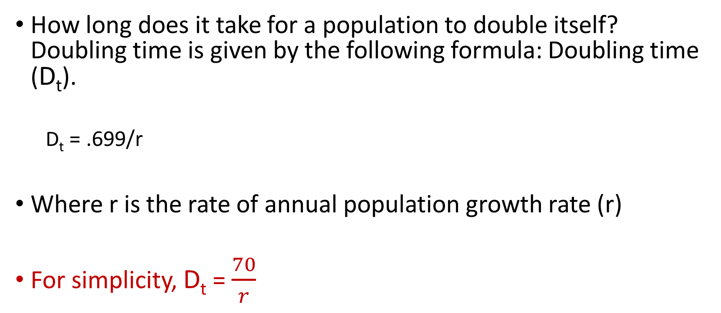
Population Doubling time
How long does it take for a population to double itself? Doubling time is given by the following formula: Doubling time (D_{t}).
  D_{t} = .699/r
Where r is the rate of annual population growth rate (r)
For simplicity, D_{t} = $\frac{70}{r}$

Slide 17
Quiz: On August 2009, the Kenyan Housing and Population census results revealed that the country had a population of 38.6 million people. If the annual rate of population growth is 2.7%;
How long will it take for Kenya’s population to double?
Which year would we expect Kenya’s population to double?
What would be the actual population of the country at the doubling time?

Slide 18
Solution
2009 population 38.6 million
Annual pop. Growth rate 2.7
Doubling time = .699/2.7% =25.9 years or
Dt = 70/2.7= 25.9 years
Time to double = 2009.6+25.9 =2035.6

