Slide 1
Mortality Analysis
Sam Wafula
School of Public Health

Slide 2
Learning objectives
Be able to define mortality and understand uses of mortality statistics
Be able to calculate some of the basic measures of morbidity and mortality
Be able to understand the pros and cons of each measure and how it is applied
Be able to understand the common errors in relation to measurement of mortality

Slide 3
Definition of death
“The permanent disappearance of all evidence of life at any time after live birth has taken place (post-natal cessation of vital functions without capability of resuscitation)“ (UN 2001:10; WHO)
What does this definition mean?
  That one cannot die unless one was born (was alive)
  That one cannot die unless there is permanent disappearance of all forms of life
All forms of prenatal, or foetal, mortality (miscarriage, still births, termination of pregnancy) are excluded from this definition, irrespective of cause – since according to this definition, one cannot die prior to having lived

Slide 4
Mortality measures
Crude Death Rate
Age specific Death Rate
Neonatal mortality
Post-neonatal mortality
Infant Mortality (IMR)
Child mortality
Maternal Mortality Rate

Slide 5
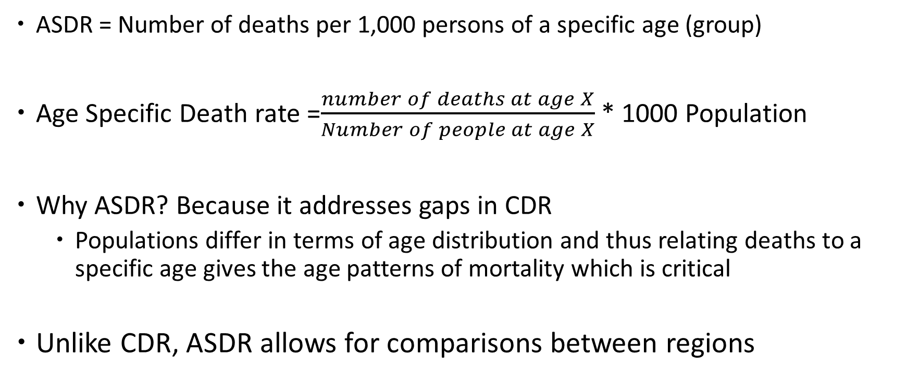
Age Specific Death Rates (ASDR)
ASDR = Number of deaths per 1,000 persons of a specific age (group)
Age Specific Death rate =$\frac{number of deaths at age X}{Number of people at age X}$ * 1000 Population
Why ASDR? Because it addresses gaps in CDR
  Populations differ in terms of age distribution and thus relating deaths to a specific age gives the age patterns of mortality which is critical
Unlike CDR, ASDR allows for comparisons between regions

Slide 6
Illustration: ASDR for Egypt, 1990

Slide 7
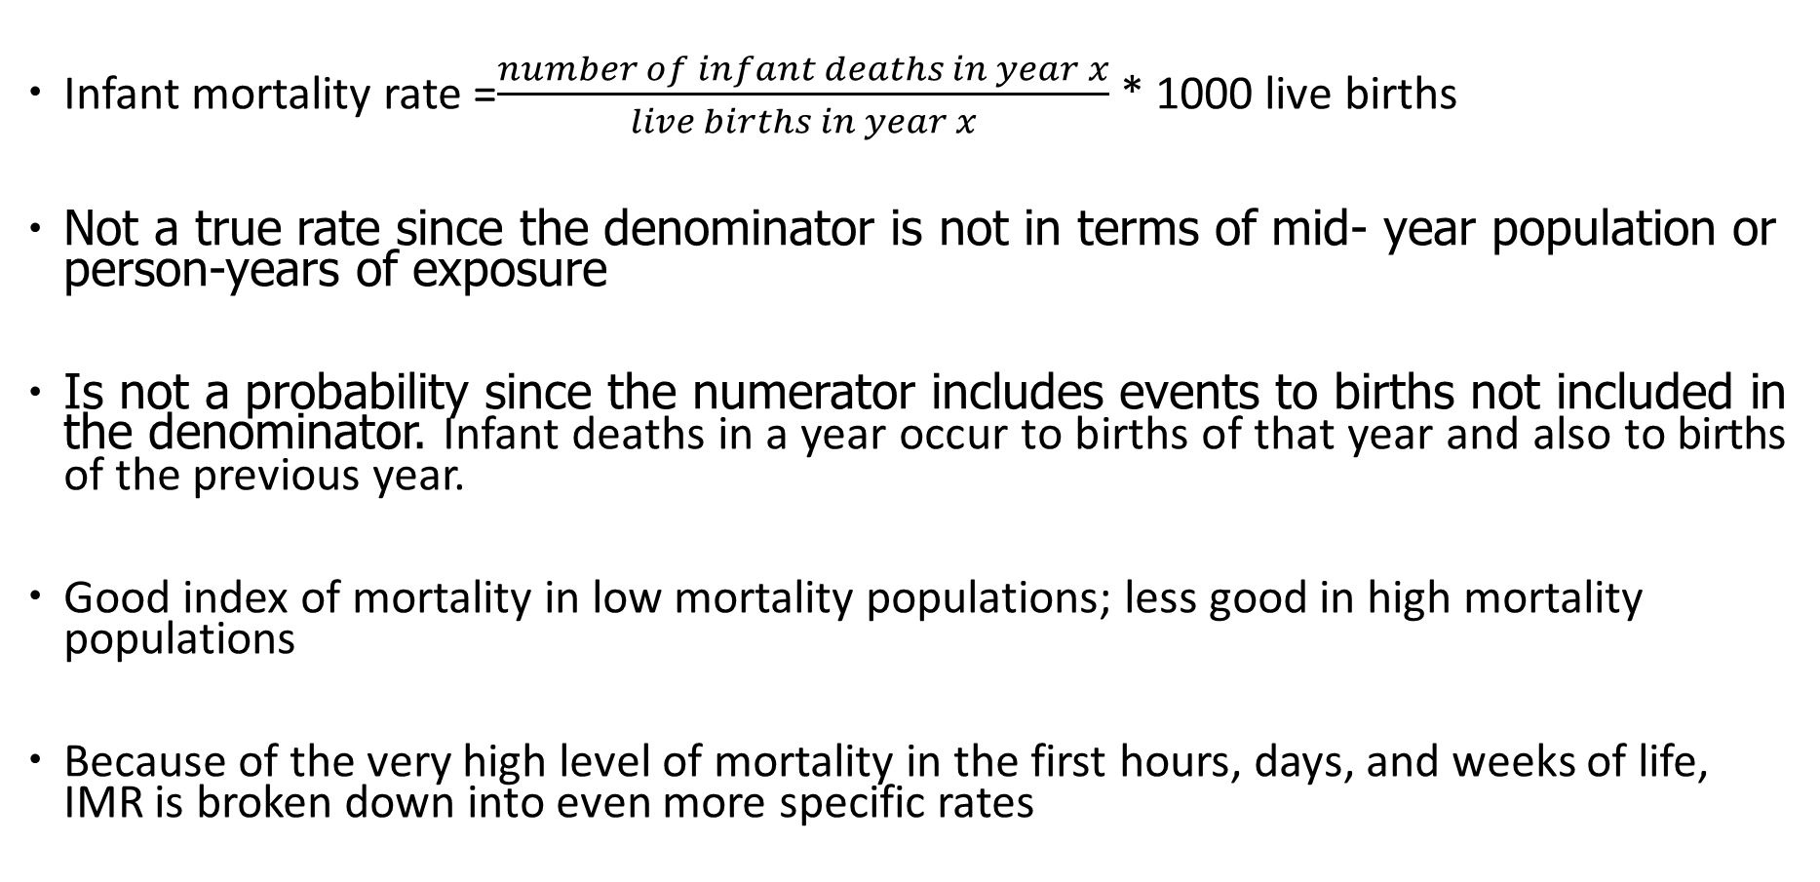
Infant Mortality Rate
Infant mortality rate =$\frac{number of infant deaths in year x}{live births in year x}$ * 1000 live births
Not a true rate since the denominator is not in terms of mid- year population or person-years of exposure
Is not a probability since the numerator includes events to births not included in the denominator. Infant deaths in a year occur to births of that year and also to births of the previous year.
Good index of mortality in low mortality populations; less good in high mortality populations
Because of the very high level of mortality in the first hours, days, and weeks of life, IMR is broken down into even more specific rates

Slide 8
Exercise: calculate IMR for the year 1990
IMR 1990 = 9.22 per 1000 live births

Slide 9
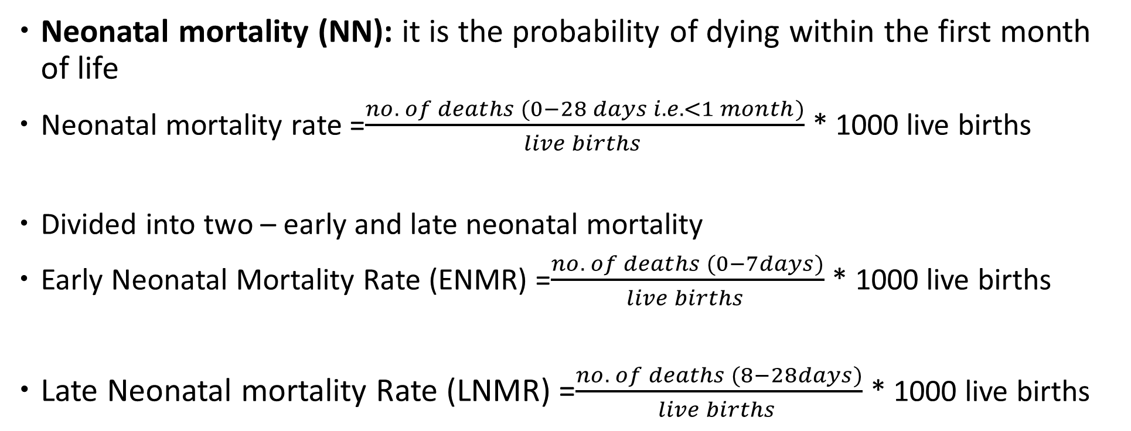
Neonatal Mortality rate
Neonatal mortality (NN): it is the probability of dying within the first month of life
Neonatal mortality rate =$\frac{no. of deaths (0−28 days i.e. <1 month)}{live births }$ * 1000 live births
Divided into two – early and late neonatal mortality
Early Neonatal Mortality Rate (ENMR) =$\frac{no. of deaths (0−7days)}{live births }$ * 1000 live births
Late Neonatal mortality Rate (LNMR) =$\frac{no. of deaths (8−28days)}{live births }$ * 1000 live births

Slide 10
Fetal Death

Slide 11
Perinatal death Rate

Slide 12
Postneonatal mortality (PNN)
It captures the probability of surviving after the first month of life to the first 11 months after birth before the first birthday.
PNN
PNN = This is the difference between infant and neonatal mortality

Slide 13
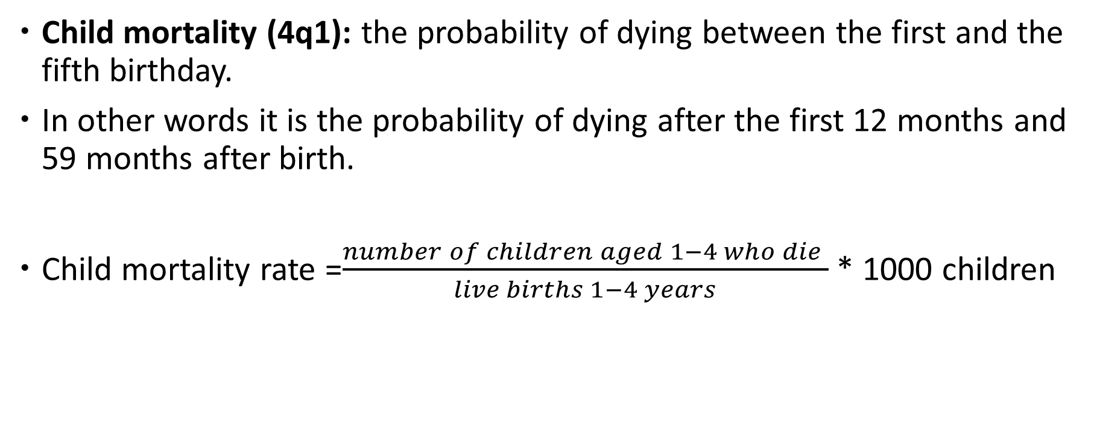
Child mortality rate
Child mortality (4q1): the probability of dying between the first and the fifth birthday.
In other words it is the probability of dying after the first 12 months and 59 months after birth.
Child mortality rate =$\frac{number of children aged 1−4 who die }{live births 1−4 years}$ * 1000 children

Slide 14
Childhood Mortality Rates - Kenya
Deaths per 1,000 live births for the five-year period before the survey
Notes:
Infant and under-5 mortality rates in the five-year period before the survey are 39 and 52 deaths per 1,000 live births, respectively. At these mortality levels, about 1 in every 26 Kenyan children dies before reaching age one. About 1 in every 19 children does not survive to their fifth birthday.
The neonatal mortality rate in the past 5 years is 22 deaths per 1,000 live births.

Slide 15
Trends in Childhood Mortality - Kenya
Deaths per 1,000 live births for the five-year period before the survey
Neonatal mortality
Notes:
Childhood mortality rates have declined in the past 11 years. Infant mortality has declined from 77 deaths per 1,000 live births in 2003 to 39 in 2014. During the same time period, under-5 mortality has sharply declined from 115 to 52 death per 1,000 live births.

Slide 16
Maternal Factors Associated with High Risk of Childhood Mortality
Children are at an elevated risk of dying if:
Too short birth interval: less than 24 months after a previous birth
Mother is “too young” (under 18) or “too old”
(over 40)
High birth order: mother has four or more children
Demographers call these the 4 “toos” – too short Birth intervals , too young; too old and too many

Slide 17
Maternal Mortality
Death of a woman during pregnancy, childbirth or within 42 days of delivery
Maternal mortality is the death of a woman while pregnant or within 42 days of termination of pregnancy, irrespective of the duration or site of the pregnancy, from any cause related to or aggravated by the pregnancy or its management but not from accidental cause (WHO)

Slide 18

Maternal Mortality Ratio
Maternal Mortality Ratio =
Maternal Mortality Ratio is the number of deaths due to maternal causes per 100,000 live births
$\frac{All maternal deaths in a year}{\text{Total} \text{livebirths}}$ *100,000

Slide 19
Maternal Mortality Rate

Slide 20
Exercise: 2 – Maternal mortality Ratio & Rate

Slide 21
Solution

Slide 22
Why is mortality data important?
Used as an input in population projections
Provide an important indicator of health and well being of a nation e.g. life expectancy at birth, infant mortality rate, etc.
Provide information about the nature and efficacy of health care delivery systems –e.g. if high child mortality may spur interventions to improve child survival e.g. intensifying child immunization programs, improving models of care and service provision, etc.
Mortality data collected by age and sex as well as causes of death are very critical- can help the policy makers know where the country stands in terms of the epidemiological transition
Information on cause of death is also important for epidemiological studies:-example high deaths from lung related diseases among workers exposed to asbestos particles

Slide 23
What are the sources of errors in mortality data?
Omissions of Deaths due to cultural reasons
Misplacement of deaths- memory lapse; recall errors
Age heaping/ digit preference/ avoidance
Age misreporting
Incomplete data on date of birth or age at death
Shifting / displacement of events in time (e.g. deaths)
Sampling errors
Political interference

