Slide 1
MSW Disposal
MBCHB II LECTURE
By
M.K KINOTI
Date : 4th March 2010
Venue: Millinium Hall II

Slide 2
Evaluation of alternatives in MSW disposal
The following points should be considered before deciding on the mode of MSWD:
The quantinty and character of the refuse and likely changes
Land availability for final deposit
Constraints possible tipping sites
The health of the public and refuse workers
Potential use of power or heat obtained by incineration
The cost of possible methods

Slide 3
Types of MSW Disposal
Major methods of Sound MSW disposal include:
Composting
Incineration
Landfilling
Waste Treatment

Slide 4
1. Composting
Composting converts refuse to soil conditioner
However, if the refuse includes factory waste, there is danger of excess metals such as lead, cadmium, mercury etc
Particularly useful in the tropics where intense rainfall erodes humus

Slide 5
Composting Cont’d
Factors affecting compositing
Moisture content should be 40—60%- too dry a material slows the process. Too wet (>60% moist) stimulates anaerobic bacterial which produce unpleasant smells
Temperature not >70oC – otherwise bacteria are killed – slowed process
Carbon/Nitrogen Ratio- High ratio allows faster decomposition
Wind- Lowersthe temperature- slows decomposition
Flies - can be reduced by turning the refuse daily.

Slide 6
Landfilling
Landfilling is the placement of wastes into the land under controlled conditions to minimize their migration or effect on the surrounding environment.
Modern landfills are well-engineered facilities that are located, designed, operated, and monitored to ensure compliance with federal regulations. Solid waste landfills must be designed to protect the environment from contaminants which may be present in the solid waste stream.

Slide 7
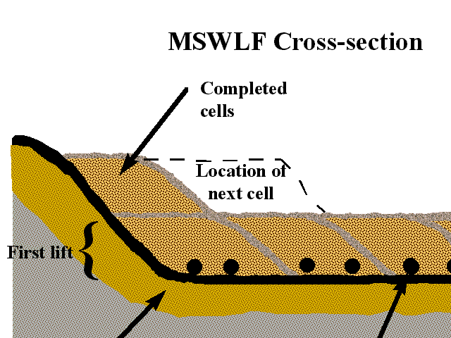
Land filling

Slide 8
Landfilling Cont’d
The landfill siting plan prevents the siting of landfills in environmentally sensitive areas and have on-site environmental monitoring systems which monitor for any sign of groundwater contamination and for landfill gas—provide additional safeguards. In addition, many new landfills collect potentially harmful landfill gas emissions and convert the gas into energy.

Slide 9
Landfilling Cont’d
Principles in controlled land filling:
Layers of refuse are compacted and covered by a layer of soil(sanitary landfilling)
Layer of waste should not exceed 2.4 meters for proper compacting
To provide adequate seal, cover material should be atleast 200mm thick.

Slide 10
Importance of compaction and cover control
Limit the odour emissions
Prevent light refuse from being blow away by wind
Prevent emergence of fly larvae
Prevent the breeding of flies
Allow rat control to be easily applied
Reduce the risk of fire
Make the tip less attractive to birds
Provide appropriate connditions for fermentation of organic matter.

Slide 11
Operation of landfills
All exposed surfaces should be quickly covered with soil possibly by the end of each working day
Small bulldozers are used to spread refuse and covering material
No surface water should pass thro’ a tip
Surface of the tip should be covered with impermeable material to protect underground waters from pollution from leachates

Slide 12
Incineration/Combustion
To reduce waste volume, local governments or private operators can implement a controlled burning process called combustion or incineration.
In addition to reducing volume, combustors, when properly equipped, can convert water into steam to fuel heating systems or generate electricity.
Incineration facilities can also remove materials for recycling.

Slide 13
Incineration/Combustion
Incineration is the controlled combustion of materials
Temps- 950-100oC – destroy odours.
Wet scrubbers must be installed to capture particles
Heat generated can be used to generate electricity through steam E.g amsterdam refuse generator handles 400,000 tonnes of refuse and generates 160, 000 Mwh (Feachem, 1986)

